Slide 1
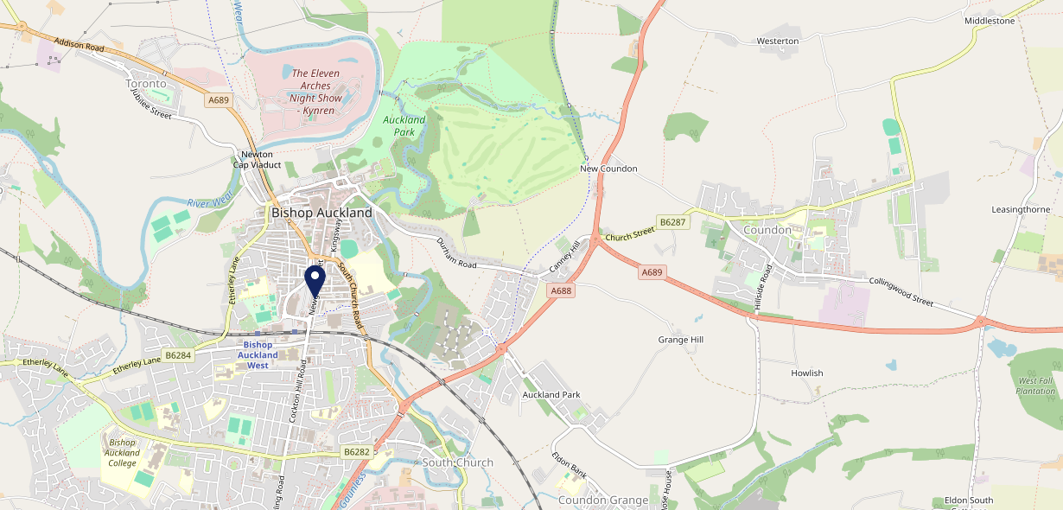
Site Intel
Kings Head DL147EJ
1 Miles
371 Chains
16/04/2025 - 08/04/2026
Site Summary
Kings Head DL147EJ
Work Area
Region
TV Region
Urbanicity
Durham and Bishop Auckland
North East
Tyne Tees
Urban city and town
DL147EJ
Punch T&L
Top Competitors
ATV
Gender
Green Tree (Bishop Auckland)
#1
£6.05
77.66%
Male
DL146EN
GK Pub Partners
Affluence
Segmentation
The Stanley Jefferson
#2
75.94%
37.99%
Low Income
Cash Conscious Communities
DL147NJ
JD Wetherspoon
Age Group
Visit Day
Tap Tun
#3
53.24%
27.42%
DL147EP
45 to 54
Fri
Pub / Bar
Nearest Station
Bishop Auckland(0.23 miles)
224 Site Customers
97 Competitors
22556 Competitor Customers

Slide 2
Site Intel
Kings Head DL147EJ
1 Miles
371 Chains
16/04/2025 - 08/04/2026
Spend by Weekpart
How is customer spend distributed throughout the week for Kings Head DL147EJ versus its competitors?
% of spend for Kings Head DL147EJ and 371 Chains in 1 Miles from 16/04/2025 - 08/04/2026 split by Day of Week
224 Site Customers
97 Competitors
22556 Competitor Customers

Slide 3
Site Intel
Kings Head DL147EJ
1 Miles
371 Chains
16/04/2025 - 08/04/2026
Visit Frequency
How frequently per year do customers visit Kings Head DL147EJ versus its competitors?
% of customer numbers for Kings Head DL147EJ and 371 Chains in 1 Miles from 16/04/2025 - 08/04/2026 and the number of visits made Per Annum
224 Site Customers
97 Competitors
22556 Competitor Customers

Slide 4
Site Intel
Kings Head DL147EJ
1 Miles
371 Chains
16/04/2025 - 08/04/2026
ATV Change
How has ATV changed between two date ranges?
224 Site Customers

Slide 5
Site Intel
Kings Head DL147EJ
1 Miles
371 Chains
16/04/2025 - 08/04/2026
Market Share Change
How has market share changed between two date ranges?
% of market share spend for Kings Head DL147EJ and 371 Chains in 1 Miles from 16/04/2025 - 08/04/2026
224 Site Customers

Slide 6
Site Intel
Kings Head DL147EJ
1 Miles
371 Chains
16/04/2025 - 08/04/2026
Age
How does the age profile of customers who visit Kings Head DL147EJ compare versus its competitors?
% of spend for Kings Head DL147EJ and 371 Chains in 1 Miles from 16/04/2025 - 08/04/2026 split by Age Range
129 Site Customers
97 Competitors
11509 Competitor Customers

Slide 7
Site Intel
Kings Head DL147EJ
1 Miles
371 Chains
16/04/2025 - 08/04/2026
Affluence
How does the affluence of customers who visit Kings Head DL147EJ compare versus its competitors?
% of spend for Kings Head DL147EJ and 371 Chains in 1 Miles from 16/04/2025 - 08/04/2026 split by Affluence
116 Site Customers
97 Competitors
10555 Competitor Customers

Slide 8
Site Intel
Kings Head DL147EJ
1 Miles
371 Chains
16/04/2025 - 08/04/2026
Gender
How does the gender profile of customers who visit Kings Head DL147EJ compare versus its competitors?
% of spend for Kings Head DL147EJ and 371 Chains in 1 Miles from 16/04/2025 - 08/04/2026 split by Gender
122 Site Customers
97 Competitors
11112 Competitor Customers

Slide 9
Site Intel
Kings Head DL147EJ
1 Miles
371 Chains
16/04/2025 - 08/04/2026
Punch Segmentation
How does the Custom segmentation profile of customers who visit Kings Head DL147EJ compare versus its competitors?
% of spend for Kings Head DL147EJ and 371 Chains in 1 Miles from 16/04/2025 - 08/04/2026 split by Segment
224 Site Customers
97 Competitors
22556 Competitor Customers

Slide 10
Site Intel
Kings Head DL147EJ
1 Miles
371 Chains
16/04/2025 - 08/04/2026
Spend by Distance
How does the spend profile of Kings Head DL147EJ compare versus its competitors based on travel distances?
% of spend for Kings Head DL147EJ and 371 Chains in 1 Miles from 16/04/2025 - 08/04/2026 split by Distance travelled
122 Site Customers
97 Competitors
11108 Competitor Customers

Slide 11
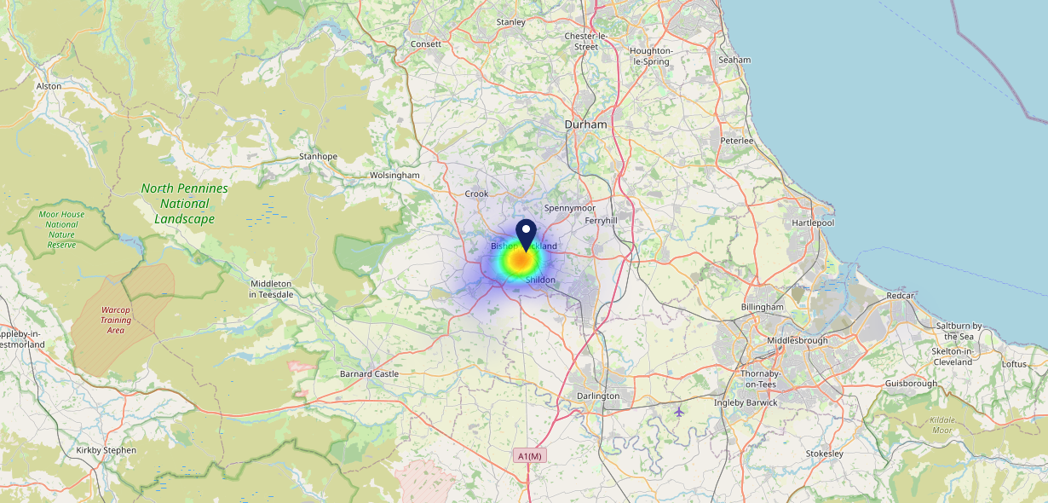
Site Intel
Kings Head DL147EJ
16/04/2025 - 08/04/2026
Map of Guest Origin
Where do customers of Kings Head DL147EJ come from?
Where do customers of Kings Head DL147EJ for 16/04/2025 - 08/04/2026 live
122 Site Customers

Slide 12
Site Intel
Kings Head DL147EJ
1 Miles
371 Chains
16/04/2025 - 08/04/2026
Share of Wallet
What are the Top 20 venues (by spend) that customers of Kings Head DL147EJ also visit?
For customers of Kings Head DL147EJ, who are the top 20 competitors from 371 Chains in 1 Miles for 16/04/2025 - 08/04/2026 split by Venue
224 Site Customers

Slide 13
Site Intel
Kings Head DL147EJ
1 Miles
371 Chains
16/04/2025 - 08/04/2026
Share of Wallet Change
How has share of wallet of customers of Kings Head DL147EJ changed between two date ranges?
224 Site Customers

Slide 14
Site Intel
Kings Head DL147EJ
16/04/2025 - 08/04/2026
Market Summary
How does the local area for Kings Head DL147EJ compare to the national average (1 = low, 10 = high)
Data Type | Name | Spend in 250m | 250m Spend vs National | Spend in 500m | 500m Spend vs National | Spend in 1 mile | 1 mile Spend vs National | Spend in 3 miles | 3 mile Spend vs National
Total | Annual Sales | £546K | 4 | £1.94M | 4 | £6.83M | 4 | £26.45M | 3
Weekpart | Mon - Thu | 28.4% | 1 | 34.4% | 2 | 37.6% | 2 | 44.0% | 8
Weekpart | Fri - Sat | 63.2% | 10 | 55.2% | 10 | 49.8% | 10 | 40.8% | 4
Weekpart | Sun | 8.4% | 1 | 10.4% | 2 | 12.6% | 2 | 15.3% | 4
Age | 18 to 24 | 0.6% | 1 | 8.1% | 7 | 6.7% | 6 | 6.9% | 5
Age | 25 to 34 | 11.5% | 1 | 13.8% | 2 | 13.3% | 1 | 18.0% | 3
Age | 35 to 44 | 19.7% | 3 | 18.1% | 2 | 18.9% | 2 | 22.9% | 5
Age | 45 to 54 | 29.3% | 10 | 25.0% | 9 | 23.3% | 9 | 21.0% | 7
Age | 55 to 64 | 25.7% | 10 | 20.8% | 9 | 23.7% | 10 | 20.2% | 9
Age | 65 to 74 | 11.3% | 9 | 10.2% | 8 | 10.2% | 9 | 7.8% | 7
Age | 75+ | 1.9% | 5 | 4.0% | 8 | 3.9% | 8 | 3.3% | 7
CAMEO | Business Elite | 1.8% | 2 | 1.0% | 1 | 1.2% | 1 | 0.9% | 1
CAMEO | Prosperous Professionals | 1.8% | 2 | 1.5% | 1 | 1.3% | 1 | 1.4% | 1
CAMEO | Flourishing Society | 12.3% | 6 | 8.3% | 3 | 7.6% | 3 | 7.6% | 2
CAMEO | Content Communities | 12.3% | 6 | 10.4% | 4 | 9.6% | 3 | 9.1% | 2
CAMEO | White Collar Neighbourhoods | 9.6% | 4 | 8.4% | 3 | 9.7% | 3 | 8.5% | 2
CAMEO | Enterprising Mainstream | 7.7% | 5 | 12.2% | 8 | 11.1% | 8 | 12.3% | 9
CAMEO | Paying The Mortgage | 11.7% | 4 | 11.3% | 4 | 14.9% | 6 | 15.1% | 6
CAMEO | Cash Conscious Communities | 21.0% | 10 | 19.5% | 10 | 17.1% | 10 | 16.7% | 10
CAMEO | On A Budget | 7.6% | 7 | 7.3% | 6 | 7.6% | 7 | 7.0% | 6
CAMEO | Family Value | 14.3% | 10 | 20.2% | 10 | 19.8% | 10 | 21.3% | 10
Affluence | AB | 15.8% | 3 | 10.8% | 2 | 10.1% | 1 | 10.0% | 1
Affluence | C1C2 | 41.4% | 3 | 42.3% | 3 | 45.3% | 4 | 45.0% | 4
Affluence | DE | 42.8% | 10 | 46.9% | 10 | 44.6% | 10 | 45.0% | 10

Slide 15
Site Intel
Kings Head DL147EJ
Site Potential 1
Site Characteristics
£3000
£18000
OCC Concept Fit
Achievable Average Weekly Takings
Non-Core
£6500
A Food-Led High Affluence B Food-Led Mid Affluence C Wet-Led Mid/High Affluence D Wet-Led Low Affluence E Food-Led Low Affluence
AWT 2 Local Regulars 3 Local Passing Trade 4 Destination Wet-Led 5 Destination Food-Led 6 Destination Very Food-Led
A
B
C
D
E
1
2
3
4
5
6

Slide 16
Site Intel
Kings Head DL147EJ
Site Potential 2
Concept Recommendation

Slide 17
Site Intel
Kings Head DL147EJ
Local Market Profile
Mix of spend by customer segment in Punch site and local market
 | Customer Count | Family Familiar | Occasional & Local | Mid-Week Seniors | Part Of The Pub | Metro Sophisticates | Young & Connected | Bubbly Weekenders | Upmarket Diners
Kings Head | 55 | 2.02% | 9.15% | 60.50% | 14.57% | 0.81% | 7.12% | 5.79% | 0.00%
Local Catchment | 1678 | 15.27% | 7.77% | 18.59% | 8.18% | 4.00% | 20.84% | 12.93% | 12.37%
Punch T&L | 93520 | 8.89% | 6.05% | 28.80% | 11.19% | 11.34% | 11.05% | 7.03% | 15.61%
Kings Head vs Local Catchment |  | -13.25% | 1.38% | 41.91% | 6.39% | -3.19% | -13.72% | -7.14% | 0.00%
Kings Head vs Punch T&L |  | -6.87% | 3.10% | 31.70% | 3.38% | -10.53% | -3.93% | -1.24% | 0.00%
Local Catchment vs Punch T&L |  | 6.38% | 1.72% | -10.21% | -3.01% | -7.34% | 9.79% | 5.90% | -3.24%

Slide 18
Site Intel
Kings Head DL147EJ
Local Competitor Profiles
Mix of spend by customer segment in Punch site and local competitors
 | Customer Count | Family Familiar | Occasional & Local | Mid-Week Seniors | Part Of The Pub | Metro Sophisticates | Young & Connected | Bubbly Weekenders | Upmarket Diners
Green Tree (Bishop Auckland) DL146EN | 111 | 3.22% | 22.21% | 9.69% | 32.64% | 10.47% | 11.20% | 8.78% | 1.75%
The Stanley Jefferson DL147NJ | 368 | 21.80% | 10.13% | 16.32% | 10.41% | 1.37% | 24.01% | 11.67% | 4.24%
Tap Tun DL147EP | 148 | 6.95% | 13.64% | 19.75% | 10.68% | 2.57% | 29.02% | 16.52% | 0.83%
Kings Head DL147EJ | 55 | 2.02% | 9.15% | 60.50% | 14.57% | 0.81% | 7.12% | 5.79% | 0.00%
Bay Horse DL147PE | 164 | 6.28% | 4.08% | 11.62% | 6.72% | 4.77% | 23.54% | 9.13% | 33.83%
Pollards (Bishop Auckland) DL146TU | 109 | 16.40% | 5.47% | 14.79% | 2.29% | 1.81% | 12.06% | 14.96% | 32.18%
Mitre DL147EN | 73 | 7.05% | 12.30% | 29.23% | 13.44% | 0.66% | 11.49% | 25.48% | 0.31%
Bishop Auckland Snooker Club DL147PL | 25 | 18.71% | 4.39% | 0.00% | 3.35% | 0.00% | 59.76% | 13.56% | 0.19%
Manor DL146UR | 18 | 7.77% | 0.68% | 21.71% | 16.06% | 0.00% | 13.62% | 40.13% | 0.00%
Welcome DL147DS | 22 | 2.09% | 4.21% | 21.74% | 41.26% | 0.27% | 28.61% | 1.64% | 0.14%
Beedles Chippy DL146HH | 113 | 16.15% | 3.97% | 26.88% | 2.69% | 1.16% | 21.52% | 18.86% | 8.72%
Gabrielles DL147LE | 41 | 37.26% | 0.86% | 19.69% | 0.76% | 8.53% | 5.57% | 9.27% | 18.02%
Laceys Bar DL147PF | 33 | 17.63% | 40.02% | 3.47% | 0.65% | 0.00% | 27.12% | 7.13% | 3.94%
Greggs DL147JQ | 275 | 36.21% | 10.40% | 18.48% | 2.07% | 2.53% | 17.14% | 7.79% | 5.34%
Bacc DL147JU | 30 | 1.62% | 2.81% | 13.20% | 7.64% | 2.54% | 51.71% | 11.83% | 8.61%
Sam Zairs Cafe DL147PF | 16 | 29.04% | 0.00% | 50.52% | 3.74% | 1.04% | 13.52% | 0.00% | 2.12%
Chang Thai Restaurant DL147NJ | 35 | 11.51% | 0.00% | 19.27% | 0.00% | 3.92% | 26.53% | 24.94% | 13.81%
The Hut Bishop DL146PD | 26 | 46.31% | 11.41% | 7.25% | 10.99% | 0.00% | 13.90% | 10.10% | 0.00%
Red Alligator DL146SP | 34 | 16.34% | 12.62% | 34.31% | 9.65% | 1.25% | 6.27% | 3.12% | 16.42%
Spice Lounge DL147PF | 38 | 16.93% | 3.37% | 23.01% | 0.00% | 13.32% | 8.80% | 10.61% | 23.93%
Kneadaslice DL146HA | 56 | 2.03% | 0.00% | 17.45% | 1.12% | 1.94% | 36.62% | 22.94% | 17.86%
Cockton Hill Working M DL146AH | 20 | 14.01% | 1.41% | 68.07% | 0.00% | 4.01% | 5.57% | 6.90% | 0.00%
Bishop Auckland Rugby Club DL147PA | 65 | 5.36% | 1.75% | 44.57% | 1.91% | 0.00% | 24.35% | 13.04% | 8.98%
Longstaffs Family Bake DL147EW | 98 | 22.25% | 7.60% | 19.01% | 1.11% | 3.35% | 30.92% | 7.81% | 7.91%
Breaking Bread Kitchen DL147NJ | 96 | 11.45% | 2.23% | 34.43% | 0.27% | 2.44% | 34.11% | 9.98% | 5.05%

