Slide 1










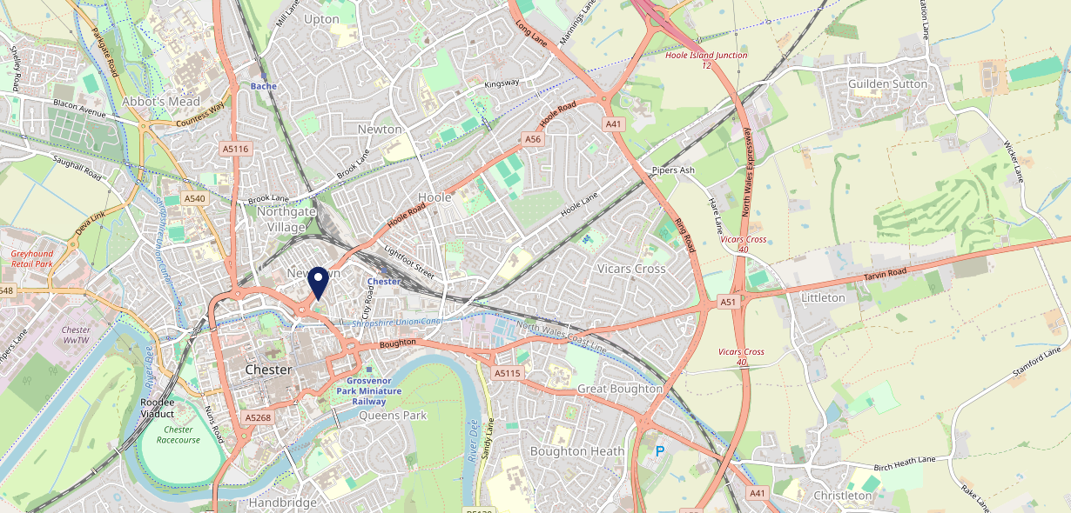









Site Intel
Stanleys CH13DZ
3 Miles
1 Chain
12/02/2025 - 04/02/2026
Site Summary
Stanleys CH13DZ
Work Area
Region
TV Region
Urbanicity
Chester
North West
North West
Urban city and town
CH13DZ
Punch T&L
Top Competitors
ATV
Gender
Coach House
#1
£7.98
76.35%
Male
CH12HQ
Pub Restaurant
Affluence
Segmentation
The Boat House Chester
#2
49.01%
26.42%
Middle Income
Paying The Mortgage
CH11SD
Pub Restaurant
Age Group
Visit Day
Pied Bull
#3
35.40%
22.12%
CH12HQ
45 to 54
Fri
Pub Restaurant
Nearest Station
Chester(0.49 miles)
311 Site Customers
8 Competitors
20532 Competitor Customers

Slide 2

Site Intel
Stanleys CH13DZ
3 Miles
1 Chain
12/02/2025 - 04/02/2026
Spend by Weekpart
How is customer spend distributed throughout the week for Stanleys CH13DZ versus its competitors?
% of spend for Stanleys CH13DZ and 1 Chains in 3 Miles from 12/02/2025 - 04/02/2026 split by Day of Week
311 Site Customers
8 Competitors
20532 Competitor Customers

Slide 3
Site Intel
Stanleys CH13DZ
3 Miles
1 Chain
12/02/2025 - 04/02/2026
Visit Frequency
How frequently per year do customers visit Stanleys CH13DZ versus its competitors?
% of customer numbers for Stanleys CH13DZ and 1 Chains in 3 Miles from 12/02/2025 - 04/02/2026 and the number of visits made Per Annum
311 Site Customers
8 Competitors
20532 Competitor Customers

Slide 4
Site Intel
Stanleys CH13DZ
3 Miles
1 Chain
12/02/2025 - 04/02/2026
ATV Change
How has ATV changed between two date ranges?
311 Site Customers

Slide 5
Site Intel
Stanleys CH13DZ
3 Miles
1 Chain
12/02/2025 - 04/02/2026
Market Share Change
How has market share changed between two date ranges?
% of market share spend for Stanleys CH13DZ and 1 Chains in 3 Miles from 12/02/2025 - 04/02/2026
311 Site Customers

Slide 6
Site Intel
Stanleys CH13DZ
3 Miles
1 Chain
12/02/2025 - 04/02/2026
Age
How does the age profile of customers who visit Stanleys CH13DZ compare versus its competitors?
% of spend for Stanleys CH13DZ and 1 Chains in 3 Miles from 12/02/2025 - 04/02/2026 split by Age Range
109 Site Customers
8 Competitors
9595 Competitor Customers

Slide 7
Site Intel
Stanleys CH13DZ
3 Miles
1 Chain
12/02/2025 - 04/02/2026
Affluence
How does the affluence of customers who visit Stanleys CH13DZ compare versus its competitors?
% of spend for Stanleys CH13DZ and 1 Chains in 3 Miles from 12/02/2025 - 04/02/2026 split by Affluence
95 Site Customers
8 Competitors
8976 Competitor Customers

Slide 8
Site Intel
Stanleys CH13DZ
3 Miles
1 Chain
12/02/2025 - 04/02/2026
Gender
How does the gender profile of customers who visit Stanleys CH13DZ compare versus its competitors?
% of spend for Stanleys CH13DZ and 1 Chains in 3 Miles from 12/02/2025 - 04/02/2026 split by Gender
103 Site Customers
8 Competitors
9352 Competitor Customers

Slide 9
Site Intel
Stanleys CH13DZ
3 Miles
1 Chain
12/02/2025 - 04/02/2026
Punch Segmentation
How does the Custom segmentation profile of customers who visit Stanleys CH13DZ compare versus its competitors?
% of spend for Stanleys CH13DZ and 1 Chains in 3 Miles from 12/02/2025 - 04/02/2026 split by Segment
311 Site Customers
8 Competitors
20532 Competitor Customers

Slide 10
Site Intel
Stanleys CH13DZ
3 Miles
1 Chain
12/02/2025 - 04/02/2026
Spend by Distance
How does the spend profile of Stanleys CH13DZ compare versus its competitors based on travel distances?
% of spend for Stanleys CH13DZ and 1 Chains in 3 Miles from 12/02/2025 - 04/02/2026 split by Distance travelled
102 Site Customers
8 Competitors
9341 Competitor Customers

Slide 11
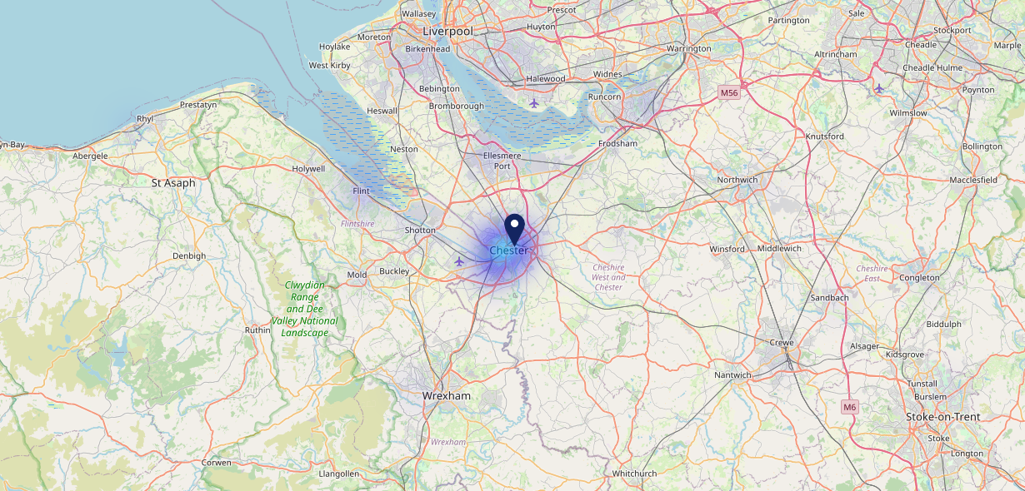

Site Intel
Stanleys CH13DZ
12/02/2025 - 04/02/2026
Map of Guest Origin
Where do customers of Stanleys CH13DZ come from?
Where do customers of Stanleys CH13DZ for 12/02/2025 - 04/02/2026 live
102 Site Customers

Slide 12
Site Intel
Stanleys CH13DZ
3 Miles
1 Chain
12/02/2025 - 04/02/2026
Share of Wallet
What are the Top 20 venues (by spend) that customers of Stanleys CH13DZ also visit?
For customers of Stanleys CH13DZ, who are the top 20 competitors from 1 Chains in 3 Miles for 12/02/2025 - 04/02/2026 split by Venue
311 Site Customers

Slide 13
Site Intel
Stanleys CH13DZ
3 Miles
1 Chain
12/02/2025 - 04/02/2026
Share of Wallet Change
How has share of wallet of customers of Stanleys CH13DZ changed between two date ranges?
311 Site Customers

Slide 14
Site Intel
Stanleys CH13DZ
12/02/2025 - 04/02/2026
Market Summary
How does the local area for Stanleys CH13DZ compare to the national average (1 = low, 10 = high)
Data Type | Name | Spend in 250m | 250m Spend vs National | Spend in 500m | 500m Spend vs National | Spend in 1 mile | 1 mile Spend vs National | Spend in 3 miles | 3 mile Spend vs National
Total | Annual Sales | £2.70M | 6 | £52.07M | 9 | £225.61M | 10 | £269.33M | 8
Weekpart | Mon - Thu | 41.0% | 6 | 38.3% | 4 | 35.3% | 1 | 36.8% | 1
Weekpart | Fri - Sat | 45.5% | 6 | 46.9% | 8 | 49.0% | 10 | 47.2% | 10
Weekpart | Sun | 13.5% | 4 | 14.8% | 5 | 15.8% | 6 | 16.0% | 7
Age | 18 to 24 | 4.6% | 4 | 5.8% | 5 | 6.5% | 5 | 6.3% | 5
Age | 25 to 34 | 12.0% | 2 | 16.6% | 3 | 17.2% | 3 | 16.8% | 2
Age | 35 to 44 | 18.3% | 2 | 22.7% | 5 | 22.7% | 5 | 22.9% | 5
Age | 45 to 54 | 20.0% | 5 | 19.9% | 5 | 19.8% | 5 | 19.7% | 5
Age | 55 to 64 | 25.7% | 10 | 21.5% | 9 | 20.0% | 9 | 20.1% | 9
Age | 65 to 74 | 11.8% | 9 | 9.9% | 8 | 9.9% | 8 | 10.0% | 9
Age | 75+ | 7.5% | 10 | 3.6% | 7 | 3.8% | 8 | 4.2% | 8
CAMEO | Business Elite | 10.4% | 7 | 9.7% | 7 | 9.7% | 7 | 9.5% | 7
CAMEO | Prosperous Professionals | 5.1% | 5 | 8.1% | 8 | 9.0% | 8 | 8.9% | 9
CAMEO | Flourishing Society | 10.1% | 4 | 10.7% | 5 | 11.7% | 5 | 11.5% | 5
CAMEO | Content Communities | 12.7% | 6 | 12.9% | 6 | 13.5% | 7 | 13.6% | 7
CAMEO | White Collar Neighbourhoods | 15.9% | 9 | 12.6% | 7 | 12.7% | 7 | 12.8% | 7
CAMEO | Enterprising Mainstream | 9.4% | 7 | 10.3% | 7 | 10.0% | 7 | 10.3% | 7
CAMEO | Paying The Mortgage | 14.0% | 5 | 15.7% | 6 | 15.0% | 6 | 14.7% | 5
CAMEO | Cash Conscious Communities | 8.3% | 5 | 7.4% | 4 | 6.8% | 3 | 6.8% | 3
CAMEO | On A Budget | 8.0% | 7 | 7.4% | 6 | 6.8% | 6 | 6.7% | 6
CAMEO | Family Value | 6.2% | 8 | 5.3% | 7 | 4.9% | 7 | 5.1% | 7
Affluence | AB | 25.5% | 5 | 28.4% | 6 | 30.4% | 6 | 30.0% | 6
Affluence | C1C2 | 52.0% | 7 | 51.5% | 7 | 51.2% | 7 | 51.4% | 7
Affluence | DE | 22.4% | 6 | 20.1% | 6 | 18.4% | 5 | 18.6% | 5

Slide 15

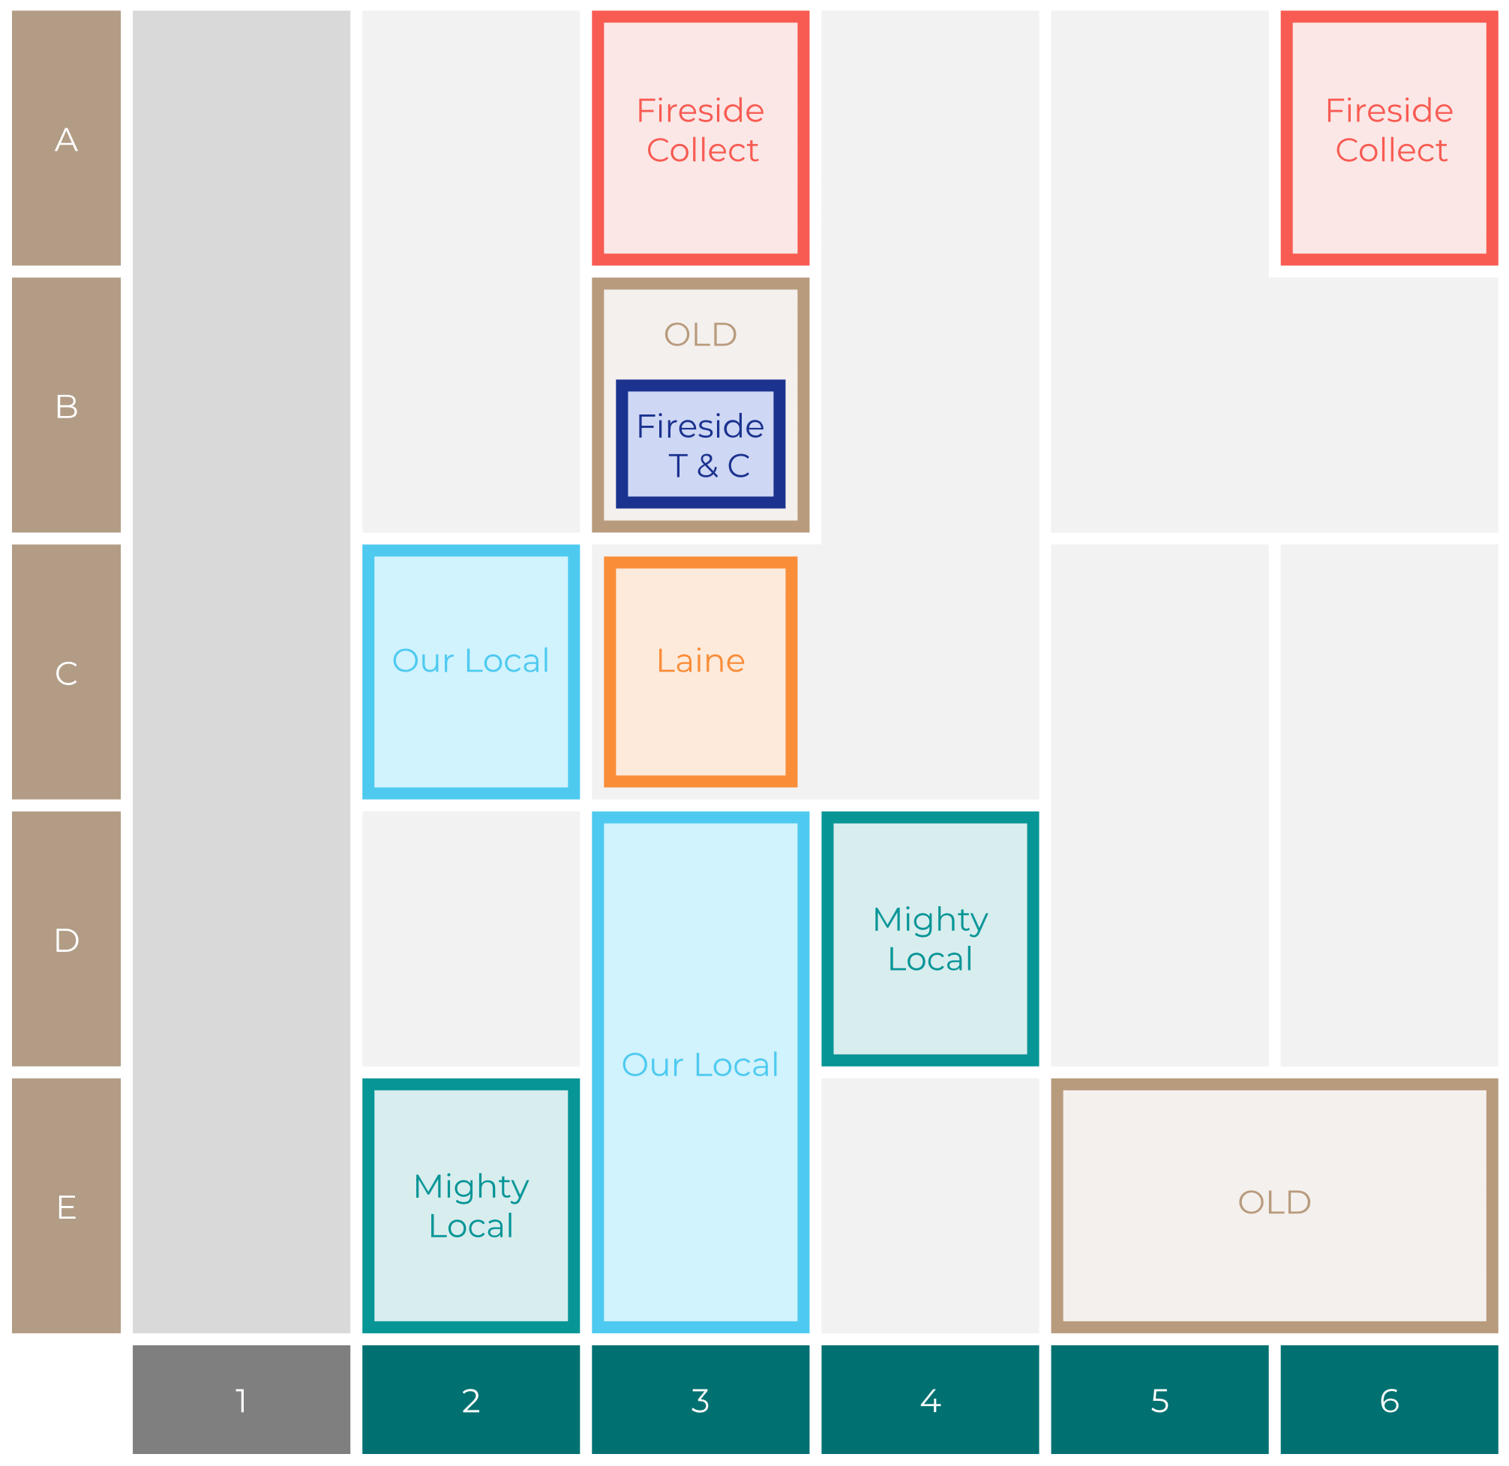

Site Intel
Stanleys CH13DZ
Site Potential 1
Site Characteristics
£3000
£18000
HDI Concept Fit
Achievable Average Weekly Takings
Our Local
£13500
A Food-Led High Affluence B Food-Led Mid Affluence C Wet-Led Mid/High Affluence D Wet-Led Low Affluence E Food-Led Low Affluence
AWT 2 Local Regulars 3 Local Passing Trade 4 Destination Wet-Led 5 Destination Food-Led 6 Destination Very Food-Led
A
B
C
D
E
1
2
3
4
5
6

Slide 16
Site Intel
Stanleys CH13DZ
Site Potential 2
Concept Recommendation

Slide 17
Site Intel
Stanleys CH13DZ
Local Market Profile
Mix of spend by customer segment in Punch site and local market
 | Customer Count | Family Familiar | Occasional & Local | Mid-Week Seniors | Part Of The Pub | Metro Sophisticates | Young & Connected | Bubbly Weekenders | Upmarket Diners
Stanleys | 45 | 22.53% | 8.61% | 10.04% | 15.24% | 3.64% | 37.70% | 1.62% | 0.57%
Local Catchment | 3348 | 11.49% | 6.57% | 22.86% | 5.13% | 10.26% | 12.60% | 8.31% | 22.74%
Punch T&L | 95120 | 8.97% | 6.12% | 29.01% | 11.18% | 11.00% | 11.13% | 7.13% | 15.42%
Stanleys vs Local Catchment |  | 11.04% | 2.04% | -12.82% | 10.11% | -6.62% | 25.10% | -6.69% | -22.17%
Stanleys vs Punch T&L |  | 13.56% | 2.49% | -18.97% | 4.06% | -7.36% | 26.57% | -5.51% | -14.85%
Local Catchment vs Punch T&L |  | 2.52% | 0.45% | -6.15% | -6.05% | -0.74% | 1.47% | 1.18% | 7.32%

Slide 18
Site Intel
Stanleys CH13DZ
Local Competitor Profiles
Mix of spend by customer segment in Punch site and local competitors
 | Customer Count | Family Familiar | Occasional & Local | Mid-Week Seniors | Part Of The Pub | Metro Sophisticates | Young & Connected | Bubbly Weekenders | Upmarket Diners
Stanleys CH13DZ | 45 | 22.53% | 8.61% | 10.04% | 15.24% | 3.64% | 37.70% | 1.62% | 0.57%
Coach House CH12HQ | 986 | 11.93% | 14.53% | 20.39% | 4.95% | 10.01% | 13.43% | 5.90% | 18.83%
The Boat House Chester CH11SD | 1154 | 14.15% | 4.34% | 23.75% | 5.11% | 9.34% | 9.95% | 9.37% | 23.96%
Pied Bull CH12HQ | 871 | 13.11% | 6.50% | 26.74% | 9.13% | 10.02% | 14.38% | 8.17% | 11.91%
Bird In Hand CH37EW | 131 | 2.98% | 2.42% | 34.11% | 0.11% | 10.20% | 4.11% | 2.04% | 44.00%
Kuckoo CH12LA | 405 | 12.58% | 3.74% | 9.87% | 3.09% | 13.07% | 25.47% | 18.65% | 13.49%
Prohibition CH12LA | 192 | 5.79% | 1.60% | 8.36% | 6.16% | 13.55% | 19.23% | 11.26% | 34.03%

