Slide 1
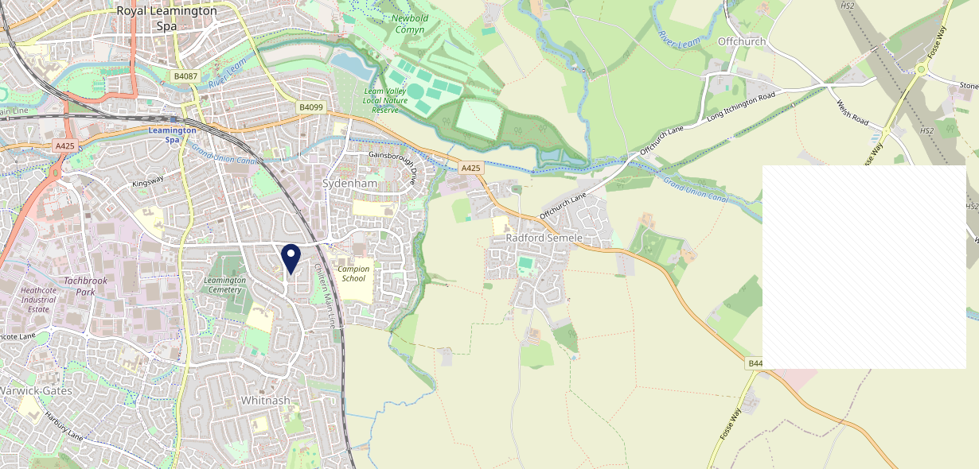
Site Intel
Bulldog CV312NX
1 Miles
371 Chains
16/04/2025 - 08/04/2026
Site Summary
Bulldog CV312NX
Work Area
Region
TV Region
Urbanicity
Leamington Spa
West Midlands
Central
Urban city and town
CV312NX
Punch T&L
Top Competitors
ATV
Gender
Plough & Harrow
#1
£11.47
51.84%
Female
CV312HX
Star Pubs & Bars
Affluence
Segmentation
McDonalds Leamington Spa Europa Way
#2
62.98%
38.64%
Middle Income
Enterprising Mainstream
CV313JZ
McDonalds
Age Group
Visit Day
Green Man
#3
45.41%
58.96%
CV312BQ
25 to 34
Sat
Pub / Bar
Nearest Station
Leamington Spa(1.42 miles)
50 Site Customers
179 Competitors
67492 Competitor Customers

Slide 2
Site Intel
Bulldog CV312NX
1 Miles
371 Chains
16/04/2025 - 08/04/2026
Spend by Weekpart
How is customer spend distributed throughout the week for Bulldog CV312NX versus its competitors?
% of spend for Bulldog CV312NX and 371 Chains in 1 Miles from 16/04/2025 - 08/04/2026 split by Day of Week
50 Site Customers
179 Competitors
67492 Competitor Customers

Slide 3
Site Intel
Bulldog CV312NX
1 Miles
371 Chains
16/04/2025 - 08/04/2026
Visit Frequency
How frequently per year do customers visit Bulldog CV312NX versus its competitors?
% of customer numbers for Bulldog CV312NX and 371 Chains in 1 Miles from 16/04/2025 - 08/04/2026 and the number of visits made Per Annum
50 Site Customers
179 Competitors
67492 Competitor Customers

Slide 4
Site Intel
Bulldog CV312NX
1 Miles
371 Chains
16/04/2025 - 08/04/2026
ATV Change
How has ATV changed between two date ranges?
50 Site Customers

Slide 5
Site Intel
Bulldog CV312NX
1 Miles
371 Chains
16/04/2025 - 08/04/2026
Market Share Change
How has market share changed between two date ranges?
% of market share spend for Bulldog CV312NX and 371 Chains in 1 Miles from 16/04/2025 - 08/04/2026
50 Site Customers

Slide 6
Site Intel
Bulldog CV312NX
1 Miles
371 Chains
16/04/2025 - 08/04/2026
Age
How does the age profile of customers who visit Bulldog CV312NX compare versus its competitors?
% of spend for Bulldog CV312NX and 371 Chains in 1 Miles from 16/04/2025 - 08/04/2026 split by Age Range
20 Site Customers
179 Competitors
24483 Competitor Customers

Slide 7
Site Intel
Bulldog CV312NX
1 Miles
371 Chains
16/04/2025 - 08/04/2026
Affluence
How does the affluence of customers who visit Bulldog CV312NX compare versus its competitors?
% of spend for Bulldog CV312NX and 371 Chains in 1 Miles from 16/04/2025 - 08/04/2026 split by Affluence
19 Site Customers
179 Competitors
21898 Competitor Customers

Slide 8
Site Intel
Bulldog CV312NX
1 Miles
371 Chains
16/04/2025 - 08/04/2026
Gender
How does the gender profile of customers who visit Bulldog CV312NX compare versus its competitors?
% of spend for Bulldog CV312NX and 371 Chains in 1 Miles from 16/04/2025 - 08/04/2026 split by Gender
20 Site Customers
179 Competitors
23627 Competitor Customers

Slide 9
Site Intel
Bulldog CV312NX
1 Miles
371 Chains
16/04/2025 - 08/04/2026
Punch Segmentation
How does the Custom segmentation profile of customers who visit Bulldog CV312NX compare versus its competitors?
% of spend for Bulldog CV312NX and 371 Chains in 1 Miles from 16/04/2025 - 08/04/2026 split by Segment
50 Site Customers
179 Competitors
67492 Competitor Customers

Slide 10
Site Intel
Bulldog CV312NX
1 Miles
371 Chains
16/04/2025 - 08/04/2026
Spend by Distance
How does the spend profile of Bulldog CV312NX compare versus its competitors based on travel distances?
% of spend for Bulldog CV312NX and 371 Chains in 1 Miles from 16/04/2025 - 08/04/2026 split by Distance travelled
20 Site Customers
179 Competitors
23619 Competitor Customers

Slide 11
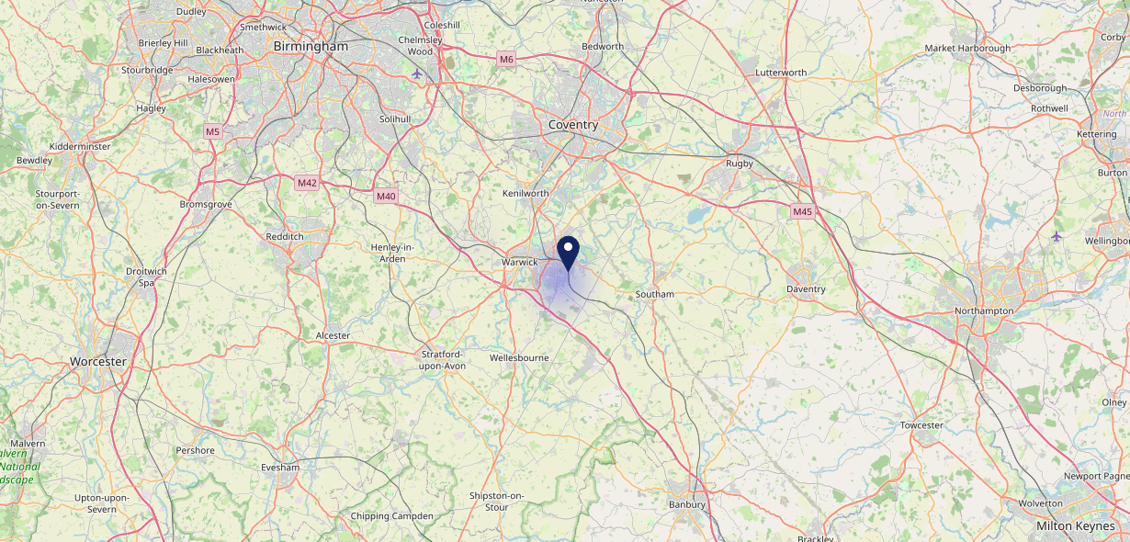
Site Intel
Bulldog CV312NX
16/04/2025 - 08/04/2026
Map of Guest Origin
Where do customers of Bulldog CV312NX come from?
Where do customers of Bulldog CV312NX for 16/04/2025 - 08/04/2026 live
20 Site Customers

Slide 12
Site Intel
Bulldog CV312NX
1 Miles
371 Chains
16/04/2025 - 08/04/2026
Share of Wallet
What are the Top 20 venues (by spend) that customers of Bulldog CV312NX also visit?
For customers of Bulldog CV312NX, who are the top 20 competitors from 371 Chains in 1 Miles for 16/04/2025 - 08/04/2026 split by Venue
50 Site Customers

Slide 13
Site Intel
Bulldog CV312NX
1 Miles
371 Chains
16/04/2025 - 08/04/2026
Share of Wallet Change
How has share of wallet of customers of Bulldog CV312NX changed between two date ranges?
50 Site Customers

Slide 14
Site Intel
Bulldog CV312NX
16/04/2025 - 08/04/2026
Market Summary
How does the local area for Bulldog CV312NX compare to the national average (1 = low, 10 = high)
Data Type | Name | Spend in 250m | 250m Spend vs National | Spend in 500m | 500m Spend vs National | Spend in 1 mile | 1 mile Spend vs National | Spend in 3 miles | 3 mile Spend vs National
Total | Annual Sales | £285K | 3 | £489K | 2 | £25.38M | 7 | £126.17M | 7
Weekpart | Mon - Thu | 46.2% | 8 | 43.9% | 7 | 41.7% | 6 | 40.0% | 3
Weekpart | Fri - Sat | 48.7% | 8 | 44.1% | 6 | 42.8% | 5 | 44.9% | 9
Weekpart | Sun | 5.1% | 1 | 12.0% | 2 | 15.5% | 6 | 15.1% | 4
Age | 18 to 24 | 0.9% | 1 | 0.8% | 1 | 5.0% | 4 | 4.4% | 2
Age | 25 to 34 | 10.7% | 1 | 20.0% | 5 | 17.5% | 3 | 16.2% | 2
Age | 35 to 44 | 23.3% | 6 | 34.2% | 10 | 26.4% | 8 | 24.9% | 7
Age | 45 to 54 | 24.8% | 9 | 17.8% | 3 | 21.6% | 7 | 21.3% | 7
Age | 55 to 64 | 21.7% | 9 | 14.7% | 5 | 16.3% | 6 | 19.5% | 9
Age | 65 to 74 | 17.4% | 10 | 11.7% | 9 | 10.4% | 9 | 9.8% | 9
Age | 75+ | 1.2% | 4 | 0.7% | 2 | 2.8% | 6 | 4.0% | 8
CAMEO | Business Elite | 0.5% | 1 | 4.0% | 4 | 8.7% | 6 | 10.9% | 7
CAMEO | Prosperous Professionals | 2.8% | 3 | 4.9% | 4 | 8.5% | 8 | 11.1% | 10
CAMEO | Flourishing Society | 10.8% | 5 | 10.4% | 5 | 14.2% | 6 | 15.6% | 7
CAMEO | Content Communities | 16.0% | 8 | 15.0% | 8 | 12.9% | 6 | 13.9% | 7
CAMEO | White Collar Neighbourhoods | 9.7% | 4 | 11.0% | 5 | 10.5% | 4 | 11.3% | 5
CAMEO | Enterprising Mainstream | 7.5% | 5 | 8.7% | 6 | 11.6% | 8 | 8.3% | 5
CAMEO | Paying The Mortgage | 16.8% | 7 | 16.3% | 7 | 12.6% | 4 | 14.3% | 5
CAMEO | Cash Conscious Communities | 9.5% | 6 | 9.6% | 6 | 7.6% | 4 | 6.3% | 3
CAMEO | On A Budget | 18.8% | 10 | 14.1% | 10 | 8.0% | 7 | 5.4% | 3
CAMEO | Family Value | 7.6% | 8 | 6.0% | 8 | 5.3% | 7 | 3.1% | 6
Affluence | AB | 14.2% | 2 | 19.3% | 3 | 31.5% | 6 | 37.6% | 7
Affluence | C1C2 | 50.0% | 6 | 51.0% | 6 | 47.6% | 5 | 47.7% | 5
Affluence | DE | 35.9% | 9 | 29.6% | 8 | 20.9% | 6 | 14.7% | 3

Slide 15
Site Intel
Bulldog CV312NX
Site Potential 1
Site Characteristics
£3000
£18000
OCC Concept Fit
Achievable Average Weekly Takings
Non-Core
£6000
A Food-Led High Affluence B Food-Led Mid Affluence C Wet-Led Mid/High Affluence D Wet-Led Low Affluence E Food-Led Low Affluence
AWT 2 Local Regulars 3 Local Passing Trade 4 Destination Wet-Led 5 Destination Food-Led 6 Destination Very Food-Led
A
B
C
D
E
1
2
3
4
5
6

Slide 16
Site Intel
Bulldog CV312NX
Site Potential 2
Concept Recommendation

Slide 17
Site Intel
Bulldog CV312NX
Local Market Profile
Mix of spend by customer segment in Punch site and local market
 | Customer Count | Family Familiar | Occasional & Local | Mid-Week Seniors | Part Of The Pub | Metro Sophisticates | Young & Connected | Bubbly Weekenders | Upmarket Diners
Bulldog | 8 | 23.36% | 54.90% | 0.00% | 0.00% | 15.07% | 2.38% | 0.00% | 4.26%
Local Catchment | 4115 | 14.80% | 7.73% | 15.84% | 7.72% | 11.53% | 11.33% | 10.29% | 20.72%
Punch T&L | 95043 | 8.91% | 6.06% | 28.65% | 11.34% | 11.30% | 11.03% | 7.03% | 15.64%
Bulldog vs Local Catchment |  | 8.56% | 47.17% | 0.00% | 0.00% | 3.54% | -8.95% | 0.00% | -16.46%
Bulldog vs Punch T&L |  | 14.45% | 48.84% | 0.00% | 0.00% | 3.77% | -8.65% | 0.00% | -11.38%
Local Catchment vs Punch T&L |  | 5.89% | 1.67% | -12.81% | -3.62% | 0.23% | 0.30% | 3.26% | 5.08%

Slide 18
Site Intel
Bulldog CV312NX
Local Competitor Profiles
Mix of spend by customer segment in Punch site and local competitors
 | Customer Count | Family Familiar | Occasional & Local | Mid-Week Seniors | Part Of The Pub | Metro Sophisticates | Young & Connected | Bubbly Weekenders | Upmarket Diners
Plough & Harrow CV312HX | 61 | 4.12% | 32.33% | 2.84% | 37.76% | 9.37% | 10.46% | 1.94% | 1.15%
McDonalds Leamington Spa Europa Way CV313JZ | 1502 | 27.37% | 6.76% | 7.98% | 4.25% | 5.57% | 15.02% | 11.44% | 21.58%
Green Man CV312BQ | 22 | 1.28% | 71.34% | 0.19% | 18.21% | 4.99% | 3.95% | 0.00% | 0.00%
Royal Horse (Warwick) CV346SW | 235 | 30.70% | 8.72% | 17.72% | 18.48% | 2.52% | 12.95% | 5.19% | 3.69%
Whitnash Sports & Social Club CV312NF | 84 | 11.29% | 5.08% | 25.15% | 13.41% | 7.12% | 4.67% | 27.93% | 5.32%
Johnnys Plaice CV312NT | 72 | 33.11% | 24.35% | 7.88% | 2.22% | 0.88% | 9.40% | 9.98% | 12.13%
Heathcote CV313DG | 294 | 19.16% | 5.70% | 25.27% | 3.13% | 6.78% | 9.49% | 8.94% | 21.49%
Bulldog CV312NX | 8 | 23.36% | 54.90% | 0.00% | 0.00% | 15.07% | 2.38% | 0.00% | 4.26%
Hod Carrier Whitnash CV312LT | 55 | 7.03% | 6.08% | 28.40% | 30.65% | 15.87% | 7.42% | 3.59% | 0.92%
Happy Nest CV312LT | 20 | 36.90% | 40.00% | 5.69% | 0.00% | 5.31% | 2.49% | 2.37% | 7.20%
Truth CV313AB | 125 | 10.33% | 3.80% | 6.30% | 1.15% | 22.87% | 12.79% | 20.06% | 22.66%
Urban Fox CV313BE | 74 | 12.34% | 12.96% | 27.17% | 6.18% | 4.96% | 14.59% | 10.46% | 11.30%
Hush Bar CV313AB | 371 | 5.68% | 3.65% | 14.99% | 6.26% | 15.33% | 14.22% | 12.31% | 27.51%
Fish Fair CV346DZ | 60 | 27.38% | 14.67% | 2.59% | 2.23% | 2.69% | 10.44% | 5.86% | 34.11%
Fusilier CV311NJ | 45 | 5.64% | 22.13% | 15.75% | 33.37% | 14.15% | 4.81% | 1.65% | 2.47%
Kelsyes CV313AW | 61 | 11.84% | 9.19% | 1.59% | 2.83% | 35.30% | 23.69% | 8.08% | 7.44%
Kelseys Live Basement CV313AW | 51 | 22.79% | 2.09% | 2.23% | 4.77% | 40.36% | 8.02% | 13.24% | 6.46%
Micro Pug CV312DN | 123 | 4.85% | 2.44% | 22.19% | 4.17% | 8.63% | 12.91% | 16.11% | 28.68%
The Old Library Leamington Spa CV313AF | 366 | 8.76% | 8.32% | 10.28% | 17.24% | 12.69% | 23.39% | 10.90% | 8.38%
Viallis CV313AB | 146 | 10.41% | 9.39% | 7.12% | 4.48% | 25.01% | 22.42% | 10.32% | 10.82%
Petes Plaice CV311NL | 38 | 23.76% | 26.11% | 15.81% | 4.79% | 5.03% | 6.37% | 13.57% | 4.52%
Pig And Fiddle CV311LN | 34 | 28.13% | 13.94% | 10.41% | 23.07% | 8.35% | 10.83% | 5.24% | 0.00%
Leamington County Golf Club CV312QA | 113 | 7.32% | 1.63% | 21.73% | 4.02% | 6.78% | 1.75% | 15.47% | 41.25%
Keep Calm And Beer It CV311HP | 11 | 6.70% | 24.60% | 3.43% | 0.00% | 48.18% | 2.57% | 0.00% | 14.48%
Flames Pizza And Grill CV311LW | 16 | 26.26% | 21.27% | 9.65% | 28.60% | 2.90% | 9.53% | 1.76% | 0.00%

