Slide 1










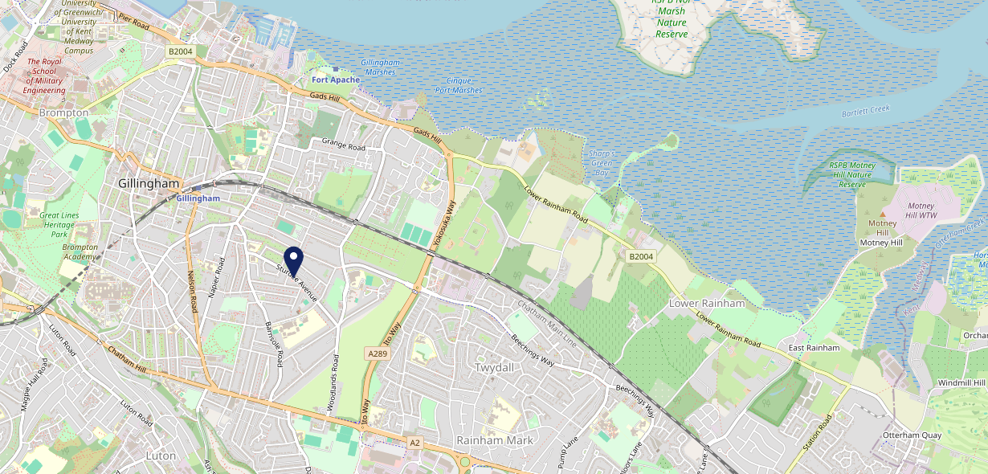









Site Intel
Cricketers ME72JR
3 Miles
1 Chain
22/02/2023 - 14/02/2024
Site Summary
Cricketers ME72JR
Work Area
Region
TV Region
Urbanicity
Medway
South East
South
Urban city and town
ME72JR
Punch - Our Local
Top Competitors
ATV
Gender
George Vaults Inn
#1
£10.90
85.45%
Male
ME11LN
Pub Restaurant
Affluence
Segmentation
Kings Arms
#2
59.72%
30.07%
Middle Income
Paying The Mortgage
ME24XG
Pub Restaurant
Age Group
Visit Day
#3
38.70%
34.30%
35 to 44
Sat
Nearest Station
Gillingham (Kent)(1.02 miles)
1184 Site Customers
3 Competitors
6323 Competitor Customers

Slide 2

Site Intel
Cricketers ME72JR
3 Miles
1 Chain
22/02/2023 - 14/02/2024
Spend by Weekpart
How is customer spend distributed throughout the week for Cricketers ME72JR versus its competitors?
% of spend for Cricketers ME72JR and 1 Chains in 3 Miles from 22/02/2023 - 14/02/2024 split by Day of Week
1184 Site Customers
3 Competitors
6323 Competitor Customers

Slide 3
Site Intel
Cricketers ME72JR
3 Miles
1 Chain
22/02/2023 - 14/02/2024
Visit Frequency
How frequently per year do customers visit Cricketers ME72JR versus its competitors?
% of customer numbers for Cricketers ME72JR and 1 Chains in 3 Miles from 22/02/2023 - 14/02/2024 and the number of visits made Per Annum
1184 Site Customers
3 Competitors
6323 Competitor Customers

Slide 4
Site Intel
Cricketers ME72JR
3 Miles
1 Chain
22/02/2023 - 14/02/2024
ATV Change
How has ATV changed between two date ranges?
1184 Site Customers

Slide 5
Site Intel
Cricketers ME72JR
3 Miles
1 Chain
22/02/2023 - 14/02/2024
Market Share Change
How has market share changed between two date ranges?
% of market share spend for Cricketers ME72JR and 1 Chains in 3 Miles from 22/02/2023 - 14/02/2024
1184 Site Customers

Slide 6
Site Intel
Cricketers ME72JR
3 Miles
1 Chain
22/02/2023 - 14/02/2024
Age
How does the age profile of customers who visit Cricketers ME72JR compare versus its competitors?
% of spend for Cricketers ME72JR and 1 Chains in 3 Miles from 22/02/2023 - 14/02/2024 split by Age Range
549 Site Customers
3 Competitors
3525 Competitor Customers

Slide 7
Site Intel
Cricketers ME72JR
3 Miles
1 Chain
22/02/2023 - 14/02/2024
Affluence
How does the affluence of customers who visit Cricketers ME72JR compare versus its competitors?
% of spend for Cricketers ME72JR and 1 Chains in 3 Miles from 22/02/2023 - 14/02/2024 split by Affluence
528 Site Customers
3 Competitors
3309 Competitor Customers

Slide 8
Site Intel
Cricketers ME72JR
3 Miles
1 Chain
22/02/2023 - 14/02/2024
Gender
How does the gender profile of customers who visit Cricketers ME72JR compare versus its competitors?
% of spend for Cricketers ME72JR and 1 Chains in 3 Miles from 22/02/2023 - 14/02/2024 split by Gender
548 Site Customers
3 Competitors
3505 Competitor Customers

Slide 9
Site Intel
Cricketers ME72JR
3 Miles
1 Chain
22/02/2023 - 14/02/2024
Punch Segmentation
How does the Custom segmentation profile of customers who visit Cricketers ME72JR compare versus its competitors?
% of spend for Cricketers ME72JR and 1 Chains in 3 Miles from 22/02/2023 - 14/02/2024 split by Segment
1184 Site Customers
3 Competitors
6323 Competitor Customers

Slide 10
Site Intel
Cricketers ME72JR
3 Miles
1 Chain
22/02/2023 - 14/02/2024
Spend by Distance
How does the spend profile of Cricketers ME72JR compare versus its competitors based on travel distances?
% of spend for Cricketers ME72JR and 1 Chains in 3 Miles from 22/02/2023 - 14/02/2024 split by Distance travelled
548 Site Customers
3 Competitors
3503 Competitor Customers

Slide 11
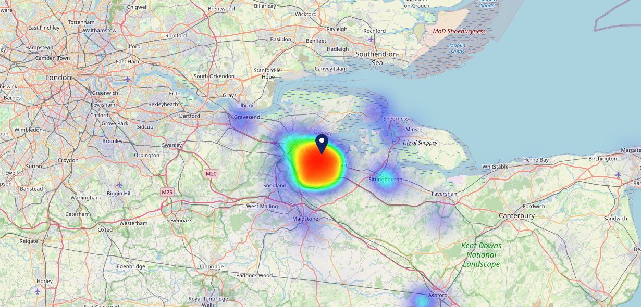

Site Intel
Cricketers ME72JR
22/02/2023 - 14/02/2024
Map of Guest Origin
Where do customers of Cricketers ME72JR come from?
Where do customers of Cricketers ME72JR for 22/02/2023 - 14/02/2024 live
548 Site Customers

Slide 12
Site Intel
Cricketers ME72JR
3 Miles
1 Chain
22/02/2023 - 14/02/2024
Share of Wallet
What are the Top 20 venues (by spend) that customers of Cricketers ME72JR also visit?
For customers of Cricketers ME72JR, who are the top 20 competitors from 1 Chains in 3 Miles for 22/02/2023 - 14/02/2024 split by Venue
1184 Site Customers

Slide 13
Site Intel
Cricketers ME72JR
3 Miles
1 Chain
22/02/2023 - 14/02/2024
Share of Wallet Change
How has share of wallet of customers of Cricketers ME72JR changed between two date ranges?
1184 Site Customers

Slide 14
Site Intel
Cricketers ME72JR
22/02/2023 - 14/02/2024
Market Summary
How does the local area for Cricketers ME72JR compare to the national average (1 = low, 10 = high)
Data Type | Name | Spend in 250m | 250m Spend vs National | Spend in 500m | 500m Spend vs National | Spend in 1 mile | 1 mile Spend vs National | Spend in 3 miles | 3 mile Spend vs National
Total | Annual Sales | £1.39M | 5 | £4.41M | 6 | £30.31M | 7 | £190.72M | 8
Weekpart | Mon - Thu | 31.6% | 2 | 47.2% | 9 | 45.6% | 9 | 40.7% | 4
Weekpart | Fri - Sat | 55.5% | 10 | 44.3% | 6 | 40.2% | 3 | 44.4% | 8
Weekpart | Sun | 12.9% | 4 | 8.4% | 1 | 14.2% | 3 | 14.9% | 3
Age | 18 to 24 | 7.3% | 7 | 5.8% | 5 | 6.1% | 5 | 6.8% | 5
Age | 25 to 34 | 12.6% | 2 | 12.2% | 1 | 16.1% | 2 | 16.6% | 2
Age | 35 to 44 | 28.5% | 9 | 28.3% | 9 | 25.7% | 8 | 25.3% | 8
Age | 45 to 54 | 26.3% | 10 | 23.5% | 9 | 21.1% | 7 | 21.4% | 8
Age | 55 to 64 | 17.4% | 7 | 17.3% | 7 | 16.8% | 7 | 16.1% | 7
Age | 65 to 74 | 5.9% | 5 | 9.6% | 8 | 9.6% | 8 | 9.0% | 8
Age | 75+ | 2.0% | 5 | 3.3% | 7 | 4.6% | 8 | 4.9% | 9
CAMEO | Business Elite | 2.3% | 2 | 5.7% | 5 | 2.9% | 2 | 4.7% | 3
CAMEO | Prosperous Professionals | 1.1% | 1 | 2.5% | 2 | 2.2% | 1 | 3.7% | 2
CAMEO | Flourishing Society | 14.0% | 6 | 18.7% | 8 | 12.6% | 6 | 15.7% | 7
CAMEO | Content Communities | 5.8% | 1 | 10.1% | 3 | 7.7% | 1 | 9.5% | 2
CAMEO | White Collar Neighbourhoods | 18.7% | 10 | 15.9% | 9 | 14.4% | 9 | 17.0% | 10
CAMEO | Enterprising Mainstream | 7.4% | 5 | 9.7% | 7 | 9.2% | 6 | 10.6% | 7
CAMEO | Paying The Mortgage | 28.4% | 10 | 20.3% | 9 | 25.6% | 10 | 20.1% | 9
CAMEO | Cash Conscious Communities | 4.3% | 2 | 5.5% | 2 | 9.6% | 6 | 7.5% | 4
CAMEO | On A Budget | 15.9% | 10 | 9.3% | 8 | 12.4% | 9 | 9.5% | 8
CAMEO | Family Value | 1.8% | 5 | 2.3% | 5 | 3.4% | 6 | 1.7% | 4
Affluence | AB | 17.5% | 3 | 26.9% | 5 | 17.7% | 3 | 24.1% | 4
Affluence | C1C2 | 60.5% | 9 | 56.0% | 8 | 56.9% | 9 | 57.2% | 10
Affluence | DE | 22.1% | 6 | 17.1% | 4 | 25.4% | 7 | 18.6% | 5

Slide 15

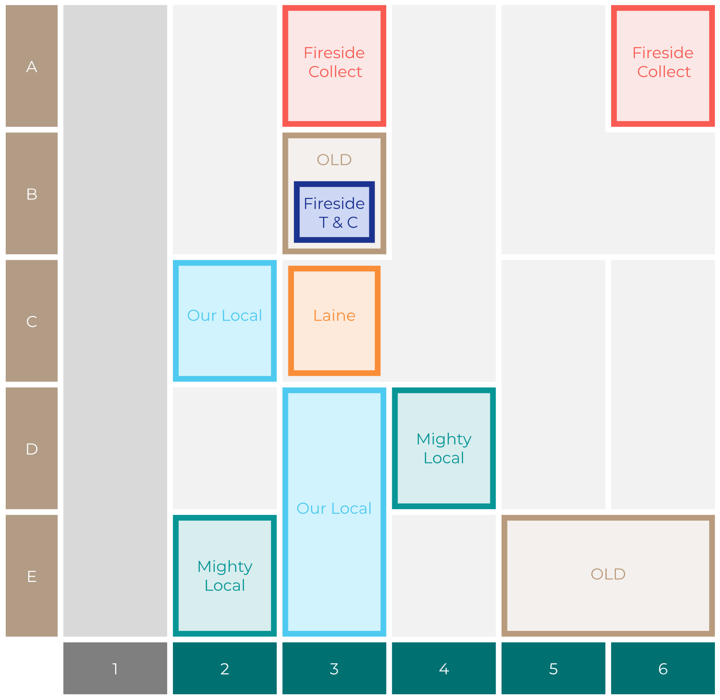

Site Intel
Cricketers ME72JR
Site Potential 1
Site Characteristics
£3000
£18000
OCC Concept Fit
Achievable Average Weekly Takings
Non-Core
£13500
A Food-Led High Affluence B Food-Led Mid Affluence C Wet-Led Mid/High Affluence D Wet-Led Low Affluence E Food-Led Low Affluence
AWT 2 Local Regulars 3 Local Passing Trade 4 Destination Wet-Led 5 Destination Food-Led 6 Destination Very Food-Led
A
B
C
D
E
1
2
3
4
5
6

Slide 16
Site Intel
Cricketers ME72JR
Site Potential 2
Concept Recommendation

Slide 17
Site Intel
Cricketers ME72JR
Local Market Profile
Mix of spend by customer segment in Punch site and local market
 | Customer Count | Family Familiar | Occasional & Local | Mid-Week Seniors | Part Of The Pub | Metro Sophisticates | Young & Connected | Bubbly Weekenders | Upmarket Diners
Cricketers | 234 | 20.08% | 9.76% | 6.00% | 37.31% | 3.17% | 14.19% | 4.80% | 4.66%
Local Catchment | 1314 | 14.72% | 2.26% | 10.34% | 3.79% | 17.72% | 17.37% | 16.41% | 17.33%
Punch T&L | 110107 | 8.03% | 5.92% | 29.65% | 11.15% | 11.28% | 11.54% | 7.14% | 15.25%
Cricketers vs Local Catchment |  | 5.36% | 7.50% | -4.34% | 33.52% | -14.55% | -3.18% | -11.61% | -12.67%
Cricketers vs Punch T&L |  | 12.05% | 3.84% | -23.65% | 26.16% | -8.11% | 2.65% | -2.34% | -10.59%
Local Catchment vs Punch T&L |  | 6.69% | -3.66% | -19.31% | -7.36% | 6.44% | 5.83% | 9.27% | 2.08%

Slide 18
Site Intel
Cricketers ME72JR
Local Competitor Profiles
Mix of spend by customer segment in Punch site and local competitors
 | Customer Count | Family Familiar | Occasional & Local | Mid-Week Seniors | Part Of The Pub | Metro Sophisticates | Young & Connected | Bubbly Weekenders | Upmarket Diners
Cricketers ME72JR | 234 | 20.08% | 9.76% | 6.00% | 37.31% | 3.17% | 14.19% | 4.80% | 4.66%
George Vaults Inn ME11LN | 1140 | 14.81% | 2.05% | 6.97% | 3.84% | 16.68% | 18.65% | 18.93% | 18.05%
Kings Arms ME24XG | 219 | 14.37% | 3.26% | 25.76% | 3.61% | 22.49% | 11.39% | 4.94% | 14.14%

