Slide 1
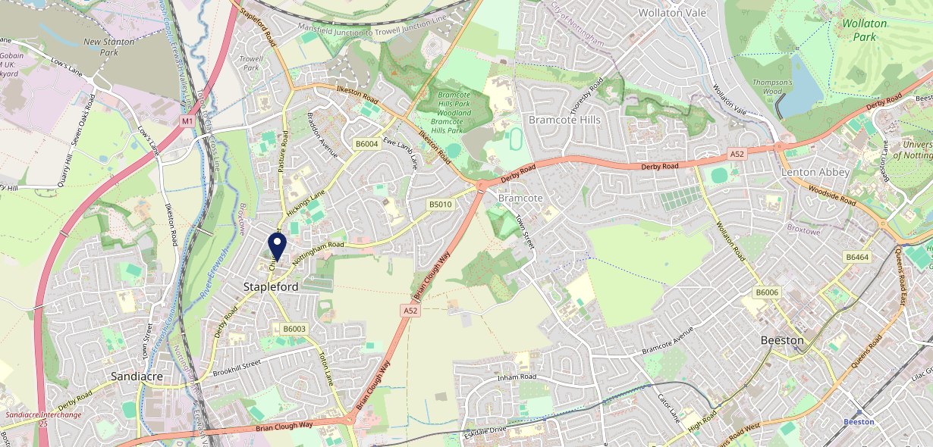
Site Intel
Old Cross NG98DA
1 Miles
371 Chains
16/04/2025 - 08/04/2026
Site Summary
Old Cross NG98DA
Work Area
Region
TV Region
Urbanicity
Nottingham
East Midlands
Central
Urban minor conurbation
NG98DA
Punch T&L
Top Competitors
ATV
Gender
The Admiral Sir John Borlase Warren
#1
£8.69
79.78%
Male
NG97AA
JD Wetherspoon
Affluence
Segmentation
Larrys Number One Bar
#2
51.66%
34.50%
Low Income
Cash Conscious Communities
NG97AN
Pub / Bar
Age Group
Visit Day
Sherwin Arms (Bramcote)
#3
42.63%
37.32%
NG93JN
45 to 54
Sat
Flaming Grill
Nearest Station
Attenborough(3.96 miles)
245 Site Customers
128 Competitors
32278 Competitor Customers

Slide 2
Site Intel
Old Cross NG98DA
1 Miles
371 Chains
16/04/2025 - 08/04/2026
Spend by Weekpart
How is customer spend distributed throughout the week for Old Cross NG98DA versus its competitors?
% of spend for Old Cross NG98DA and 371 Chains in 1 Miles from 16/04/2025 - 08/04/2026 split by Day of Week
245 Site Customers
128 Competitors
32278 Competitor Customers

Slide 3
Site Intel
Old Cross NG98DA
1 Miles
371 Chains
16/04/2025 - 08/04/2026
Visit Frequency
How frequently per year do customers visit Old Cross NG98DA versus its competitors?
% of customer numbers for Old Cross NG98DA and 371 Chains in 1 Miles from 16/04/2025 - 08/04/2026 and the number of visits made Per Annum
245 Site Customers
128 Competitors
32278 Competitor Customers

Slide 4
Site Intel
Old Cross NG98DA
1 Miles
371 Chains
16/04/2025 - 08/04/2026
ATV Change
How has ATV changed between two date ranges?
245 Site Customers

Slide 5
Site Intel
Old Cross NG98DA
1 Miles
371 Chains
16/04/2025 - 08/04/2026
Market Share Change
How has market share changed between two date ranges?
% of market share spend for Old Cross NG98DA and 371 Chains in 1 Miles from 16/04/2025 - 08/04/2026
245 Site Customers

Slide 6
Site Intel
Old Cross NG98DA
1 Miles
371 Chains
16/04/2025 - 08/04/2026
Age
How does the age profile of customers who visit Old Cross NG98DA compare versus its competitors?
% of spend for Old Cross NG98DA and 371 Chains in 1 Miles from 16/04/2025 - 08/04/2026 split by Age Range
123 Site Customers
128 Competitors
14841 Competitor Customers

Slide 7
Site Intel
Old Cross NG98DA
1 Miles
371 Chains
16/04/2025 - 08/04/2026
Affluence
How does the affluence of customers who visit Old Cross NG98DA compare versus its competitors?
% of spend for Old Cross NG98DA and 371 Chains in 1 Miles from 16/04/2025 - 08/04/2026 split by Affluence
115 Site Customers
128 Competitors
13717 Competitor Customers

Slide 8
Site Intel
Old Cross NG98DA
1 Miles
371 Chains
16/04/2025 - 08/04/2026
Gender
How does the gender profile of customers who visit Old Cross NG98DA compare versus its competitors?
% of spend for Old Cross NG98DA and 371 Chains in 1 Miles from 16/04/2025 - 08/04/2026 split by Gender
120 Site Customers
128 Competitors
14242 Competitor Customers

Slide 9
Site Intel
Old Cross NG98DA
1 Miles
371 Chains
16/04/2025 - 08/04/2026
Punch Segmentation
How does the Custom segmentation profile of customers who visit Old Cross NG98DA compare versus its competitors?
% of spend for Old Cross NG98DA and 371 Chains in 1 Miles from 16/04/2025 - 08/04/2026 split by Segment
245 Site Customers
128 Competitors
32278 Competitor Customers

Slide 10
Site Intel
Old Cross NG98DA
1 Miles
371 Chains
16/04/2025 - 08/04/2026
Spend by Distance
How does the spend profile of Old Cross NG98DA compare versus its competitors based on travel distances?
% of spend for Old Cross NG98DA and 371 Chains in 1 Miles from 16/04/2025 - 08/04/2026 split by Distance travelled
118 Site Customers
128 Competitors
14236 Competitor Customers

Slide 11
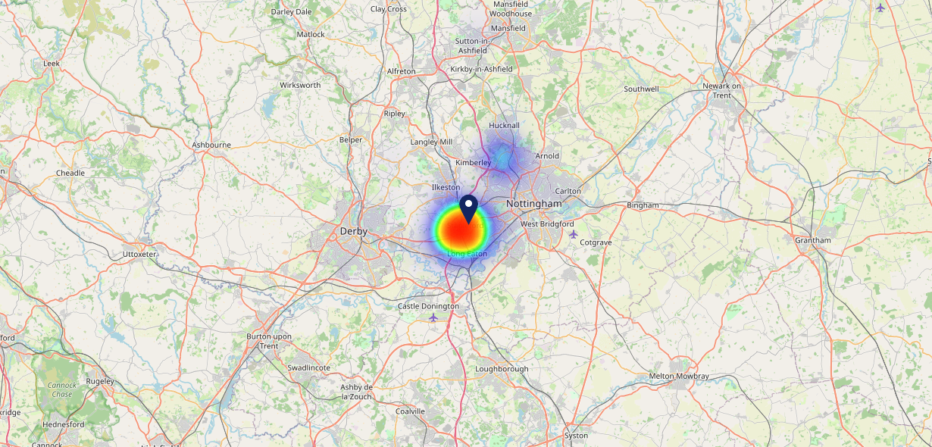
Site Intel
Old Cross NG98DA
16/04/2025 - 08/04/2026
Map of Guest Origin
Where do customers of Old Cross NG98DA come from?
Where do customers of Old Cross NG98DA for 16/04/2025 - 08/04/2026 live
118 Site Customers

Slide 12
Site Intel
Old Cross NG98DA
1 Miles
371 Chains
16/04/2025 - 08/04/2026
Share of Wallet
What are the Top 20 venues (by spend) that customers of Old Cross NG98DA also visit?
For customers of Old Cross NG98DA, who are the top 20 competitors from 371 Chains in 1 Miles for 16/04/2025 - 08/04/2026 split by Venue
245 Site Customers

Slide 13
Site Intel
Old Cross NG98DA
1 Miles
371 Chains
16/04/2025 - 08/04/2026
Share of Wallet Change
How has share of wallet of customers of Old Cross NG98DA changed between two date ranges?
245 Site Customers

Slide 14
Site Intel
Old Cross NG98DA
16/04/2025 - 08/04/2026
Market Summary
How does the local area for Old Cross NG98DA compare to the national average (1 = low, 10 = high)
Data Type | Name | Spend in 250m | 250m Spend vs National | Spend in 500m | 500m Spend vs National | Spend in 1 mile | 1 mile Spend vs National | Spend in 3 miles | 3 mile Spend vs National
Total | Annual Sales | £3.11M | 6 | £3.80M | 5 | £15.33M | 5 | £129.24M | 7
Weekpart | Mon - Thu | 48.8% | 9 | 46.5% | 9 | 42.0% | 6 | 42.4% | 6
Weekpart | Fri - Sat | 41.8% | 4 | 42.8% | 5 | 45.0% | 7 | 42.3% | 6
Weekpart | Sun | 9.5% | 2 | 10.8% | 2 | 13.1% | 2 | 15.3% | 5
Age | 18 to 24 | 2.1% | 2 | 2.1% | 2 | 5.1% | 4 | 5.2% | 4
Age | 25 to 34 | 11.3% | 1 | 13.0% | 2 | 12.2% | 1 | 15.0% | 1
Age | 35 to 44 | 19.9% | 3 | 20.9% | 4 | 22.0% | 4 | 24.1% | 6
Age | 45 to 54 | 25.1% | 9 | 23.8% | 9 | 22.3% | 8 | 20.2% | 6
Age | 55 to 64 | 24.6% | 10 | 24.5% | 10 | 22.5% | 10 | 19.9% | 9
Age | 65 to 74 | 12.5% | 9 | 11.6% | 9 | 10.9% | 9 | 10.6% | 9
Age | 75+ | 4.6% | 8 | 4.0% | 8 | 5.0% | 9 | 4.9% | 9
CAMEO | Business Elite | 1.3% | 1 | 1.1% | 1 | 1.7% | 1 | 2.9% | 2
CAMEO | Prosperous Professionals | 1.4% | 1 | 1.3% | 1 | 2.1% | 1 | 4.1% | 2
CAMEO | Flourishing Society | 1.2% | 1 | 1.1% | 1 | 3.5% | 1 | 5.4% | 1
CAMEO | Content Communities | 10.4% | 4 | 9.8% | 3 | 13.7% | 7 | 14.9% | 8
CAMEO | White Collar Neighbourhoods | 2.5% | 1 | 2.6% | 1 | 3.2% | 1 | 6.4% | 1
CAMEO | Enterprising Mainstream | 20.6% | 10 | 18.9% | 10 | 14.3% | 9 | 13.2% | 9
CAMEO | Paying The Mortgage | 22.7% | 9 | 21.8% | 9 | 19.5% | 9 | 22.7% | 10
CAMEO | Cash Conscious Communities | 26.6% | 10 | 27.1% | 10 | 21.9% | 10 | 14.7% | 10
CAMEO | On A Budget | 6.5% | 6 | 6.4% | 5 | 8.6% | 7 | 7.2% | 6
CAMEO | Family Value | 6.9% | 8 | 9.8% | 9 | 11.5% | 9 | 8.6% | 8
Affluence | AB | 3.8% | 1 | 3.6% | 1 | 7.3% | 1 | 12.3% | 1
Affluence | C1C2 | 56.2% | 8 | 53.1% | 7 | 50.7% | 6 | 57.2% | 10
Affluence | DE | 40.0% | 9 | 43.3% | 10 | 42.0% | 10 | 30.5% | 9

Slide 15
Site Intel
Old Cross NG98DA
Site Potential 1
Site Characteristics
£3000
£18000
OCC Concept Fit
Achievable Average Weekly Takings
Non-Core
£5500
A Food-Led High Affluence B Food-Led Mid Affluence C Wet-Led Mid/High Affluence D Wet-Led Low Affluence E Food-Led Low Affluence
AWT 2 Local Regulars 3 Local Passing Trade 4 Destination Wet-Led 5 Destination Food-Led 6 Destination Very Food-Led
A
B
C
D
E
1
2
3
4
5
6

Slide 16
Site Intel
Old Cross NG98DA
Site Potential 2
Concept Recommendation

Slide 17
Site Intel
Old Cross NG98DA
Local Market Profile
Mix of spend by customer segment in Punch site and local market
 | Customer Count | Family Familiar | Occasional & Local | Mid-Week Seniors | Part Of The Pub | Metro Sophisticates | Young & Connected | Bubbly Weekenders | Upmarket Diners
Old Cross | 71 | 3.37% | 2.70% | 0.39% | 74.02% | 7.07% | 5.56% | 5.87% | 1.00%
Local Catchment | 2560 | 28.03% | 4.71% | 12.98% | 22.22% | 4.94% | 16.64% | 5.83% | 4.61%
Punch T&L | 95043 | 8.91% | 6.06% | 28.65% | 11.34% | 11.30% | 11.03% | 7.03% | 15.64%
Old Cross vs Local Catchment |  | -24.66% | -2.01% | -12.59% | 51.80% | 2.13% | -11.08% | 0.04% | -3.61%
Old Cross vs Punch T&L |  | -5.54% | -3.36% | -28.26% | 62.68% | -4.23% | -5.47% | -1.16% | -14.64%
Local Catchment vs Punch T&L |  | 19.12% | -1.35% | -15.67% | 10.88% | -6.36% | 5.61% | -1.20% | -11.03%

Slide 18
Site Intel
Old Cross NG98DA
Local Competitor Profiles
Mix of spend by customer segment in Punch site and local competitors
 | Customer Count | Family Familiar | Occasional & Local | Mid-Week Seniors | Part Of The Pub | Metro Sophisticates | Young & Connected | Bubbly Weekenders | Upmarket Diners
Old Cross NG98DA | 71 | 3.37% | 2.70% | 0.39% | 74.02% | 7.07% | 5.56% | 5.87% | 1.00%
The Admiral Sir John Borlase Warren NG97AA | 557 | 17.03% | 3.89% | 5.45% | 49.51% | 1.45% | 17.40% | 4.17% | 1.06%
Larrys Number One Bar NG97AN | 64 | 2.22% | 11.38% | 1.72% | 78.09% | 1.35% | 2.10% | 2.98% | 0.10%
Sherwin Arms (Bramcote) NG93JN | 315 | 18.99% | 4.01% | 9.03% | 41.00% | 3.00% | 17.03% | 4.66% | 2.23%
Man of Iron (Stapleford) NG98HZ | 56 | 2.60% | 4.06% | 0.47% | 80.63% | 0.15% | 2.34% | 9.73% | 0.00%
Horse & Jockey NG98AA | 184 | 8.27% | 4.83% | 12.11% | 29.56% | 17.59% | 13.61% | 4.76% | 9.22%
White Lion Sandiacre NG105HW | 184 | 19.53% | 7.28% | 1.86% | 12.82% | 6.59% | 49.21% | 2.69% | 0.00%
Erewash Valley Golf Club DE74QR | 146 | 25.01% | 0.78% | 26.62% | 9.05% | 17.32% | 10.86% | 4.40% | 5.93%
Midland Hotel NG97AZ | 101 | 29.47% | 13.64% | 1.92% | 36.70% | 0.65% | 12.36% | 4.55% | 0.66%
The Plough Inn NG105DU | 319 | 39.95% | 8.42% | 11.73% | 12.35% | 1.68% | 14.93% | 7.15% | 3.76%
West End Club NG97AZ | 70 | 4.66% | 1.15% | 76.84% | 7.02% | 1.98% | 6.91% | 1.23% | 0.17%
New Manor Fish Bar NG98GF | 167 | 39.64% | 1.76% | 3.33% | 25.70% | 2.68% | 18.66% | 6.42% | 1.77%
Blue Bell NG105DF | 104 | 12.49% | 5.61% | 30.60% | 27.86% | 7.77% | 11.99% | 3.22% | 0.42%
Vivo Restaurant NG97AY | 112 | 23.18% | 6.92% | 19.08% | 5.49% | 5.88% | 13.61% | 7.86% | 17.93%
Greggs NG97AA | 373 | 49.20% | 3.25% | 3.00% | 7.75% | 1.58% | 26.38% | 8.00% | 0.80%
Sandiacre Fish Bar NG105HS | 272 | 47.17% | 2.71% | 15.97% | 3.84% | 1.42% | 16.32% | 6.70% | 5.84%
Burger King NG105AG | 316 | 46.57% | 3.93% | 3.98% | 4.60% | 1.22% | 22.01% | 12.47% | 5.16%
Buonissima Aperitivo Bar NG105BG | 273 | 44.95% | 2.70% | 13.44% | 2.86% | 2.27% | 9.74% | 10.52% | 13.48%
New Red Cap NG97BG | 18 | 7.65% | 43.41% | 2.09% | 1.76% | 1.06% | 42.49% | 1.50% | 0.00%
Tommy Tuckers NG97AY | 85 | 50.56% | 0.98% | 20.26% | 5.48% | 1.04% | 8.78% | 4.53% | 8.32%
Old Mill Social Club NG98GD | 31 | 73.87% | 4.29% | 2.40% | 11.23% | 0.00% | 2.97% | 5.21% | 0.00%
Gurkha Curry Nights NG98AA | 47 | 25.85% | 3.74% | 8.42% | 7.15% | 10.73% | 23.38% | 6.74% | 13.95%
Andys Fish Bar NG98AT | 139 | 53.25% | 1.61% | 18.07% | 4.06% | 2.49% | 11.64% | 7.91% | 0.94%
Cinnamon NG97AY | 65 | 49.27% | 5.34% | 3.79% | 5.08% | 1.63% | 25.94% | 6.37% | 2.55%
Subway NG98PA | 308 | 40.95% | 1.49% | 9.18% | 5.53% | 1.01% | 31.37% | 7.98% | 2.44%

