Slide 1










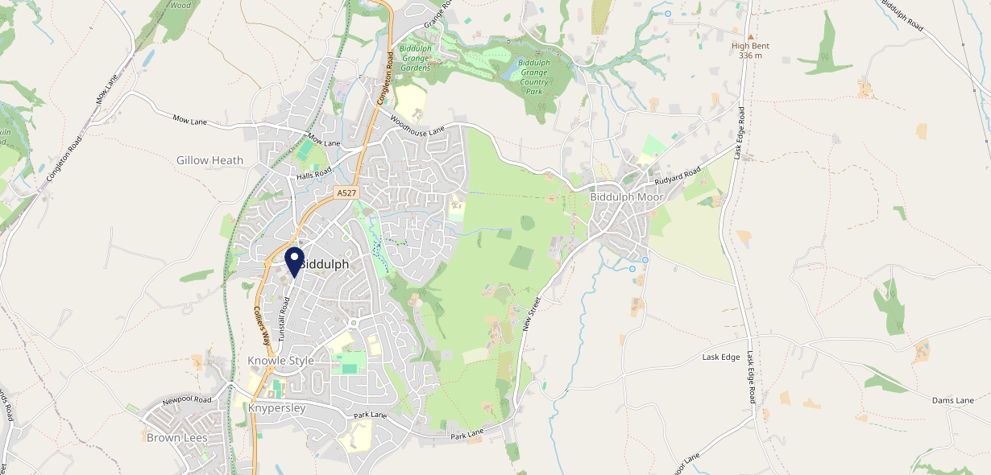









Site Intel
Crown & Cushion ST86AS
3 Miles
1 Chain
22/02/2023 - 14/02/2024
Site Summary
Crown & Cushion ST86AS
Work Area
Region
TV Region
Urbanicity
Stoke-on-Trent
West Midlands
Central
Urban city and town
ST86AS
Punch T&L
Top Competitors
ATV
Gender
The Top Pub Brown Edge
#1
£9.34
61.19%
Male
ST68TX
Pub Restaurant
Affluence
Segmentation
Mow Cop Inn
#2
53.31%
30.91%
Middle Income
Paying The Mortgage
ST73PJ
Pub Restaurant
Age Group
Visit Day
#3
38.65%
40.16%
45 to 54
Sat
Nearest Station
Congleton(4.82 miles)
379 Site Customers
2 Competitors
581 Competitor Customers

Slide 2

Site Intel
Crown & Cushion ST86AS
3 Miles
1 Chain
22/02/2023 - 14/02/2024
Spend by Weekpart
How is customer spend distributed throughout the week for Crown & Cushion ST86AS versus its competitors?
% of spend for Crown & Cushion ST86AS and 1 Chains in 3 Miles from 22/02/2023 - 14/02/2024 split by Day of Week
379 Site Customers
2 Competitors
581 Competitor Customers

Slide 3
Site Intel
Crown & Cushion ST86AS
3 Miles
1 Chain
22/02/2023 - 14/02/2024
Visit Frequency
How frequently per year do customers visit Crown & Cushion ST86AS versus its competitors?
% of customer numbers for Crown & Cushion ST86AS and 1 Chains in 3 Miles from 22/02/2023 - 14/02/2024 and the number of visits made Per Annum
379 Site Customers
2 Competitors
581 Competitor Customers

Slide 4
Site Intel
Crown & Cushion ST86AS
3 Miles
1 Chain
22/02/2023 - 14/02/2024
ATV Change
How has ATV changed between two date ranges?
379 Site Customers

Slide 5
Site Intel
Crown & Cushion ST86AS
3 Miles
1 Chain
22/02/2023 - 14/02/2024
Market Share Change
How has market share changed between two date ranges?
% of market share spend for Crown & Cushion ST86AS and 1 Chains in 3 Miles from 22/02/2023 - 14/02/2024
379 Site Customers

Slide 6
Site Intel
Crown & Cushion ST86AS
3 Miles
1 Chain
22/02/2023 - 14/02/2024
Age
How does the age profile of customers who visit Crown & Cushion ST86AS compare versus its competitors?
% of spend for Crown & Cushion ST86AS and 1 Chains in 3 Miles from 22/02/2023 - 14/02/2024 split by Age Range
139 Site Customers
2 Competitors
271 Competitor Customers

Slide 7
Site Intel
Crown & Cushion ST86AS
3 Miles
1 Chain
22/02/2023 - 14/02/2024
Affluence
How does the affluence of customers who visit Crown & Cushion ST86AS compare versus its competitors?
% of spend for Crown & Cushion ST86AS and 1 Chains in 3 Miles from 22/02/2023 - 14/02/2024 split by Affluence
140 Site Customers
2 Competitors
260 Competitor Customers

Slide 8
Site Intel
Crown & Cushion ST86AS
3 Miles
1 Chain
22/02/2023 - 14/02/2024
Gender
How does the gender profile of customers who visit Crown & Cushion ST86AS compare versus its competitors?
% of spend for Crown & Cushion ST86AS and 1 Chains in 3 Miles from 22/02/2023 - 14/02/2024 split by Gender
144 Site Customers
2 Competitors
267 Competitor Customers

Slide 9
Site Intel
Crown & Cushion ST86AS
3 Miles
1 Chain
22/02/2023 - 14/02/2024
Punch Segmentation
How does the Custom segmentation profile of customers who visit Crown & Cushion ST86AS compare versus its competitors?
% of spend for Crown & Cushion ST86AS and 1 Chains in 3 Miles from 22/02/2023 - 14/02/2024 split by Segment
379 Site Customers
2 Competitors
581 Competitor Customers

Slide 10
Site Intel
Crown & Cushion ST86AS
3 Miles
1 Chain
22/02/2023 - 14/02/2024
Spend by Distance
How does the spend profile of Crown & Cushion ST86AS compare versus its competitors based on travel distances?
% of spend for Crown & Cushion ST86AS and 1 Chains in 3 Miles from 22/02/2023 - 14/02/2024 split by Distance travelled
144 Site Customers
2 Competitors
267 Competitor Customers

Slide 11
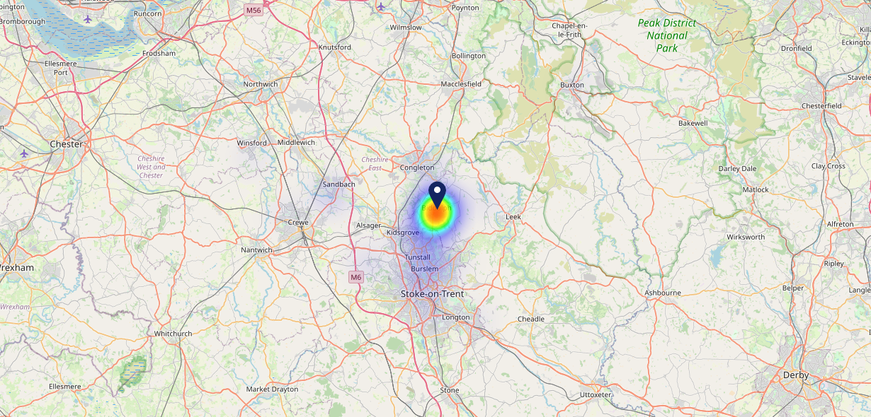

Site Intel
Crown & Cushion ST86AS
22/02/2023 - 14/02/2024
Map of Guest Origin
Where do customers of Crown & Cushion ST86AS come from?
Where do customers of Crown & Cushion ST86AS for 22/02/2023 - 14/02/2024 live
144 Site Customers

Slide 12
Site Intel
Crown & Cushion ST86AS
3 Miles
1 Chain
22/02/2023 - 14/02/2024
Share of Wallet
What are the Top 20 venues (by spend) that customers of Crown & Cushion ST86AS also visit?
For customers of Crown & Cushion ST86AS, who are the top 20 competitors from 1 Chains in 3 Miles for 22/02/2023 - 14/02/2024 split by Venue
379 Site Customers

Slide 13
Site Intel
Crown & Cushion ST86AS
3 Miles
1 Chain
22/02/2023 - 14/02/2024
Share of Wallet Change
How has share of wallet of customers of Crown & Cushion ST86AS changed between two date ranges?
379 Site Customers

Slide 14
Site Intel
Crown & Cushion ST86AS
22/02/2023 - 14/02/2024
Market Summary
How does the local area for Crown & Cushion ST86AS compare to the national average (1 = low, 10 = high)
Data Type | Name | Spend in 250m | 250m Spend vs National | Spend in 500m | 500m Spend vs National | Spend in 1 mile | 1 mile Spend vs National | Spend in 3 miles | 3 mile Spend vs National
Total | Annual Sales | £3.03M | 6 | £3.80M | 5 | £5.88M | 3 | £18.24M | 3
Weekpart | Mon - Thu | 42.7% | 7 | 39.4% | 5 | 36.6% | 2 | 38.2% | 1
Weekpart | Fri - Sat | 44.4% | 6 | 46.9% | 8 | 48.7% | 10 | 44.2% | 8
Weekpart | Sun | 12.9% | 4 | 13.7% | 4 | 14.7% | 4 | 17.6% | 9
Age | 18 to 24 | 1.9% | 2 | 3.5% | 3 | 3.9% | 3 | 4.1% | 2
Age | 25 to 34 | 9.5% | 1 | 12.4% | 1 | 14.2% | 2 | 12.8% | 1
Age | 35 to 44 | 20.3% | 3 | 20.0% | 3 | 22.8% | 5 | 21.1% | 3
Age | 45 to 54 | 19.1% | 4 | 20.1% | 5 | 20.0% | 5 | 24.0% | 10
Age | 55 to 64 | 24.7% | 10 | 22.8% | 9 | 20.3% | 9 | 19.3% | 9
Age | 65 to 74 | 18.6% | 10 | 16.3% | 10 | 14.6% | 10 | 12.0% | 10
Age | 75+ | 5.8% | 9 | 4.9% | 9 | 4.2% | 8 | 6.7% | 10
CAMEO | Business Elite | 0.9% | 1 | 0.8% | 1 | 0.8% | 1 | 3.4% | 2
CAMEO | Prosperous Professionals | 1.8% | 2 | 1.7% | 1 | 1.9% | 1 | 5.7% | 4
CAMEO | Flourishing Society | 1.0% | 1 | 1.1% | 1 | 1.2% | 1 | 4.3% | 1
CAMEO | Content Communities | 19.6% | 10 | 17.5% | 9 | 16.9% | 9 | 18.7% | 10
CAMEO | White Collar Neighbourhoods | 9.6% | 4 | 10.0% | 4 | 11.5% | 5 | 9.9% | 3
CAMEO | Enterprising Mainstream | 8.8% | 6 | 8.4% | 6 | 7.5% | 5 | 11.7% | 8
CAMEO | Paying The Mortgage | 20.9% | 9 | 22.7% | 10 | 23.1% | 10 | 20.1% | 9
CAMEO | Cash Conscious Communities | 15.4% | 9 | 15.8% | 9 | 14.3% | 9 | 11.6% | 8
CAMEO | On A Budget | 8.7% | 7 | 10.0% | 8 | 9.0% | 8 | 6.6% | 5
CAMEO | Family Value | 13.2% | 9 | 12.0% | 9 | 13.7% | 10 | 8.0% | 8
Affluence | AB | 3.7% | 1 | 3.6% | 1 | 3.9% | 1 | 13.4% | 2
Affluence | C1C2 | 59.0% | 9 | 58.6% | 9 | 59.1% | 10 | 60.4% | 10
Affluence | DE | 37.3% | 9 | 37.8% | 9 | 37.0% | 9 | 26.1% | 8

Slide 15

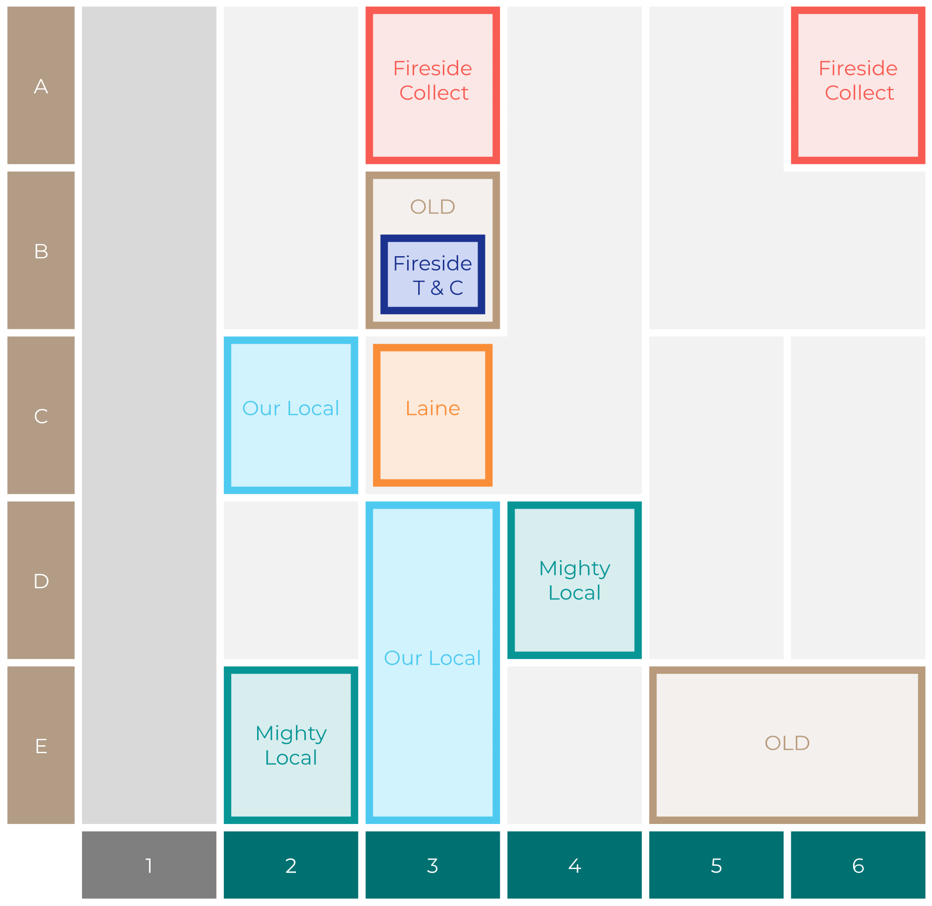

Site Intel
Crown & Cushion ST86AS
Site Potential 1
Site Characteristics
£3000
£18000
OCC Concept Fit
Achievable Average Weekly Takings
Non-Core
£4000
A Food-Led High Affluence B Food-Led Mid Affluence C Wet-Led Mid/High Affluence D Wet-Led Low Affluence E Food-Led Low Affluence
AWT 2 Local Regulars 3 Local Passing Trade 4 Destination Wet-Led 5 Destination Food-Led 6 Destination Very Food-Led
A
B
C
D
E
1
2
3
4
5
6

Slide 16
Site Intel
Crown & Cushion ST86AS
Site Potential 2
Concept Recommendation

Slide 17
Site Intel
Crown & Cushion ST86AS
Local Market Profile
Mix of spend by customer segment in Punch site and local market
 | Customer Count | Family Familiar | Occasional & Local | Mid-Week Seniors | Part Of The Pub | Metro Sophisticates | Young & Connected | Bubbly Weekenders | Upmarket Diners
Crown & Cushion | 66 | 8.40% | 8.92% | 0.71% | 41.48% | 4.28% | 30.17% | 4.13% | 1.87%
Local Catchment | 105 | 14.37% | 2.53% | 35.60% | 11.97% | 1.60% | 14.79% | 9.48% | 9.62%
Punch T&L | 110504 | 8.08% | 5.92% | 29.54% | 11.18% | 11.29% | 11.62% | 7.15% | 15.19%
Crown & Cushion vs Local Catchment |  | -5.97% | 6.39% | -34.89% | 29.51% | 2.68% | 15.38% | -5.35% | -7.75%
Crown & Cushion vs Punch T&L |  | 0.32% | 3.00% | -28.83% | 30.30% | -7.01% | 18.55% | -3.02% | -13.32%
Local Catchment vs Punch T&L |  | 6.29% | -3.39% | 6.06% | 0.79% | -9.69% | 3.17% | 2.33% | -5.57%

Slide 18
Site Intel
Crown & Cushion ST86AS
Local Competitor Profiles
Mix of spend by customer segment in Punch site and local competitors
 | Customer Count | Family Familiar | Occasional & Local | Mid-Week Seniors | Part Of The Pub | Metro Sophisticates | Young & Connected | Bubbly Weekenders | Upmarket Diners
Crown & Cushion ST86AS | 66 | 8.40% | 8.92% | 0.71% | 41.48% | 4.28% | 30.17% | 4.13% | 1.87%
The Top Pub Brown Edge ST68TX | 81 | 15.90% | 3.66% | 20.63% | 15.67% | 1.70% | 18.20% | 10.59% | 13.60%
Mow Cop Inn ST73PJ | 25 | 10.96% | 0.00% | 69.17% | 3.65% | 1.38% | 7.15% | 6.98% | 0.69%

