Slide 1
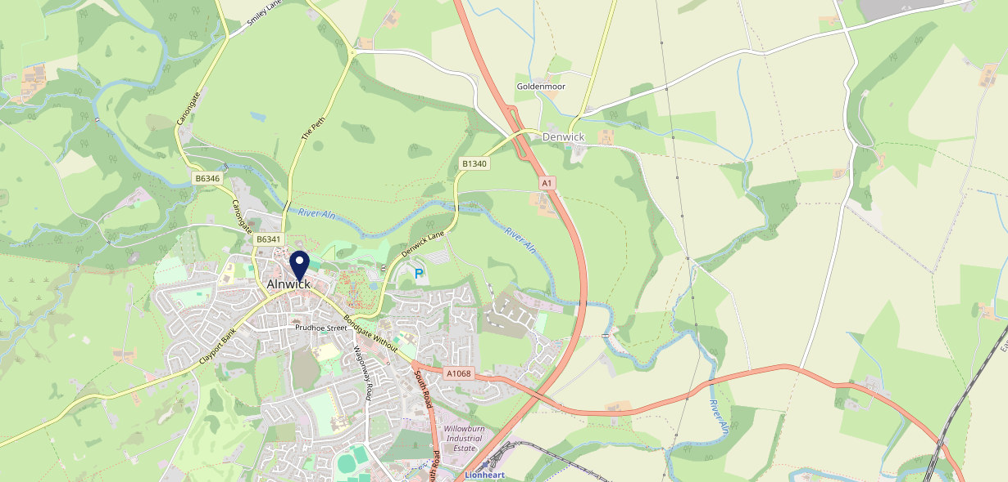
Site Intel
George Inn NE661HZ
1 Miles
371 Chains
16/04/2025 - 08/04/2026
Site Summary
George Inn NE661HZ
Work Area
Region
TV Region
Urbanicity
Blyth and Ashington
North East
Tyne Tees
Rural town and fringe in a sparse setting
NE661HZ
Punch Unity
Top Competitors
ATV
Gender
Fleece
#1
£7.71
59.81%
Male
NE661PR
Punch - Our Local
Affluence
Segmentation
Queens Head Alnwick
#2
49.14%
28.45%
Middle Income
Paying The Mortgage
NE661SS
Craft Union
Age Group
Visit Day
Dirty Bottles Alnwick
#3
28.60%
31.33%
NE661JG
65 to 74
Sat
GK - Pub & Social
Nearest Station
Alnmouth(4.97 miles)
344 Site Customers
84 Competitors
40999 Competitor Customers

Slide 2
Site Intel
George Inn NE661HZ
1 Miles
371 Chains
16/04/2025 - 08/04/2026
Spend by Weekpart
How is customer spend distributed throughout the week for George Inn NE661HZ versus its competitors?
% of spend for George Inn NE661HZ and 371 Chains in 1 Miles from 16/04/2025 - 08/04/2026 split by Day of Week
344 Site Customers
84 Competitors
40999 Competitor Customers

Slide 3
Site Intel
George Inn NE661HZ
1 Miles
371 Chains
16/04/2025 - 08/04/2026
Visit Frequency
How frequently per year do customers visit George Inn NE661HZ versus its competitors?
% of customer numbers for George Inn NE661HZ and 371 Chains in 1 Miles from 16/04/2025 - 08/04/2026 and the number of visits made Per Annum
344 Site Customers
84 Competitors
40999 Competitor Customers

Slide 4
Site Intel
George Inn NE661HZ
1 Miles
371 Chains
16/04/2025 - 08/04/2026
ATV Change
How has ATV changed between two date ranges?
344 Site Customers

Slide 5
Site Intel
George Inn NE661HZ
1 Miles
371 Chains
16/04/2025 - 08/04/2026
Market Share Change
How has market share changed between two date ranges?
% of market share spend for George Inn NE661HZ and 371 Chains in 1 Miles from 16/04/2025 - 08/04/2026
344 Site Customers

Slide 6
Site Intel
George Inn NE661HZ
1 Miles
371 Chains
16/04/2025 - 08/04/2026
Age
How does the age profile of customers who visit George Inn NE661HZ compare versus its competitors?
% of spend for George Inn NE661HZ and 371 Chains in 1 Miles from 16/04/2025 - 08/04/2026 split by Age Range
176 Site Customers
84 Competitors
20947 Competitor Customers

Slide 7
Site Intel
George Inn NE661HZ
1 Miles
371 Chains
16/04/2025 - 08/04/2026
Affluence
How does the affluence of customers who visit George Inn NE661HZ compare versus its competitors?
% of spend for George Inn NE661HZ and 371 Chains in 1 Miles from 16/04/2025 - 08/04/2026 split by Affluence
158 Site Customers
84 Competitors
19323 Competitor Customers

Slide 8
Site Intel
George Inn NE661HZ
1 Miles
371 Chains
16/04/2025 - 08/04/2026
Gender
How does the gender profile of customers who visit George Inn NE661HZ compare versus its competitors?
% of spend for George Inn NE661HZ and 371 Chains in 1 Miles from 16/04/2025 - 08/04/2026 split by Gender
170 Site Customers
84 Competitors
20543 Competitor Customers

Slide 9
Site Intel
George Inn NE661HZ
1 Miles
371 Chains
16/04/2025 - 08/04/2026
Punch Segmentation
How does the Custom segmentation profile of customers who visit George Inn NE661HZ compare versus its competitors?
% of spend for George Inn NE661HZ and 371 Chains in 1 Miles from 16/04/2025 - 08/04/2026 split by Segment
344 Site Customers
84 Competitors
40999 Competitor Customers

Slide 10
Site Intel
George Inn NE661HZ
1 Miles
371 Chains
16/04/2025 - 08/04/2026
Spend by Distance
How does the spend profile of George Inn NE661HZ compare versus its competitors based on travel distances?
% of spend for George Inn NE661HZ and 371 Chains in 1 Miles from 16/04/2025 - 08/04/2026 split by Distance travelled
170 Site Customers
84 Competitors
20536 Competitor Customers

Slide 11
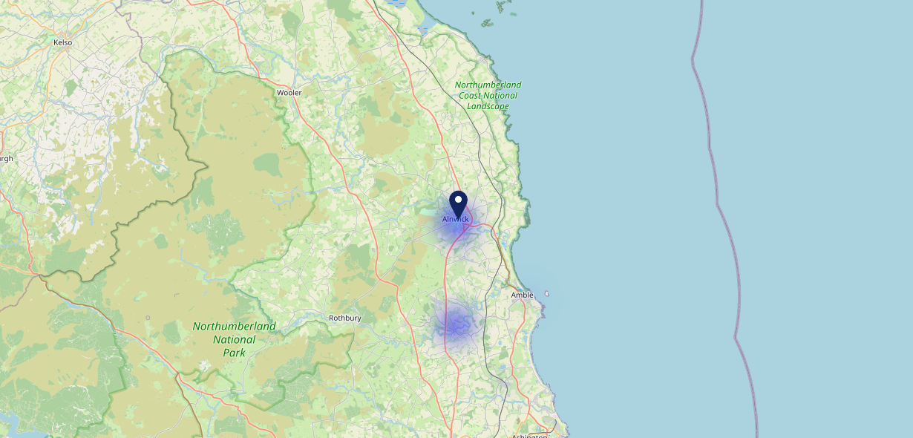
Site Intel
George Inn NE661HZ
16/04/2025 - 08/04/2026
Map of Guest Origin
Where do customers of George Inn NE661HZ come from?
Where do customers of George Inn NE661HZ for 16/04/2025 - 08/04/2026 live
170 Site Customers

Slide 12
Site Intel
George Inn NE661HZ
1 Miles
371 Chains
16/04/2025 - 08/04/2026
Share of Wallet
What are the Top 20 venues (by spend) that customers of George Inn NE661HZ also visit?
For customers of George Inn NE661HZ, who are the top 20 competitors from 371 Chains in 1 Miles for 16/04/2025 - 08/04/2026 split by Venue
344 Site Customers

Slide 13
Site Intel
George Inn NE661HZ
1 Miles
371 Chains
16/04/2025 - 08/04/2026
Share of Wallet Change
How has share of wallet of customers of George Inn NE661HZ changed between two date ranges?
344 Site Customers

Slide 14
Site Intel
George Inn NE661HZ
16/04/2025 - 08/04/2026
Market Summary
How does the local area for George Inn NE661HZ compare to the national average (1 = low, 10 = high)
Data Type | Name | Spend in 250m | 250m Spend vs National | Spend in 500m | 500m Spend vs National | Spend in 1 mile | 1 mile Spend vs National | Spend in 3 miles | 3 mile Spend vs National
Total | Annual Sales | £7.85M | 8 | £9.88M | 7 | £12.61M | 5 | £16.86M | 3
Weekpart | Mon - Thu | 46.3% | 8 | 46.6% | 9 | 47.2% | 9 | 47.5% | 10
Weekpart | Fri - Sat | 41.0% | 4 | 41.5% | 4 | 39.6% | 3 | 38.6% | 1
Weekpart | Sun | 12.7% | 4 | 11.9% | 2 | 13.2% | 2 | 13.9% | 2
Age | 18 to 24 | 1.1% | 1 | 1.0% | 1 | 1.3% | 1 | 2.0% | 1
Age | 25 to 34 | 9.0% | 1 | 8.8% | 1 | 8.5% | 1 | 9.7% | 1
Age | 35 to 44 | 18.5% | 2 | 18.4% | 2 | 18.5% | 2 | 21.0% | 3
Age | 45 to 54 | 19.6% | 5 | 19.7% | 5 | 19.7% | 5 | 19.9% | 5
Age | 55 to 64 | 29.9% | 10 | 29.1% | 10 | 29.0% | 10 | 27.0% | 10
Age | 65 to 74 | 16.6% | 10 | 17.6% | 10 | 17.2% | 10 | 15.3% | 10
Age | 75+ | 5.3% | 9 | 5.3% | 9 | 5.7% | 9 | 5.1% | 9
CAMEO | Business Elite | 7.2% | 6 | 7.0% | 6 | 7.1% | 6 | 6.7% | 5
CAMEO | Prosperous Professionals | 7.7% | 7 | 7.9% | 8 | 8.0% | 8 | 7.8% | 8
CAMEO | Flourishing Society | 15.8% | 7 | 16.5% | 7 | 16.5% | 7 | 15.8% | 7
CAMEO | Content Communities | 13.8% | 7 | 14.0% | 7 | 14.0% | 7 | 13.8% | 7
CAMEO | White Collar Neighbourhoods | 10.2% | 4 | 10.3% | 4 | 10.1% | 4 | 9.6% | 3
CAMEO | Enterprising Mainstream | 10.6% | 8 | 10.6% | 8 | 10.6% | 7 | 10.5% | 7
CAMEO | Paying The Mortgage | 15.5% | 6 | 15.1% | 6 | 15.3% | 6 | 15.8% | 7
CAMEO | Cash Conscious Communities | 10.9% | 7 | 10.9% | 7 | 10.6% | 7 | 10.9% | 7
CAMEO | On A Budget | 3.3% | 2 | 3.1% | 2 | 3.2% | 2 | 3.6% | 2
CAMEO | Family Value | 4.8% | 7 | 4.5% | 7 | 4.6% | 7 | 5.5% | 7
Affluence | AB | 30.8% | 6 | 31.4% | 6 | 31.6% | 6 | 30.3% | 6
Affluence | C1C2 | 50.1% | 6 | 50.0% | 6 | 50.0% | 6 | 49.6% | 6
Affluence | DE | 19.1% | 5 | 18.5% | 5 | 18.4% | 5 | 20.1% | 6

