Slide 1
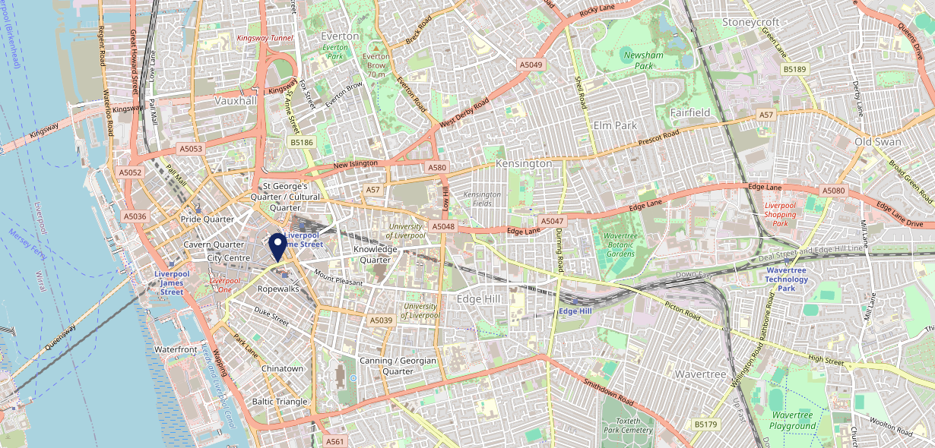
Site Intel
Globe L11HW
1 Miles
371 Chains
16/04/2025 - 08/04/2026
Site Summary
Globe L11HW
Work Area
Region
TV Region
Urbanicity
Liverpool
North West
North West
Urban major conurbation
L11HW
Punch Unity
Top Competitors
ATV
Gender
Fitzgerald Midlands Ho
#1
£11.04
84.88%
Male
L11JP
Pub / Bar
Affluence
Segmentation
Vines
#2
45.65%
30.90%
Low Income
On A Budget
L11JQ
Pub / Bar
Age Group
Visit Day
Alberts Schloss Liverpool
#3
36.13%
30.22%
L14DS
55 to 64
Sat
Alberts Schloss
Nearest Station
Liverpool Central(0.11 miles)
663 Site Customers
1000 of 1747 Competitors
1658502 Competitor Customers

Slide 2
Site Intel
Globe L11HW
1 Miles
371 Chains
16/04/2025 - 08/04/2026
Spend by Weekpart
How is customer spend distributed throughout the week for Globe L11HW versus its competitors?
% of spend for Globe L11HW and 371 Chains in 1 Miles from 16/04/2025 - 08/04/2026 split by Day of Week
663 Site Customers
1000 of 1747 Competitors
1658502 Competitor Customers

Slide 3
Site Intel
Globe L11HW
1 Miles
371 Chains
16/04/2025 - 08/04/2026
Visit Frequency
How frequently per year do customers visit Globe L11HW versus its competitors?
% of customer numbers for Globe L11HW and 371 Chains in 1 Miles from 16/04/2025 - 08/04/2026 and the number of visits made Per Annum
663 Site Customers
1000 of 1747 Competitors
1658502 Competitor Customers

Slide 4
Site Intel
Globe L11HW
1 Miles
371 Chains
16/04/2025 - 08/04/2026
ATV Change
How has ATV changed between two date ranges?
663 Site Customers

Slide 5
Site Intel
Globe L11HW
1 Miles
371 Chains
16/04/2025 - 08/04/2026
Market Share Change
How has market share changed between two date ranges?
% of market share spend for Globe L11HW and 371 Chains in 1 Miles from 16/04/2025 - 08/04/2026
663 Site Customers

Slide 6
Site Intel
Globe L11HW
1 Miles
371 Chains
16/04/2025 - 08/04/2026
Age
How does the age profile of customers who visit Globe L11HW compare versus its competitors?
% of spend for Globe L11HW and 371 Chains in 1 Miles from 16/04/2025 - 08/04/2026 split by Age Range
353 Site Customers
1000 of 1747 Competitors
566300 Competitor Customers

Slide 7
Site Intel
Globe L11HW
1 Miles
371 Chains
16/04/2025 - 08/04/2026
Affluence
How does the affluence of customers who visit Globe L11HW compare versus its competitors?
% of spend for Globe L11HW and 371 Chains in 1 Miles from 16/04/2025 - 08/04/2026 split by Affluence
343 Site Customers
1000 of 1747 Competitors
523660 Competitor Customers

Slide 8
Site Intel
Globe L11HW
1 Miles
371 Chains
16/04/2025 - 08/04/2026
Gender
How does the gender profile of customers who visit Globe L11HW compare versus its competitors?
% of spend for Globe L11HW and 371 Chains in 1 Miles from 16/04/2025 - 08/04/2026 split by Gender
348 Site Customers
1000 of 1747 Competitors
547067 Competitor Customers

Slide 9
Site Intel
Globe L11HW
1 Miles
371 Chains
16/04/2025 - 08/04/2026
Punch Segmentation
How does the Custom segmentation profile of customers who visit Globe L11HW compare versus its competitors?
% of spend for Globe L11HW and 371 Chains in 1 Miles from 16/04/2025 - 08/04/2026 split by Segment
663 Site Customers
1000 of 1747 Competitors
1658502 Competitor Customers

Slide 10
Site Intel
Globe L11HW
1 Miles
371 Chains
16/04/2025 - 08/04/2026
Spend by Distance
How does the spend profile of Globe L11HW compare versus its competitors based on travel distances?
% of spend for Globe L11HW and 371 Chains in 1 Miles from 16/04/2025 - 08/04/2026 split by Distance travelled
348 Site Customers
1000 of 1747 Competitors
546486 Competitor Customers

Slide 11
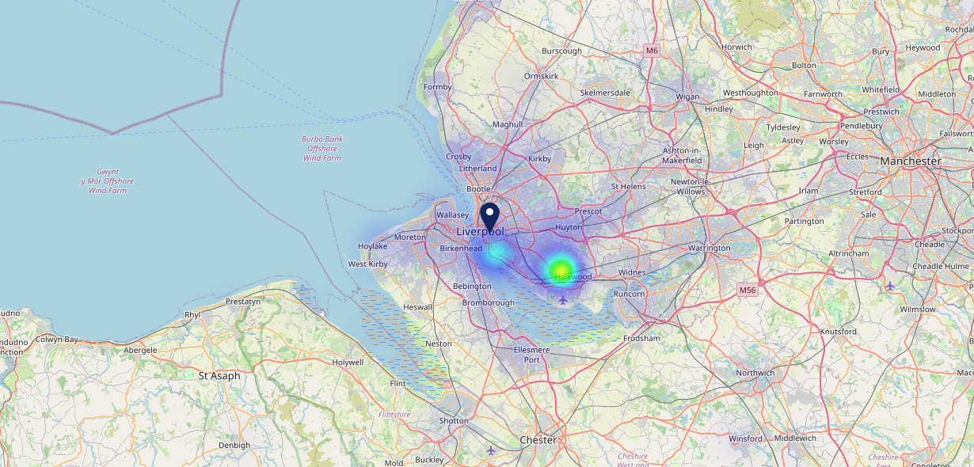
Site Intel
Globe L11HW
16/04/2025 - 08/04/2026
Map of Guest Origin
Where do customers of Globe L11HW come from?
Where do customers of Globe L11HW for 16/04/2025 - 08/04/2026 live
348 Site Customers

Slide 12
Site Intel
Globe L11HW
1 Miles
371 Chains
16/04/2025 - 08/04/2026
Share of Wallet
What are the Top 20 venues (by spend) that customers of Globe L11HW also visit?
For customers of Globe L11HW, who are the top 20 competitors from 371 Chains in 1 Miles for 16/04/2025 - 08/04/2026 split by Venue
663 Site Customers

Slide 13
Site Intel
Globe L11HW
1 Miles
371 Chains
16/04/2025 - 08/04/2026
Share of Wallet Change
How has share of wallet of customers of Globe L11HW changed between two date ranges?
663 Site Customers

Slide 14
Site Intel
Globe L11HW
16/04/2025 - 08/04/2026
Market Summary
How does the local area for Globe L11HW compare to the national average (1 = low, 10 = high)
Data Type | Name | Spend in 250m | 250m Spend vs National | Spend in 500m | 500m Spend vs National | Spend in 1 mile | 1 mile Spend vs National | Spend in 3 miles | 3 mile Spend vs National
Total | Annual Sales | £120.76M | 10 | £370.54M | 10 | £665.21M | 10 | £867.24M | 10
Weekpart | Mon - Thu | 32.9% | 2 | 34.1% | 2 | 34.8% | 1 | 36.5% | 1
Weekpart | Fri - Sat | 51.1% | 9 | 49.9% | 9 | 50.2% | 10 | 48.0% | 10
Weekpart | Sun | 15.9% | 7 | 16.0% | 7 | 15.0% | 5 | 15.5% | 5
Age | 18 to 24 | 10.3% | 8 | 9.3% | 8 | 7.9% | 7 | 7.6% | 6
Age | 25 to 34 | 18.9% | 4 | 19.8% | 4 | 19.6% | 4 | 19.3% | 3
Age | 35 to 44 | 22.3% | 5 | 23.5% | 6 | 24.1% | 6 | 24.6% | 7
Age | 45 to 54 | 19.9% | 5 | 19.9% | 5 | 20.1% | 5 | 19.9% | 5
Age | 55 to 64 | 18.8% | 8 | 17.6% | 7 | 18.5% | 8 | 18.4% | 9
Age | 65 to 74 | 8.1% | 7 | 7.9% | 7 | 7.9% | 7 | 8.1% | 7
Age | 75+ | 1.8% | 5 | 2.0% | 5 | 2.0% | 4 | 2.1% | 4
CAMEO | Business Elite | 4.9% | 4 | 6.1% | 5 | 7.2% | 6 | 6.6% | 5
CAMEO | Prosperous Professionals | 3.8% | 3 | 4.5% | 4 | 5.0% | 4 | 4.7% | 3
CAMEO | Flourishing Society | 6.0% | 2 | 6.9% | 3 | 7.4% | 3 | 6.9% | 2
CAMEO | Content Communities | 9.3% | 3 | 10.0% | 3 | 10.3% | 3 | 9.5% | 2
CAMEO | White Collar Neighbourhoods | 12.8% | 7 | 13.2% | 8 | 14.0% | 9 | 13.9% | 9
CAMEO | Enterprising Mainstream | 9.0% | 6 | 9.0% | 6 | 9.1% | 6 | 8.9% | 6
CAMEO | Paying The Mortgage | 16.8% | 7 | 16.5% | 7 | 16.0% | 7 | 16.0% | 7
CAMEO | Cash Conscious Communities | 12.7% | 8 | 12.1% | 8 | 11.4% | 7 | 12.0% | 8
CAMEO | On A Budget | 12.4% | 9 | 11.3% | 9 | 10.4% | 9 | 12.0% | 10
CAMEO | Family Value | 12.3% | 9 | 10.4% | 9 | 9.1% | 9 | 9.6% | 9
Affluence | AB | 14.8% | 3 | 17.5% | 3 | 19.6% | 3 | 18.2% | 3
Affluence | C1C2 | 47.9% | 5 | 48.8% | 6 | 49.4% | 6 | 48.3% | 5
Affluence | DE | 37.3% | 9 | 33.7% | 9 | 31.0% | 8 | 33.5% | 9

