Slide 1
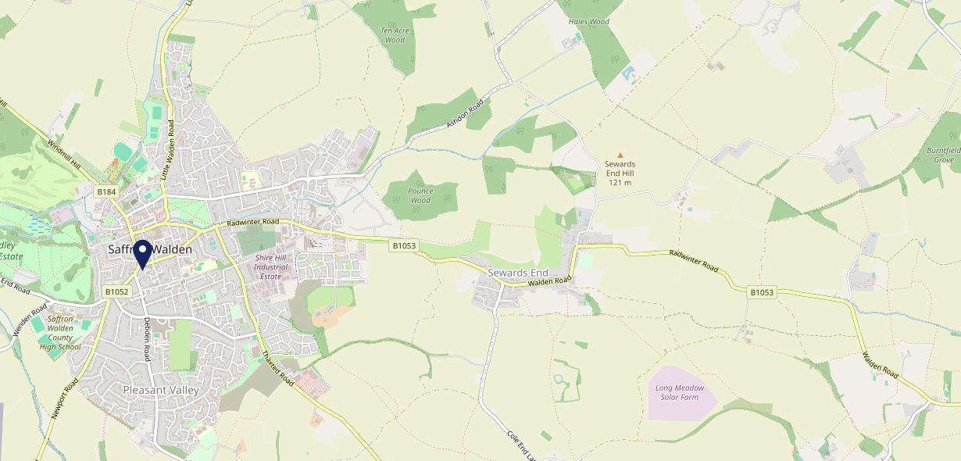
Site Intel
Duke Of York CB101EA
1 Miles
371 Chains
16/04/2025 - 08/04/2026
Site Summary
Duke Of York CB101EA
Work Area
Region
TV Region
Urbanicity
Cambridge
East of England
Anglia
Urban city and town
CB101EA
Punch T&L
Top Competitors
ATV
Gender
Railway Arms
#1
£18.84
94.45%
Male
CB113HQ
Pub / Bar
Affluence
Segmentation
Old English Gentlemen Saffron
#2
50.56%
38.29%
High Income
Flourishing Society
CB101EJ
Stonegate PP
Age Group
Visit Day
The Temeraire
#3
66.44%
26.43%
CB101AA
55 to 64
Sat
JD Wetherspoon
Nearest Station
Audley End(2.84 miles)
327 Site Customers
161 Competitors
41563 Competitor Customers

Slide 2
Site Intel
Duke Of York CB101EA
1 Miles
371 Chains
16/04/2025 - 08/04/2026
Spend by Weekpart
How is customer spend distributed throughout the week for Duke Of York CB101EA versus its competitors?
% of spend for Duke Of York CB101EA and 371 Chains in 1 Miles from 16/04/2025 - 08/04/2026 split by Day of Week
327 Site Customers
161 Competitors
41563 Competitor Customers

Slide 3
Site Intel
Duke Of York CB101EA
1 Miles
371 Chains
16/04/2025 - 08/04/2026
Visit Frequency
How frequently per year do customers visit Duke Of York CB101EA versus its competitors?
% of customer numbers for Duke Of York CB101EA and 371 Chains in 1 Miles from 16/04/2025 - 08/04/2026 and the number of visits made Per Annum
327 Site Customers
161 Competitors
41563 Competitor Customers

Slide 4
Site Intel
Duke Of York CB101EA
1 Miles
371 Chains
16/04/2025 - 08/04/2026
ATV Change
How has ATV changed between two date ranges?
327 Site Customers

Slide 5
Site Intel
Duke Of York CB101EA
1 Miles
371 Chains
16/04/2025 - 08/04/2026
Market Share Change
How has market share changed between two date ranges?
% of market share spend for Duke Of York CB101EA and 371 Chains in 1 Miles from 16/04/2025 - 08/04/2026
327 Site Customers

Slide 6
Site Intel
Duke Of York CB101EA
1 Miles
371 Chains
16/04/2025 - 08/04/2026
Age
How does the age profile of customers who visit Duke Of York CB101EA compare versus its competitors?
% of spend for Duke Of York CB101EA and 371 Chains in 1 Miles from 16/04/2025 - 08/04/2026 split by Age Range
143 Site Customers
161 Competitors
19786 Competitor Customers

Slide 7
Site Intel
Duke Of York CB101EA
1 Miles
371 Chains
16/04/2025 - 08/04/2026
Affluence
How does the affluence of customers who visit Duke Of York CB101EA compare versus its competitors?
% of spend for Duke Of York CB101EA and 371 Chains in 1 Miles from 16/04/2025 - 08/04/2026 split by Affluence
132 Site Customers
161 Competitors
17818 Competitor Customers

Slide 8
Site Intel
Duke Of York CB101EA
1 Miles
371 Chains
16/04/2025 - 08/04/2026
Gender
How does the gender profile of customers who visit Duke Of York CB101EA compare versus its competitors?
% of spend for Duke Of York CB101EA and 371 Chains in 1 Miles from 16/04/2025 - 08/04/2026 split by Gender
138 Site Customers
161 Competitors
19100 Competitor Customers

Slide 9
Site Intel
Duke Of York CB101EA
1 Miles
371 Chains
16/04/2025 - 08/04/2026
Punch Segmentation
How does the Custom segmentation profile of customers who visit Duke Of York CB101EA compare versus its competitors?
% of spend for Duke Of York CB101EA and 371 Chains in 1 Miles from 16/04/2025 - 08/04/2026 split by Segment
327 Site Customers
161 Competitors
41563 Competitor Customers

Slide 10
Site Intel
Duke Of York CB101EA
1 Miles
371 Chains
16/04/2025 - 08/04/2026
Spend by Distance
How does the spend profile of Duke Of York CB101EA compare versus its competitors based on travel distances?
% of spend for Duke Of York CB101EA and 371 Chains in 1 Miles from 16/04/2025 - 08/04/2026 split by Distance travelled
138 Site Customers
161 Competitors
19072 Competitor Customers

Slide 11
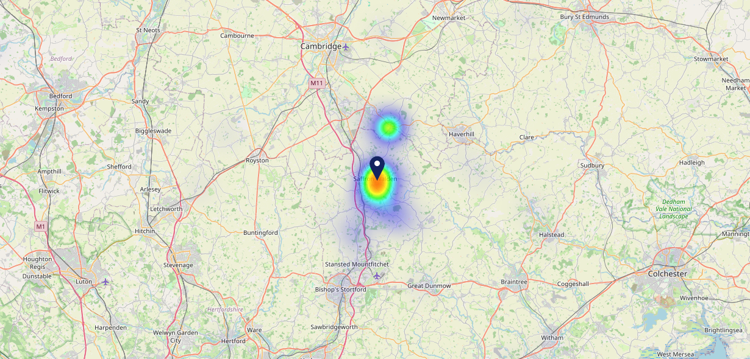
Site Intel
Duke Of York CB101EA
16/04/2025 - 08/04/2026
Map of Guest Origin
Where do customers of Duke Of York CB101EA come from?
Where do customers of Duke Of York CB101EA for 16/04/2025 - 08/04/2026 live
138 Site Customers

Slide 12
Site Intel
Duke Of York CB101EA
1 Miles
371 Chains
16/04/2025 - 08/04/2026
Share of Wallet
What are the Top 20 venues (by spend) that customers of Duke Of York CB101EA also visit?
For customers of Duke Of York CB101EA, who are the top 20 competitors from 371 Chains in 1 Miles for 16/04/2025 - 08/04/2026 split by Venue
327 Site Customers

Slide 13
Site Intel
Duke Of York CB101EA
1 Miles
371 Chains
16/04/2025 - 08/04/2026
Share of Wallet Change
How has share of wallet of customers of Duke Of York CB101EA changed between two date ranges?
327 Site Customers

Slide 14
Site Intel
Duke Of York CB101EA
16/04/2025 - 08/04/2026
Market Summary
How does the local area for Duke Of York CB101EA compare to the national average (1 = low, 10 = high)
Data Type | Name | Spend in 250m | 250m Spend vs National | Spend in 500m | 500m Spend vs National | Spend in 1 mile | 1 mile Spend vs National | Spend in 3 miles | 3 mile Spend vs National
Total | Annual Sales | £3.42M | 7 | £14.09M | 8 | £17.29M | 6 | £19.54M | 3
Weekpart | Mon - Thu | 40.8% | 6 | 39.8% | 5 | 40.9% | 5 | 40.3% | 4
Weekpart | Fri - Sat | 44.6% | 6 | 47.0% | 8 | 45.9% | 8 | 45.8% | 10
Weekpart | Sun | 14.6% | 5 | 13.2% | 3 | 13.3% | 2 | 13.8% | 2
Age | 18 to 24 | 2.9% | 3 | 2.6% | 2 | 2.3% | 1 | 2.1% | 1
Age | 25 to 34 | 9.3% | 1 | 11.0% | 1 | 11.2% | 1 | 10.6% | 1
Age | 35 to 44 | 18.9% | 3 | 20.6% | 3 | 21.0% | 3 | 20.3% | 2
Age | 45 to 54 | 20.9% | 6 | 21.3% | 7 | 21.3% | 7 | 21.2% | 7
Age | 55 to 64 | 23.2% | 9 | 22.5% | 9 | 21.3% | 9 | 21.0% | 10
Age | 65 to 74 | 20.3% | 10 | 15.8% | 10 | 15.8% | 10 | 16.1% | 10
Age | 75+ | 4.6% | 8 | 6.1% | 9 | 7.2% | 10 | 8.7% | 10
CAMEO | Business Elite | 10.3% | 7 | 11.6% | 8 | 13.2% | 8 | 13.1% | 8
CAMEO | Prosperous Professionals | 13.7% | 10 | 10.5% | 9 | 10.2% | 9 | 10.1% | 9
CAMEO | Flourishing Society | 17.1% | 8 | 18.3% | 8 | 18.0% | 8 | 18.2% | 8
CAMEO | Content Communities | 17.9% | 9 | 19.1% | 10 | 19.4% | 10 | 19.9% | 10
CAMEO | White Collar Neighbourhoods | 9.4% | 4 | 11.6% | 6 | 10.9% | 5 | 11.0% | 5
CAMEO | Enterprising Mainstream | 6.4% | 4 | 5.7% | 4 | 5.8% | 4 | 5.7% | 4
CAMEO | Paying The Mortgage | 17.2% | 7 | 14.9% | 6 | 14.5% | 5 | 14.2% | 5
CAMEO | Cash Conscious Communities | 4.4% | 2 | 4.1% | 2 | 3.9% | 1 | 3.7% | 1
CAMEO | On A Budget | 2.9% | 2 | 3.7% | 2 | 3.7% | 2 | 3.7% | 2
CAMEO | Family Value | 0.6% | 2 | 0.5% | 1 | 0.5% | 1 | 0.4% | 1
Affluence | AB | 41.1% | 8 | 40.5% | 8 | 41.4% | 8 | 41.4% | 8
Affluence | C1C2 | 50.9% | 6 | 51.3% | 7 | 50.5% | 6 | 50.8% | 7
Affluence | DE | 8.0% | 1 | 8.3% | 1 | 8.1% | 1 | 7.8% | 1

Slide 15
Site Intel
Duke Of York CB101EA
Site Potential 1
Site Characteristics
£3000
£18000
OCC Concept Fit
Achievable Average Weekly Takings
Fireside Scenic
£6000
A Food-Led High Affluence B Food-Led Mid Affluence C Wet-Led Mid/High Affluence D Wet-Led Low Affluence E Food-Led Low Affluence
AWT 2 Local Regulars 3 Local Passing Trade 4 Destination Wet-Led 5 Destination Food-Led 6 Destination Very Food-Led
A
B
C
D
E
1
2
3
4
5
6

Slide 16
Site Intel
Duke Of York CB101EA
Site Potential 2
Concept Recommendation

Slide 17
Site Intel
Duke Of York CB101EA
Local Market Profile
Mix of spend by customer segment in Punch site and local market
 | Customer Count | Family Familiar | Occasional & Local | Mid-Week Seniors | Part Of The Pub | Metro Sophisticates | Young & Connected | Bubbly Weekenders | Upmarket Diners
Duke Of York | 55 | 0.78% | 0.17% | 35.42% | 10.26% | 12.98% | 27.06% | 7.98% | 5.30%
Local Catchment | 2427 | 4.72% | 0.83% | 22.66% | 7.92% | 10.83% | 9.48% | 9.79% | 33.74%
Punch T&L | 94949 | 8.86% | 6.04% | 28.82% | 10.94% | 11.37% | 11.00% | 7.08% | 15.84%
Duke Of York vs Local Catchment |  | -3.94% | -0.66% | 12.76% | 2.34% | 2.15% | 17.58% | -1.81% | -28.44%
Duke Of York vs Punch T&L |  | -8.08% | -5.87% | 6.60% | -0.68% | 1.61% | 16.06% | 0.90% | -10.54%
Local Catchment vs Punch T&L |  | -4.14% | -5.21% | -6.16% | -3.02% | -0.54% | -1.52% | 2.71% | 17.90%

Slide 18
Site Intel
Duke Of York CB101EA
Local Competitor Profiles
Mix of spend by customer segment in Punch site and local competitors
 | Customer Count | Family Familiar | Occasional & Local | Mid-Week Seniors | Part Of The Pub | Metro Sophisticates | Young & Connected | Bubbly Weekenders | Upmarket Diners
Duke Of York CB101EA | 55 | 0.78% | 0.17% | 35.42% | 10.26% | 12.98% | 27.06% | 7.98% | 5.30%
Railway Arms CB113HQ | 215 | 4.68% | 0.79% | 20.74% | 12.36% | 14.58% | 10.25% | 11.85% | 24.70%
Old English Gentlemen Saffron CB101EJ | 195 | 2.10% | 1.09% | 16.61% | 30.01% | 19.13% | 5.87% | 7.97% | 17.18%
The Temeraire CB101AA | 260 | 10.97% | 0.13% | 17.23% | 35.95% | 5.41% | 11.68% | 6.89% | 11.71%
Saffron Walden Golf Club CB101BX | 91 | 0.16% | 0.00% | 31.46% | 1.73% | 4.36% | 8.99% | 1.74% | 51.52%
Kings Arms CB101HQ | 118 | 2.54% | 0.50% | 26.32% | 31.31% | 15.21% | 5.66% | 5.31% | 13.11%
Abc Grill CB101EQ | 91 | 3.70% | 2.62% | 11.47% | 6.27% | 18.88% | 20.75% | 12.38% | 23.88%
Goat And Grass CB101EX | 280 | 4.89% | 0.65% | 16.20% | 4.27% | 10.45% | 7.89% | 7.75% | 47.87%
Axe CB102AT | 22 | 0.21% | 0.00% | 1.71% | 5.49% | 7.83% | 82.67% | 2.06% | 0.00%
Indigo CB101EQ | 64 | 0.48% | 0.61% | 19.34% | 2.50% | 17.16% | 3.31% | 13.49% | 43.07%
Ls Darcys Lounge And B CB101EE | 54 | 3.97% | 0.00% | 18.77% | 14.30% | 10.50% | 14.19% | 13.09% | 25.15%
Chaters CB101JW | 138 | 0.70% | 0.00% | 22.99% | 1.06% | 13.53% | 5.77% | 6.42% | 49.50%
Eight Bells CB101BU | 198 | 9.48% | 1.19% | 24.19% | 1.56% | 13.37% | 5.55% | 6.46% | 38.16%
Trio Italian CB101EX | 89 | 3.89% | 0.00% | 24.38% | 0.00% | 15.61% | 4.15% | 6.70% | 45.24%
Zafferano Lounge CB101HR | 190 | 9.57% | 0.58% | 34.91% | 3.03% | 9.33% | 10.04% | 8.59% | 23.90%
Cross Keys Hotel CB101AX | 237 | 4.61% | 1.78% | 27.48% | 6.58% | 8.54% | 10.32% | 7.79% | 32.86%
Costa Coffee CB102UQ | 225 | 9.70% | 0.95% | 29.79% | 5.37% | 6.70% | 14.20% | 15.82% | 17.43%
Costa Coffee 43011578 CB101HR | 240 | 4.76% | 0.21% | 27.28% | 7.71% | 20.55% | 6.84% | 13.73% | 18.88%
Mogul Restaurant CB101AT | 46 | 4.02% | 2.34% | 20.05% | 2.60% | 6.92% | 5.74% | 9.04% | 49.25%
Sushi Salad Saffron CB101EX | 68 | 0.00% | 0.68% | 12.26% | 1.38% | 11.68% | 4.47% | 2.33% | 67.17%
Wafflecoffee CB101JZ | 242 | 2.30% | 1.10% | 19.82% | 0.52% | 8.70% | 8.31% | 33.06% | 26.15%
Greggs Saffron Walden CB101HZ | 315 | 15.04% | 0.40% | 17.35% | 11.23% | 6.13% | 13.17% | 16.43% | 20.21%
Jade Garden CB101HQ | 25 | 11.27% | 0.00% | 27.42% | 0.00% | 14.30% | 9.29% | 13.14% | 24.56%
Market House CB101HQ | 32 | 4.54% | 0.85% | 22.75% | 3.13% | 7.54% | 30.26% | 11.73% | 19.16%
Wrights Fish Chips CB114BY | 74 | 6.88% | 0.00% | 26.97% | 1.79% | 17.57% | 1.72% | 25.35% | 19.70%

