Slide 1










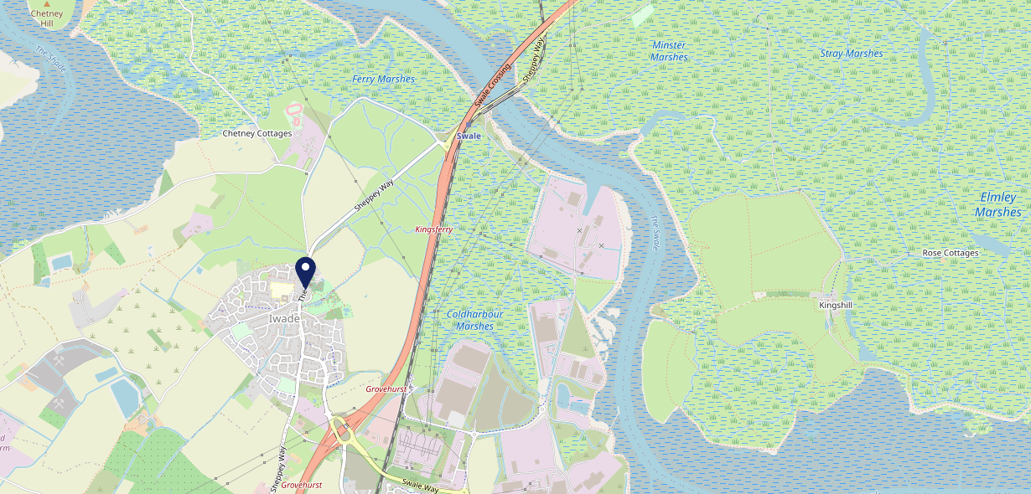









Site Intel
Woolpack ME98SH
3 Miles
1 Chain
22/02/2023 - 14/02/2024
Site Summary
Woolpack ME98SH
Work Area
Region
TV Region
Urbanicity
Medway
South East
South
Rural town and fringe
ME98SH
Punch T&L
Top Competitors
ATV
Gender
Three Tuns
#1
£23.52
66.50%
Male
ME97DY
Pub Restaurant
Affluence
Segmentation
#2
70.18%
25.14%
Middle Income
Paying The Mortgage
Age Group
Visit Day
#3
26.10%
28.54%
45 to 54
Sat
Nearest Station
Swale(1.69 miles)
890 Site Customers
1 Competitors
1658 Competitor Customers

Slide 2

Site Intel
Woolpack ME98SH
3 Miles
1 Chain
22/02/2023 - 14/02/2024
Spend by Weekpart
How is customer spend distributed throughout the week for Woolpack ME98SH versus its competitors?
% of spend for Woolpack ME98SH and 1 Chains in 3 Miles from 22/02/2023 - 14/02/2024 split by Day of Week
890 Site Customers
1 Competitors
1658 Competitor Customers

Slide 3
Site Intel
Woolpack ME98SH
3 Miles
1 Chain
22/02/2023 - 14/02/2024
Visit Frequency
How frequently per year do customers visit Woolpack ME98SH versus its competitors?
% of customer numbers for Woolpack ME98SH and 1 Chains in 3 Miles from 22/02/2023 - 14/02/2024 and the number of visits made Per Annum
890 Site Customers
1 Competitors
1658 Competitor Customers

Slide 4
Site Intel
Woolpack ME98SH
3 Miles
1 Chain
22/02/2023 - 14/02/2024
ATV Change
How has ATV changed between two date ranges?
890 Site Customers

Slide 5
Site Intel
Woolpack ME98SH
3 Miles
1 Chain
22/02/2023 - 14/02/2024
Market Share Change
How has market share changed between two date ranges?
% of market share spend for Woolpack ME98SH and 1 Chains in 3 Miles from 22/02/2023 - 14/02/2024
890 Site Customers

Slide 6
Site Intel
Woolpack ME98SH
3 Miles
1 Chain
22/02/2023 - 14/02/2024
Age
How does the age profile of customers who visit Woolpack ME98SH compare versus its competitors?
% of spend for Woolpack ME98SH and 1 Chains in 3 Miles from 22/02/2023 - 14/02/2024 split by Age Range
501 Site Customers
1 Competitors
996 Competitor Customers

Slide 7
Site Intel
Woolpack ME98SH
3 Miles
1 Chain
22/02/2023 - 14/02/2024
Affluence
How does the affluence of customers who visit Woolpack ME98SH compare versus its competitors?
% of spend for Woolpack ME98SH and 1 Chains in 3 Miles from 22/02/2023 - 14/02/2024 split by Affluence
480 Site Customers
1 Competitors
916 Competitor Customers

Slide 8
Site Intel
Woolpack ME98SH
3 Miles
1 Chain
22/02/2023 - 14/02/2024
Gender
How does the gender profile of customers who visit Woolpack ME98SH compare versus its competitors?
% of spend for Woolpack ME98SH and 1 Chains in 3 Miles from 22/02/2023 - 14/02/2024 split by Gender
503 Site Customers
1 Competitors
968 Competitor Customers

Slide 9
Site Intel
Woolpack ME98SH
3 Miles
1 Chain
22/02/2023 - 14/02/2024
Punch Segmentation
How does the Custom segmentation profile of customers who visit Woolpack ME98SH compare versus its competitors?
% of spend for Woolpack ME98SH and 1 Chains in 3 Miles from 22/02/2023 - 14/02/2024 split by Segment
890 Site Customers
1 Competitors
1658 Competitor Customers

Slide 10
Site Intel
Woolpack ME98SH
3 Miles
1 Chain
22/02/2023 - 14/02/2024
Spend by Distance
How does the spend profile of Woolpack ME98SH compare versus its competitors based on travel distances?
% of spend for Woolpack ME98SH and 1 Chains in 3 Miles from 22/02/2023 - 14/02/2024 split by Distance travelled
503 Site Customers
1 Competitors
968 Competitor Customers

Slide 11
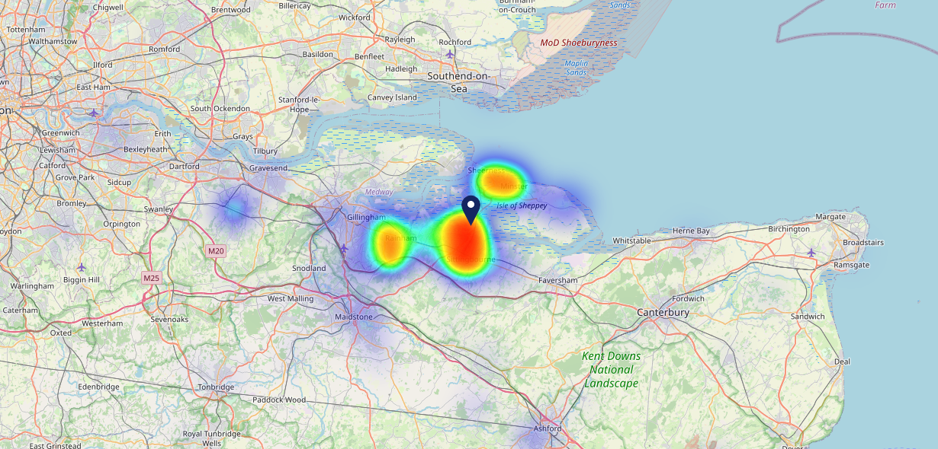

Site Intel
Woolpack ME98SH
22/02/2023 - 14/02/2024
Map of Guest Origin
Where do customers of Woolpack ME98SH come from?
Where do customers of Woolpack ME98SH for 22/02/2023 - 14/02/2024 live
503 Site Customers

Slide 12
Site Intel
Woolpack ME98SH
3 Miles
1 Chain
22/02/2023 - 14/02/2024
Share of Wallet
What are the Top 20 venues (by spend) that customers of Woolpack ME98SH also visit?
For customers of Woolpack ME98SH, who are the top 20 competitors from 1 Chains in 3 Miles for 22/02/2023 - 14/02/2024 split by Venue
890 Site Customers

Slide 13
Site Intel
Woolpack ME98SH
3 Miles
1 Chain
22/02/2023 - 14/02/2024
Share of Wallet Change
How has share of wallet of customers of Woolpack ME98SH changed between two date ranges?
890 Site Customers

Slide 14
Site Intel
Woolpack ME98SH
22/02/2023 - 14/02/2024
Market Summary
How does the local area for Woolpack ME98SH compare to the national average (1 = low, 10 = high)
Data Type | Name | Spend in 250m | 250m Spend vs National | Spend in 500m | 500m Spend vs National | Spend in 1 mile | 1 mile Spend vs National | Spend in 3 miles | 3 mile Spend vs National
Total | Annual Sales | £759K | 4 | £759K | 3 | £770K | 1 | £57.79M | 5
Weekpart | Mon - Thu | 35.3% | 3 | 35.3% | 2 | 35.0% | 1 | 44.0% | 8
Weekpart | Fri - Sat | 49.2% | 8 | 49.2% | 9 | 49.5% | 10 | 40.5% | 4
Weekpart | Sun | 15.5% | 7 | 15.5% | 6 | 15.5% | 6 | 15.5% | 5
Age | 18 to 24 | 4.5% | 4 | 4.5% | 4 | 4.5% | 3 | 9.4% | 8
Age | 25 to 34 | 13.3% | 2 | 13.3% | 2 | 13.6% | 1 | 18.7% | 3
Age | 35 to 44 | 26.1% | 7 | 26.1% | 8 | 26.3% | 8 | 24.8% | 7
Age | 45 to 54 | 18.7% | 4 | 18.7% | 4 | 18.6% | 3 | 18.2% | 2
Age | 55 to 64 | 16.3% | 6 | 16.3% | 6 | 16.1% | 6 | 16.4% | 7
Age | 65 to 74 | 16.0% | 10 | 16.0% | 10 | 15.9% | 10 | 8.5% | 8
Age | 75+ | 5.1% | 9 | 5.1% | 9 | 5.0% | 9 | 4.0% | 8
CAMEO | Business Elite | 0.4% | 1 | 0.4% | 1 | 0.4% | 1 | 2.5% | 1
CAMEO | Prosperous Professionals | 0.9% | 1 | 0.9% | 1 | 0.9% | 1 | 2.9% | 1
CAMEO | Flourishing Society | 18.1% | 8 | 18.1% | 8 | 18.2% | 8 | 12.6% | 5
CAMEO | Content Communities | 17.8% | 9 | 17.8% | 9 | 17.7% | 9 | 12.7% | 6
CAMEO | White Collar Neighbourhoods | 20.1% | 10 | 20.1% | 10 | 20.1% | 10 | 17.3% | 10
CAMEO | Enterprising Mainstream | 21.5% | 10 | 21.5% | 10 | 21.4% | 10 | 15.0% | 10
CAMEO | Paying The Mortgage | 12.0% | 4 | 12.0% | 4 | 12.1% | 4 | 17.0% | 7
CAMEO | Cash Conscious Communities | 5.1% | 2 | 5.1% | 2 | 5.1% | 2 | 8.8% | 5
CAMEO | On A Budget | 3.7% | 3 | 3.7% | 2 | 3.7% | 2 | 10.1% | 9
CAMEO | Family Value | 0.5% | 2 | 0.5% | 1 | 0.5% | 1 | 1.1% | 3
Affluence | AB | 19.4% | 4 | 19.4% | 4 | 19.5% | 3 | 18.0% | 2
Affluence | C1C2 | 71.4% | 10 | 71.4% | 10 | 71.3% | 10 | 62.0% | 10
Affluence | DE | 9.2% | 2 | 9.2% | 2 | 9.3% | 1 | 20.0% | 6

Slide 15

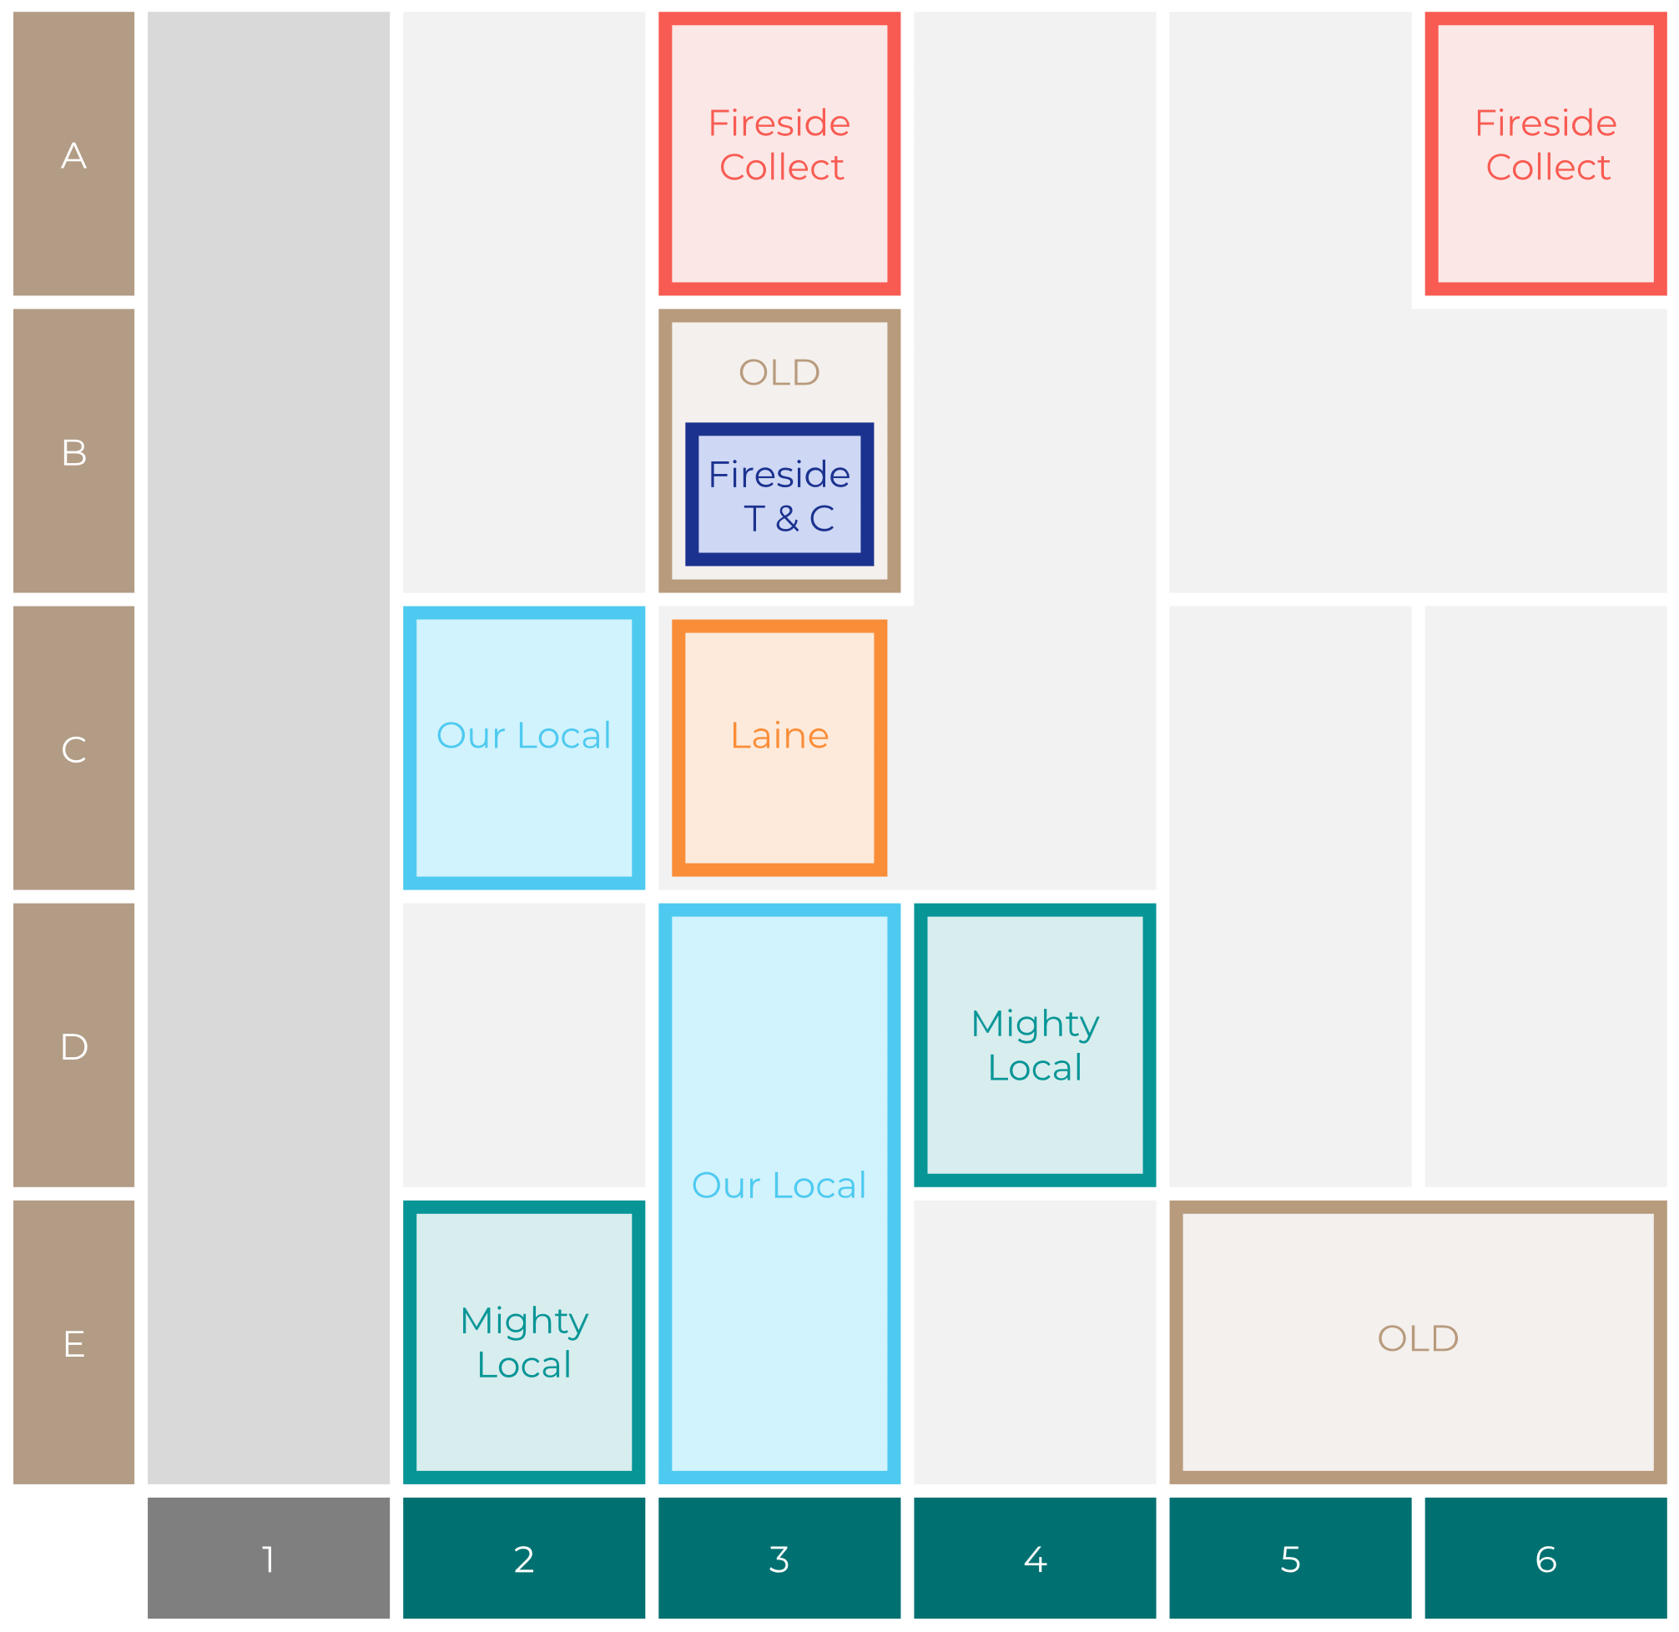

Site Intel
Woolpack ME98SH
Site Potential 1
Site Characteristics
£3000
£18000
OCC Concept Fit
Achievable Average Weekly Takings
Our Local Destination
£12000
A Food-Led High Affluence B Food-Led Mid Affluence C Wet-Led Mid/High Affluence D Wet-Led Low Affluence E Food-Led Low Affluence
AWT 2 Local Regulars 3 Local Passing Trade 4 Destination Wet-Led 5 Destination Food-Led 6 Destination Very Food-Led
A
B
C
D
E
1
2
3
4
5
6

Slide 16
Site Intel
Woolpack ME98SH
Site Potential 2
Concept Recommendation

Slide 17
Site Intel
Woolpack ME98SH
Local Market Profile
Mix of spend by customer segment in Punch site and local market
 | Customer Count | Family Familiar | Occasional & Local | Mid-Week Seniors | Part Of The Pub | Metro Sophisticates | Young & Connected | Bubbly Weekenders | Upmarket Diners
Woolpack | 201 | 16.31% | 1.52% | 37.51% | 0.75% | 4.01% | 19.21% | 6.51% | 14.14%
Local Catchment | 350 | 14.10% | 1.01% | 42.14% | 2.55% | 5.39% | 8.24% | 8.70% | 17.84%
Punch T&L | 110515 | 8.08% | 5.92% | 29.54% | 11.18% | 11.29% | 11.62% | 7.15% | 15.19%
Woolpack vs Local Catchment |  | 2.21% | 0.51% | -4.63% | -1.80% | -1.38% | 10.97% | -2.19% | -3.70%
Woolpack vs Punch T&L |  | 8.23% | -4.40% | 7.97% | -10.43% | -7.28% | 7.59% | -0.64% | -1.05%
Local Catchment vs Punch T&L |  | 6.02% | -4.91% | 12.60% | -8.63% | -5.90% | -3.38% | 1.55% | 2.65%

Slide 18
Site Intel
Woolpack ME98SH
Local Competitor Profiles
Mix of spend by customer segment in Punch site and local competitors
 | Customer Count | Family Familiar | Occasional & Local | Mid-Week Seniors | Part Of The Pub | Metro Sophisticates | Young & Connected | Bubbly Weekenders | Upmarket Diners
Woolpack ME98SH | 201 | 16.31% | 1.52% | 37.51% | 0.75% | 4.01% | 19.21% | 6.51% | 14.14%
Three Tuns ME97DY | 350 | 14.10% | 1.01% | 42.14% | 2.55% | 5.39% | 8.24% | 8.70% | 17.84%

