Slide 1
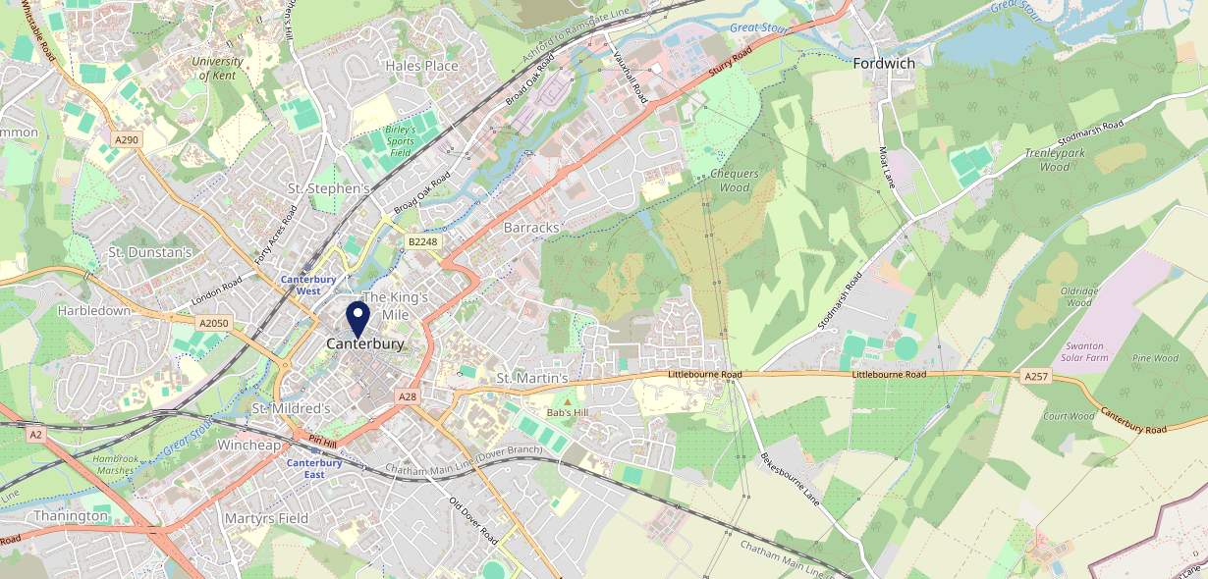
Site Intel
Thomas Becket CT12JB
1 Miles
371 Chains
16/04/2025 - 08/04/2026
Site Summary
Thomas Becket CT12JB
Work Area
Region
TV Region
Urbanicity
Canterbury
South East
South
Urban city and town
CT12JB
Punch - Fireside Inns
Top Competitors
ATV
Gender
McDonalds Canterbury High Street
#1
£13.39
68.78%
Male
CT12SS
McDonalds
Affluence
Segmentation
Dolphin Inn Canterbury
#2
52.75%
15.78%
Middle Income
Content Communities
CT12AA
Stonegate PP
Age Group
Visit Day
Unicorn Canterbury
#3
27.33%
30.46%
CT28BS
55 to 64
Sat
Stonegate PP
Nearest Station
Canterbury West(0.53 miles)
1738 Site Customers
436 Competitors
320444 Competitor Customers

Slide 2
Site Intel
Thomas Becket CT12JB
1 Miles
371 Chains
16/04/2025 - 08/04/2026
Spend by Weekpart
How is customer spend distributed throughout the week for Thomas Becket CT12JB versus its competitors?
% of spend for Thomas Becket CT12JB and 371 Chains in 1 Miles from 16/04/2025 - 08/04/2026 split by Day of Week
1738 Site Customers
436 Competitors
320444 Competitor Customers

Slide 3
Site Intel
Thomas Becket CT12JB
1 Miles
371 Chains
16/04/2025 - 08/04/2026
Visit Frequency
How frequently per year do customers visit Thomas Becket CT12JB versus its competitors?
% of customer numbers for Thomas Becket CT12JB and 371 Chains in 1 Miles from 16/04/2025 - 08/04/2026 and the number of visits made Per Annum
1738 Site Customers
436 Competitors
320444 Competitor Customers

Slide 4
Site Intel
Thomas Becket CT12JB
1 Miles
371 Chains
16/04/2025 - 08/04/2026
ATV Change
How has ATV changed between two date ranges?
1738 Site Customers

Slide 5
Site Intel
Thomas Becket CT12JB
1 Miles
371 Chains
16/04/2025 - 08/04/2026
Market Share Change
How has market share changed between two date ranges?
% of market share spend for Thomas Becket CT12JB and 371 Chains in 1 Miles from 16/04/2025 - 08/04/2026
1738 Site Customers

Slide 6
Site Intel
Thomas Becket CT12JB
1 Miles
371 Chains
16/04/2025 - 08/04/2026
Age
How does the age profile of customers who visit Thomas Becket CT12JB compare versus its competitors?
% of spend for Thomas Becket CT12JB and 371 Chains in 1 Miles from 16/04/2025 - 08/04/2026 split by Age Range
762 Site Customers
436 Competitors
120255 Competitor Customers

Slide 7
Site Intel
Thomas Becket CT12JB
1 Miles
371 Chains
16/04/2025 - 08/04/2026
Affluence
How does the affluence of customers who visit Thomas Becket CT12JB compare versus its competitors?
% of spend for Thomas Becket CT12JB and 371 Chains in 1 Miles from 16/04/2025 - 08/04/2026 split by Affluence
725 Site Customers
436 Competitors
110400 Competitor Customers

Slide 8
Site Intel
Thomas Becket CT12JB
1 Miles
371 Chains
16/04/2025 - 08/04/2026
Gender
How does the gender profile of customers who visit Thomas Becket CT12JB compare versus its competitors?
% of spend for Thomas Becket CT12JB and 371 Chains in 1 Miles from 16/04/2025 - 08/04/2026 split by Gender
748 Site Customers
436 Competitors
116579 Competitor Customers

Slide 9
Site Intel
Thomas Becket CT12JB
1 Miles
371 Chains
16/04/2025 - 08/04/2026
Punch Segmentation
How does the Custom segmentation profile of customers who visit Thomas Becket CT12JB compare versus its competitors?
% of spend for Thomas Becket CT12JB and 371 Chains in 1 Miles from 16/04/2025 - 08/04/2026 split by Segment
1738 Site Customers
436 Competitors
320444 Competitor Customers

Slide 10
Site Intel
Thomas Becket CT12JB
1 Miles
371 Chains
16/04/2025 - 08/04/2026
Spend by Distance
How does the spend profile of Thomas Becket CT12JB compare versus its competitors based on travel distances?
% of spend for Thomas Becket CT12JB and 371 Chains in 1 Miles from 16/04/2025 - 08/04/2026 split by Distance travelled
748 Site Customers
436 Competitors
116445 Competitor Customers

Slide 11
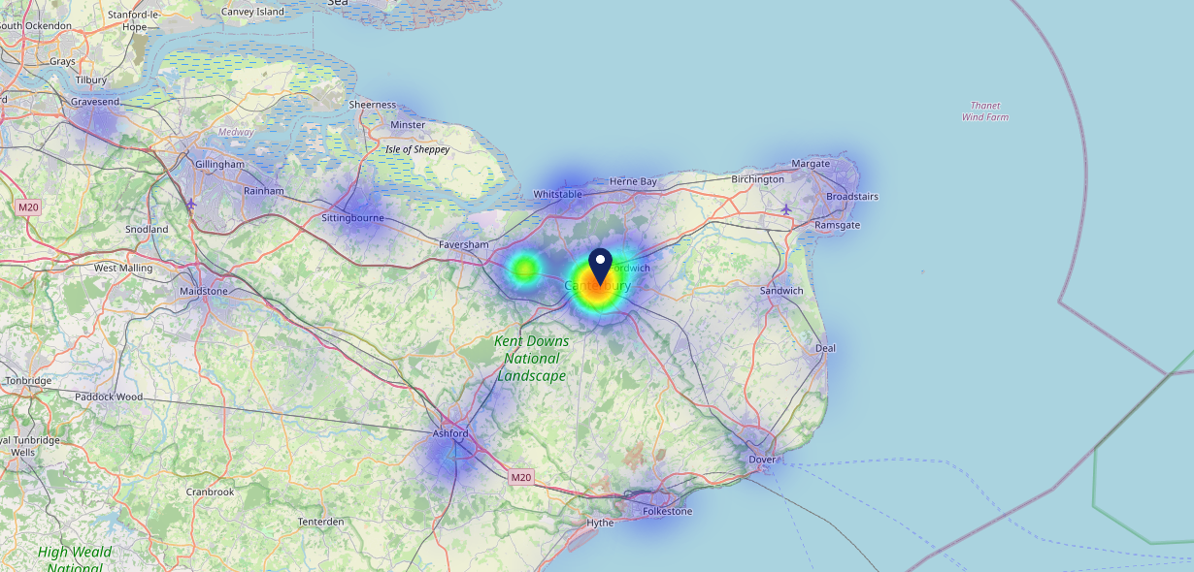
Site Intel
Thomas Becket CT12JB
16/04/2025 - 08/04/2026
Map of Guest Origin
Where do customers of Thomas Becket CT12JB come from?
Where do customers of Thomas Becket CT12JB for 16/04/2025 - 08/04/2026 live
748 Site Customers

Slide 12
Site Intel
Thomas Becket CT12JB
1 Miles
371 Chains
16/04/2025 - 08/04/2026
Share of Wallet
What are the Top 20 venues (by spend) that customers of Thomas Becket CT12JB also visit?
For customers of Thomas Becket CT12JB, who are the top 20 competitors from 371 Chains in 1 Miles for 16/04/2025 - 08/04/2026 split by Venue
1738 Site Customers

Slide 13
Site Intel
Thomas Becket CT12JB
1 Miles
371 Chains
16/04/2025 - 08/04/2026
Share of Wallet Change
How has share of wallet of customers of Thomas Becket CT12JB changed between two date ranges?
1738 Site Customers

Slide 14
Site Intel
Thomas Becket CT12JB
16/04/2025 - 08/04/2026
Market Summary
How does the local area for Thomas Becket CT12JB compare to the national average (1 = low, 10 = high)
Data Type | Name | Spend in 250m | 250m Spend vs National | Spend in 500m | 500m Spend vs National | Spend in 1 mile | 1 mile Spend vs National | Spend in 3 miles | 3 mile Spend vs National
Total | Annual Sales | £34.97M | 10 | £84.44M | 10 | £106.10M | 9 | £128.12M | 7
Weekpart | Mon - Thu | 39.7% | 5 | 41.0% | 6 | 40.7% | 5 | 41.9% | 6
Weekpart | Fri - Sat | 47.1% | 7 | 45.9% | 7 | 45.8% | 8 | 44.3% | 8
Weekpart | Sun | 13.2% | 4 | 13.1% | 3 | 13.5% | 2 | 13.9% | 2
Age | 18 to 24 | 8.4% | 7 | 7.5% | 7 | 8.1% | 7 | 8.1% | 7
Age | 25 to 34 | 14.5% | 2 | 14.0% | 2 | 14.2% | 2 | 14.0% | 1
Age | 35 to 44 | 21.4% | 4 | 21.0% | 4 | 21.5% | 4 | 21.3% | 3
Age | 45 to 54 | 20.0% | 5 | 20.6% | 6 | 20.2% | 5 | 20.1% | 5
Age | 55 to 64 | 18.7% | 7 | 19.1% | 8 | 18.8% | 8 | 18.8% | 9
Age | 65 to 74 | 12.0% | 9 | 12.0% | 9 | 11.4% | 9 | 11.5% | 9
Age | 75+ | 5.1% | 9 | 5.8% | 9 | 5.7% | 9 | 6.2% | 10
CAMEO | Business Elite | 5.6% | 5 | 6.1% | 5 | 5.8% | 5 | 5.7% | 4
CAMEO | Prosperous Professionals | 6.7% | 6 | 6.7% | 6 | 6.6% | 6 | 6.6% | 6
CAMEO | Flourishing Society | 16.0% | 7 | 16.3% | 7 | 16.3% | 7 | 16.4% | 7
CAMEO | Content Communities | 16.0% | 8 | 16.4% | 9 | 16.3% | 9 | 16.4% | 9
CAMEO | White Collar Neighbourhoods | 12.1% | 6 | 11.7% | 6 | 11.3% | 5 | 11.1% | 5
CAMEO | Enterprising Mainstream | 12.0% | 8 | 11.6% | 8 | 11.6% | 8 | 11.5% | 8
CAMEO | Paying The Mortgage | 15.1% | 6 | 14.9% | 6 | 15.1% | 6 | 15.2% | 6
CAMEO | Cash Conscious Communities | 7.1% | 4 | 7.3% | 4 | 7.6% | 4 | 7.6% | 4
CAMEO | On A Budget | 7.7% | 7 | 7.4% | 6 | 7.8% | 7 | 7.8% | 7
CAMEO | Family Value | 1.6% | 4 | 1.6% | 4 | 1.7% | 4 | 1.7% | 4
Affluence | AB | 28.3% | 6 | 29.1% | 6 | 28.8% | 6 | 28.7% | 5
Affluence | C1C2 | 55.2% | 8 | 54.6% | 8 | 54.2% | 8 | 54.3% | 8
Affluence | DE | 16.5% | 4 | 16.3% | 4 | 17.0% | 4 | 17.0% | 4

Slide 15
Site Intel
Thomas Becket CT12JB
Site Potential 1
Site Characteristics
£3000
£18000
OCC Concept Fit
Achievable Average Weekly Takings
Non-Core
£12000
A Food-Led High Affluence B Food-Led Mid Affluence C Wet-Led Mid/High Affluence D Wet-Led Low Affluence E Food-Led Low Affluence
AWT 2 Local Regulars 3 Local Passing Trade 4 Destination Wet-Led 5 Destination Food-Led 6 Destination Very Food-Led
A
B
C
D
E
1
2
3
4
5
6

Slide 16
Site Intel
Thomas Becket CT12JB
Site Potential 2
Concept Recommendation

Slide 17
Site Intel
Thomas Becket CT12JB
Local Market Profile
Mix of spend by customer segment in Punch site and local market
 | Customer Count | Family Familiar | Occasional & Local | Mid-Week Seniors | Part Of The Pub | Metro Sophisticates | Young & Connected | Bubbly Weekenders | Upmarket Diners
Thomas Becket | 347 | 3.72% | 4.24% | 26.83% | 3.96% | 17.25% | 16.76% | 5.61% | 21.59%
Local Catchment | 10974 | 10.30% | 3.99% | 18.51% | 4.43% | 10.30% | 16.20% | 9.63% | 26.61%
Punch T&L | 94346 | 8.90% | 6.08% | 28.74% | 11.25% | 11.34% | 11.07% | 7.03% | 15.56%
Thomas Becket vs Local Catchment |  | -6.58% | 0.25% | 8.32% | -0.47% | 6.95% | 0.56% | -4.02% | -5.02%
Thomas Becket vs Punch T&L |  | -5.18% | -1.84% | -1.91% | -7.29% | 5.91% | 5.69% | -1.42% | 6.03%
Local Catchment vs Punch T&L |  | 1.40% | -2.09% | -10.23% | -6.82% | -1.04% | 5.13% | 2.60% | 11.05%

Slide 18
Site Intel
Thomas Becket CT12JB
Local Competitor Profiles
Mix of spend by customer segment in Punch site and local competitors
 | Customer Count | Family Familiar | Occasional & Local | Mid-Week Seniors | Part Of The Pub | Metro Sophisticates | Young & Connected | Bubbly Weekenders | Upmarket Diners
Thomas Becket CT12JB | 347 | 3.72% | 4.24% | 26.83% | 3.96% | 17.25% | 16.76% | 5.61% | 21.59%
McDonalds Canterbury High Street CT12SS | 1232 | 21.99% | 7.18% | 10.44% | 3.43% | 5.17% | 30.76% | 9.07% | 11.93%
Dolphin Inn Canterbury CT12AA | 427 | 8.18% | 4.66% | 19.52% | 6.02% | 12.11% | 17.24% | 11.15% | 21.09%
Unicorn Canterbury CT28BS | 192 | 2.86% | 2.35% | 19.64% | 17.26% | 31.44% | 6.85% | 9.87% | 9.68%
Shakespeare CT12JR | 634 | 5.64% | 3.41% | 25.76% | 3.29% | 15.06% | 15.82% | 7.32% | 23.67%
Drapers Arms CT12HX | 382 | 12.79% | 3.13% | 13.06% | 4.14% | 19.79% | 21.51% | 10.90% | 14.66%
Maidens Head (Canterbury) CT13QZ | 121 | 2.01% | 3.38% | 12.68% | 25.15% | 5.65% | 37.51% | 8.61% | 4.97%
The Thomas Ingoldsby CT12HG | 947 | 12.72% | 4.20% | 19.12% | 14.53% | 2.97% | 30.23% | 8.84% | 7.34%
Bell Crown CT12DE | 304 | 6.79% | 8.61% | 26.00% | 7.51% | 18.82% | 16.22% | 6.27% | 9.73%
Millers Arms Inn CT12AW | 324 | 3.00% | 5.61% | 49.09% | 2.40% | 9.24% | 4.95% | 1.90% | 23.76%
Lady Luck Canterbury CT12BQ | 352 | 4.83% | 4.89% | 20.95% | 9.81% | 14.35% | 23.67% | 9.82% | 11.64%
Black Griffin Canterbury CT12BG | 295 | 4.75% | 15.12% | 8.14% | 33.40% | 9.05% | 17.37% | 5.37% | 6.76%
Cherry Tree CT12RU | 294 | 5.95% | 6.40% | 6.57% | 6.90% | 10.37% | 44.04% | 13.09% | 6.65%
Bishops Finger CT28AF | 481 | 8.16% | 2.67% | 15.44% | 5.39% | 20.61% | 16.27% | 9.64% | 21.79%
Monument CT28BZ | 134 | 0.60% | 3.02% | 16.09% | 1.98% | 29.89% | 6.30% | 1.23% | 40.86%
Carpenters Arms CT12DE | 107 | 3.14% | 16.28% | 3.73% | 23.90% | 21.89% | 18.67% | 5.21% | 7.14%
Cafe Des Amis CT28AA | 374 | 7.42% | 1.38% | 19.79% | 0.77% | 12.10% | 16.55% | 7.83% | 34.13%
The West Gate Inn CT27EB | 715 | 13.95% | 8.94% | 16.82% | 21.33% | 7.24% | 17.93% | 5.41% | 8.34%
Penny Theatre Canterbury CT11BL | 397 | 12.09% | 3.14% | 18.94% | 8.38% | 8.17% | 27.14% | 12.18% | 9.92%
Cosy Club Canterbury CT12TH | 615 | 11.13% | 3.30% | 14.86% | 2.27% | 11.78% | 17.55% | 11.34% | 27.74%
New Inn CT11NP | 88 | 0.17% | 13.08% | 18.74% | 46.72% | 14.98% | 1.51% | 0.17% | 4.56%
Old City Bar CT13HJ | 190 | 4.51% | 4.34% | 14.98% | 8.95% | 18.09% | 27.59% | 9.44% | 12.07%
Ivy Canterbury CT12SH | 588 | 8.39% | 1.23% | 19.77% | 1.38% | 9.96% | 8.61% | 7.64% | 42.98%
Parrot CT12AG | 337 | 3.57% | 2.60% | 29.64% | 0.71% | 13.30% | 9.85% | 6.59% | 33.70%
White Hart CT12QX | 261 | 10.31% | 6.67% | 23.92% | 2.72% | 17.73% | 8.93% | 9.04% | 20.65%

