Slide 1











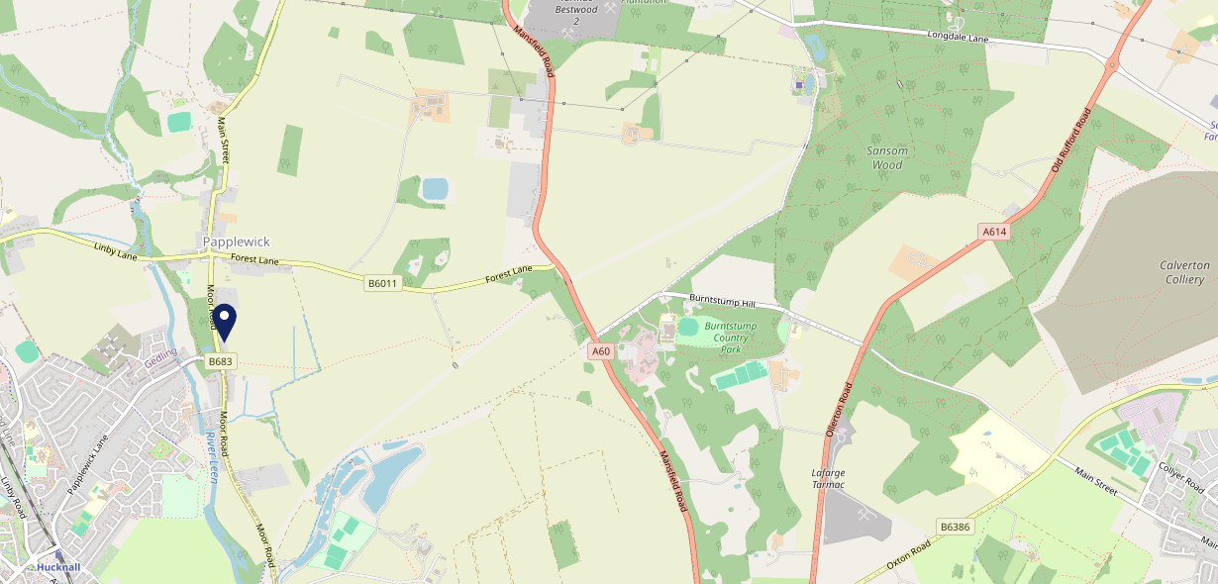











Site Intel
Griffins Head NG158EN
Griffins Head NG158EN
97 Chains
31/05/2023 - 22/05/2024
Site Summary
Griffins Head NG158EN
Work Area
Region
TV Region
Urbanicity
Mansfield
East Midlands
Central
Rural hamlet and isolated dwellings
NG158EN
Punch - Our Local +
Top Competitors
ATV
Gender
Horse & Groom
#1
£17.09
61.34%
Male
NG158AE
Star Pubs & Bars
Affluence
Segmentation
Station Hotel
#2
70.61%
21.44%
Middle Income
Enterprising Mainstream
NG157TQ
Star Pubs & Bars
Age Group
Visit Day
Nabb Inn (Hucknall)
#3
25.67%
24.91%
NG156NT
35 to 44
Sun
GK - Locals - Value
Nearest Station
Hucknall(1.56 miles)
2171 Site Customers
49 Competitors
20875 Competitor Customers

Slide 2

Site Intel
Griffins Head NG158EN
Griffins Head NG158EN
97 Chains
31/05/2023 - 22/05/2024
Spend by Weekpart
How is customer spend distributed throughout the week for Griffins Head NG158EN versus its competitors?
% of spend for Griffins Head NG158EN and 97 Chains in 3 Miles from 31/05/2023 - 22/05/2024 split by Day of Week
2171 Site Customers
49 Competitors
20875 Competitor Customers

Slide 3
Site Intel
Griffins Head NG158EN
Griffins Head NG158EN
97 Chains
31/05/2023 - 22/05/2024
Visit Frequency
How frequently per year do customers visit Griffins Head NG158EN versus its competitors?
% of customer numbers for Griffins Head NG158EN and 97 Chains in 3 Miles from 31/05/2023 - 22/05/2024 and the number of visits made Per Annum
2171 Site Customers
49 Competitors
20875 Competitor Customers

Slide 4
Site Intel
Griffins Head NG158EN
Griffins Head NG158EN
97 Chains
31/05/2023 - 22/05/2024
ATV Change
How has ATV changed between two date ranges?
2171 Site Customers

Slide 5
Site Intel
Griffins Head NG158EN
Griffins Head NG158EN
97 Chains
31/05/2023 - 22/05/2024
Market Share Change
How has market share changed between two date ranges?
% of market share spend for Griffins Head NG158EN and 97 Chains in 3 Miles from 31/05/2023 - 22/05/2024
2171 Site Customers

Slide 6
Site Intel
Griffins Head NG158EN
Griffins Head NG158EN
97 Chains
31/05/2023 - 22/05/2024
Age
How does the age profile of customers who visit Griffins Head NG158EN compare versus its competitors?
% of spend for Griffins Head NG158EN and 97 Chains in 3 Miles from 31/05/2023 - 22/05/2024 split by Age Range
1182 Site Customers
49 Competitors
10026 Competitor Customers

Slide 7
Site Intel
Griffins Head NG158EN
Griffins Head NG158EN
97 Chains
31/05/2023 - 22/05/2024
Affluence
How does the affluence of customers who visit Griffins Head NG158EN compare versus its competitors?
% of spend for Griffins Head NG158EN and 97 Chains in 3 Miles from 31/05/2023 - 22/05/2024 split by Affluence
1203 Site Customers
49 Competitors
10071 Competitor Customers

Slide 8
Site Intel
Griffins Head NG158EN
Griffins Head NG158EN
97 Chains
31/05/2023 - 22/05/2024
Gender
How does the gender profile of customers who visit Griffins Head NG158EN compare versus its competitors?
% of spend for Griffins Head NG158EN and 97 Chains in 3 Miles from 31/05/2023 - 22/05/2024 split by Gender
1203 Site Customers
49 Competitors
10071 Competitor Customers

Slide 9
Site Intel
Griffins Head NG158EN
Griffins Head NG158EN
97 Chains
31/05/2023 - 22/05/2024
Punch Segmentation
How does the Custom segmentation profile of customers who visit Griffins Head NG158EN compare versus its competitors?
% of spend for Griffins Head NG158EN and 97 Chains in 3 Miles from 31/05/2023 - 22/05/2024 split by Segment
2171 Site Customers
49 Competitors
20875 Competitor Customers

Slide 10
Site Intel
Griffins Head NG158EN
Griffins Head NG158EN
97 Chains
31/05/2023 - 22/05/2024
Spend by Distance
How does the spend profile of Griffins Head NG158EN compare versus its competitors based on travel distances?
% of spend for Griffins Head NG158EN and 97 Chains in 3 Miles from 31/05/2023 - 22/05/2024 split by Distance travelled
1179 Site Customers
49 Competitors
9717 Competitor Customers

Slide 11
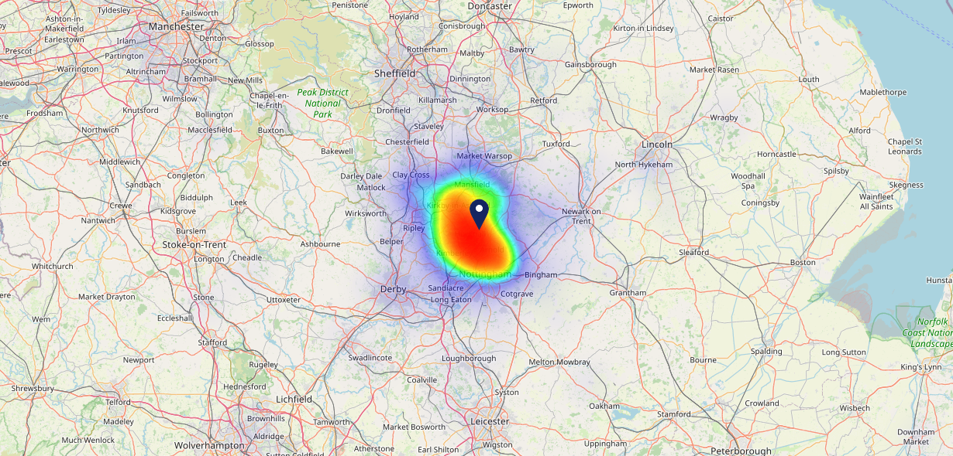

Site Intel
Griffins Head NG158EN
31/05/2023 - 22/05/2024
Map of Guest Origin
Where do customers of Griffins Head NG158EN come from?
Where do customers of Griffins Head NG158EN for 31/05/2023 - 22/05/2024 live
1179 Site Customers

Slide 12
Site Intel
Griffins Head NG158EN
Griffins Head NG158EN
97 Chains
31/05/2023 - 22/05/2024
Share of Wallet
What are the Top 20 venues (by spend) that customers of Griffins Head NG158EN also visit?
For customers of Griffins Head NG158EN, who are the top 20 competitors from 97 Chains in 3 Miles for 31/05/2023 - 22/05/2024 split by Venue
2171 Site Customers

Slide 13
Site Intel
Griffins Head NG158EN
Griffins Head NG158EN
97 Chains
31/05/2023 - 22/05/2024
Share of Wallet Change
How has share of wallet of customers of Griffins Head NG158EN changed between two date ranges?
2171 Site Customers

Slide 14
Site Intel
Griffins Head NG158EN
31/05/2023 - 22/05/2024
Market Summary
How does the local area for Griffins Head NG158EN compare to the national average (1 = low, 10 = high)
Data Type | Name | Spend in 250m | 250m Spend vs National | Spend in 500m | 500m Spend vs National | Spend in 1 mile | 1 mile Spend vs National | Spend in 3 miles | 3 mile Spend vs National
Total | Annual Sales | £1.14M | 5 | £1.14M | 4 | £2.83M | 2 | £43.70M | 4
Weekpart | Mon - Thu | 35.4% | 3 | 35.4% | 2 | 33.1% | 1 | 41.1% | 5
Weekpart | Fri - Sat | 39.7% | 3 | 39.7% | 3 | 44.7% | 7 | 42.7% | 6
Weekpart | Sun | 24.9% | 10 | 24.9% | 10 | 22.2% | 10 | 16.2% | 7
Age | 18 to 24 | 8.2% | 7 | 8.2% | 7 | 5.4% | 4 | 6.9% | 5
Age | 25 to 34 | 13.0% | 2 | 13.0% | 2 | 11.4% | 1 | 17.3% | 2
Age | 35 to 44 | 25.7% | 7 | 25.7% | 7 | 24.9% | 7 | 27.1% | 9
Age | 45 to 54 | 21.3% | 6 | 21.3% | 7 | 28.3% | 10 | 21.3% | 7
Age | 55 to 64 | 19.9% | 8 | 19.9% | 8 | 19.8% | 9 | 16.4% | 7
Age | 65 to 74 | 8.7% | 7 | 8.7% | 7 | 7.6% | 7 | 7.2% | 6
Age | 75+ | 3.3% | 7 | 3.3% | 7 | 2.6% | 6 | 3.8% | 8
CAMEO | Business Elite | 1.8% | 2 | 1.8% | 2 | 1.5% | 1 | 2.0% | 1
CAMEO | Prosperous Professionals | 1.6% | 2 | 1.6% | 1 | 3.1% | 2 | 2.4% | 1
CAMEO | Flourishing Society | 3.2% | 1 | 3.2% | 1 | 4.0% | 1 | 4.2% | 1
CAMEO | Content Communities | 18.6% | 9 | 18.6% | 9 | 16.9% | 9 | 14.4% | 8
CAMEO | White Collar Neighbourhoods | 15.3% | 9 | 15.3% | 9 | 11.3% | 5 | 5.6% | 1
CAMEO | Enterprising Mainstream | 21.4% | 10 | 21.4% | 10 | 21.8% | 10 | 12.3% | 9
CAMEO | Paying The Mortgage | 15.3% | 6 | 15.3% | 6 | 20.5% | 9 | 19.8% | 9
CAMEO | Cash Conscious Communities | 12.7% | 8 | 12.7% | 8 | 13.4% | 9 | 17.2% | 10
CAMEO | On A Budget | 3.7% | 3 | 3.7% | 2 | 3.2% | 2 | 6.8% | 6
CAMEO | Family Value | 6.3% | 8 | 6.3% | 8 | 4.2% | 7 | 15.5% | 10
Affluence | AB | 6.7% | 1 | 6.7% | 1 | 8.6% | 1 | 8.5% | 1
Affluence | C1C2 | 70.6% | 10 | 70.6% | 10 | 70.5% | 10 | 52.0% | 7
Affluence | DE | 22.7% | 6 | 22.7% | 6 | 20.8% | 6 | 39.4% | 10

