Slide 1
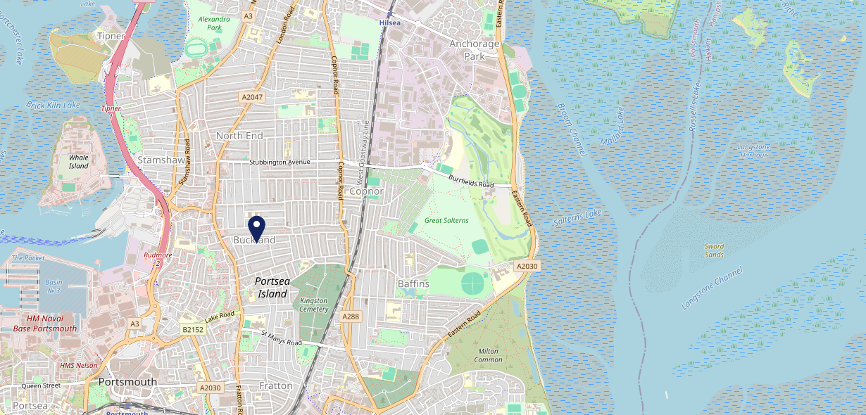
Site Intel
Winchester PO27PS
1 Miles
371 Chains
16/04/2025 - 08/04/2026
Site Summary
Winchester PO27PS
Work Area
Region
TV Region
Urbanicity
Portsmouth
South East
South
Urban city and town
PO27PS
Punch T&L
Top Competitors
ATV
Gender
The Druids Arm
#1
£10.99
66.32%
Male
PO27PH
Admiral Taverns Ltd
Affluence
Segmentation
Jolly Taxpayer
#2
67.70%
48.11%
Middle Income
Paying The Mortgage
PO36LN
Pub / Bar
Age Group
Visit Day
Lord Chichester Portsmouth
#3
58.18%
22.92%
PO20AX
55 to 64
Sat
Stonegate PP
Nearest Station
Fratton(1.61 miles)
32 Site Customers
382 Competitors
152781 Competitor Customers

Slide 2
Site Intel
Winchester PO27PS
1 Miles
371 Chains
16/04/2025 - 08/04/2026
Spend by Weekpart
How is customer spend distributed throughout the week for Winchester PO27PS versus its competitors?
% of spend for Winchester PO27PS and 371 Chains in 1 Miles from 16/04/2025 - 08/04/2026 split by Day of Week
32 Site Customers
382 Competitors
152781 Competitor Customers

Slide 3
Site Intel
Winchester PO27PS
1 Miles
371 Chains
16/04/2025 - 08/04/2026
Visit Frequency
How frequently per year do customers visit Winchester PO27PS versus its competitors?
% of customer numbers for Winchester PO27PS and 371 Chains in 1 Miles from 16/04/2025 - 08/04/2026 and the number of visits made Per Annum
32 Site Customers
382 Competitors
152781 Competitor Customers

Slide 4
Site Intel
Winchester PO27PS
1 Miles
371 Chains
16/04/2025 - 08/04/2026
ATV Change
How has ATV changed between two date ranges?
32 Site Customers

Slide 5
Site Intel
Winchester PO27PS
1 Miles
371 Chains
16/04/2025 - 08/04/2026
Market Share Change
How has market share changed between two date ranges?
% of market share spend for Winchester PO27PS and 371 Chains in 1 Miles from 16/04/2025 - 08/04/2026
32 Site Customers

Slide 6
Site Intel
Winchester PO27PS
1 Miles
371 Chains
16/04/2025 - 08/04/2026
Age
How does the age profile of customers who visit Winchester PO27PS compare versus its competitors?
% of spend for Winchester PO27PS and 371 Chains in 1 Miles from 16/04/2025 - 08/04/2026 split by Age Range
19 Site Customers
382 Competitors
65358 Competitor Customers

Slide 7
Site Intel
Winchester PO27PS
1 Miles
371 Chains
16/04/2025 - 08/04/2026
Affluence
How does the affluence of customers who visit Winchester PO27PS compare versus its competitors?
% of spend for Winchester PO27PS and 371 Chains in 1 Miles from 16/04/2025 - 08/04/2026 split by Affluence
19 Site Customers
382 Competitors
60673 Competitor Customers

Slide 8
Site Intel
Winchester PO27PS
1 Miles
371 Chains
16/04/2025 - 08/04/2026
Gender
How does the gender profile of customers who visit Winchester PO27PS compare versus its competitors?
% of spend for Winchester PO27PS and 371 Chains in 1 Miles from 16/04/2025 - 08/04/2026 split by Gender
19 Site Customers
382 Competitors
62675 Competitor Customers

Slide 9
Site Intel
Winchester PO27PS
1 Miles
371 Chains
16/04/2025 - 08/04/2026
Punch Segmentation
How does the Custom segmentation profile of customers who visit Winchester PO27PS compare versus its competitors?
% of spend for Winchester PO27PS and 371 Chains in 1 Miles from 16/04/2025 - 08/04/2026 split by Segment
32 Site Customers
382 Competitors
152781 Competitor Customers

Slide 10
Site Intel
Winchester PO27PS
1 Miles
371 Chains
16/04/2025 - 08/04/2026
Spend by Distance
How does the spend profile of Winchester PO27PS compare versus its competitors based on travel distances?
% of spend for Winchester PO27PS and 371 Chains in 1 Miles from 16/04/2025 - 08/04/2026 split by Distance travelled
19 Site Customers
382 Competitors
62611 Competitor Customers

Slide 11
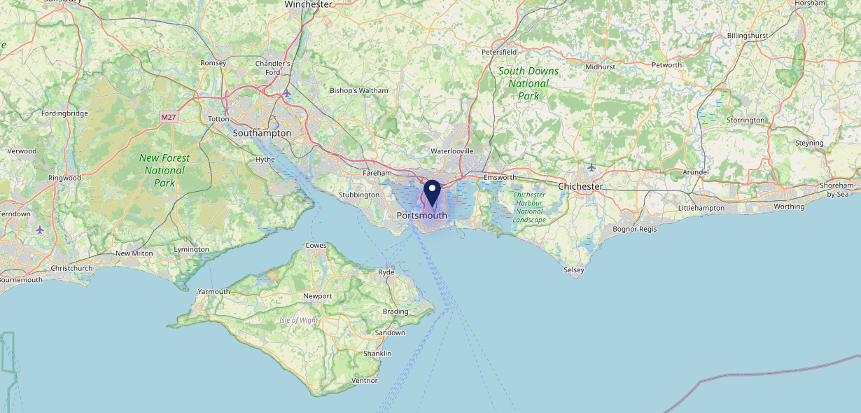
Site Intel
Winchester PO27PS
16/04/2025 - 08/04/2026
Map of Guest Origin
Where do customers of Winchester PO27PS come from?
Where do customers of Winchester PO27PS for 16/04/2025 - 08/04/2026 live
19 Site Customers

Slide 12
Site Intel
Winchester PO27PS
1 Miles
371 Chains
16/04/2025 - 08/04/2026
Share of Wallet
What are the Top 20 venues (by spend) that customers of Winchester PO27PS also visit?
For customers of Winchester PO27PS, who are the top 20 competitors from 371 Chains in 1 Miles for 16/04/2025 - 08/04/2026 split by Venue
32 Site Customers

Slide 13
Site Intel
Winchester PO27PS
1 Miles
371 Chains
16/04/2025 - 08/04/2026
Share of Wallet Change
How has share of wallet of customers of Winchester PO27PS changed between two date ranges?
32 Site Customers

Slide 14
Site Intel
Winchester PO27PS
16/04/2025 - 08/04/2026
Market Summary
How does the local area for Winchester PO27PS compare to the national average (1 = low, 10 = high)
Data Type | Name | Spend in 250m | 250m Spend vs National | Spend in 500m | 500m Spend vs National | Spend in 1 mile | 1 mile Spend vs National | Spend in 3 miles | 3 mile Spend vs National
Total | Annual Sales | £641K | 4 | £5.33M | 6 | £47.41M | 8 | £309.17M | 8
Weekpart | Mon - Thu | 32.4% | 2 | 38.9% | 4 | 44.6% | 8 | 41.0% | 5
Weekpart | Fri - Sat | 46.6% | 7 | 45.5% | 7 | 41.4% | 4 | 43.8% | 8
Weekpart | Sun | 21.0% | 9 | 15.7% | 7 | 14.1% | 3 | 15.1% | 4
Age | 18 to 24 | 7.5% | 7 | 5.4% | 5 | 6.8% | 6 | 6.8% | 5
Age | 25 to 34 | 11.6% | 1 | 15.3% | 2 | 16.8% | 3 | 15.3% | 2
Age | 35 to 44 | 13.1% | 1 | 24.2% | 6 | 24.6% | 7 | 22.5% | 4
Age | 45 to 54 | 39.1% | 10 | 21.6% | 7 | 19.7% | 5 | 19.8% | 5
Age | 55 to 64 | 23.4% | 9 | 19.6% | 8 | 17.8% | 8 | 19.7% | 9
Age | 65 to 74 | 4.1% | 3 | 11.6% | 9 | 10.8% | 9 | 11.3% | 9
Age | 75+ | 1.1% | 3 | 2.5% | 6 | 3.4% | 7 | 4.7% | 9
CAMEO | Business Elite | 2.2% | 2 | 1.5% | 1 | 1.5% | 1 | 4.4% | 3
CAMEO | Prosperous Professionals | 3.0% | 3 | 1.9% | 2 | 2.6% | 2 | 5.9% | 5
CAMEO | Flourishing Society | 1.2% | 1 | 4.0% | 1 | 5.8% | 2 | 10.2% | 4
CAMEO | Content Communities | 5.3% | 1 | 3.9% | 1 | 5.9% | 1 | 9.4% | 2
CAMEO | White Collar Neighbourhoods | 8.0% | 3 | 16.6% | 9 | 23.0% | 10 | 20.7% | 10
CAMEO | Enterprising Mainstream | 2.4% | 1 | 6.1% | 4 | 6.5% | 4 | 8.1% | 5
CAMEO | Paying The Mortgage | 25.5% | 10 | 28.0% | 10 | 23.1% | 10 | 17.9% | 8
CAMEO | Cash Conscious Communities | 13.5% | 8 | 13.2% | 8 | 9.6% | 6 | 8.0% | 4
CAMEO | On A Budget | 34.9% | 10 | 18.7% | 10 | 15.4% | 10 | 10.3% | 9
CAMEO | Family Value | 3.8% | 7 | 6.1% | 8 | 6.8% | 8 | 5.2% | 7
Affluence | AB | 6.5% | 1 | 7.4% | 1 | 9.8% | 1 | 20.5% | 3
Affluence | C1C2 | 41.3% | 3 | 54.6% | 8 | 58.5% | 9 | 56.0% | 9
Affluence | DE | 52.2% | 10 | 38.0% | 9 | 31.7% | 9 | 23.5% | 7

Slide 15
Site Intel
Winchester PO27PS
Site Potential 1
Site Characteristics
£3000
£18000
OCC Concept Fit
Achievable Average Weekly Takings
Our Local
£4000
A Food-Led High Affluence B Food-Led Mid Affluence C Wet-Led Mid/High Affluence D Wet-Led Low Affluence E Food-Led Low Affluence
AWT 2 Local Regulars 3 Local Passing Trade 4 Destination Wet-Led 5 Destination Food-Led 6 Destination Very Food-Led
A
B
C
D
E
1
2
3
4
5
6

Slide 16
Site Intel
Winchester PO27PS
Site Potential 2
Concept Recommendation

Slide 17
Site Intel
Winchester PO27PS
Local Market Profile
Mix of spend by customer segment in Punch site and local market
 | Customer Count | Family Familiar | Occasional & Local | Mid-Week Seniors | Part Of The Pub | Metro Sophisticates | Young & Connected | Bubbly Weekenders | Upmarket Diners
Winchester | 10 | 0.00% | 0.00% | 3.19% | 0.00% | 11.49% | 74.80% | 1.55% | 8.96%
Local Catchment | 7237 | 20.56% | 14.25% | 6.69% | 12.90% | 5.32% | 26.18% | 9.79% | 4.27%
Punch T&L | 95121 | 8.84% | 6.05% | 28.76% | 10.94% | 11.46% | 10.98% | 7.06% | 15.86%
Winchester vs Local Catchment |  | 0.00% | 0.00% | -3.50% | 0.00% | 6.17% | 48.62% | -8.24% | 4.69%
Winchester vs Punch T&L |  | 0.00% | 0.00% | -25.57% | 0.00% | 0.03% | 63.82% | -5.51% | -6.90%
Local Catchment vs Punch T&L |  | 11.72% | 8.20% | -22.07% | 1.96% | -6.14% | 15.20% | 2.73% | -11.59%

Slide 18
Site Intel
Winchester PO27PS
Local Competitor Profiles
Mix of spend by customer segment in Punch site and local competitors
 | Customer Count | Family Familiar | Occasional & Local | Mid-Week Seniors | Part Of The Pub | Metro Sophisticates | Young & Connected | Bubbly Weekenders | Upmarket Diners
The Druids Arm PO27PH | 68 | 1.03% | 6.33% | 1.68% | 60.35% | 0.82% | 29.26% | 0.44% | 0.03%
Jolly Taxpayer PO36LN | 86 | 3.66% | 3.62% | 9.20% | 52.36% | 1.28% | 12.02% | 7.24% | 10.58%
Lord Chichester Portsmouth PO20AX | 81 | 7.39% | 20.81% | 0.90% | 5.63% | 22.91% | 33.55% | 7.14% | 1.63%
Stag PO27QU | 72 | 4.45% | 19.48% | 1.70% | 3.31% | 16.82% | 52.10% | 1.97% | 0.13%
Baffins (Portsmouth) PO36PD | 305 | 20.71% | 14.95% | 21.17% | 9.82% | 5.31% | 18.28% | 7.30% | 2.41%
Rose In June Portsmouth PO36AR | 234 | 12.60% | 9.87% | 3.28% | 31.35% | 17.38% | 12.46% | 9.10% | 3.92%
Winchester PO27PS | 10 | 0.00% | 0.00% | 3.19% | 0.00% | 11.49% | 74.80% | 1.55% | 8.96%
Mermaid PO27RW | 93 | 5.98% | 42.50% | 1.10% | 31.70% | 4.70% | 9.94% | 3.40% | 0.64%
Green Posts (Portsmouth) PO29HJ | 278 | 9.21% | 9.33% | 2.22% | 36.54% | 6.10% | 27.03% | 7.95% | 1.57%
Copnor Kitchen PO35EQ | 194 | 22.61% | 4.46% | 7.09% | 1.87% | 3.81% | 35.99% | 16.99% | 7.14%
Harvest Home PO35AN | 78 | 6.38% | 39.18% | 30.82% | 4.62% | 1.13% | 15.06% | 1.94% | 0.83%
Yan Woo PO27DP | 34 | 20.36% | 26.50% | 4.15% | 8.34% | 0.00% | 32.55% | 4.37% | 3.69%
Fountain Portsmouth PO29AA | 126 | 8.35% | 20.92% | 6.95% | 26.70% | 11.17% | 19.51% | 5.79% | 0.58%
Gandhi Indian Restaura PO27EB | 46 | 31.02% | 25.38% | 4.49% | 2.19% | 4.25% | 19.37% | 7.13% | 6.14%
Shearer Arms PO15LP | 31 | 2.33% | 22.15% | 45.03% | 5.17% | 9.58% | 15.71% | 0.00% | 0.00%
McDonalds PO35NP | 1651 | 33.59% | 9.59% | 3.83% | 3.89% | 3.33% | 26.46% | 14.83% | 4.44%
George & Dragon PO27EB | 85 | 23.77% | 19.47% | 1.44% | 12.82% | 6.10% | 32.48% | 3.75% | 0.14%
Noor Indian Restaurant PO29DE | 72 | 40.82% | 8.94% | 7.21% | 4.17% | 3.79% | 19.80% | 13.60% | 1.63%
Golden Hind (Portsmouth) PO35EN | 397 | 18.20% | 22.63% | 5.87% | 11.99% | 11.82% | 20.41% | 7.44% | 1.60%
Portsmouth Post Offi PO29DE | 78 | 41.96% | 4.30% | 1.19% | 23.97% | 0.33% | 13.25% | 13.56% | 1.40%
Pelham PO20AH | 87 | 3.62% | 14.25% | 2.99% | 40.36% | 5.31% | 20.58% | 12.70% | 0.14%
The Sir John Baker PO20LN | 446 | 10.14% | 14.94% | 3.21% | 30.77% | 1.69% | 34.81% | 3.94% | 0.46%
Mars PO14DG | 22 | 5.09% | 10.73% | 0.00% | 12.36% | 5.07% | 65.43% | 1.30% | 0.00%
Mcdonalds Portsmouth Hub PO20BH | 409 | 20.77% | 16.78% | 3.07% | 7.04% | 1.69% | 38.42% | 11.48% | 0.71%
Buse Restaurant Limite PO20BN | 94 | 23.02% | 15.12% | 14.85% | 4.03% | 5.30% | 19.48% | 11.91% | 6.26%

