Slide 1










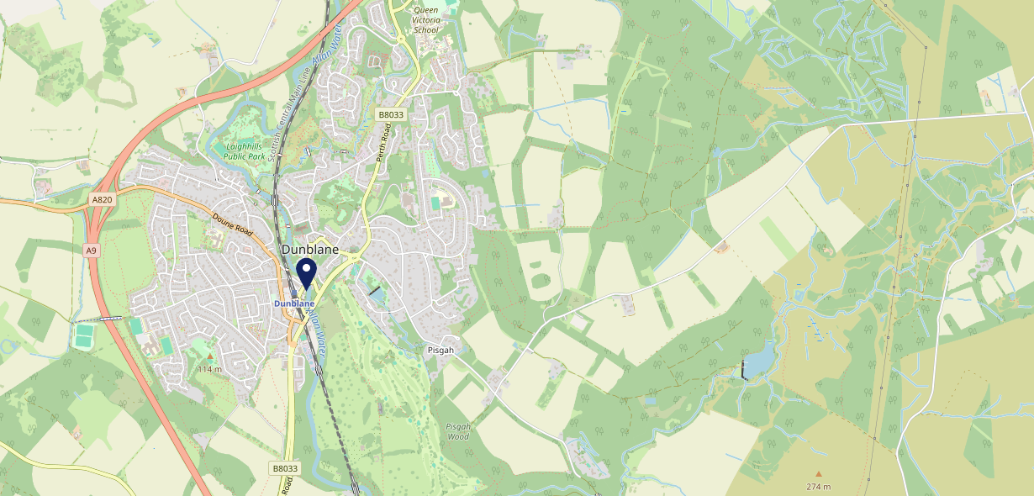









Site Intel
Dunblane Hotel FK159EP
3 Miles
1 Chain
12/02/2025 - 04/02/2026
Site Summary
Dunblane Hotel FK159EP
Work Area
Region
TV Region
Urbanicity
Falkirk and Stirling
Scotland
Scotland
Accessible small town
FK159EP
Punch T&L
Top Competitors
ATV
Gender
#1
£9.46
90.00%
Male
Affluence
Segmentation
#2
51.00%
34.88%
High Income
Flourishing Society
Age Group
Visit Day
#3
57.96%
24.20%
55 to 64
Sat
Nearest Station
Dunblane(0.05 miles)
556 Site Customers
1 Competitors
3045 Competitor Customers

Slide 2

Site Intel
Dunblane Hotel FK159EP
3 Miles
1 Chain
12/02/2025 - 04/02/2026
Spend by Weekpart
How is customer spend distributed throughout the week for Dunblane Hotel FK159EP versus its competitors?
% of spend for Dunblane Hotel FK159EP and 1 Chains in 3 Miles from 12/02/2025 - 04/02/2026 split by Day of Week
556 Site Customers
1 Competitors
3045 Competitor Customers

Slide 3
Site Intel
Dunblane Hotel FK159EP
3 Miles
1 Chain
12/02/2025 - 04/02/2026
Visit Frequency
How frequently per year do customers visit Dunblane Hotel FK159EP versus its competitors?
% of customer numbers for Dunblane Hotel FK159EP and 1 Chains in 3 Miles from 12/02/2025 - 04/02/2026 and the number of visits made Per Annum
556 Site Customers
1 Competitors
3045 Competitor Customers

Slide 4
Site Intel
Dunblane Hotel FK159EP
3 Miles
1 Chain
12/02/2025 - 04/02/2026
ATV Change
How has ATV changed between two date ranges?
556 Site Customers

Slide 5
Site Intel
Dunblane Hotel FK159EP
3 Miles
1 Chain
12/02/2025 - 04/02/2026
Market Share Change
How has market share changed between two date ranges?
% of market share spend for Dunblane Hotel FK159EP and 1 Chains in 3 Miles from 12/02/2025 - 04/02/2026
556 Site Customers

Slide 6
Site Intel
Dunblane Hotel FK159EP
3 Miles
1 Chain
12/02/2025 - 04/02/2026
Age
How does the age profile of customers who visit Dunblane Hotel FK159EP compare versus its competitors?
% of spend for Dunblane Hotel FK159EP and 1 Chains in 3 Miles from 12/02/2025 - 04/02/2026 split by Age Range
240 Site Customers
1 Competitors
1330 Competitor Customers

Slide 7
Site Intel
Dunblane Hotel FK159EP
3 Miles
1 Chain
12/02/2025 - 04/02/2026
Affluence
How does the affluence of customers who visit Dunblane Hotel FK159EP compare versus its competitors?
% of spend for Dunblane Hotel FK159EP and 1 Chains in 3 Miles from 12/02/2025 - 04/02/2026 split by Affluence
226 Site Customers
1 Competitors
1251 Competitor Customers

Slide 8
Site Intel
Dunblane Hotel FK159EP
3 Miles
1 Chain
12/02/2025 - 04/02/2026
Gender
How does the gender profile of customers who visit Dunblane Hotel FK159EP compare versus its competitors?
% of spend for Dunblane Hotel FK159EP and 1 Chains in 3 Miles from 12/02/2025 - 04/02/2026 split by Gender
234 Site Customers
1 Competitors
1303 Competitor Customers

Slide 9
Site Intel
Dunblane Hotel FK159EP
3 Miles
1 Chain
12/02/2025 - 04/02/2026
Punch Segmentation
How does the Custom segmentation profile of customers who visit Dunblane Hotel FK159EP compare versus its competitors?
% of spend for Dunblane Hotel FK159EP and 1 Chains in 3 Miles from 12/02/2025 - 04/02/2026 split by Segment
556 Site Customers
1 Competitors
3045 Competitor Customers

Slide 10
Site Intel
Dunblane Hotel FK159EP
3 Miles
1 Chain
12/02/2025 - 04/02/2026
Spend by Distance
How does the spend profile of Dunblane Hotel FK159EP compare versus its competitors based on travel distances?
% of spend for Dunblane Hotel FK159EP and 1 Chains in 3 Miles from 12/02/2025 - 04/02/2026 split by Distance travelled
233 Site Customers
1 Competitors
1298 Competitor Customers

Slide 11
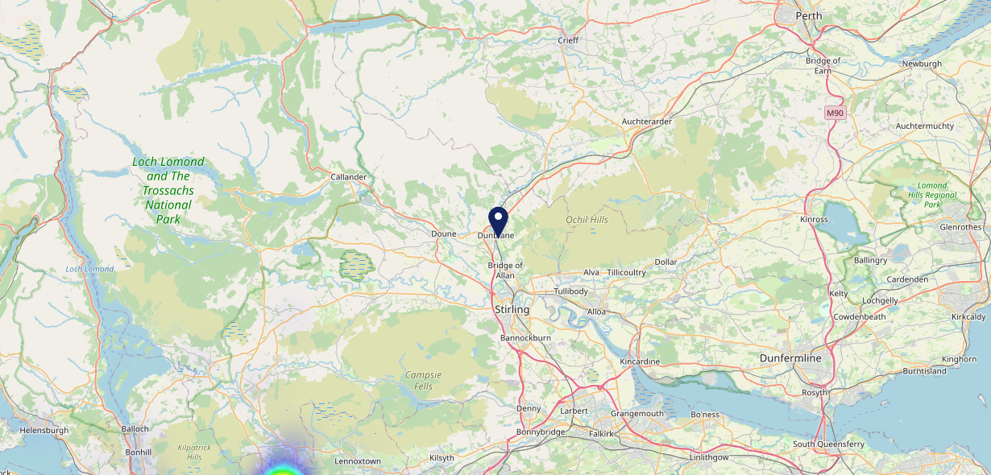

Site Intel
Dunblane Hotel FK159EP
12/02/2025 - 04/02/2026
Map of Guest Origin
Where do customers of Dunblane Hotel FK159EP come from?
Where do customers of Dunblane Hotel FK159EP for 12/02/2025 - 04/02/2026 live
233 Site Customers

Slide 12
Site Intel
Dunblane Hotel FK159EP
3 Miles
1 Chain
12/02/2025 - 04/02/2026
Share of Wallet
What are the Top 20 venues (by spend) that customers of Dunblane Hotel FK159EP also visit?
For customers of Dunblane Hotel FK159EP, who are the top 20 competitors from 1 Chains in 3 Miles for 12/02/2025 - 04/02/2026 split by Venue
556 Site Customers

Slide 13
Site Intel
Dunblane Hotel FK159EP
3 Miles
1 Chain
12/02/2025 - 04/02/2026
Share of Wallet Change
How has share of wallet of customers of Dunblane Hotel FK159EP changed between two date ranges?
556 Site Customers

Slide 14
Site Intel
Dunblane Hotel FK159EP
12/02/2025 - 04/02/2026
Market Summary
How does the local area for Dunblane Hotel FK159EP compare to the national average (1 = low, 10 = high)
Data Type | Name | Spend in 250m | 250m Spend vs National | Spend in 500m | 500m Spend vs National | Spend in 1 mile | 1 mile Spend vs National | Spend in 3 miles | 3 mile Spend vs National
Total | Annual Sales | £4.54M | 7 | £7.42M | 7 | £7.90M | 4 | £23.02M | 3
Weekpart | Mon - Thu | 39.5% | 5 | 40.1% | 5 | 40.6% | 5 | 38.5% | 2
Weekpart | Fri - Sat | 44.5% | 6 | 44.0% | 5 | 44.0% | 6 | 45.4% | 9
Weekpart | Sun | 15.9% | 7 | 15.9% | 7 | 15.4% | 6 | 16.1% | 7
Age | 18 to 24 | 1.6% | 2 | 2.0% | 2 | 2.2% | 1 | 2.8% | 1
Age | 25 to 34 | 6.5% | 1 | 6.9% | 1 | 7.0% | 1 | 8.1% | 1
Age | 35 to 44 | 11.6% | 1 | 12.9% | 1 | 13.8% | 1 | 14.5% | 1
Age | 45 to 54 | 19.8% | 5 | 20.7% | 6 | 21.2% | 7 | 24.4% | 10
Age | 55 to 64 | 29.6% | 10 | 28.2% | 10 | 27.5% | 10 | 25.7% | 10
Age | 65 to 74 | 20.9% | 10 | 20.4% | 10 | 19.8% | 10 | 16.7% | 10
Age | 75+ | 10.0% | 10 | 9.0% | 10 | 8.6% | 10 | 7.9% | 10
CAMEO | Business Elite | 27.0% | 10 | 26.8% | 10 | 26.0% | 10 | 23.9% | 10
CAMEO | Prosperous Professionals | 16.9% | 10 | 17.7% | 10 | 17.5% | 10 | 17.0% | 10
CAMEO | Flourishing Society | 23.5% | 9 | 25.0% | 10 | 24.9% | 10 | 25.5% | 10
CAMEO | Content Communities | 9.4% | 3 | 8.1% | 2 | 8.5% | 2 | 8.3% | 1
CAMEO | White Collar Neighbourhoods | 4.5% | 1 | 4.2% | 1 | 4.3% | 1 | 6.0% | 1
CAMEO | Enterprising Mainstream | 2.2% | 1 | 1.9% | 1 | 2.0% | 1 | 2.3% | 1
CAMEO | Paying The Mortgage | 9.9% | 3 | 9.6% | 2 | 9.5% | 2 | 8.7% | 1
CAMEO | Cash Conscious Communities | 2.8% | 1 | 2.6% | 1 | 2.8% | 1 | 3.0% | 1
CAMEO | On A Budget | 2.6% | 2 | 2.6% | 2 | 3.0% | 1 | 3.3% | 1
CAMEO | Family Value | 1.3% | 4 | 1.4% | 4 | 1.4% | 4 | 2.1% | 5
Affluence | AB | 67.4% | 10 | 69.5% | 10 | 68.4% | 10 | 66.4% | 10
Affluence | C1C2 | 26.0% | 1 | 23.9% | 1 | 24.4% | 1 | 25.2% | 1
Affluence | DE | 6.7% | 1 | 6.6% | 1 | 7.2% | 1 | 8.4% | 1

Slide 15

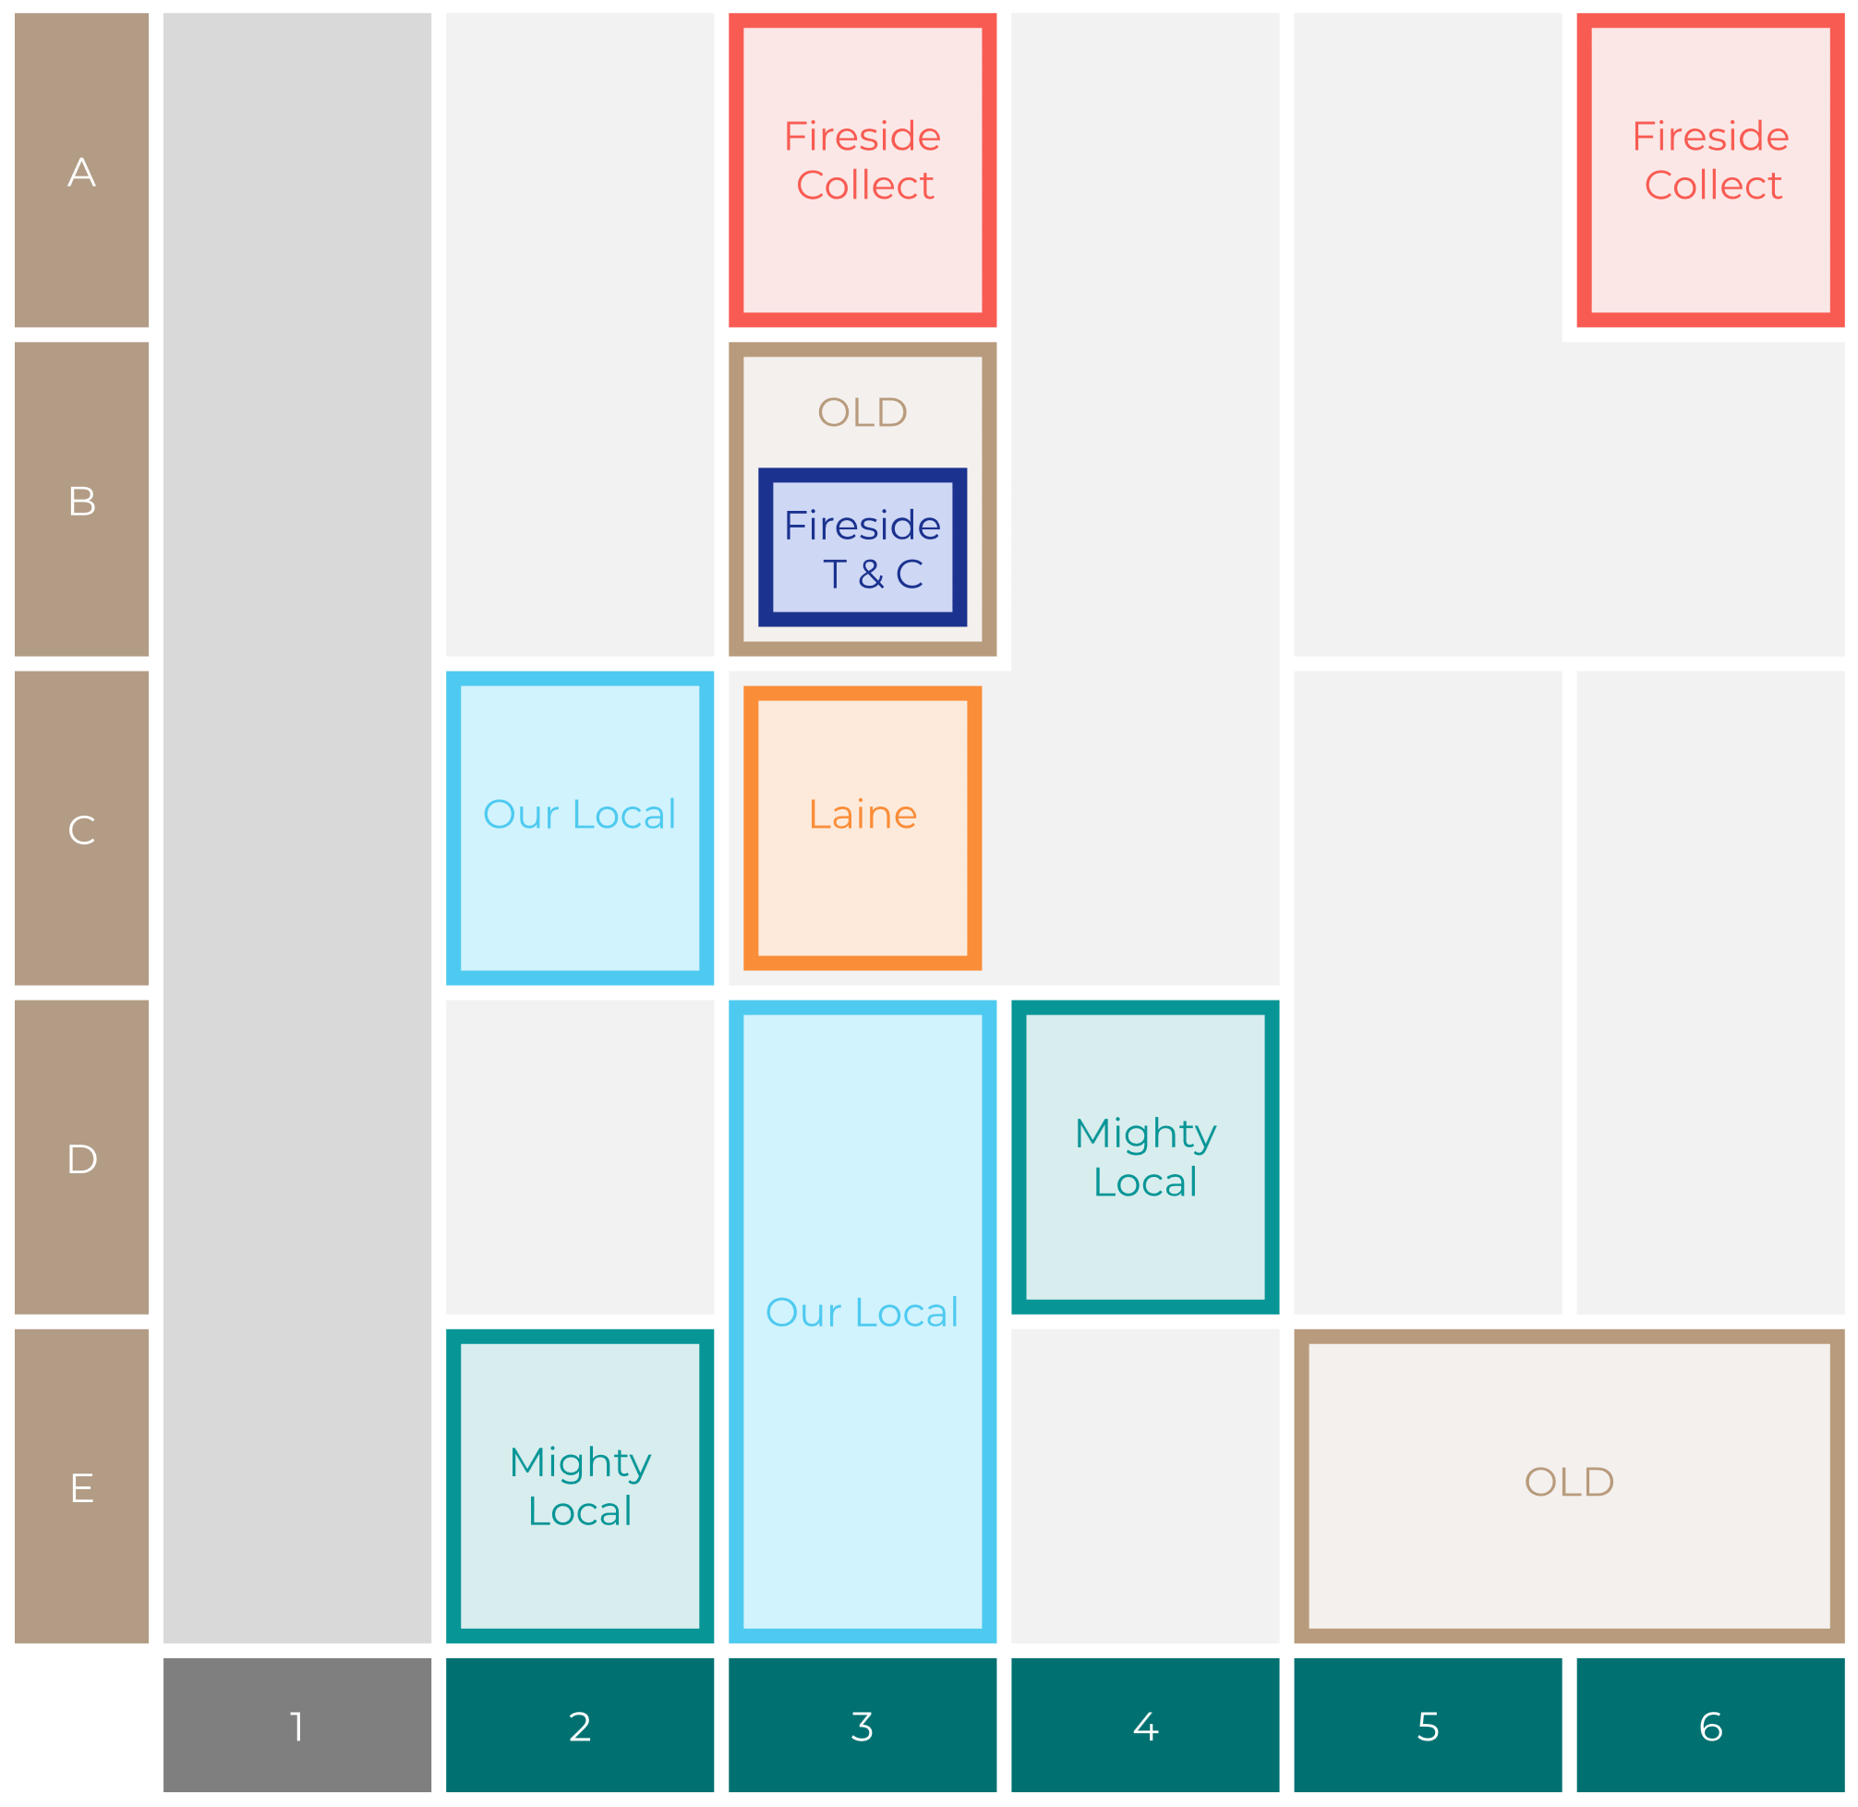

Site Intel
Dunblane Hotel FK159EP
Site Potential 1
Site Characteristics
£3000
£18000
OCC Concept Fit
Achievable Average Weekly Takings
Non-Core
£11000
A Food-Led High Affluence B Food-Led Mid Affluence C Wet-Led Mid/High Affluence D Wet-Led Low Affluence E Food-Led Low Affluence
AWT 2 Local Regulars 3 Local Passing Trade 4 Destination Wet-Led 5 Destination Food-Led 6 Destination Very Food-Led
A
B
C
D
E
1
2
3
4
5
6

Slide 16
Site Intel
Dunblane Hotel FK159EP
Site Potential 2
Concept Recommendation

Slide 17
Site Intel
Dunblane Hotel FK159EP
Local Market Profile
Mix of spend by customer segment in Punch site and local market
 | Customer Count | Family Familiar | Occasional & Local | Mid-Week Seniors | Part Of The Pub | Metro Sophisticates | Young & Connected | Bubbly Weekenders | Upmarket Diners
Dunblane Hotel | 98 | 13.87% | 1.72% | 23.27% | 41.02% | 1.48% | 1.21% | 8.21% | 9.17%
Local Catchment | 291 | 1.54% | 6.10% | 44.61% | 0.27% | 8.95% | 6.18% | 14.35% | 17.95%
Punch T&L | 95120 | 8.97% | 6.12% | 29.01% | 11.18% | 11.00% | 11.13% | 7.13% | 15.42%
Dunblane Hotel vs Local Catchment |  | 12.33% | -4.38% | -21.34% | 40.75% | -7.47% | -4.97% | -6.14% | -8.78%
Dunblane Hotel vs Punch T&L |  | 4.90% | -4.40% | -5.74% | 29.84% | -9.52% | -9.92% | 1.08% | -6.25%
Local Catchment vs Punch T&L |  | -7.43% | -0.02% | 15.60% | -10.91% | -2.05% | -4.95% | 7.22% | 2.53%

Slide 18
Site Intel
Dunblane Hotel FK159EP
Local Competitor Profiles
Mix of spend by customer segment in Punch site and local competitors
 | Customer Count | Family Familiar | Occasional & Local | Mid-Week Seniors | Part Of The Pub | Metro Sophisticates | Young & Connected | Bubbly Weekenders | Upmarket Diners
Dunblane Hotel FK159EP | 98 | 13.87% | 1.72% | 23.27% | 41.02% | 1.48% | 1.21% | 8.21% | 9.17%

