Slide 1
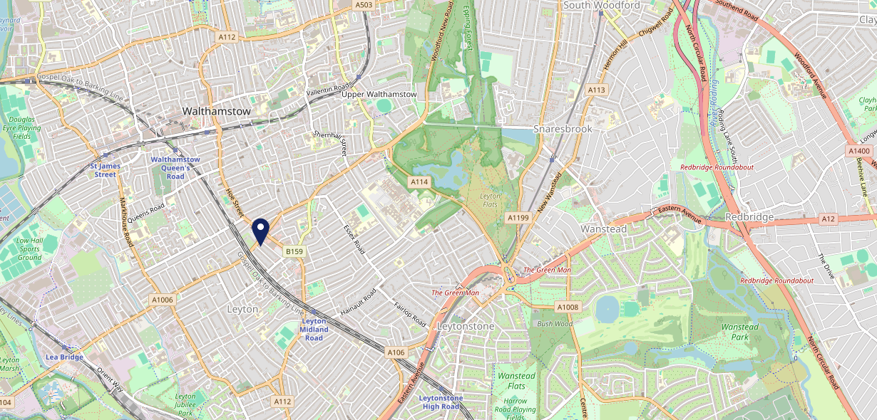
Site Intel
Auctioneer E107DN
1 Miles
371 Chains
16/04/2025 - 08/04/2026
Site Summary
Auctioneer E107DN
Work Area
Region
TV Region
Urbanicity
London
London
London
Urban major conurbation
E107DN
Punch Unity
Top Competitors
ATV
Gender
Coach & Horses
#1
£8.99
86.97%
Male
E105NA
Pub / Bar
Affluence
Segmentation
William the Fourth
#2
56.56%
37.47%
Low Income
On A Budget
E106AE
Pub Restaurant
Age Group
Visit Day
Goose Walthamstow
#3
31.69%
36.65%
E173AX
55 to 64
Fri
Proper Pubs
Nearest Station
Leyton Midland Road(0.66 miles)
95 Site Customers
834 Competitors
250664 Competitor Customers

Slide 2
Site Intel
Auctioneer E107DN
1 Miles
371 Chains
16/04/2025 - 08/04/2026
Spend by Weekpart
How is customer spend distributed throughout the week for Auctioneer E107DN versus its competitors?
% of spend for Auctioneer E107DN and 371 Chains in 1 Miles from 16/04/2025 - 08/04/2026 split by Day of Week
95 Site Customers
834 Competitors
250664 Competitor Customers

Slide 3
Site Intel
Auctioneer E107DN
1 Miles
371 Chains
16/04/2025 - 08/04/2026
Visit Frequency
How frequently per year do customers visit Auctioneer E107DN versus its competitors?
% of customer numbers for Auctioneer E107DN and 371 Chains in 1 Miles from 16/04/2025 - 08/04/2026 and the number of visits made Per Annum
95 Site Customers
834 Competitors
250664 Competitor Customers

Slide 4
Site Intel
Auctioneer E107DN
1 Miles
371 Chains
16/04/2025 - 08/04/2026
ATV Change
How has ATV changed between two date ranges?
95 Site Customers

Slide 5
Site Intel
Auctioneer E107DN
1 Miles
371 Chains
16/04/2025 - 08/04/2026
Market Share Change
How has market share changed between two date ranges?
% of market share spend for Auctioneer E107DN and 371 Chains in 1 Miles from 16/04/2025 - 08/04/2026
95 Site Customers

Slide 6
Site Intel
Auctioneer E107DN
1 Miles
371 Chains
16/04/2025 - 08/04/2026
Age
How does the age profile of customers who visit Auctioneer E107DN compare versus its competitors?
% of spend for Auctioneer E107DN and 371 Chains in 1 Miles from 16/04/2025 - 08/04/2026 split by Age Range
34 Site Customers
834 Competitors
94754 Competitor Customers

Slide 7
Site Intel
Auctioneer E107DN
1 Miles
371 Chains
16/04/2025 - 08/04/2026
Affluence
How does the affluence of customers who visit Auctioneer E107DN compare versus its competitors?
% of spend for Auctioneer E107DN and 371 Chains in 1 Miles from 16/04/2025 - 08/04/2026 split by Affluence
29 Site Customers
834 Competitors
86746 Competitor Customers

Slide 8
Site Intel
Auctioneer E107DN
1 Miles
371 Chains
16/04/2025 - 08/04/2026
Gender
How does the gender profile of customers who visit Auctioneer E107DN compare versus its competitors?
% of spend for Auctioneer E107DN and 371 Chains in 1 Miles from 16/04/2025 - 08/04/2026 split by Gender
30 Site Customers
834 Competitors
90344 Competitor Customers

Slide 9
Site Intel
Auctioneer E107DN
1 Miles
371 Chains
16/04/2025 - 08/04/2026
Punch Segmentation
How does the Custom segmentation profile of customers who visit Auctioneer E107DN compare versus its competitors?
% of spend for Auctioneer E107DN and 371 Chains in 1 Miles from 16/04/2025 - 08/04/2026 split by Segment
95 Site Customers
834 Competitors
250664 Competitor Customers

Slide 10
Site Intel
Auctioneer E107DN
1 Miles
371 Chains
16/04/2025 - 08/04/2026
Spend by Distance
How does the spend profile of Auctioneer E107DN compare versus its competitors based on travel distances?
% of spend for Auctioneer E107DN and 371 Chains in 1 Miles from 16/04/2025 - 08/04/2026 split by Distance travelled
30 Site Customers
834 Competitors
90222 Competitor Customers

Slide 11
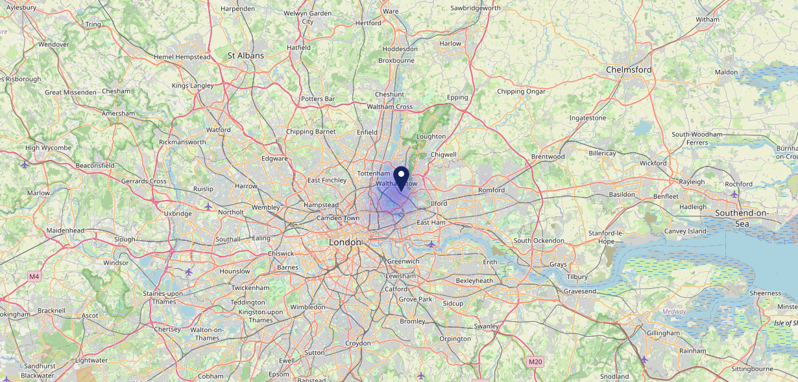
Site Intel
Auctioneer E107DN
16/04/2025 - 08/04/2026
Map of Guest Origin
Where do customers of Auctioneer E107DN come from?
Where do customers of Auctioneer E107DN for 16/04/2025 - 08/04/2026 live
30 Site Customers

Slide 12
Site Intel
Auctioneer E107DN
1 Miles
371 Chains
16/04/2025 - 08/04/2026
Share of Wallet
What are the Top 20 venues (by spend) that customers of Auctioneer E107DN also visit?
For customers of Auctioneer E107DN, who are the top 20 competitors from 371 Chains in 1 Miles for 16/04/2025 - 08/04/2026 split by Venue
95 Site Customers

Slide 13
Site Intel
Auctioneer E107DN
1 Miles
371 Chains
16/04/2025 - 08/04/2026
Share of Wallet Change
How has share of wallet of customers of Auctioneer E107DN changed between two date ranges?
95 Site Customers

Slide 14
Site Intel
Auctioneer E107DN
16/04/2025 - 08/04/2026
Market Summary
How does the local area for Auctioneer E107DN compare to the national average (1 = low, 10 = high)
Data Type | Name | Spend in 250m | 250m Spend vs National | Spend in 500m | 500m Spend vs National | Spend in 1 mile | 1 mile Spend vs National | Spend in 3 miles | 3 mile Spend vs National
Total | Annual Sales | £6.48M | 8 | £7.97M | 7 | £72.87M | 9 | £576.71M | 9
Weekpart | Mon - Thu | 44.0% | 7 | 43.2% | 7 | 41.8% | 6 | 41.7% | 6
Weekpart | Fri - Sat | 38.6% | 3 | 38.9% | 3 | 41.5% | 4 | 41.9% | 5
Weekpart | Sun | 17.5% | 8 | 17.9% | 9 | 16.7% | 8 | 16.3% | 7
Age | 18 to 24 | 8.0% | 7 | 7.3% | 7 | 3.8% | 2 | 5.1% | 3
Age | 25 to 34 | 23.7% | 6 | 23.7% | 6 | 21.3% | 5 | 19.5% | 3
Age | 35 to 44 | 35.4% | 10 | 35.7% | 10 | 36.5% | 10 | 30.4% | 10
Age | 45 to 54 | 16.7% | 3 | 17.2% | 2 | 18.8% | 3 | 20.4% | 6
Age | 55 to 64 | 10.3% | 2 | 10.6% | 2 | 11.9% | 2 | 15.4% | 6
Age | 65 to 74 | 5.0% | 4 | 4.7% | 3 | 6.2% | 5 | 6.8% | 6
Age | 75+ | 0.9% | 3 | 0.8% | 2 | 1.5% | 3 | 2.4% | 5
CAMEO | Business Elite | 3.8% | 4 | 3.7% | 3 | 6.0% | 5 | 9.2% | 6
CAMEO | Prosperous Professionals | 1.0% | 1 | 1.0% | 1 | 2.0% | 1 | 3.5% | 2
CAMEO | Flourishing Society | 3.3% | 1 | 3.3% | 1 | 5.7% | 2 | 10.6% | 4
CAMEO | Content Communities | 4.2% | 1 | 4.6% | 1 | 6.2% | 1 | 9.3% | 2
CAMEO | White Collar Neighbourhoods | 10.9% | 5 | 11.3% | 5 | 15.1% | 9 | 12.9% | 8
CAMEO | Enterprising Mainstream | 4.3% | 3 | 4.9% | 3 | 5.8% | 4 | 4.7% | 2
CAMEO | Paying The Mortgage | 36.0% | 10 | 34.9% | 10 | 31.3% | 10 | 19.6% | 9
CAMEO | Cash Conscious Communities | 20.6% | 10 | 20.6% | 10 | 16.5% | 10 | 17.6% | 10
CAMEO | On A Budget | 15.0% | 10 | 15.0% | 10 | 10.7% | 9 | 11.5% | 9
CAMEO | Family Value | 0.7% | 2 | 0.8% | 2 | 0.6% | 1 | 1.1% | 3
Affluence | AB | 8.2% | 1 | 7.9% | 1 | 13.7% | 2 | 23.3% | 4
Affluence | C1C2 | 55.5% | 8 | 55.7% | 8 | 58.4% | 9 | 46.5% | 4
Affluence | DE | 36.3% | 9 | 36.4% | 9 | 27.9% | 8 | 30.2% | 9

