Slide 1
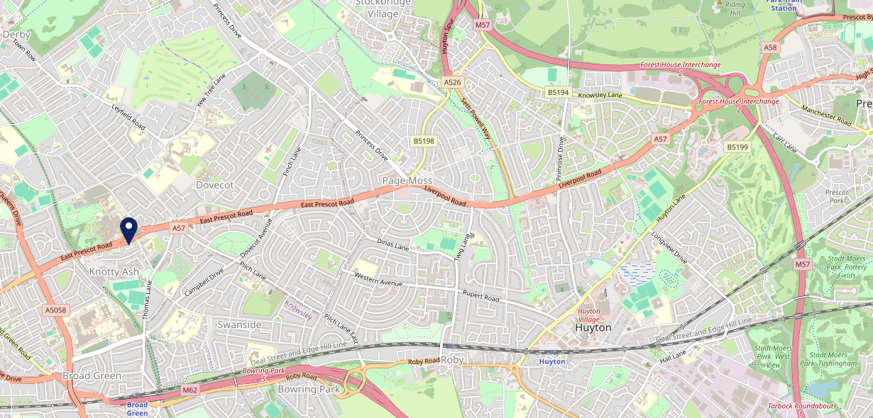
Site Intel
Wheatsheaf L145NG
1 Miles
371 Chains
16/04/2025 - 08/04/2026
Site Summary
Wheatsheaf L145NG
Work Area
Region
TV Region
Urbanicity
Liverpool
North West
North West
Urban major conurbation
L145NG
Punch - Our Local
Top Competitors
ATV
Gender
The Navigator
#1
£9.29
64.72%
Male
L135UH
JD Wetherspoon
Affluence
Segmentation
The Turnpike
#2
51.46%
19.53%
Middle Income
Paying The Mortgage
L143PL
Sizzling
Age Group
Visit Day
Royal Standard (West Derby)
#3
31.21%
29.15%
L129EY
35 to 44
Fri
GK - Pub & Social
Nearest Station
Broad Green(1.21 miles)
438 Site Customers
146 Competitors
45457 Competitor Customers

Slide 2
Site Intel
Wheatsheaf L145NG
1 Miles
371 Chains
16/04/2025 - 08/04/2026
Spend by Weekpart
How is customer spend distributed throughout the week for Wheatsheaf L145NG versus its competitors?
% of spend for Wheatsheaf L145NG and 371 Chains in 1 Miles from 16/04/2025 - 08/04/2026 split by Day of Week
438 Site Customers
146 Competitors
45457 Competitor Customers

Slide 3
Site Intel
Wheatsheaf L145NG
1 Miles
371 Chains
16/04/2025 - 08/04/2026
Visit Frequency
How frequently per year do customers visit Wheatsheaf L145NG versus its competitors?
% of customer numbers for Wheatsheaf L145NG and 371 Chains in 1 Miles from 16/04/2025 - 08/04/2026 and the number of visits made Per Annum
438 Site Customers
146 Competitors
45457 Competitor Customers

Slide 4
Site Intel
Wheatsheaf L145NG
1 Miles
371 Chains
16/04/2025 - 08/04/2026
ATV Change
How has ATV changed between two date ranges?
438 Site Customers

Slide 5
Site Intel
Wheatsheaf L145NG
1 Miles
371 Chains
16/04/2025 - 08/04/2026
Market Share Change
How has market share changed between two date ranges?
% of market share spend for Wheatsheaf L145NG and 371 Chains in 1 Miles from 16/04/2025 - 08/04/2026
438 Site Customers

Slide 6
Site Intel
Wheatsheaf L145NG
1 Miles
371 Chains
16/04/2025 - 08/04/2026
Age
How does the age profile of customers who visit Wheatsheaf L145NG compare versus its competitors?
% of spend for Wheatsheaf L145NG and 371 Chains in 1 Miles from 16/04/2025 - 08/04/2026 split by Age Range
199 Site Customers
146 Competitors
19302 Competitor Customers

Slide 7
Site Intel
Wheatsheaf L145NG
1 Miles
371 Chains
16/04/2025 - 08/04/2026
Affluence
How does the affluence of customers who visit Wheatsheaf L145NG compare versus its competitors?
% of spend for Wheatsheaf L145NG and 371 Chains in 1 Miles from 16/04/2025 - 08/04/2026 split by Affluence
186 Site Customers
146 Competitors
18131 Competitor Customers

Slide 8
Site Intel
Wheatsheaf L145NG
1 Miles
371 Chains
16/04/2025 - 08/04/2026
Gender
How does the gender profile of customers who visit Wheatsheaf L145NG compare versus its competitors?
% of spend for Wheatsheaf L145NG and 371 Chains in 1 Miles from 16/04/2025 - 08/04/2026 split by Gender
190 Site Customers
146 Competitors
18699 Competitor Customers

Slide 9
Site Intel
Wheatsheaf L145NG
1 Miles
371 Chains
16/04/2025 - 08/04/2026
Punch Segmentation
How does the Custom segmentation profile of customers who visit Wheatsheaf L145NG compare versus its competitors?
% of spend for Wheatsheaf L145NG and 371 Chains in 1 Miles from 16/04/2025 - 08/04/2026 split by Segment
438 Site Customers
146 Competitors
45457 Competitor Customers

Slide 10
Site Intel
Wheatsheaf L145NG
1 Miles
371 Chains
16/04/2025 - 08/04/2026
Spend by Distance
How does the spend profile of Wheatsheaf L145NG compare versus its competitors based on travel distances?
% of spend for Wheatsheaf L145NG and 371 Chains in 1 Miles from 16/04/2025 - 08/04/2026 split by Distance travelled
190 Site Customers
146 Competitors
18688 Competitor Customers

Slide 11
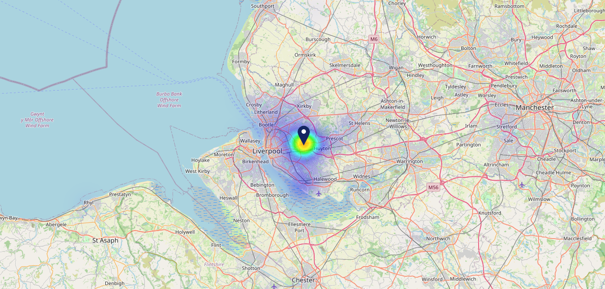
Site Intel
Wheatsheaf L145NG
16/04/2025 - 08/04/2026
Map of Guest Origin
Where do customers of Wheatsheaf L145NG come from?
Where do customers of Wheatsheaf L145NG for 16/04/2025 - 08/04/2026 live
190 Site Customers

Slide 12
Site Intel
Wheatsheaf L145NG
1 Miles
371 Chains
16/04/2025 - 08/04/2026
Share of Wallet
What are the Top 20 venues (by spend) that customers of Wheatsheaf L145NG also visit?
For customers of Wheatsheaf L145NG, who are the top 20 competitors from 371 Chains in 1 Miles for 16/04/2025 - 08/04/2026 split by Venue
438 Site Customers

Slide 13
Site Intel
Wheatsheaf L145NG
1 Miles
371 Chains
16/04/2025 - 08/04/2026
Share of Wallet Change
How has share of wallet of customers of Wheatsheaf L145NG changed between two date ranges?
438 Site Customers

Slide 14
Site Intel
Wheatsheaf L145NG
16/04/2025 - 08/04/2026
Market Summary
How does the local area for Wheatsheaf L145NG compare to the national average (1 = low, 10 = high)
Data Type | Name | Spend in 250m | 250m Spend vs National | Spend in 500m | 500m Spend vs National | Spend in 1 mile | 1 mile Spend vs National | Spend in 3 miles | 3 mile Spend vs National
Total | Annual Sales | £468K | 3 | £1.09M | 4 | £16.46M | 6 | £192.61M | 8
Weekpart | Mon - Thu | 41.1% | 6 | 51.2% | 10 | 44.2% | 8 | 44.3% | 8
Weekpart | Fri - Sat | 47.2% | 7 | 38.3% | 2 | 39.4% | 3 | 40.1% | 3
Weekpart | Sun | 11.7% | 3 | 10.5% | 2 | 16.4% | 8 | 15.7% | 5
Age | 18 to 24 | 1.8% | 2 | 2.0% | 2 | 3.5% | 2 | 5.1% | 3
Age | 25 to 34 | 12.7% | 2 | 14.5% | 2 | 15.5% | 2 | 17.9% | 2
Age | 35 to 44 | 29.9% | 9 | 28.2% | 9 | 26.1% | 8 | 27.5% | 10
Age | 45 to 54 | 27.6% | 10 | 19.4% | 5 | 23.2% | 9 | 18.6% | 3
Age | 55 to 64 | 14.3% | 5 | 19.4% | 8 | 20.5% | 9 | 18.5% | 9
Age | 65 to 74 | 8.8% | 7 | 10.7% | 9 | 8.8% | 8 | 9.2% | 8
Age | 75+ | 4.9% | 9 | 5.8% | 9 | 2.4% | 5 | 3.2% | 7
CAMEO | Business Elite | 0.2% | 1 | 1.4% | 1 | 2.1% | 2 | 4.7% | 3
CAMEO | Prosperous Professionals | 0.5% | 1 | 1.2% | 1 | 1.7% | 1 | 3.6% | 2
CAMEO | Flourishing Society | 2.9% | 1 | 3.0% | 1 | 3.6% | 1 | 5.6% | 1
CAMEO | Content Communities | 6.1% | 1 | 5.5% | 1 | 5.0% | 1 | 6.6% | 1
CAMEO | White Collar Neighbourhoods | 15.3% | 9 | 15.2% | 9 | 9.8% | 4 | 14.2% | 9
CAMEO | Enterprising Mainstream | 6.9% | 5 | 8.2% | 6 | 7.3% | 5 | 7.7% | 5
CAMEO | Paying The Mortgage | 19.2% | 8 | 20.4% | 9 | 19.3% | 9 | 15.9% | 7
CAMEO | Cash Conscious Communities | 16.7% | 9 | 17.2% | 10 | 18.6% | 10 | 12.7% | 9
CAMEO | On A Budget | 12.7% | 9 | 12.3% | 9 | 17.7% | 10 | 14.6% | 10
CAMEO | Family Value | 19.7% | 10 | 15.6% | 10 | 14.9% | 10 | 14.3% | 10
Affluence | AB | 3.6% | 1 | 5.6% | 1 | 7.3% | 1 | 13.9% | 2
Affluence | C1C2 | 47.4% | 5 | 49.3% | 6 | 41.4% | 3 | 44.5% | 4
Affluence | DE | 49.1% | 10 | 45.1% | 10 | 51.2% | 10 | 41.6% | 10

Slide 15
Site Intel
Wheatsheaf L145NG
Site Potential 1
Site Characteristics
£3000
£18000
OCC Concept Fit
Achievable Average Weekly Takings
Non-Core
£10500
A Food-Led High Affluence B Food-Led Mid Affluence C Wet-Led Mid/High Affluence D Wet-Led Low Affluence E Food-Led Low Affluence
AWT 2 Local Regulars 3 Local Passing Trade 4 Destination Wet-Led 5 Destination Food-Led 6 Destination Very Food-Led
A
B
C
D
E
1
2
3
4
5
6

Slide 16
Site Intel
Wheatsheaf L145NG
Site Potential 2
Concept Recommendation

Slide 17
Site Intel
Wheatsheaf L145NG
Local Market Profile
Mix of spend by customer segment in Punch site and local market
 | Customer Count | Family Familiar | Occasional & Local | Mid-Week Seniors | Part Of The Pub | Metro Sophisticates | Young & Connected | Bubbly Weekenders | Upmarket Diners
Wheatsheaf | 92 | 18.13% | 26.20% | 14.35% | 19.00% | 2.90% | 7.51% | 5.97% | 5.88%
Local Catchment | 3519 | 29.25% | 9.42% | 5.93% | 20.47% | 5.77% | 12.87% | 11.07% | 5.17%
Punch T&L | 95687 | 8.84% | 6.07% | 28.69% | 10.97% | 11.46% | 11.00% | 7.08% | 15.85%
Wheatsheaf vs Local Catchment |  | -11.12% | 16.78% | 8.42% | -1.47% | -2.87% | -5.36% | -5.10% | 0.71%
Wheatsheaf vs Punch T&L |  | 9.29% | 20.13% | -14.34% | 8.03% | -8.56% | -3.49% | -1.11% | -9.97%
Local Catchment vs Punch T&L |  | 20.41% | 3.35% | -22.76% | 9.50% | -5.69% | 1.87% | 3.99% | -10.68%

Slide 18
Site Intel
Wheatsheaf L145NG
Local Competitor Profiles
Mix of spend by customer segment in Punch site and local competitors
 | Customer Count | Family Familiar | Occasional & Local | Mid-Week Seniors | Part Of The Pub | Metro Sophisticates | Young & Connected | Bubbly Weekenders | Upmarket Diners
Wheatsheaf L145NG | 92 | 18.13% | 26.20% | 14.35% | 19.00% | 2.90% | 7.51% | 5.97% | 5.88%
The Navigator L135UH | 307 | 20.82% | 6.94% | 3.71% | 31.30% | 3.08% | 26.34% | 6.51% | 1.25%
The Turnpike L143PL | 306 | 18.78% | 23.05% | 4.26% | 29.94% | 4.46% | 10.11% | 7.26% | 2.10%
Royal Standard (West Derby) L129EY | 253 | 34.33% | 6.10% | 10.02% | 4.83% | 8.03% | 14.71% | 14.61% | 7.34%
KFC Liverpool East Prescott Road L142DE | 476 | 55.18% | 5.40% | 3.87% | 3.04% | 4.65% | 12.05% | 12.11% | 3.67%
Black Horse (Old Swan) L135XD | 201 | 10.06% | 11.07% | 1.90% | 53.90% | 4.68% | 11.02% | 6.46% | 0.87%
Nog Group L122AH | 99 | 40.91% | 3.10% | 13.17% | 3.21% | 4.20% | 15.89% | 7.01% | 12.48%
Masons Arms (Old Swan) L135XE | 144 | 16.82% | 14.14% | 0.80% | 58.80% | 1.52% | 5.41% | 2.48% | 0.00%
Rangoli Restaurant L147NH | 47 | 50.62% | 4.41% | 10.15% | 2.16% | 3.58% | 10.45% | 10.80% | 7.79%
Bulldog (Liverpool) L129HB | 62 | 45.06% | 1.95% | 5.73% | 25.29% | 8.86% | 7.01% | 2.02% | 4.05%
Toby Carvery Stoneycroft L130AS | 478 | 41.46% | 10.57% | 11.73% | 5.74% | 4.30% | 15.35% | 7.32% | 3.50%
Old Swan Liverpool L135SA | 115 | 16.56% | 7.68% | 1.05% | 58.08% | 1.98% | 9.41% | 4.90% | 0.30%
George Scott Snooker Club L136QA | 50 | 22.68% | 1.61% | 12.88% | 12.72% | 3.89% | 1.42% | 43.91% | 0.86%
Old Tavern L135XG | 54 | 3.82% | 2.52% | 2.18% | 86.11% | 0.34% | 1.13% | 3.86% | 0.00%
Dilan Bbq And Steak L122AH | 40 | 28.93% | 2.81% | 16.90% | 8.15% | 1.84% | 19.20% | 8.95% | 13.17%
Rocket (Liverpool) L143PA | 169 | 12.01% | 12.86% | 2.29% | 29.53% | 16.02% | 11.71% | 5.71% | 9.83%
Subway L142DD | 156 | 39.51% | 3.27% | 2.89% | 1.00% | 6.73% | 12.43% | 13.79% | 20.34%
Burger King L142DE | 280 | 41.18% | 5.54% | 6.35% | 2.04% | 4.17% | 20.45% | 15.12% | 5.12%
Knotty Ash Cafe Bistro L145NG | 18 | 20.50% | 14.33% | 4.38% | 11.96% | 3.31% | 31.64% | 13.84% | 0.00%
Costa Coffee L135XE | 136 | 29.47% | 13.67% | 8.97% | 1.15% | 4.50% | 11.72% | 29.08% | 1.40%
Dilan Cafe Bistro Wi L122AH | 39 | 21.34% | 9.81% | 12.67% | 12.32% | 10.11% | 14.39% | 9.01% | 10.31%
Timothys L141PW | 26 | 31.20% | 28.75% | 1.11% | 7.11% | 0.00% | 26.60% | 5.18% | 0.00%
Butterfingers L147QH | 49 | 48.86% | 4.09% | 0.84% | 5.34% | 34.34% | 1.75% | 3.96% | 0.78%
Greggs L135UR | 253 | 32.56% | 8.97% | 4.60% | 9.59% | 3.51% | 23.32% | 15.38% | 2.03%
Tsthi Kitty Old Swan L141PW | 42 | 50.10% | 7.57% | 0.00% | 2.35% | 3.46% | 21.30% | 13.86% | 1.33%

