Slide 1










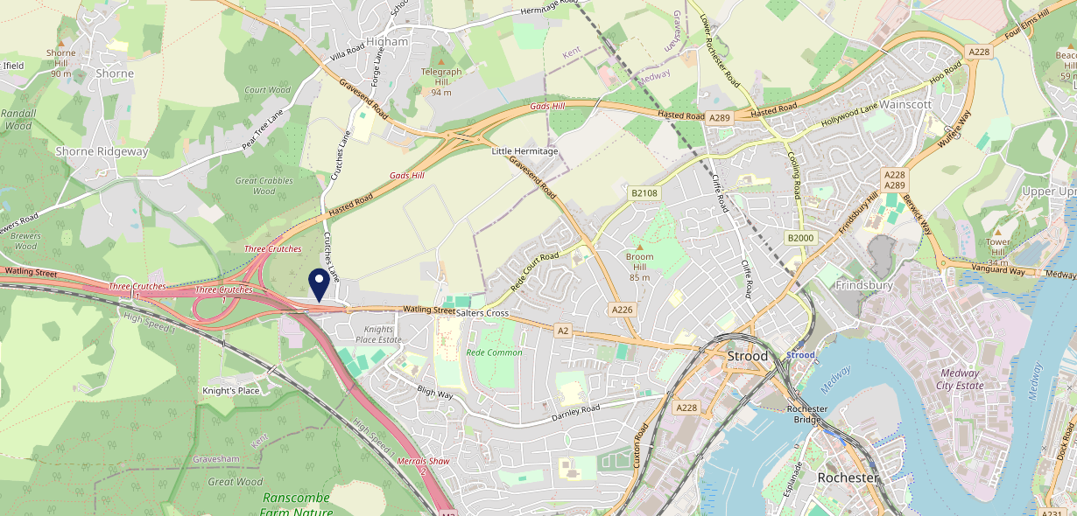









Site Intel
Three Crutches ME23UG
1 Miles
1 Chain
05/02/2025 - 28/01/2026
Site Summary
Three Crutches ME23UG
Work Area
Region
TV Region
Urbanicity
London
South East
South
Urban city and town
ME23UG
Punch - Fireside Inns
Top Competitors
ATV
Gender
#1
£20.69
68.79%
Male
Affluence
Segmentation
#2
42.73%
23.94%
Middle Income
Flourishing Society
Age Group
Visit Day
#3
23.88%
20.70%
35 to 44
Fri
Nearest Station
Cuxton(2.87 miles)
1342 Site Customers
0 Competitors
0 Competitor Customers

Slide 2

Site Intel
Three Crutches ME23UG
1 Miles
1 Chain
05/02/2025 - 28/01/2026
Spend by Weekpart
How is customer spend distributed throughout the week for Three Crutches ME23UG versus its competitors?
% of spend for Three Crutches ME23UG and 1 Chains in 1 Miles from 05/02/2025 - 28/01/2026 split by Day of Week
1342 Site Customers
0 Competitors
0 Competitor Customers

Slide 3
Site Intel
Three Crutches ME23UG
1 Miles
1 Chain
05/02/2025 - 28/01/2026
Visit Frequency
How frequently per year do customers visit Three Crutches ME23UG versus its competitors?
% of customer numbers for Three Crutches ME23UG and 1 Chains in 1 Miles from 05/02/2025 - 28/01/2026 and the number of visits made Per Annum
1342 Site Customers
0 Competitors
0 Competitor Customers

Slide 4
Site Intel
Three Crutches ME23UG
1 Miles
1 Chain
05/02/2025 - 28/01/2026
ATV Change
How has ATV changed between two date ranges?
1342 Site Customers

Slide 5
Site Intel
Three Crutches ME23UG
1 Miles
1 Chain
05/02/2025 - 28/01/2026
Market Share Change
How has market share changed between two date ranges?
% of market share spend for Three Crutches ME23UG and 1 Chains in 1 Miles from 05/02/2025 - 28/01/2026
1342 Site Customers

Slide 6
Site Intel
Three Crutches ME23UG
1 Miles
1 Chain
05/02/2025 - 28/01/2026
Age
How does the age profile of customers who visit Three Crutches ME23UG compare versus its competitors?
% of spend for Three Crutches ME23UG and 1 Chains in 1 Miles from 05/02/2025 - 28/01/2026 split by Age Range
682 Site Customers
0 Competitors

Slide 7
Site Intel
Three Crutches ME23UG
1 Miles
1 Chain
05/02/2025 - 28/01/2026
Affluence
How does the affluence of customers who visit Three Crutches ME23UG compare versus its competitors?
% of spend for Three Crutches ME23UG and 1 Chains in 1 Miles from 05/02/2025 - 28/01/2026 split by Affluence
634 Site Customers
0 Competitors

Slide 8
Site Intel
Three Crutches ME23UG
1 Miles
1 Chain
05/02/2025 - 28/01/2026
Gender
How does the gender profile of customers who visit Three Crutches ME23UG compare versus its competitors?
% of spend for Three Crutches ME23UG and 1 Chains in 1 Miles from 05/02/2025 - 28/01/2026 split by Gender
670 Site Customers
0 Competitors

Slide 9
Site Intel
Three Crutches ME23UG
1 Miles
1 Chain
05/02/2025 - 28/01/2026
Punch Segmentation
How does the Custom segmentation profile of customers who visit Three Crutches ME23UG compare versus its competitors?
% of spend for Three Crutches ME23UG and 1 Chains in 1 Miles from 05/02/2025 - 28/01/2026 split by Segment
1342 Site Customers
0 Competitors
0 Competitor Customers

Slide 10
Site Intel
Three Crutches ME23UG
1 Miles
1 Chain
05/02/2025 - 28/01/2026
Spend by Distance
How does the spend profile of Three Crutches ME23UG compare versus its competitors based on travel distances?
% of spend for Three Crutches ME23UG and 1 Chains in 1 Miles from 05/02/2025 - 28/01/2026 split by Distance travelled
670 Site Customers
0 Competitors
0 Competitor Customers

Slide 11
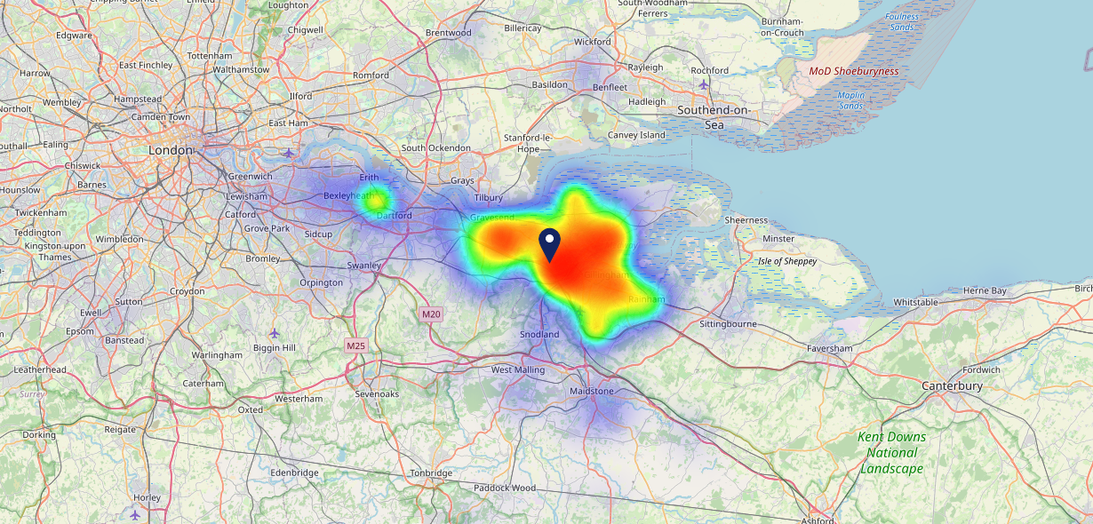

Site Intel
Three Crutches ME23UG
05/02/2025 - 28/01/2026
Map of Guest Origin
Where do customers of Three Crutches ME23UG come from?
Where do customers of Three Crutches ME23UG for 05/02/2025 - 28/01/2026 live
670 Site Customers

Slide 12
Site Intel
Three Crutches ME23UG
1 Miles
1 Chain
05/02/2025 - 28/01/2026
Share of Wallet
What are the Top 20 venues (by spend) that customers of Three Crutches ME23UG also visit?
For customers of Three Crutches ME23UG, who are the top 20 competitors from 1 Chains in 1 Miles for 05/02/2025 - 28/01/2026 split by Venue
1342 Site Customers

Slide 13
Site Intel
Three Crutches ME23UG
1 Miles
1 Chain
05/02/2025 - 28/01/2026
Share of Wallet Change
How has share of wallet of customers of Three Crutches ME23UG changed between two date ranges?
1342 Site Customers

Slide 14
Site Intel
Three Crutches ME23UG
05/02/2025 - 28/01/2026
Market Summary
How does the local area for Three Crutches ME23UG compare to the national average (1 = low, 10 = high)
Data Type | Name | Spend in 250m | 250m Spend vs National | Spend in 500m | 500m Spend vs National | Spend in 1 mile | 1 mile Spend vs National | Spend in 3 miles | 3 mile Spend vs National
Total | Annual Sales | £925K | 4 | £925K | 3 | £2.63M | 2 | £95.04M | 6
Weekpart | Mon - Thu | 40.2% | 5 | 40.2% | 5 | 42.8% | 7 | 37.5% | 1
Weekpart | Fri - Sat | 41.6% | 4 | 41.6% | 4 | 41.8% | 5 | 46.2% | 10
Weekpart | Sun | 18.3% | 9 | 18.3% | 9 | 15.4% | 6 | 16.4% | 7
Age | 18 to 24 | 2.0% | 2 | 2.0% | 2 | 3.2% | 2 | 6.7% | 5
Age | 25 to 34 | 13.1% | 2 | 13.1% | 2 | 10.0% | 1 | 17.9% | 2
Age | 35 to 44 | 24.1% | 6 | 24.1% | 6 | 21.7% | 4 | 25.3% | 8
Age | 45 to 54 | 14.8% | 2 | 14.8% | 1 | 14.9% | 1 | 20.7% | 6
Age | 55 to 64 | 21.6% | 9 | 21.6% | 9 | 23.2% | 10 | 16.4% | 7
Age | 65 to 74 | 13.6% | 9 | 13.6% | 9 | 15.0% | 10 | 9.0% | 8
Age | 75+ | 10.8% | 10 | 10.8% | 10 | 11.9% | 10 | 4.1% | 8
CAMEO | Business Elite | 4.9% | 4 | 4.9% | 4 | 4.4% | 4 | 5.0% | 4
CAMEO | Prosperous Professionals | 6.3% | 6 | 6.3% | 6 | 4.5% | 3 | 4.2% | 3
CAMEO | Flourishing Society | 24.0% | 9 | 24.0% | 9 | 24.0% | 10 | 18.4% | 8
CAMEO | Content Communities | 9.1% | 3 | 9.1% | 3 | 7.0% | 1 | 10.2% | 3
CAMEO | White Collar Neighbourhoods | 12.0% | 6 | 12.0% | 6 | 12.2% | 6 | 16.1% | 10
CAMEO | Enterprising Mainstream | 6.5% | 4 | 6.5% | 4 | 6.1% | 4 | 9.8% | 7
CAMEO | Paying The Mortgage | 15.2% | 6 | 15.2% | 6 | 14.7% | 6 | 18.2% | 8
CAMEO | Cash Conscious Communities | 9.4% | 6 | 9.4% | 6 | 12.5% | 8 | 7.7% | 4
CAMEO | On A Budget | 11.3% | 9 | 11.3% | 9 | 13.4% | 10 | 9.2% | 8
CAMEO | Family Value | 1.3% | 4 | 1.3% | 4 | 1.2% | 3 | 1.1% | 3
Affluence | AB | 35.2% | 7 | 35.2% | 7 | 32.9% | 7 | 27.7% | 5
Affluence | C1C2 | 42.8% | 4 | 42.8% | 4 | 40.0% | 3 | 54.3% | 8
Affluence | DE | 22.0% | 6 | 22.0% | 6 | 27.1% | 8 | 18.0% | 4

Slide 15

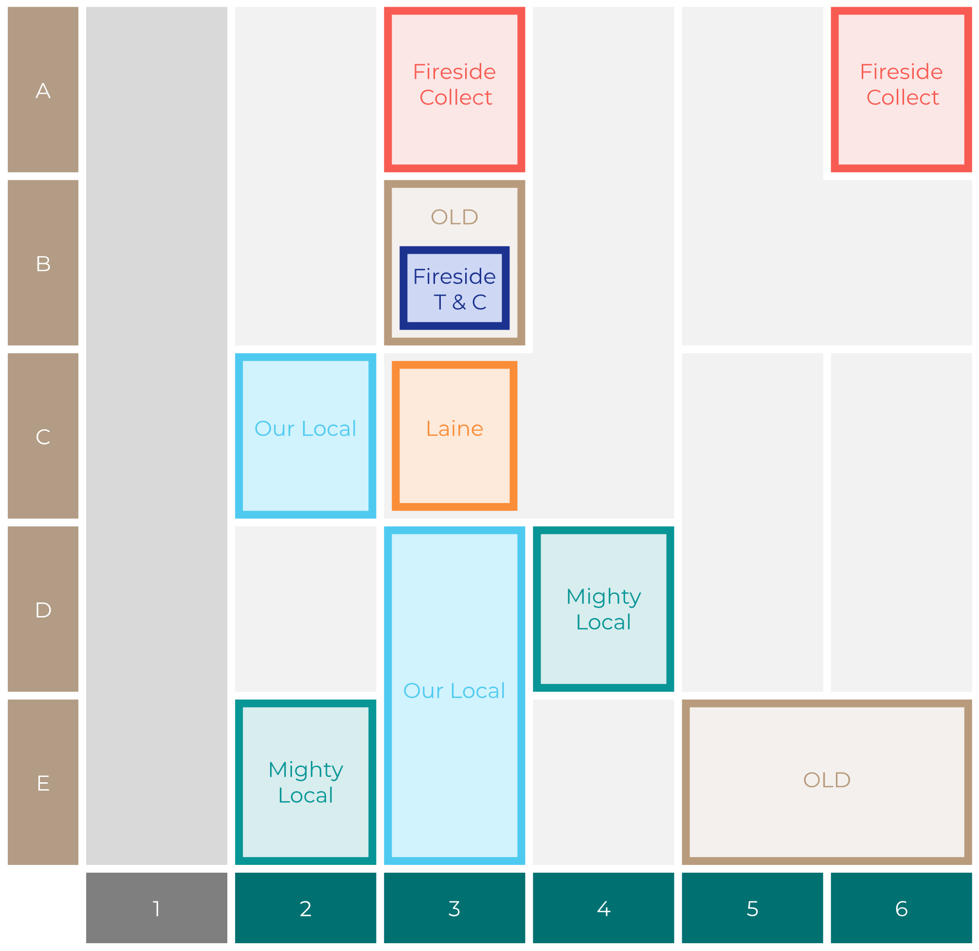

Site Intel
Three Crutches ME23UG
Site Potential 1
Site Characteristics
£3000
£18000
OCC Concept Fit
Achievable Average Weekly Takings
Non-Core
£0
A Food-Led High Affluence B Food-Led Mid Affluence C Wet-Led Mid/High Affluence D Wet-Led Low Affluence E Food-Led Low Affluence
AWT 2 Local Regulars 3 Local Passing Trade 4 Destination Wet-Led 5 Destination Food-Led 6 Destination Very Food-Led
A
B
C
D
E
1
2
3
4
5
6

Slide 16
Site Intel
Three Crutches ME23UG
Site Potential 2
Concept Recommendation

Slide 17
Site Intel
Three Crutches ME23UG
Local Market Profile
Mix of spend by customer segment in Punch site and local market
 | Customer Count | Family Familiar | Occasional & Local | Mid-Week Seniors | Part Of The Pub | Metro Sophisticates | Young & Connected | Bubbly Weekenders | Upmarket Diners
Three Crutches | 204 | 12.10% | 3.77% | 21.68% | 1.99% | 14.89% | 13.25% | 9.48% | 22.81%
Punch T&L | 95247 | 8.96% | 6.12% | 29.02% | 11.18% | 10.98% | 11.14% | 7.14% | 15.41%
Three Crutches vs Punch T&L |  | 3.14% | -2.35% | -7.34% | -9.19% | 3.91% | 2.11% | 2.34% | 7.40%

Slide 18
Site Intel
Three Crutches ME23UG
Local Competitor Profiles
Mix of spend by customer segment in Punch site and local competitors
 | Customer Count | Family Familiar | Occasional & Local | Mid-Week Seniors | Part Of The Pub | Metro Sophisticates | Young & Connected | Bubbly Weekenders | Upmarket Diners
Three Crutches ME23UG | 204 | 12.10% | 3.77% | 21.68% | 1.99% | 14.89% | 13.25% | 9.48% | 22.81%

