Slide 1











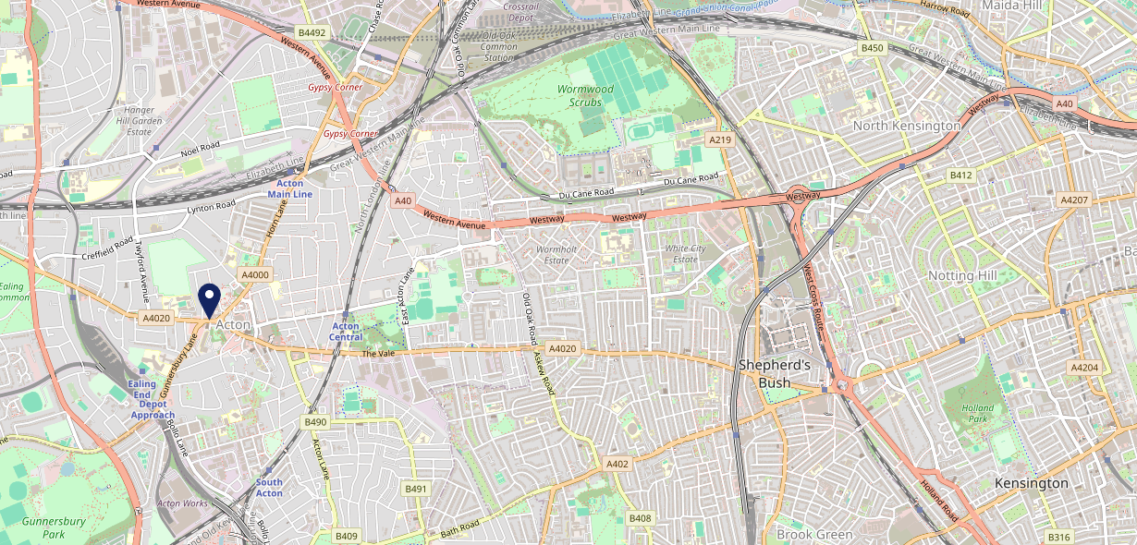











Site Intel
Aeronaut W39BH
Aeronaut W39BH
97 Chains
31/05/2023 - 22/05/2024
Site Summary
Aeronaut W39BH
Work Area
Region
TV Region
Urbanicity
London
London
London
Urban major conurbation
W39BH
Laine Pub Company
Top Competitors
ATV
Gender
The Red Lion & Pineapple
#1
£12.90
57.39%
Male
W39BP
JD Wetherspoon
Affluence
Segmentation
Station House
#2
51.02%
28.69%
Middle Income
Content Communities
W36BH
Pub / Bar
Age Group
Visit Day
The George & Dragon
#3
38.93%
36.65%
W39DJ
25 to 34
Sat
Pub / Bar
Nearest Station
Acton Town(0.68 miles)
1063 Site Customers
32 Competitors
17280 Competitor Customers

Slide 2

Site Intel
Aeronaut W39BH
Aeronaut W39BH
97 Chains
31/05/2023 - 22/05/2024
Spend by Weekpart
How is customer spend distributed throughout the week for Aeronaut W39BH versus its competitors?
% of spend for Aeronaut W39BH and 97 Chains in 1 Miles from 31/05/2023 - 22/05/2024 split by Day of Week
1063 Site Customers
32 Competitors
17280 Competitor Customers

Slide 3
Site Intel
Aeronaut W39BH
Aeronaut W39BH
97 Chains
31/05/2023 - 22/05/2024
Visit Frequency
How frequently per year do customers visit Aeronaut W39BH versus its competitors?
% of customer numbers for Aeronaut W39BH and 97 Chains in 1 Miles from 31/05/2023 - 22/05/2024 and the number of visits made Per Annum
1063 Site Customers
32 Competitors
17280 Competitor Customers

Slide 4
Site Intel
Aeronaut W39BH
Aeronaut W39BH
97 Chains
31/05/2023 - 22/05/2024
ATV Change
How has ATV changed between two date ranges?
1063 Site Customers

Slide 5
Site Intel
Aeronaut W39BH
Aeronaut W39BH
97 Chains
31/05/2023 - 22/05/2024
Market Share Change
How has market share changed between two date ranges?
% of market share spend for Aeronaut W39BH and 97 Chains in 1 Miles from 31/05/2023 - 22/05/2024
1063 Site Customers

Slide 6
Site Intel
Aeronaut W39BH
Aeronaut W39BH
97 Chains
31/05/2023 - 22/05/2024
Age
How does the age profile of customers who visit Aeronaut W39BH compare versus its competitors?
% of spend for Aeronaut W39BH and 97 Chains in 1 Miles from 31/05/2023 - 22/05/2024 split by Age Range
407 Site Customers
32 Competitors
7559 Competitor Customers

Slide 7
Site Intel
Aeronaut W39BH
Aeronaut W39BH
97 Chains
31/05/2023 - 22/05/2024
Affluence
How does the affluence of customers who visit Aeronaut W39BH compare versus its competitors?
% of spend for Aeronaut W39BH and 97 Chains in 1 Miles from 31/05/2023 - 22/05/2024 split by Affluence
419 Site Customers
32 Competitors
7604 Competitor Customers

Slide 8
Site Intel
Aeronaut W39BH
Aeronaut W39BH
97 Chains
31/05/2023 - 22/05/2024
Gender
How does the gender profile of customers who visit Aeronaut W39BH compare versus its competitors?
% of spend for Aeronaut W39BH and 97 Chains in 1 Miles from 31/05/2023 - 22/05/2024 split by Gender
419 Site Customers
32 Competitors
7604 Competitor Customers

Slide 9
Site Intel
Aeronaut W39BH
Aeronaut W39BH
97 Chains
31/05/2023 - 22/05/2024
Punch Segmentation
How does the Custom segmentation profile of customers who visit Aeronaut W39BH compare versus its competitors?
% of spend for Aeronaut W39BH and 97 Chains in 1 Miles from 31/05/2023 - 22/05/2024 split by Segment
1063 Site Customers
32 Competitors
17280 Competitor Customers

Slide 10
Site Intel
Aeronaut W39BH
Aeronaut W39BH
97 Chains
31/05/2023 - 22/05/2024
Spend by Distance
How does the spend profile of Aeronaut W39BH compare versus its competitors based on travel distances?
% of spend for Aeronaut W39BH and 97 Chains in 1 Miles from 31/05/2023 - 22/05/2024 split by Distance travelled
399 Site Customers
32 Competitors
7301 Competitor Customers

Slide 11
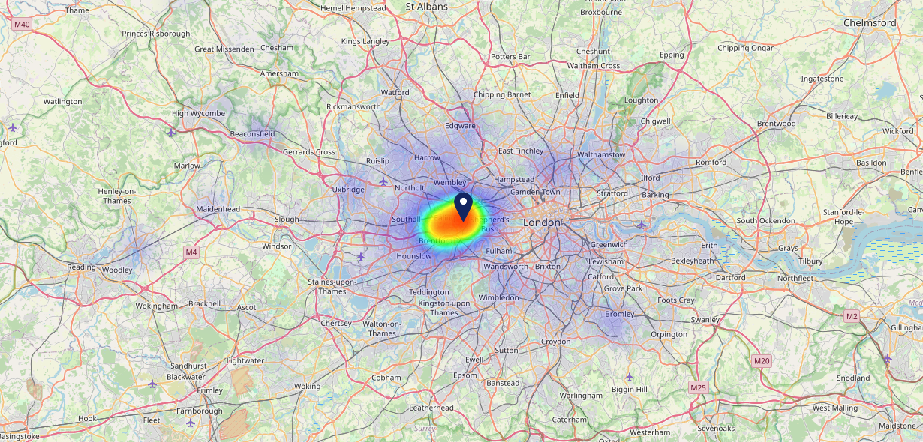

Site Intel
Aeronaut W39BH
31/05/2023 - 22/05/2024
Map of Guest Origin
Where do customers of Aeronaut W39BH come from?
Where do customers of Aeronaut W39BH for 31/05/2023 - 22/05/2024 live
399 Site Customers

Slide 12
Site Intel
Aeronaut W39BH
Aeronaut W39BH
97 Chains
31/05/2023 - 22/05/2024
Share of Wallet
What are the Top 20 venues (by spend) that customers of Aeronaut W39BH also visit?
For customers of Aeronaut W39BH, who are the top 20 competitors from 97 Chains in 1 Miles for 31/05/2023 - 22/05/2024 split by Venue
1063 Site Customers

Slide 13
Site Intel
Aeronaut W39BH
Aeronaut W39BH
97 Chains
31/05/2023 - 22/05/2024
Share of Wallet Change
How has share of wallet of customers of Aeronaut W39BH changed between two date ranges?
1063 Site Customers

Slide 14
Site Intel
Aeronaut W39BH
31/05/2023 - 22/05/2024
Market Summary
How does the local area for Aeronaut W39BH compare to the national average (1 = low, 10 = high)
Data Type | Name | Spend in 250m | 250m Spend vs National | Spend in 500m | 500m Spend vs National | Spend in 1 mile | 1 mile Spend vs National | Spend in 3 miles | 3 mile Spend vs National
Total | Annual Sales | £3.54M | 7 | £8.40M | 7 | £34.41M | 7 | £608.78M | 9
Weekpart | Mon - Thu | 42.5% | 7 | 44.1% | 8 | 47.2% | 9 | 45.4% | 9
Weekpart | Fri - Sat | 40.5% | 4 | 39.0% | 3 | 36.5% | 1 | 39.2% | 2
Weekpart | Sun | 17.0% | 8 | 17.0% | 8 | 16.4% | 7 | 15.4% | 5
Age | 18 to 24 | 5.5% | 5 | 5.7% | 5 | 4.4% | 3 | 4.1% | 2
Age | 25 to 34 | 18.2% | 4 | 18.4% | 4 | 16.6% | 2 | 15.6% | 2
Age | 35 to 44 | 20.2% | 3 | 26.3% | 8 | 25.9% | 8 | 24.2% | 6
Age | 45 to 54 | 20.6% | 6 | 22.0% | 7 | 23.5% | 9 | 23.4% | 10
Age | 55 to 64 | 17.9% | 7 | 15.3% | 5 | 18.4% | 8 | 19.2% | 9
Age | 65 to 74 | 11.5% | 9 | 8.4% | 7 | 8.0% | 7 | 8.9% | 8
Age | 75+ | 6.0% | 9 | 3.8% | 8 | 3.2% | 7 | 4.6% | 9
CAMEO | Business Elite | 12.3% | 8 | 10.6% | 7 | 14.9% | 8 | 18.8% | 9
CAMEO | Prosperous Professionals | 3.7% | 3 | 2.5% | 2 | 4.2% | 3 | 5.3% | 4
CAMEO | Flourishing Society | 5.5% | 2 | 4.5% | 1 | 7.8% | 3 | 10.5% | 4
CAMEO | Content Communities | 23.4% | 10 | 20.9% | 10 | 22.9% | 10 | 17.7% | 10
CAMEO | White Collar Neighbourhoods | 15.3% | 9 | 15.4% | 9 | 15.3% | 9 | 13.2% | 8
CAMEO | Enterprising Mainstream | 5.9% | 4 | 6.7% | 4 | 5.2% | 3 | 4.6% | 2
CAMEO | Paying The Mortgage | 12.9% | 5 | 10.1% | 3 | 8.4% | 2 | 10.2% | 3
CAMEO | Cash Conscious Communities | 12.5% | 8 | 17.1% | 10 | 13.6% | 9 | 12.3% | 8
CAMEO | On A Budget | 6.9% | 6 | 10.7% | 8 | 6.6% | 6 | 6.4% | 5
CAMEO | Family Value | 1.6% | 5 | 1.6% | 4 | 0.9% | 2 | 0.9% | 2
Affluence | AB | 21.5% | 4 | 17.5% | 3 | 27.0% | 5 | 34.6% | 7
Affluence | C1C2 | 57.5% | 9 | 53.1% | 7 | 51.9% | 7 | 45.8% | 4
Affluence | DE | 21.0% | 6 | 29.3% | 8 | 21.2% | 6 | 19.6% | 5

