Slide 1
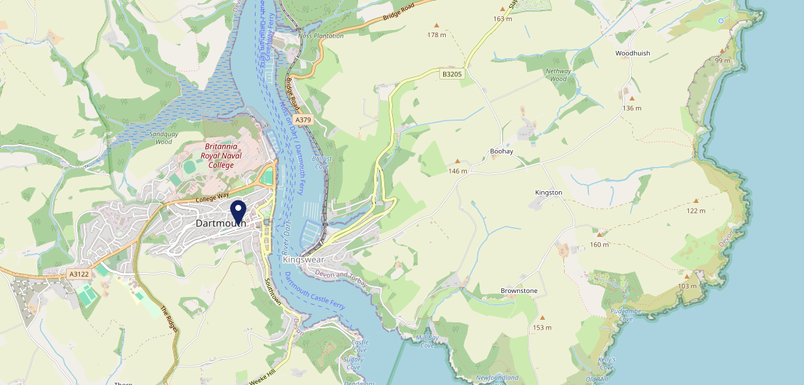
Site Intel
Seale Arms TQ69SA
1 Miles
371 Chains
16/04/2025 - 08/04/2026
Site Summary
Seale Arms TQ69SA
Work Area
Region
TV Region
Urbanicity
Kingsbridge and Dartmouth
South West
HarWest
Rural town and fringe
TQ69SA
Punch T&L
Top Competitors
ATV
Gender
Dolphin Dartmouth
#1
£9.49
64.08%
Male
TQ69QE
Stonegate PP
Affluence
Segmentation
Market House Inn Dartmouth
#2
45.52%
24.85%
High Income
Flourishing Society
TQ69QE
Stonegate PP
Age Group
Visit Day
Dartmouth A F C
#3
38.03%
26.71%
TQ69LW
45 to 54
Sat
Clubs
Nearest Station
Paignton(9.35 miles)
582 Site Customers
129 Competitors
59831 Competitor Customers

Slide 2
Site Intel
Seale Arms TQ69SA
1 Miles
371 Chains
16/04/2025 - 08/04/2026
Spend by Weekpart
How is customer spend distributed throughout the week for Seale Arms TQ69SA versus its competitors?
% of spend for Seale Arms TQ69SA and 371 Chains in 1 Miles from 16/04/2025 - 08/04/2026 split by Day of Week
582 Site Customers
129 Competitors
59831 Competitor Customers

Slide 3
Site Intel
Seale Arms TQ69SA
1 Miles
371 Chains
16/04/2025 - 08/04/2026
Visit Frequency
How frequently per year do customers visit Seale Arms TQ69SA versus its competitors?
% of customer numbers for Seale Arms TQ69SA and 371 Chains in 1 Miles from 16/04/2025 - 08/04/2026 and the number of visits made Per Annum
582 Site Customers
129 Competitors
59831 Competitor Customers

Slide 4
Site Intel
Seale Arms TQ69SA
1 Miles
371 Chains
16/04/2025 - 08/04/2026
ATV Change
How has ATV changed between two date ranges?
582 Site Customers

Slide 5
Site Intel
Seale Arms TQ69SA
1 Miles
371 Chains
16/04/2025 - 08/04/2026
Market Share Change
How has market share changed between two date ranges?
% of market share spend for Seale Arms TQ69SA and 371 Chains in 1 Miles from 16/04/2025 - 08/04/2026
582 Site Customers

Slide 6
Site Intel
Seale Arms TQ69SA
1 Miles
371 Chains
16/04/2025 - 08/04/2026
Age
How does the age profile of customers who visit Seale Arms TQ69SA compare versus its competitors?
% of spend for Seale Arms TQ69SA and 371 Chains in 1 Miles from 16/04/2025 - 08/04/2026 split by Age Range
257 Site Customers
129 Competitors
31167 Competitor Customers

Slide 7
Site Intel
Seale Arms TQ69SA
1 Miles
371 Chains
16/04/2025 - 08/04/2026
Affluence
How does the affluence of customers who visit Seale Arms TQ69SA compare versus its competitors?
% of spend for Seale Arms TQ69SA and 371 Chains in 1 Miles from 16/04/2025 - 08/04/2026 split by Affluence
236 Site Customers
129 Competitors
29240 Competitor Customers

Slide 8
Site Intel
Seale Arms TQ69SA
1 Miles
371 Chains
16/04/2025 - 08/04/2026
Gender
How does the gender profile of customers who visit Seale Arms TQ69SA compare versus its competitors?
% of spend for Seale Arms TQ69SA and 371 Chains in 1 Miles from 16/04/2025 - 08/04/2026 split by Gender
248 Site Customers
129 Competitors
30377 Competitor Customers

Slide 9
Site Intel
Seale Arms TQ69SA
1 Miles
371 Chains
16/04/2025 - 08/04/2026
Punch Segmentation
How does the Custom segmentation profile of customers who visit Seale Arms TQ69SA compare versus its competitors?
% of spend for Seale Arms TQ69SA and 371 Chains in 1 Miles from 16/04/2025 - 08/04/2026 split by Segment
582 Site Customers
129 Competitors
59831 Competitor Customers

Slide 10
Site Intel
Seale Arms TQ69SA
1 Miles
371 Chains
16/04/2025 - 08/04/2026
Spend by Distance
How does the spend profile of Seale Arms TQ69SA compare versus its competitors based on travel distances?
% of spend for Seale Arms TQ69SA and 371 Chains in 1 Miles from 16/04/2025 - 08/04/2026 split by Distance travelled
248 Site Customers
129 Competitors
30344 Competitor Customers

Slide 11
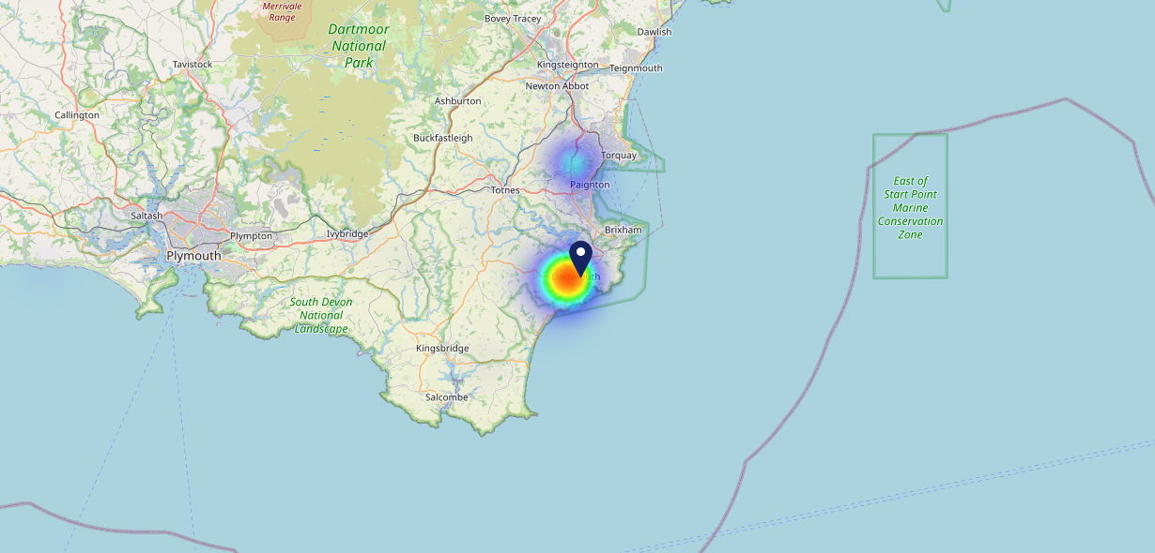
Site Intel
Seale Arms TQ69SA
16/04/2025 - 08/04/2026
Map of Guest Origin
Where do customers of Seale Arms TQ69SA come from?
Where do customers of Seale Arms TQ69SA for 16/04/2025 - 08/04/2026 live
248 Site Customers

Slide 12
Site Intel
Seale Arms TQ69SA
1 Miles
371 Chains
16/04/2025 - 08/04/2026
Share of Wallet
What are the Top 20 venues (by spend) that customers of Seale Arms TQ69SA also visit?
For customers of Seale Arms TQ69SA, who are the top 20 competitors from 371 Chains in 1 Miles for 16/04/2025 - 08/04/2026 split by Venue
582 Site Customers

Slide 13
Site Intel
Seale Arms TQ69SA
1 Miles
371 Chains
16/04/2025 - 08/04/2026
Share of Wallet Change
How has share of wallet of customers of Seale Arms TQ69SA changed between two date ranges?
582 Site Customers

Slide 14
Site Intel
Seale Arms TQ69SA
16/04/2025 - 08/04/2026
Market Summary
How does the local area for Seale Arms TQ69SA compare to the national average (1 = low, 10 = high)
Data Type | Name | Spend in 250m | 250m Spend vs National | Spend in 500m | 500m Spend vs National | Spend in 1 mile | 1 mile Spend vs National | Spend in 3 miles | 3 mile Spend vs National
Total | Annual Sales | £9.15M | 8 | £22.62M | 9 | £26.09M | 7 | £30.69M | 4
Weekpart | Mon - Thu | 42.4% | 7 | 45.9% | 8 | 45.7% | 9 | 45.8% | 9
Weekpart | Fri - Sat | 45.5% | 6 | 41.5% | 4 | 41.1% | 4 | 40.6% | 4
Weekpart | Sun | 12.1% | 3 | 12.6% | 3 | 13.2% | 2 | 13.7% | 2
Age | 18 to 24 | 2.5% | 2 | 2.4% | 2 | 2.8% | 2 | 2.5% | 1
Age | 25 to 34 | 8.4% | 1 | 8.2% | 1 | 8.2% | 1 | 8.5% | 1
Age | 35 to 44 | 10.5% | 1 | 11.8% | 1 | 11.8% | 1 | 12.5% | 1
Age | 45 to 54 | 21.5% | 7 | 19.0% | 4 | 18.4% | 3 | 18.1% | 2
Age | 55 to 64 | 28.1% | 10 | 27.7% | 10 | 27.9% | 10 | 27.2% | 10
Age | 65 to 74 | 18.6% | 10 | 19.8% | 10 | 20.1% | 10 | 19.4% | 10
Age | 75+ | 10.5% | 10 | 11.1% | 10 | 10.8% | 10 | 11.8% | 10
CAMEO | Business Elite | 8.1% | 6 | 9.0% | 7 | 8.9% | 7 | 9.0% | 6
CAMEO | Prosperous Professionals | 13.1% | 10 | 14.6% | 10 | 15.0% | 10 | 14.6% | 10
CAMEO | Flourishing Society | 25.6% | 10 | 25.0% | 10 | 24.7% | 10 | 26.2% | 10
CAMEO | Content Communities | 11.2% | 5 | 12.9% | 6 | 13.2% | 6 | 13.2% | 6
CAMEO | White Collar Neighbourhoods | 11.2% | 5 | 10.9% | 5 | 10.7% | 5 | 10.5% | 4
CAMEO | Enterprising Mainstream | 9.6% | 7 | 8.3% | 6 | 8.1% | 5 | 8.0% | 5
CAMEO | Paying The Mortgage | 7.4% | 2 | 7.2% | 1 | 7.2% | 1 | 7.2% | 1
CAMEO | Cash Conscious Communities | 6.7% | 4 | 5.5% | 2 | 5.2% | 2 | 5.0% | 1
CAMEO | On A Budget | 5.7% | 5 | 5.5% | 4 | 5.7% | 4 | 5.3% | 3
CAMEO | Family Value | 1.4% | 4 | 1.1% | 3 | 1.2% | 3 | 1.1% | 3
Affluence | AB | 46.8% | 9 | 48.6% | 9 | 48.6% | 9 | 49.8% | 10
Affluence | C1C2 | 39.4% | 3 | 39.3% | 2 | 39.2% | 2 | 38.9% | 2
Affluence | DE | 13.8% | 3 | 12.1% | 2 | 12.1% | 2 | 11.4% | 2

Slide 15
Site Intel
Seale Arms TQ69SA
Site Potential 1
Site Characteristics
£3000
£18000
OCC Concept Fit
Achievable Average Weekly Takings
Non-Core
£5000
A Food-Led High Affluence B Food-Led Mid Affluence C Wet-Led Mid/High Affluence D Wet-Led Low Affluence E Food-Led Low Affluence
AWT 2 Local Regulars 3 Local Passing Trade 4 Destination Wet-Led 5 Destination Food-Led 6 Destination Very Food-Led
A
B
C
D
E
1
2
3
4
5
6

Slide 16
Site Intel
Seale Arms TQ69SA
Site Potential 2
Concept Recommendation

Slide 17
Site Intel
Seale Arms TQ69SA
Local Market Profile
Mix of spend by customer segment in Punch site and local market
 | Customer Count | Family Familiar | Occasional & Local | Mid-Week Seniors | Part Of The Pub | Metro Sophisticates | Young & Connected | Bubbly Weekenders | Upmarket Diners
Seale Arms | 108 | 5.24% | 12.57% | 7.53% | 53.30% | 8.81% | 4.34% | 1.38% | 6.80%
Local Catchment | 4682 | 4.36% | 7.08% | 25.62% | 4.16% | 14.32% | 5.50% | 4.92% | 34.00%
Punch T&L | 95027 | 8.91% | 6.06% | 28.65% | 11.34% | 11.30% | 11.04% | 7.03% | 15.64%
Seale Arms vs Local Catchment |  | 0.88% | 5.49% | -18.09% | 49.14% | -5.51% | -1.16% | -3.54% | -27.20%
Seale Arms vs Punch T&L |  | -3.67% | 6.51% | -21.12% | 41.96% | -2.49% | -6.70% | -5.65% | -8.84%
Local Catchment vs Punch T&L |  | -4.55% | 1.02% | -3.03% | -7.18% | 3.02% | -5.54% | -2.11% | 18.36%

Slide 18
Site Intel
Seale Arms TQ69SA
Local Competitor Profiles
Mix of spend by customer segment in Punch site and local competitors
 | Customer Count | Family Familiar | Occasional & Local | Mid-Week Seniors | Part Of The Pub | Metro Sophisticates | Young & Connected | Bubbly Weekenders | Upmarket Diners
Dolphin Dartmouth TQ69QE | 382 | 1.78% | 14.69% | 32.51% | 4.37% | 23.84% | 3.74% | 2.40% | 16.63%
Seale Arms TQ69SA | 108 | 5.24% | 12.57% | 7.53% | 53.30% | 8.81% | 4.34% | 1.38% | 6.80%
Market House Inn Dartmouth TQ69QE | 259 | 8.46% | 9.19% | 18.61% | 14.78% | 14.21% | 12.91% | 8.28% | 13.51%
Dartmouth A F C TQ69LW | 54 | 3.37% | 16.64% | 36.21% | 3.01% | 9.51% | 9.45% | 19.11% | 2.67%
George & Dragon TQ69NG | 313 | 8.78% | 16.16% | 21.87% | 3.47% | 14.71% | 5.04% | 5.88% | 24.04%
Crab And Bucket TQ69BH | 397 | 3.29% | 19.65% | 22.85% | 12.94% | 13.02% | 5.12% | 4.52% | 18.58%
Royal Castle Hotel TQ69PS | 491 | 5.12% | 4.83% | 23.21% | 4.40% | 13.30% | 3.46% | 4.44% | 41.21%
Sail Loft TQ69DR | 261 | 3.59% | 10.22% | 13.75% | 3.51% | 21.63% | 4.77% | 4.74% | 37.75%
Dartmouth Yacht Club TQ69BB | 295 | 1.31% | 9.60% | 16.57% | 8.65% | 16.62% | 26.26% | 3.24% | 17.70%
Tsang Restaurant TQ69AB | 99 | 18.73% | 8.48% | 19.81% | 6.90% | 11.01% | 6.73% | 12.24% | 16.06%
Bar 1620 TQ69AA | 175 | 5.53% | 3.97% | 10.05% | 12.09% | 16.01% | 7.86% | 8.43% | 36.03%
Seven Stars TQ69QR | 350 | 3.31% | 4.65% | 20.03% | 6.59% | 23.77% | 5.01% | 5.11% | 31.49%
Dartmouth & District Conservative Club TQ69SA | 31 | 0.54% | 4.62% | 11.12% | 45.39% | 29.31% | 0.00% | 0.41% | 8.58%
Floating Bridge Dartmouth TQ69PQ | 373 | 2.63% | 8.04% | 31.97% | 3.73% | 11.91% | 5.63% | 3.11% | 32.94%
Spice Merchant TQ69DJ | 155 | 6.43% | 12.47% | 21.20% | 8.18% | 10.88% | 4.07% | 4.63% | 32.09%
Vinos Pizzeria TQ69RT | 90 | 6.30% | 5.41% | 8.79% | 14.55% | 20.56% | 8.92% | 14.71% | 20.71%
Dartmouth Arms Dartmouth TQ69AN | 551 | 3.38% | 6.44% | 23.51% | 4.67% | 17.25% | 6.20% | 6.90% | 31.61%
Rockfish Dartmouth TQ69BH | 889 | 3.64% | 4.04% | 25.94% | 0.91% | 12.80% | 3.26% | 6.07% | 43.30%
Central Amenities Fund TQ60HJ | 80 | 11.78% | 0.84% | 18.15% | 24.15% | 3.95% | 28.54% | 4.22% | 8.33%
Bayards Cove Inn TQ69AN | 392 | 3.86% | 3.99% | 26.91% | 1.21% | 10.14% | 6.16% | 2.69% | 45.00%
Embankment Bistro TQ69RT | 680 | 5.08% | 2.30% | 29.19% | 1.93% | 15.68% | 5.49% | 4.07% | 36.21%
Seahorse Restaurant TQ69BH | 103 | 1.74% | 8.42% | 23.76% | 0.85% | 11.53% | 1.13% | 1.25% | 51.28%
Steam Packet Inn TQ60AD | 327 | 6.07% | 4.46% | 27.59% | 2.00% | 15.87% | 6.50% | 4.19% | 33.27%
Kendricks TQ69AB | 105 | 3.73% | 7.78% | 21.18% | 3.97% | 12.08% | 3.64% | 3.53% | 44.05%
Cornish Bakery Dartmouth TQ69AB | 657 | 8.35% | 9.33% | 26.99% | 1.73% | 6.45% | 7.14% | 11.23% | 28.75%

