Slide 1











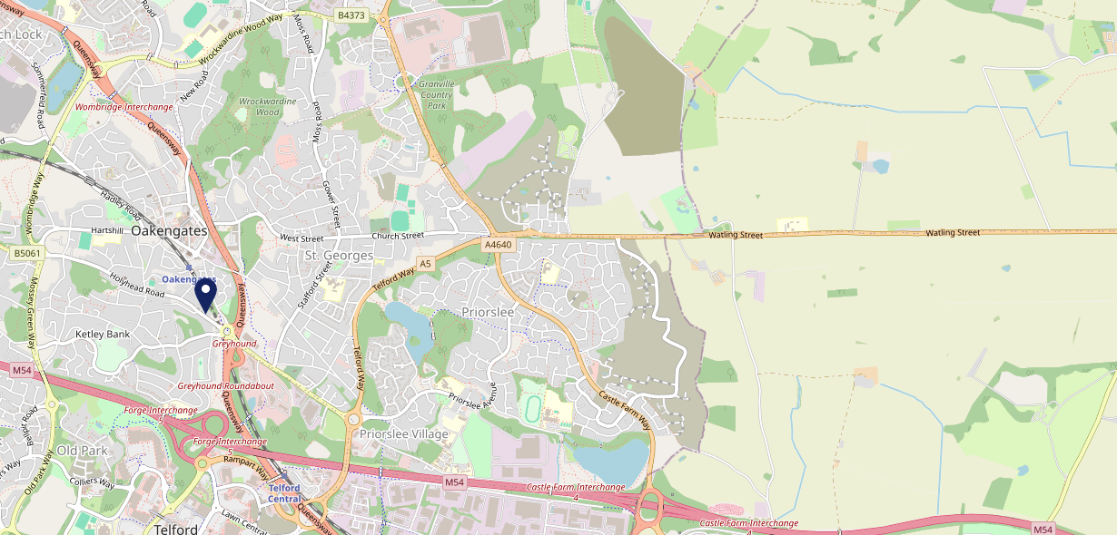











Site Intel
Hare & Hounds TF26DJ
1 Miles
97 Chains
06/09/2023 - 28/08/2024
Site Summary
Hare & Hounds TF26DJ
Work Area
Region
TV Region
Urbanicity
Telford
West Midlands
Central
Urban city and town
TF26DJ
Punch - Our Local
Top Competitors
ATV
Gender
Bell & Bails
#1
£15.28
60.00%
Male
TF29LT
Pub / Bar
Affluence
Segmentation
Old Fighting Cocks
#2
49.90%
20.70%
Middle Income
Paying The Mortgage
TF26DU
Everards
Age Group
Visit Day
Pheasant Inn
#3
28.17%
26.10%
TF26LF
45 to 54
Sat
Pub / Bar
Nearest Station
Oakengates(0.33 miles)
871 Site Customers
15 Competitors
2958 Competitor Customers

Slide 2

Site Intel
Hare & Hounds TF26DJ
1 Miles
97 Chains
06/09/2023 - 28/08/2024
Spend by Weekpart
How is customer spend distributed throughout the week for Hare & Hounds TF26DJ versus its competitors?
% of spend for Hare & Hounds TF26DJ and 97 Chains in 1 Miles from 06/09/2023 - 28/08/2024 split by Day of Week
871 Site Customers
15 Competitors
2958 Competitor Customers

Slide 3
Site Intel
Hare & Hounds TF26DJ
1 Miles
97 Chains
06/09/2023 - 28/08/2024
Visit Frequency
How frequently per year do customers visit Hare & Hounds TF26DJ versus its competitors?
% of customer numbers for Hare & Hounds TF26DJ and 97 Chains in 1 Miles from 06/09/2023 - 28/08/2024 and the number of visits made Per Annum
871 Site Customers
15 Competitors
2958 Competitor Customers

Slide 4
Site Intel
Hare & Hounds TF26DJ
1 Miles
97 Chains
06/09/2023 - 28/08/2024
ATV Change
How has ATV changed between two date ranges?
871 Site Customers

Slide 5
Site Intel
Hare & Hounds TF26DJ
1 Miles
97 Chains
06/09/2023 - 28/08/2024
Market Share Change
How has market share changed between two date ranges?
% of market share spend for Hare & Hounds TF26DJ and 97 Chains in 1 Miles from 06/09/2023 - 28/08/2024
871 Site Customers

Slide 6
Site Intel
Hare & Hounds TF26DJ
1 Miles
97 Chains
06/09/2023 - 28/08/2024
Age
How does the age profile of customers who visit Hare & Hounds TF26DJ compare versus its competitors?
% of spend for Hare & Hounds TF26DJ and 97 Chains in 1 Miles from 06/09/2023 - 28/08/2024 split by Age Range
427 Site Customers
15 Competitors
1349 Competitor Customers

Slide 7
Site Intel
Hare & Hounds TF26DJ
1 Miles
97 Chains
06/09/2023 - 28/08/2024
Affluence
How does the affluence of customers who visit Hare & Hounds TF26DJ compare versus its competitors?
% of spend for Hare & Hounds TF26DJ and 97 Chains in 1 Miles from 06/09/2023 - 28/08/2024 split by Affluence
433 Site Customers
15 Competitors
1367 Competitor Customers

Slide 8
Site Intel
Hare & Hounds TF26DJ
1 Miles
97 Chains
06/09/2023 - 28/08/2024
Gender
How does the gender profile of customers who visit Hare & Hounds TF26DJ compare versus its competitors?
% of spend for Hare & Hounds TF26DJ and 97 Chains in 1 Miles from 06/09/2023 - 28/08/2024 split by Gender
433 Site Customers
15 Competitors
1367 Competitor Customers

Slide 9
Site Intel
Hare & Hounds TF26DJ
1 Miles
97 Chains
06/09/2023 - 28/08/2024
Punch Segmentation
How does the Custom segmentation profile of customers who visit Hare & Hounds TF26DJ compare versus its competitors?
% of spend for Hare & Hounds TF26DJ and 97 Chains in 1 Miles from 06/09/2023 - 28/08/2024 split by Segment
871 Site Customers
15 Competitors
2958 Competitor Customers

Slide 10
Site Intel
Hare & Hounds TF26DJ
1 Miles
97 Chains
06/09/2023 - 28/08/2024
Spend by Distance
How does the spend profile of Hare & Hounds TF26DJ compare versus its competitors based on travel distances?
% of spend for Hare & Hounds TF26DJ and 97 Chains in 1 Miles from 06/09/2023 - 28/08/2024 split by Distance travelled
421 Site Customers
15 Competitors
1323 Competitor Customers

Slide 11


Site Intel
Hare & Hounds TF26DJ
06/09/2023 - 28/08/2024
Map of Guest Origin
Where do customers of Hare & Hounds TF26DJ come from?
Where do customers of Hare & Hounds TF26DJ for 06/09/2023 - 28/08/2024 live
421 Site Customers

Slide 12
Site Intel
Hare & Hounds TF26DJ
1 Miles
97 Chains
06/09/2023 - 28/08/2024
Share of Wallet
What are the Top 20 venues (by spend) that customers of Hare & Hounds TF26DJ also visit?
For customers of Hare & Hounds TF26DJ, who are the top 20 competitors from 97 Chains in 1 Miles for 06/09/2023 - 28/08/2024 split by Venue
871 Site Customers

Slide 13
Site Intel
Hare & Hounds TF26DJ
1 Miles
97 Chains
06/09/2023 - 28/08/2024
Share of Wallet Change
How has share of wallet of customers of Hare & Hounds TF26DJ changed between two date ranges?
871 Site Customers

Slide 14
Site Intel
Hare & Hounds TF26DJ
06/09/2023 - 28/08/2024
Market Summary
How does the local area for Hare & Hounds TF26DJ compare to the national average (1 = low, 10 = high)
Data Type | Name | Spend in 250m | 250m Spend vs National | Spend in 500m | 500m Spend vs National | Spend in 1 mile | 1 mile Spend vs National | Spend in 3 miles | 3 mile Spend vs National
Total | Annual Sales | £708K | 4 | £1.34M | 4 | £26.73M | 7 | £87.09M | 6
Weekpart | Mon - Thu | 36.8% | 3 | 40.6% | 6 | 47.0% | 9 | 44.5% | 8
Weekpart | Fri - Sat | 43.5% | 5 | 42.8% | 5 | 37.4% | 2 | 40.5% | 3
Weekpart | Sun | 19.8% | 9 | 16.6% | 8 | 15.7% | 6 | 15.0% | 4
Age | 18 to 24 | 5.3% | 5 | 10.4% | 8 | 10.5% | 8 | 9.3% | 8
Age | 25 to 34 | 18.0% | 4 | 16.7% | 3 | 18.0% | 3 | 17.7% | 2
Age | 35 to 44 | 21.5% | 4 | 30.9% | 10 | 28.5% | 9 | 27.1% | 9
Age | 45 to 54 | 28.0% | 10 | 22.7% | 8 | 20.9% | 6 | 21.9% | 8
Age | 55 to 64 | 13.6% | 4 | 10.6% | 2 | 13.3% | 4 | 14.7% | 5
Age | 65 to 74 | 9.6% | 8 | 6.6% | 6 | 6.2% | 5 | 6.3% | 5
Age | 75+ | 3.9% | 8 | 2.1% | 5 | 2.6% | 6 | 3.1% | 6
CAMEO | Business Elite | 1.7% | 2 | 1.6% | 1 | 1.8% | 1 | 2.2% | 1
CAMEO | Prosperous Professionals | 2.4% | 2 | 2.0% | 2 | 3.1% | 2 | 3.7% | 2
CAMEO | Flourishing Society | 9.5% | 4 | 9.8% | 4 | 7.3% | 3 | 7.7% | 2
CAMEO | Content Communities | 12.0% | 5 | 12.1% | 5 | 13.1% | 6 | 14.5% | 8
CAMEO | White Collar Neighbourhoods | 8.2% | 3 | 6.9% | 2 | 10.0% | 4 | 11.1% | 5
CAMEO | Enterprising Mainstream | 9.5% | 7 | 9.4% | 7 | 9.7% | 7 | 10.4% | 7
CAMEO | Paying The Mortgage | 19.8% | 9 | 19.9% | 9 | 17.3% | 8 | 16.6% | 7
CAMEO | Cash Conscious Communities | 17.7% | 10 | 13.9% | 9 | 13.3% | 9 | 12.3% | 8
CAMEO | On A Budget | 11.5% | 9 | 15.8% | 10 | 13.2% | 10 | 11.6% | 10
CAMEO | Family Value | 7.6% | 8 | 8.6% | 9 | 11.3% | 9 | 9.8% | 9
Affluence | AB | 13.7% | 2 | 13.4% | 2 | 12.1% | 2 | 13.6% | 2
Affluence | C1C2 | 49.6% | 6 | 48.3% | 5 | 50.2% | 6 | 52.7% | 7
Affluence | DE | 36.8% | 9 | 38.3% | 9 | 37.7% | 10 | 33.7% | 9

Slide 15

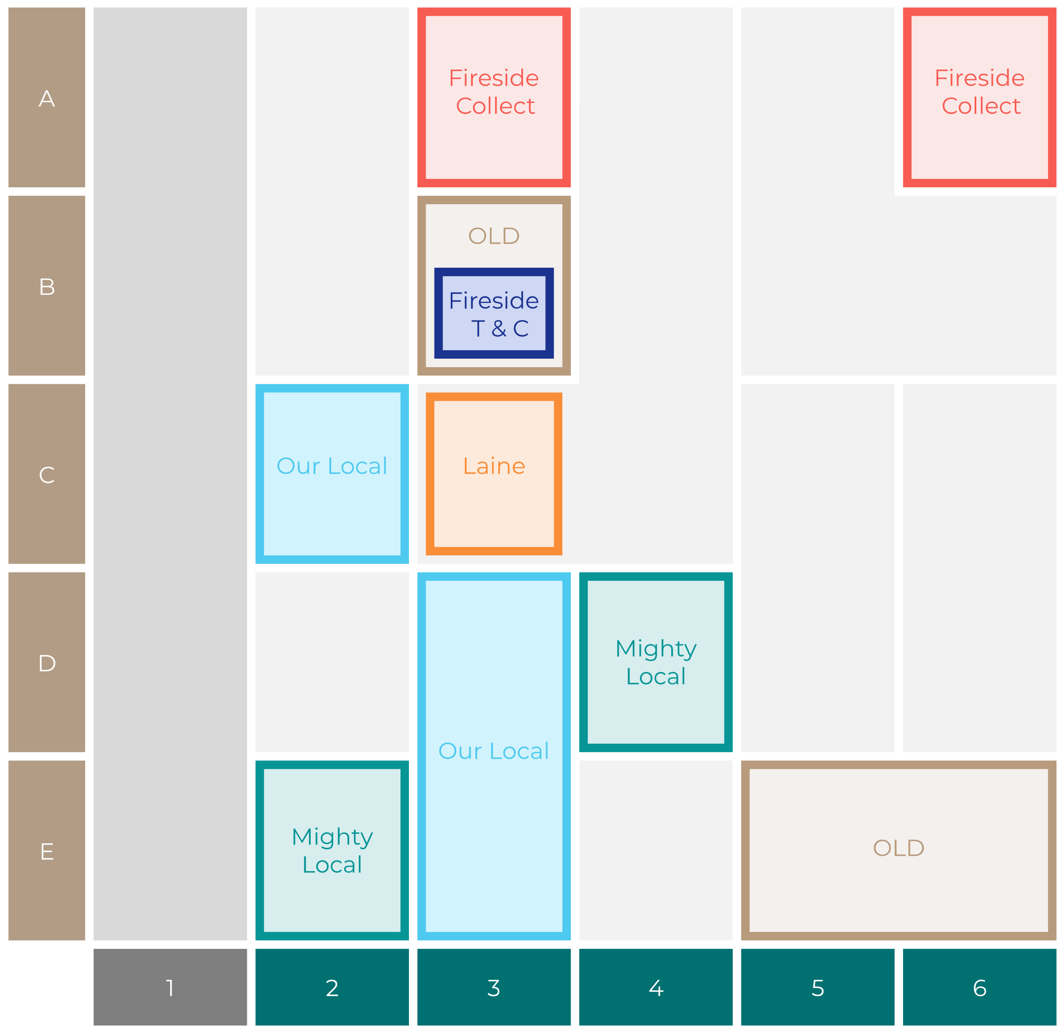

Site Intel
Hare & Hounds TF26DJ
Site Potential 1
Site Characteristics
£3000
£18000
OCC Concept Fit
Achievable Average Weekly Takings
Our Local Destination
£10000
A Food-Led High Affluence B Food-Led Mid Affluence C Wet-Led Mid/High Affluence D Wet-Led Low Affluence E Food-Led Low Affluence
AWT 2 Local Regulars 3 Local Passing Trade 4 Destination Wet-Led 5 Destination Food-Led 6 Destination Very Food-Led
A
B
C
D
E
1
2
3
4
5
6

Slide 16
Site Intel
Hare & Hounds TF26DJ
Site Potential 2
Concept Recommendation

Slide 17
Site Intel
Hare & Hounds TF26DJ
Local Market Profile
Mix of spend by customer segment in Punch site and local market
 | Customer Count | Family Familiar | Occasional & Local | Mid-Week Seniors | Part Of The Pub | Metro Sophisticates | Young & Connected | Bubbly Weekenders | Upmarket Diners
Hare & Hounds | 142 | 17.31% | 15.18% | 25.18% | 10.17% | 2.69% | 6.58% | 18.04% | 4.82%
Local Catchment | 367 | 15.30% | 6.67% | 22.70% | 10.56% | 3.15% | 9.81% | 12.93% | 18.84%
Punch T&L | 103230 | 8.34% | 5.96% | 29.07% | 10.93% | 11.57% | 11.74% | 7.08% | 15.27%
Hare & Hounds vs Local Catchment |  | 2.01% | 8.51% | 2.48% | -0.39% | -0.46% | -3.23% | 5.11% | -14.02%
Hare & Hounds vs Punch T&L |  | 8.97% | 9.22% | -3.89% | -0.76% | -8.88% | -5.16% | 10.96% | -10.45%
Local Catchment vs Punch T&L |  | 6.96% | 0.71% | -6.37% | -0.37% | -8.42% | -1.93% | 5.85% | 3.57%

Slide 18
Site Intel
Hare & Hounds TF26DJ
Local Competitor Profiles
Mix of spend by customer segment in Punch site and local competitors
 | Customer Count | Family Familiar | Occasional & Local | Mid-Week Seniors | Part Of The Pub | Metro Sophisticates | Young & Connected | Bubbly Weekenders | Upmarket Diners
Hare & Hounds TF26DJ | 142 | 17.31% | 15.18% | 25.18% | 10.17% | 2.69% | 6.58% | 18.04% | 4.82%
Bell & Bails TF29LT | 47 | 43.89% | 10.48% | 13.50% | 3.41% | 2.59% | 3.90% | 8.30% | 13.89%
Old Fighting Cocks TF26DU | 103 | 10.40% | 8.14% | 42.22% | 7.96% | 1.20% | 18.07% | 6.64% | 5.34%
Pheasant Inn TF26LF | 20 | 1.73% | 1.40% | 1.10% | 2.10% | 8.85% | 0.02% | 6.58% | 78.17%
Ballpoint TF29BF | 83 | 18.12% | 1.31% | 12.90% | 18.79% | 0.51% | 11.98% | 32.33% | 4.02%
Crown Inn TF26EA | 60 | 11.92% | 24.46% | 19.20% | 13.14% | 0.14% | 17.75% | 10.25% | 3.09%
Duke Of York TF26DU | 53 | 17.99% | 15.94% | 1.72% | 22.74% | 4.12% | 12.05% | 17.57% | 7.83%
Station Hotel TF26DU | 43 | 5.94% | 13.82% | 37.53% | 3.32% | 4.98% | 14.91% | 12.09% | 7.38%
Coalport Inn TF26AH | 51 | 12.55% | 5.38% | 4.30% | 52.96% | 2.43% | 9.98% | 10.71% | 1.66%
Compasses Inn TF26SD | 33 | 45.68% | 0.00% | 19.62% | 0.00% | 7.90% | 16.68% | 10.08% | 0.00%
Albion Inn TF29AD | 25 | 8.38% | 2.86% | 76.92% | 1.68% | 0.00% | 2.19% | 6.12% | 1.81%
Turf Inn TF29JW | 20 | 1.98% | 10.52% | 64.36% | 2.88% | 0.00% | 13.31% | 6.92% | 0.00%
Talbot Inn TF29BL | 2 | 94.62% | 0.00% | 0.00% | 0.00% | 0.00% | 0.00% | 0.00% | 5.37%
Lord Hill Telford TF20DH | 1 | 0.00% | 0.00% | 0.00% | 0.00% | 100.00% | 0.00% | 0.00% | 0.00%

