Slide 1











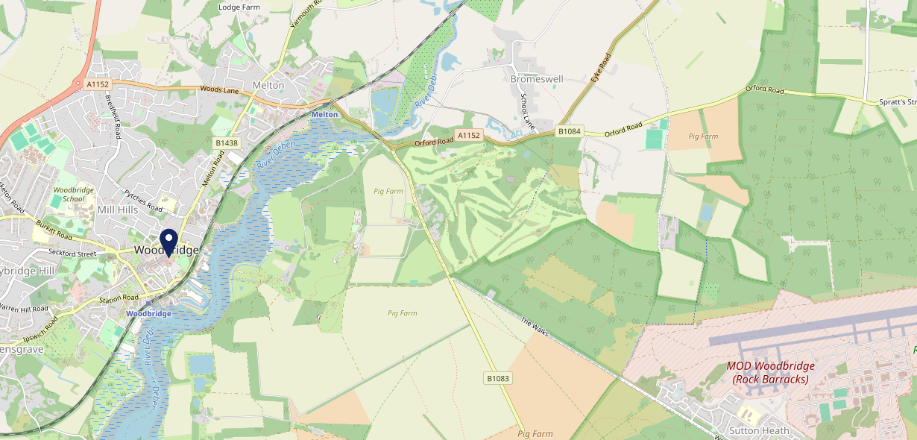











Site Intel
Red Lion IP121AL
3 Miles
97 Chains
06/09/2023 - 28/08/2024
Site Summary
Red Lion IP121AL
Work Area
Region
TV Region
Urbanicity
Ipswich
East of England
Anglia
Urban city and town
IP121AL
Punch - Our Local +
Top Competitors
ATV
Gender
Anchor (Woodbridge)
#1
£15.73
68.40%
Male
IP121BX
GK Pub Partners
Affluence
Segmentation
Kings Head
#2
42.85%
21.86%
Middle Income
Flourishing Society
IP124LP
Pub / Bar
Age Group
Visit Day
Old Mariner
#3
31.84%
21.88%
IP121DX
55 to 64
Sat
Punch T&L
Nearest Station
Woodbridge(0.38 miles)
1453 Site Customers
26 Competitors
19272 Competitor Customers

Slide 2

Site Intel
Red Lion IP121AL
3 Miles
97 Chains
06/09/2023 - 28/08/2024
Spend by Weekpart
How is customer spend distributed throughout the week for Red Lion IP121AL versus its competitors?
% of spend for Red Lion IP121AL and 97 Chains in 3 Miles from 06/09/2023 - 28/08/2024 split by Day of Week
1453 Site Customers
26 Competitors
19272 Competitor Customers

Slide 3
Site Intel
Red Lion IP121AL
3 Miles
97 Chains
06/09/2023 - 28/08/2024
Visit Frequency
How frequently per year do customers visit Red Lion IP121AL versus its competitors?
% of customer numbers for Red Lion IP121AL and 97 Chains in 3 Miles from 06/09/2023 - 28/08/2024 and the number of visits made Per Annum
1453 Site Customers
26 Competitors
19272 Competitor Customers

Slide 4
Site Intel
Red Lion IP121AL
3 Miles
97 Chains
06/09/2023 - 28/08/2024
ATV Change
How has ATV changed between two date ranges?
1453 Site Customers

Slide 5
Site Intel
Red Lion IP121AL
3 Miles
97 Chains
06/09/2023 - 28/08/2024
Market Share Change
How has market share changed between two date ranges?
% of market share spend for Red Lion IP121AL and 97 Chains in 3 Miles from 06/09/2023 - 28/08/2024
1453 Site Customers

Slide 6
Site Intel
Red Lion IP121AL
3 Miles
97 Chains
06/09/2023 - 28/08/2024
Age
How does the age profile of customers who visit Red Lion IP121AL compare versus its competitors?
% of spend for Red Lion IP121AL and 97 Chains in 3 Miles from 06/09/2023 - 28/08/2024 split by Age Range
621 Site Customers
26 Competitors
9060 Competitor Customers

Slide 7
Site Intel
Red Lion IP121AL
3 Miles
97 Chains
06/09/2023 - 28/08/2024
Affluence
How does the affluence of customers who visit Red Lion IP121AL compare versus its competitors?
% of spend for Red Lion IP121AL and 97 Chains in 3 Miles from 06/09/2023 - 28/08/2024 split by Affluence
633 Site Customers
26 Competitors
9144 Competitor Customers

Slide 8
Site Intel
Red Lion IP121AL
3 Miles
97 Chains
06/09/2023 - 28/08/2024
Gender
How does the gender profile of customers who visit Red Lion IP121AL compare versus its competitors?
% of spend for Red Lion IP121AL and 97 Chains in 3 Miles from 06/09/2023 - 28/08/2024 split by Gender
633 Site Customers
26 Competitors
9144 Competitor Customers

Slide 9
Site Intel
Red Lion IP121AL
3 Miles
97 Chains
06/09/2023 - 28/08/2024
Punch Segmentation
How does the Custom segmentation profile of customers who visit Red Lion IP121AL compare versus its competitors?
% of spend for Red Lion IP121AL and 97 Chains in 3 Miles from 06/09/2023 - 28/08/2024 split by Segment
1453 Site Customers
26 Competitors
19272 Competitor Customers

Slide 10
Site Intel
Red Lion IP121AL
3 Miles
97 Chains
06/09/2023 - 28/08/2024
Spend by Distance
How does the spend profile of Red Lion IP121AL compare versus its competitors based on travel distances?
% of spend for Red Lion IP121AL and 97 Chains in 3 Miles from 06/09/2023 - 28/08/2024 split by Distance travelled
608 Site Customers
26 Competitors
8846 Competitor Customers

Slide 11
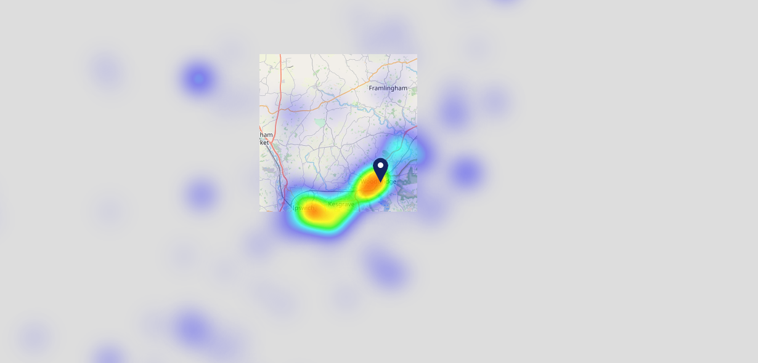

Site Intel
Red Lion IP121AL
06/09/2023 - 28/08/2024
Map of Guest Origin
Where do customers of Red Lion IP121AL come from?
Where do customers of Red Lion IP121AL for 06/09/2023 - 28/08/2024 live
608 Site Customers

Slide 12
Site Intel
Red Lion IP121AL
3 Miles
97 Chains
06/09/2023 - 28/08/2024
Share of Wallet
What are the Top 20 venues (by spend) that customers of Red Lion IP121AL also visit?
For customers of Red Lion IP121AL, who are the top 20 competitors from 97 Chains in 3 Miles for 06/09/2023 - 28/08/2024 split by Venue
1453 Site Customers

Slide 13
Site Intel
Red Lion IP121AL
3 Miles
97 Chains
06/09/2023 - 28/08/2024
Share of Wallet Change
How has share of wallet of customers of Red Lion IP121AL changed between two date ranges?
1453 Site Customers

Slide 14
Site Intel
Red Lion IP121AL
06/09/2023 - 28/08/2024
Market Summary
How does the local area for Red Lion IP121AL compare to the national average (1 = low, 10 = high)
Data Type | Name | Spend in 250m | 250m Spend vs National | Spend in 500m | 500m Spend vs National | Spend in 1 mile | 1 mile Spend vs National | Spend in 3 miles | 3 mile Spend vs National
Total | Annual Sales | £3.46M | 7 | £11.95M | 8 | £15.79M | 5 | £31.70M | 4
Weekpart | Mon - Thu | 43.5% | 7 | 39.1% | 4 | 39.8% | 4 | 42.1% | 6
Weekpart | Fri - Sat | 42.5% | 4 | 47.1% | 8 | 45.1% | 7 | 41.0% | 4
Weekpart | Sun | 14.0% | 5 | 13.8% | 4 | 15.1% | 5 | 16.9% | 8
Age | 18 to 24 | 2.5% | 2 | 3.1% | 3 | 3.0% | 2 | 3.1% | 1
Age | 25 to 34 | 11.1% | 1 | 10.9% | 1 | 10.4% | 1 | 11.1% | 1
Age | 35 to 44 | 18.1% | 2 | 17.2% | 2 | 17.4% | 1 | 18.7% | 1
Age | 45 to 54 | 17.5% | 3 | 19.5% | 5 | 18.5% | 3 | 18.1% | 2
Age | 55 to 64 | 24.5% | 10 | 25.4% | 10 | 24.5% | 10 | 23.0% | 10
Age | 65 to 74 | 17.5% | 10 | 15.4% | 10 | 16.4% | 10 | 15.8% | 10
Age | 75+ | 8.9% | 10 | 8.5% | 10 | 9.8% | 10 | 10.1% | 10
CAMEO | Business Elite | 8.8% | 7 | 8.4% | 6 | 7.9% | 6 | 7.1% | 5
CAMEO | Prosperous Professionals | 7.9% | 7 | 8.8% | 8 | 8.4% | 8 | 8.5% | 8
CAMEO | Flourishing Society | 21.3% | 9 | 22.0% | 9 | 21.8% | 9 | 20.5% | 9
CAMEO | Content Communities | 14.2% | 7 | 15.4% | 8 | 15.0% | 8 | 16.1% | 9
CAMEO | White Collar Neighbourhoods | 12.3% | 7 | 10.8% | 5 | 10.8% | 5 | 10.3% | 4
CAMEO | Enterprising Mainstream | 15.3% | 10 | 16.9% | 10 | 17.6% | 10 | 16.0% | 10
CAMEO | Paying The Mortgage | 8.9% | 2 | 8.9% | 2 | 9.2% | 2 | 11.2% | 3
CAMEO | Cash Conscious Communities | 7.4% | 4 | 5.5% | 3 | 5.5% | 2 | 6.3% | 3
CAMEO | On A Budget | 2.5% | 2 | 2.5% | 1 | 2.7% | 1 | 2.7% | 1
CAMEO | Family Value | 1.4% | 4 | 0.9% | 3 | 1.1% | 3 | 1.3% | 3
Affluence | AB | 38.0% | 8 | 39.2% | 8 | 38.2% | 8 | 36.1% | 7
Affluence | C1C2 | 50.7% | 6 | 51.9% | 7 | 52.6% | 7 | 53.5% | 8
Affluence | DE | 11.3% | 2 | 8.9% | 2 | 9.2% | 1 | 10.4% | 1

Slide 15

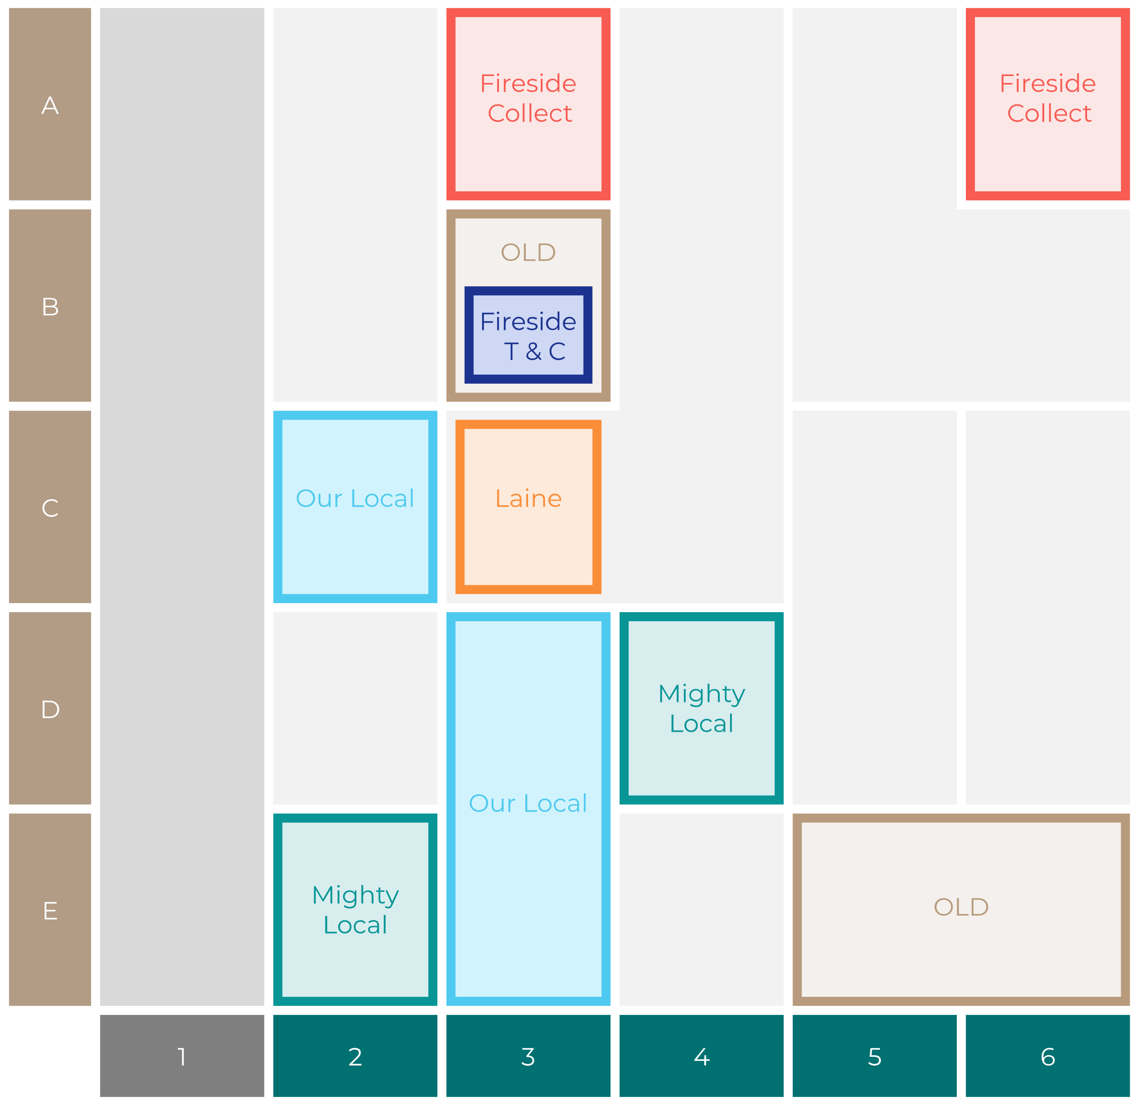

Site Intel
Red Lion IP121AL
Site Potential 1
Site Characteristics
£3000
£18000
OCC Concept Fit
Achievable Average Weekly Takings
Fireside Scenic
£12000
A Food-Led High Affluence B Food-Led Mid Affluence C Wet-Led Mid/High Affluence D Wet-Led Low Affluence E Food-Led Low Affluence
AWT 2 Local Regulars 3 Local Passing Trade 4 Destination Wet-Led 5 Destination Food-Led 6 Destination Very Food-Led
A
B
C
D
E
1
2
3
4
5
6

Slide 16
Site Intel
Red Lion IP121AL
Site Potential 2
Concept Recommendation

Slide 17
Site Intel
Red Lion IP121AL
Local Market Profile
Mix of spend by customer segment in Punch site and local market
 | Customer Count | Family Familiar | Occasional & Local | Mid-Week Seniors | Part Of The Pub | Metro Sophisticates | Young & Connected | Bubbly Weekenders | Upmarket Diners
Red Lion | 201 | 10.83% | 33.65% | 18.21% | 1.93% | 9.53% | 6.97% | 6.69% | 12.16%
Local Catchment | 1879 | 6.10% | 7.13% | 23.64% | 3.00% | 11.68% | 4.58% | 6.43% | 37.40%
Punch T&L | 103230 | 8.34% | 5.96% | 29.07% | 10.93% | 11.57% | 11.74% | 7.08% | 15.27%
Red Lion vs Local Catchment |  | 4.73% | 26.52% | -5.43% | -1.07% | -2.15% | 2.39% | 0.26% | -25.24%
Red Lion vs Punch T&L |  | 2.49% | 27.69% | -10.86% | -9.00% | -2.04% | -4.77% | -0.39% | -3.11%
Local Catchment vs Punch T&L |  | -2.24% | 1.17% | -5.43% | -7.93% | 0.11% | -7.16% | -0.65% | 22.13%

Slide 18
Site Intel
Red Lion IP121AL
Local Competitor Profiles
Mix of spend by customer segment in Punch site and local competitors
 | Customer Count | Family Familiar | Occasional & Local | Mid-Week Seniors | Part Of The Pub | Metro Sophisticates | Young & Connected | Bubbly Weekenders | Upmarket Diners
Red Lion IP121AL | 201 | 10.83% | 33.65% | 18.21% | 1.93% | 9.53% | 6.97% | 6.69% | 12.16%
Anchor (Woodbridge) IP121BX | 417 | 1.77% | 2.50% | 26.89% | 11.25% | 16.11% | 3.15% | 4.66% | 33.62%
Kings Head IP124LP | 326 | 4.31% | 19.13% | 17.87% | 1.55% | 12.15% | 4.32% | 3.42% | 37.21%
Old Mariner IP121DX | 122 | 1.63% | 30.92% | 22.64% | 2.60% | 19.55% | 1.34% | 4.87% | 16.43%
Coach & Horses Woodbridge IP121PD | 278 | 12.13% | 3.10% | 28.59% | 7.96% | 5.72% | 6.59% | 5.10% | 30.76%
Cherry Tree IP124AG | 254 | 10.82% | 13.53% | 26.39% | 1.35% | 9.15% | 3.45% | 5.82% | 29.45%
Ye Olde Bell & Steelyard (Woodbridge) IP121DZ | 105 | 1.83% | 6.36% | 30.37% | 3.80% | 24.03% | 7.44% | 8.03% | 18.10%
Maybush Inn IP124QL | 582 | 8.63% | 1.80% | 25.02% | 1.33% | 6.26% | 6.43% | 7.74% | 42.75%
Fearless Inns IP124NE | 76 | 0.61% | 5.46% | 39.96% | 0.12% | 21.45% | 6.12% | 15.01% | 11.23%
Wilford Bridge IP122PA | 193 | 6.70% | 14.16% | 27.24% | 1.08% | 5.21% | 4.63% | 8.14% | 32.80%
White Lion Inn IP136DW | 83 | 11.74% | 0.48% | 21.67% | 1.82% | 20.98% | 0.30% | 0.49% | 42.48%
Warwick IP121JX | 27 | 10.49% | 21.71% | 27.91% | 4.81% | 12.44% | 13.75% | 5.80% | 3.03%
Ufford Crown IP136EL | 127 | 4.51% | 0.61% | 22.65% | 0.72% | 14.20% | 2.10% | 7.07% | 48.11%
Unruly Pig IP122PU | 205 | 2.87% | 1.95% | 14.71% | 0.58% | 15.25% | 3.02% | 8.62% | 52.95%
Black Tiles IP124SP | 65 | 26.11% | 7.63% | 11.06% | 0.90% | 7.25% | 3.25% | 11.45% | 32.32%
Woodbridge Rugby Union IP122PP | 45 | 1.17% | 3.03% | 19.33% | 0.00% | 24.74% | 0.00% | 7.76% | 43.94%
Turks Head IP136JG | 35 | 7.87% | 1.39% | 13.76% | 6.51% | 6.04% | 22.73% | 12.74% | 28.93%
Mt Tappers IP124PP | 26 | 2.57% | 0.00% | 44.01% | 1.54% | 0.00% | 11.56% | 1.72% | 38.56%
Plough IP123DU | 17 | 0.00% | 2.75% | 31.83% | 2.92% | 0.00% | 1.56% | 0.00% | 60.91%
Park Bar IP121QW | 45 | 5.89% | 0.00% | 42.14% | 2.27% | 12.44% | 16.67% | 5.12% | 15.44%

