Slide 1











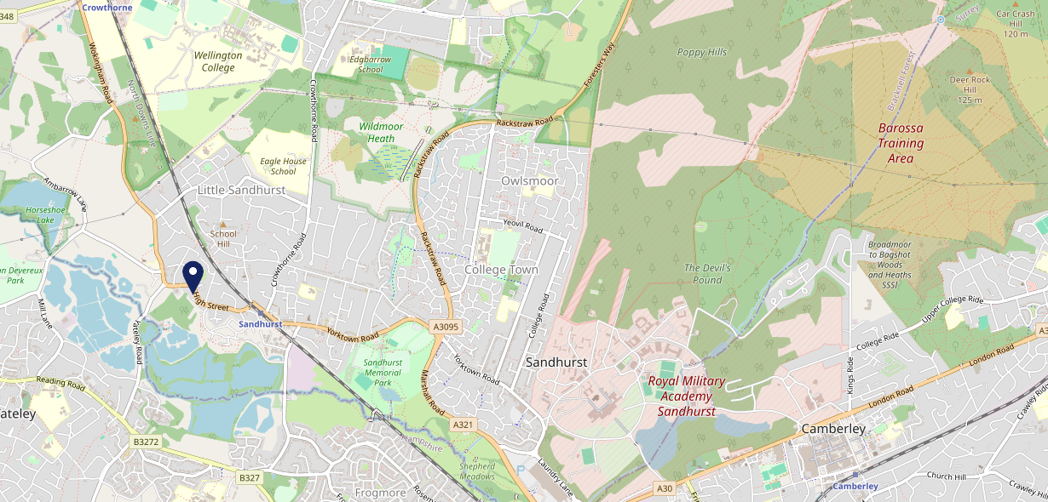











Site Intel
Rose & Crown GU478HA
3 Miles
97 Chains
06/09/2023 - 28/08/2024
Site Summary
Rose & Crown GU478HA
Work Area
Region
TV Region
Urbanicity
Reading
South East
London
Urban city and town
GU478HA
Punch - Our Local
Top Competitors
ATV
Gender
Wellington Arms
#1
£12.63
76.19%
Male
GU479BN
Pub / Bar
Affluence
Segmentation
White Swan (Sandhurst)
#2
58.23%
23.24%
High Income
Business Elite
GU479BU
GK - Locals - Value
Age Group
Visit Day
Bird in Hand (Little Sandhurst)
#3
23.88%
25.94%
GU478LQ
35 to 44
Sat
GK Pub Partners
Nearest Station
Sandhurst (Berks)(0.45 miles)
901 Site Customers
63 Competitors
39347 Competitor Customers

Slide 2

Site Intel
Rose & Crown GU478HA
3 Miles
97 Chains
06/09/2023 - 28/08/2024
Spend by Weekpart
How is customer spend distributed throughout the week for Rose & Crown GU478HA versus its competitors?
% of spend for Rose & Crown GU478HA and 97 Chains in 3 Miles from 06/09/2023 - 28/08/2024 split by Day of Week
901 Site Customers
63 Competitors
39347 Competitor Customers

Slide 3
Site Intel
Rose & Crown GU478HA
3 Miles
97 Chains
06/09/2023 - 28/08/2024
Visit Frequency
How frequently per year do customers visit Rose & Crown GU478HA versus its competitors?
% of customer numbers for Rose & Crown GU478HA and 97 Chains in 3 Miles from 06/09/2023 - 28/08/2024 and the number of visits made Per Annum
901 Site Customers
63 Competitors
39347 Competitor Customers

Slide 4
Site Intel
Rose & Crown GU478HA
3 Miles
97 Chains
06/09/2023 - 28/08/2024
ATV Change
How has ATV changed between two date ranges?
901 Site Customers

Slide 5
Site Intel
Rose & Crown GU478HA
3 Miles
97 Chains
06/09/2023 - 28/08/2024
Market Share Change
How has market share changed between two date ranges?
% of market share spend for Rose & Crown GU478HA and 97 Chains in 3 Miles from 06/09/2023 - 28/08/2024
901 Site Customers

Slide 6
Site Intel
Rose & Crown GU478HA
3 Miles
97 Chains
06/09/2023 - 28/08/2024
Age
How does the age profile of customers who visit Rose & Crown GU478HA compare versus its competitors?
% of spend for Rose & Crown GU478HA and 97 Chains in 3 Miles from 06/09/2023 - 28/08/2024 split by Age Range
439 Site Customers
63 Competitors
18510 Competitor Customers

Slide 7
Site Intel
Rose & Crown GU478HA
3 Miles
97 Chains
06/09/2023 - 28/08/2024
Affluence
How does the affluence of customers who visit Rose & Crown GU478HA compare versus its competitors?
% of spend for Rose & Crown GU478HA and 97 Chains in 3 Miles from 06/09/2023 - 28/08/2024 split by Affluence
448 Site Customers
63 Competitors
18771 Competitor Customers

Slide 8
Site Intel
Rose & Crown GU478HA
3 Miles
97 Chains
06/09/2023 - 28/08/2024
Gender
How does the gender profile of customers who visit Rose & Crown GU478HA compare versus its competitors?
% of spend for Rose & Crown GU478HA and 97 Chains in 3 Miles from 06/09/2023 - 28/08/2024 split by Gender
448 Site Customers
63 Competitors
18771 Competitor Customers

Slide 9
Site Intel
Rose & Crown GU478HA
3 Miles
97 Chains
06/09/2023 - 28/08/2024
Punch Segmentation
How does the Custom segmentation profile of customers who visit Rose & Crown GU478HA compare versus its competitors?
% of spend for Rose & Crown GU478HA and 97 Chains in 3 Miles from 06/09/2023 - 28/08/2024 split by Segment
901 Site Customers
63 Competitors
39347 Competitor Customers

Slide 10
Site Intel
Rose & Crown GU478HA
3 Miles
97 Chains
06/09/2023 - 28/08/2024
Spend by Distance
How does the spend profile of Rose & Crown GU478HA compare versus its competitors based on travel distances?
% of spend for Rose & Crown GU478HA and 97 Chains in 3 Miles from 06/09/2023 - 28/08/2024 split by Distance travelled
432 Site Customers
63 Competitors
18122 Competitor Customers

Slide 11
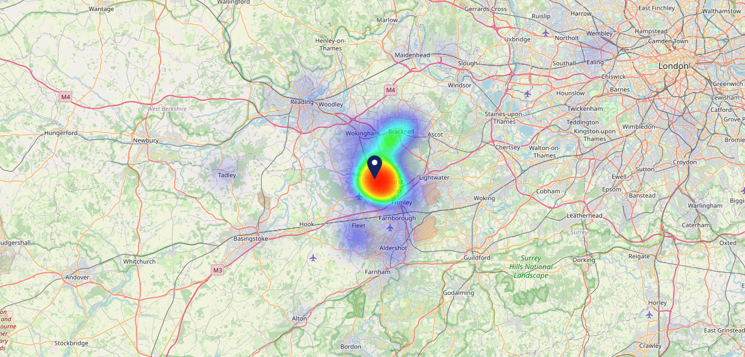

Site Intel
Rose & Crown GU478HA
06/09/2023 - 28/08/2024
Map of Guest Origin
Where do customers of Rose & Crown GU478HA come from?
Where do customers of Rose & Crown GU478HA for 06/09/2023 - 28/08/2024 live
432 Site Customers

Slide 12
Site Intel
Rose & Crown GU478HA
3 Miles
97 Chains
06/09/2023 - 28/08/2024
Share of Wallet
What are the Top 20 venues (by spend) that customers of Rose & Crown GU478HA also visit?
For customers of Rose & Crown GU478HA, who are the top 20 competitors from 97 Chains in 3 Miles for 06/09/2023 - 28/08/2024 split by Venue
901 Site Customers

Slide 13
Site Intel
Rose & Crown GU478HA
3 Miles
97 Chains
06/09/2023 - 28/08/2024
Share of Wallet Change
How has share of wallet of customers of Rose & Crown GU478HA changed between two date ranges?
901 Site Customers

Slide 14
Site Intel
Rose & Crown GU478HA
06/09/2023 - 28/08/2024
Market Summary
How does the local area for Rose & Crown GU478HA compare to the national average (1 = low, 10 = high)
Data Type | Name | Spend in 250m | 250m Spend vs National | Spend in 500m | 500m Spend vs National | Spend in 1 mile | 1 mile Spend vs National | Spend in 3 miles | 3 mile Spend vs National
Total | Annual Sales | £1.12M | 5 | £1.22M | 4 | £15.04M | 5 | £80.78M | 6
Weekpart | Mon - Thu | 38.9% | 5 | 39.5% | 5 | 40.5% | 5 | 40.6% | 4
Weekpart | Fri - Sat | 41.0% | 4 | 40.5% | 3 | 44.5% | 7 | 43.3% | 7
Weekpart | Sun | 20.1% | 9 | 20.0% | 9 | 15.0% | 5 | 16.0% | 7
Age | 18 to 24 | 7.8% | 7 | 7.2% | 6 | 5.3% | 4 | 6.1% | 4
Age | 25 to 34 | 12.5% | 2 | 13.6% | 2 | 11.0% | 1 | 13.4% | 1
Age | 35 to 44 | 24.6% | 7 | 25.8% | 7 | 21.1% | 3 | 23.4% | 5
Age | 45 to 54 | 19.8% | 5 | 18.6% | 4 | 21.8% | 8 | 22.3% | 9
Age | 55 to 64 | 16.4% | 6 | 16.2% | 6 | 19.1% | 8 | 18.5% | 9
Age | 65 to 74 | 15.6% | 10 | 15.2% | 10 | 17.1% | 10 | 11.5% | 9
Age | 75+ | 3.3% | 7 | 3.3% | 7 | 4.6% | 8 | 4.8% | 9
CAMEO | Business Elite | 15.4% | 9 | 14.8% | 8 | 10.1% | 7 | 12.6% | 8
CAMEO | Prosperous Professionals | 13.1% | 10 | 12.7% | 10 | 12.3% | 10 | 11.4% | 10
CAMEO | Flourishing Society | 20.3% | 9 | 20.7% | 9 | 29.5% | 10 | 23.6% | 10
CAMEO | Content Communities | 8.7% | 3 | 9.3% | 3 | 10.3% | 3 | 12.7% | 6
CAMEO | White Collar Neighbourhoods | 15.7% | 9 | 16.0% | 9 | 15.9% | 9 | 14.9% | 9
CAMEO | Enterprising Mainstream | 6.9% | 5 | 6.7% | 5 | 4.7% | 2 | 4.8% | 2
CAMEO | Paying The Mortgage | 5.8% | 1 | 6.5% | 1 | 9.6% | 2 | 10.5% | 3
CAMEO | Cash Conscious Communities | 6.6% | 4 | 6.4% | 3 | 4.3% | 1 | 4.5% | 1
CAMEO | On A Budget | 6.4% | 6 | 6.2% | 5 | 3.0% | 1 | 4.3% | 2
CAMEO | Family Value | 0.9% | 3 | 0.8% | 2 | 0.4% | 1 | 0.7% | 1
Affluence | AB | 48.8% | 9 | 48.2% | 9 | 51.8% | 10 | 47.6% | 10
Affluence | C1C2 | 37.2% | 2 | 38.4% | 2 | 40.5% | 3 | 42.9% | 3
Affluence | DE | 13.9% | 3 | 13.4% | 3 | 7.7% | 1 | 9.5% | 1

Slide 15

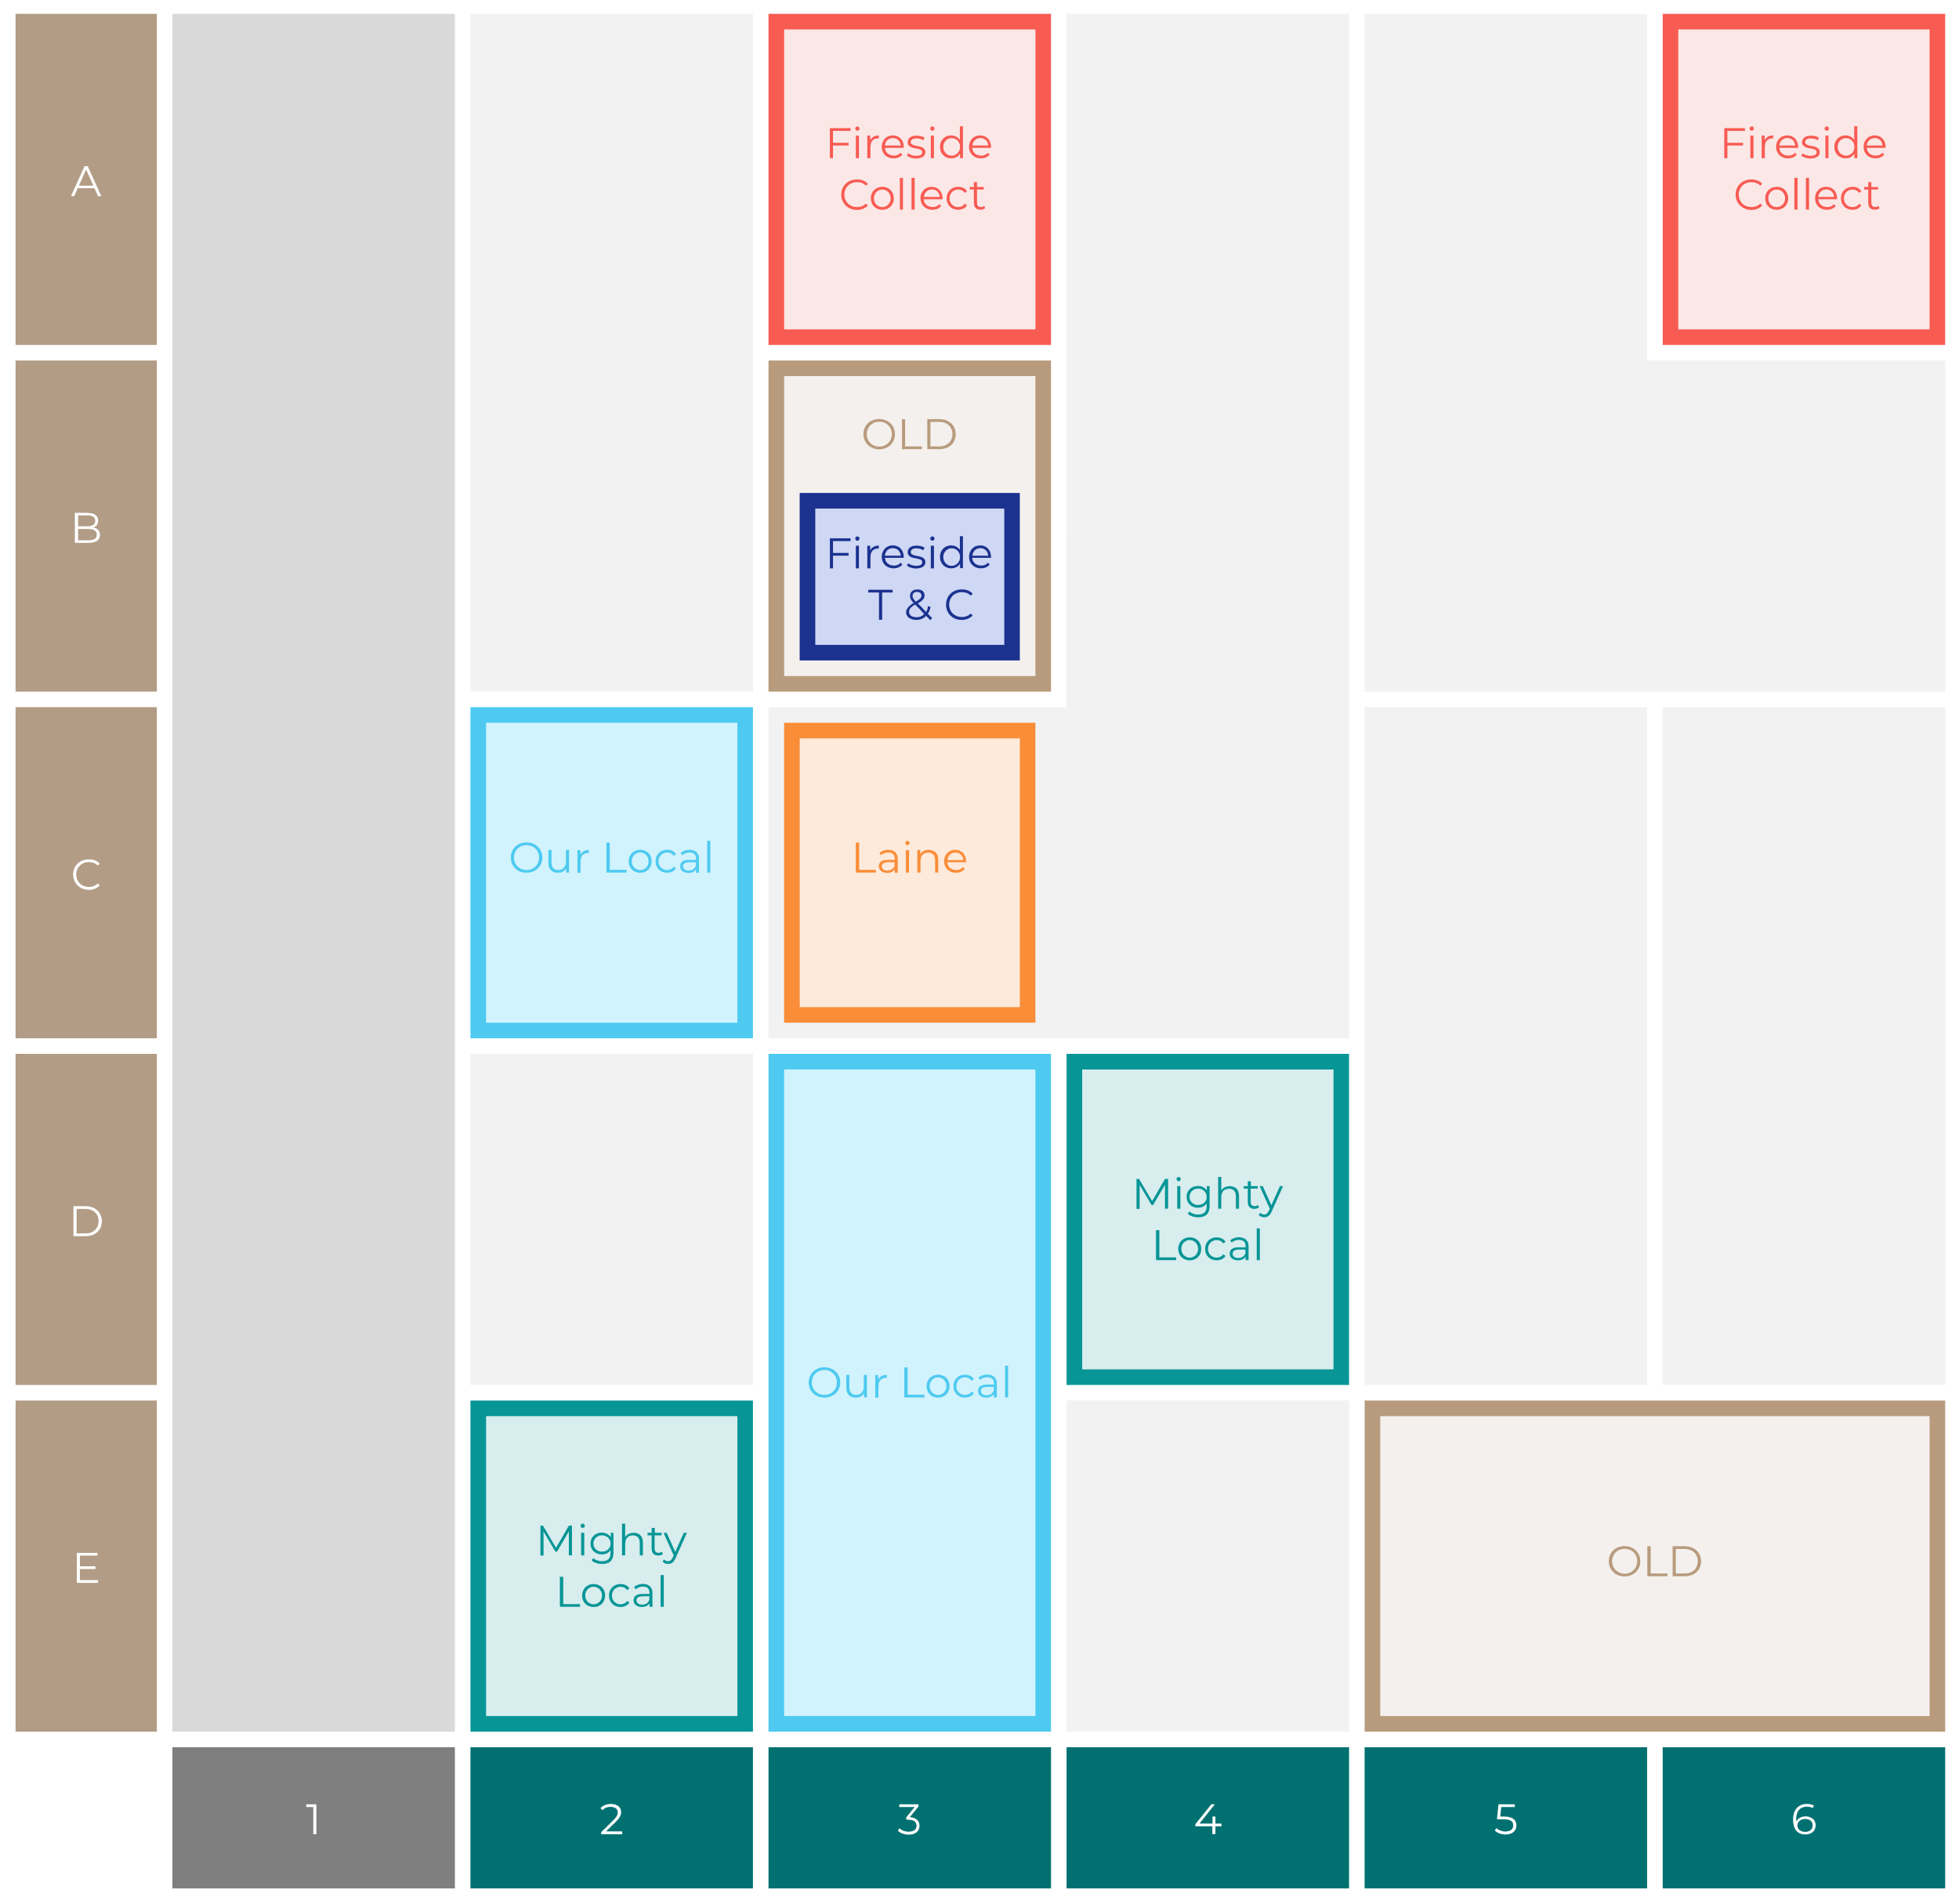

Site Intel
Rose & Crown GU478HA
Site Potential 1
Site Characteristics
£3000
£18000
OCC Concept Fit
Achievable Average Weekly Takings
Non-Core
£9500
A Food-Led High Affluence B Food-Led Mid Affluence C Wet-Led Mid/High Affluence D Wet-Led Low Affluence E Food-Led Low Affluence
AWT 2 Local Regulars 3 Local Passing Trade 4 Destination Wet-Led 5 Destination Food-Led 6 Destination Very Food-Led
A
B
C
D
E
1
2
3
4
5
6

Slide 16
Site Intel
Rose & Crown GU478HA
Site Potential 2
Concept Recommendation

Slide 17
Site Intel
Rose & Crown GU478HA
Local Market Profile
Mix of spend by customer segment in Punch site and local market
 | Customer Count | Family Familiar | Occasional & Local | Mid-Week Seniors | Part Of The Pub | Metro Sophisticates | Young & Connected | Bubbly Weekenders | Upmarket Diners
Rose & Crown | 181 | 9.08% | 1.71% | 45.66% | 4.57% | 8.37% | 9.34% | 13.18% | 8.05%
Local Catchment | 3934 | 8.60% | 3.88% | 15.74% | 16.71% | 9.35% | 15.05% | 7.56% | 23.06%
Punch T&L | 103230 | 8.34% | 5.96% | 29.07% | 10.93% | 11.57% | 11.74% | 7.08% | 15.27%
Rose & Crown vs Local Catchment |  | 0.48% | -2.17% | 29.92% | -12.14% | -0.98% | -5.71% | 5.62% | -15.01%
Rose & Crown vs Punch T&L |  | 0.74% | -4.25% | 16.59% | -6.36% | -3.20% | -2.40% | 6.10% | -7.22%
Local Catchment vs Punch T&L |  | 0.26% | -2.08% | -13.33% | 5.78% | -2.22% | 3.31% | 0.48% | 7.79%

Slide 18
Site Intel
Rose & Crown GU478HA
Local Competitor Profiles
Mix of spend by customer segment in Punch site and local competitors
 | Customer Count | Family Familiar | Occasional & Local | Mid-Week Seniors | Part Of The Pub | Metro Sophisticates | Young & Connected | Bubbly Weekenders | Upmarket Diners
Rose & Crown GU478HA | 181 | 9.08% | 1.71% | 45.66% | 4.57% | 8.37% | 9.34% | 13.18% | 8.05%
Wellington Arms GU479BN | 204 | 5.29% | 0.36% | 4.81% | 61.92% | 9.40% | 8.06% | 4.85% | 5.27%
White Swan (Sandhurst) GU479BU | 189 | 6.98% | 9.06% | 10.98% | 53.41% | 3.48% | 6.25% | 4.87% | 4.94%
Bird in Hand (Little Sandhurst) GU478LQ | 120 | 12.06% | 10.59% | 4.36% | 1.59% | 10.53% | 33.65% | 4.84% | 22.35%
Village Inn GU479DX | 112 | 3.89% | 3.01% | 24.09% | 53.76% | 2.77% | 8.05% | 2.75% | 1.64%
Dog & Partridge GU467LR | 269 | 8.87% | 4.67% | 42.10% | 5.68% | 8.60% | 7.59% | 6.80% | 15.65%
Prince (Crowthorne) RG457AZ | 312 | 13.74% | 2.87% | 18.42% | 1.97% | 17.29% | 18.22% | 10.29% | 17.17%
Royal Oak (Yateley) GU467UG | 166 | 9.82% | 12.57% | 12.66% | 17.32% | 14.97% | 11.65% | 10.99% | 9.98%
Sandhurst Social Club GU479AW | 49 | 10.92% | 3.18% | 32.45% | 2.61% | 0.03% | 1.03% | 47.39% | 2.35%
The Frog & Wicket (Eversley) RG270NS | 236 | 4.16% | 0.91% | 8.95% | 23.77% | 17.55% | 7.48% | 1.77% | 35.37%
Verthe Wellington Ar GU479BN | 77 | 8.25% | 0.77% | 1.75% | 70.26% | 2.58% | 8.58% | 3.02% | 4.75%
Chequers (Eversley Cross) RG270NS | 312 | 3.05% | 0.19% | 11.09% | 0.78% | 15.54% | 2.95% | 5.04% | 61.32%
Cricketers (Yateley) GU466BA | 220 | 18.83% | 3.35% | 35.25% | 4.62% | 10.46% | 8.92% | 5.56% | 12.96%
Crown & Cushion (Blackwater) GU179UA | 623 | 7.21% | 0.99% | 22.16% | 0.93% | 11.83% | 13.05% | 5.67% | 38.11%
Mr Bumble GU179AP | 109 | 3.27% | 1.14% | 8.26% | 62.32% | 8.39% | 7.82% | 5.35% | 3.41%
Greyhound (Finchampstead) RG403TS | 256 | 2.15% | 0.00% | 7.12% | 2.78% | 9.20% | 3.38% | 2.37% | 72.96%
Station Tap Camberley GU153RB | 350 | 8.83% | 1.63% | 6.72% | 2.02% | 4.20% | 59.57% | 11.63% | 5.36%
The Claude du Vall GU153RB | 468 | 12.77% | 3.54% | 16.77% | 12.88% | 3.61% | 29.56% | 14.08% | 6.76%
Crowthorne Inn (Crowthorne) RG457AD | 45 | 1.30% | 6.60% | 30.17% | 6.02% | 10.04% | 5.32% | 9.07% | 31.44%
Bear Frimley GU153PQ | 383 | 10.39% | 1.04% | 16.88% | 4.87% | 13.87% | 28.90% | 8.62% | 15.39%
Carpenters Arms (Camberley) GU153PE | 359 | 6.99% | 1.41% | 13.67% | 19.01% | 9.26% | 25.39% | 12.58% | 11.66%
Queens Oak RG404LS | 176 | 2.64% | 1.98% | 16.66% | 3.49% | 8.68% | 2.13% | 4.46% | 59.91%
Camberley - Tru GU153RS | 106 | 0.97% | 2.31% | 2.11% | 2.86% | 2.17% | 78.59% | 10.57% | 0.38%
Golden Pot RG270NB | 42 | 1.59% | 4.71% | 31.92% | 1.03% | 31.00% | 10.29% | 9.18% | 10.23%
Ascot Ales GU153DL | 113 | 2.70% | 0.89% | 19.43% | 0.00% | 6.32% | 37.68% | 6.76% | 26.19%

