Slide 1
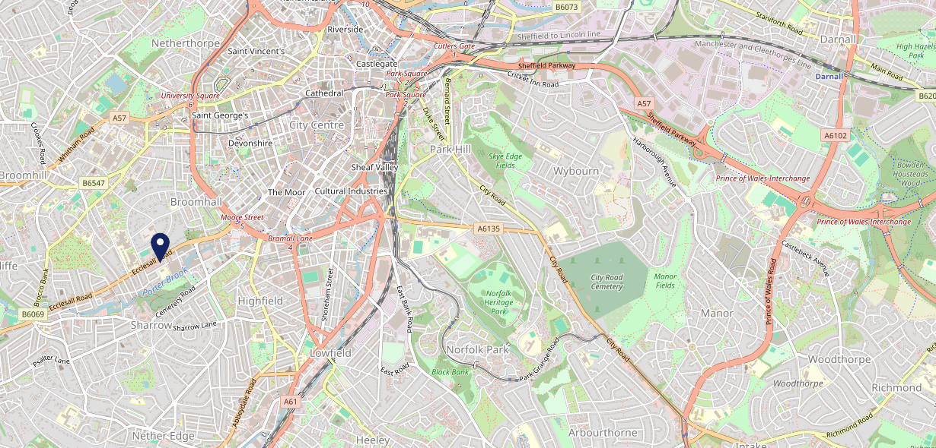
Site Intel
Champs Sports Bar & Grill S118NX
1 Miles
99 Chains
08/11/2023 - 30/10/2024
Site Summary
Champs Sports Bar & Grill S118NX
Work Area
Region
TV Region
Urbanicity
Sheffield
Yorkshire and The Humber
Yorkshire
Urban minor conurbation
S118NX
Punch - Mighty Local
Top Competitors
ATV
Gender
Nursery Tavern
#1
£8.19
81.37%
Male
S118PE
M&B High Street
Affluence
Segmentation
Molly Malones
#2
49.01%
21.80%
Middle Income
Paying The Mortgage
S14ES
Pub / Bar
Age Group
Visit Day
Tiger Works
#3
31.24%
35.12%
S14ES
25 to 34
Sat
Pub / Bar
Nearest Station
Sheffield(1.88 miles)
3612 Site Customers
235 Competitors
400427 Competitor Customers

Slide 2
Site Intel
Champs Sports Bar & Grill S118NX
1 Miles
99 Chains
08/11/2023 - 30/10/2024
Spend by Weekpart
How is customer spend distributed throughout the week for Champs Sports Bar & Grill S118NX versus its competitors?
% of spend for Champs Sports Bar & Grill S118NX and 99 Chains in 1 Miles from 08/11/2023 - 30/10/2024 split by Day of Week
3612 Site Customers
235 Competitors
400427 Competitor Customers

Slide 3
Site Intel
Champs Sports Bar & Grill S118NX
1 Miles
99 Chains
08/11/2023 - 30/10/2024
Visit Frequency
How frequently per year do customers visit Champs Sports Bar & Grill S118NX versus its competitors?
% of customer numbers for Champs Sports Bar & Grill S118NX and 99 Chains in 1 Miles from 08/11/2023 - 30/10/2024 and the number of visits made Per Annum
3612 Site Customers
235 Competitors
400427 Competitor Customers

Slide 4
Site Intel
Champs Sports Bar & Grill S118NX
1 Miles
99 Chains
08/11/2023 - 30/10/2024
ATV Change
How has ATV changed between two date ranges?
3612 Site Customers

Slide 5
Site Intel
Champs Sports Bar & Grill S118NX
1 Miles
99 Chains
08/11/2023 - 30/10/2024
Market Share Change
How has market share changed between two date ranges?
% of market share spend for Champs Sports Bar & Grill S118NX and 99 Chains in 1 Miles from 08/11/2023 - 30/10/2024
3612 Site Customers

Slide 6
Site Intel
Champs Sports Bar & Grill S118NX
1 Miles
99 Chains
08/11/2023 - 30/10/2024
Age
How does the age profile of customers who visit Champs Sports Bar & Grill S118NX compare versus its competitors?
% of spend for Champs Sports Bar & Grill S118NX and 99 Chains in 1 Miles from 08/11/2023 - 30/10/2024 split by Age Range
995 Site Customers
235 Competitors
137849 Competitor Customers

Slide 7
Site Intel
Champs Sports Bar & Grill S118NX
1 Miles
99 Chains
08/11/2023 - 30/10/2024
Affluence
How does the affluence of customers who visit Champs Sports Bar & Grill S118NX compare versus its competitors?
% of spend for Champs Sports Bar & Grill S118NX and 99 Chains in 1 Miles from 08/11/2023 - 30/10/2024 split by Affluence
1016 Site Customers
235 Competitors
139895 Competitor Customers

Slide 8
Site Intel
Champs Sports Bar & Grill S118NX
1 Miles
99 Chains
08/11/2023 - 30/10/2024
Gender
How does the gender profile of customers who visit Champs Sports Bar & Grill S118NX compare versus its competitors?
% of spend for Champs Sports Bar & Grill S118NX and 99 Chains in 1 Miles from 08/11/2023 - 30/10/2024 split by Gender
1016 Site Customers
235 Competitors
139895 Competitor Customers

Slide 9
Site Intel
Champs Sports Bar & Grill S118NX
1 Miles
99 Chains
08/11/2023 - 30/10/2024
Punch Segmentation
How does the Custom segmentation profile of customers who visit Champs Sports Bar & Grill S118NX compare versus its competitors?
% of spend for Champs Sports Bar & Grill S118NX and 99 Chains in 1 Miles from 08/11/2023 - 30/10/2024 split by Segment
3612 Site Customers
235 Competitors
400427 Competitor Customers

Slide 10
Site Intel
Champs Sports Bar & Grill S118NX
1 Miles
99 Chains
08/11/2023 - 30/10/2024
Spend by Distance
How does the spend profile of Champs Sports Bar & Grill S118NX compare versus its competitors based on travel distances?
% of spend for Champs Sports Bar & Grill S118NX and 99 Chains in 1 Miles from 08/11/2023 - 30/10/2024 split by Distance travelled
966 Site Customers
235 Competitors
134289 Competitor Customers

Slide 11
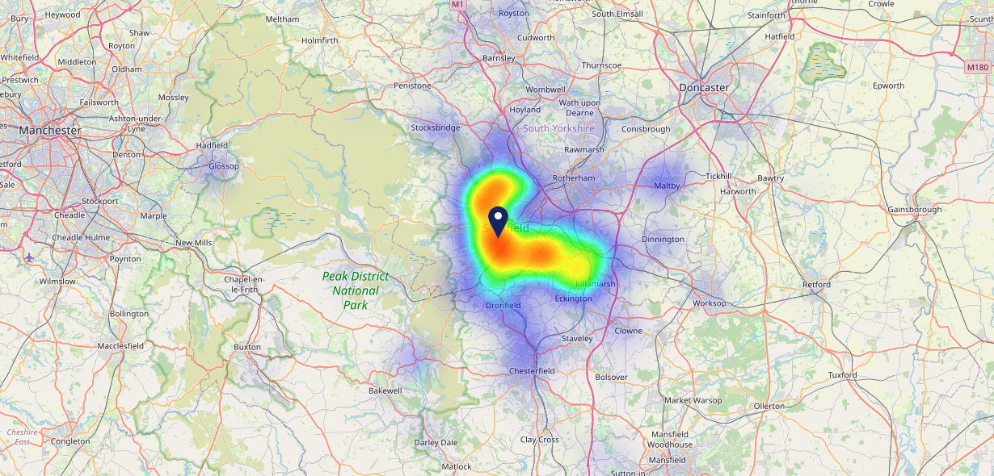
Site Intel
Champs Sports Bar & Grill S118NX
08/11/2023 - 30/10/2024
Map of Guest Origin
Where do customers of Champs Sports Bar & Grill S118NX come from?
Where do customers of Champs Sports Bar & Grill S118NX for 08/11/2023 - 30/10/2024 live
966 Site Customers

Slide 12
Site Intel
Champs Sports Bar & Grill S118NX
1 Miles
99 Chains
08/11/2023 - 30/10/2024
Share of Wallet
What are the Top 20 venues (by spend) that customers of Champs Sports Bar & Grill S118NX also visit?
For customers of Champs Sports Bar & Grill S118NX, who are the top 20 competitors from 99 Chains in 1 Miles for 08/11/2023 - 30/10/2024 split by Venue
3612 Site Customers

Slide 13
Site Intel
Champs Sports Bar & Grill S118NX
1 Miles
99 Chains
08/11/2023 - 30/10/2024
Share of Wallet Change
How has share of wallet of customers of Champs Sports Bar & Grill S118NX changed between two date ranges?
3612 Site Customers

Slide 14
Site Intel
Champs Sports Bar & Grill S118NX
08/11/2023 - 30/10/2024
Market Summary
How does the local area for Champs Sports Bar & Grill S118NX compare to the national average (1 = low, 10 = high)
Data Type | Name | Spend in 250m | 250m Spend vs National | Spend in 500m | 500m Spend vs National | Spend in 1 mile | 1 mile Spend vs National | Spend in 3 miles | 3 mile Spend vs National
Total | Annual Sales | £7.11M | 8 | £12.51M | 8 | £231.46M | 10 | £463.84M | 9
Weekpart | Mon - Thu | 35.8% | 3 | 39.7% | 5 | 33.7% | 1 | 37.1% | 1
Weekpart | Fri - Sat | 46.8% | 7 | 43.6% | 5 | 50.5% | 10 | 47.4% | 10
Weekpart | Sun | 17.4% | 8 | 16.7% | 8 | 15.8% | 6 | 15.5% | 5
Age | 18 to 24 | 16.2% | 10 | 14.3% | 10 | 10.3% | 8 | 8.4% | 7
Age | 25 to 34 | 23.9% | 6 | 22.1% | 6 | 24.8% | 7 | 22.9% | 6
Age | 35 to 44 | 19.1% | 3 | 20.7% | 4 | 23.8% | 6 | 24.4% | 7
Age | 45 to 54 | 13.6% | 1 | 16.2% | 2 | 17.4% | 2 | 17.9% | 2
Age | 55 to 64 | 17.6% | 7 | 17.0% | 7 | 15.1% | 5 | 16.1% | 7
Age | 65 to 74 | 7.2% | 6 | 7.1% | 6 | 6.4% | 5 | 7.3% | 7
Age | 75+ | 2.4% | 6 | 2.5% | 6 | 2.1% | 5 | 2.9% | 6
CAMEO | Business Elite | 6.2% | 5 | 7.7% | 6 | 7.1% | 6 | 7.1% | 5
CAMEO | Prosperous Professionals | 8.2% | 8 | 9.7% | 9 | 6.8% | 6 | 6.3% | 5
CAMEO | Flourishing Society | 7.6% | 3 | 7.4% | 3 | 5.8% | 2 | 5.5% | 1
CAMEO | Content Communities | 13.9% | 7 | 13.4% | 7 | 11.7% | 5 | 11.8% | 4
CAMEO | White Collar Neighbourhoods | 11.4% | 6 | 10.8% | 5 | 9.2% | 3 | 9.3% | 3
CAMEO | Enterprising Mainstream | 7.1% | 5 | 6.9% | 5 | 7.8% | 5 | 7.7% | 5
CAMEO | Paying The Mortgage | 15.0% | 6 | 14.5% | 6 | 17.8% | 8 | 17.4% | 8
CAMEO | Cash Conscious Communities | 13.5% | 8 | 12.9% | 8 | 14.7% | 9 | 15.0% | 10
CAMEO | On A Budget | 6.7% | 6 | 7.9% | 7 | 8.5% | 7 | 8.5% | 8
CAMEO | Family Value | 10.5% | 9 | 8.8% | 9 | 10.5% | 9 | 11.5% | 9
Affluence | AB | 21.9% | 4 | 24.7% | 5 | 19.7% | 3 | 18.9% | 3
Affluence | C1C2 | 47.4% | 5 | 45.7% | 4 | 46.5% | 4 | 46.2% | 4
Affluence | DE | 30.7% | 8 | 29.6% | 8 | 33.8% | 9 | 34.9% | 9

Slide 15
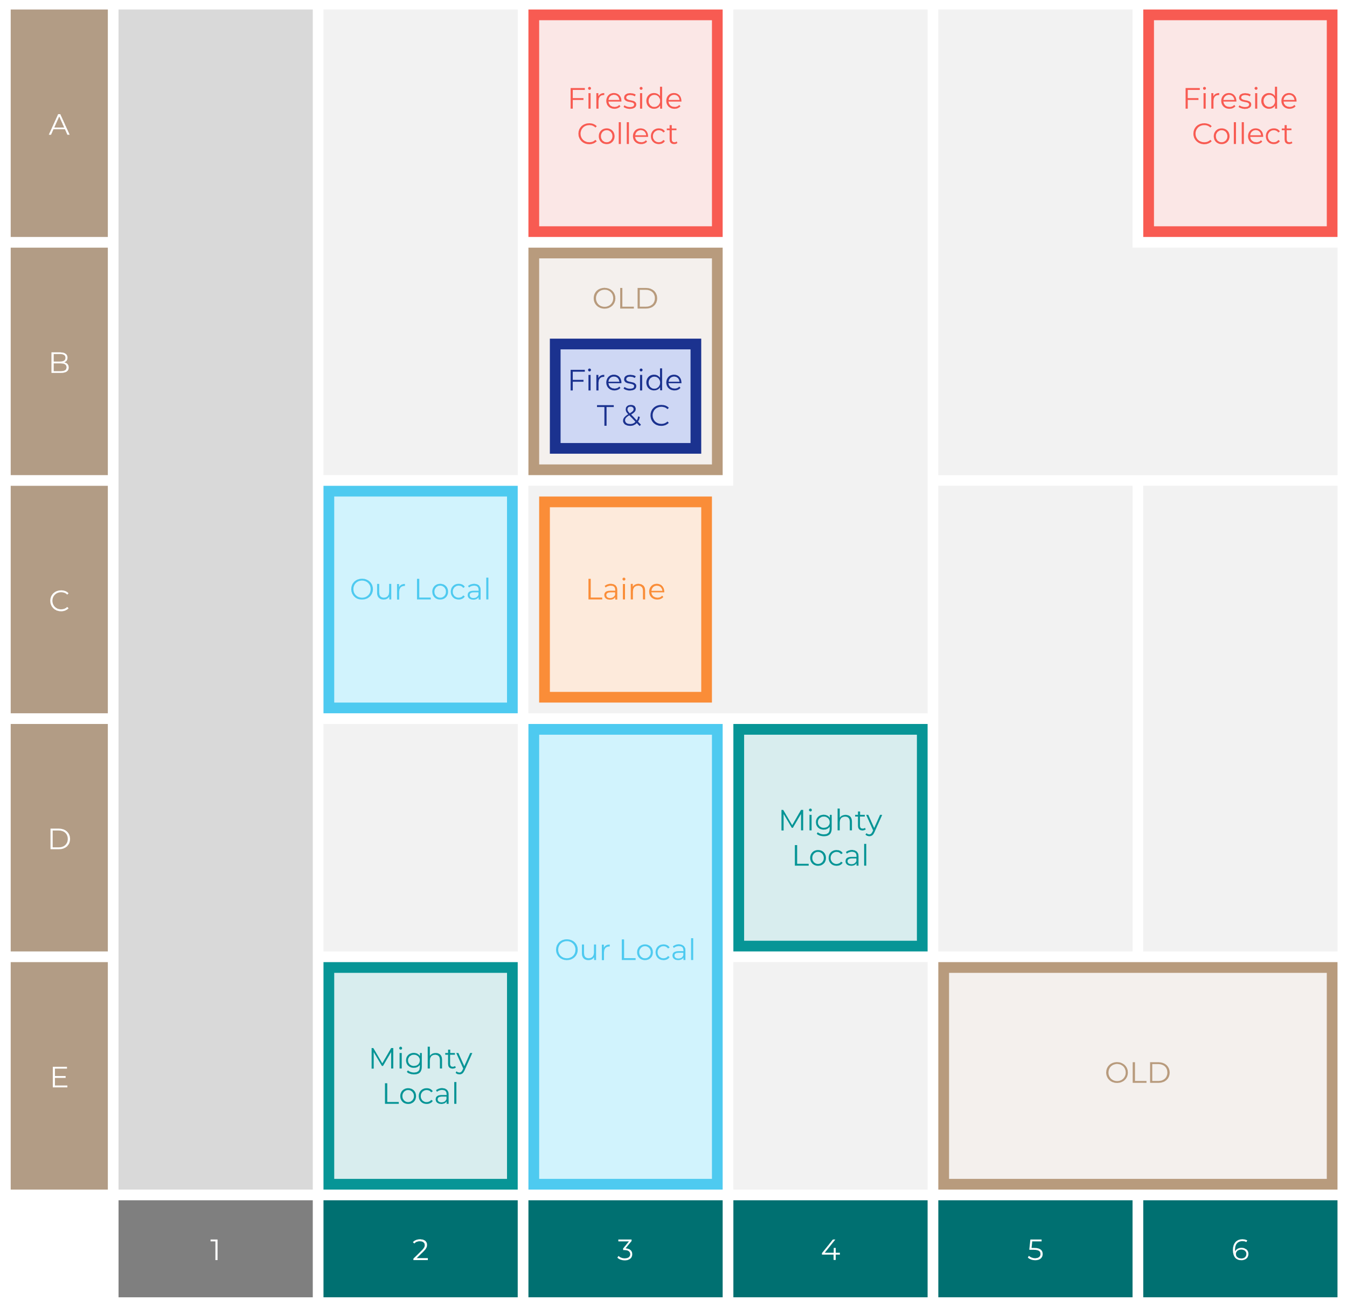
Site Intel
Champs Sports Bar & Grill S118NX
Site Potential 1
Site Characteristics
£3000
£18000
OCC Concept Fit
Achievable Average Weekly Takings
Mighty Local
£19000
A Food-Led High Affluence B Food-Led Mid Affluence C Wet-Led Mid/High Affluence D Wet-Led Low Affluence E Food-Led Low Affluence
AWT 2 Local Regulars 3 Local Passing Trade 4 Destination Wet-Led 5 Destination Food-Led 6 Destination Very Food-Led
A
B
C
D
E
1
2
3
4
5
6

Slide 16
Site Intel
Champs Sports Bar & Grill S118NX
Site Potential 2
Concept Recommendation

Slide 17
Site Intel
Champs Sports Bar & Grill S118NX
Local Market Profile
Mix of spend by customer segment in Punch site and local market
 | Customer Count | Family Familiar | Occasional & Local | Mid-Week Seniors | Part Of The Pub | Metro Sophisticates | Young & Connected | Bubbly Weekenders | Upmarket Diners
Champs Sports Bar & Grill | 411 | 9.90% | 4.71% | 2.43% | 17.15% | 9.90% | 43.72% | 8.88% | 3.28%
Local Catchment | 16540 | 11.49% | 8.16% | 8.21% | 9.52% | 16.63% | 24.45% | 12.93% | 8.57%
Punch T&L | 105276 | 8.60% | 6.18% | 28.63% | 11.51% | 11.04% | 11.82% | 7.12% | 15.06%
Champs Sports Bar & Grill vs Local Catchment |  | -1.59% | -3.45% | -5.78% | 7.63% | -6.73% | 19.27% | -4.05% | -5.29%
Champs Sports Bar & Grill vs Punch T&L |  | 1.30% | -1.47% | -26.20% | 5.64% | -1.14% | 31.90% | 1.76% | -11.78%
Local Catchment vs Punch T&L |  | 2.89% | 1.98% | -20.42% | -1.99% | 5.59% | 12.63% | 5.81% | -6.49%

Slide 18
Site Intel
Champs Sports Bar & Grill S118NX
Local Competitor Profiles
Mix of spend by customer segment in Punch site and local competitors
 | Customer Count | Family Familiar | Occasional & Local | Mid-Week Seniors | Part Of The Pub | Metro Sophisticates | Young & Connected | Bubbly Weekenders | Upmarket Diners
Nursery Tavern S118PE | 566 | 8.28% | 4.93% | 2.74% | 8.16% | 10.75% | 56.26% | 5.65% | 3.19%
Champs Sports Bar & Grill S118NX | 411 | 9.90% | 4.71% | 2.43% | 17.15% | 9.90% | 43.72% | 8.88% | 3.28%
Molly Malones S14ES | 1398 | 12.53% | 3.20% | 3.49% | 5.77% | 12.46% | 44.56% | 14.05% | 3.91%
Tiger Works S14ES | 526 | 14.11% | 5.60% | 2.86% | 6.54% | 6.50% | 53.28% | 9.35% | 1.72%
Manahatta Sheffield S12JA | 1603 | 16.57% | 4.33% | 6.12% | 4.03% | 12.56% | 32.80% | 17.10% | 6.45%
The Sheaf Island S118HW | 690 | 13.49% | 10.32% | 8.09% | 25.48% | 8.19% | 25.08% | 7.20% | 2.11%
Washington Hotel S14JP | 694 | 4.44% | 14.88% | 5.87% | 4.22% | 24.55% | 31.38% | 11.50% | 3.12%
Peaks Sports Bar Diner S118XQ | 393 | 16.56% | 11.07% | 4.87% | 7.36% | 25.38% | 15.54% | 8.25% | 10.93%
Cavendish Sheffield S14EU | 1066 | 19.39% | 5.96% | 6.15% | 12.06% | 6.80% | 35.97% | 10.60% | 3.03%
Popworld Sheffield S14FS | 736 | 15.05% | 4.11% | 2.66% | 6.74% | 8.80% | 48.57% | 11.35% | 2.68%
West Street Live S14ES | 735 | 13.15% | 8.53% | 1.45% | 9.12% | 9.06% | 45.77% | 11.36% | 1.53%
Katie Obriens Irish Ta S14DT | 880 | 13.48% | 2.06% | 3.99% | 6.55% | 12.48% | 39.85% | 17.74% | 3.81%
The Benjamin Huntsman S14HP | 1799 | 17.51% | 8.52% | 8.07% | 18.71% | 7.26% | 28.55% | 9.62% | 1.72%
The Lescar S118ZF | 1034 | 4.34% | 10.64% | 8.79% | 3.13% | 29.90% | 8.99% | 13.10% | 21.07%
Common Room S37SB | 1015 | 11.06% | 4.31% | 4.38% | 5.54% | 16.94% | 36.48% | 16.65% | 4.60%
Steinhaus S14EP | 471 | 16.74% | 7.05% | 3.34% | 7.33% | 2.93% | 49.01% | 11.15% | 2.41%
Porter Brook (Sheffield) S118PR | 639 | 3.83% | 8.30% | 17.54% | 15.49% | 28.93% | 12.30% | 8.05% | 5.52%
One Four One S14EW | 438 | 19.65% | 8.43% | 0.67% | 6.41% | 7.88% | 40.43% | 15.14% | 1.34%
Cubana S12JG | 1401 | 15.66% | 6.37% | 9.06% | 4.66% | 15.51% | 19.94% | 17.13% | 11.62%
Tropicana S14FS | 199 | 17.96% | 2.99% | 0.78% | 17.53% | 3.75% | 42.51% | 13.35% | 1.08%
Lost & Found (Sheffield) S118PY | 671 | 12.28% | 5.16% | 8.54% | 2.36% | 18.37% | 19.94% | 15.45% | 17.87%
Corporation S14JU | 624 | 9.28% | 9.59% | 4.99% | 9.46% | 8.83% | 38.94% | 14.18% | 4.69%
Slug and Lettuce Sheffield S12GT | 1196 | 22.22% | 7.59% | 6.26% | 4.90% | 6.47% | 34.39% | 16.39% | 1.75%
Revolution Sheffield S14JL | 989 | 19.19% | 3.39% | 3.44% | 6.39% | 6.40% | 37.84% | 19.31% | 3.99%
Old Grindstone S101UA | 429 | 3.80% | 9.54% | 6.11% | 38.80% | 17.70% | 12.69% | 6.65% | 4.69%

