Slide 1

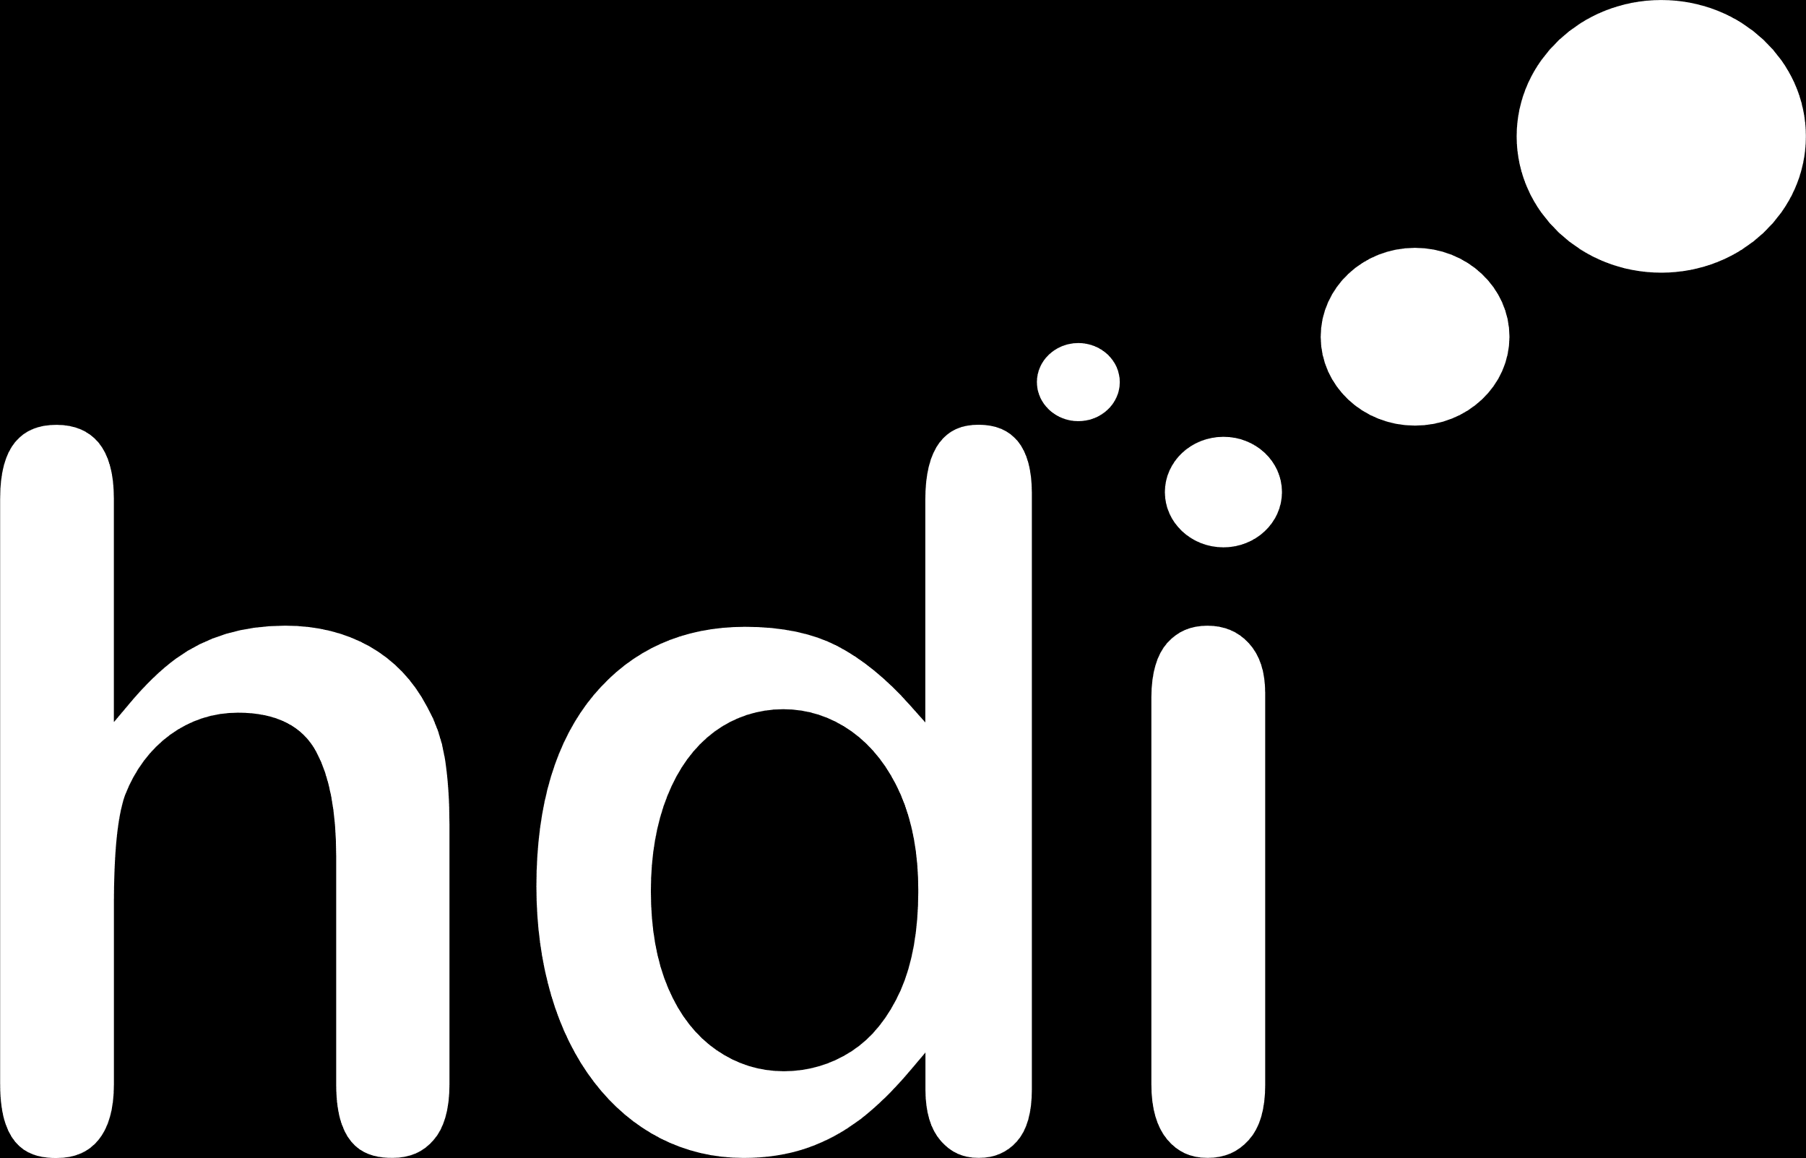


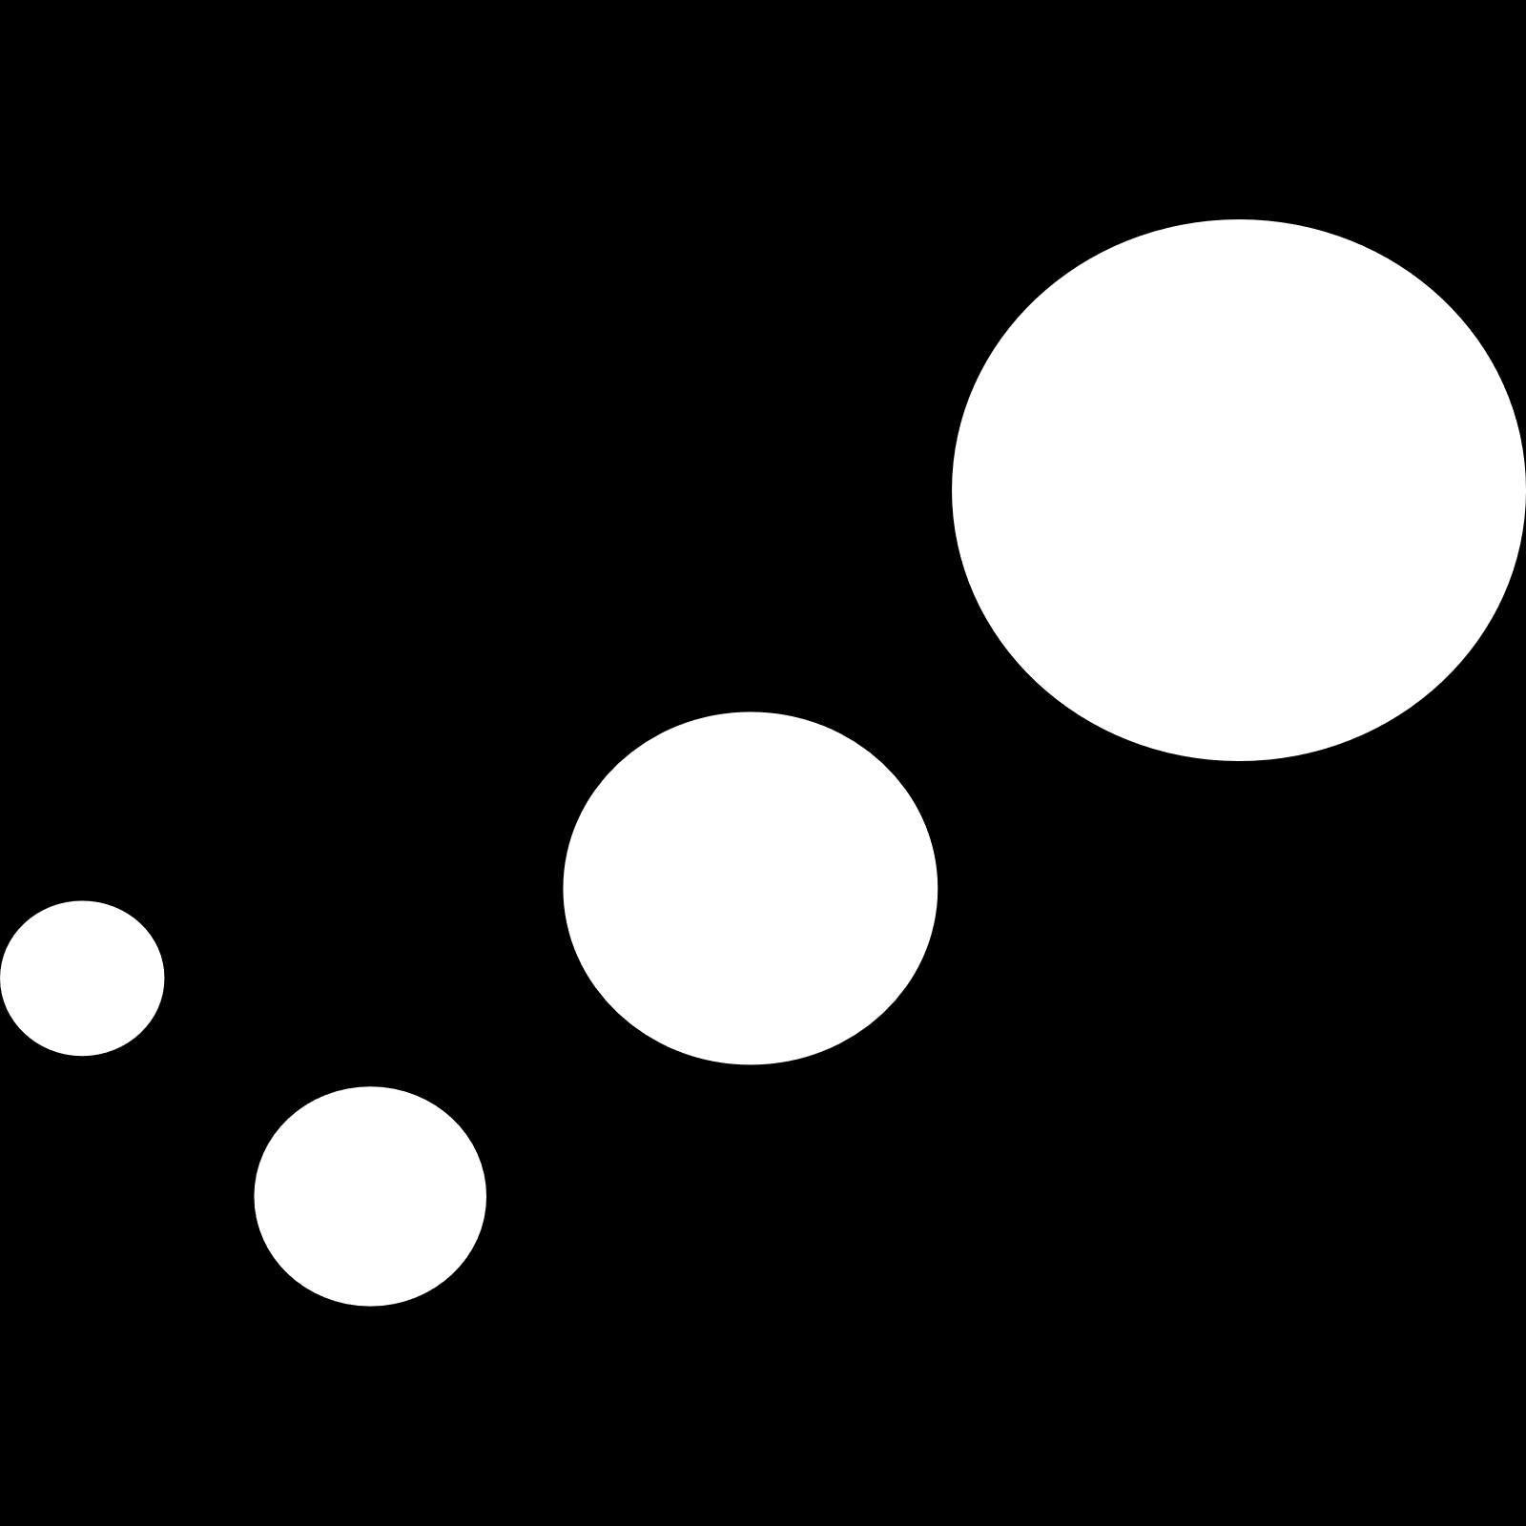






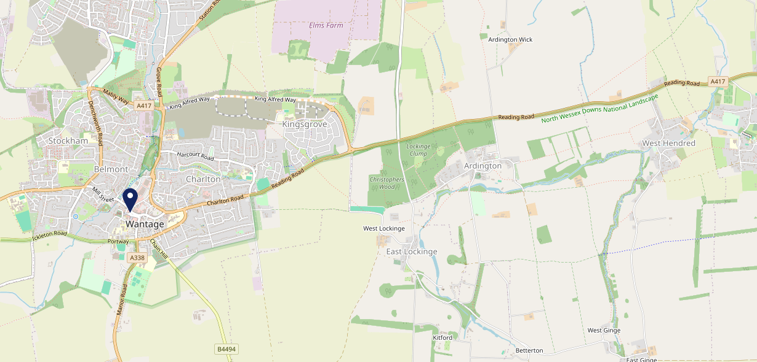











Site Intel
King Alfreds Head OX128AH
3 Miles
99 Chains
08/11/2023 - 30/10/2024
Site Summary
King Alfreds Head OX128AH
Work Area
Region
TV Region
Urbanicity
Oxford
South East
Central
Urban city and town
OX128AH
Punch T&L
Top Competitors
ATV
Gender
Bay Tree (Grove)
#1
£14.18
67.85%
Male
OX120AN
GK - Pub & Social
Affluence
Segmentation
Swan
#2
59.26%
19.99%
Middle Income
Content Communities
OX128AE
Pub / Bar
Age Group
Visit Day
Bear Hotel
#3
28.66%
37.04%
OX128AB
35 to 44
Sat
Pub Restaurant
Nearest Station
Didcot Parkway(12.96 miles)
1285 Site Customers
42 Competitors
12179 Competitor Customers

Slide 2

Site Intel
King Alfreds Head OX128AH
3 Miles
99 Chains
08/11/2023 - 30/10/2024
Spend by Weekpart
How is customer spend distributed throughout the week for King Alfreds Head OX128AH versus its competitors?
% of spend for King Alfreds Head OX128AH and 99 Chains in 3 Miles from 08/11/2023 - 30/10/2024 split by Day of Week
1285 Site Customers
42 Competitors
12179 Competitor Customers

Slide 3
Site Intel
King Alfreds Head OX128AH
3 Miles
99 Chains
08/11/2023 - 30/10/2024
Visit Frequency
How frequently per year do customers visit King Alfreds Head OX128AH versus its competitors?
% of customer numbers for King Alfreds Head OX128AH and 99 Chains in 3 Miles from 08/11/2023 - 30/10/2024 and the number of visits made Per Annum
1285 Site Customers
42 Competitors
12179 Competitor Customers

Slide 4
Site Intel
King Alfreds Head OX128AH
3 Miles
99 Chains
08/11/2023 - 30/10/2024
ATV Change
How has ATV changed between two date ranges?
1285 Site Customers

Slide 5
Site Intel
King Alfreds Head OX128AH
3 Miles
99 Chains
08/11/2023 - 30/10/2024
Market Share Change
How has market share changed between two date ranges?
% of market share spend for King Alfreds Head OX128AH and 99 Chains in 3 Miles from 08/11/2023 - 30/10/2024
1285 Site Customers

Slide 6
Site Intel
King Alfreds Head OX128AH
3 Miles
99 Chains
08/11/2023 - 30/10/2024
Age
How does the age profile of customers who visit King Alfreds Head OX128AH compare versus its competitors?
% of spend for King Alfreds Head OX128AH and 99 Chains in 3 Miles from 08/11/2023 - 30/10/2024 split by Age Range
585 Site Customers
42 Competitors
5876 Competitor Customers

Slide 7
Site Intel
King Alfreds Head OX128AH
3 Miles
99 Chains
08/11/2023 - 30/10/2024
Affluence
How does the affluence of customers who visit King Alfreds Head OX128AH compare versus its competitors?
% of spend for King Alfreds Head OX128AH and 99 Chains in 3 Miles from 08/11/2023 - 30/10/2024 split by Affluence
594 Site Customers
42 Competitors
5897 Competitor Customers

Slide 8
Site Intel
King Alfreds Head OX128AH
3 Miles
99 Chains
08/11/2023 - 30/10/2024
Gender
How does the gender profile of customers who visit King Alfreds Head OX128AH compare versus its competitors?
% of spend for King Alfreds Head OX128AH and 99 Chains in 3 Miles from 08/11/2023 - 30/10/2024 split by Gender
594 Site Customers
42 Competitors
5897 Competitor Customers

Slide 9
Site Intel
King Alfreds Head OX128AH
3 Miles
99 Chains
08/11/2023 - 30/10/2024
Punch Segmentation
How does the Custom segmentation profile of customers who visit King Alfreds Head OX128AH compare versus its competitors?
% of spend for King Alfreds Head OX128AH and 99 Chains in 3 Miles from 08/11/2023 - 30/10/2024 split by Segment
1285 Site Customers
42 Competitors
12179 Competitor Customers

Slide 10
Site Intel
King Alfreds Head OX128AH
3 Miles
99 Chains
08/11/2023 - 30/10/2024
Spend by Distance
How does the spend profile of King Alfreds Head OX128AH compare versus its competitors based on travel distances?
% of spend for King Alfreds Head OX128AH and 99 Chains in 3 Miles from 08/11/2023 - 30/10/2024 split by Distance travelled
577 Site Customers
42 Competitors
5716 Competitor Customers

Slide 11
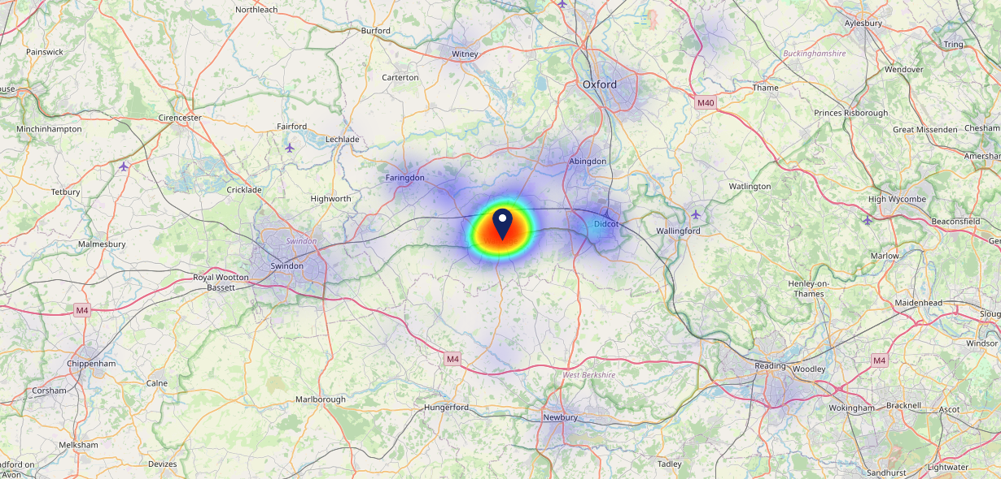
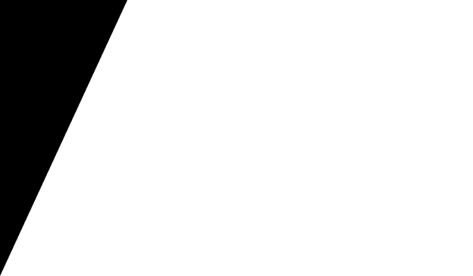
Site Intel
King Alfreds Head OX128AH
08/11/2023 - 30/10/2024
Map of Guest Origin
Where do customers of King Alfreds Head OX128AH come from?
Where do customers of King Alfreds Head OX128AH for 08/11/2023 - 30/10/2024 live
577 Site Customers

Slide 12
Site Intel
King Alfreds Head OX128AH
3 Miles
99 Chains
08/11/2023 - 30/10/2024
Share of Wallet
What are the Top 20 venues (by spend) that customers of King Alfreds Head OX128AH also visit?
For customers of King Alfreds Head OX128AH, who are the top 20 competitors from 99 Chains in 3 Miles for 08/11/2023 - 30/10/2024 split by Venue
1285 Site Customers

Slide 13
Site Intel
King Alfreds Head OX128AH
3 Miles
99 Chains
08/11/2023 - 30/10/2024
Share of Wallet Change
How has share of wallet of customers of King Alfreds Head OX128AH changed between two date ranges?
1285 Site Customers

Slide 14
Site Intel
King Alfreds Head OX128AH
08/11/2023 - 30/10/2024
Market Summary
How does the local area for King Alfreds Head OX128AH compare to the national average (1 = low, 10 = high)
Data Type | Name | Spend in 250m | 250m Spend vs National | Spend in 500m | 500m Spend vs National | Spend in 1 mile | 1 mile Spend vs National | Spend in 3 miles | 3 mile Spend vs National
Total | Annual Sales | £8.19M | 8 | £8.21M | 7 | £9.32M | 4 | £16.39M | 2
Weekpart | Mon - Thu | 38.6% | 4 | 38.6% | 4 | 38.3% | 3 | 43.6% | 8
Weekpart | Fri - Sat | 46.2% | 7 | 46.1% | 7 | 46.1% | 8 | 41.5% | 5
Weekpart | Sun | 15.3% | 6 | 15.3% | 6 | 15.7% | 6 | 14.9% | 4
Age | 18 to 24 | 5.7% | 6 | 5.7% | 5 | 5.8% | 5 | 8.1% | 7
Age | 25 to 34 | 14.1% | 2 | 14.1% | 2 | 14.0% | 2 | 13.2% | 1
Age | 35 to 44 | 22.3% | 5 | 22.3% | 5 | 22.7% | 5 | 21.8% | 3
Age | 45 to 54 | 19.4% | 5 | 19.3% | 4 | 19.5% | 4 | 18.7% | 3
Age | 55 to 64 | 21.7% | 9 | 21.7% | 9 | 20.9% | 9 | 19.5% | 9
Age | 65 to 74 | 10.9% | 8 | 10.9% | 9 | 10.7% | 9 | 11.2% | 9
Age | 75+ | 6.0% | 9 | 5.9% | 9 | 6.4% | 9 | 7.5% | 10
CAMEO | Business Elite | 4.4% | 4 | 4.4% | 4 | 4.4% | 4 | 6.0% | 4
CAMEO | Prosperous Professionals | 6.0% | 6 | 6.0% | 5 | 6.1% | 5 | 6.4% | 5
CAMEO | Flourishing Society | 18.9% | 8 | 18.9% | 8 | 18.9% | 8 | 20.0% | 9
CAMEO | Content Communities | 17.4% | 9 | 17.4% | 9 | 17.6% | 9 | 20.2% | 10
CAMEO | White Collar Neighbourhoods | 14.1% | 8 | 14.1% | 8 | 13.8% | 8 | 11.9% | 6
CAMEO | Enterprising Mainstream | 9.3% | 7 | 9.3% | 7 | 9.9% | 7 | 9.2% | 6
CAMEO | Paying The Mortgage | 16.0% | 7 | 15.9% | 7 | 15.7% | 6 | 14.8% | 6
CAMEO | Cash Conscious Communities | 8.2% | 5 | 8.1% | 5 | 7.9% | 4 | 6.5% | 3
CAMEO | On A Budget | 5.2% | 4 | 5.2% | 4 | 5.1% | 4 | 4.5% | 2
CAMEO | Family Value | 0.5% | 2 | 0.5% | 1 | 0.6% | 1 | 0.5% | 1
Affluence | AB | 29.4% | 6 | 29.4% | 6 | 29.4% | 6 | 32.4% | 6
Affluence | C1C2 | 56.7% | 9 | 56.8% | 9 | 56.9% | 9 | 56.1% | 9
Affluence | DE | 13.9% | 3 | 13.8% | 3 | 13.6% | 3 | 11.5% | 2

Slide 15
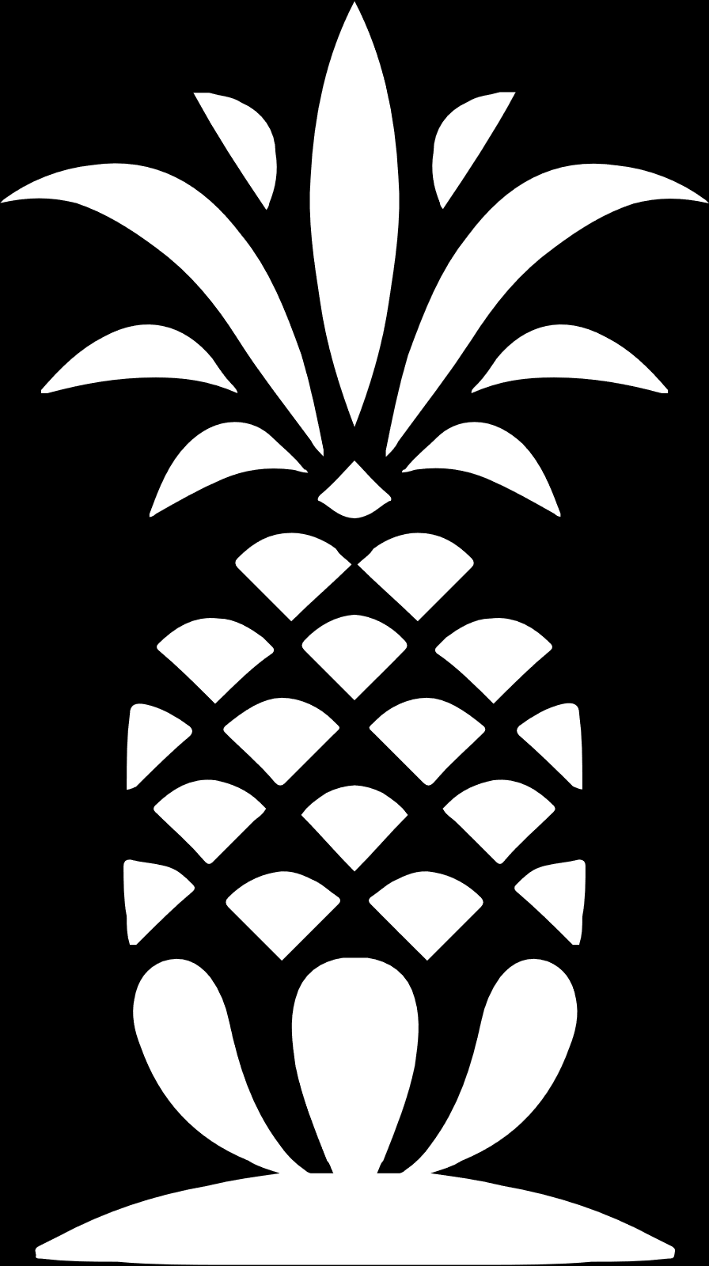
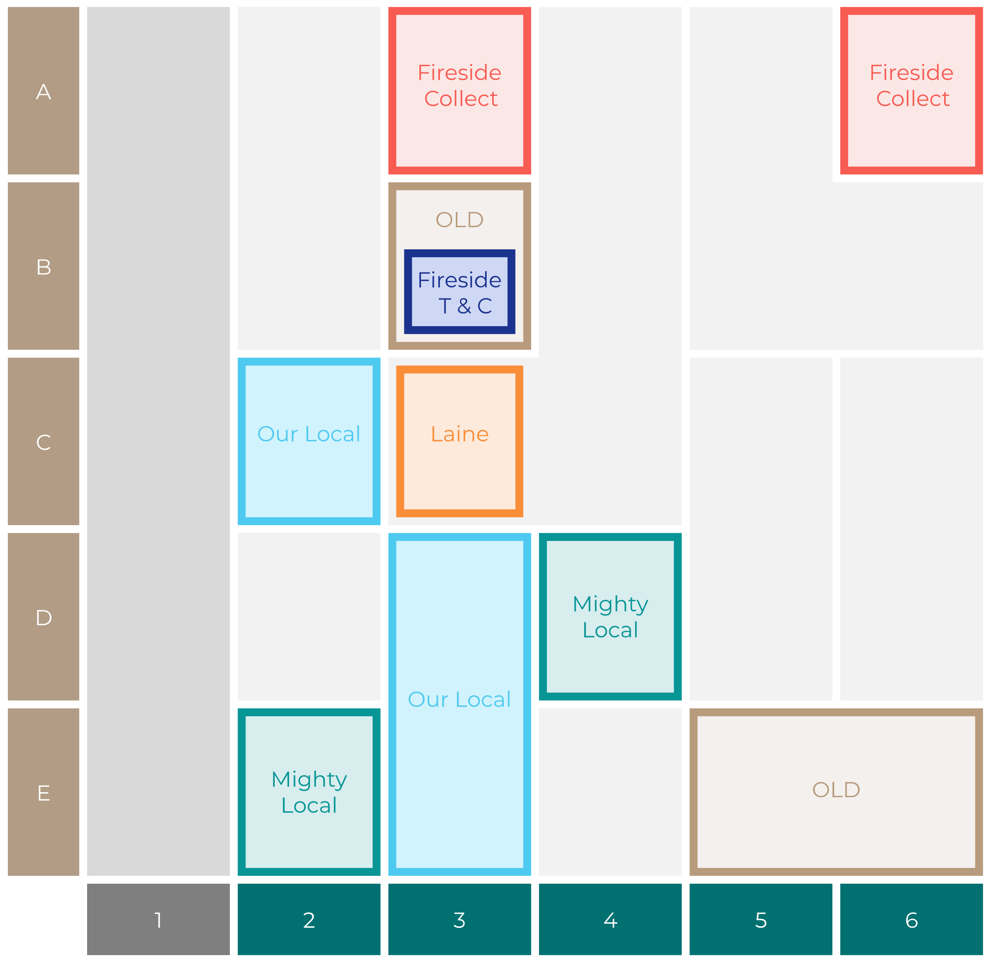

Site Intel
King Alfreds Head OX128AH
Site Potential 1
Site Characteristics
£3000
£18000
OCC Concept Fit
Achievable Average Weekly Takings
Non-Core
£14000
A Food-Led High Affluence B Food-Led Mid Affluence C Wet-Led Mid/High Affluence D Wet-Led Low Affluence E Food-Led Low Affluence
AWT 2 Local Regulars 3 Local Passing Trade 4 Destination Wet-Led 5 Destination Food-Led 6 Destination Very Food-Led
A
B
C
D
E
1
2
3
4
5
6

Slide 16
Site Intel
King Alfreds Head OX128AH
Site Potential 2
Concept Recommendation

Slide 17
Site Intel
King Alfreds Head OX128AH
Local Market Profile
Mix of spend by customer segment in Punch site and local market
 | Customer Count | Family Familiar | Occasional & Local | Mid-Week Seniors | Part Of The Pub | Metro Sophisticates | Young & Connected | Bubbly Weekenders | Upmarket Diners
King Alfreds Head | 209 | 8.68% | 2.02% | 18.89% | 7.16% | 25.46% | 8.01% | 5.44% | 24.30%
Local Catchment | 1271 | 8.71% | 2.05% | 22.06% | 5.26% | 25.22% | 7.67% | 5.48% | 23.51%
Punch T&L | 105276 | 8.60% | 6.18% | 28.63% | 11.51% | 11.04% | 11.82% | 7.12% | 15.06%
King Alfreds Head vs Local Catchment |  | -0.03% | -0.03% | -3.17% | 1.90% | 0.24% | 0.34% | -0.04% | 0.79%
King Alfreds Head vs Punch T&L |  | 0.08% | -4.16% | -9.74% | -4.35% | 14.42% | -3.81% | -1.68% | 9.24%
Local Catchment vs Punch T&L |  | 0.11% | -4.13% | -6.57% | -6.25% | 14.18% | -4.15% | -1.64% | 8.45%

Slide 18
Site Intel
King Alfreds Head OX128AH
Local Competitor Profiles
Mix of spend by customer segment in Punch site and local competitors
 | Customer Count | Family Familiar | Occasional & Local | Mid-Week Seniors | Part Of The Pub | Metro Sophisticates | Young & Connected | Bubbly Weekenders | Upmarket Diners
Bay Tree (Grove) OX120AN | 189 | 7.97% | 1.55% | 10.28% | 5.08% | 62.59% | 7.56% | 3.29% | 1.64%
King Alfreds Head OX128AH | 209 | 8.68% | 2.02% | 18.89% | 7.16% | 25.46% | 8.01% | 5.44% | 24.30%
Swan OX128AE | 149 | 10.57% | 2.90% | 11.56% | 5.13% | 44.51% | 8.21% | 8.57% | 8.52%
Bear Hotel OX128AB | 271 | 3.36% | 2.93% | 39.08% | 3.35% | 8.42% | 6.76% | 3.96% | 32.10%
Lamb Inn Wantage OX129AB | 133 | 15.96% | 0.92% | 26.33% | 1.35% | 34.15% | 4.10% | 8.30% | 8.85%
Lord Nelson (Wantage) OX128HL | 210 | 32.28% | 3.15% | 17.38% | 2.85% | 9.60% | 15.10% | 5.04% | 14.56%
Bell (Wantage) OX128AH | 55 | 8.69% | 4.86% | 11.96% | 53.32% | 1.60% | 5.42% | 4.39% | 9.72%
Greyhound OX129JL | 165 | 0.31% | 1.28% | 15.01% | 0.89% | 7.69% | 6.70% | 6.75% | 61.31%
Blue Boar (Wantage) OX128BS | 108 | 2.47% | 0.32% | 35.94% | 9.68% | 12.31% | 7.02% | 3.94% | 28.27%
Kings Arms OX128AU | 90 | 2.19% | 0.09% | 13.49% | 6.96% | 30.21% | 16.86% | 6.14% | 24.02%
Shoulder Of Mutton OX128AX | 81 | 1.70% | 4.65% | 10.34% | 14.08% | 39.72% | 8.41% | 11.12% | 9.94%
Bell Inn Grove OX127JT | 31 | 0.52% | 5.77% | 59.45% | 17.87% | 1.71% | 0.64% | 1.81% | 12.20%
Challow Childrey Cri OX129RR | 24 | 6.69% | 0.00% | 77.22% | 1.08% | 0.83% | 4.11% | 0.51% | 9.53%
Swan In Wantage Ox128ae | 48 | 6.00% | 1.86% | 12.95% | 3.40% | 51.40% | 9.54% | 5.07% | 9.74%
Delaneys Club OX128BU | 39 | 14.24% | 0.00% | 4.29% | 3.05% | 10.70% | 43.98% | 15.48% | 8.23%
Boars Head OX128QA | 79 | 0.55% | 2.02% | 22.75% | 0.10% | 8.23% | 0.95% | 0.37% | 64.99%
Challows Royal OX129RP | 34 | 19.21% | 6.07% | 24.02% | 21.43% | 0.00% | 2.41% | 6.58% | 20.25%
Fox (Denchworth) OX120DX | 66 | 11.91% | 2.16% | 39.75% | 0.49% | 1.07% | 3.05% | 5.99% | 35.53%
Volunteer OX120DH | 86 | 20.75% | 1.47% | 25.91% | 7.35% | 19.20% | 4.61% | 7.39% | 13.27%
Cozzy Lounge OX128BU | 22 | 33.06% | 0.00% | 10.68% | 0.00% | 15.75% | 14.58% | 3.23% | 22.66%
Lains Barn OX127QG | 89 | 2.86% | 0.56% | 54.70% | 1.60% | 7.76% | 9.27% | 8.00% | 15.20%
Blackbird OX128AJ | 33 | 5.38% | 1.81% | 26.20% | 0.00% | 8.23% | 1.55% | 0.72% | 56.08%
Paul Hexter Ta Th OX128DF | 13 | 22.43% | 3.81% | 42.25% | 0.00% | 0.00% | 0.00% | 5.79% | 25.69%
Swan Wantage Cock OX128AE | 1 | 0.00% | 0.00% | 0.00% | 0.00% | 0.00% | 0.00% | 0.00% | 100.00%
Ardington Spor OX128PS | 6 | 0.00% | 0.00% | 23.61% | 15.07% | 0.00% | 0.00% | 38.19% | 23.11%

