Slide 1
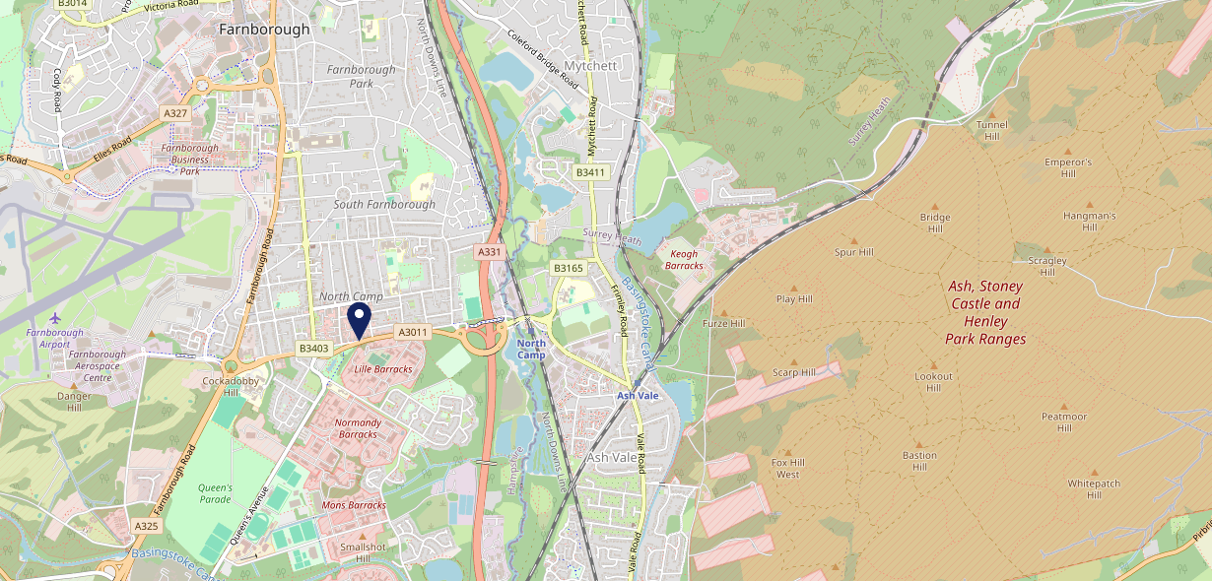
Site Intel
North Camp GU146ET
1 Miles
371 Chains
16/04/2025 - 08/04/2026
Site Summary
North Camp GU146ET
Work Area
Region
TV Region
Urbanicity
Guildford and Aldershot
South East
South
Urban city and town
GU146ET
Punch Unity
Top Competitors
ATV
Gender
Elephant & Castle Farnborough
#1
£8.04
80.77%
Male
GU146ET
Craft Union
Affluence
Segmentation
Squirrel Farnborough
#2
67.90%
39.60%
Middle Income
Content Communities
GU146LR
Heritage Pubs
Age Group
Visit Day
Everest Tandoori
#3
34.41%
22.10%
GU146EJ
55 to 64
Sat
Restaurant
Nearest Station
North Camp(1.04 miles)
803 Site Customers
99 Competitors
22398 Competitor Customers

Slide 2
Site Intel
North Camp GU146ET
1 Miles
371 Chains
16/04/2025 - 08/04/2026
Spend by Weekpart
How is customer spend distributed throughout the week for North Camp GU146ET versus its competitors?
% of spend for North Camp GU146ET and 371 Chains in 1 Miles from 16/04/2025 - 08/04/2026 split by Day of Week
803 Site Customers
99 Competitors
22398 Competitor Customers

Slide 3
Site Intel
North Camp GU146ET
1 Miles
371 Chains
16/04/2025 - 08/04/2026
Visit Frequency
How frequently per year do customers visit North Camp GU146ET versus its competitors?
% of customer numbers for North Camp GU146ET and 371 Chains in 1 Miles from 16/04/2025 - 08/04/2026 and the number of visits made Per Annum
803 Site Customers
99 Competitors
22398 Competitor Customers

Slide 4
Site Intel
North Camp GU146ET
1 Miles
371 Chains
16/04/2025 - 08/04/2026
ATV Change
How has ATV changed between two date ranges?
803 Site Customers

Slide 5
Site Intel
North Camp GU146ET
1 Miles
371 Chains
16/04/2025 - 08/04/2026
Market Share Change
How has market share changed between two date ranges?
% of market share spend for North Camp GU146ET and 371 Chains in 1 Miles from 16/04/2025 - 08/04/2026
803 Site Customers

Slide 6
Site Intel
North Camp GU146ET
1 Miles
371 Chains
16/04/2025 - 08/04/2026
Age
How does the age profile of customers who visit North Camp GU146ET compare versus its competitors?
% of spend for North Camp GU146ET and 371 Chains in 1 Miles from 16/04/2025 - 08/04/2026 split by Age Range
353 Site Customers
99 Competitors
10094 Competitor Customers

Slide 7
Site Intel
North Camp GU146ET
1 Miles
371 Chains
16/04/2025 - 08/04/2026
Affluence
How does the affluence of customers who visit North Camp GU146ET compare versus its competitors?
% of spend for North Camp GU146ET and 371 Chains in 1 Miles from 16/04/2025 - 08/04/2026 split by Affluence
324 Site Customers
99 Competitors
9228 Competitor Customers

Slide 8
Site Intel
North Camp GU146ET
1 Miles
371 Chains
16/04/2025 - 08/04/2026
Gender
How does the gender profile of customers who visit North Camp GU146ET compare versus its competitors?
% of spend for North Camp GU146ET and 371 Chains in 1 Miles from 16/04/2025 - 08/04/2026 split by Gender
345 Site Customers
99 Competitors
9811 Competitor Customers

Slide 9
Site Intel
North Camp GU146ET
1 Miles
371 Chains
16/04/2025 - 08/04/2026
Punch Segmentation
How does the Custom segmentation profile of customers who visit North Camp GU146ET compare versus its competitors?
% of spend for North Camp GU146ET and 371 Chains in 1 Miles from 16/04/2025 - 08/04/2026 split by Segment
803 Site Customers
99 Competitors
22398 Competitor Customers

Slide 10
Site Intel
North Camp GU146ET
1 Miles
371 Chains
16/04/2025 - 08/04/2026
Spend by Distance
How does the spend profile of North Camp GU146ET compare versus its competitors based on travel distances?
% of spend for North Camp GU146ET and 371 Chains in 1 Miles from 16/04/2025 - 08/04/2026 split by Distance travelled
345 Site Customers
99 Competitors
9800 Competitor Customers

Slide 11
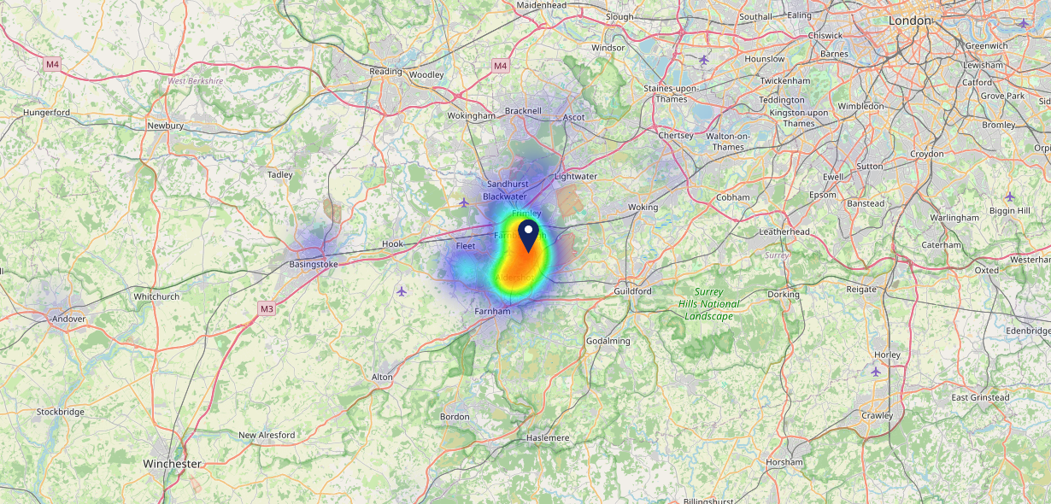
Site Intel
North Camp GU146ET
16/04/2025 - 08/04/2026
Map of Guest Origin
Where do customers of North Camp GU146ET come from?
Where do customers of North Camp GU146ET for 16/04/2025 - 08/04/2026 live
345 Site Customers

Slide 12
Site Intel
North Camp GU146ET
1 Miles
371 Chains
16/04/2025 - 08/04/2026
Share of Wallet
What are the Top 20 venues (by spend) that customers of North Camp GU146ET also visit?
For customers of North Camp GU146ET, who are the top 20 competitors from 371 Chains in 1 Miles for 16/04/2025 - 08/04/2026 split by Venue
803 Site Customers

Slide 13
Site Intel
North Camp GU146ET
1 Miles
371 Chains
16/04/2025 - 08/04/2026
Share of Wallet Change
How has share of wallet of customers of North Camp GU146ET changed between two date ranges?
803 Site Customers

Slide 14
Site Intel
North Camp GU146ET
16/04/2025 - 08/04/2026
Market Summary
How does the local area for North Camp GU146ET compare to the national average (1 = low, 10 = high)
Data Type | Name | Spend in 250m | 250m Spend vs National | Spend in 500m | 500m Spend vs National | Spend in 1 mile | 1 mile Spend vs National | Spend in 3 miles | 3 mile Spend vs National
Total | Annual Sales | £4.61M | 7 | £6.24M | 6 | £11.25M | 5 | £109.17M | 7
Weekpart | Mon - Thu | 48.2% | 9 | 46.2% | 9 | 43.9% | 8 | 44.8% | 9
Weekpart | Fri - Sat | 40.3% | 3 | 42.4% | 4 | 43.8% | 6 | 40.3% | 3
Weekpart | Sun | 11.5% | 3 | 11.4% | 2 | 12.2% | 1 | 14.9% | 3
Age | 18 to 24 | 5.2% | 5 | 5.3% | 5 | 4.7% | 3 | 6.7% | 5
Age | 25 to 34 | 14.9% | 2 | 15.2% | 2 | 13.9% | 2 | 15.5% | 2
Age | 35 to 44 | 21.9% | 5 | 22.2% | 5 | 22.6% | 5 | 25.0% | 7
Age | 45 to 54 | 19.0% | 4 | 19.9% | 5 | 21.5% | 7 | 20.6% | 6
Age | 55 to 64 | 24.9% | 10 | 23.9% | 10 | 21.9% | 9 | 18.5% | 9
Age | 65 to 74 | 9.4% | 8 | 8.8% | 7 | 10.3% | 9 | 9.3% | 8
Age | 75+ | 4.7% | 8 | 4.8% | 8 | 5.1% | 9 | 4.4% | 8
CAMEO | Business Elite | 5.4% | 5 | 6.0% | 5 | 5.2% | 4 | 5.5% | 4
CAMEO | Prosperous Professionals | 6.6% | 6 | 7.0% | 7 | 6.8% | 6 | 7.7% | 7
CAMEO | Flourishing Society | 14.6% | 7 | 15.9% | 7 | 16.5% | 7 | 19.4% | 8
CAMEO | Content Communities | 26.6% | 10 | 23.3% | 10 | 21.3% | 10 | 15.4% | 8
CAMEO | White Collar Neighbourhoods | 17.4% | 10 | 18.3% | 10 | 20.1% | 10 | 17.2% | 10
CAMEO | Enterprising Mainstream | 7.1% | 5 | 7.0% | 5 | 6.4% | 4 | 6.4% | 4
CAMEO | Paying The Mortgage | 10.6% | 3 | 10.9% | 3 | 10.7% | 3 | 14.1% | 5
CAMEO | Cash Conscious Communities | 6.3% | 3 | 6.3% | 3 | 6.1% | 3 | 6.5% | 3
CAMEO | On A Budget | 4.2% | 3 | 4.3% | 3 | 5.6% | 4 | 6.9% | 6
CAMEO | Family Value | 1.1% | 4 | 1.1% | 3 | 1.1% | 3 | 0.9% | 2
Affluence | AB | 26.6% | 5 | 28.9% | 6 | 28.6% | 6 | 32.6% | 6
Affluence | C1C2 | 61.7% | 10 | 59.5% | 9 | 58.6% | 9 | 53.0% | 8
Affluence | DE | 11.7% | 2 | 11.6% | 2 | 12.8% | 3 | 14.4% | 3

