Slide 1
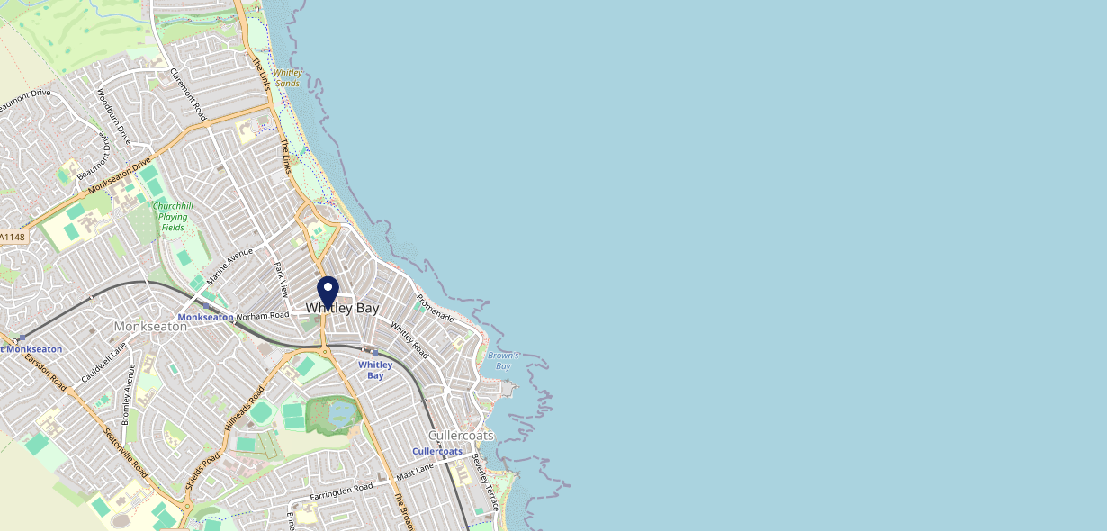
Site Intel
Townhouse NE262TG
1 Miles
371 Chains
16/04/2025 - 08/04/2026
Site Summary
Townhouse NE262TG
Work Area
Region
TV Region
Urbanicity
Newcastle
North East
Tyne Tees
Urban major conurbation
NE262TG
Punch T&L
Top Competitors
ATV
Gender
Brewery
#1
£8.94
73.85%
Male
NE262RG
Pub / Bar
Affluence
Segmentation
The Fire Station
#2
64.57%
26.95%
Middle Income
Paying The Mortgage
NE261AB
JD Wetherspoon
Age Group
Visit Day
Fox & Finch
#3
31.04%
34.92%
NE263RF
45 to 54
Sat
Restaurant
Nearest Station
Cramlington(10.90 miles)
1141 Site Customers
280 Competitors
91959 Competitor Customers

Slide 2
Site Intel
Townhouse NE262TG
1 Miles
371 Chains
16/04/2025 - 08/04/2026
Spend by Weekpart
How is customer spend distributed throughout the week for Townhouse NE262TG versus its competitors?
% of spend for Townhouse NE262TG and 371 Chains in 1 Miles from 16/04/2025 - 08/04/2026 split by Day of Week
1141 Site Customers
280 Competitors
91959 Competitor Customers

Slide 3
Site Intel
Townhouse NE262TG
1 Miles
371 Chains
16/04/2025 - 08/04/2026
Visit Frequency
How frequently per year do customers visit Townhouse NE262TG versus its competitors?
% of customer numbers for Townhouse NE262TG and 371 Chains in 1 Miles from 16/04/2025 - 08/04/2026 and the number of visits made Per Annum
1141 Site Customers
280 Competitors
91959 Competitor Customers

Slide 4
Site Intel
Townhouse NE262TG
1 Miles
371 Chains
16/04/2025 - 08/04/2026
ATV Change
How has ATV changed between two date ranges?
1141 Site Customers

Slide 5
Site Intel
Townhouse NE262TG
1 Miles
371 Chains
16/04/2025 - 08/04/2026
Market Share Change
How has market share changed between two date ranges?
% of market share spend for Townhouse NE262TG and 371 Chains in 1 Miles from 16/04/2025 - 08/04/2026
1141 Site Customers

Slide 6
Site Intel
Townhouse NE262TG
1 Miles
371 Chains
16/04/2025 - 08/04/2026
Age
How does the age profile of customers who visit Townhouse NE262TG compare versus its competitors?
% of spend for Townhouse NE262TG and 371 Chains in 1 Miles from 16/04/2025 - 08/04/2026 split by Age Range
477 Site Customers
280 Competitors
44945 Competitor Customers

Slide 7
Site Intel
Townhouse NE262TG
1 Miles
371 Chains
16/04/2025 - 08/04/2026
Affluence
How does the affluence of customers who visit Townhouse NE262TG compare versus its competitors?
% of spend for Townhouse NE262TG and 371 Chains in 1 Miles from 16/04/2025 - 08/04/2026 split by Affluence
445 Site Customers
280 Competitors
41852 Competitor Customers

Slide 8
Site Intel
Townhouse NE262TG
1 Miles
371 Chains
16/04/2025 - 08/04/2026
Gender
How does the gender profile of customers who visit Townhouse NE262TG compare versus its competitors?
% of spend for Townhouse NE262TG and 371 Chains in 1 Miles from 16/04/2025 - 08/04/2026 split by Gender
463 Site Customers
280 Competitors
43841 Competitor Customers

Slide 9
Site Intel
Townhouse NE262TG
1 Miles
371 Chains
16/04/2025 - 08/04/2026
Punch Segmentation
How does the Custom segmentation profile of customers who visit Townhouse NE262TG compare versus its competitors?
% of spend for Townhouse NE262TG and 371 Chains in 1 Miles from 16/04/2025 - 08/04/2026 split by Segment
1141 Site Customers
280 Competitors
91959 Competitor Customers

Slide 10
Site Intel
Townhouse NE262TG
1 Miles
371 Chains
16/04/2025 - 08/04/2026
Spend by Distance
How does the spend profile of Townhouse NE262TG compare versus its competitors based on travel distances?
% of spend for Townhouse NE262TG and 371 Chains in 1 Miles from 16/04/2025 - 08/04/2026 split by Distance travelled
463 Site Customers
280 Competitors
43815 Competitor Customers

Slide 11
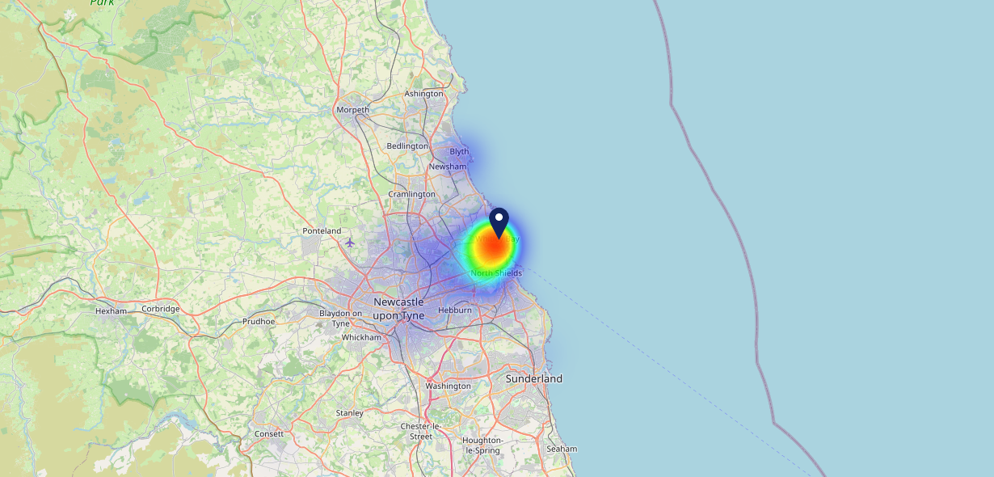
Site Intel
Townhouse NE262TG
16/04/2025 - 08/04/2026
Map of Guest Origin
Where do customers of Townhouse NE262TG come from?
Where do customers of Townhouse NE262TG for 16/04/2025 - 08/04/2026 live
463 Site Customers

Slide 12
Site Intel
Townhouse NE262TG
1 Miles
371 Chains
16/04/2025 - 08/04/2026
Share of Wallet
What are the Top 20 venues (by spend) that customers of Townhouse NE262TG also visit?
For customers of Townhouse NE262TG, who are the top 20 competitors from 371 Chains in 1 Miles for 16/04/2025 - 08/04/2026 split by Venue
1141 Site Customers

Slide 13
Site Intel
Townhouse NE262TG
1 Miles
371 Chains
16/04/2025 - 08/04/2026
Share of Wallet Change
How has share of wallet of customers of Townhouse NE262TG changed between two date ranges?
1141 Site Customers

Slide 14
Site Intel
Townhouse NE262TG
16/04/2025 - 08/04/2026
Market Summary
How does the local area for Townhouse NE262TG compare to the national average (1 = low, 10 = high)
Data Type | Name | Spend in 250m | 250m Spend vs National | Spend in 500m | 500m Spend vs National | Spend in 1 mile | 1 mile Spend vs National | Spend in 3 miles | 3 mile Spend vs National
Total | Annual Sales | £5.70M | 8 | £15.93M | 8 | £30.52M | 7 | £88.11M | 6
Weekpart | Mon - Thu | 39.6% | 5 | 38.9% | 4 | 39.2% | 4 | 39.4% | 2
Weekpart | Fri - Sat | 46.6% | 7 | 45.5% | 7 | 44.6% | 7 | 43.2% | 7
Weekpart | Sun | 13.8% | 5 | 15.6% | 7 | 16.2% | 7 | 17.5% | 9
Age | 18 to 24 | 3.3% | 3 | 3.9% | 3 | 2.7% | 2 | 3.1% | 1
Age | 25 to 34 | 9.9% | 1 | 10.9% | 1 | 10.6% | 1 | 12.4% | 1
Age | 35 to 44 | 23.5% | 6 | 25.1% | 7 | 26.4% | 8 | 25.1% | 7
Age | 45 to 54 | 23.6% | 8 | 23.1% | 8 | 21.9% | 8 | 21.8% | 8
Age | 55 to 64 | 19.6% | 8 | 20.1% | 8 | 20.3% | 9 | 20.6% | 9
Age | 65 to 74 | 15.6% | 10 | 12.6% | 9 | 13.2% | 10 | 12.5% | 10
Age | 75+ | 4.4% | 8 | 4.3% | 8 | 4.9% | 9 | 4.6% | 9
CAMEO | Business Elite | 2.9% | 3 | 3.7% | 3 | 4.1% | 3 | 3.7% | 3
CAMEO | Prosperous Professionals | 2.0% | 2 | 3.5% | 3 | 4.0% | 3 | 3.9% | 2
CAMEO | Flourishing Society | 8.2% | 4 | 9.7% | 4 | 10.5% | 4 | 9.2% | 3
CAMEO | Content Communities | 11.0% | 4 | 10.9% | 4 | 10.6% | 3 | 9.7% | 2
CAMEO | White Collar Neighbourhoods | 15.7% | 9 | 18.3% | 10 | 19.3% | 10 | 17.6% | 10
CAMEO | Enterprising Mainstream | 6.5% | 4 | 7.0% | 5 | 7.7% | 5 | 8.1% | 5
CAMEO | Paying The Mortgage | 22.1% | 9 | 21.4% | 9 | 20.1% | 9 | 17.5% | 8
CAMEO | Cash Conscious Communities | 18.5% | 10 | 14.2% | 9 | 12.7% | 8 | 14.8% | 10
CAMEO | On A Budget | 5.5% | 5 | 4.2% | 3 | 3.9% | 2 | 3.9% | 2
CAMEO | Family Value | 7.5% | 8 | 7.0% | 8 | 7.0% | 8 | 11.7% | 9
Affluence | AB | 13.1% | 2 | 16.9% | 3 | 18.6% | 3 | 16.7% | 2
Affluence | C1C2 | 55.3% | 8 | 57.7% | 9 | 57.8% | 9 | 52.8% | 8
Affluence | DE | 31.5% | 8 | 25.4% | 7 | 23.7% | 7 | 30.4% | 9

Slide 15
Site Intel
Townhouse NE262TG
Local Market Profile
Mix of spend by customer segment in Punch site and local market
 | Customer Count | Family Familiar | Occasional & Local | Mid-Week Seniors | Part Of The Pub | Metro Sophisticates | Young & Connected | Bubbly Weekenders | Upmarket Diners
Townhouse | 194 | 8.43% | 3.91% | 7.18% | 15.41% | 38.88% | 11.77% | 6.65% | 7.74%
Local Catchment | 5255 | 12.23% | 7.49% | 15.25% | 8.34% | 19.60% | 8.15% | 13.67% | 15.21%
Punch T&L | 94952 | 8.90% | 6.04% | 28.67% | 11.30% | 11.32% | 11.05% | 7.03% | 15.65%
Townhouse vs Local Catchment |  | -3.80% | -3.58% | -8.07% | 7.07% | 19.28% | 3.62% | -7.02% | -7.47%
Townhouse vs Punch T&L |  | -0.47% | -2.13% | -21.49% | 4.11% | 27.56% | 0.72% | -0.38% | -7.91%
Local Catchment vs Punch T&L |  | 3.33% | 1.45% | -13.42% | -2.96% | 8.28% | -2.90% | 6.64% | -0.44%

Slide 16
Site Intel
Townhouse NE262TG
Local Competitor Profiles
Mix of spend by customer segment in Punch site and local competitors
 | Customer Count | Family Familiar | Occasional & Local | Mid-Week Seniors | Part Of The Pub | Metro Sophisticates | Young & Connected | Bubbly Weekenders | Upmarket Diners
Townhouse NE262TG | 194 | 8.43% | 3.91% | 7.18% | 15.41% | 38.88% | 11.77% | 6.65% | 7.74%
Brewery NE262RG | 207 | 7.59% | 18.44% | 6.29% | 40.17% | 12.85% | 7.75% | 5.46% | 1.41%
The Fire Station NE261AB | 429 | 8.16% | 12.04% | 27.40% | 27.01% | 8.80% | 9.84% | 5.33% | 1.38%
Fox & Finch NE263RF | 357 | 11.44% | 23.31% | 16.76% | 1.90% | 15.09% | 8.55% | 11.91% | 11.00%
Three Brass Monkeys W NE262TE | 179 | 8.94% | 12.66% | 9.32% | 30.92% | 13.77% | 15.25% | 6.81% | 2.27%
Al Bear NE262TH | 263 | 18.79% | 12.26% | 15.33% | 5.83% | 19.14% | 7.31% | 11.57% | 9.73%
The Ship NE258DP | 162 | 6.42% | 16.29% | 12.97% | 6.84% | 32.02% | 4.92% | 16.94% | 3.55%
Fat Ox Hotel Whitley Bay NE262TG | 126 | 3.06% | 15.39% | 7.06% | 40.86% | 23.73% | 5.24% | 4.16% | 0.46%
Monkseaton Arms NE258DP | 258 | 15.23% | 7.66% | 10.99% | 16.56% | 25.10% | 6.89% | 12.60% | 4.94%
The Library NE262RE | 204 | 4.94% | 1.60% | 8.97% | 9.11% | 47.06% | 5.96% | 13.47% | 8.84%
Rockcliffe Arms NE262DT | 131 | 1.26% | 3.23% | 13.55% | 14.58% | 60.86% | 2.34% | 1.75% | 2.40%
Left Luggage Room NE263NR | 379 | 4.83% | 1.00% | 11.95% | 7.62% | 43.68% | 4.36% | 13.12% | 13.41%
The Ticket Off NE262QT | 174 | 5.18% | 1.93% | 5.78% | 3.27% | 37.54% | 10.33% | 16.67% | 19.25%
Gilbert And Smiths NE263RD | 179 | 11.58% | 5.83% | 10.92% | 4.21% | 38.04% | 5.78% | 10.18% | 13.44%
Sambuca Whitley Bay NE261DG | 82 | 22.21% | 23.31% | 11.46% | 0.59% | 9.14% | 11.71% | 18.94% | 2.60%
Whitley Bay Shampan Lt NE262DN | 120 | 12.66% | 5.42% | 11.23% | 9.27% | 23.34% | 8.85% | 16.00% | 13.20%
Greggs NE262TE | 487 | 17.80% | 9.02% | 11.03% | 11.20% | 7.46% | 12.24% | 20.19% | 11.02%
Border Terrier NE303SF | 40 | 25.81% | 9.16% | 4.02% | 37.85% | 0.68% | 11.23% | 9.43% | 1.78%
Glass House NE262RQ | 127 | 24.35% | 12.12% | 9.46% | 9.70% | 10.90% | 6.17% | 17.57% | 9.70%
Room 305 NE262HU | 119 | 18.49% | 0.60% | 18.13% | 1.51% | 23.25% | 6.67% | 9.94% | 21.37%
Phoenix Tap Whitley Bay NE258HS | 42 | 4.75% | 23.46% | 23.76% | 41.94% | 0.95% | 1.98% | 2.21% | 0.92%
Club Havana NE262RQ | 61 | 23.43% | 2.37% | 2.00% | 29.57% | 10.53% | 9.78% | 19.00% | 3.28%
Omni NE258AN | 228 | 4.76% | 1.76% | 15.72% | 1.60% | 28.18% | 4.41% | 19.28% | 24.23%
Black Horse Monkseaton NE258DP | 68 | 14.46% | 5.12% | 6.41% | 19.01% | 29.72% | 6.01% | 15.24% | 3.98%
Ahar Restaurant NE263QX | 78 | 12.39% | 22.04% | 21.24% | 7.01% | 17.04% | 2.86% | 7.67% | 9.70%

