Slide 1
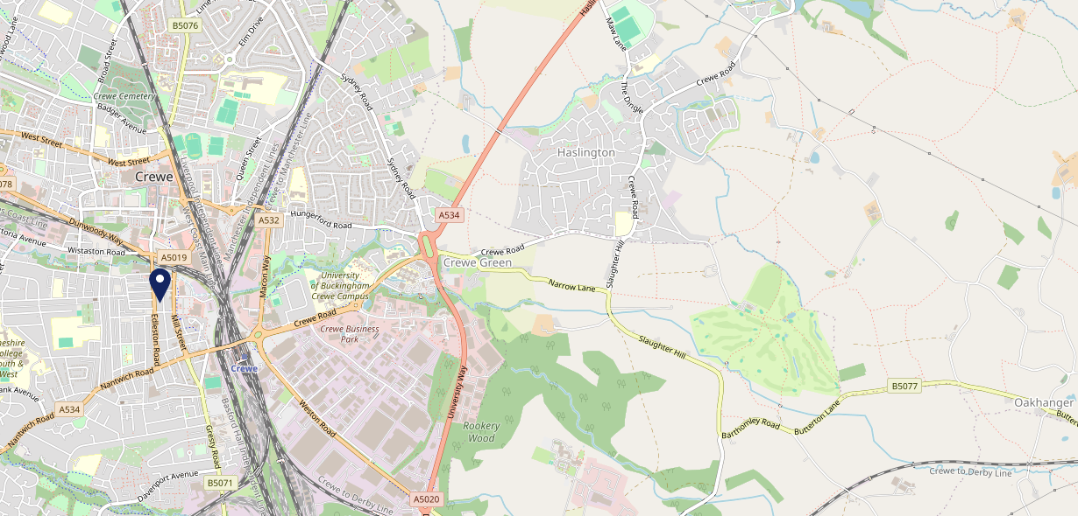
Site Intel
Imperial Hotel CW27HR
1 Miles
371 Chains
16/04/2025 - 08/04/2026
Site Summary
Imperial Hotel CW27HR
Work Area
Region
TV Region
Urbanicity
Crewe
North West
North West
Urban city and town
CW27HR
Punch - Mighty Local
Top Competitors
ATV
Gender
McDonalds Crewe - Dunwoody
#1
£8.14
79.16%
Male
CW13AW
McDonalds
Affluence
Segmentation
McDonalds Crewe - Macon Way
#2
74.24%
62.35%
Low Income
On A Budget
CW16DR
McDonalds
Age Group
Visit Day
Mcdonalds Crewe Market Centre
#3
41.72%
30.88%
CW12NG
45 to 54
Sat
McDonalds
Nearest Station
Crewe(0.62 miles)
711 Site Customers
266 Competitors
176480 Competitor Customers

Slide 2
Site Intel
Imperial Hotel CW27HR
1 Miles
371 Chains
16/04/2025 - 08/04/2026
Spend by Weekpart
How is customer spend distributed throughout the week for Imperial Hotel CW27HR versus its competitors?
% of spend for Imperial Hotel CW27HR and 371 Chains in 1 Miles from 16/04/2025 - 08/04/2026 split by Day of Week
711 Site Customers
266 Competitors
176480 Competitor Customers

Slide 3
Site Intel
Imperial Hotel CW27HR
1 Miles
371 Chains
16/04/2025 - 08/04/2026
Visit Frequency
How frequently per year do customers visit Imperial Hotel CW27HR versus its competitors?
% of customer numbers for Imperial Hotel CW27HR and 371 Chains in 1 Miles from 16/04/2025 - 08/04/2026 and the number of visits made Per Annum
711 Site Customers
266 Competitors
176480 Competitor Customers

Slide 4
Site Intel
Imperial Hotel CW27HR
1 Miles
371 Chains
16/04/2025 - 08/04/2026
ATV Change
How has ATV changed between two date ranges?
711 Site Customers

Slide 5
Site Intel
Imperial Hotel CW27HR
1 Miles
371 Chains
16/04/2025 - 08/04/2026
Market Share Change
How has market share changed between two date ranges?
% of market share spend for Imperial Hotel CW27HR and 371 Chains in 1 Miles from 16/04/2025 - 08/04/2026
711 Site Customers

Slide 6
Site Intel
Imperial Hotel CW27HR
1 Miles
371 Chains
16/04/2025 - 08/04/2026
Age
How does the age profile of customers who visit Imperial Hotel CW27HR compare versus its competitors?
% of spend for Imperial Hotel CW27HR and 371 Chains in 1 Miles from 16/04/2025 - 08/04/2026 split by Age Range
188 Site Customers
266 Competitors
69330 Competitor Customers

Slide 7
Site Intel
Imperial Hotel CW27HR
1 Miles
371 Chains
16/04/2025 - 08/04/2026
Affluence
How does the affluence of customers who visit Imperial Hotel CW27HR compare versus its competitors?
% of spend for Imperial Hotel CW27HR and 371 Chains in 1 Miles from 16/04/2025 - 08/04/2026 split by Affluence
168 Site Customers
266 Competitors
60974 Competitor Customers

Slide 8
Site Intel
Imperial Hotel CW27HR
1 Miles
371 Chains
16/04/2025 - 08/04/2026
Gender
How does the gender profile of customers who visit Imperial Hotel CW27HR compare versus its competitors?
% of spend for Imperial Hotel CW27HR and 371 Chains in 1 Miles from 16/04/2025 - 08/04/2026 split by Gender
180 Site Customers
266 Competitors
66439 Competitor Customers

Slide 9
Site Intel
Imperial Hotel CW27HR
1 Miles
371 Chains
16/04/2025 - 08/04/2026
Punch Segmentation
How does the Custom segmentation profile of customers who visit Imperial Hotel CW27HR compare versus its competitors?
% of spend for Imperial Hotel CW27HR and 371 Chains in 1 Miles from 16/04/2025 - 08/04/2026 split by Segment
711 Site Customers
266 Competitors
176480 Competitor Customers

Slide 10
Site Intel
Imperial Hotel CW27HR
1 Miles
371 Chains
16/04/2025 - 08/04/2026
Spend by Distance
How does the spend profile of Imperial Hotel CW27HR compare versus its competitors based on travel distances?
% of spend for Imperial Hotel CW27HR and 371 Chains in 1 Miles from 16/04/2025 - 08/04/2026 split by Distance travelled
180 Site Customers
266 Competitors
66378 Competitor Customers

Slide 11
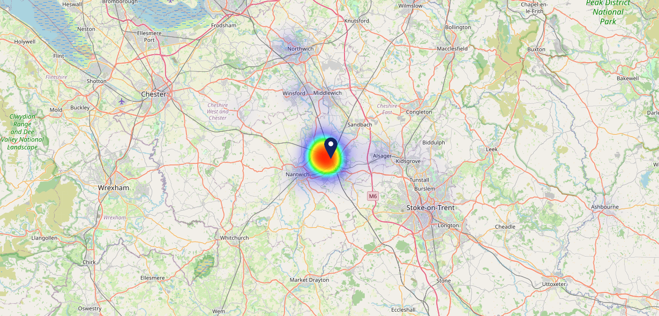
Site Intel
Imperial Hotel CW27HR
16/04/2025 - 08/04/2026
Map of Guest Origin
Where do customers of Imperial Hotel CW27HR come from?
Where do customers of Imperial Hotel CW27HR for 16/04/2025 - 08/04/2026 live
180 Site Customers

Slide 12
Site Intel
Imperial Hotel CW27HR
1 Miles
371 Chains
16/04/2025 - 08/04/2026
Share of Wallet
What are the Top 20 venues (by spend) that customers of Imperial Hotel CW27HR also visit?
For customers of Imperial Hotel CW27HR, who are the top 20 competitors from 371 Chains in 1 Miles for 16/04/2025 - 08/04/2026 split by Venue
711 Site Customers

Slide 13
Site Intel
Imperial Hotel CW27HR
1 Miles
371 Chains
16/04/2025 - 08/04/2026
Share of Wallet Change
How has share of wallet of customers of Imperial Hotel CW27HR changed between two date ranges?
711 Site Customers

Slide 14
Site Intel
Imperial Hotel CW27HR
16/04/2025 - 08/04/2026
Market Summary
How does the local area for Imperial Hotel CW27HR compare to the national average (1 = low, 10 = high)
Data Type | Name | Spend in 250m | 250m Spend vs National | Spend in 500m | 500m Spend vs National | Spend in 1 mile | 1 mile Spend vs National | Spend in 3 miles | 3 mile Spend vs National
Total | Annual Sales | £454K | 3 | £8.33M | 7 | £47.77M | 8 | £87.62M | 6
Weekpart | Mon - Thu | 31.1% | 1 | 43.3% | 7 | 48.1% | 10 | 46.5% | 9
Weekpart | Fri - Sat | 48.1% | 8 | 43.5% | 5 | 38.5% | 2 | 38.9% | 1
Weekpart | Sun | 20.8% | 9 | 13.1% | 3 | 13.4% | 2 | 14.6% | 3
Age | 18 to 24 | 4.4% | 4 | 5.2% | 5 | 6.9% | 6 | 5.6% | 4
Age | 25 to 34 | 16.7% | 3 | 19.3% | 4 | 21.4% | 5 | 18.9% | 3
Age | 35 to 44 | 25.9% | 7 | 25.7% | 7 | 27.4% | 9 | 25.6% | 8
Age | 45 to 54 | 33.7% | 10 | 19.4% | 5 | 19.0% | 4 | 18.7% | 3
Age | 55 to 64 | 16.9% | 6 | 17.9% | 7 | 15.6% | 6 | 18.1% | 8
Age | 65 to 74 | 2.1% | 1 | 8.3% | 7 | 7.0% | 6 | 8.7% | 8
Age | 75+ | 0.2% | 1 | 4.2% | 8 | 2.7% | 6 | 4.4% | 8
CAMEO | Business Elite | 0.4% | 1 | 5.0% | 4 | 4.9% | 4 | 5.4% | 4
CAMEO | Prosperous Professionals | 0.6% | 1 | 5.2% | 5 | 4.3% | 3 | 4.6% | 3
CAMEO | Flourishing Society | 1.5% | 1 | 6.9% | 3 | 8.7% | 3 | 10.1% | 4
CAMEO | Content Communities | 4.2% | 1 | 15.4% | 8 | 14.5% | 8 | 15.2% | 8
CAMEO | White Collar Neighbourhoods | 2.2% | 1 | 7.1% | 2 | 7.8% | 2 | 8.4% | 2
CAMEO | Enterprising Mainstream | 8.7% | 6 | 12.0% | 8 | 12.4% | 9 | 14.0% | 10
CAMEO | Paying The Mortgage | 12.7% | 4 | 18.8% | 8 | 17.8% | 8 | 18.2% | 8
CAMEO | Cash Conscious Communities | 10.5% | 7 | 10.8% | 7 | 10.0% | 6 | 9.0% | 5
CAMEO | On A Budget | 53.1% | 10 | 12.5% | 9 | 11.7% | 9 | 8.5% | 8
CAMEO | Family Value | 6.1% | 8 | 6.3% | 8 | 7.9% | 8 | 6.5% | 8
Affluence | AB | 2.5% | 1 | 17.1% | 3 | 17.9% | 3 | 20.1% | 3
Affluence | C1C2 | 27.7% | 1 | 53.3% | 7 | 52.5% | 7 | 55.9% | 9
Affluence | DE | 69.7% | 10 | 29.6% | 8 | 29.6% | 8 | 24.0% | 7

Slide 15
Site Intel
Imperial Hotel CW27HR
Site Potential 1
Site Characteristics
£3000
£18000
OCC Concept Fit
Achievable Average Weekly Takings
Mighty Local
£8000
A Food-Led High Affluence B Food-Led Mid Affluence C Wet-Led Mid/High Affluence D Wet-Led Low Affluence E Food-Led Low Affluence
AWT 2 Local Regulars 3 Local Passing Trade 4 Destination Wet-Led 5 Destination Food-Led 6 Destination Very Food-Led
A
B
C
D
E
1
2
3
4
5
6

Slide 16
Site Intel
Imperial Hotel CW27HR
Site Potential 2
Concept Recommendation

Slide 17
Site Intel
Imperial Hotel CW27HR
Local Market Profile
Mix of spend by customer segment in Punch site and local market
 | Customer Count | Family Familiar | Occasional & Local | Mid-Week Seniors | Part Of The Pub | Metro Sophisticates | Young & Connected | Bubbly Weekenders | Upmarket Diners
Imperial Hotel | 72 | 24.86% | 5.20% | 7.24% | 10.79% | 0.97% | 18.45% | 26.59% | 5.86%
Local Catchment | 10600 | 23.20% | 6.99% | 12.32% | 7.26% | 6.82% | 15.55% | 11.02% | 16.81%
Punch T&L | 95399 | 8.87% | 6.08% | 28.77% | 10.99% | 11.35% | 11.01% | 7.08% | 15.81%
Imperial Hotel vs Local Catchment |  | 1.66% | -1.79% | -5.08% | 3.53% | -5.85% | 2.90% | 15.57% | -10.95%
Imperial Hotel vs Punch T&L |  | 15.99% | -0.88% | -21.53% | -0.20% | -10.38% | 7.44% | 19.51% | -9.95%
Local Catchment vs Punch T&L |  | 14.33% | 0.91% | -16.45% | -3.73% | -4.53% | 4.54% | 3.94% | 1.00%

Slide 18
Site Intel
Imperial Hotel CW27HR
Local Competitor Profiles
Mix of spend by customer segment in Punch site and local competitors
 | Customer Count | Family Familiar | Occasional & Local | Mid-Week Seniors | Part Of The Pub | Metro Sophisticates | Young & Connected | Bubbly Weekenders | Upmarket Diners
Imperial Hotel CW27HR | 72 | 24.86% | 5.20% | 7.24% | 10.79% | 0.97% | 18.45% | 26.59% | 5.86%
McDonalds Crewe - Dunwoody CW13AW | 1036 | 33.31% | 8.88% | 7.70% | 4.48% | 3.98% | 14.28% | 12.24% | 15.09%
McDonalds Crewe - Macon Way CW16DR | 1863 | 28.04% | 8.04% | 10.99% | 3.09% | 5.28% | 13.58% | 14.67% | 16.26%
Mcdonalds Crewe Market Centre CW12NG | 733 | 35.24% | 10.27% | 7.96% | 2.62% | 2.78% | 16.75% | 12.49% | 11.88%
Express Crewe CW27AT | 111 | 7.12% | 3.04% | 8.96% | 8.41% | 5.00% | 45.10% | 8.43% | 13.89%
Alberts Corner CW12DF | 104 | 51.02% | 16.05% | 4.53% | 7.81% | 1.17% | 13.07% | 2.38% | 3.93%
Raven CW26NA | 115 | 4.24% | 9.49% | 23.51% | 46.24% | 2.75% | 5.57% | 7.35% | 0.81%
Cheese Hall CW12BS | 164 | 22.43% | 5.51% | 14.84% | 31.23% | 4.60% | 12.78% | 5.08% | 3.49%
Grand Junction Crewe CW12BZ | 134 | 41.42% | 3.90% | 4.45% | 22.66% | 2.00% | 14.82% | 4.48% | 6.23%
Four Eagles (Crewe) CW13AW | 220 | 36.96% | 12.02% | 15.17% | 15.30% | 0.90% | 9.37% | 3.94% | 6.30%
KFC Crewe Dunwoody Way CW13AS | 408 | 35.21% | 6.58% | 6.48% | 2.70% | 2.43% | 17.99% | 13.49% | 15.07%
Dishers Pool & Snooker CW26HL | 107 | 12.20% | 12.99% | 10.97% | 6.30% | 10.23% | 9.28% | 23.48% | 14.52%
British Lion CW26AL | 91 | 16.45% | 10.10% | 8.99% | 26.16% | 7.79% | 20.68% | 6.88% | 2.90%
Burger King CW12RP | 533 | 35.31% | 6.35% | 7.44% | 3.97% | 2.91% | 16.53% | 12.80% | 14.65%
Hops Belgian Bar CW12DF | 132 | 2.68% | 4.15% | 15.59% | 2.21% | 10.36% | 40.80% | 17.27% | 6.91%
Ebenezers Crewe CW26DF | 91 | 1.57% | 1.32% | 16.92% | 0.19% | 20.89% | 45.06% | 6.41% | 7.60%
Passage To India CW26AD | 196 | 18.84% | 4.74% | 17.24% | 4.31% | 10.30% | 15.97% | 9.91% | 18.65%
Miller & Carter Crewe CW26PB | 190 | 30.82% | 6.03% | 20.44% | 1.16% | 2.82% | 7.46% | 4.17% | 27.06%
Borough Arms CW12BG | 123 | 2.48% | 4.60% | 8.52% | 49.31% | 14.89% | 13.27% | 2.67% | 4.21%
Hongs Noodle And Dumpl CW12BS | 106 | 26.80% | 13.70% | 5.08% | 5.26% | 1.06% | 13.58% | 18.13% | 16.34%
Crewe Dog CW12BL | 429 | 11.55% | 5.98% | 30.22% | 2.73% | 10.11% | 15.05% | 8.93% | 15.39%
Thai Taste Noodle Bar CW26AT | 159 | 38.37% | 7.85% | 5.85% | 2.21% | 2.42% | 9.31% | 14.38% | 19.57%
Flying Lady CW15LE | 39 | 26.85% | 44.20% | 5.68% | 10.30% | 1.45% | 6.40% | 4.05% | 1.02%
Taco Bell CW13AJ | 351 | 21.79% | 6.88% | 6.05% | 1.23% | 3.70% | 24.28% | 17.77% | 18.25%
Istanbul Restaurant Cr CW27EH | 64 | 22.26% | 3.92% | 13.20% | 4.63% | 9.56% | 10.83% | 8.76% | 26.80%

