Slide 1
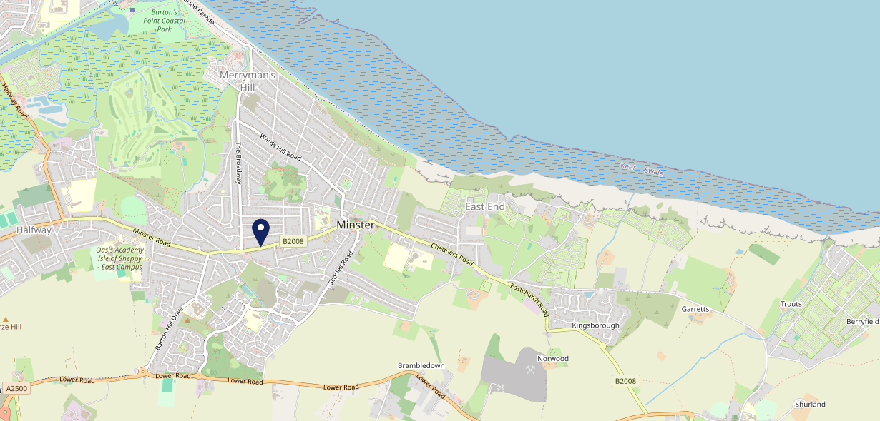
Site Intel
Harps Inn ME123NR
1 Miles
371 Chains
16/04/2025 - 08/04/2026
Site Summary
Harps Inn ME123NR
Work Area
Region
TV Region
Urbanicity
Medway
South East
South
Urban city and town
ME123NR
Punch - Fireside Inns
Top Competitors
ATV
Gender
Dragon
#1
£19.87
64.37%
Male
ME123JE
Restaurant
Affluence
Segmentation
Minster Working Mens Club
#2
74.77%
34.74%
Middle Income
Enterprising Mainstream
ME122HW
Clubs
Age Group
Visit Day
Highlander
#3
29.65%
24.76%
ME123QD
18 to 24
Sat
Star Pubs & Bars
Nearest Station
Queenborough(3.55 miles)
1453 Site Customers
45 Competitors
7338 Competitor Customers

Slide 2
Site Intel
Harps Inn ME123NR
1 Miles
371 Chains
16/04/2025 - 08/04/2026
Spend by Weekpart
How is customer spend distributed throughout the week for Harps Inn ME123NR versus its competitors?
% of spend for Harps Inn ME123NR and 371 Chains in 1 Miles from 16/04/2025 - 08/04/2026 split by Day of Week
1453 Site Customers
45 Competitors
7338 Competitor Customers

Slide 3
Site Intel
Harps Inn ME123NR
1 Miles
371 Chains
16/04/2025 - 08/04/2026
Visit Frequency
How frequently per year do customers visit Harps Inn ME123NR versus its competitors?
% of customer numbers for Harps Inn ME123NR and 371 Chains in 1 Miles from 16/04/2025 - 08/04/2026 and the number of visits made Per Annum
1453 Site Customers
45 Competitors
7338 Competitor Customers

Slide 4
Site Intel
Harps Inn ME123NR
1 Miles
371 Chains
16/04/2025 - 08/04/2026
ATV Change
How has ATV changed between two date ranges?
1453 Site Customers

Slide 5
Site Intel
Harps Inn ME123NR
1 Miles
371 Chains
16/04/2025 - 08/04/2026
Market Share Change
How has market share changed between two date ranges?
% of market share spend for Harps Inn ME123NR and 371 Chains in 1 Miles from 16/04/2025 - 08/04/2026
1453 Site Customers

Slide 6
Site Intel
Harps Inn ME123NR
1 Miles
371 Chains
16/04/2025 - 08/04/2026
Age
How does the age profile of customers who visit Harps Inn ME123NR compare versus its competitors?
% of spend for Harps Inn ME123NR and 371 Chains in 1 Miles from 16/04/2025 - 08/04/2026 split by Age Range
718 Site Customers
45 Competitors
3718 Competitor Customers

Slide 7
Site Intel
Harps Inn ME123NR
1 Miles
371 Chains
16/04/2025 - 08/04/2026
Affluence
How does the affluence of customers who visit Harps Inn ME123NR compare versus its competitors?
% of spend for Harps Inn ME123NR and 371 Chains in 1 Miles from 16/04/2025 - 08/04/2026 split by Affluence
678 Site Customers
45 Competitors
3467 Competitor Customers

Slide 8
Site Intel
Harps Inn ME123NR
1 Miles
371 Chains
16/04/2025 - 08/04/2026
Gender
How does the gender profile of customers who visit Harps Inn ME123NR compare versus its competitors?
% of spend for Harps Inn ME123NR and 371 Chains in 1 Miles from 16/04/2025 - 08/04/2026 split by Gender
695 Site Customers
45 Competitors
3589 Competitor Customers

Slide 9
Site Intel
Harps Inn ME123NR
1 Miles
371 Chains
16/04/2025 - 08/04/2026
Punch Segmentation
How does the Custom segmentation profile of customers who visit Harps Inn ME123NR compare versus its competitors?
% of spend for Harps Inn ME123NR and 371 Chains in 1 Miles from 16/04/2025 - 08/04/2026 split by Segment
1453 Site Customers
45 Competitors
7338 Competitor Customers

Slide 10
Site Intel
Harps Inn ME123NR
1 Miles
371 Chains
16/04/2025 - 08/04/2026
Spend by Distance
How does the spend profile of Harps Inn ME123NR compare versus its competitors based on travel distances?
% of spend for Harps Inn ME123NR and 371 Chains in 1 Miles from 16/04/2025 - 08/04/2026 split by Distance travelled
693 Site Customers
45 Competitors
3586 Competitor Customers

Slide 11
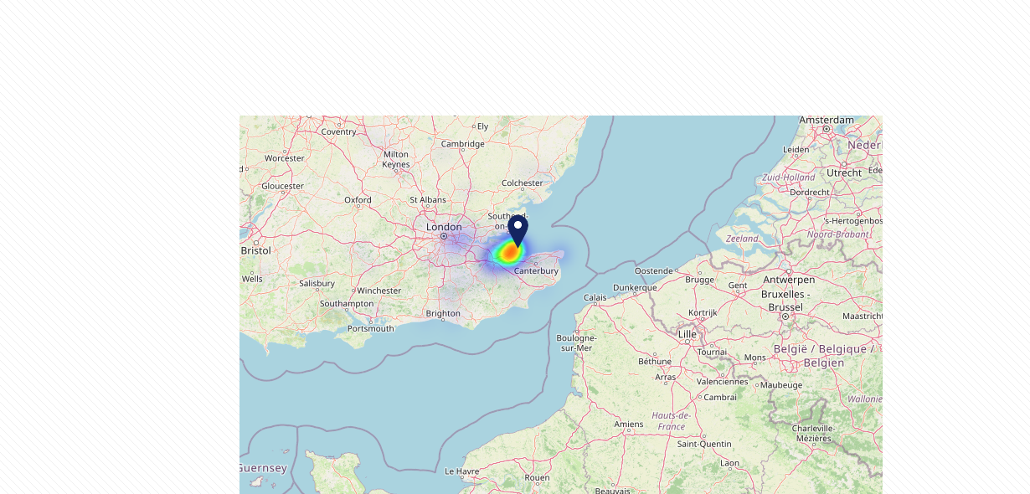
Site Intel
Harps Inn ME123NR
16/04/2025 - 08/04/2026
Map of Guest Origin
Where do customers of Harps Inn ME123NR come from?
Where do customers of Harps Inn ME123NR for 16/04/2025 - 08/04/2026 live
693 Site Customers

Slide 12
Site Intel
Harps Inn ME123NR
1 Miles
371 Chains
16/04/2025 - 08/04/2026
Share of Wallet
What are the Top 20 venues (by spend) that customers of Harps Inn ME123NR also visit?
For customers of Harps Inn ME123NR, who are the top 20 competitors from 371 Chains in 1 Miles for 16/04/2025 - 08/04/2026 split by Venue
1453 Site Customers

Slide 13
Site Intel
Harps Inn ME123NR
1 Miles
371 Chains
16/04/2025 - 08/04/2026
Share of Wallet Change
How has share of wallet of customers of Harps Inn ME123NR changed between two date ranges?
1453 Site Customers

Slide 14
Site Intel
Harps Inn ME123NR
16/04/2025 - 08/04/2026
Market Summary
How does the local area for Harps Inn ME123NR compare to the national average (1 = low, 10 = high)
Data Type | Name | Spend in 250m | 250m Spend vs National | Spend in 500m | 500m Spend vs National | Spend in 1 mile | 1 mile Spend vs National | Spend in 3 miles | 3 mile Spend vs National
Total | Annual Sales | £1.43M | 5 | £1.43M | 4 | £4.68M | 3 | £27.58M | 3
Weekpart | Mon - Thu | 36.5% | 3 | 36.5% | 3 | 36.9% | 2 | 43.2% | 7
Weekpart | Fri - Sat | 45.8% | 6 | 45.8% | 7 | 46.5% | 9 | 41.4% | 5
Weekpart | Sun | 17.7% | 8 | 17.7% | 8 | 16.6% | 8 | 15.4% | 5
Age | 18 to 24 | 27.1% | 10 | 27.1% | 10 | 14.2% | 10 | 10.4% | 9
Age | 25 to 34 | 6.7% | 1 | 6.7% | 1 | 10.5% | 1 | 16.4% | 2
Age | 35 to 44 | 18.2% | 2 | 18.2% | 2 | 19.5% | 2 | 22.5% | 4
Age | 45 to 54 | 17.1% | 3 | 17.1% | 2 | 15.2% | 1 | 16.9% | 1
Age | 55 to 64 | 14.6% | 5 | 14.6% | 5 | 18.3% | 8 | 17.9% | 8
Age | 65 to 74 | 11.3% | 9 | 11.3% | 9 | 16.5% | 10 | 10.9% | 9
Age | 75+ | 5.0% | 9 | 5.0% | 9 | 5.7% | 9 | 5.1% | 9
CAMEO | Business Elite | 0.9% | 1 | 0.9% | 1 | 1.6% | 1 | 1.6% | 1
CAMEO | Prosperous Professionals | 2.1% | 2 | 2.1% | 2 | 2.1% | 1 | 2.0% | 1
CAMEO | Flourishing Society | 7.0% | 3 | 7.0% | 3 | 6.9% | 2 | 7.4% | 2
CAMEO | Content Communities | 18.8% | 9 | 18.8% | 9 | 20.6% | 10 | 14.4% | 8
CAMEO | White Collar Neighbourhoods | 12.0% | 6 | 12.0% | 6 | 12.5% | 7 | 13.0% | 8
CAMEO | Enterprising Mainstream | 30.1% | 10 | 30.1% | 10 | 26.4% | 10 | 17.8% | 10
CAMEO | Paying The Mortgage | 11.4% | 4 | 11.4% | 4 | 14.8% | 6 | 17.5% | 8
CAMEO | Cash Conscious Communities | 6.6% | 3 | 6.6% | 3 | 5.7% | 2 | 10.1% | 6
CAMEO | On A Budget | 10.8% | 8 | 10.8% | 9 | 8.1% | 7 | 14.1% | 10
CAMEO | Family Value | 0.4% | 1 | 0.4% | 1 | 1.2% | 3 | 2.1% | 5
Affluence | AB | 10.0% | 2 | 10.0% | 1 | 10.6% | 1 | 11.1% | 1
Affluence | C1C2 | 72.3% | 10 | 72.3% | 10 | 74.3% | 10 | 62.7% | 10
Affluence | DE | 17.7% | 5 | 17.7% | 5 | 15.1% | 3 | 26.3% | 8

Slide 15
Site Intel
Harps Inn ME123NR
Site Potential 1
Site Characteristics
£3000
£18000
OCC Concept Fit
Achievable Average Weekly Takings
Our Local Destination
£14000
A Food-Led High Affluence B Food-Led Mid Affluence C Wet-Led Mid/High Affluence D Wet-Led Low Affluence E Food-Led Low Affluence
AWT 2 Local Regulars 3 Local Passing Trade 4 Destination Wet-Led 5 Destination Food-Led 6 Destination Very Food-Led
A
B
C
D
E
1
2
3
4
5
6

Slide 16
Site Intel
Harps Inn ME123NR
Site Potential 2
Concept Recommendation

Slide 17
Site Intel
Harps Inn ME123NR
Local Market Profile
Mix of spend by customer segment in Punch site and local market
 | Customer Count | Family Familiar | Occasional & Local | Mid-Week Seniors | Part Of The Pub | Metro Sophisticates | Young & Connected | Bubbly Weekenders | Upmarket Diners
Harps Inn | 234 | 12.07% | 7.36% | 14.59% | 2.21% | 1.23% | 54.41% | 4.25% | 3.84%
Local Catchment | 709 | 17.04% | 6.27% | 14.54% | 6.09% | 6.26% | 27.08% | 9.13% | 13.56%
Punch T&L | 95190 | 8.85% | 6.05% | 28.75% | 10.94% | 11.45% | 10.97% | 7.07% | 15.87%
Harps Inn vs Local Catchment |  | -4.97% | 1.09% | 0.05% | -3.88% | -5.03% | 27.33% | -4.88% | -9.72%
Harps Inn vs Punch T&L |  | 3.22% | 1.31% | -14.16% | -8.73% | -10.22% | 43.44% | -2.82% | -12.03%
Local Catchment vs Punch T&L |  | 8.19% | 0.22% | -14.21% | -4.85% | -5.19% | 16.11% | 2.06% | -2.31%

Slide 18
Site Intel
Harps Inn ME123NR
Local Competitor Profiles
Mix of spend by customer segment in Punch site and local competitors
 | Customer Count | Family Familiar | Occasional & Local | Mid-Week Seniors | Part Of The Pub | Metro Sophisticates | Young & Connected | Bubbly Weekenders | Upmarket Diners
Harps Inn ME123NR | 234 | 12.07% | 7.36% | 14.59% | 2.21% | 1.23% | 54.41% | 4.25% | 3.84%
Dragon ME123JE | 98 | 26.86% | 2.43% | 15.85% | 5.06% | 12.09% | 12.21% | 12.22% | 13.24%
Minster Working Mens Club ME122HW | 84 | 12.79% | 27.95% | 11.39% | 1.05% | 6.03% | 26.69% | 11.43% | 2.62%
Highlander ME123QD | 89 | 10.53% | 2.77% | 4.61% | 25.67% | 1.88% | 42.92% | 9.11% | 2.47%
Banks Restaurant ME123NZ | 74 | 17.08% | 2.49% | 19.73% | 1.07% | 8.16% | 13.37% | 5.63% | 32.44%
Mlcb Hospitality ME122NL | 188 | 21.91% | 2.35% | 21.28% | 3.46% | 7.28% | 19.75% | 3.02% | 20.91%
Beach Hotel ME122NJ | 59 | 10.64% | 0.00% | 23.66% | 0.98% | 15.46% | 28.31% | 8.17% | 12.74%
Sheppey Rugby Football Club ME123RT | 68 | 2.76% | 0.34% | 4.09% | 1.98% | 0.50% | 63.33% | 9.38% | 17.59%
Briny Fishbar ME122NJ | 89 | 24.90% | 0.00% | 25.01% | 0.29% | 5.05% | 18.73% | 13.67% | 12.32%
Abbey Cake Shop ME123QF | 47 | 28.31% | 0.52% | 29.59% | 0.00% | 0.21% | 15.30% | 12.85% | 13.18%
Charisma Cocktail Bar ME123SA | 38 | 30.69% | 0.00% | 20.42% | 2.23% | 3.18% | 20.57% | 11.14% | 11.74%
Spice Of India Kent Lt ME123QD | 17 | 13.76% | 0.00% | 9.91% | 13.95% | 17.34% | 30.08% | 6.85% | 8.09%
Little Oyster Cafe ME122NJ | 111 | 29.37% | 10.12% | 28.97% | 0.77% | 0.87% | 6.44% | 7.79% | 15.63%
Sheerness Tow ME122RP | 6 | 81.47% | 0.00% | 3.69% | 0.00% | 0.00% | 2.46% | 0.00% | 12.36%
Lols Cafe ME123JE | 16 | 34.06% | 0.00% | 21.55% | 0.00% | 0.00% | 8.87% | 18.38% | 17.12%
Graces Kitchen ME122DX | 1 | 100.00% | 0.00% | 0.00% | 0.00% | 0.00% | 0.00% | 0.00% | 0.00%
Nacho Wagon ME123SD | 53 | 17.69% | 0.99% | 11.82% | 0.00% | 8.53% | 23.31% | 15.65% | 21.97%
It Sea Food Ba ME123SN | 10 | 26.31% | 0.00% | 22.80% | 0.00% | 0.00% | 17.54% | 16.66% | 16.66%
Oakapplefarm ME123RP | 3 | 0.00% | 0.00% | 16.10% | 0.00% | 37.58% | 46.30% | 0.00% | 0.00%
Minster Chippy ME122RW | 1 | 0.00% | 0.00% | 100.00% | 0.00% | 0.00% | 0.00% | 0.00% | 0.00%
The Highlander ME123QD | 3 | 44.55% | 0.00% | 0.00% | 0.00% | 0.00% | 0.00% | 19.80% | 35.64%

