Slide 1
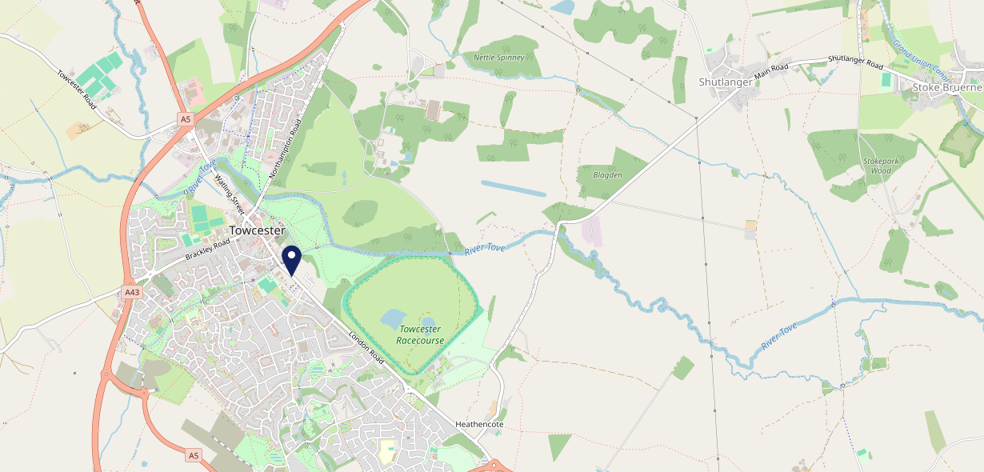
Site Intel
Peacock NN126AG
1 Miles
371 Chains
16/04/2025 - 08/04/2026
Site Summary
Peacock NN126AG
Work Area
Region
TV Region
Urbanicity
Northampton
East Midlands
Anglia
Rural town and fringe
NN126AG
Punch T&L
Top Competitors
ATV
Gender
Towcester Mill Brewery
#1
£7.78
97.07%
Male
NN126YY
Pub / Bar
Affluence
Segmentation
Brave Old Oak
#2
69.13%
63.77%
Low Income
On A Budget
NN126BT
Marstons Community Wet
Age Group
Visit Day
Watling St Village
#3
61.61%
25.73%
NN126BX
45 to 54
Sat
Pub / Bar
Nearest Station
Northampton(13.14 miles)
212 Site Customers
69 Competitors
38213 Competitor Customers

Slide 2
Site Intel
Peacock NN126AG
1 Miles
371 Chains
16/04/2025 - 08/04/2026
Spend by Weekpart
How is customer spend distributed throughout the week for Peacock NN126AG versus its competitors?
% of spend for Peacock NN126AG and 371 Chains in 1 Miles from 16/04/2025 - 08/04/2026 split by Day of Week
212 Site Customers
69 Competitors
38213 Competitor Customers

Slide 3
Site Intel
Peacock NN126AG
1 Miles
371 Chains
16/04/2025 - 08/04/2026
Visit Frequency
How frequently per year do customers visit Peacock NN126AG versus its competitors?
% of customer numbers for Peacock NN126AG and 371 Chains in 1 Miles from 16/04/2025 - 08/04/2026 and the number of visits made Per Annum
212 Site Customers
69 Competitors
38213 Competitor Customers

Slide 4
Site Intel
Peacock NN126AG
1 Miles
371 Chains
16/04/2025 - 08/04/2026
ATV Change
How has ATV changed between two date ranges?
212 Site Customers

Slide 5
Site Intel
Peacock NN126AG
1 Miles
371 Chains
16/04/2025 - 08/04/2026
Market Share Change
How has market share changed between two date ranges?
% of market share spend for Peacock NN126AG and 371 Chains in 1 Miles from 16/04/2025 - 08/04/2026
212 Site Customers

Slide 6
Site Intel
Peacock NN126AG
1 Miles
371 Chains
16/04/2025 - 08/04/2026
Age
How does the age profile of customers who visit Peacock NN126AG compare versus its competitors?
% of spend for Peacock NN126AG and 371 Chains in 1 Miles from 16/04/2025 - 08/04/2026 split by Age Range
68 Site Customers
69 Competitors
18155 Competitor Customers

Slide 7
Site Intel
Peacock NN126AG
1 Miles
371 Chains
16/04/2025 - 08/04/2026
Affluence
How does the affluence of customers who visit Peacock NN126AG compare versus its competitors?
% of spend for Peacock NN126AG and 371 Chains in 1 Miles from 16/04/2025 - 08/04/2026 split by Affluence
55 Site Customers
69 Competitors
16011 Competitor Customers

Slide 8
Site Intel
Peacock NN126AG
1 Miles
371 Chains
16/04/2025 - 08/04/2026
Gender
How does the gender profile of customers who visit Peacock NN126AG compare versus its competitors?
% of spend for Peacock NN126AG and 371 Chains in 1 Miles from 16/04/2025 - 08/04/2026 split by Gender
63 Site Customers
69 Competitors
17667 Competitor Customers

Slide 9
Site Intel
Peacock NN126AG
1 Miles
371 Chains
16/04/2025 - 08/04/2026
Punch Segmentation
How does the Custom segmentation profile of customers who visit Peacock NN126AG compare versus its competitors?
% of spend for Peacock NN126AG and 371 Chains in 1 Miles from 16/04/2025 - 08/04/2026 split by Segment
212 Site Customers
69 Competitors
38213 Competitor Customers

Slide 10
Site Intel
Peacock NN126AG
1 Miles
371 Chains
16/04/2025 - 08/04/2026
Spend by Distance
How does the spend profile of Peacock NN126AG compare versus its competitors based on travel distances?
% of spend for Peacock NN126AG and 371 Chains in 1 Miles from 16/04/2025 - 08/04/2026 split by Distance travelled
63 Site Customers
69 Competitors
17655 Competitor Customers

Slide 11
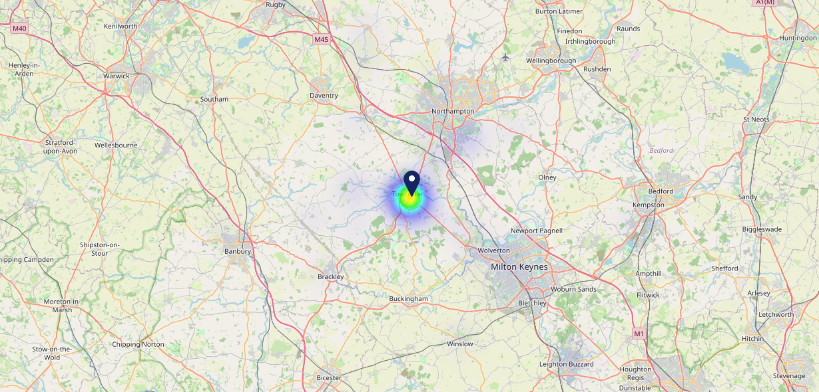
Site Intel
Peacock NN126AG
16/04/2025 - 08/04/2026
Map of Guest Origin
Where do customers of Peacock NN126AG come from?
Where do customers of Peacock NN126AG for 16/04/2025 - 08/04/2026 live
63 Site Customers

Slide 12
Site Intel
Peacock NN126AG
1 Miles
371 Chains
16/04/2025 - 08/04/2026
Share of Wallet
What are the Top 20 venues (by spend) that customers of Peacock NN126AG also visit?
For customers of Peacock NN126AG, who are the top 20 competitors from 371 Chains in 1 Miles for 16/04/2025 - 08/04/2026 split by Venue
212 Site Customers

Slide 13
Site Intel
Peacock NN126AG
1 Miles
371 Chains
16/04/2025 - 08/04/2026
Share of Wallet Change
How has share of wallet of customers of Peacock NN126AG changed between two date ranges?
212 Site Customers

Slide 14
Site Intel
Peacock NN126AG
16/04/2025 - 08/04/2026
Market Summary
How does the local area for Peacock NN126AG compare to the national average (1 = low, 10 = high)
Data Type | Name | Spend in 250m | 250m Spend vs National | Spend in 500m | 500m Spend vs National | Spend in 1 mile | 1 mile Spend vs National | Spend in 3 miles | 3 mile Spend vs National
Total | Annual Sales | £1.13M | 5 | £8.37M | 7 | £14.09M | 5 | £16.11M | 2
Weekpart | Mon - Thu | 35.7% | 3 | 37.6% | 3 | 40.6% | 5 | 39.6% | 3
Weekpart | Fri - Sat | 50.0% | 9 | 48.8% | 9 | 44.2% | 7 | 44.2% | 8
Weekpart | Sun | 14.3% | 5 | 13.7% | 4 | 15.2% | 5 | 16.1% | 7
Age | 18 to 24 | 4.7% | 5 | 7.7% | 7 | 7.1% | 6 | 6.4% | 5
Age | 25 to 34 | 13.7% | 2 | 12.3% | 1 | 14.7% | 2 | 13.9% | 1
Age | 35 to 44 | 22.1% | 5 | 20.4% | 3 | 23.5% | 6 | 22.7% | 5
Age | 45 to 54 | 23.7% | 8 | 21.6% | 7 | 21.8% | 8 | 22.0% | 8
Age | 55 to 64 | 23.1% | 9 | 20.8% | 9 | 18.4% | 8 | 18.6% | 9
Age | 65 to 74 | 9.6% | 8 | 12.8% | 9 | 10.6% | 9 | 12.2% | 10
Age | 75+ | 3.1% | 7 | 4.5% | 8 | 3.8% | 8 | 4.2% | 8
CAMEO | Business Elite | 6.0% | 5 | 6.0% | 5 | 5.6% | 5 | 6.1% | 5
CAMEO | Prosperous Professionals | 12.3% | 10 | 15.6% | 10 | 13.6% | 10 | 13.3% | 10
CAMEO | Flourishing Society | 16.5% | 7 | 18.6% | 8 | 17.9% | 8 | 18.4% | 8
CAMEO | Content Communities | 14.2% | 7 | 17.4% | 9 | 17.2% | 9 | 17.9% | 10
CAMEO | White Collar Neighbourhoods | 8.6% | 3 | 8.9% | 3 | 8.9% | 3 | 8.8% | 2
CAMEO | Enterprising Mainstream | 10.3% | 7 | 8.7% | 6 | 9.9% | 7 | 9.7% | 7
CAMEO | Paying The Mortgage | 10.4% | 3 | 10.1% | 3 | 11.3% | 3 | 11.0% | 3
CAMEO | Cash Conscious Communities | 10.7% | 7 | 9.3% | 6 | 9.7% | 6 | 9.2% | 6
CAMEO | On A Budget | 8.8% | 7 | 3.7% | 2 | 3.8% | 2 | 3.5% | 1
CAMEO | Family Value | 2.2% | 5 | 1.8% | 5 | 2.2% | 5 | 2.1% | 5
Affluence | AB | 34.8% | 7 | 40.2% | 8 | 37.1% | 7 | 37.7% | 7
Affluence | C1C2 | 43.5% | 4 | 45.0% | 4 | 47.4% | 5 | 47.4% | 5
Affluence | DE | 21.7% | 6 | 14.8% | 3 | 15.6% | 4 | 14.8% | 3

Slide 15
Site Intel
Peacock NN126AG
Site Potential 1
Site Characteristics
£3000
£18000
OCC Concept Fit
Achievable Average Weekly Takings
Non-Core
£11500
A Food-Led High Affluence B Food-Led Mid Affluence C Wet-Led Mid/High Affluence D Wet-Led Low Affluence E Food-Led Low Affluence
AWT 2 Local Regulars 3 Local Passing Trade 4 Destination Wet-Led 5 Destination Food-Led 6 Destination Very Food-Led
A
B
C
D
E
1
2
3
4
5
6

Slide 16
Site Intel
Peacock NN126AG
Site Potential 2
Concept Recommendation

Slide 17
Site Intel
Peacock NN126AG
Local Market Profile
Mix of spend by customer segment in Punch site and local market
 | Customer Count | Family Familiar | Occasional & Local | Mid-Week Seniors | Part Of The Pub | Metro Sophisticates | Young & Connected | Bubbly Weekenders | Upmarket Diners
Peacock | 27 | 0.80% | 0.00% | 3.06% | 75.41% | 2.83% | 13.15% | 2.86% | 1.85%
Local Catchment | 3631 | 13.57% | 1.75% | 25.16% | 2.83% | 8.81% | 12.22% | 9.12% | 26.49%
Punch T&L | 95043 | 8.91% | 6.06% | 28.65% | 11.34% | 11.30% | 11.03% | 7.03% | 15.64%
Peacock vs Local Catchment |  | -12.77% | 0.00% | -22.10% | 72.58% | -5.98% | 0.93% | -6.26% | -24.64%
Peacock vs Punch T&L |  | -8.11% | 0.00% | -25.59% | 64.07% | -8.47% | 2.12% | -4.17% | -13.79%
Local Catchment vs Punch T&L |  | 4.66% | -4.31% | -3.49% | -8.51% | -2.49% | 1.19% | 2.09% | 10.85%

Slide 18
Site Intel
Peacock NN126AG
Local Competitor Profiles
Mix of spend by customer segment in Punch site and local competitors
 | Customer Count | Family Familiar | Occasional & Local | Mid-Week Seniors | Part Of The Pub | Metro Sophisticates | Young & Connected | Bubbly Weekenders | Upmarket Diners
Towcester Mill Brewery NN126YY | 223 | 5.89% | 0.55% | 29.81% | 1.01% | 21.52% | 7.60% | 8.89% | 24.68%
Brave Old Oak NN126BT | 113 | 29.97% | 1.14% | 33.83% | 19.73% | 1.46% | 6.74% | 4.40% | 2.68%
Watling St Village NN126BX | 314 | 6.98% | 2.42% | 25.33% | 2.29% | 8.94% | 12.79% | 15.08% | 26.13%
Peacock NN126AG | 27 | 0.80% | 0.00% | 3.06% | 75.41% | 2.83% | 13.15% | 2.86% | 1.85%
McDonalds NN126DJ | 2073 | 21.43% | 2.23% | 18.27% | 1.62% | 6.16% | 18.18% | 10.16% | 21.92%
Bull NN126BT | 33 | 9.24% | 1.05% | 47.31% | 2.49% | 8.44% | 20.75% | 10.68% | 0.00%
Saracens Head Hotel (Towcester) NN126BX | 273 | 17.68% | 1.37% | 39.93% | 3.00% | 4.61% | 7.32% | 3.75% | 22.30%
Plough Inn NN126BT | 105 | 1.65% | 0.13% | 43.18% | 1.08% | 4.80% | 6.30% | 17.68% | 25.15%
Monk & Tipster NN126AF | 68 | 1.41% | 2.77% | 24.34% | 4.52% | 6.87% | 20.42% | 23.59% | 16.05%
Ganges 03 NN126ED | 40 | 8.04% | 0.00% | 31.03% | 1.14% | 9.81% | 15.98% | 1.73% | 32.23%
McDonalds NN126TQ | 201 | 29.94% | 0.99% | 12.53% | 1.27% | 0.80% | 33.14% | 5.39% | 15.89%
Moghul Rooms NN126BX | 84 | 1.62% | 0.00% | 20.61% | 1.28% | 40.79% | 5.19% | 5.59% | 24.88%
Rice Bowl NN126BT | 65 | 9.56% | 0.00% | 18.52% | 0.82% | 6.64% | 13.19% | 9.77% | 41.44%
Dna Steak Grill NN126BX | 66 | 6.81% | 0.00% | 21.32% | 3.04% | 12.84% | 6.26% | 8.01% | 41.69%
Vault Cocktail Lou NN126EX | 60 | 3.59% | 3.75% | 17.79% | 1.53% | 15.56% | 8.61% | 6.51% | 42.62%
Amarone Bar And Restau NN126BT | 72 | 6.07% | 1.66% | 18.62% | 0.00% | 10.32% | 3.65% | 5.60% | 54.04%
Monk Tipster NN126AF | 22 | 20.76% | 0.00% | 18.07% | 20.02% | 0.72% | 24.92% | 14.24% | 1.24%
Marlin Fish Bar NN126AG | 86 | 19.80% | 2.06% | 25.66% | 1.85% | 2.25% | 11.76% | 6.51% | 30.08%
Ganges Takeaway 01 NN126ED | 23 | 23.51% | 0.00% | 33.23% | 5.73% | 5.97% | 15.24% | 4.78% | 11.50%
One Pound Baguettes NN126BX | 71 | 13.08% | 12.22% | 26.01% | 0.86% | 3.70% | 10.69% | 19.94% | 13.46%
Dominos Towcester NN126EX | 17 | 41.74% | 2.09% | 18.87% | 2.56% | 2.09% | 8.78% | 10.00% | 13.82%
Folly NN126LB | 74 | 6.79% | 0.00% | 21.77% | 3.16% | 5.92% | 14.43% | 5.50% | 42.39%
Olive Tree Towcester NN126AJ | 59 | 10.99% | 4.44% | 13.40% | 3.04% | 3.40% | 9.10% | 5.63% | 49.96%
Have I Got Brews for you NN126BX | 61 | 1.55% | 0.00% | 30.88% | 12.40% | 18.75% | 8.07% | 11.07% | 17.25%
Dil Raj NN126AG | 30 | 17.39% | 0.00% | 14.99% | 0.00% | 10.72% | 14.01% | 7.64% | 35.22%

