Slide 1











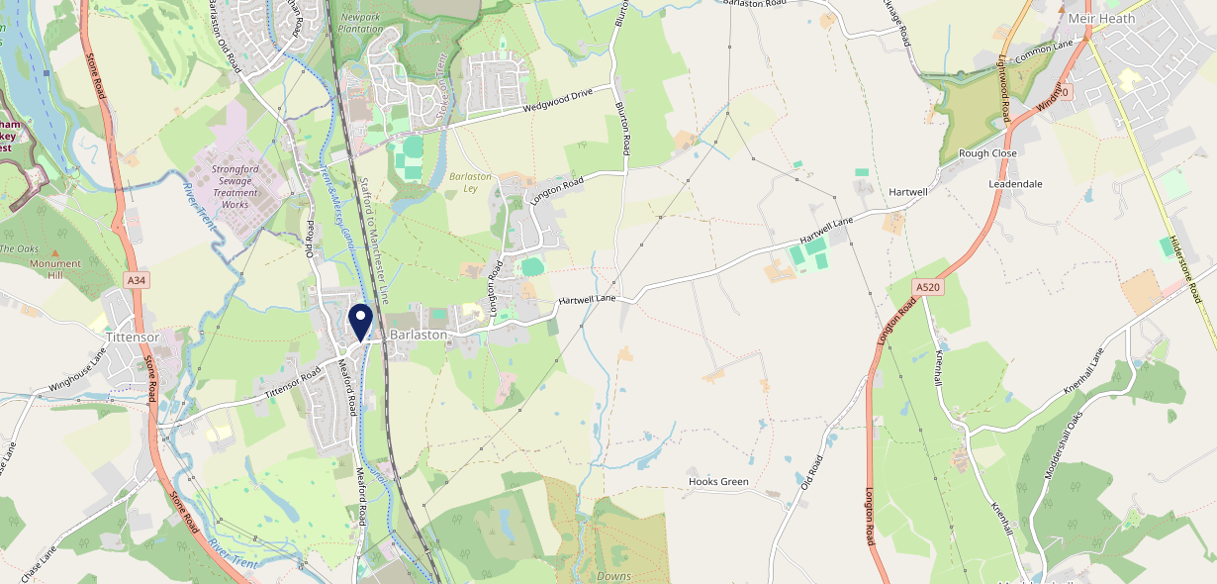











Site Intel
Plume Of Feathers ST129DH
1 Miles
338 Chains
29/01/2025 - 21/01/2026
Site Summary
Plume Of Feathers ST129DH
Work Area
Region
TV Region
Urbanicity
Stoke-on-Trent
West Midlands
Central
Rural town and fringe
ST129DH
Punch - Fireside Inns
Top Competitors
ATV
Gender
Lunar Wedgwood
#1
£17.32
63.16%
Male
ST129ER
Restaurant
Affluence
Segmentation
Lunar Stripe Payments
#2
57.84%
20.36%
Middle Income
Content Communities
ST129ER
Restaurant
Age Group
Visit Day
Trailer
#3
28.62%
20.98%
ST129AA
55 to 64
Sun
Fast-Food
Nearest Station
Stone (Staffs)(3.90 miles)
4570 Site Customers
6 Competitors
790 Competitor Customers

Slide 2

Site Intel
Plume Of Feathers ST129DH
1 Miles
338 Chains
29/01/2025 - 21/01/2026
Spend by Weekpart
How is customer spend distributed throughout the week for Plume Of Feathers ST129DH versus its competitors?
% of spend for Plume Of Feathers ST129DH and 338 Chains in 1 Miles from 29/01/2025 - 21/01/2026 split by Day of Week
4570 Site Customers
6 Competitors
790 Competitor Customers

Slide 3
Site Intel
Plume Of Feathers ST129DH
1 Miles
338 Chains
29/01/2025 - 21/01/2026
Visit Frequency
How frequently per year do customers visit Plume Of Feathers ST129DH versus its competitors?
% of customer numbers for Plume Of Feathers ST129DH and 338 Chains in 1 Miles from 29/01/2025 - 21/01/2026 and the number of visits made Per Annum
4570 Site Customers
6 Competitors
790 Competitor Customers

Slide 4
Site Intel
Plume Of Feathers ST129DH
1 Miles
338 Chains
29/01/2025 - 21/01/2026
ATV Change
How has ATV changed between two date ranges?
4570 Site Customers

Slide 5
Site Intel
Plume Of Feathers ST129DH
1 Miles
338 Chains
29/01/2025 - 21/01/2026
Market Share Change
How has market share changed between two date ranges?
% of market share spend for Plume Of Feathers ST129DH and 338 Chains in 1 Miles from 29/01/2025 - 21/01/2026
4570 Site Customers

Slide 6
Site Intel
Plume Of Feathers ST129DH
1 Miles
338 Chains
29/01/2025 - 21/01/2026
Age
How does the age profile of customers who visit Plume Of Feathers ST129DH compare versus its competitors?
% of spend for Plume Of Feathers ST129DH and 338 Chains in 1 Miles from 29/01/2025 - 21/01/2026 split by Age Range
2326 Site Customers
6 Competitors
469 Competitor Customers

Slide 7
Site Intel
Plume Of Feathers ST129DH
1 Miles
338 Chains
29/01/2025 - 21/01/2026
Affluence
How does the affluence of customers who visit Plume Of Feathers ST129DH compare versus its competitors?
% of spend for Plume Of Feathers ST129DH and 338 Chains in 1 Miles from 29/01/2025 - 21/01/2026 split by Affluence
2150 Site Customers
6 Competitors
437 Competitor Customers

Slide 8
Site Intel
Plume Of Feathers ST129DH
1 Miles
338 Chains
29/01/2025 - 21/01/2026
Gender
How does the gender profile of customers who visit Plume Of Feathers ST129DH compare versus its competitors?
% of spend for Plume Of Feathers ST129DH and 338 Chains in 1 Miles from 29/01/2025 - 21/01/2026 split by Gender
2243 Site Customers
6 Competitors
458 Competitor Customers

Slide 9
Site Intel
Plume Of Feathers ST129DH
1 Miles
338 Chains
29/01/2025 - 21/01/2026
Punch Segmentation
How does the Custom segmentation profile of customers who visit Plume Of Feathers ST129DH compare versus its competitors?
% of spend for Plume Of Feathers ST129DH and 338 Chains in 1 Miles from 29/01/2025 - 21/01/2026 split by Segment
4570 Site Customers
6 Competitors
790 Competitor Customers

Slide 10
Site Intel
Plume Of Feathers ST129DH
1 Miles
338 Chains
29/01/2025 - 21/01/2026
Spend by Distance
How does the spend profile of Plume Of Feathers ST129DH compare versus its competitors based on travel distances?
% of spend for Plume Of Feathers ST129DH and 338 Chains in 1 Miles from 29/01/2025 - 21/01/2026 split by Distance travelled
2240 Site Customers
6 Competitors
458 Competitor Customers

Slide 11
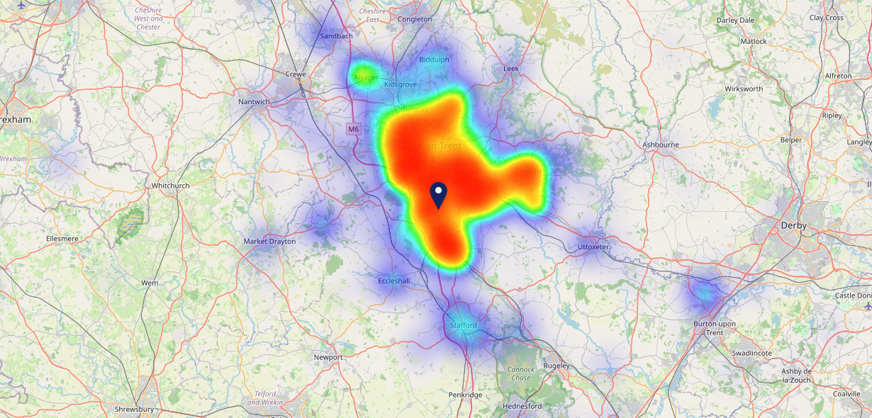

Site Intel
Plume Of Feathers ST129DH
29/01/2025 - 21/01/2026
Map of Guest Origin
Where do customers of Plume Of Feathers ST129DH come from?
Where do customers of Plume Of Feathers ST129DH for 29/01/2025 - 21/01/2026 live
2240 Site Customers

Slide 12
Site Intel
Plume Of Feathers ST129DH
1 Miles
338 Chains
29/01/2025 - 21/01/2026
Share of Wallet
What are the Top 20 venues (by spend) that customers of Plume Of Feathers ST129DH also visit?
For customers of Plume Of Feathers ST129DH, who are the top 20 competitors from 338 Chains in 1 Miles for 29/01/2025 - 21/01/2026 split by Venue
4570 Site Customers

Slide 13
Site Intel
Plume Of Feathers ST129DH
1 Miles
338 Chains
29/01/2025 - 21/01/2026
Share of Wallet Change
How has share of wallet of customers of Plume Of Feathers ST129DH changed between two date ranges?
4570 Site Customers

Slide 14
Site Intel
Plume Of Feathers ST129DH
29/01/2025 - 21/01/2026
Market Summary
How does the local area for Plume Of Feathers ST129DH compare to the national average (1 = low, 10 = high)
Data Type | Name | Spend in 250m | 250m Spend vs National | Spend in 500m | 500m Spend vs National | Spend in 1 mile | 1 mile Spend vs National | Spend in 3 miles | 3 mile Spend vs National
Total | Annual Sales | £2.46M | 6 | £2.46M | 5 | £4.04M | 3 | £76.67M | 6
Weekpart | Mon - Thu | 39.9% | 5 | 39.9% | 5 | 35.3% | 1 | 40.6% | 4
Weekpart | Fri - Sat | 38.9% | 3 | 38.9% | 3 | 44.4% | 7 | 42.2% | 6
Weekpart | Sun | 21.1% | 9 | 21.1% | 10 | 20.3% | 10 | 17.2% | 9
Age | 18 to 24 | 3.3% | 3 | 3.3% | 3 | 3.1% | 2 | 5.5% | 4
Age | 25 to 34 | 10.3% | 1 | 10.3% | 1 | 10.0% | 1 | 14.1% | 1
Age | 35 to 44 | 16.8% | 2 | 16.8% | 1 | 19.9% | 2 | 21.0% | 3
Age | 45 to 54 | 14.5% | 2 | 14.5% | 1 | 18.8% | 3 | 16.3% | 1
Age | 55 to 64 | 29.2% | 10 | 29.2% | 10 | 25.0% | 10 | 21.4% | 10
Age | 65 to 74 | 18.0% | 10 | 18.0% | 10 | 16.5% | 10 | 14.1% | 10
Age | 75+ | 7.9% | 10 | 7.9% | 10 | 6.8% | 10 | 7.5% | 10
CAMEO | Business Elite | 2.9% | 3 | 2.9% | 3 | 4.7% | 4 | 3.9% | 3
CAMEO | Prosperous Professionals | 4.6% | 4 | 4.6% | 4 | 6.3% | 6 | 6.6% | 6
CAMEO | Flourishing Society | 17.7% | 8 | 17.7% | 8 | 19.3% | 8 | 11.6% | 5
CAMEO | Content Communities | 19.7% | 10 | 19.7% | 10 | 17.8% | 9 | 16.6% | 9
CAMEO | White Collar Neighbourhoods | 7.5% | 2 | 7.5% | 2 | 6.8% | 1 | 9.4% | 3
CAMEO | Enterprising Mainstream | 11.9% | 8 | 11.9% | 8 | 14.0% | 9 | 11.4% | 8
CAMEO | Paying The Mortgage | 20.0% | 9 | 20.0% | 9 | 17.6% | 8 | 19.3% | 9
CAMEO | Cash Conscious Communities | 6.3% | 3 | 6.3% | 3 | 5.0% | 2 | 8.6% | 5
CAMEO | On A Budget | 4.1% | 3 | 4.1% | 3 | 3.6% | 2 | 5.5% | 3
CAMEO | Family Value | 5.2% | 7 | 5.2% | 7 | 4.9% | 7 | 7.1% | 8
Affluence | AB | 25.2% | 5 | 25.2% | 5 | 30.3% | 6 | 22.1% | 4
Affluence | C1C2 | 59.2% | 9 | 59.2% | 9 | 56.1% | 9 | 56.7% | 9
Affluence | DE | 15.6% | 4 | 15.6% | 4 | 13.6% | 3 | 21.2% | 6

Slide 15

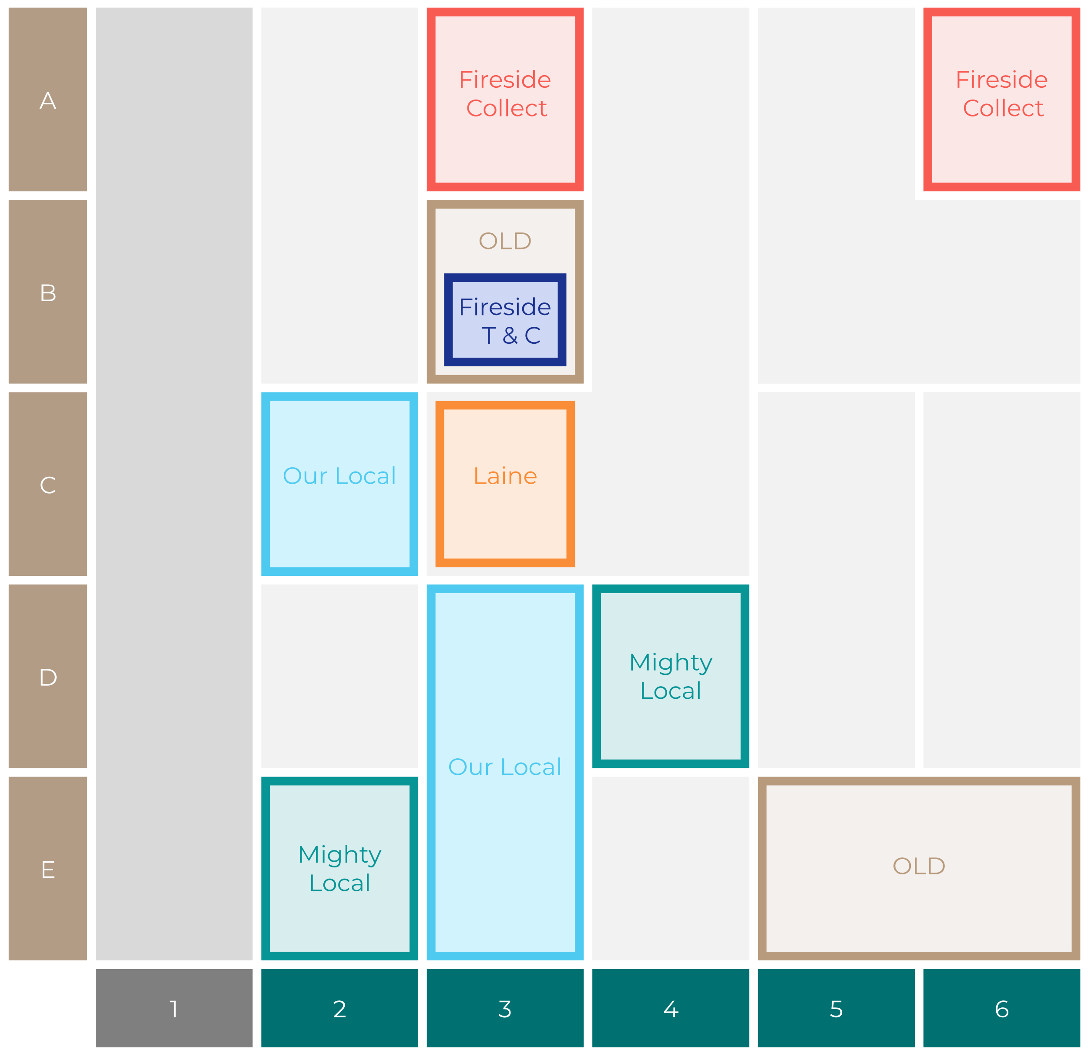

Site Intel
Plume Of Feathers ST129DH
Site Potential 1
Site Characteristics
£3000
£18000
OCC Concept Fit
Achievable Average Weekly Takings
Our Local Destination
£17500
A Food-Led High Affluence B Food-Led Mid Affluence C Wet-Led Mid/High Affluence D Wet-Led Low Affluence E Food-Led Low Affluence
AWT 2 Local Regulars 3 Local Passing Trade 4 Destination Wet-Led 5 Destination Food-Led 6 Destination Very Food-Led
A
B
C
D
E
1
2
3
4
5
6

Slide 16
Site Intel
Plume Of Feathers ST129DH
Site Potential 2
Concept Recommendation

Slide 17
Site Intel
Plume Of Feathers ST129DH
Local Market Profile
Mix of spend by customer segment in Punch site and local market
 | Customer Count | Family Familiar | Occasional & Local | Mid-Week Seniors | Part Of The Pub | Metro Sophisticates | Young & Connected | Bubbly Weekenders | Upmarket Diners
Plume Of Feathers | 889 | 20.63% | 2.78% | 29.26% | 11.84% | 5.74% | 9.03% | 4.20% | 16.48%
Local Catchment | 163 | 16.41% | 4.50% | 12.37% | 2.98% | 11.61% | 11.69% | 7.94% | 32.45%
Punch T&L | 97273 | 8.89% | 6.07% | 28.67% | 11.39% | 11.22% | 11.03% | 7.12% | 15.56%
Plume Of Feathers vs Local Catchment |  | 4.22% | -1.72% | 16.89% | 8.86% | -5.87% | -2.66% | -3.74% | -15.97%
Plume Of Feathers vs Punch T&L |  | 11.74% | -3.29% | 0.59% | 0.45% | -5.48% | -2.00% | -2.92% | 0.92%
Local Catchment vs Punch T&L |  | 7.52% | -1.57% | -16.30% | -8.41% | 0.39% | 0.66% | 0.82% | 16.89%

Slide 18
Site Intel
Plume Of Feathers ST129DH
Local Competitor Profiles
Mix of spend by customer segment in Punch site and local competitors
 | Customer Count | Family Familiar | Occasional & Local | Mid-Week Seniors | Part Of The Pub | Metro Sophisticates | Young & Connected | Bubbly Weekenders | Upmarket Diners
Plume Of Feathers ST129DH | 889 | 20.63% | 2.78% | 29.26% | 11.84% | 5.74% | 9.03% | 4.20% | 16.48%
Lunar Wedgwood ST129ER | 149 | 16.94% | 4.59% | 13.18% | 3.01% | 11.68% | 12.55% | 8.53% | 29.48%
Lunar Stripe Payments ST129ER | 3 | 0.00% | 3.70% | 0.00% | 0.00% | 12.34% | 0.00% | 0.00% | 83.95%
Trailer ST129AA | 12 | 70.52% | 0.00% | 10.85% | 18.62% | 0.00% | 0.00% | 0.00% | 0.00%

