Slide 1
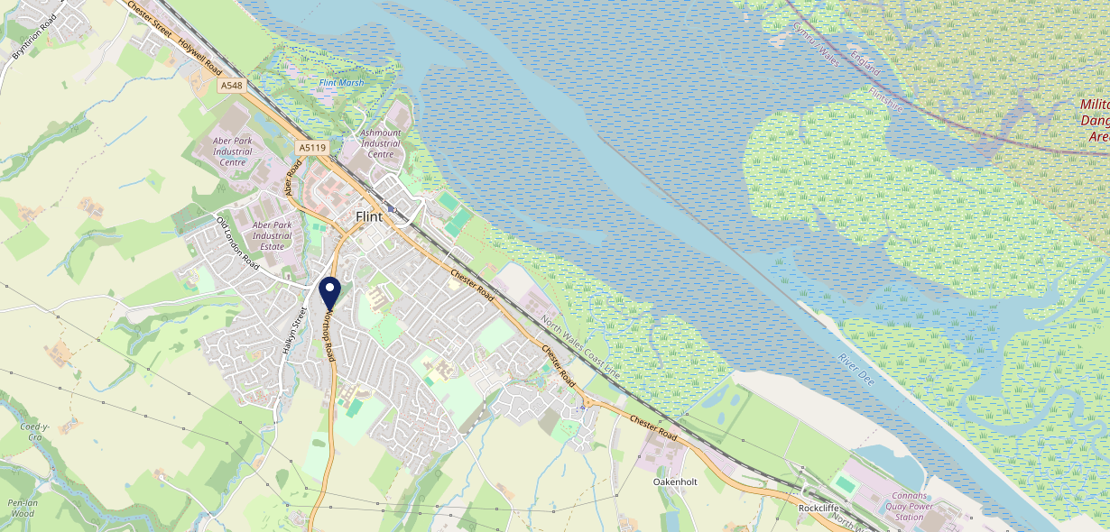
Site Intel
Mill Tavern CH65LQ
3 Miles
113 Chains
22/02/2023 - 14/02/2024
Site Summary
Mill Tavern CH65LQ
Work Area
Region
TV Region
Urbanicity
Chester
Wales
Harwest
Urban city and town
CH65LQ
Punch - Mighty Local
Top Competitors
ATV
Gender
George & Dragon
#1
£8.06
58.58%
Male
CH65AE
Marstons Community Non Catering
Affluence
Segmentation
Boot Inn
#2
46.44%
20.20%
Middle Income
Flourishing Society
CH76BQ
Punch - Our Local
Age Group
Visit Day
Dee Flint
#3
28.77%
31.48%
CH65NR
45 to 54
Sat
Craft Union
Nearest Station
Flint(0.73 miles)
567 Site Customers
5 Competitors
2711 Competitor Customers

Slide 2
Site Intel
Mill Tavern CH65LQ
3 Miles
113 Chains
22/02/2023 - 14/02/2024
Spend by Weekpart
How is customer spend distributed throughout the week for Mill Tavern CH65LQ versus its competitors?
% of spend for Mill Tavern CH65LQ and 113 Chains in 3 Miles from 22/02/2023 - 14/02/2024 split by Day of Week
567 Site Customers
5 Competitors
2711 Competitor Customers

Slide 3
Site Intel
Mill Tavern CH65LQ
3 Miles
113 Chains
22/02/2023 - 14/02/2024
Visit Frequency
How frequently per year do customers visit Mill Tavern CH65LQ versus its competitors?
% of customer numbers for Mill Tavern CH65LQ and 113 Chains in 3 Miles from 22/02/2023 - 14/02/2024 and the number of visits made Per Annum
567 Site Customers
5 Competitors
2711 Competitor Customers

Slide 4
Site Intel
Mill Tavern CH65LQ
3 Miles
113 Chains
22/02/2023 - 14/02/2024
ATV Change
How has ATV changed between two date ranges?
567 Site Customers

Slide 5
Site Intel
Mill Tavern CH65LQ
3 Miles
113 Chains
22/02/2023 - 14/02/2024
Market Share Change
How has market share changed between two date ranges?
% of market share spend for Mill Tavern CH65LQ and 113 Chains in 3 Miles from 22/02/2023 - 14/02/2024
567 Site Customers

Slide 6
Site Intel
Mill Tavern CH65LQ
3 Miles
113 Chains
22/02/2023 - 14/02/2024
Age
How does the age profile of customers who visit Mill Tavern CH65LQ compare versus its competitors?
% of spend for Mill Tavern CH65LQ and 113 Chains in 3 Miles from 22/02/2023 - 14/02/2024 split by Age Range
230 Site Customers
5 Competitors
1249 Competitor Customers

Slide 7
Site Intel
Mill Tavern CH65LQ
3 Miles
113 Chains
22/02/2023 - 14/02/2024
Affluence
How does the affluence of customers who visit Mill Tavern CH65LQ compare versus its competitors?
% of spend for Mill Tavern CH65LQ and 113 Chains in 3 Miles from 22/02/2023 - 14/02/2024 split by Affluence
210 Site Customers
5 Competitors
1170 Competitor Customers

Slide 8
Site Intel
Mill Tavern CH65LQ
3 Miles
113 Chains
22/02/2023 - 14/02/2024
Gender
How does the gender profile of customers who visit Mill Tavern CH65LQ compare versus its competitors?
% of spend for Mill Tavern CH65LQ and 113 Chains in 3 Miles from 22/02/2023 - 14/02/2024 split by Gender
221 Site Customers
5 Competitors
1220 Competitor Customers

Slide 9
Site Intel
Mill Tavern CH65LQ
3 Miles
113 Chains
22/02/2023 - 14/02/2024
Punch Segmentation
How does the Custom segmentation profile of customers who visit Mill Tavern CH65LQ compare versus its competitors?
% of spend for Mill Tavern CH65LQ and 113 Chains in 3 Miles from 22/02/2023 - 14/02/2024 split by Segment
567 Site Customers
5 Competitors
2711 Competitor Customers

Slide 10
Site Intel
Mill Tavern CH65LQ
3 Miles
113 Chains
22/02/2023 - 14/02/2024
Spend by Distance
How does the spend profile of Mill Tavern CH65LQ compare versus its competitors based on travel distances?
% of spend for Mill Tavern CH65LQ and 113 Chains in 3 Miles from 22/02/2023 - 14/02/2024 split by Distance travelled
221 Site Customers
5 Competitors
1220 Competitor Customers

Slide 11
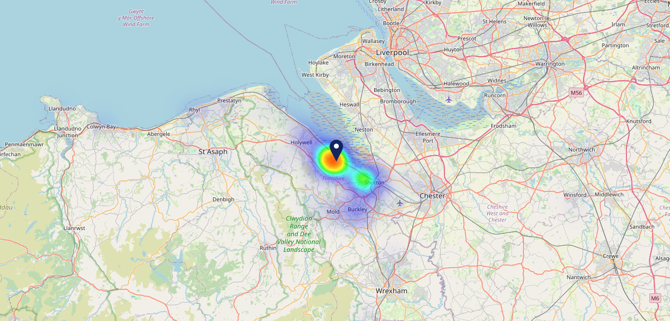
Site Intel
Mill Tavern CH65LQ
22/02/2023 - 14/02/2024
Map of Guest Origin
Where do customers of Mill Tavern CH65LQ come from?
Where do customers of Mill Tavern CH65LQ for 22/02/2023 - 14/02/2024 live
221 Site Customers

Slide 12
Site Intel
Mill Tavern CH65LQ
3 Miles
113 Chains
22/02/2023 - 14/02/2024
Share of Wallet
What are the Top 20 venues (by spend) that customers of Mill Tavern CH65LQ also visit?
For customers of Mill Tavern CH65LQ, who are the top 20 competitors from 113 Chains in 3 Miles for 22/02/2023 - 14/02/2024 split by Venue
567 Site Customers

Slide 13
Site Intel
Mill Tavern CH65LQ
3 Miles
113 Chains
22/02/2023 - 14/02/2024
Share of Wallet Change
How has share of wallet of customers of Mill Tavern CH65LQ changed between two date ranges?
567 Site Customers

Slide 14
Site Intel
Mill Tavern CH65LQ
22/02/2023 - 14/02/2024
Market Summary
How does the local area for Mill Tavern CH65LQ compare to the national average (1 = low, 10 = high)
Data Type | Name | Spend in 250m | 250m Spend vs National | Spend in 500m | 500m Spend vs National | Spend in 1 mile | 1 mile Spend vs National | Spend in 3 miles | 3 mile Spend vs National
Total | Annual Sales | £495K | 4 | £599K | 3 | £9.00M | 4 | £15.20M | 2
Weekpart | Mon - Thu | 28.0% | 1 | 27.7% | 1 | 46.8% | 9 | 43.2% | 7
Weekpart | Fri - Sat | 58.2% | 10 | 58.0% | 10 | 39.3% | 3 | 40.8% | 4
Weekpart | Sun | 13.8% | 5 | 14.3% | 5 | 13.9% | 3 | 16.0% | 6
Age | 18 to 24 | 3.4% | 3 | 2.4% | 2 | 5.4% | 4 | 3.9% | 2
Age | 25 to 34 | 17.8% | 4 | 19.0% | 4 | 20.6% | 4 | 16.6% | 2
Age | 35 to 44 | 32.0% | 10 | 40.1% | 10 | 25.7% | 8 | 22.0% | 4
Age | 45 to 54 | 26.2% | 10 | 22.8% | 8 | 22.1% | 8 | 22.0% | 8
Age | 55 to 64 | 16.4% | 6 | 12.8% | 4 | 15.8% | 6 | 21.6% | 10
Age | 65 to 74 | 3.4% | 3 | 2.3% | 1 | 7.6% | 7 | 9.2% | 8
Age | 75+ | 0.8% | 3 | 0.5% | 1 | 2.8% | 6 | 4.7% | 9
CAMEO | Business Elite | 1.1% | 1 | 0.9% | 1 | 2.4% | 2 | 5.1% | 4
CAMEO | Prosperous Professionals | 3.6% | 3 | 2.5% | 2 | 3.2% | 2 | 7.2% | 7
CAMEO | Flourishing Society | 18.9% | 8 | 37.5% | 10 | 9.2% | 4 | 11.8% | 5
CAMEO | Content Communities | 8.7% | 3 | 6.4% | 1 | 10.8% | 4 | 13.2% | 7
CAMEO | White Collar Neighbourhoods | 20.0% | 10 | 14.1% | 8 | 18.3% | 10 | 16.8% | 10
CAMEO | Enterprising Mainstream | 12.6% | 9 | 9.9% | 7 | 12.5% | 9 | 11.3% | 8
CAMEO | Paying The Mortgage | 11.0% | 4 | 7.6% | 1 | 14.4% | 5 | 12.7% | 4
CAMEO | Cash Conscious Communities | 2.7% | 1 | 1.8% | 1 | 6.1% | 3 | 4.9% | 1
CAMEO | On A Budget | 18.5% | 10 | 17.1% | 10 | 14.3% | 10 | 10.3% | 9
CAMEO | Family Value | 2.9% | 6 | 2.1% | 5 | 8.7% | 9 | 6.6% | 8
Affluence | AB | 23.7% | 5 | 40.9% | 8 | 14.8% | 2 | 24.2% | 4
Affluence | C1C2 | 52.3% | 7 | 38.1% | 2 | 56.0% | 9 | 54.0% | 8
Affluence | DE | 24.0% | 7 | 21.0% | 6 | 29.2% | 8 | 21.8% | 6

Slide 15
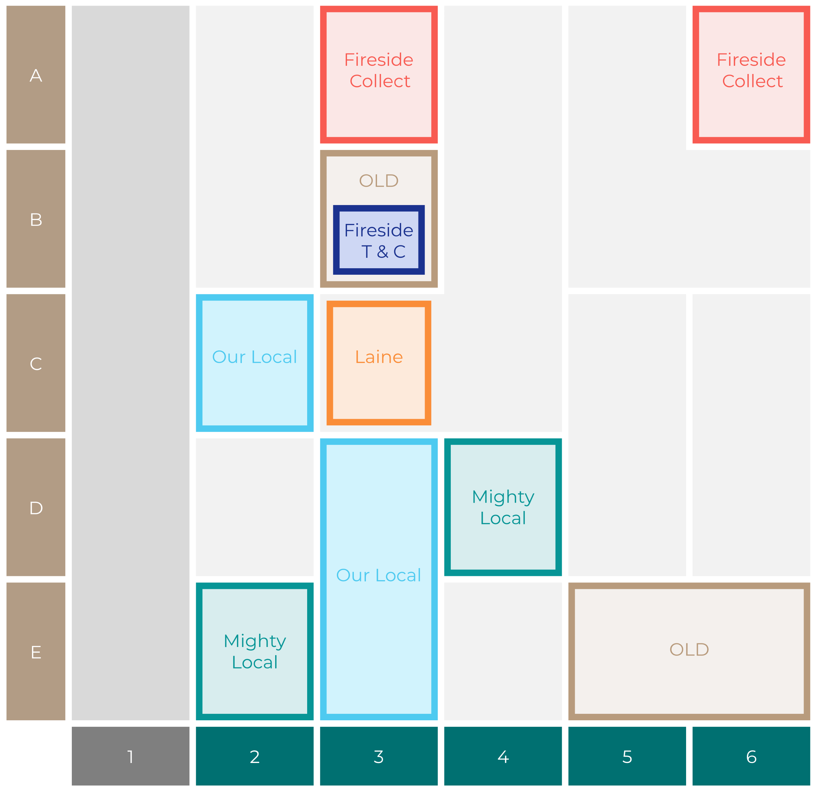
Site Intel
Mill Tavern CH65LQ
Site Potential 1
Site Characteristics
£3000
£18000
OCC Concept Fit
Achievable Average Weekly Takings
Our Local
£8500
A Food-Led High Affluence B Food-Led Mid Affluence C Wet-Led Mid/High Affluence D Wet-Led Low Affluence E Food-Led Low Affluence
AWT 2 Local Regulars 3 Local Passing Trade 4 Destination Wet-Led 5 Destination Food-Led 6 Destination Very Food-Led
A
B
C
D
E
1
2
3
4
5
6

Slide 16
Site Intel
Mill Tavern CH65LQ
Site Potential 2
Concept Recommendation

Slide 17
Site Intel
Mill Tavern CH65LQ
Local Market Profile
Mix of spend by customer segment in Punch site and local market
 | Customer Count | Family Familiar | Occasional & Local | Mid-Week Seniors | Part Of The Pub | Metro Sophisticates | Young & Connected | Bubbly Weekenders | Upmarket Diners
Mill Tavern | 76 | 24.64% | 14.42% | 7.49% | 5.71% | 13.00% | 14.37% | 12.12% | 8.21%
Local Catchment | 424 | 9.07% | 13.57% | 42.30% | 5.57% | 4.76% | 6.26% | 7.64% | 10.80%
Punch T&L | 115554 | 8.24% | 6.01% | 29.08% | 11.44% | 11.18% | 11.99% | 7.12% | 14.90%
Mill Tavern vs Local Catchment |  | 15.57% | 0.85% | -34.81% | 0.14% | 8.24% | 8.11% | 4.48% | -2.59%
Mill Tavern vs Punch T&L |  | 16.40% | 8.41% | -21.59% | -5.73% | 1.82% | 2.38% | 5.00% | -6.69%
Local Catchment vs Punch T&L |  | 0.83% | 7.56% | 13.22% | -5.87% | -6.42% | -5.73% | 0.52% | -4.10%

Slide 18
Site Intel
Mill Tavern CH65LQ
Local Competitor Profiles
Mix of spend by customer segment in Punch site and local competitors
 | Customer Count | Family Familiar | Occasional & Local | Mid-Week Seniors | Part Of The Pub | Metro Sophisticates | Young & Connected | Bubbly Weekenders | Upmarket Diners
Mill Tavern CH65LQ | 76 | 24.64% | 14.42% | 7.49% | 5.71% | 13.00% | 14.37% | 12.12% | 8.21%
George & Dragon CH65AE | 59 | 4.19% | 41.22% | 41.96% | 8.23% | 0.43% | 1.76% | 2.15% | 0.03%
Boot Inn CH76BQ | 155 | 12.45% | 4.15% | 55.03% | 2.44% | 5.35% | 7.97% | 6.82% | 5.75%
Dee Flint CH65NR | 93 | 17.01% | 2.69% | 32.61% | 8.86% | 7.33% | 12.23% | 16.13% | 3.09%
Coach & Horses CH65QG | 62 | 11.35% | 0.45% | 25.48% | 2.80% | 17.03% | 7.24% | 14.91% | 20.70%
Britannia Inn (Halkyn) CH88BY | 122 | 6.47% | 0.80% | 29.39% | 7.72% | 3.91% | 7.26% | 11.33% | 33.09%

