Slide 1










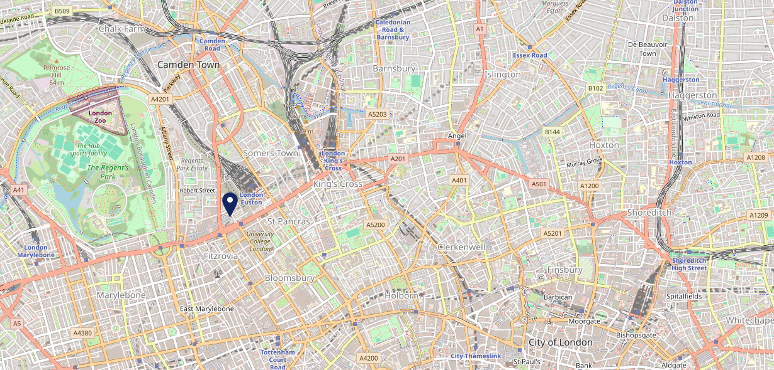









Site Intel
Square Tavern NW12PE
3 Miles
1 Chain
22/02/2023 - 14/02/2024
Site Summary
Square Tavern NW12PE
Work Area
Region
TV Region
Urbanicity
London
London
London
Urban major conurbation
NW12PE
Punch - Fireside Collection
Top Competitors
ATV
Gender
Lighterman
#1
£15.17
68.76%
Male
N1C4BH
Pub Restaurant
Affluence
Segmentation
Bowler
#2
41.88%
23.16%
High Income
Business Elite
EC1R0BJ
Pub Restaurant
Age Group
Visit Day
Blues Kitchen
#3
30.79%
30.61%
EC2A3AR
35 to 44
Thu
Pub Restaurant
Nearest Station
Euston Square(0.17 miles)
1299 Site Customers
70 Competitors
129688 Competitor Customers

Slide 2

Site Intel
Square Tavern NW12PE
3 Miles
1 Chain
22/02/2023 - 14/02/2024
Spend by Weekpart
How is customer spend distributed throughout the week for Square Tavern NW12PE versus its competitors?
% of spend for Square Tavern NW12PE and 1 Chains in 3 Miles from 22/02/2023 - 14/02/2024 split by Day of Week
1299 Site Customers
70 Competitors
129688 Competitor Customers

Slide 3
Site Intel
Square Tavern NW12PE
3 Miles
1 Chain
22/02/2023 - 14/02/2024
Visit Frequency
How frequently per year do customers visit Square Tavern NW12PE versus its competitors?
% of customer numbers for Square Tavern NW12PE and 1 Chains in 3 Miles from 22/02/2023 - 14/02/2024 and the number of visits made Per Annum
1299 Site Customers
70 Competitors
129688 Competitor Customers

Slide 4
Site Intel
Square Tavern NW12PE
3 Miles
1 Chain
22/02/2023 - 14/02/2024
ATV Change
How has ATV changed between two date ranges?
1299 Site Customers

Slide 5
Site Intel
Square Tavern NW12PE
3 Miles
1 Chain
22/02/2023 - 14/02/2024
Market Share Change
How has market share changed between two date ranges?
% of market share spend for Square Tavern NW12PE and 1 Chains in 3 Miles from 22/02/2023 - 14/02/2024
1299 Site Customers

Slide 6
Site Intel
Square Tavern NW12PE
3 Miles
1 Chain
22/02/2023 - 14/02/2024
Age
How does the age profile of customers who visit Square Tavern NW12PE compare versus its competitors?
% of spend for Square Tavern NW12PE and 1 Chains in 3 Miles from 22/02/2023 - 14/02/2024 split by Age Range
582 Site Customers
70 Competitors
55135 Competitor Customers

Slide 7
Site Intel
Square Tavern NW12PE
3 Miles
1 Chain
22/02/2023 - 14/02/2024
Affluence
How does the affluence of customers who visit Square Tavern NW12PE compare versus its competitors?
% of spend for Square Tavern NW12PE and 1 Chains in 3 Miles from 22/02/2023 - 14/02/2024 split by Affluence
549 Site Customers
70 Competitors
51758 Competitor Customers

Slide 8
Site Intel
Square Tavern NW12PE
3 Miles
1 Chain
22/02/2023 - 14/02/2024
Gender
How does the gender profile of customers who visit Square Tavern NW12PE compare versus its competitors?
% of spend for Square Tavern NW12PE and 1 Chains in 3 Miles from 22/02/2023 - 14/02/2024 split by Gender
575 Site Customers
70 Competitors
54409 Competitor Customers

Slide 9
Site Intel
Square Tavern NW12PE
3 Miles
1 Chain
22/02/2023 - 14/02/2024
Punch Segmentation
How does the Custom segmentation profile of customers who visit Square Tavern NW12PE compare versus its competitors?
% of spend for Square Tavern NW12PE and 1 Chains in 3 Miles from 22/02/2023 - 14/02/2024 split by Segment
1299 Site Customers
70 Competitors
129688 Competitor Customers

Slide 10
Site Intel
Square Tavern NW12PE
3 Miles
1 Chain
22/02/2023 - 14/02/2024
Spend by Distance
How does the spend profile of Square Tavern NW12PE compare versus its competitors based on travel distances?
% of spend for Square Tavern NW12PE and 1 Chains in 3 Miles from 22/02/2023 - 14/02/2024 split by Distance travelled
574 Site Customers
70 Competitors
54301 Competitor Customers

Slide 11
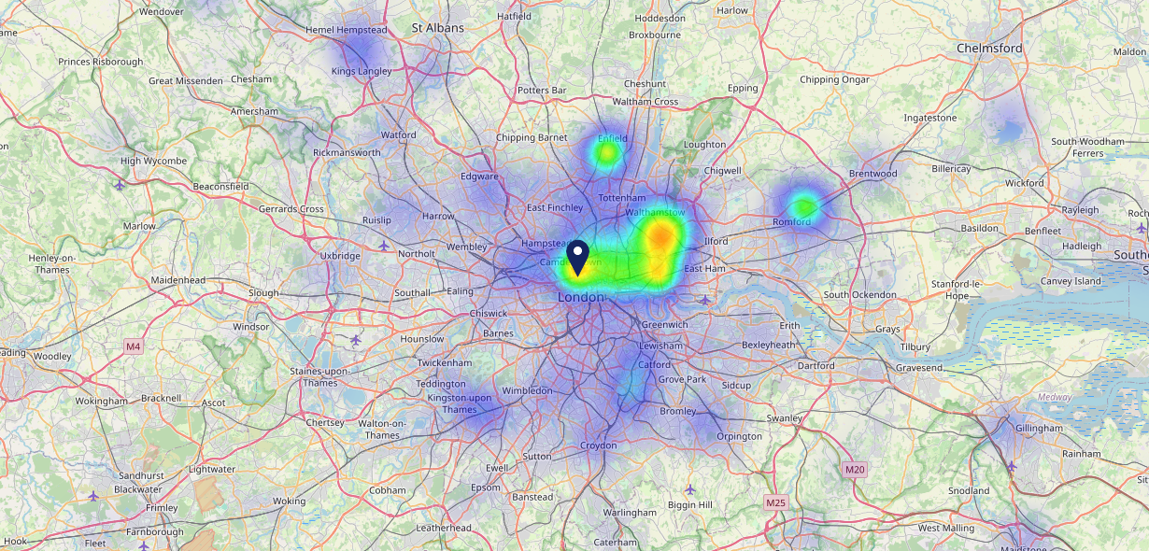

Site Intel
Square Tavern NW12PE
22/02/2023 - 14/02/2024
Map of Guest Origin
Where do customers of Square Tavern NW12PE come from?
Where do customers of Square Tavern NW12PE for 22/02/2023 - 14/02/2024 live
574 Site Customers

Slide 12
Site Intel
Square Tavern NW12PE
3 Miles
1 Chain
22/02/2023 - 14/02/2024
Share of Wallet
What are the Top 20 venues (by spend) that customers of Square Tavern NW12PE also visit?
For customers of Square Tavern NW12PE, who are the top 20 competitors from 1 Chains in 3 Miles for 22/02/2023 - 14/02/2024 split by Venue
1299 Site Customers

Slide 13
Site Intel
Square Tavern NW12PE
3 Miles
1 Chain
22/02/2023 - 14/02/2024
Share of Wallet Change
How has share of wallet of customers of Square Tavern NW12PE changed between two date ranges?
1299 Site Customers

Slide 14
Site Intel
Square Tavern NW12PE
22/02/2023 - 14/02/2024
Market Summary
How does the local area for Square Tavern NW12PE compare to the national average (1 = low, 10 = high)
Data Type | Name | Spend in 250m | 250m Spend vs National | Spend in 500m | 500m Spend vs National | Spend in 1 mile | 1 mile Spend vs National | Spend in 3 miles | 3 mile Spend vs National
Total | Annual Sales | £21.78M | 10 | £89.26M | 10 | £1.27B | 10 | £5.35B | 10
Weekpart | Mon - Thu | 56.5% | 10 | 58.0% | 10 | 50.0% | 10 | 50.6% | 10
Weekpart | Fri - Sat | 33.6% | 1 | 31.6% | 1 | 38.8% | 2 | 37.9% | 1
Weekpart | Sun | 9.9% | 2 | 10.4% | 2 | 11.2% | 1 | 11.5% | 1
Age | 18 to 24 | 7.7% | 7 | 4.8% | 4 | 5.1% | 4 | 4.9% | 3
Age | 25 to 34 | 16.5% | 3 | 17.4% | 3 | 18.8% | 3 | 18.3% | 3
Age | 35 to 44 | 28.3% | 9 | 29.0% | 9 | 26.8% | 8 | 26.4% | 9
Age | 45 to 54 | 23.2% | 8 | 23.5% | 9 | 22.0% | 8 | 22.4% | 9
Age | 55 to 64 | 17.6% | 7 | 17.7% | 7 | 18.2% | 8 | 18.3% | 9
Age | 65 to 74 | 5.3% | 4 | 5.8% | 5 | 6.7% | 6 | 6.9% | 6
Age | 75+ | 1.4% | 4 | 1.7% | 4 | 2.3% | 5 | 2.8% | 6
CAMEO | Business Elite | 14.6% | 8 | 15.3% | 9 | 19.1% | 9 | 20.3% | 9
CAMEO | Prosperous Professionals | 5.8% | 5 | 6.4% | 6 | 7.3% | 7 | 7.3% | 7
CAMEO | Flourishing Society | 11.8% | 5 | 13.0% | 6 | 14.0% | 6 | 14.4% | 7
CAMEO | Content Communities | 11.6% | 5 | 12.3% | 5 | 13.0% | 6 | 12.8% | 6
CAMEO | White Collar Neighbourhoods | 12.8% | 7 | 13.2% | 8 | 12.4% | 7 | 12.1% | 6
CAMEO | Enterprising Mainstream | 6.3% | 4 | 6.6% | 4 | 5.7% | 4 | 5.3% | 4
CAMEO | Paying The Mortgage | 12.8% | 5 | 12.4% | 4 | 10.5% | 3 | 9.9% | 2
CAMEO | Cash Conscious Communities | 13.5% | 8 | 11.6% | 7 | 10.7% | 7 | 10.7% | 7
CAMEO | On A Budget | 9.0% | 8 | 7.1% | 6 | 6.0% | 5 | 6.1% | 4
CAMEO | Family Value | 1.8% | 5 | 2.1% | 5 | 1.3% | 4 | 1.2% | 3
Affluence | AB | 32.1% | 7 | 34.8% | 7 | 40.4% | 8 | 42.0% | 8
Affluence | C1C2 | 43.6% | 4 | 44.4% | 4 | 41.6% | 3 | 40.1% | 3
Affluence | DE | 24.3% | 7 | 20.8% | 6 | 18.0% | 5 | 17.9% | 4

Slide 15

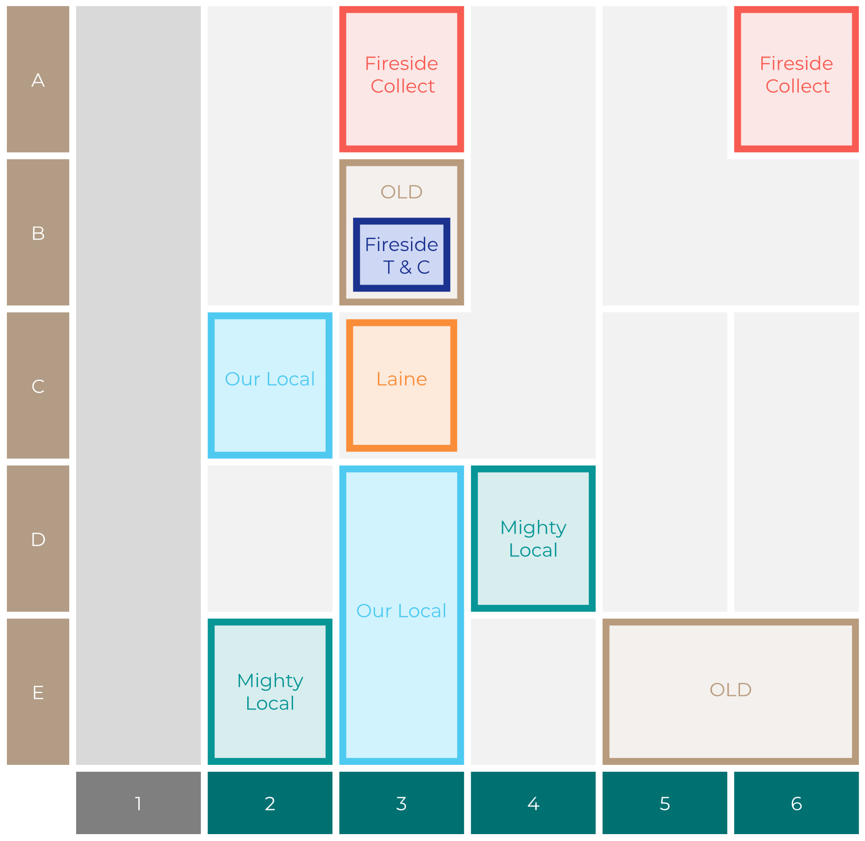

Site Intel
Square Tavern NW12PE
Site Potential 1
Site Characteristics
£3000
£18000
OCC Concept Fit
Achievable Average Weekly Takings
Non-Core
£0
A Food-Led High Affluence B Food-Led Mid Affluence C Wet-Led Mid/High Affluence D Wet-Led Low Affluence E Food-Led Low Affluence
AWT 2 Local Regulars 3 Local Passing Trade 4 Destination Wet-Led 5 Destination Food-Led 6 Destination Very Food-Led
A
B
C
D
E
1
2
3
4
5
6

Slide 16
Site Intel
Square Tavern NW12PE
Site Potential 2
Concept Recommendation

Slide 17
Site Intel
Square Tavern NW12PE
Local Market Profile
Mix of spend by customer segment in Punch site and local market
 | Customer Count | Family Familiar | Occasional & Local | Mid-Week Seniors | Part Of The Pub | Metro Sophisticates | Young & Connected | Bubbly Weekenders | Upmarket Diners
Square Tavern | 253 | 2.48% | 0.51% | 12.27% | 2.00% | 45.74% | 9.68% | 7.26% | 20.01%
Local Catchment | 19832 | 1.92% | 2.62% | 7.53% | 1.10% | 36.47% | 8.60% | 9.24% | 32.47%
Punch T&L | 110504 | 8.08% | 5.92% | 29.54% | 11.18% | 11.29% | 11.62% | 7.15% | 15.19%
Square Tavern vs Local Catchment |  | 0.56% | -2.11% | 4.74% | 0.90% | 9.27% | 1.08% | -1.98% | -12.46%
Square Tavern vs Punch T&L |  | -5.60% | -5.41% | -17.27% | -9.18% | 34.45% | -1.94% | 0.11% | 4.82%
Local Catchment vs Punch T&L |  | -6.16% | -3.30% | -22.01% | -10.08% | 25.18% | -3.02% | 2.09% | 17.28%

Slide 18
Site Intel
Square Tavern NW12PE
Local Competitor Profiles
Mix of spend by customer segment in Punch site and local competitors
 | Customer Count | Family Familiar | Occasional & Local | Mid-Week Seniors | Part Of The Pub | Metro Sophisticates | Young & Connected | Bubbly Weekenders | Upmarket Diners
Square Tavern NW12PE | 253 | 2.48% | 0.51% | 12.27% | 2.00% | 45.74% | 9.68% | 7.26% | 20.01%
Lighterman N1C4BH | 3076 | 1.88% | 1.45% | 8.14% | 0.75% | 31.84% | 5.61% | 9.57% | 40.72%
Bowler EC1R0BJ | 501 | 0.17% | 2.05% | 8.64% | 0.92% | 52.40% | 4.76% | 10.57% | 20.45%
Blues Kitchen EC2A3AR | 2254 | 2.68% | 2.11% | 6.68% | 0.41% | 34.14% | 20.07% | 17.04% | 16.84%
Blues Kitchen NW17JN | 1435 | 2.18% | 2.65% | 4.87% | 1.23% | 36.06% | 16.44% | 17.73% | 18.80%
Lore of the Land W1T6BB | 417 | 0.19% | 2.81% | 3.62% | 4.75% | 41.93% | 4.97% | 3.26% | 38.42%
The Coronet N76NJ | 642 | 5.11% | 12.91% | 8.05% | 17.88% | 20.14% | 26.31% | 5.75% | 3.81%
Archer Street W1D7AP | 802 | 1.96% | 1.40% | 4.73% | 0.00% | 37.63% | 9.08% | 10.69% | 34.47%
Swan at the Globe SE19DT | 1796 | 3.12% | 1.91% | 12.81% | 0.92% | 25.39% | 6.10% | 6.77% | 42.95%
Queens Head W1D7HN | 878 | 2.40% | 1.96% | 12.68% | 1.29% | 51.67% | 8.52% | 6.86% | 14.58%
Stag NW32QU | 534 | 1.76% | 6.04% | 4.46% | 0.30% | 39.97% | 2.37% | 6.27% | 38.79%
Duke Of Cambridge N18JT | 334 | 0.42% | 5.89% | 4.13% | 0.00% | 38.94% | 2.25% | 3.90% | 44.44%
Eagle EC1R3AL | 665 | 0.55% | 4.20% | 7.46% | 0.00% | 43.63% | 1.26% | 3.04% | 39.83%
Drapers Arms N11ER | 516 | 0.13% | 4.20% | 4.52% | 3.19% | 42.68% | 0.50% | 3.05% | 41.68%
Lucky Pig W1W6BB | 146 | 0.00% | 2.60% | 3.29% | 8.08% | 42.92% | 4.89% | 9.33% | 28.86%
Heist Bank W21LA | 408 | 2.34% | 2.18% | 6.12% | 1.11% | 33.88% | 12.04% | 8.67% | 33.62%
Duke Of Hamilton NW31JD | 320 | 0.46% | 1.35% | 4.99% | 0.12% | 33.51% | 3.19% | 4.47% | 51.88%
Homeboy N18LX | 231 | 0.84% | 2.58% | 4.40% | 1.30% | 51.22% | 8.95% | 7.99% | 22.67%
The Tommyfield SE114EZ | 420 | 1.55% | 3.91% | 7.99% | 0.39% | 39.30% | 3.19% | 6.14% | 37.50%
Salvador & Amanda WC2H7JA | 308 | 5.68% | 1.55% | 10.05% | 0.57% | 22.37% | 16.27% | 21.16% | 22.31%
Lighthouse EC2A3AY | 295 | 3.72% | 3.40% | 1.31% | 0.36% | 23.12% | 35.63% | 25.05% | 7.37%
Humble Grape N10QY | 144 | 0.81% | 2.94% | 5.49% | 0.00% | 42.13% | 1.68% | 10.59% | 36.31%
White Bear EC1M4AN | 354 | 1.86% | 1.50% | 7.65% | 0.24% | 51.47% | 5.18% | 10.72% | 21.33%
Basement State W1F8HN | 155 | 1.55% | 4.34% | 2.85% | 0.00% | 43.99% | 9.78% | 15.24% | 22.22%
Smoking Goat E16JJ | 505 | 1.46% | 3.90% | 6.99% | 0.34% | 37.97% | 3.50% | 7.61% | 38.20%

