Slide 1










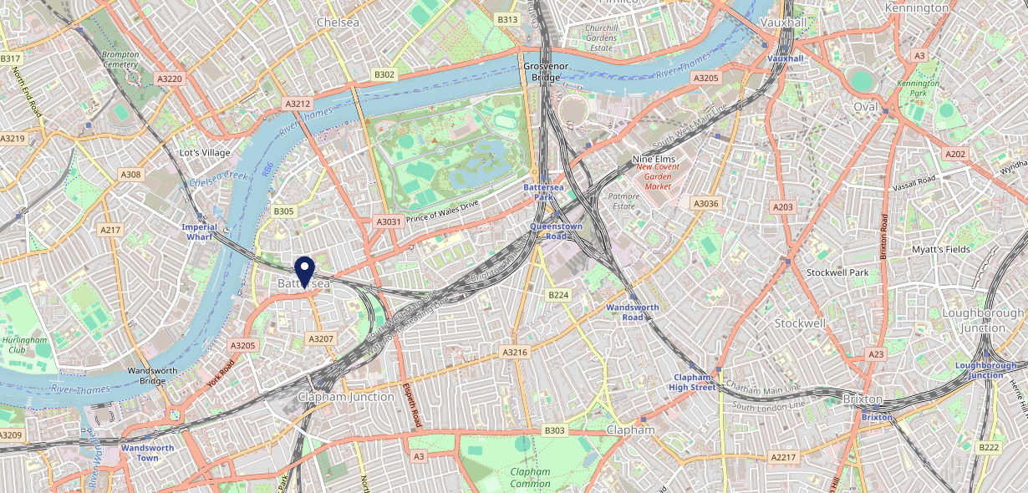









Site Intel
Candlemaker SW113JR
3 Miles
1 Chain
22/02/2023 - 14/02/2024
Site Summary
Candlemaker SW113JR
Work Area
Region
TV Region
Urbanicity
London
London
London
Urban major conurbation
SW113JR
Punch T&L
Top Competitors
ATV
Gender
Bolingbroke
#1
£14.95
84.82%
Male
SW116RE
Pub Restaurant
Affluence
Segmentation
Fox & Pheasant
#2
51.43%
38.20%
High Income
Business Elite
SW109UJ
Pub Restaurant
Age Group
Visit Day
Stonhouse
#3
31.85%
21.30%
SW46BJ
45 to 54
Fri
Pub Restaurant
Nearest Station
Clapham Junction(0.69 miles)
685 Site Customers
19 Competitors
20367 Competitor Customers

Slide 2

Site Intel
Candlemaker SW113JR
3 Miles
1 Chain
22/02/2023 - 14/02/2024
Spend by Weekpart
How is customer spend distributed throughout the week for Candlemaker SW113JR versus its competitors?
% of spend for Candlemaker SW113JR and 1 Chains in 3 Miles from 22/02/2023 - 14/02/2024 split by Day of Week
685 Site Customers
19 Competitors
20367 Competitor Customers

Slide 3
Site Intel
Candlemaker SW113JR
3 Miles
1 Chain
22/02/2023 - 14/02/2024
Visit Frequency
How frequently per year do customers visit Candlemaker SW113JR versus its competitors?
% of customer numbers for Candlemaker SW113JR and 1 Chains in 3 Miles from 22/02/2023 - 14/02/2024 and the number of visits made Per Annum
685 Site Customers
19 Competitors
20367 Competitor Customers

Slide 4
Site Intel
Candlemaker SW113JR
3 Miles
1 Chain
22/02/2023 - 14/02/2024
ATV Change
How has ATV changed between two date ranges?
685 Site Customers

Slide 5
Site Intel
Candlemaker SW113JR
3 Miles
1 Chain
22/02/2023 - 14/02/2024
Market Share Change
How has market share changed between two date ranges?
% of market share spend for Candlemaker SW113JR and 1 Chains in 3 Miles from 22/02/2023 - 14/02/2024
685 Site Customers

Slide 6
Site Intel
Candlemaker SW113JR
3 Miles
1 Chain
22/02/2023 - 14/02/2024
Age
How does the age profile of customers who visit Candlemaker SW113JR compare versus its competitors?
% of spend for Candlemaker SW113JR and 1 Chains in 3 Miles from 22/02/2023 - 14/02/2024 split by Age Range
270 Site Customers
19 Competitors
8487 Competitor Customers

Slide 7
Site Intel
Candlemaker SW113JR
3 Miles
1 Chain
22/02/2023 - 14/02/2024
Affluence
How does the affluence of customers who visit Candlemaker SW113JR compare versus its competitors?
% of spend for Candlemaker SW113JR and 1 Chains in 3 Miles from 22/02/2023 - 14/02/2024 split by Affluence
249 Site Customers
19 Competitors
8132 Competitor Customers

Slide 8
Site Intel
Candlemaker SW113JR
3 Miles
1 Chain
22/02/2023 - 14/02/2024
Gender
How does the gender profile of customers who visit Candlemaker SW113JR compare versus its competitors?
% of spend for Candlemaker SW113JR and 1 Chains in 3 Miles from 22/02/2023 - 14/02/2024 split by Gender
260 Site Customers
19 Competitors
8429 Competitor Customers

Slide 9
Site Intel
Candlemaker SW113JR
3 Miles
1 Chain
22/02/2023 - 14/02/2024
Punch Segmentation
How does the Custom segmentation profile of customers who visit Candlemaker SW113JR compare versus its competitors?
% of spend for Candlemaker SW113JR and 1 Chains in 3 Miles from 22/02/2023 - 14/02/2024 split by Segment
685 Site Customers
19 Competitors
20367 Competitor Customers

Slide 10
Site Intel
Candlemaker SW113JR
3 Miles
1 Chain
22/02/2023 - 14/02/2024
Spend by Distance
How does the spend profile of Candlemaker SW113JR compare versus its competitors based on travel distances?
% of spend for Candlemaker SW113JR and 1 Chains in 3 Miles from 22/02/2023 - 14/02/2024 split by Distance travelled
258 Site Customers
19 Competitors
8405 Competitor Customers

Slide 11
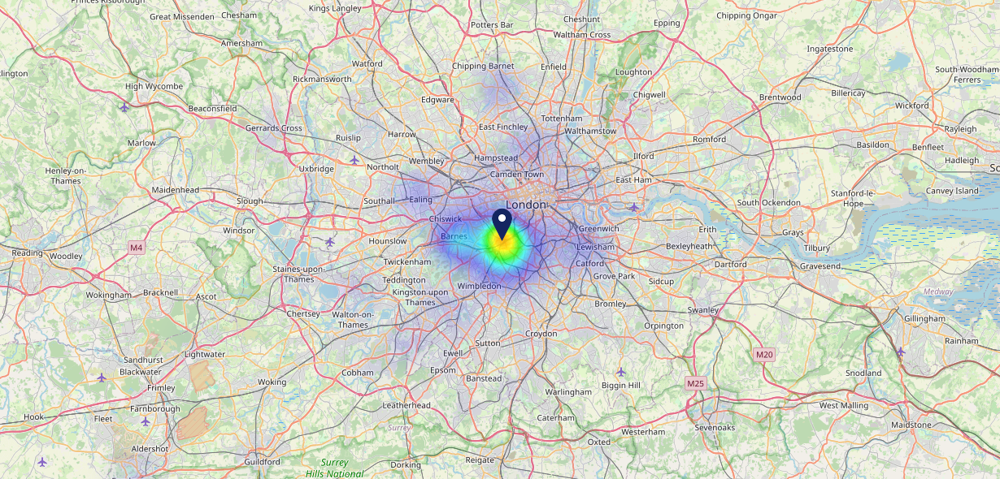

Site Intel
Candlemaker SW113JR
22/02/2023 - 14/02/2024
Map of Guest Origin
Where do customers of Candlemaker SW113JR come from?
Where do customers of Candlemaker SW113JR for 22/02/2023 - 14/02/2024 live
258 Site Customers

Slide 12
Site Intel
Candlemaker SW113JR
3 Miles
1 Chain
22/02/2023 - 14/02/2024
Share of Wallet
What are the Top 20 venues (by spend) that customers of Candlemaker SW113JR also visit?
For customers of Candlemaker SW113JR, who are the top 20 competitors from 1 Chains in 3 Miles for 22/02/2023 - 14/02/2024 split by Venue
685 Site Customers

Slide 13
Site Intel
Candlemaker SW113JR
3 Miles
1 Chain
22/02/2023 - 14/02/2024
Share of Wallet Change
How has share of wallet of customers of Candlemaker SW113JR changed between two date ranges?
685 Site Customers

Slide 14
Site Intel
Candlemaker SW113JR
22/02/2023 - 14/02/2024
Market Summary
How does the local area for Candlemaker SW113JR compare to the national average (1 = low, 10 = high)
Data Type | Name | Spend in 250m | 250m Spend vs National | Spend in 500m | 500m Spend vs National | Spend in 1 mile | 1 mile Spend vs National | Spend in 3 miles | 3 mile Spend vs National
Total | Annual Sales | £3.61M | 7 | £9.18M | 7 | £154.46M | 9 | £1.74B | 10
Weekpart | Mon - Thu | 43.6% | 7 | 42.9% | 7 | 39.3% | 4 | 45.0% | 9
Weekpart | Fri - Sat | 40.9% | 4 | 41.6% | 4 | 45.2% | 7 | 40.3% | 3
Weekpart | Sun | 15.5% | 7 | 15.5% | 6 | 15.5% | 6 | 14.7% | 3
Age | 18 to 24 | 7.3% | 7 | 6.0% | 5 | 6.3% | 5 | 5.1% | 3
Age | 25 to 34 | 16.1% | 3 | 22.1% | 6 | 21.8% | 5 | 18.1% | 3
Age | 35 to 44 | 21.3% | 4 | 21.5% | 4 | 23.4% | 5 | 24.0% | 6
Age | 45 to 54 | 27.1% | 10 | 20.4% | 6 | 19.1% | 4 | 21.3% | 7
Age | 55 to 64 | 18.2% | 7 | 19.5% | 8 | 18.8% | 8 | 19.3% | 9
Age | 65 to 74 | 5.1% | 4 | 5.6% | 4 | 7.0% | 6 | 8.2% | 8
Age | 75+ | 4.9% | 9 | 5.0% | 9 | 3.6% | 7 | 4.1% | 8
CAMEO | Business Elite | 26.9% | 10 | 23.7% | 10 | 29.3% | 10 | 25.5% | 10
CAMEO | Prosperous Professionals | 6.3% | 6 | 7.5% | 7 | 8.0% | 8 | 7.8% | 8
CAMEO | Flourishing Society | 5.0% | 2 | 7.4% | 3 | 11.2% | 5 | 12.1% | 5
CAMEO | Content Communities | 9.9% | 3 | 15.5% | 8 | 13.7% | 7 | 12.7% | 6
CAMEO | White Collar Neighbourhoods | 8.7% | 3 | 12.0% | 6 | 11.3% | 5 | 11.5% | 5
CAMEO | Enterprising Mainstream | 4.0% | 2 | 4.0% | 2 | 3.5% | 1 | 4.7% | 2
CAMEO | Paying The Mortgage | 5.2% | 1 | 5.8% | 1 | 6.8% | 1 | 8.4% | 1
CAMEO | Cash Conscious Communities | 23.5% | 10 | 16.0% | 9 | 10.4% | 7 | 10.3% | 7
CAMEO | On A Budget | 8.4% | 7 | 6.7% | 6 | 5.1% | 4 | 6.0% | 4
CAMEO | Family Value | 2.1% | 5 | 1.4% | 4 | 0.6% | 1 | 1.0% | 2
Affluence | AB | 38.2% | 8 | 38.6% | 8 | 48.6% | 9 | 45.4% | 9
Affluence | C1C2 | 27.7% | 1 | 37.3% | 2 | 35.3% | 1 | 37.2% | 1
Affluence | DE | 34.0% | 9 | 24.1% | 7 | 16.1% | 4 | 17.3% | 4

Slide 15

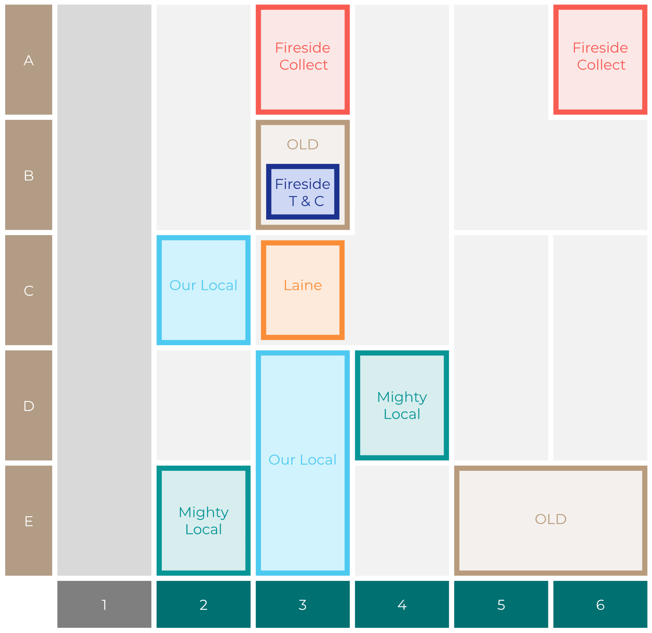

Site Intel
Candlemaker SW113JR
Site Potential 1
Site Characteristics
£3000
£18000
HDI Concept Fit
Achievable Average Weekly Takings
Fireside Scenic
£0
A Food-Led High Affluence B Food-Led Mid Affluence C Wet-Led Mid/High Affluence D Wet-Led Low Affluence E Food-Led Low Affluence
AWT 2 Local Regulars 3 Local Passing Trade 4 Destination Wet-Led 5 Destination Food-Led 6 Destination Very Food-Led
A
B
C
D
E
1
2
3
4
5
6

Slide 16
Site Intel
Candlemaker SW113JR
Site Potential 2
Concept Recommendation

Slide 17
Site Intel
Candlemaker SW113JR
Local Market Profile
Mix of spend by customer segment in Punch site and local market
 | Customer Count | Family Familiar | Occasional & Local | Mid-Week Seniors | Part Of The Pub | Metro Sophisticates | Young & Connected | Bubbly Weekenders | Upmarket Diners
Candlemaker | 117 | 0.00% | 1.72% | 9.16% | 5.67% | 66.38% | 4.81% | 3.93% | 8.28%
Local Catchment | 3534 | 0.90% | 3.68% | 5.99% | 1.74% | 33.73% | 3.53% | 5.87% | 44.52%
Punch T&L | 110504 | 8.08% | 5.92% | 29.54% | 11.18% | 11.29% | 11.62% | 7.15% | 15.19%
Candlemaker vs Local Catchment |  | 0.00% | -1.96% | 3.17% | 3.93% | 32.65% | 1.28% | -1.94% | -36.24%
Candlemaker vs Punch T&L |  | 0.00% | -4.20% | -20.38% | -5.51% | 55.09% | -6.81% | -3.22% | -6.91%
Local Catchment vs Punch T&L |  | -7.18% | -2.24% | -23.55% | -9.44% | 22.44% | -8.09% | -1.28% | 29.33%

Slide 18
Site Intel
Candlemaker SW113JR
Local Competitor Profiles
Mix of spend by customer segment in Punch site and local competitors
 | Customer Count | Family Familiar | Occasional & Local | Mid-Week Seniors | Part Of The Pub | Metro Sophisticates | Young & Connected | Bubbly Weekenders | Upmarket Diners
Candlemaker SW113JR | 117 | 0.00% | 1.72% | 9.16% | 5.67% | 66.38% | 4.81% | 3.93% | 8.28%
Bolingbroke SW116RE | 505 | 0.35% | 2.97% | 3.60% | 1.55% | 27.28% | 3.81% | 3.74% | 56.67%
Fox & Pheasant SW109UJ | 495 | 0.36% | 1.52% | 8.68% | 0.51% | 32.16% | 2.32% | 7.10% | 47.30%
Stonhouse SW46BJ | 498 | 0.18% | 4.14% | 8.36% | 3.96% | 43.90% | 6.50% | 10.45% | 22.47%
Abbeville SW49JW | 450 | 1.03% | 8.00% | 3.53% | 4.63% | 43.36% | 1.64% | 6.79% | 30.99%
Elephant And Barrel SW67LW | 380 | 6.37% | 6.16% | 11.31% | 4.18% | 35.09% | 11.87% | 11.57% | 13.41%
Brook House SW64SG | 292 | 0.00% | 2.29% | 2.21% | 0.17% | 28.69% | 0.57% | 1.67% | 64.37%
The Tommyfield SE114EZ | 420 | 1.55% | 3.91% | 7.99% | 0.39% | 39.30% | 3.19% | 6.14% | 37.50%
Barts SW33DW | 81 | 0.58% | 4.29% | 1.97% | 0.00% | 37.00% | 7.19% | 7.01% | 41.93%
Tap 13 Tooting SW170RJ | 192 | 1.01% | 3.70% | 5.17% | 0.73% | 46.82% | 5.13% | 11.13% | 26.27%
Bird in Hand W140LR | 169 | 0.39% | 2.24% | 5.50% | 0.74% | 17.65% | 1.50% | 1.68% | 70.25%
The Cadogan Arms SW35UG | 89 | 0.00% | 3.10% | 5.27% | 0.00% | 32.69% | 0.85% | 4.44% | 53.61%
Nags Head SW1X8ED | 258 | 0.97% | 3.87% | 11.63% | 1.00% | 46.18% | 2.74% | 4.27% | 29.30%

