Slide 1











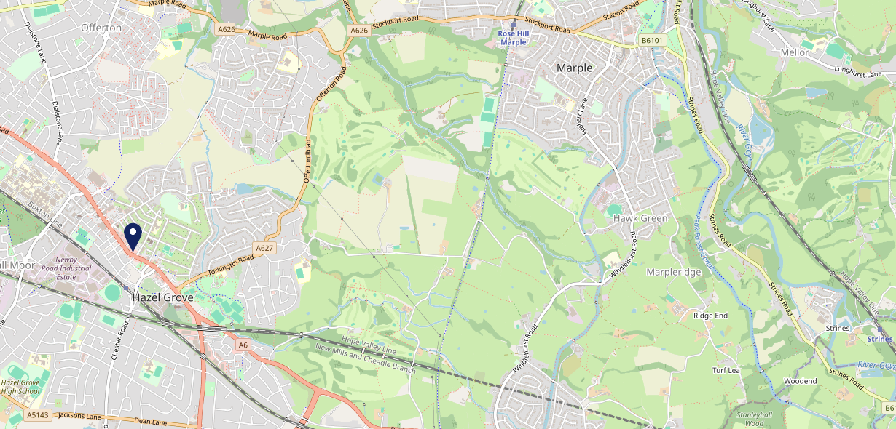











Site Intel
Horse & Jockey SK74HJ
3 Miles
1 Chain
22/02/2023 - 14/02/2024
Site Summary
Horse & Jockey SK74HJ
Work Area
Region
TV Region
Urbanicity
Manchester
North West
North West
Urban major conurbation
SK74HJ
Punch T&L
Top Competitors
ATV
Gender
Chiverton Tap
#1
£8.36
77.23%
Male
SK85AU
Pub Restaurant
Affluence
Segmentation
#2
50.67%
30.20%
Low Income
Family Value
Age Group
Visit Day
#3
26.62%
34.44%
55 to 64
Sat
Nearest Station
Hazel Grove(0.28 miles)
770 Site Customers
1 Competitors
1289 Competitor Customers

Slide 2

Site Intel
Horse & Jockey SK74HJ
3 Miles
1 Chain
22/02/2023 - 14/02/2024
Spend by Weekpart
How is customer spend distributed throughout the week for Horse & Jockey SK74HJ versus its competitors?
% of spend for Horse & Jockey SK74HJ and 1 Chains in 3 Miles from 22/02/2023 - 14/02/2024 split by Day of Week
770 Site Customers
1 Competitors
1289 Competitor Customers

Slide 3
Site Intel
Horse & Jockey SK74HJ
3 Miles
1 Chain
22/02/2023 - 14/02/2024
Visit Frequency
How frequently per year do customers visit Horse & Jockey SK74HJ versus its competitors?
% of customer numbers for Horse & Jockey SK74HJ and 1 Chains in 3 Miles from 22/02/2023 - 14/02/2024 and the number of visits made Per Annum
770 Site Customers
1 Competitors
1289 Competitor Customers

Slide 4
Site Intel
Horse & Jockey SK74HJ
3 Miles
1 Chain
22/02/2023 - 14/02/2024
ATV Change
How has ATV changed between two date ranges?
770 Site Customers

Slide 5
Site Intel
Horse & Jockey SK74HJ
3 Miles
1 Chain
22/02/2023 - 14/02/2024
Market Share Change
How has market share changed between two date ranges?
% of market share spend for Horse & Jockey SK74HJ and 1 Chains in 3 Miles from 22/02/2023 - 14/02/2024
770 Site Customers

Slide 6
Site Intel
Horse & Jockey SK74HJ
3 Miles
1 Chain
22/02/2023 - 14/02/2024
Age
How does the age profile of customers who visit Horse & Jockey SK74HJ compare versus its competitors?
% of spend for Horse & Jockey SK74HJ and 1 Chains in 3 Miles from 22/02/2023 - 14/02/2024 split by Age Range
257 Site Customers
1 Competitors
575 Competitor Customers

Slide 7
Site Intel
Horse & Jockey SK74HJ
3 Miles
1 Chain
22/02/2023 - 14/02/2024
Affluence
How does the affluence of customers who visit Horse & Jockey SK74HJ compare versus its competitors?
% of spend for Horse & Jockey SK74HJ and 1 Chains in 3 Miles from 22/02/2023 - 14/02/2024 split by Affluence
233 Site Customers
1 Competitors
548 Competitor Customers

Slide 8
Site Intel
Horse & Jockey SK74HJ
3 Miles
1 Chain
22/02/2023 - 14/02/2024
Gender
How does the gender profile of customers who visit Horse & Jockey SK74HJ compare versus its competitors?
% of spend for Horse & Jockey SK74HJ and 1 Chains in 3 Miles from 22/02/2023 - 14/02/2024 split by Gender
240 Site Customers
1 Competitors
562 Competitor Customers

Slide 9
Site Intel
Horse & Jockey SK74HJ
3 Miles
1 Chain
22/02/2023 - 14/02/2024
Punch Segmentation
How does the Custom segmentation profile of customers who visit Horse & Jockey SK74HJ compare versus its competitors?
% of spend for Horse & Jockey SK74HJ and 1 Chains in 3 Miles from 22/02/2023 - 14/02/2024 split by Segment
770 Site Customers
1 Competitors
1289 Competitor Customers

Slide 10
Site Intel
Horse & Jockey SK74HJ
3 Miles
1 Chain
22/02/2023 - 14/02/2024
Spend by Distance
How does the spend profile of Horse & Jockey SK74HJ compare versus its competitors based on travel distances?
% of spend for Horse & Jockey SK74HJ and 1 Chains in 3 Miles from 22/02/2023 - 14/02/2024 split by Distance travelled
240 Site Customers
1 Competitors
562 Competitor Customers

Slide 11
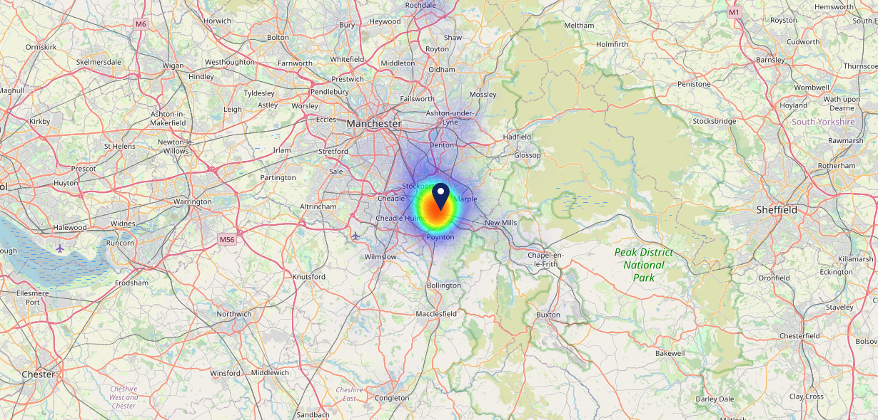

Site Intel
Horse & Jockey SK74HJ
22/02/2023 - 14/02/2024
Map of Guest Origin
Where do customers of Horse & Jockey SK74HJ come from?
Where do customers of Horse & Jockey SK74HJ for 22/02/2023 - 14/02/2024 live
240 Site Customers

Slide 12
Site Intel
Horse & Jockey SK74HJ
3 Miles
1 Chain
22/02/2023 - 14/02/2024
Share of Wallet
What are the Top 20 venues (by spend) that customers of Horse & Jockey SK74HJ also visit?
For customers of Horse & Jockey SK74HJ, who are the top 20 competitors from 1 Chains in 3 Miles for 22/02/2023 - 14/02/2024 split by Venue
770 Site Customers

Slide 13
Site Intel
Horse & Jockey SK74HJ
3 Miles
1 Chain
22/02/2023 - 14/02/2024
Share of Wallet Change
How has share of wallet of customers of Horse & Jockey SK74HJ changed between two date ranges?
770 Site Customers

Slide 14
Site Intel
Horse & Jockey SK74HJ
22/02/2023 - 14/02/2024
Market Summary
How does the local area for Horse & Jockey SK74HJ compare to the national average (1 = low, 10 = high)
Data Type | Name | Spend in 250m | 250m Spend vs National | Spend in 500m | 500m Spend vs National | Spend in 1 mile | 1 mile Spend vs National | Spend in 3 miles | 3 mile Spend vs National
Total | Annual Sales | £9.53M | 9 | £30.04M | 9 | £51.80M | 8 | £350.19M | 9
Weekpart | Mon - Thu | 35.5% | 3 | 43.1% | 7 | 42.1% | 6 | 40.2% | 3
Weekpart | Fri - Sat | 49.7% | 9 | 41.0% | 4 | 42.6% | 5 | 44.6% | 8
Weekpart | Sun | 14.8% | 6 | 15.9% | 7 | 15.4% | 6 | 15.2% | 4
Age | 18 to 24 | 5.5% | 5 | 8.5% | 7 | 7.1% | 6 | 4.8% | 3
Age | 25 to 34 | 12.0% | 2 | 17.3% | 3 | 15.8% | 2 | 15.3% | 2
Age | 35 to 44 | 18.0% | 2 | 25.6% | 7 | 23.8% | 6 | 24.0% | 6
Age | 45 to 54 | 22.1% | 7 | 21.0% | 6 | 21.6% | 7 | 19.8% | 5
Age | 55 to 64 | 24.4% | 10 | 16.2% | 6 | 17.5% | 7 | 19.1% | 9
Age | 65 to 74 | 12.7% | 9 | 7.8% | 7 | 9.3% | 8 | 10.6% | 9
Age | 75+ | 5.2% | 9 | 3.6% | 7 | 5.0% | 9 | 6.2% | 10
CAMEO | Business Elite | 3.5% | 3 | 6.5% | 5 | 6.4% | 5 | 10.0% | 7
CAMEO | Prosperous Professionals | 4.2% | 4 | 5.2% | 5 | 6.4% | 6 | 7.6% | 7
CAMEO | Flourishing Society | 4.1% | 1 | 4.6% | 1 | 4.9% | 1 | 7.5% | 2
CAMEO | Content Communities | 13.3% | 7 | 14.5% | 8 | 14.5% | 8 | 14.4% | 8
CAMEO | White Collar Neighbourhoods | 18.0% | 10 | 15.7% | 9 | 16.1% | 9 | 12.9% | 8
CAMEO | Enterprising Mainstream | 10.7% | 8 | 10.1% | 7 | 9.3% | 6 | 8.7% | 6
CAMEO | Paying The Mortgage | 24.8% | 10 | 22.9% | 10 | 22.3% | 10 | 18.3% | 8
CAMEO | Cash Conscious Communities | 10.9% | 7 | 9.8% | 6 | 9.3% | 6 | 8.2% | 5
CAMEO | On A Budget | 4.2% | 3 | 5.2% | 4 | 5.2% | 4 | 6.6% | 6
CAMEO | Family Value | 6.4% | 8 | 5.7% | 8 | 5.5% | 7 | 5.9% | 7
Affluence | AB | 11.8% | 2 | 16.2% | 3 | 17.7% | 3 | 25.0% | 4
Affluence | C1C2 | 66.8% | 10 | 63.1% | 10 | 62.3% | 10 | 54.3% | 8
Affluence | DE | 21.4% | 6 | 20.6% | 6 | 20.0% | 6 | 20.7% | 6

Slide 15

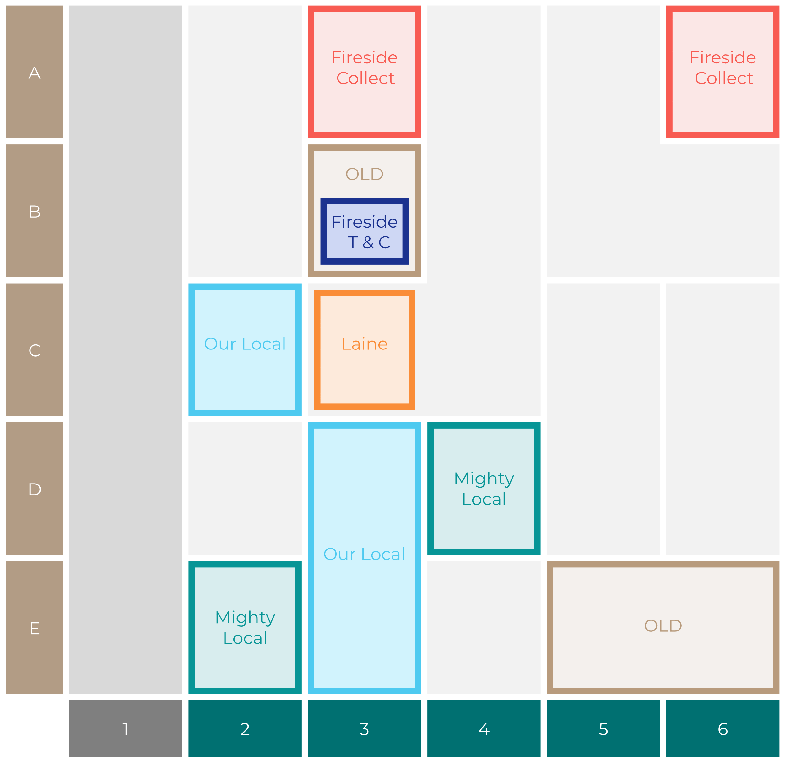

Site Intel
Horse & Jockey SK74HJ
Site Potential 1
Site Characteristics
£3000
£18000
OCC Concept Fit
Achievable Average Weekly Takings
Non-Core
£4500
A Food-Led High Affluence B Food-Led Mid Affluence C Wet-Led Mid/High Affluence D Wet-Led Low Affluence E Food-Led Low Affluence
AWT 2 Local Regulars 3 Local Passing Trade 4 Destination Wet-Led 5 Destination Food-Led 6 Destination Very Food-Led
A
B
C
D
E
1
2
3
4
5
6

Slide 16
Site Intel
Horse & Jockey SK74HJ
Site Potential 2
Concept Recommendation

Slide 17
Site Intel
Horse & Jockey SK74HJ
Local Market Profile
Mix of spend by customer segment in Punch site and local market
 | Customer Count | Family Familiar | Occasional & Local | Mid-Week Seniors | Part Of The Pub | Metro Sophisticates | Young & Connected | Bubbly Weekenders | Upmarket Diners
Horse & Jockey | 127 | 4.04% | 24.05% | 2.86% | 35.77% | 6.28% | 16.00% | 9.49% | 1.47%
Local Catchment | 269 | 5.27% | 5.28% | 13.82% | 4.64% | 30.61% | 2.87% | 7.19% | 30.28%
Punch T&L | 115554 | 8.24% | 6.01% | 29.08% | 11.44% | 11.18% | 11.99% | 7.12% | 14.90%
Horse & Jockey vs Local Catchment |  | -1.23% | 18.77% | -10.96% | 31.13% | -24.33% | 13.13% | 2.30% | -28.81%
Horse & Jockey vs Punch T&L |  | -4.20% | 18.04% | -26.22% | 24.33% | -4.90% | 4.01% | 2.37% | -13.43%
Local Catchment vs Punch T&L |  | -2.97% | -0.73% | -15.26% | -6.80% | 19.43% | -9.12% | 0.07% | 15.38%

