Slide 1
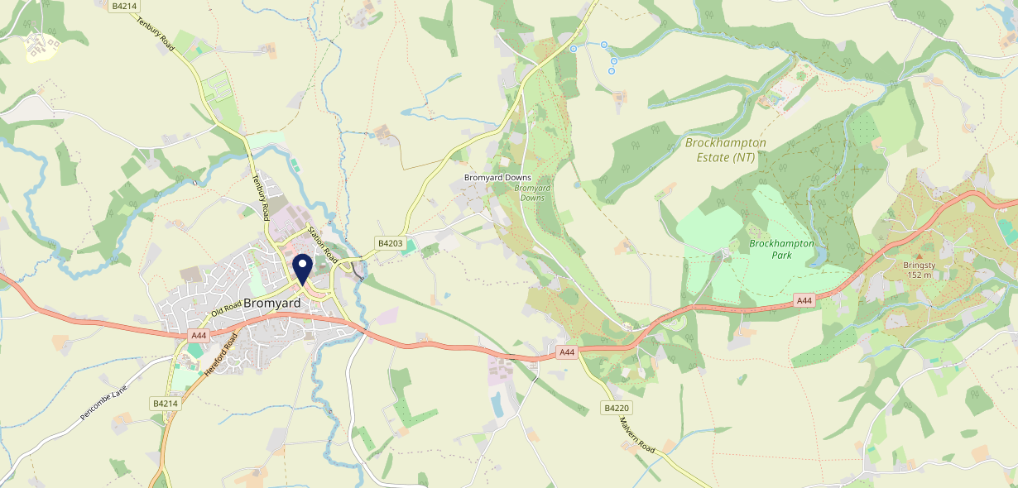
Site Intel
Kings Arms HR74AE
1 Miles
371 Chains
16/04/2025 - 08/04/2026
Site Summary
Kings Arms HR74AE
Work Area
Region
TV Region
Urbanicity
Hereford
West Midlands
Central
Rural town and fringe
HR74AE
Punch T&L
Top Competitors
ATV
Gender
Inn At Bromyard
#1
£8.61
91.18%
Male
HR74AA
Pub Restaurant
Affluence
Segmentation
Tipsy Toad
#2
47.33%
39.59%
Middle Income
Enterprising Mainstream
HR74AE
Pub / Bar
Age Group
Visit Day
Queens Arms
#3
35.63%
34.82%
HR74AE
55 to 64
Sat
Pub / Bar
Nearest Station
Malvern Link(14.69 miles)
116 Site Customers
27 Competitors
4332 Competitor Customers

Slide 2
Site Intel
Kings Arms HR74AE
1 Miles
371 Chains
16/04/2025 - 08/04/2026
Spend by Weekpart
How is customer spend distributed throughout the week for Kings Arms HR74AE versus its competitors?
% of spend for Kings Arms HR74AE and 371 Chains in 1 Miles from 16/04/2025 - 08/04/2026 split by Day of Week
116 Site Customers
27 Competitors
4332 Competitor Customers

Slide 3
Site Intel
Kings Arms HR74AE
1 Miles
371 Chains
16/04/2025 - 08/04/2026
Visit Frequency
How frequently per year do customers visit Kings Arms HR74AE versus its competitors?
% of customer numbers for Kings Arms HR74AE and 371 Chains in 1 Miles from 16/04/2025 - 08/04/2026 and the number of visits made Per Annum
116 Site Customers
27 Competitors
4332 Competitor Customers

Slide 4
Site Intel
Kings Arms HR74AE
1 Miles
371 Chains
16/04/2025 - 08/04/2026
ATV Change
How has ATV changed between two date ranges?
116 Site Customers

Slide 5
Site Intel
Kings Arms HR74AE
1 Miles
371 Chains
16/04/2025 - 08/04/2026
Market Share Change
How has market share changed between two date ranges?
% of market share spend for Kings Arms HR74AE and 371 Chains in 1 Miles from 16/04/2025 - 08/04/2026
116 Site Customers

Slide 6
Site Intel
Kings Arms HR74AE
1 Miles
371 Chains
16/04/2025 - 08/04/2026
Age
How does the age profile of customers who visit Kings Arms HR74AE compare versus its competitors?
% of spend for Kings Arms HR74AE and 371 Chains in 1 Miles from 16/04/2025 - 08/04/2026 split by Age Range
52 Site Customers
27 Competitors
1882 Competitor Customers

Slide 7
Site Intel
Kings Arms HR74AE
1 Miles
371 Chains
16/04/2025 - 08/04/2026
Affluence
How does the affluence of customers who visit Kings Arms HR74AE compare versus its competitors?
% of spend for Kings Arms HR74AE and 371 Chains in 1 Miles from 16/04/2025 - 08/04/2026 split by Affluence
42 Site Customers
27 Competitors
1732 Competitor Customers

Slide 8
Site Intel
Kings Arms HR74AE
1 Miles
371 Chains
16/04/2025 - 08/04/2026
Gender
How does the gender profile of customers who visit Kings Arms HR74AE compare versus its competitors?
% of spend for Kings Arms HR74AE and 371 Chains in 1 Miles from 16/04/2025 - 08/04/2026 split by Gender
44 Site Customers
27 Competitors
1822 Competitor Customers

Slide 9
Site Intel
Kings Arms HR74AE
1 Miles
371 Chains
16/04/2025 - 08/04/2026
Punch Segmentation
How does the Custom segmentation profile of customers who visit Kings Arms HR74AE compare versus its competitors?
% of spend for Kings Arms HR74AE and 371 Chains in 1 Miles from 16/04/2025 - 08/04/2026 split by Segment
116 Site Customers
27 Competitors
4332 Competitor Customers

Slide 10
Site Intel
Kings Arms HR74AE
1 Miles
371 Chains
16/04/2025 - 08/04/2026
Spend by Distance
How does the spend profile of Kings Arms HR74AE compare versus its competitors based on travel distances?
% of spend for Kings Arms HR74AE and 371 Chains in 1 Miles from 16/04/2025 - 08/04/2026 split by Distance travelled
44 Site Customers
27 Competitors
1819 Competitor Customers

Slide 11
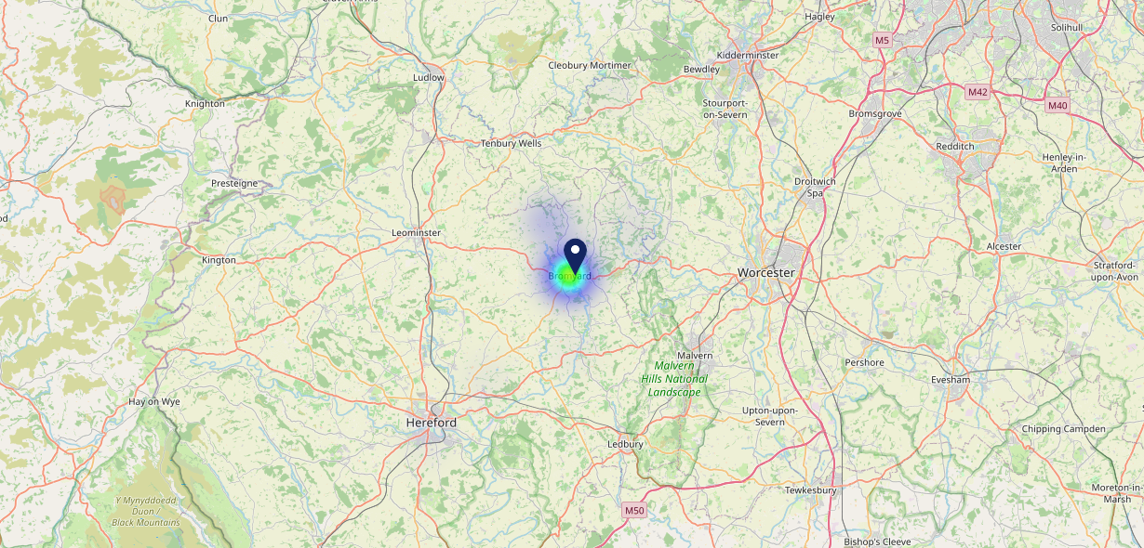
Site Intel
Kings Arms HR74AE
16/04/2025 - 08/04/2026
Map of Guest Origin
Where do customers of Kings Arms HR74AE come from?
Where do customers of Kings Arms HR74AE for 16/04/2025 - 08/04/2026 live
44 Site Customers

Slide 12
Site Intel
Kings Arms HR74AE
1 Miles
371 Chains
16/04/2025 - 08/04/2026
Share of Wallet
What are the Top 20 venues (by spend) that customers of Kings Arms HR74AE also visit?
For customers of Kings Arms HR74AE, who are the top 20 competitors from 371 Chains in 1 Miles for 16/04/2025 - 08/04/2026 split by Venue
116 Site Customers

Slide 13
Site Intel
Kings Arms HR74AE
1 Miles
371 Chains
16/04/2025 - 08/04/2026
Share of Wallet Change
How has share of wallet of customers of Kings Arms HR74AE changed between two date ranges?
116 Site Customers

Slide 14
Site Intel
Kings Arms HR74AE
16/04/2025 - 08/04/2026
Market Summary
How does the local area for Kings Arms HR74AE compare to the national average (1 = low, 10 = high)
Data Type | Name | Spend in 250m | 250m Spend vs National | Spend in 500m | 500m Spend vs National | Spend in 1 mile | 1 mile Spend vs National | Spend in 3 miles | 3 mile Spend vs National
Total | Annual Sales | £1.41M | 5 | £1.86M | 4 | £1.90M | 2 | £2.88M | 1
Weekpart | Mon - Thu | 39.5% | 5 | 43.8% | 7 | 44.4% | 8 | 38.9% | 2
Weekpart | Fri - Sat | 47.1% | 7 | 43.4% | 5 | 43.1% | 6 | 46.3% | 10
Weekpart | Sun | 13.5% | 4 | 12.8% | 3 | 12.5% | 2 | 14.8% | 3
Age | 18 to 24 | 1.6% | 2 | 5.4% | 5 | 5.2% | 4 | 3.3% | 1
Age | 25 to 34 | 9.5% | 1 | 11.8% | 1 | 13.3% | 1 | 11.4% | 1
Age | 35 to 44 | 16.3% | 2 | 19.1% | 2 | 19.4% | 2 | 17.3% | 1
Age | 45 to 54 | 19.7% | 5 | 19.4% | 5 | 19.0% | 4 | 17.7% | 2
Age | 55 to 64 | 30.2% | 10 | 26.1% | 10 | 25.4% | 10 | 29.6% | 10
Age | 65 to 74 | 18.7% | 10 | 14.5% | 10 | 14.3% | 10 | 17.3% | 10
Age | 75+ | 4.1% | 8 | 3.5% | 7 | 3.4% | 7 | 3.4% | 7
CAMEO | Business Elite | 1.2% | 1 | 1.4% | 1 | 1.4% | 1 | 2.0% | 1
CAMEO | Prosperous Professionals | 12.7% | 10 | 13.9% | 10 | 13.9% | 10 | 12.3% | 10
CAMEO | Flourishing Society | 26.3% | 10 | 25.7% | 10 | 25.0% | 10 | 26.2% | 10
CAMEO | Content Communities | 6.7% | 2 | 7.8% | 2 | 7.7% | 1 | 7.9% | 1
CAMEO | White Collar Neighbourhoods | 7.6% | 2 | 6.7% | 2 | 6.9% | 1 | 8.1% | 2
CAMEO | Enterprising Mainstream | 18.4% | 10 | 17.3% | 10 | 17.8% | 10 | 15.9% | 10
CAMEO | Paying The Mortgage | 13.6% | 5 | 13.2% | 5 | 13.2% | 5 | 12.5% | 4
CAMEO | Cash Conscious Communities | 8.8% | 5 | 9.1% | 6 | 9.3% | 6 | 10.7% | 7
CAMEO | On A Budget | 4.2% | 3 | 4.0% | 3 | 3.9% | 2 | 3.4% | 1
CAMEO | Family Value | 0.5% | 2 | 0.9% | 3 | 0.9% | 2 | 1.0% | 2
Affluence | AB | 40.2% | 8 | 41.0% | 8 | 40.3% | 8 | 40.5% | 8
Affluence | C1C2 | 46.3% | 5 | 45.0% | 4 | 45.7% | 4 | 44.4% | 4
Affluence | DE | 13.5% | 3 | 14.0% | 3 | 14.0% | 3 | 15.1% | 3

Slide 15
Site Intel
Kings Arms HR74AE
Site Potential 1
Site Characteristics
£3000
£18000
OCC Concept Fit
Achievable Average Weekly Takings
Non-Core
£8500
A Food-Led High Affluence B Food-Led Mid Affluence C Wet-Led Mid/High Affluence D Wet-Led Low Affluence E Food-Led Low Affluence
AWT 2 Local Regulars 3 Local Passing Trade 4 Destination Wet-Led 5 Destination Food-Led 6 Destination Very Food-Led
A
B
C
D
E
1
2
3
4
5
6

Slide 16
Site Intel
Kings Arms HR74AE
Site Potential 2
Concept Recommendation

Slide 17
Site Intel
Kings Arms HR74AE
Local Market Profile
Mix of spend by customer segment in Punch site and local market
 | Customer Count | Family Familiar | Occasional & Local | Mid-Week Seniors | Part Of The Pub | Metro Sophisticates | Young & Connected | Bubbly Weekenders | Upmarket Diners
Kings Arms | 23 | 5.15% | 0.79% | 64.76% | 0.00% | 0.00% | 14.20% | 13.62% | 1.44%
Local Catchment | 419 | 12.06% | 0.77% | 44.50% | 1.60% | 4.84% | 15.05% | 5.09% | 16.05%
Punch T&L | 94952 | 8.90% | 6.04% | 28.67% | 11.30% | 11.32% | 11.05% | 7.03% | 15.65%
Kings Arms vs Local Catchment |  | -6.91% | 0.02% | 20.26% | 0.00% | 0.00% | -0.85% | 8.53% | -14.61%
Kings Arms vs Punch T&L |  | -3.75% | -5.25% | 36.09% | 0.00% | 0.00% | 3.15% | 6.59% | -14.21%
Local Catchment vs Punch T&L |  | 3.16% | -5.27% | 15.83% | -9.70% | -6.48% | 4.00% | -1.94% | 0.40%

Slide 18
Site Intel
Kings Arms HR74AE
Local Competitor Profiles
Mix of spend by customer segment in Punch site and local competitors
 | Customer Count | Family Familiar | Occasional & Local | Mid-Week Seniors | Part Of The Pub | Metro Sophisticates | Young & Connected | Bubbly Weekenders | Upmarket Diners
Inn At Bromyard HR74AA | 43 | 12.11% | 0.00% | 53.17% | 3.05% | 1.46% | 18.44% | 10.81% | 0.93%
Tipsy Toad HR74AE | 65 | 1.50% | 0.17% | 70.14% | 1.05% | 8.52% | 3.32% | 2.43% | 12.82%
Kings Arms HR74AE | 23 | 5.15% | 0.79% | 64.76% | 0.00% | 0.00% | 14.20% | 13.62% | 1.44%
Queens Arms HR74AE | 27 | 10.26% | 1.23% | 56.96% | 0.00% | 5.84% | 4.73% | 7.74% | 13.21%
Grayne Beverages HR74AJ | 25 | 3.03% | 2.00% | 76.73% | 2.40% | 0.60% | 8.46% | 1.60% | 5.13%
Mahis HR74AA | 32 | 7.75% | 0.00% | 33.89% | 0.79% | 1.80% | 23.37% | 1.44% | 30.93%
Greggs At Mfg HR74DJ | 234 | 28.76% | 2.03% | 17.57% | 1.80% | 2.61% | 29.34% | 7.30% | 10.54%
Rose Lion HR74AJ | 13 | 17.58% | 0.00% | 53.32% | 5.06% | 14.56% | 0.00% | 2.46% | 7.00%
Foxys Steak Bar HR74AE | 12 | 19.21% | 0.00% | 13.67% | 3.06% | 8.07% | 0.00% | 3.03% | 52.94%
Cosy Cafe HR74EB | 27 | 5.75% | 2.72% | 48.67% | 0.00% | 0.00% | 18.50% | 6.18% | 18.14%
Oaklands Cafe HR74BS | 48 | 16.15% | 0.00% | 17.58% | 1.62% | 12.62% | 14.36% | 9.38% | 28.25%
Bromyard Rugby Club HR74LW | 7 | 1.98% | 0.00% | 42.26% | 0.00% | 0.00% | 55.75% | 0.00% | 0.00%
Emmas Farmhouse Cafe HR74BP | 24 | 21.00% | 0.00% | 28.79% | 2.51% | 0.62% | 5.59% | 9.66% | 31.79%
Solid Silver HR74BT | 8 | 0.00% | 6.74% | 53.99% | 0.00% | 0.00% | 28.90% | 10.34% | 0.00%
Bromyard Town Football HR74NT | 10 | 8.15% | 0.00% | 42.55% | 6.67% | 3.33% | 25.87% | 0.00% | 13.41%
Hope Family Centre HR74QU | 6 | 0.00% | 0.00% | 24.88% | 0.00% | 0.00% | 36.23% | 0.00% | 38.88%

