Slide 1










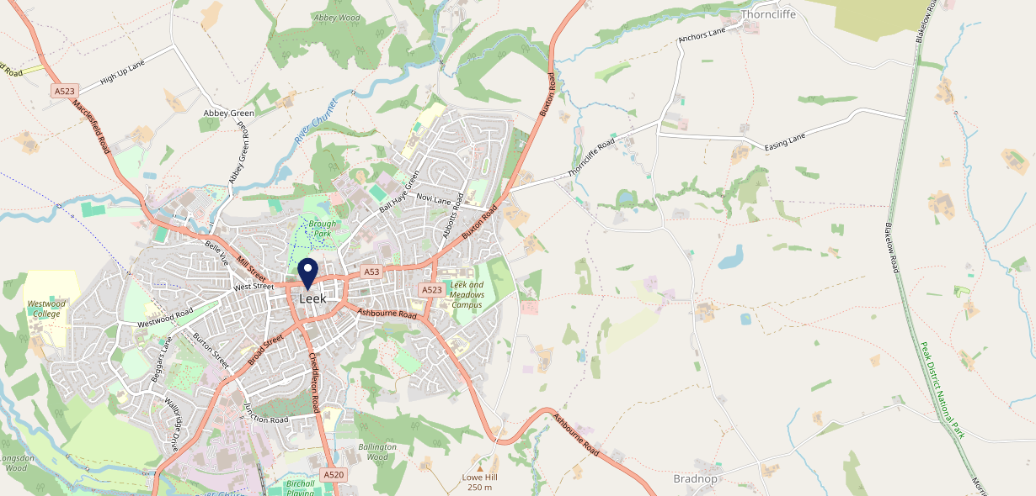









Site Intel
Red Lion ST135HH
3 Miles
1 Chain
22/02/2023 - 14/02/2024
Site Summary
Red Lion ST135HH
Work Area
Region
TV Region
Urbanicity
Stoke-on-Trent
West Midlands
Central
Urban city and town
ST135HH
Punch T&L
Top Competitors
ATV
Gender
Red Lion
#1
£12.24
53.75%
Male
ST137LP
Pub Restaurant
Affluence
Segmentation
Lazy Trout Inn
#2
50.23%
19.97%
Middle Income
Cash Conscious Communities
ST138SN
Pub Restaurant
Age Group
Visit Day
Three Horse Shoes
#3
28.37%
41.01%
ST138TW
25 to 34
Sat
Pub Restaurant
Nearest Station
Congleton(12.55 miles)
3068 Site Customers
5 Competitors
13897 Competitor Customers

Slide 2

Site Intel
Red Lion ST135HH
3 Miles
1 Chain
22/02/2023 - 14/02/2024
Spend by Weekpart
How is customer spend distributed throughout the week for Red Lion ST135HH versus its competitors?
% of spend for Red Lion ST135HH and 1 Chains in 3 Miles from 22/02/2023 - 14/02/2024 split by Day of Week
3068 Site Customers
5 Competitors
13897 Competitor Customers

Slide 3
Site Intel
Red Lion ST135HH
3 Miles
1 Chain
22/02/2023 - 14/02/2024
Visit Frequency
How frequently per year do customers visit Red Lion ST135HH versus its competitors?
% of customer numbers for Red Lion ST135HH and 1 Chains in 3 Miles from 22/02/2023 - 14/02/2024 and the number of visits made Per Annum
3068 Site Customers
5 Competitors
13897 Competitor Customers

Slide 4
Site Intel
Red Lion ST135HH
3 Miles
1 Chain
22/02/2023 - 14/02/2024
ATV Change
How has ATV changed between two date ranges?
3068 Site Customers

Slide 5
Site Intel
Red Lion ST135HH
3 Miles
1 Chain
22/02/2023 - 14/02/2024
Market Share Change
How has market share changed between two date ranges?
% of market share spend for Red Lion ST135HH and 1 Chains in 3 Miles from 22/02/2023 - 14/02/2024
3068 Site Customers

Slide 6
Site Intel
Red Lion ST135HH
3 Miles
1 Chain
22/02/2023 - 14/02/2024
Age
How does the age profile of customers who visit Red Lion ST135HH compare versus its competitors?
% of spend for Red Lion ST135HH and 1 Chains in 3 Miles from 22/02/2023 - 14/02/2024 split by Age Range
1344 Site Customers
5 Competitors
6883 Competitor Customers

Slide 7
Site Intel
Red Lion ST135HH
3 Miles
1 Chain
22/02/2023 - 14/02/2024
Affluence
How does the affluence of customers who visit Red Lion ST135HH compare versus its competitors?
% of spend for Red Lion ST135HH and 1 Chains in 3 Miles from 22/02/2023 - 14/02/2024 split by Affluence
1298 Site Customers
5 Competitors
6547 Competitor Customers

Slide 8
Site Intel
Red Lion ST135HH
3 Miles
1 Chain
22/02/2023 - 14/02/2024
Gender
How does the gender profile of customers who visit Red Lion ST135HH compare versus its competitors?
% of spend for Red Lion ST135HH and 1 Chains in 3 Miles from 22/02/2023 - 14/02/2024 split by Gender
1333 Site Customers
5 Competitors
6818 Competitor Customers

Slide 9
Site Intel
Red Lion ST135HH
3 Miles
1 Chain
22/02/2023 - 14/02/2024
Punch Segmentation
How does the Custom segmentation profile of customers who visit Red Lion ST135HH compare versus its competitors?
% of spend for Red Lion ST135HH and 1 Chains in 3 Miles from 22/02/2023 - 14/02/2024 split by Segment
3068 Site Customers
5 Competitors
13897 Competitor Customers

Slide 10
Site Intel
Red Lion ST135HH
3 Miles
1 Chain
22/02/2023 - 14/02/2024
Spend by Distance
How does the spend profile of Red Lion ST135HH compare versus its competitors based on travel distances?
% of spend for Red Lion ST135HH and 1 Chains in 3 Miles from 22/02/2023 - 14/02/2024 split by Distance travelled
1332 Site Customers
5 Competitors
6812 Competitor Customers

Slide 11
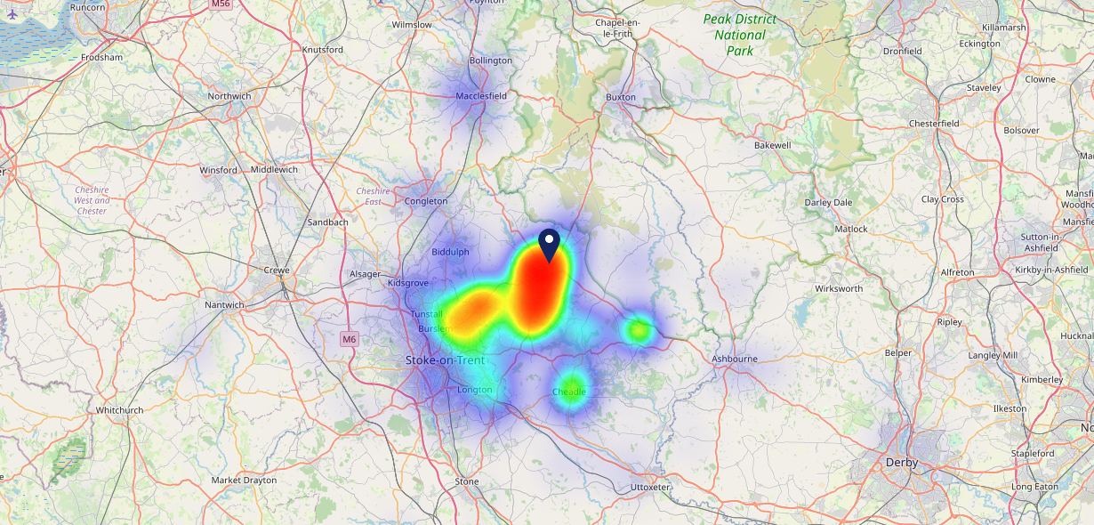

Site Intel
Red Lion ST135HH
22/02/2023 - 14/02/2024
Map of Guest Origin
Where do customers of Red Lion ST135HH come from?
Where do customers of Red Lion ST135HH for 22/02/2023 - 14/02/2024 live
1332 Site Customers

Slide 12
Site Intel
Red Lion ST135HH
3 Miles
1 Chain
22/02/2023 - 14/02/2024
Share of Wallet
What are the Top 20 venues (by spend) that customers of Red Lion ST135HH also visit?
For customers of Red Lion ST135HH, who are the top 20 competitors from 1 Chains in 3 Miles for 22/02/2023 - 14/02/2024 split by Venue
3068 Site Customers

Slide 13
Site Intel
Red Lion ST135HH
3 Miles
1 Chain
22/02/2023 - 14/02/2024
Share of Wallet Change
How has share of wallet of customers of Red Lion ST135HH changed between two date ranges?
3068 Site Customers

Slide 14
Site Intel
Red Lion ST135HH
22/02/2023 - 14/02/2024
Market Summary
How does the local area for Red Lion ST135HH compare to the national average (1 = low, 10 = high)
Data Type | Name | Spend in 250m | 250m Spend vs National | Spend in 500m | 500m Spend vs National | Spend in 1 mile | 1 mile Spend vs National | Spend in 3 miles | 3 mile Spend vs National
Total | Annual Sales | £18.60M | 9 | £22.79M | 9 | £34.85M | 7 | £49.48M | 5
Weekpart | Mon - Thu | 35.9% | 3 | 35.9% | 2 | 38.8% | 3 | 38.4% | 2
Weekpart | Fri - Sat | 50.6% | 9 | 50.5% | 9 | 46.9% | 9 | 44.4% | 8
Weekpart | Sun | 13.5% | 4 | 13.6% | 4 | 14.4% | 4 | 17.2% | 9
Age | 18 to 24 | 5.2% | 5 | 5.1% | 5 | 5.9% | 5 | 5.8% | 4
Age | 25 to 34 | 15.6% | 3 | 16.4% | 3 | 18.8% | 3 | 18.1% | 3
Age | 35 to 44 | 19.7% | 3 | 20.2% | 3 | 22.9% | 5 | 21.7% | 3
Age | 45 to 54 | 16.7% | 3 | 16.8% | 2 | 16.6% | 2 | 16.8% | 1
Age | 55 to 64 | 22.0% | 9 | 21.8% | 9 | 18.9% | 8 | 19.2% | 9
Age | 65 to 74 | 14.2% | 10 | 13.6% | 9 | 11.5% | 9 | 12.3% | 10
Age | 75+ | 6.5% | 9 | 6.2% | 9 | 5.5% | 9 | 6.2% | 9
CAMEO | Business Elite | 4.2% | 4 | 4.2% | 4 | 3.8% | 3 | 4.9% | 4
CAMEO | Prosperous Professionals | 5.1% | 5 | 5.1% | 5 | 5.1% | 4 | 5.6% | 4
CAMEO | Flourishing Society | 8.8% | 4 | 8.8% | 4 | 8.6% | 3 | 9.3% | 3
CAMEO | Content Communities | 15.8% | 8 | 15.3% | 8 | 14.5% | 8 | 14.3% | 8
CAMEO | White Collar Neighbourhoods | 9.0% | 3 | 9.0% | 3 | 8.0% | 2 | 8.2% | 2
CAMEO | Enterprising Mainstream | 9.9% | 7 | 10.2% | 7 | 10.3% | 7 | 11.1% | 8
CAMEO | Paying The Mortgage | 15.5% | 6 | 15.7% | 6 | 15.7% | 6 | 16.4% | 7
CAMEO | Cash Conscious Communities | 17.6% | 9 | 17.4% | 10 | 17.2% | 10 | 14.9% | 10
CAMEO | On A Budget | 9.8% | 8 | 10.3% | 8 | 12.0% | 9 | 10.3% | 9
CAMEO | Family Value | 4.2% | 7 | 4.1% | 7 | 4.8% | 7 | 5.1% | 7
Affluence | AB | 18.1% | 3 | 18.1% | 3 | 17.4% | 3 | 19.8% | 3
Affluence | C1C2 | 50.2% | 6 | 50.2% | 6 | 48.5% | 5 | 49.9% | 6
Affluence | DE | 31.6% | 8 | 31.8% | 8 | 34.0% | 9 | 30.3% | 9

Slide 15
Site Intel
Red Lion ST135HH
Local Market Profile
Mix of spend by customer segment in Punch site and local market
 | Customer Count | Family Familiar | Occasional & Local | Mid-Week Seniors | Part Of The Pub | Metro Sophisticates | Young & Connected | Bubbly Weekenders | Upmarket Diners
Red Lion | 540 | 17.54% | 4.27% | 11.09% | 25.25% | 6.23% | 19.78% | 9.10% | 6.69%
Local Catchment | 2273 | 13.80% | 3.00% | 26.62% | 9.37% | 5.70% | 13.55% | 8.20% | 19.71%
Punch T&L | 110504 | 8.08% | 5.92% | 29.54% | 11.18% | 11.29% | 11.62% | 7.15% | 15.19%
Red Lion vs Local Catchment |  | 3.74% | 1.27% | -15.53% | 15.88% | 0.53% | 6.23% | 0.90% | -13.02%
Red Lion vs Punch T&L |  | 9.46% | -1.65% | -18.45% | 14.07% | -5.06% | 8.16% | 1.95% | -8.50%
Local Catchment vs Punch T&L |  | 5.72% | -2.92% | -2.92% | -1.81% | -5.59% | 1.93% | 1.05% | 4.52%

Slide 16
Site Intel
Red Lion ST135HH
Local Competitor Profiles
Mix of spend by customer segment in Punch site and local competitors
 | Customer Count | Family Familiar | Occasional & Local | Mid-Week Seniors | Part Of The Pub | Metro Sophisticates | Young & Connected | Bubbly Weekenders | Upmarket Diners
Red Lion ST135HH | 540 | 17.54% | 4.27% | 11.09% | 25.25% | 6.23% | 19.78% | 9.10% | 6.69%
Red Lion ST137LP | 343 | 10.21% | 1.81% | 35.78% | 16.44% | 5.18% | 10.71% | 4.67% | 15.15%
Lazy Trout Inn ST138SN | 1022 | 10.67% | 2.13% | 32.67% | 5.97% | 4.74% | 10.19% | 6.69% | 26.89%
Three Horse Shoes ST138TW | 1259 | 17.18% | 4.01% | 19.34% | 9.34% | 6.54% | 16.82% | 10.43% | 16.29%

