Slide 1
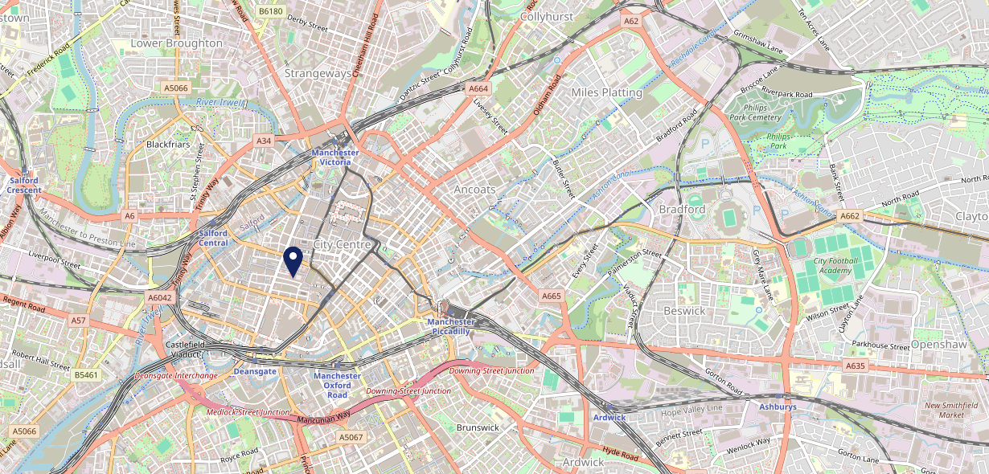
Site Intel
Rising Sun M25HX
1 Miles
371 Chains
16/04/2025 - 08/04/2026
Site Summary
Rising Sun M25HX
Work Area
Region
TV Region
Urbanicity
Manchester
North West
North West
Urban major conurbation
M25HX
Punch Unity
Top Competitors
ATV
Gender
Oast House
#1
£10.02
82.90%
Male
M33AY
New World Trading
Affluence
Segmentation
Alberts Schloss Manchester
#2
53.57%
16.23%
Middle Income
Paying The Mortgage
M25QR
Alberts Schloss
Age Group
Visit Day
Mulligans Bar
#3
24.52%
30.51%
M32RB
25 to 34
Sat
Pub / Bar
Nearest Station
Deansgate(0.63 miles)
2582 Site Customers
1000 of 2590 Competitors
1963009 Competitor Customers

Slide 2
Site Intel
Rising Sun M25HX
1 Miles
371 Chains
16/04/2025 - 08/04/2026
Spend by Weekpart
How is customer spend distributed throughout the week for Rising Sun M25HX versus its competitors?
% of spend for Rising Sun M25HX and 371 Chains in 1 Miles from 16/04/2025 - 08/04/2026 split by Day of Week
2582 Site Customers
1000 of 2590 Competitors
1963009 Competitor Customers

Slide 3
Site Intel
Rising Sun M25HX
1 Miles
371 Chains
16/04/2025 - 08/04/2026
Visit Frequency
How frequently per year do customers visit Rising Sun M25HX versus its competitors?
% of customer numbers for Rising Sun M25HX and 371 Chains in 1 Miles from 16/04/2025 - 08/04/2026 and the number of visits made Per Annum
2582 Site Customers
1000 of 2590 Competitors
1963009 Competitor Customers

Slide 4
Site Intel
Rising Sun M25HX
1 Miles
371 Chains
16/04/2025 - 08/04/2026
ATV Change
How has ATV changed between two date ranges?
2582 Site Customers

Slide 5
Site Intel
Rising Sun M25HX
1 Miles
371 Chains
16/04/2025 - 08/04/2026
Market Share Change
How has market share changed between two date ranges?
% of market share spend for Rising Sun M25HX and 371 Chains in 1 Miles from 16/04/2025 - 08/04/2026
2582 Site Customers

Slide 6
Site Intel
Rising Sun M25HX
1 Miles
371 Chains
16/04/2025 - 08/04/2026
Age
How does the age profile of customers who visit Rising Sun M25HX compare versus its competitors?
% of spend for Rising Sun M25HX and 371 Chains in 1 Miles from 16/04/2025 - 08/04/2026 split by Age Range
1161 Site Customers
1000 of 2590 Competitors
680707 Competitor Customers

Slide 7
Site Intel
Rising Sun M25HX
1 Miles
371 Chains
16/04/2025 - 08/04/2026
Affluence
How does the affluence of customers who visit Rising Sun M25HX compare versus its competitors?
% of spend for Rising Sun M25HX and 371 Chains in 1 Miles from 16/04/2025 - 08/04/2026 split by Affluence
1080 Site Customers
1000 of 2590 Competitors
619426 Competitor Customers

Slide 8
Site Intel
Rising Sun M25HX
1 Miles
371 Chains
16/04/2025 - 08/04/2026
Gender
How does the gender profile of customers who visit Rising Sun M25HX compare versus its competitors?
% of spend for Rising Sun M25HX and 371 Chains in 1 Miles from 16/04/2025 - 08/04/2026 split by Gender
1134 Site Customers
1000 of 2590 Competitors
659067 Competitor Customers

Slide 9
Site Intel
Rising Sun M25HX
1 Miles
371 Chains
16/04/2025 - 08/04/2026
Punch Segmentation
How does the Custom segmentation profile of customers who visit Rising Sun M25HX compare versus its competitors?
% of spend for Rising Sun M25HX and 371 Chains in 1 Miles from 16/04/2025 - 08/04/2026 split by Segment
2582 Site Customers
1000 of 2590 Competitors
1963009 Competitor Customers

Slide 10
Site Intel
Rising Sun M25HX
1 Miles
371 Chains
16/04/2025 - 08/04/2026
Spend by Distance
How does the spend profile of Rising Sun M25HX compare versus its competitors based on travel distances?
% of spend for Rising Sun M25HX and 371 Chains in 1 Miles from 16/04/2025 - 08/04/2026 split by Distance travelled
1132 Site Customers
1000 of 2590 Competitors
658465 Competitor Customers

Slide 11
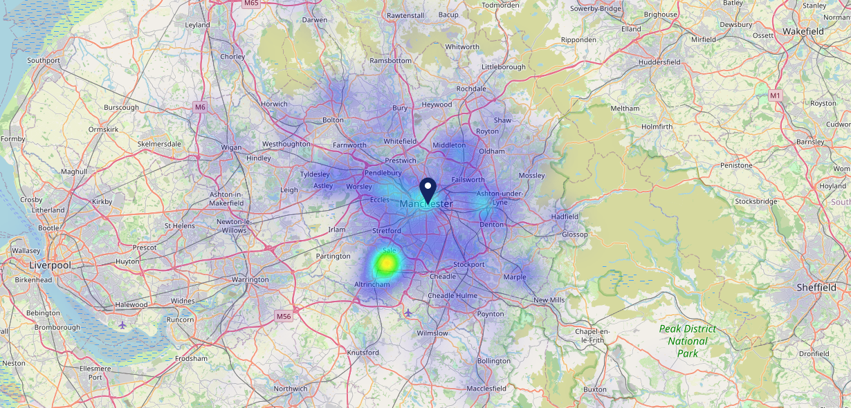
Site Intel
Rising Sun M25HX
16/04/2025 - 08/04/2026
Map of Guest Origin
Where do customers of Rising Sun M25HX come from?
Where do customers of Rising Sun M25HX for 16/04/2025 - 08/04/2026 live
1132 Site Customers

Slide 12
Site Intel
Rising Sun M25HX
1 Miles
371 Chains
16/04/2025 - 08/04/2026
Share of Wallet
What are the Top 20 venues (by spend) that customers of Rising Sun M25HX also visit?
For customers of Rising Sun M25HX, who are the top 20 competitors from 371 Chains in 1 Miles for 16/04/2025 - 08/04/2026 split by Venue
2582 Site Customers

Slide 13
Site Intel
Rising Sun M25HX
1 Miles
371 Chains
16/04/2025 - 08/04/2026
Share of Wallet Change
How has share of wallet of customers of Rising Sun M25HX changed between two date ranges?
2582 Site Customers

Slide 14
Site Intel
Rising Sun M25HX
16/04/2025 - 08/04/2026
Market Summary
How does the local area for Rising Sun M25HX compare to the national average (1 = low, 10 = high)
Data Type | Name | Spend in 250m | 250m Spend vs National | Spend in 500m | 500m Spend vs National | Spend in 1 mile | 1 mile Spend vs National | Spend in 3 miles | 3 mile Spend vs National
Total | Annual Sales | £219.04M | 10 | £473.63M | 10 | £1.14B | 10 | £1.53B | 10
Weekpart | Mon - Thu | 32.5% | 2 | 34.9% | 2 | 35.6% | 1 | 38.1% | 1
Weekpart | Fri - Sat | 51.1% | 9 | 50.3% | 9 | 49.5% | 10 | 47.0% | 10
Weekpart | Sun | 16.5% | 7 | 14.8% | 5 | 14.9% | 5 | 15.0% | 4
Age | 18 to 24 | 11.3% | 9 | 10.7% | 8 | 10.4% | 8 | 9.8% | 8
Age | 25 to 34 | 23.9% | 6 | 22.8% | 6 | 24.8% | 7 | 24.1% | 7
Age | 35 to 44 | 25.6% | 7 | 25.1% | 7 | 26.0% | 8 | 26.8% | 9
Age | 45 to 54 | 19.3% | 5 | 19.7% | 5 | 18.8% | 4 | 19.2% | 4
Age | 55 to 64 | 14.4% | 5 | 15.2% | 5 | 14.0% | 4 | 13.9% | 4
Age | 65 to 74 | 4.3% | 3 | 5.1% | 4 | 4.6% | 3 | 4.8% | 2
Age | 75+ | 1.2% | 4 | 1.5% | 4 | 1.3% | 3 | 1.4% | 2
CAMEO | Business Elite | 11.3% | 8 | 10.8% | 7 | 9.9% | 7 | 8.9% | 6
CAMEO | Prosperous Professionals | 6.9% | 6 | 6.6% | 6 | 5.8% | 5 | 5.4% | 4
CAMEO | Flourishing Society | 10.5% | 5 | 10.0% | 4 | 8.9% | 4 | 8.2% | 3
CAMEO | Content Communities | 12.0% | 5 | 11.7% | 5 | 11.0% | 4 | 11.0% | 3
CAMEO | White Collar Neighbourhoods | 13.4% | 8 | 13.1% | 7 | 12.8% | 7 | 12.4% | 7
CAMEO | Enterprising Mainstream | 9.1% | 6 | 9.1% | 6 | 9.1% | 6 | 9.0% | 6
CAMEO | Paying The Mortgage | 15.6% | 7 | 15.8% | 7 | 16.1% | 7 | 16.0% | 7
CAMEO | Cash Conscious Communities | 9.0% | 5 | 9.2% | 6 | 10.0% | 6 | 10.0% | 6
CAMEO | On A Budget | 6.2% | 5 | 7.0% | 6 | 8.5% | 7 | 9.6% | 8
CAMEO | Family Value | 6.0% | 8 | 6.7% | 8 | 7.9% | 8 | 9.4% | 9
Affluence | AB | 28.7% | 6 | 27.4% | 5 | 24.6% | 5 | 22.6% | 4
Affluence | C1C2 | 50.2% | 6 | 49.7% | 6 | 49.0% | 6 | 48.4% | 5
Affluence | DE | 21.1% | 6 | 22.9% | 6 | 26.4% | 8 | 29.0% | 8

