Slide 1
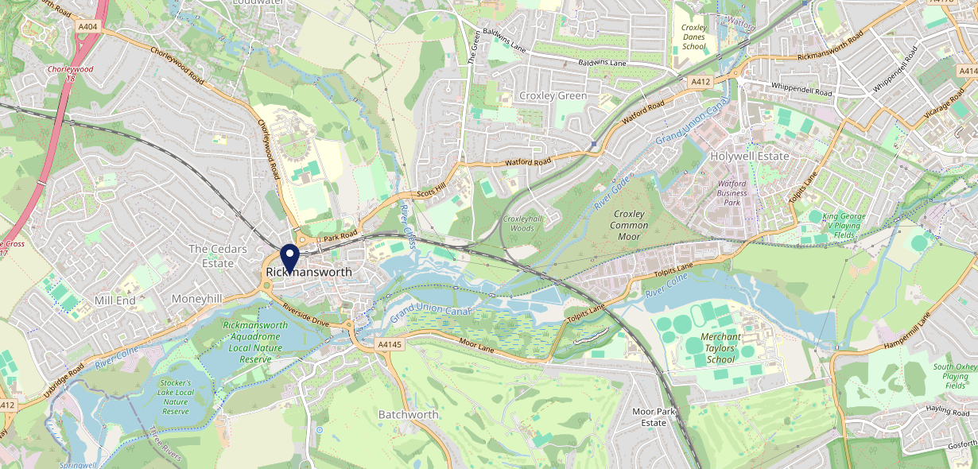
Site Intel
The Western Sports & Social WD31BB
1 Miles
371 Chains
16/04/2025 - 08/04/2026
Site Summary
The Western Sports & Social WD31BB
Work Area
Region
TV Region
Urbanicity
London
East of England
London
Urban major conurbation
WD31BB
Punch - Fireside Inns
Top Competitors
ATV
Gender
Feathers (Rickmansworth)
#1
£10.92
85.25%
Male
WD31DJ
GK Pub Partners
Affluence
Segmentation
Coach & Horses (Rickmansworth)
#2
42.31%
26.04%
Middle Income
White Collar Neighbourhoods
WD31ER
GK Pub Partners
Age Group
Visit Day
The Pennsylvanian
#3
29.10%
30.42%
WD31AN
35 to 44
Sat
JD Wetherspoon
Nearest Station
Rickmansworth(0.17 miles)
891 Site Customers
128 Competitors
62017 Competitor Customers

Slide 2
Site Intel
The Western Sports & Social WD31BB
1 Miles
371 Chains
16/04/2025 - 08/04/2026
Spend by Weekpart
How is customer spend distributed throughout the week for The Western Sports & Social WD31BB versus its competitors?
% of spend for The Western Sports & Social WD31BB and 371 Chains in 1 Miles from 16/04/2025 - 08/04/2026 split by Day of Week
891 Site Customers
128 Competitors
62017 Competitor Customers

Slide 3
Site Intel
The Western Sports & Social WD31BB
1 Miles
371 Chains
16/04/2025 - 08/04/2026
Visit Frequency
How frequently per year do customers visit The Western Sports & Social WD31BB versus its competitors?
% of customer numbers for The Western Sports & Social WD31BB and 371 Chains in 1 Miles from 16/04/2025 - 08/04/2026 and the number of visits made Per Annum
891 Site Customers
128 Competitors
62017 Competitor Customers

Slide 4
Site Intel
The Western Sports & Social WD31BB
1 Miles
371 Chains
16/04/2025 - 08/04/2026
ATV Change
How has ATV changed between two date ranges?
891 Site Customers

Slide 5
Site Intel
The Western Sports & Social WD31BB
1 Miles
371 Chains
16/04/2025 - 08/04/2026
Market Share Change
How has market share changed between two date ranges?
% of market share spend for The Western Sports & Social WD31BB and 371 Chains in 1 Miles from 16/04/2025 - 08/04/2026
891 Site Customers

Slide 6
Site Intel
The Western Sports & Social WD31BB
1 Miles
371 Chains
16/04/2025 - 08/04/2026
Age
How does the age profile of customers who visit The Western Sports & Social WD31BB compare versus its competitors?
% of spend for The Western Sports & Social WD31BB and 371 Chains in 1 Miles from 16/04/2025 - 08/04/2026 split by Age Range
325 Site Customers
128 Competitors
27108 Competitor Customers

Slide 7
Site Intel
The Western Sports & Social WD31BB
1 Miles
371 Chains
16/04/2025 - 08/04/2026
Affluence
How does the affluence of customers who visit The Western Sports & Social WD31BB compare versus its competitors?
% of spend for The Western Sports & Social WD31BB and 371 Chains in 1 Miles from 16/04/2025 - 08/04/2026 split by Affluence
296 Site Customers
128 Competitors
25211 Competitor Customers

Slide 8
Site Intel
The Western Sports & Social WD31BB
1 Miles
371 Chains
16/04/2025 - 08/04/2026
Gender
How does the gender profile of customers who visit The Western Sports & Social WD31BB compare versus its competitors?
% of spend for The Western Sports & Social WD31BB and 371 Chains in 1 Miles from 16/04/2025 - 08/04/2026 split by Gender
306 Site Customers
128 Competitors
26259 Competitor Customers

Slide 9
Site Intel
The Western Sports & Social WD31BB
1 Miles
371 Chains
16/04/2025 - 08/04/2026
Punch Segmentation
How does the Custom segmentation profile of customers who visit The Western Sports & Social WD31BB compare versus its competitors?
% of spend for The Western Sports & Social WD31BB and 371 Chains in 1 Miles from 16/04/2025 - 08/04/2026 split by Segment
891 Site Customers
128 Competitors
62017 Competitor Customers

Slide 10
Site Intel
The Western Sports & Social WD31BB
1 Miles
371 Chains
16/04/2025 - 08/04/2026
Spend by Distance
How does the spend profile of The Western Sports & Social WD31BB compare versus its competitors based on travel distances?
% of spend for The Western Sports & Social WD31BB and 371 Chains in 1 Miles from 16/04/2025 - 08/04/2026 split by Distance travelled
305 Site Customers
128 Competitors
26242 Competitor Customers

Slide 11
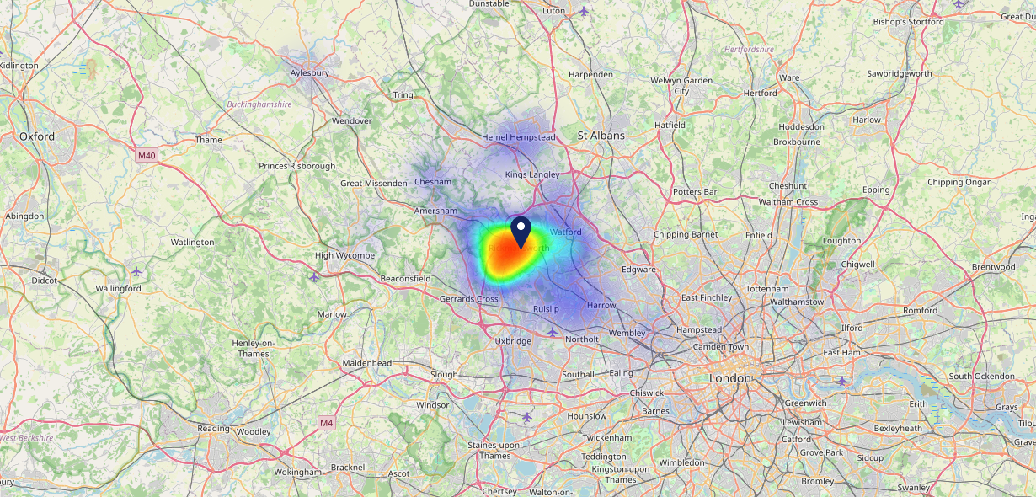
Site Intel
The Western Sports & Social WD31BB
16/04/2025 - 08/04/2026
Map of Guest Origin
Where do customers of The Western Sports & Social WD31BB come from?
Where do customers of The Western Sports & Social WD31BB for 16/04/2025 - 08/04/2026 live
305 Site Customers

Slide 12
Site Intel
The Western Sports & Social WD31BB
1 Miles
371 Chains
16/04/2025 - 08/04/2026
Share of Wallet
What are the Top 20 venues (by spend) that customers of The Western Sports & Social WD31BB also visit?
For customers of The Western Sports & Social WD31BB, who are the top 20 competitors from 371 Chains in 1 Miles for 16/04/2025 - 08/04/2026 split by Venue
891 Site Customers

Slide 13
Site Intel
The Western Sports & Social WD31BB
1 Miles
371 Chains
16/04/2025 - 08/04/2026
Share of Wallet Change
How has share of wallet of customers of The Western Sports & Social WD31BB changed between two date ranges?
891 Site Customers

Slide 14
Site Intel
The Western Sports & Social WD31BB
16/04/2025 - 08/04/2026
Market Summary
How does the local area for The Western Sports & Social WD31BB compare to the national average (1 = low, 10 = high)
Data Type | Name | Spend in 250m | 250m Spend vs National | Spend in 500m | 500m Spend vs National | Spend in 1 mile | 1 mile Spend vs National | Spend in 3 miles | 3 mile Spend vs National
Total | Annual Sales | £5.37M | 7 | £16.34M | 8 | £27.22M | 7 | £68.89M | 5
Weekpart | Mon - Thu | 45.8% | 8 | 44.8% | 8 | 42.7% | 7 | 42.2% | 6
Weekpart | Fri - Sat | 41.2% | 4 | 40.8% | 4 | 42.1% | 5 | 41.0% | 4
Weekpart | Sun | 13.0% | 4 | 14.4% | 5 | 15.2% | 5 | 16.8% | 8
Age | 18 to 24 | 3.1% | 3 | 5.9% | 5 | 5.0% | 4 | 3.5% | 1
Age | 25 to 34 | 9.4% | 1 | 13.8% | 2 | 12.3% | 1 | 10.1% | 1
Age | 35 to 44 | 23.1% | 5 | 24.3% | 6 | 22.8% | 5 | 21.4% | 3
Age | 45 to 54 | 25.8% | 9 | 21.6% | 7 | 21.7% | 7 | 22.0% | 8
Age | 55 to 64 | 21.9% | 9 | 20.7% | 9 | 22.6% | 10 | 23.3% | 10
Age | 65 to 74 | 11.9% | 9 | 9.7% | 8 | 11.2% | 9 | 12.7% | 10
Age | 75+ | 4.8% | 8 | 4.1% | 8 | 4.5% | 8 | 7.0% | 10
CAMEO | Business Elite | 25.8% | 10 | 19.4% | 9 | 22.2% | 10 | 24.3% | 10
CAMEO | Prosperous Professionals | 5.9% | 5 | 9.3% | 9 | 7.9% | 7 | 7.1% | 7
CAMEO | Flourishing Society | 24.4% | 10 | 20.2% | 9 | 20.3% | 9 | 21.9% | 9
CAMEO | Content Communities | 7.9% | 2 | 12.8% | 6 | 12.1% | 5 | 12.4% | 5
CAMEO | White Collar Neighbourhoods | 11.8% | 6 | 11.0% | 5 | 9.7% | 3 | 8.1% | 2
CAMEO | Enterprising Mainstream | 1.7% | 1 | 3.7% | 2 | 3.0% | 1 | 2.9% | 1
CAMEO | Paying The Mortgage | 11.6% | 4 | 11.8% | 4 | 12.9% | 4 | 12.7% | 4
CAMEO | Cash Conscious Communities | 5.0% | 2 | 5.5% | 2 | 6.4% | 3 | 5.3% | 2
CAMEO | On A Budget | 5.4% | 4 | 5.7% | 5 | 5.0% | 3 | 4.3% | 2
CAMEO | Family Value | 0.4% | 2 | 0.6% | 2 | 0.6% | 1 | 0.9% | 1
Affluence | AB | 56.1% | 10 | 48.9% | 9 | 50.4% | 10 | 53.4% | 10
Affluence | C1C2 | 33.1% | 1 | 39.3% | 2 | 37.7% | 2 | 36.1% | 1
Affluence | DE | 10.9% | 2 | 11.8% | 2 | 12.0% | 2 | 10.5% | 1

Slide 15
Site Intel
The Western Sports & Social WD31BB
Site Potential 1
Site Characteristics
£3000
£18000
OCC Concept Fit
Achievable Average Weekly Takings
Fireside Scenic
£14500
A Food-Led High Affluence B Food-Led Mid Affluence C Wet-Led Mid/High Affluence D Wet-Led Low Affluence E Food-Led Low Affluence
AWT 2 Local Regulars 3 Local Passing Trade 4 Destination Wet-Led 5 Destination Food-Led 6 Destination Very Food-Led
A
B
C
D
E
1
2
3
4
5
6

Slide 16
Site Intel
The Western Sports & Social WD31BB
Site Potential 2
Concept Recommendation

Slide 17
Site Intel
The Western Sports & Social WD31BB
Local Market Profile
Mix of spend by customer segment in Punch site and local market
 | Customer Count | Family Familiar | Occasional & Local | Mid-Week Seniors | Part Of The Pub | Metro Sophisticates | Young & Connected | Bubbly Weekenders | Upmarket Diners
The Western Sports & Social | 146 | 3.30% | 2.21% | 30.63% | 4.47% | 42.00% | 8.35% | 2.20% | 6.80%
Local Catchment | 4092 | 9.19% | 3.52% | 19.62% | 5.93% | 12.06% | 10.39% | 6.80% | 32.45%
Punch T&L | 95399 | 8.87% | 6.08% | 28.77% | 10.99% | 11.35% | 11.01% | 7.08% | 15.81%
The Western Sports & Social vs Local Catchment |  | -5.89% | -1.31% | 11.01% | -1.46% | 29.94% | -2.04% | -4.60% | -25.65%
The Western Sports & Social vs Punch T&L |  | -5.57% | -3.87% | 1.86% | -6.52% | 30.65% | -2.66% | -4.88% | -9.01%
Local Catchment vs Punch T&L |  | 0.32% | -2.56% | -9.15% | -5.06% | 0.71% | -0.62% | -0.28% | 16.64%

Slide 18
Site Intel
The Western Sports & Social WD31BB
Local Competitor Profiles
Mix of spend by customer segment in Punch site and local competitors
 | Customer Count | Family Familiar | Occasional & Local | Mid-Week Seniors | Part Of The Pub | Metro Sophisticates | Young & Connected | Bubbly Weekenders | Upmarket Diners
The Western Sports & Social WD31BB | 146 | 3.30% | 2.21% | 30.63% | 4.47% | 42.00% | 8.35% | 2.20% | 6.80%
Feathers (Rickmansworth) WD31DJ | 537 | 3.34% | 1.81% | 28.97% | 1.52% | 21.84% | 7.79% | 6.10% | 28.61%
Coach & Horses (Rickmansworth) WD31ER | 228 | 5.48% | 3.06% | 14.14% | 2.20% | 22.92% | 10.54% | 7.25% | 34.37%
The Pennsylvanian WD31AN | 369 | 10.06% | 3.53% | 18.68% | 15.90% | 11.07% | 15.57% | 5.41% | 19.74%
White Bear (Rickmansworth) WD31JQ | 191 | 3.33% | 1.14% | 48.30% | 24.84% | 5.51% | 4.04% | 1.66% | 11.14%
Fox & Hounds Rickmansworth WD31AY | 119 | 3.57% | 2.92% | 34.07% | 4.46% | 23.68% | 3.15% | 3.35% | 24.77%
Halfway House Rickmansworth WD37DQ | 119 | 12.46% | 0.17% | 11.87% | 6.74% | 26.51% | 8.26% | 3.85% | 30.11%
Mcdonalds WD31AQ | 309 | 12.56% | 3.85% | 9.83% | 4.01% | 8.10% | 14.33% | 11.68% | 35.60%
Royal British Legion Rickmansworth WD31BN | 39 | 0.00% | 0.52% | 25.38% | 21.19% | 38.50% | 0.97% | 0.40% | 12.99%
Woks Cookin WD37DW | 101 | 8.09% | 5.68% | 7.74% | 17.99% | 9.94% | 11.86% | 5.21% | 33.45%
Kebab Centre WD37BE | 127 | 7.68% | 4.20% | 6.78% | 4.40% | 7.92% | 20.32% | 16.76% | 31.90%
Miller & Carter Rickmansworth WD31AT | 171 | 10.47% | 5.36% | 10.31% | 3.93% | 7.03% | 13.38% | 5.94% | 43.54%
Costa Coffee WD31AR | 180 | 5.40% | 14.42% | 10.58% | 0.33% | 7.60% | 2.70% | 6.76% | 52.18%
Pour Me WD37BE | 52 | 0.91% | 2.31% | 6.94% | 3.40% | 46.69% | 12.69% | 2.92% | 24.09%
Mangal Grill WD31EE | 63 | 11.53% | 3.36% | 3.60% | 2.97% | 17.21% | 10.87% | 10.42% | 40.00%
Shish Meze WD37BE | 64 | 11.38% | 10.97% | 5.09% | 5.09% | 4.20% | 17.01% | 2.65% | 43.57%
KFC Rickmansworth Uxbridge Road WD37DW | 195 | 20.89% | 12.73% | 10.32% | 1.11% | 9.47% | 10.20% | 12.99% | 22.23%
Maurizios Restaurant WD31BX | 100 | 7.16% | 2.90% | 14.01% | 2.06% | 4.14% | 5.22% | 7.90% | 56.56%
Starbucks WD31AR | 189 | 14.70% | 3.81% | 6.43% | 0.53% | 12.91% | 6.46% | 11.43% | 43.69%
Mangal Express WD31EE | 99 | 13.82% | 5.38% | 5.48% | 1.77% | 10.82% | 3.48% | 11.28% | 47.91%
Pepes Piri Piri WD37DW | 63 | 15.13% | 0.00% | 4.50% | 0.35% | 11.14% | 16.26% | 24.83% | 27.76%
Rasal Brasserie WD31AY | 63 | 6.55% | 3.12% | 12.52% | 6.03% | 25.56% | 6.70% | 3.95% | 35.52%
Wishful Drinking WD31AB | 95 | 1.40% | 2.07% | 55.43% | 2.62% | 16.51% | 0.62% | 0.89% | 20.42%
Dolce Caffe Restaura WD37BE | 95 | 6.51% | 3.10% | 8.78% | 2.47% | 5.00% | 2.55% | 1.75% | 69.81%
The Cafe In Th WD31NB | 566 | 8.56% | 5.85% | 14.26% | 0.47% | 8.00% | 11.14% | 9.16% | 42.53%

