Slide 1










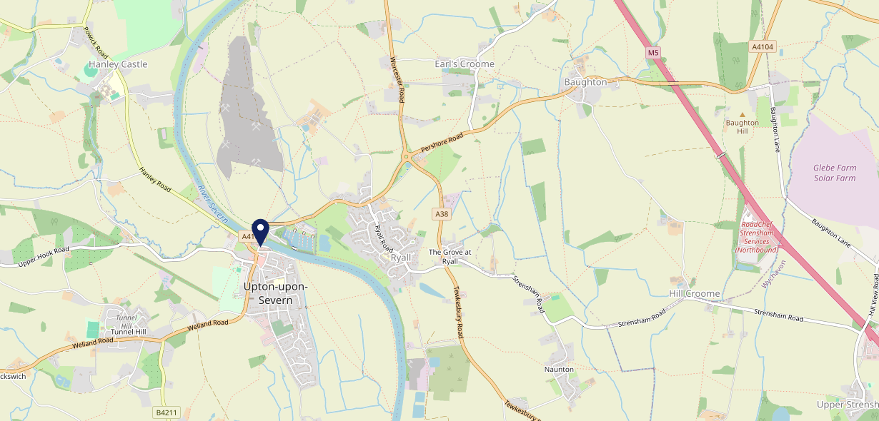









Site Intel
Kings Head WR80HF
1 Miles
338 Chains
29/01/2025 - 21/01/2026
Site Summary
Kings Head WR80HF
Work Area
Region
TV Region
Urbanicity
Worcester and Kidderminster
West Midlands
Central
Rural town and fringe
WR80HF
Punch T&L
Top Competitors
ATV
Gender
Plough Inn
#1
£10.31
76.14%
Male
WR80HY
Marstons Community Non Catering
Affluence
Segmentation
Swan Hotel
#2
54.08%
17.60%
Middle Income
Flourishing Society
WR80JD
Marstons Community Wet
Age Group
Visit Day
Upton Chippy
#3
33.64%
29.79%
WR80HR
55 to 64
Sat
Fish And Chips
Nearest Station
Great Malvern(8.49 miles)
560 Site Customers
24 Competitors
4774 Competitor Customers

Slide 2

Site Intel
Kings Head WR80HF
1 Miles
338 Chains
29/01/2025 - 21/01/2026
Spend by Weekpart
How is customer spend distributed throughout the week for Kings Head WR80HF versus its competitors?
% of spend for Kings Head WR80HF and 338 Chains in 1 Miles from 29/01/2025 - 21/01/2026 split by Day of Week
560 Site Customers
24 Competitors
4774 Competitor Customers

Slide 3
Site Intel
Kings Head WR80HF
1 Miles
338 Chains
29/01/2025 - 21/01/2026
Visit Frequency
How frequently per year do customers visit Kings Head WR80HF versus its competitors?
% of customer numbers for Kings Head WR80HF and 338 Chains in 1 Miles from 29/01/2025 - 21/01/2026 and the number of visits made Per Annum
560 Site Customers
24 Competitors
4774 Competitor Customers

Slide 4
Site Intel
Kings Head WR80HF
1 Miles
338 Chains
29/01/2025 - 21/01/2026
ATV Change
How has ATV changed between two date ranges?
560 Site Customers

Slide 5
Site Intel
Kings Head WR80HF
1 Miles
338 Chains
29/01/2025 - 21/01/2026
Market Share Change
How has market share changed between two date ranges?
% of market share spend for Kings Head WR80HF and 338 Chains in 1 Miles from 29/01/2025 - 21/01/2026
560 Site Customers

Slide 6
Site Intel
Kings Head WR80HF
1 Miles
338 Chains
29/01/2025 - 21/01/2026
Age
How does the age profile of customers who visit Kings Head WR80HF compare versus its competitors?
% of spend for Kings Head WR80HF and 338 Chains in 1 Miles from 29/01/2025 - 21/01/2026 split by Age Range
280 Site Customers
24 Competitors
2369 Competitor Customers

Slide 7
Site Intel
Kings Head WR80HF
1 Miles
338 Chains
29/01/2025 - 21/01/2026
Affluence
How does the affluence of customers who visit Kings Head WR80HF compare versus its competitors?
% of spend for Kings Head WR80HF and 338 Chains in 1 Miles from 29/01/2025 - 21/01/2026 split by Affluence
260 Site Customers
24 Competitors
2208 Competitor Customers

Slide 8
Site Intel
Kings Head WR80HF
1 Miles
338 Chains
29/01/2025 - 21/01/2026
Gender
How does the gender profile of customers who visit Kings Head WR80HF compare versus its competitors?
% of spend for Kings Head WR80HF and 338 Chains in 1 Miles from 29/01/2025 - 21/01/2026 split by Gender
270 Site Customers
24 Competitors
2304 Competitor Customers

Slide 9
Site Intel
Kings Head WR80HF
1 Miles
338 Chains
29/01/2025 - 21/01/2026
Punch Segmentation
How does the Custom segmentation profile of customers who visit Kings Head WR80HF compare versus its competitors?
% of spend for Kings Head WR80HF and 338 Chains in 1 Miles from 29/01/2025 - 21/01/2026 split by Segment
560 Site Customers
24 Competitors
4774 Competitor Customers

Slide 10
Site Intel
Kings Head WR80HF
1 Miles
338 Chains
29/01/2025 - 21/01/2026
Spend by Distance
How does the spend profile of Kings Head WR80HF compare versus its competitors based on travel distances?
% of spend for Kings Head WR80HF and 338 Chains in 1 Miles from 29/01/2025 - 21/01/2026 split by Distance travelled
270 Site Customers
24 Competitors
2304 Competitor Customers

Slide 11
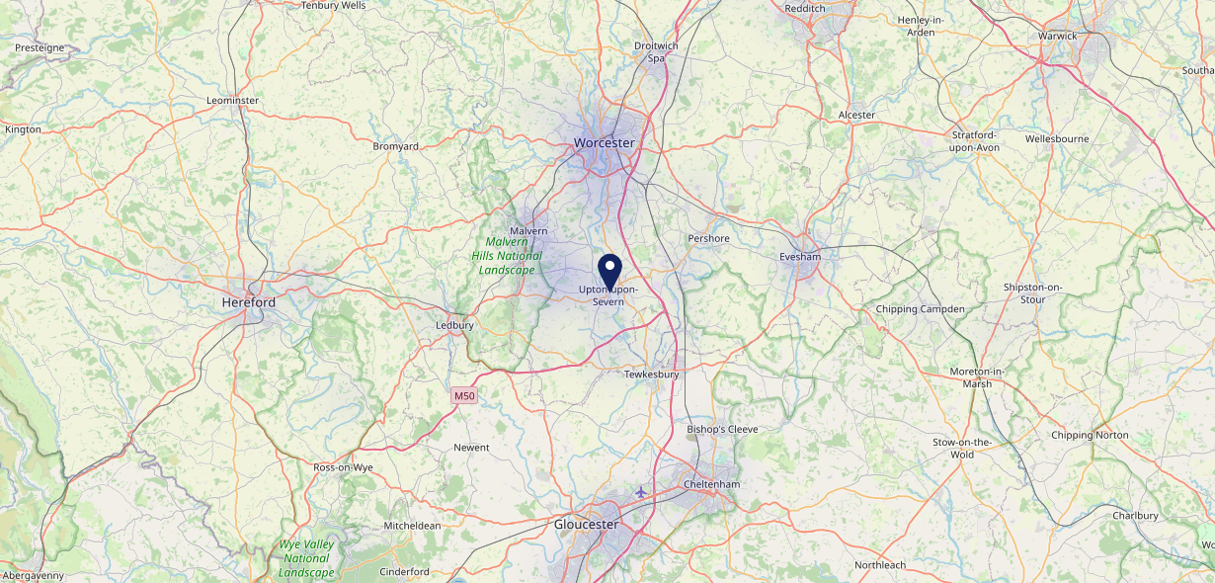

Site Intel
Kings Head WR80HF
29/01/2025 - 21/01/2026
Map of Guest Origin
Where do customers of Kings Head WR80HF come from?
Where do customers of Kings Head WR80HF for 29/01/2025 - 21/01/2026 live
270 Site Customers

Slide 12
Site Intel
Kings Head WR80HF
1 Miles
338 Chains
29/01/2025 - 21/01/2026
Share of Wallet
What are the Top 20 venues (by spend) that customers of Kings Head WR80HF also visit?
For customers of Kings Head WR80HF, who are the top 20 competitors from 338 Chains in 1 Miles for 29/01/2025 - 21/01/2026 split by Venue
560 Site Customers

Slide 13
Site Intel
Kings Head WR80HF
1 Miles
338 Chains
29/01/2025 - 21/01/2026
Share of Wallet Change
How has share of wallet of customers of Kings Head WR80HF changed between two date ranges?
560 Site Customers

Slide 14
Site Intel
Kings Head WR80HF
29/01/2025 - 21/01/2026
Market Summary
How does the local area for Kings Head WR80HF compare to the national average (1 = low, 10 = high)
Data Type | Name | Spend in 250m | 250m Spend vs National | Spend in 500m | 500m Spend vs National | Spend in 1 mile | 1 mile Spend vs National | Spend in 3 miles | 3 mile Spend vs National
Total | Annual Sales | £2.78M | 6 | £3.11M | 5 | £3.33M | 3 | £30.22M | 3
Weekpart | Mon - Thu | 36.8% | 3 | 36.2% | 2 | 36.6% | 2 | 43.2% | 7
Weekpart | Fri - Sat | 46.0% | 7 | 46.8% | 8 | 46.7% | 9 | 39.3% | 2
Weekpart | Sun | 17.2% | 8 | 17.0% | 8 | 16.7% | 8 | 17.5% | 9
Age | 18 to 24 | 0.7% | 1 | 0.7% | 1 | 1.3% | 1 | 5.2% | 3
Age | 25 to 34 | 6.5% | 1 | 6.5% | 1 | 6.4% | 1 | 15.6% | 2
Age | 35 to 44 | 12.3% | 1 | 12.9% | 1 | 12.9% | 1 | 23.3% | 5
Age | 45 to 54 | 23.7% | 8 | 23.4% | 9 | 23.0% | 9 | 21.4% | 8
Age | 55 to 64 | 31.1% | 10 | 32.0% | 10 | 32.6% | 10 | 20.1% | 9
Age | 65 to 74 | 16.5% | 10 | 15.8% | 10 | 15.2% | 10 | 9.6% | 8
Age | 75+ | 9.2% | 10 | 8.7% | 10 | 8.7% | 10 | 4.8% | 9
CAMEO | Business Elite | 5.6% | 5 | 6.4% | 5 | 7.2% | 6 | 5.7% | 4
CAMEO | Prosperous Professionals | 13.0% | 10 | 14.0% | 10 | 13.5% | 10 | 8.6% | 8
CAMEO | Flourishing Society | 20.2% | 9 | 19.7% | 8 | 20.3% | 9 | 15.2% | 7
CAMEO | Content Communities | 12.6% | 6 | 12.0% | 5 | 11.8% | 5 | 13.2% | 7
CAMEO | White Collar Neighbourhoods | 8.7% | 3 | 8.6% | 3 | 8.6% | 2 | 9.7% | 3
CAMEO | Enterprising Mainstream | 15.3% | 10 | 15.2% | 10 | 15.0% | 10 | 10.9% | 8
CAMEO | Paying The Mortgage | 11.0% | 4 | 10.9% | 3 | 10.5% | 3 | 15.4% | 6
CAMEO | Cash Conscious Communities | 6.7% | 4 | 6.8% | 4 | 6.6% | 3 | 9.4% | 6
CAMEO | On A Budget | 4.3% | 3 | 4.1% | 3 | 4.1% | 2 | 6.4% | 5
CAMEO | Family Value | 2.5% | 6 | 2.5% | 5 | 2.5% | 5 | 5.5% | 7
Affluence | AB | 38.9% | 8 | 40.1% | 8 | 41.0% | 8 | 29.5% | 6
Affluence | C1C2 | 47.7% | 5 | 46.6% | 5 | 45.8% | 4 | 49.2% | 6
Affluence | DE | 13.4% | 3 | 13.3% | 3 | 13.2% | 3 | 21.3% | 6

Slide 15
Site Intel
Kings Head WR80HF
Local Market Profile
Mix of spend by customer segment in Punch site and local market
 | Customer Count | Family Familiar | Occasional & Local | Mid-Week Seniors | Part Of The Pub | Metro Sophisticates | Young & Connected | Bubbly Weekenders | Upmarket Diners
Kings Head | 137 | 11.83% | 2.77% | 34.18% | 10.86% | 6.18% | 11.07% | 5.78% | 17.29%
Local Catchment | 672 | 7.11% | 1.36% | 31.99% | 7.75% | 10.39% | 11.25% | 9.38% | 20.73%
Punch T&L | 95488 | 8.97% | 6.13% | 29.00% | 11.19% | 10.97% | 11.15% | 7.16% | 15.39%
Kings Head vs Local Catchment |  | 4.72% | 1.41% | 2.19% | 3.11% | -4.21% | -0.18% | -3.60% | -3.44%
Kings Head vs Punch T&L |  | 2.86% | -3.36% | 5.18% | -0.33% | -4.79% | -0.08% | -1.38% | 1.90%
Local Catchment vs Punch T&L |  | -1.86% | -4.77% | 2.99% | -3.44% | -0.58% | 0.10% | 2.22% | 5.34%

Slide 16
Site Intel
Kings Head WR80HF
Local Competitor Profiles
Mix of spend by customer segment in Punch site and local competitors
 | Customer Count | Family Familiar | Occasional & Local | Mid-Week Seniors | Part Of The Pub | Metro Sophisticates | Young & Connected | Bubbly Weekenders | Upmarket Diners
Plough Inn WR80HY | 114 | 8.48% | 1.14% | 32.49% | 14.35% | 10.74% | 14.88% | 7.53% | 10.35%
Kings Head WR80HF | 137 | 11.83% | 2.77% | 34.18% | 10.86% | 6.18% | 11.07% | 5.78% | 17.29%
Swan Hotel WR80JD | 256 | 7.20% | 1.31% | 32.37% | 3.31% | 12.09% | 10.20% | 11.03% | 22.45%
Upton Chippy WR80HR | 103 | 9.15% | 2.88% | 48.31% | 5.24% | 5.53% | 5.00% | 10.51% | 13.34%
Coffee Wolf WR80HB | 70 | 12.66% | 0.00% | 40.22% | 0.00% | 3.13% | 1.62% | 7.71% | 34.63%
Pundits Fusion WR80HN | 30 | 4.19% | 5.35% | 43.72% | 2.94% | 18.09% | 3.26% | 9.86% | 12.57%
Flava Indian Fusion WR80HQ | 33 | 9.85% | 1.82% | 20.87% | 9.49% | 8.14% | 26.05% | 11.16% | 12.58%
Thrishna WR80HW | 19 | 2.76% | 0.00% | 7.95% | 3.59% | 11.67% | 2.03% | 2.59% | 69.37%
The Boathouse WR80HG | 78 | 6.90% | 1.46% | 37.46% | 2.21% | 7.13% | 9.26% | 4.61% | 30.94%
Bluebell Inn WR80PP | 77 | 4.60% | 0.16% | 20.13% | 22.23% | 10.64% | 17.08% | 12.37% | 12.75%
Indian WR80HA | 18 | 12.01% | 0.00% | 30.49% | 0.00% | 10.06% | 24.27% | 0.00% | 23.15%
Henrys Cafe WR80HB | 53 | 10.81% | 0.00% | 36.54% | 2.09% | 9.11% | 7.77% | 9.07% | 24.58%
La Gelateria Shop WR80HB | 16 | 13.55% | 0.00% | 30.34% | 0.00% | 6.77% | 2.25% | 10.16% | 36.89%
Spackmans Shop WR80PA | 2 | 0.00% | 0.00% | 56.04% | 0.00% | 0.00% | 0.00% | 0.00% | 43.95%
Nacho Brothers WR80HW | 8 | 0.00% | 0.00% | 76.97% | 8.63% | 0.00% | 0.00% | 14.38% | 0.00%
Ice Cream Booths WR80HW | 6 | 0.00% | 0.00% | 36.00% | 0.00% | 56.00% | 0.00% | 8.00% | 0.00%

