Slide 1










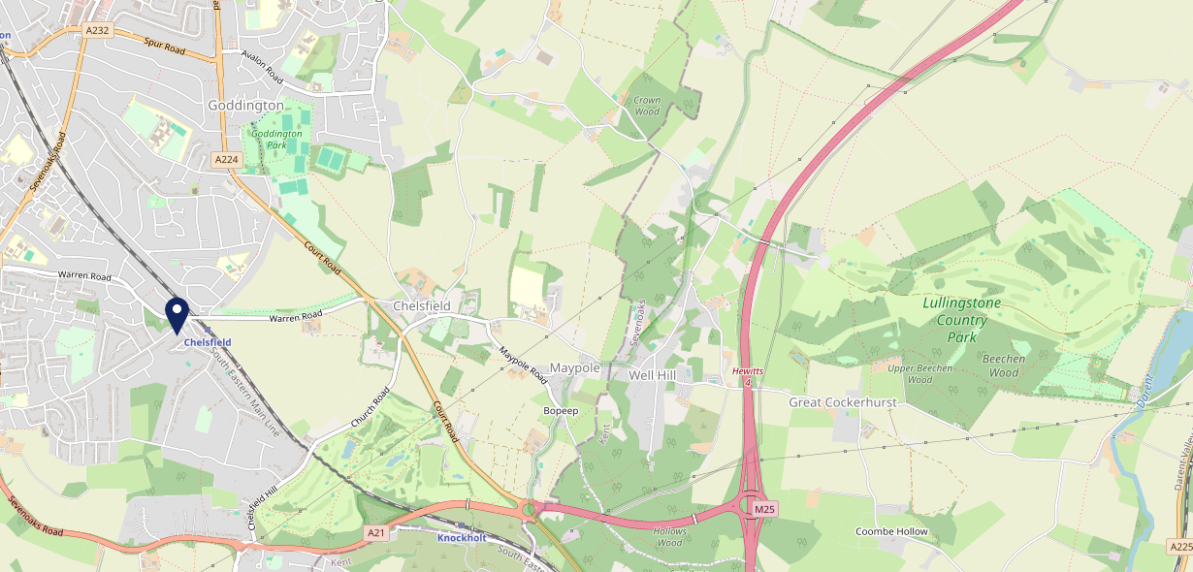









Site Intel
Chelsfield BR66EY
3 Miles
1 Chain
22/02/2023 - 14/02/2024
Site Summary
Chelsfield BR66EY
Work Area
Region
TV Region
Urbanicity
London
London
London
Urban major conurbation
BR66EY
Punch - Fireside Collection
Top Competitors
ATV
Gender
Three Horseshoes
#1
£16.40
63.14%
Male
TN147LD
Pub Restaurant
Affluence
Segmentation
Rose & Crown
#2
58.42%
25.29%
High Income
Business Elite
TN147EA
Pub Restaurant
Age Group
Visit Day
#3
22.82%
26.44%
55 to 64
Sat
Nearest Station
Chelsfield(0.25 miles)
1356 Site Customers
2 Competitors
1156 Competitor Customers

Slide 2

Site Intel
Chelsfield BR66EY
3 Miles
1 Chain
22/02/2023 - 14/02/2024
Spend by Weekpart
How is customer spend distributed throughout the week for Chelsfield BR66EY versus its competitors?
% of spend for Chelsfield BR66EY and 1 Chains in 3 Miles from 22/02/2023 - 14/02/2024 split by Day of Week
1356 Site Customers
2 Competitors
1156 Competitor Customers

Slide 3
Site Intel
Chelsfield BR66EY
3 Miles
1 Chain
22/02/2023 - 14/02/2024
Visit Frequency
How frequently per year do customers visit Chelsfield BR66EY versus its competitors?
% of customer numbers for Chelsfield BR66EY and 1 Chains in 3 Miles from 22/02/2023 - 14/02/2024 and the number of visits made Per Annum
1356 Site Customers
2 Competitors
1156 Competitor Customers

Slide 4
Site Intel
Chelsfield BR66EY
3 Miles
1 Chain
22/02/2023 - 14/02/2024
ATV Change
How has ATV changed between two date ranges?
1356 Site Customers

Slide 5
Site Intel
Chelsfield BR66EY
3 Miles
1 Chain
22/02/2023 - 14/02/2024
Market Share Change
How has market share changed between two date ranges?
% of market share spend for Chelsfield BR66EY and 1 Chains in 3 Miles from 22/02/2023 - 14/02/2024
1356 Site Customers

Slide 6
Site Intel
Chelsfield BR66EY
3 Miles
1 Chain
22/02/2023 - 14/02/2024
Age
How does the age profile of customers who visit Chelsfield BR66EY compare versus its competitors?
% of spend for Chelsfield BR66EY and 1 Chains in 3 Miles from 22/02/2023 - 14/02/2024 split by Age Range
713 Site Customers
2 Competitors
606 Competitor Customers

Slide 7
Site Intel
Chelsfield BR66EY
3 Miles
1 Chain
22/02/2023 - 14/02/2024
Affluence
How does the affluence of customers who visit Chelsfield BR66EY compare versus its competitors?
% of spend for Chelsfield BR66EY and 1 Chains in 3 Miles from 22/02/2023 - 14/02/2024 split by Affluence
687 Site Customers
2 Competitors
573 Competitor Customers

Slide 8
Site Intel
Chelsfield BR66EY
3 Miles
1 Chain
22/02/2023 - 14/02/2024
Gender
How does the gender profile of customers who visit Chelsfield BR66EY compare versus its competitors?
% of spend for Chelsfield BR66EY and 1 Chains in 3 Miles from 22/02/2023 - 14/02/2024 split by Gender
701 Site Customers
2 Competitors
593 Competitor Customers

Slide 9
Site Intel
Chelsfield BR66EY
3 Miles
1 Chain
22/02/2023 - 14/02/2024
Punch Segmentation
How does the Custom segmentation profile of customers who visit Chelsfield BR66EY compare versus its competitors?
% of spend for Chelsfield BR66EY and 1 Chains in 3 Miles from 22/02/2023 - 14/02/2024 split by Segment
1356 Site Customers
2 Competitors
1156 Competitor Customers

Slide 10
Site Intel
Chelsfield BR66EY
3 Miles
1 Chain
22/02/2023 - 14/02/2024
Spend by Distance
How does the spend profile of Chelsfield BR66EY compare versus its competitors based on travel distances?
% of spend for Chelsfield BR66EY and 1 Chains in 3 Miles from 22/02/2023 - 14/02/2024 split by Distance travelled
700 Site Customers
2 Competitors
591 Competitor Customers

Slide 11
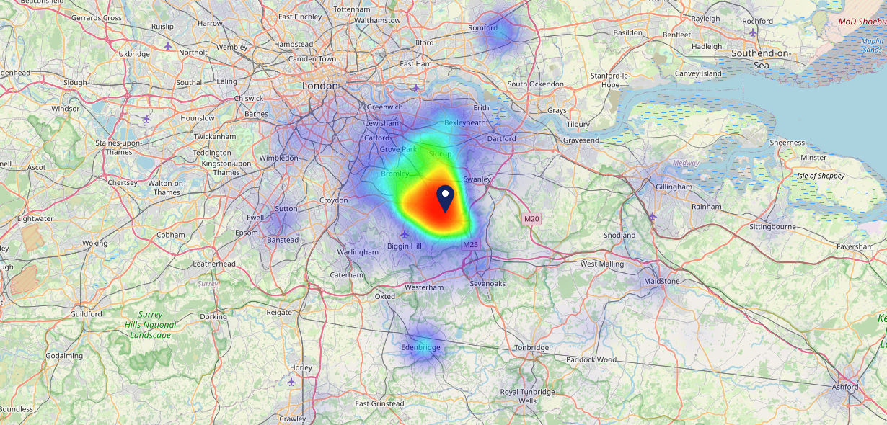

Site Intel
Chelsfield BR66EY
22/02/2023 - 14/02/2024
Map of Guest Origin
Where do customers of Chelsfield BR66EY come from?
Where do customers of Chelsfield BR66EY for 22/02/2023 - 14/02/2024 live
700 Site Customers

Slide 12
Site Intel
Chelsfield BR66EY
3 Miles
1 Chain
22/02/2023 - 14/02/2024
Share of Wallet
What are the Top 20 venues (by spend) that customers of Chelsfield BR66EY also visit?
For customers of Chelsfield BR66EY, who are the top 20 competitors from 1 Chains in 3 Miles for 22/02/2023 - 14/02/2024 split by Venue
1356 Site Customers

Slide 13
Site Intel
Chelsfield BR66EY
3 Miles
1 Chain
22/02/2023 - 14/02/2024
Share of Wallet Change
How has share of wallet of customers of Chelsfield BR66EY changed between two date ranges?
1356 Site Customers

Slide 14
Site Intel
Chelsfield BR66EY
22/02/2023 - 14/02/2024
Market Summary
How does the local area for Chelsfield BR66EY compare to the national average (1 = low, 10 = high)
Data Type | Name | Spend in 250m | 250m Spend vs National | Spend in 500m | 500m Spend vs National | Spend in 1 mile | 1 mile Spend vs National | Spend in 3 miles | 3 mile Spend vs National
Total | Annual Sales | £1.56M | 5 | £1.56M | 4 | £12.83M | 5 | £81.57M | 6
Weekpart | Mon - Thu | 39.3% | 5 | 39.3% | 5 | 41.9% | 6 | 42.8% | 7
Weekpart | Fri - Sat | 46.1% | 7 | 46.1% | 7 | 40.7% | 4 | 41.1% | 4
Weekpart | Sun | 14.7% | 6 | 14.7% | 5 | 17.4% | 9 | 16.1% | 7
Age | 18 to 24 | 10.5% | 8 | 10.5% | 8 | 6.6% | 5 | 4.8% | 3
Age | 25 to 34 | 11.8% | 1 | 11.8% | 1 | 10.8% | 1 | 10.5% | 1
Age | 35 to 44 | 22.6% | 5 | 22.6% | 5 | 20.0% | 3 | 20.4% | 2
Age | 45 to 54 | 20.4% | 6 | 20.4% | 6 | 20.4% | 6 | 21.4% | 7
Age | 55 to 64 | 24.1% | 10 | 24.1% | 10 | 21.2% | 9 | 21.0% | 10
Age | 65 to 74 | 7.3% | 6 | 7.3% | 6 | 12.9% | 9 | 13.0% | 10
Age | 75+ | 3.4% | 7 | 3.4% | 7 | 8.1% | 10 | 9.0% | 10
CAMEO | Business Elite | 21.7% | 10 | 21.7% | 10 | 19.3% | 9 | 20.6% | 9
CAMEO | Prosperous Professionals | 10.1% | 9 | 10.1% | 9 | 8.7% | 8 | 7.7% | 7
CAMEO | Flourishing Society | 27.4% | 10 | 27.4% | 10 | 33.4% | 10 | 30.7% | 10
CAMEO | Content Communities | 12.4% | 6 | 12.4% | 6 | 8.9% | 2 | 8.4% | 1
CAMEO | White Collar Neighbourhoods | 9.2% | 4 | 9.2% | 3 | 11.7% | 6 | 10.9% | 5
CAMEO | Enterprising Mainstream | 1.7% | 1 | 1.7% | 1 | 2.4% | 1 | 2.5% | 1
CAMEO | Paying The Mortgage | 13.6% | 5 | 13.6% | 5 | 9.3% | 2 | 9.8% | 2
CAMEO | Cash Conscious Communities | 1.6% | 1 | 1.6% | 1 | 2.0% | 1 | 3.4% | 1
CAMEO | On A Budget | 1.8% | 1 | 1.8% | 1 | 4.0% | 2 | 5.6% | 4
CAMEO | Family Value | 0.5% | 2 | 0.5% | 1 | 0.3% | 1 | 0.5% | 1
Affluence | AB | 59.3% | 10 | 59.3% | 10 | 61.4% | 10 | 58.9% | 10
Affluence | C1C2 | 36.8% | 2 | 36.8% | 2 | 32.3% | 1 | 31.5% | 1
Affluence | DE | 3.9% | 1 | 3.9% | 1 | 6.3% | 1 | 9.6% | 1

Slide 15

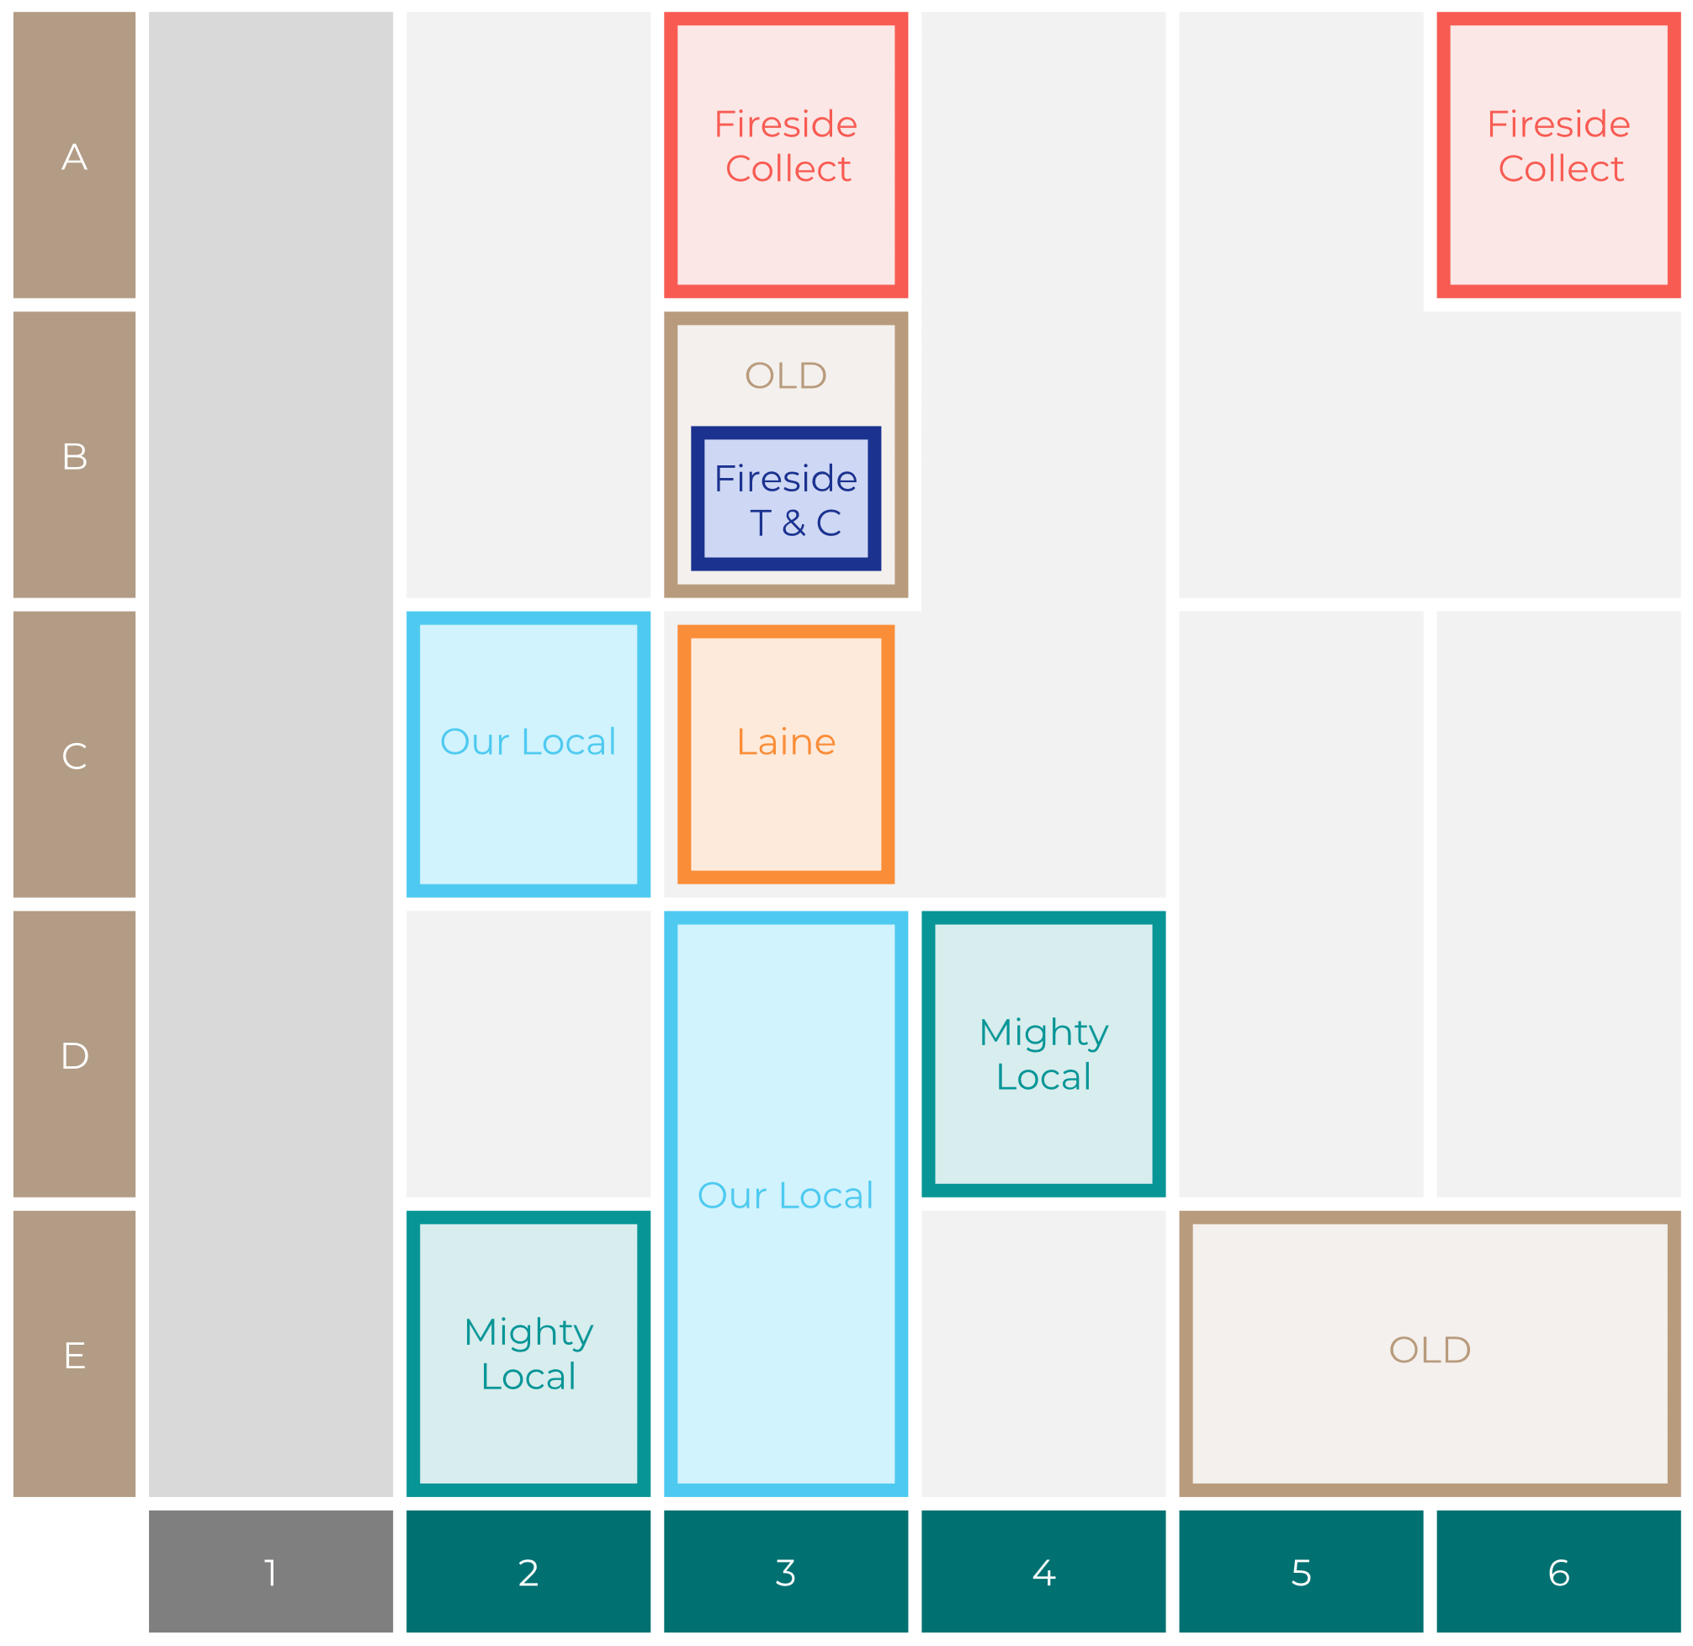

Site Intel
Chelsfield BR66EY
Site Potential 1
Site Characteristics
£3000
£18000
OCC Concept Fit
Achievable Average Weekly Takings
Non-Core
£12000
A Food-Led High Affluence B Food-Led Mid Affluence C Wet-Led Mid/High Affluence D Wet-Led Low Affluence E Food-Led Low Affluence
AWT 2 Local Regulars 3 Local Passing Trade 4 Destination Wet-Led 5 Destination Food-Led 6 Destination Very Food-Led
A
B
C
D
E
1
2
3
4
5
6

Slide 16
Site Intel
Chelsfield BR66EY
Site Potential 2
Concept Recommendation

Slide 17
Site Intel
Chelsfield BR66EY
Local Market Profile
Mix of spend by customer segment in Punch site and local market
 | Customer Count | Family Familiar | Occasional & Local | Mid-Week Seniors | Part Of The Pub | Metro Sophisticates | Young & Connected | Bubbly Weekenders | Upmarket Diners
Chelsfield | 299 | 2.48% | 0.57% | 17.92% | 5.55% | 30.80% | 14.69% | 6.28% | 21.67%
Local Catchment | 211 | 4.83% | 0.73% | 25.87% | 16.44% | 5.94% | 4.76% | 2.49% | 38.90%
Punch T&L | 110107 | 8.03% | 5.92% | 29.65% | 11.15% | 11.28% | 11.54% | 7.14% | 15.25%
Chelsfield vs Local Catchment |  | -2.35% | -0.16% | -7.95% | -10.89% | 24.86% | 9.93% | 3.79% | -17.23%
Chelsfield vs Punch T&L |  | -5.55% | -5.35% | -11.73% | -5.60% | 19.52% | 3.15% | -0.86% | 6.42%
Local Catchment vs Punch T&L |  | -3.20% | -5.19% | -3.78% | 5.29% | -5.34% | -6.78% | -4.65% | 23.65%

Slide 18
Site Intel
Chelsfield BR66EY
Local Competitor Profiles
Mix of spend by customer segment in Punch site and local competitors
 | Customer Count | Family Familiar | Occasional & Local | Mid-Week Seniors | Part Of The Pub | Metro Sophisticates | Young & Connected | Bubbly Weekenders | Upmarket Diners
Chelsfield BR66EY | 299 | 2.48% | 0.57% | 17.92% | 5.55% | 30.80% | 14.69% | 6.28% | 21.67%
Three Horseshoes TN147LD | 187 | 2.33% | 0.86% | 22.52% | 19.45% | 6.12% | 5.59% | 2.64% | 40.44%
Rose & Crown TN147EA | 36 | 18.46% | 0.00% | 44.14% | 0.00% | 4.98% | 0.25% | 1.69% | 30.45%

