Slide 1










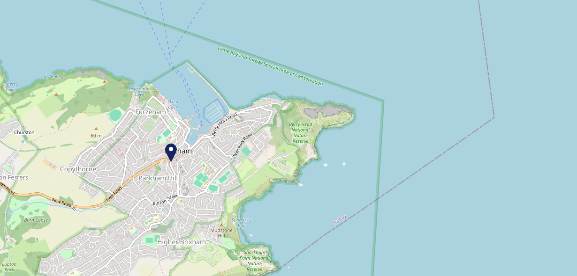









Site Intel
Birdcage TQ58LT
1 Miles
118 Chains
22/02/2023 - 14/02/2024
Site Summary
Birdcage TQ58LT
Work Area
Region
TV Region
Urbanicity
Torquay and Paignton
South West
HarWest
Urban city and town
TQ58LT
Punch - Our Local
Top Competitors
ATV
Gender
The Vigilance
#1
£17.33
67.14%
Male
TQ59DE
JD Wetherspoon
Affluence
Segmentation
Blue Anchor
#2
65.41%
25.67%
Middle Income
Enterprising Mainstream
TQ58AH
Punch - Fireside Inns
Age Group
Visit Day
Old Market House
#3
30.47%
24.53%
TQ58AW
55 to 64
Sat
SA-Managed
Nearest Station
Paignton(5.69 miles)
669 Site Customers
3 Competitors
8571 Competitor Customers

Slide 2

Site Intel
Birdcage TQ58LT
1 Miles
118 Chains
22/02/2023 - 14/02/2024
Spend by Weekpart
How is customer spend distributed throughout the week for Birdcage TQ58LT versus its competitors?
% of spend for Birdcage TQ58LT and 118 Chains in 1 Miles from 22/02/2023 - 14/02/2024 split by Day of Week
669 Site Customers
3 Competitors
8571 Competitor Customers

Slide 3
Site Intel
Birdcage TQ58LT
1 Miles
118 Chains
22/02/2023 - 14/02/2024
Visit Frequency
How frequently per year do customers visit Birdcage TQ58LT versus its competitors?
% of customer numbers for Birdcage TQ58LT and 118 Chains in 1 Miles from 22/02/2023 - 14/02/2024 and the number of visits made Per Annum
669 Site Customers
3 Competitors
8571 Competitor Customers

Slide 4
Site Intel
Birdcage TQ58LT
1 Miles
118 Chains
22/02/2023 - 14/02/2024
ATV Change
How has ATV changed between two date ranges?
669 Site Customers

Slide 5
Site Intel
Birdcage TQ58LT
1 Miles
118 Chains
22/02/2023 - 14/02/2024
Market Share Change
How has market share changed between two date ranges?
% of market share spend for Birdcage TQ58LT and 118 Chains in 1 Miles from 22/02/2023 - 14/02/2024
669 Site Customers

Slide 6
Site Intel
Birdcage TQ58LT
1 Miles
118 Chains
22/02/2023 - 14/02/2024
Age
How does the age profile of customers who visit Birdcage TQ58LT compare versus its competitors?
% of spend for Birdcage TQ58LT and 118 Chains in 1 Miles from 22/02/2023 - 14/02/2024 split by Age Range
350 Site Customers
3 Competitors
4460 Competitor Customers

Slide 7
Site Intel
Birdcage TQ58LT
1 Miles
118 Chains
22/02/2023 - 14/02/2024
Affluence
How does the affluence of customers who visit Birdcage TQ58LT compare versus its competitors?
% of spend for Birdcage TQ58LT and 118 Chains in 1 Miles from 22/02/2023 - 14/02/2024 split by Affluence
335 Site Customers
3 Competitors
4216 Competitor Customers

Slide 8
Site Intel
Birdcage TQ58LT
1 Miles
118 Chains
22/02/2023 - 14/02/2024
Gender
How does the gender profile of customers who visit Birdcage TQ58LT compare versus its competitors?
% of spend for Birdcage TQ58LT and 118 Chains in 1 Miles from 22/02/2023 - 14/02/2024 split by Gender
341 Site Customers
3 Competitors
4380 Competitor Customers

Slide 9
Site Intel
Birdcage TQ58LT
1 Miles
118 Chains
22/02/2023 - 14/02/2024
Punch Segmentation
How does the Custom segmentation profile of customers who visit Birdcage TQ58LT compare versus its competitors?
% of spend for Birdcage TQ58LT and 118 Chains in 1 Miles from 22/02/2023 - 14/02/2024 split by Segment
669 Site Customers
3 Competitors
8571 Competitor Customers

Slide 10
Site Intel
Birdcage TQ58LT
1 Miles
118 Chains
22/02/2023 - 14/02/2024
Spend by Distance
How does the spend profile of Birdcage TQ58LT compare versus its competitors based on travel distances?
% of spend for Birdcage TQ58LT and 118 Chains in 1 Miles from 22/02/2023 - 14/02/2024 split by Distance travelled
341 Site Customers
3 Competitors
4378 Competitor Customers

Slide 11
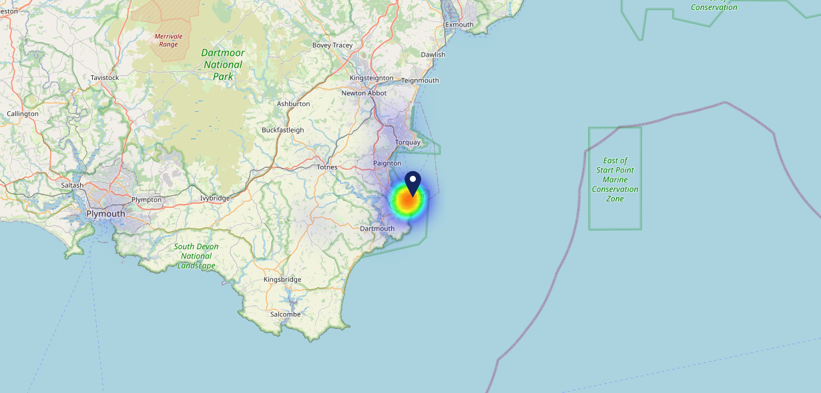

Site Intel
Birdcage TQ58LT
22/02/2023 - 14/02/2024
Map of Guest Origin
Where do customers of Birdcage TQ58LT come from?
Where do customers of Birdcage TQ58LT for 22/02/2023 - 14/02/2024 live
341 Site Customers

Slide 12
Site Intel
Birdcage TQ58LT
1 Miles
118 Chains
22/02/2023 - 14/02/2024
Share of Wallet
What are the Top 20 venues (by spend) that customers of Birdcage TQ58LT also visit?
For customers of Birdcage TQ58LT, who are the top 20 competitors from 118 Chains in 1 Miles for 22/02/2023 - 14/02/2024 split by Venue
669 Site Customers

Slide 13
Site Intel
Birdcage TQ58LT
1 Miles
118 Chains
22/02/2023 - 14/02/2024
Share of Wallet Change
How has share of wallet of customers of Birdcage TQ58LT changed between two date ranges?
669 Site Customers

Slide 14
Site Intel
Birdcage TQ58LT
22/02/2023 - 14/02/2024
Market Summary
How does the local area for Birdcage TQ58LT compare to the national average (1 = low, 10 = high)
Data Type | Name | Spend in 250m | 250m Spend vs National | Spend in 500m | 500m Spend vs National | Spend in 1 mile | 1 mile Spend vs National | Spend in 3 miles | 3 mile Spend vs National
Total | Annual Sales | £4.43M | 7 | £16.69M | 8 | £23.81M | 7 | £33.60M | 4
Weekpart | Mon - Thu | 43.4% | 7 | 42.5% | 7 | 42.0% | 6 | 42.8% | 7
Weekpart | Fri - Sat | 44.1% | 5 | 42.4% | 5 | 42.4% | 5 | 41.0% | 4
Weekpart | Sun | 12.5% | 3 | 15.1% | 6 | 15.6% | 6 | 16.2% | 7
Age | 18 to 24 | 1.6% | 2 | 1.7% | 1 | 1.6% | 1 | 2.0% | 1
Age | 25 to 34 | 10.3% | 1 | 9.3% | 1 | 8.9% | 1 | 9.4% | 1
Age | 35 to 44 | 16.3% | 2 | 16.9% | 2 | 17.5% | 1 | 18.1% | 1
Age | 45 to 54 | 18.8% | 4 | 19.8% | 5 | 19.9% | 5 | 19.2% | 4
Age | 55 to 64 | 27.9% | 10 | 28.5% | 10 | 28.1% | 10 | 26.6% | 10
Age | 65 to 74 | 13.6% | 9 | 14.1% | 10 | 14.6% | 10 | 15.4% | 10
Age | 75+ | 11.5% | 10 | 9.7% | 10 | 9.3% | 10 | 9.3% | 10
CAMEO | Business Elite | 3.2% | 3 | 4.8% | 4 | 4.8% | 4 | 4.6% | 3
CAMEO | Prosperous Professionals | 6.7% | 6 | 6.5% | 6 | 6.6% | 6 | 7.1% | 7
CAMEO | Flourishing Society | 11.5% | 5 | 14.0% | 6 | 14.5% | 7 | 14.6% | 7
CAMEO | Content Communities | 9.6% | 3 | 13.0% | 6 | 12.5% | 6 | 12.8% | 6
CAMEO | White Collar Neighbourhoods | 17.0% | 9 | 15.7% | 9 | 15.1% | 9 | 14.3% | 9
CAMEO | Enterprising Mainstream | 25.1% | 10 | 19.5% | 10 | 21.0% | 10 | 19.4% | 10
CAMEO | Paying The Mortgage | 9.7% | 3 | 11.7% | 4 | 11.1% | 3 | 11.9% | 3
CAMEO | Cash Conscious Communities | 11.6% | 7 | 8.7% | 5 | 8.2% | 5 | 8.4% | 5
CAMEO | On A Budget | 3.9% | 3 | 4.3% | 3 | 4.4% | 3 | 4.9% | 3
CAMEO | Family Value | 1.7% | 5 | 2.0% | 5 | 1.8% | 4 | 2.0% | 4
Affluence | AB | 21.3% | 4 | 25.3% | 5 | 25.9% | 5 | 26.3% | 5
Affluence | C1C2 | 61.5% | 10 | 59.8% | 9 | 59.7% | 10 | 58.4% | 10
Affluence | DE | 17.2% | 4 | 14.9% | 4 | 14.4% | 3 | 15.3% | 3

Slide 15

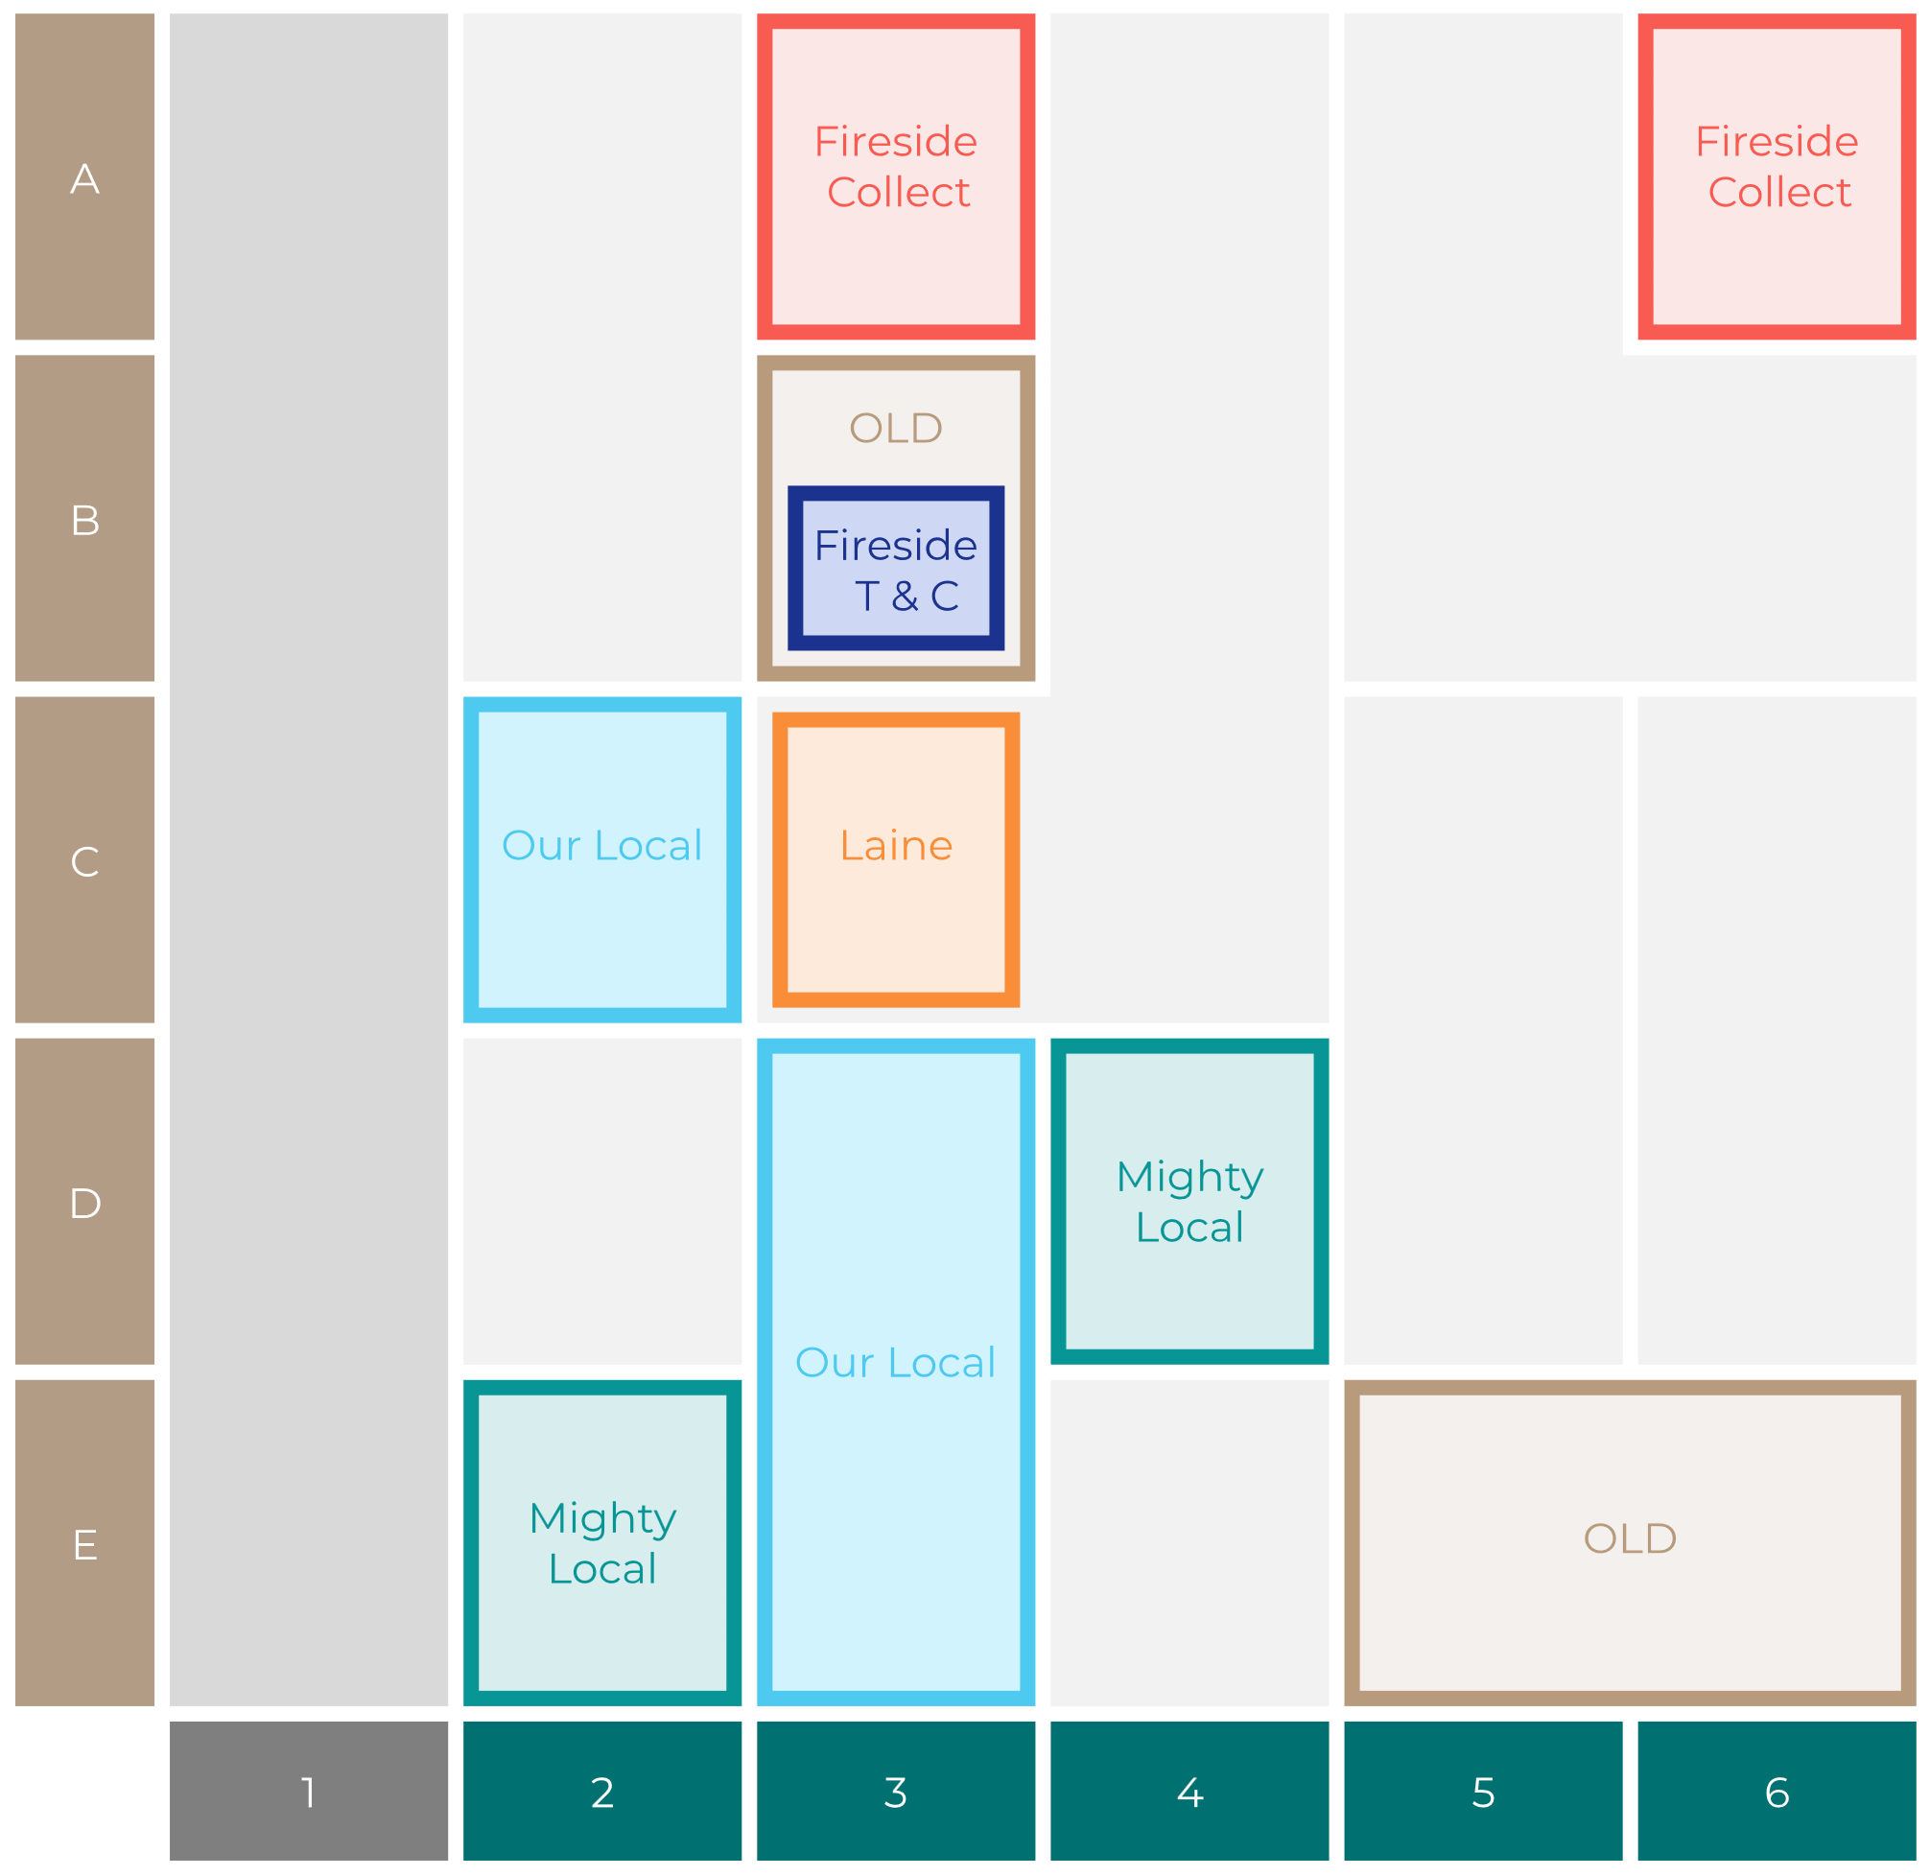

Site Intel
Birdcage TQ58LT
Site Potential 1
Site Characteristics
£3000
£18000
OCC Concept Fit
Achievable Average Weekly Takings
Non-Core
£6500
A Food-Led High Affluence B Food-Led Mid Affluence C Wet-Led Mid/High Affluence D Wet-Led Low Affluence E Food-Led Low Affluence
AWT 2 Local Regulars 3 Local Passing Trade 4 Destination Wet-Led 5 Destination Food-Led 6 Destination Very Food-Led
A
B
C
D
E
1
2
3
4
5
6

Slide 16
Site Intel
Birdcage TQ58LT
Site Potential 2
Concept Recommendation

Slide 17
Site Intel
Birdcage TQ58LT
Local Market Profile
Mix of spend by customer segment in Punch site and local market
 | Customer Count | Family Familiar | Occasional & Local | Mid-Week Seniors | Part Of The Pub | Metro Sophisticates | Young & Connected | Bubbly Weekenders | Upmarket Diners
Birdcage | 152 | 13.50% | 2.49% | 35.34% | 11.54% | 12.48% | 7.53% | 5.61% | 11.48%
Local Catchment | 1575 | 10.27% | 3.18% | 36.29% | 8.57% | 9.79% | 15.43% | 7.21% | 9.22%
Punch T&L | 110515 | 8.08% | 5.92% | 29.54% | 11.18% | 11.29% | 11.62% | 7.15% | 15.19%
Birdcage vs Local Catchment |  | 3.23% | -0.69% | -0.95% | 2.97% | 2.69% | -7.90% | -1.60% | 2.26%
Birdcage vs Punch T&L |  | 5.42% | -3.43% | 5.80% | 0.36% | 1.19% | -4.09% | -1.54% | -3.71%
Local Catchment vs Punch T&L |  | 2.19% | -2.74% | 6.75% | -2.61% | -1.50% | 3.81% | 0.06% | -5.97%

Slide 18
Site Intel
Birdcage TQ58LT
Local Competitor Profiles
Mix of spend by customer segment in Punch site and local competitors
 | Customer Count | Family Familiar | Occasional & Local | Mid-Week Seniors | Part Of The Pub | Metro Sophisticates | Young & Connected | Bubbly Weekenders | Upmarket Diners
Birdcage TQ58LT | 152 | 13.50% | 2.49% | 35.34% | 11.54% | 12.48% | 7.53% | 5.61% | 11.48%
The Vigilance TQ59DE | 485 | 15.22% | 7.34% | 24.28% | 16.59% | 3.79% | 26.13% | 3.78% | 2.84%
Blue Anchor TQ58AH | 403 | 5.71% | 1.57% | 51.14% | 8.25% | 8.00% | 10.48% | 6.25% | 8.56%
Old Market House TQ58AW | 993 | 10.35% | 1.98% | 33.91% | 4.67% | 13.88% | 12.81% | 9.50% | 12.86%

