Slide 1










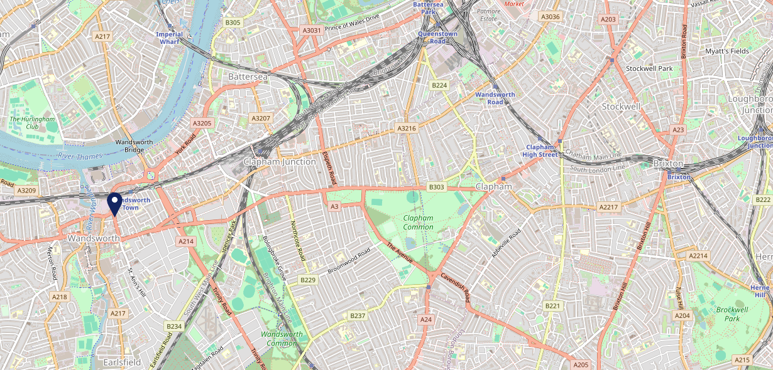









Site Intel
Grapes SW181DX
3 Miles
1 Chain
22/02/2023 - 14/02/2024
Site Summary
Grapes SW181DX
Work Area
Region
TV Region
Urbanicity
London
London
London
Urban major conurbation
SW181DX
Punch T&L
Top Competitors
ATV
Gender
Bolingbroke
#1
£10.15
86.70%
Male
SW116RE
Pub Restaurant
Affluence
Segmentation
Brook House
#2
37.79%
31.39%
Middle Income
Cash Conscious Communities
SW64SG
Pub Restaurant
Age Group
Visit Day
Fox & Pheasant
#3
43.80%
26.21%
SW109UJ
45 to 54
Fri
Pub Restaurant
Nearest Station
Wandsworth Town(0.30 miles)
434 Site Customers
18 Competitors
17415 Competitor Customers

Slide 2

Site Intel
Grapes SW181DX
3 Miles
1 Chain
22/02/2023 - 14/02/2024
Spend by Weekpart
How is customer spend distributed throughout the week for Grapes SW181DX versus its competitors?
% of spend for Grapes SW181DX and 1 Chains in 3 Miles from 22/02/2023 - 14/02/2024 split by Day of Week
434 Site Customers
18 Competitors
17415 Competitor Customers

Slide 3
Site Intel
Grapes SW181DX
3 Miles
1 Chain
22/02/2023 - 14/02/2024
Visit Frequency
How frequently per year do customers visit Grapes SW181DX versus its competitors?
% of customer numbers for Grapes SW181DX and 1 Chains in 3 Miles from 22/02/2023 - 14/02/2024 and the number of visits made Per Annum
434 Site Customers
18 Competitors
17415 Competitor Customers

Slide 4
Site Intel
Grapes SW181DX
3 Miles
1 Chain
22/02/2023 - 14/02/2024
ATV Change
How has ATV changed between two date ranges?
434 Site Customers

Slide 5
Site Intel
Grapes SW181DX
3 Miles
1 Chain
22/02/2023 - 14/02/2024
Market Share Change
How has market share changed between two date ranges?
% of market share spend for Grapes SW181DX and 1 Chains in 3 Miles from 22/02/2023 - 14/02/2024
434 Site Customers

Slide 6
Site Intel
Grapes SW181DX
3 Miles
1 Chain
22/02/2023 - 14/02/2024
Age
How does the age profile of customers who visit Grapes SW181DX compare versus its competitors?
% of spend for Grapes SW181DX and 1 Chains in 3 Miles from 22/02/2023 - 14/02/2024 split by Age Range
191 Site Customers
18 Competitors
7429 Competitor Customers

Slide 7
Site Intel
Grapes SW181DX
3 Miles
1 Chain
22/02/2023 - 14/02/2024
Affluence
How does the affluence of customers who visit Grapes SW181DX compare versus its competitors?
% of spend for Grapes SW181DX and 1 Chains in 3 Miles from 22/02/2023 - 14/02/2024 split by Affluence
180 Site Customers
18 Competitors
7136 Competitor Customers

Slide 8
Site Intel
Grapes SW181DX
3 Miles
1 Chain
22/02/2023 - 14/02/2024
Gender
How does the gender profile of customers who visit Grapes SW181DX compare versus its competitors?
% of spend for Grapes SW181DX and 1 Chains in 3 Miles from 22/02/2023 - 14/02/2024 split by Gender
185 Site Customers
18 Competitors
7375 Competitor Customers

Slide 9
Site Intel
Grapes SW181DX
3 Miles
1 Chain
22/02/2023 - 14/02/2024
Punch Segmentation
How does the Custom segmentation profile of customers who visit Grapes SW181DX compare versus its competitors?
% of spend for Grapes SW181DX and 1 Chains in 3 Miles from 22/02/2023 - 14/02/2024 split by Segment
434 Site Customers
18 Competitors
17415 Competitor Customers

Slide 10
Site Intel
Grapes SW181DX
3 Miles
1 Chain
22/02/2023 - 14/02/2024
Spend by Distance
How does the spend profile of Grapes SW181DX compare versus its competitors based on travel distances?
% of spend for Grapes SW181DX and 1 Chains in 3 Miles from 22/02/2023 - 14/02/2024 split by Distance travelled
184 Site Customers
18 Competitors
7355 Competitor Customers

Slide 11
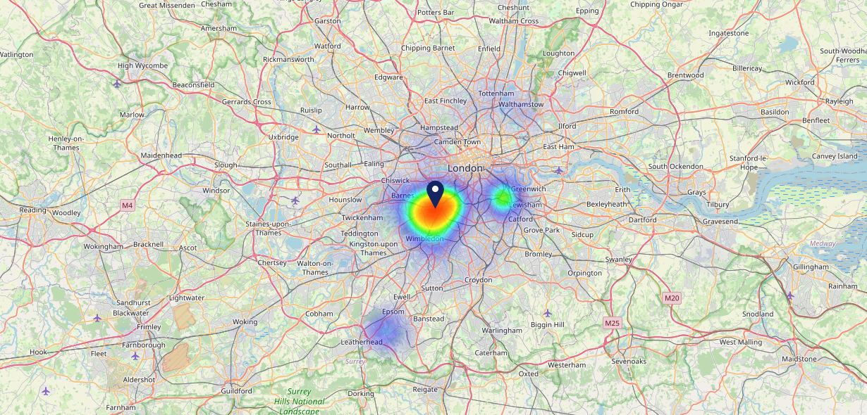

Site Intel
Grapes SW181DX
22/02/2023 - 14/02/2024
Map of Guest Origin
Where do customers of Grapes SW181DX come from?
Where do customers of Grapes SW181DX for 22/02/2023 - 14/02/2024 live
184 Site Customers

Slide 12
Site Intel
Grapes SW181DX
3 Miles
1 Chain
22/02/2023 - 14/02/2024
Share of Wallet
What are the Top 20 venues (by spend) that customers of Grapes SW181DX also visit?
For customers of Grapes SW181DX, who are the top 20 competitors from 1 Chains in 3 Miles for 22/02/2023 - 14/02/2024 split by Venue
434 Site Customers

Slide 13
Site Intel
Grapes SW181DX
3 Miles
1 Chain
22/02/2023 - 14/02/2024
Share of Wallet Change
How has share of wallet of customers of Grapes SW181DX changed between two date ranges?
434 Site Customers

Slide 14
Site Intel
Grapes SW181DX
22/02/2023 - 14/02/2024
Market Summary
How does the local area for Grapes SW181DX compare to the national average (1 = low, 10 = high)
Data Type | Name | Spend in 250m | 250m Spend vs National | Spend in 500m | 500m Spend vs National | Spend in 1 mile | 1 mile Spend vs National | Spend in 3 miles | 3 mile Spend vs National
Total | Annual Sales | £6.81M | 8 | £25.95M | 9 | £85.97M | 9 | £1.21B | 10
Weekpart | Mon - Thu | 39.6% | 5 | 40.3% | 5 | 41.7% | 6 | 43.1% | 7
Weekpart | Fri - Sat | 45.9% | 7 | 43.1% | 5 | 42.7% | 5 | 41.3% | 4
Weekpart | Sun | 14.5% | 5 | 16.6% | 8 | 15.6% | 6 | 15.6% | 5
Age | 18 to 24 | 4.8% | 5 | 5.8% | 5 | 5.0% | 4 | 4.7% | 2
Age | 25 to 34 | 30.6% | 9 | 25.5% | 7 | 22.7% | 6 | 18.2% | 3
Age | 35 to 44 | 27.0% | 8 | 28.3% | 9 | 26.5% | 8 | 23.2% | 5
Age | 45 to 54 | 15.1% | 2 | 18.2% | 3 | 19.3% | 4 | 21.1% | 7
Age | 55 to 64 | 15.6% | 6 | 15.5% | 6 | 16.9% | 7 | 19.6% | 9
Age | 65 to 74 | 5.4% | 5 | 5.1% | 4 | 6.6% | 6 | 8.7% | 8
Age | 75+ | 1.6% | 4 | 1.5% | 4 | 3.0% | 6 | 4.6% | 9
CAMEO | Business Elite | 32.5% | 10 | 27.3% | 10 | 30.2% | 10 | 27.6% | 10
CAMEO | Prosperous Professionals | 10.5% | 9 | 9.6% | 9 | 8.7% | 8 | 8.4% | 8
CAMEO | Flourishing Society | 12.0% | 5 | 11.0% | 5 | 10.5% | 4 | 12.0% | 5
CAMEO | Content Communities | 12.2% | 5 | 12.6% | 6 | 12.5% | 6 | 12.8% | 6
CAMEO | White Collar Neighbourhoods | 10.7% | 5 | 12.0% | 6 | 11.3% | 5 | 11.3% | 5
CAMEO | Enterprising Mainstream | 2.7% | 1 | 3.1% | 1 | 3.3% | 1 | 4.3% | 2
CAMEO | Paying The Mortgage | 6.5% | 1 | 7.5% | 1 | 7.3% | 1 | 8.0% | 1
CAMEO | Cash Conscious Communities | 9.6% | 6 | 10.5% | 7 | 10.1% | 6 | 9.5% | 6
CAMEO | On A Budget | 2.9% | 2 | 5.5% | 4 | 5.4% | 4 | 5.5% | 3
CAMEO | Family Value | 0.6% | 2 | 0.9% | 3 | 0.7% | 2 | 0.7% | 1
Affluence | AB | 54.9% | 10 | 47.9% | 9 | 49.4% | 9 | 47.9% | 10
Affluence | C1C2 | 32.0% | 1 | 35.2% | 2 | 34.4% | 1 | 36.4% | 1
Affluence | DE | 13.1% | 3 | 16.9% | 4 | 16.2% | 4 | 15.7% | 3

Slide 15

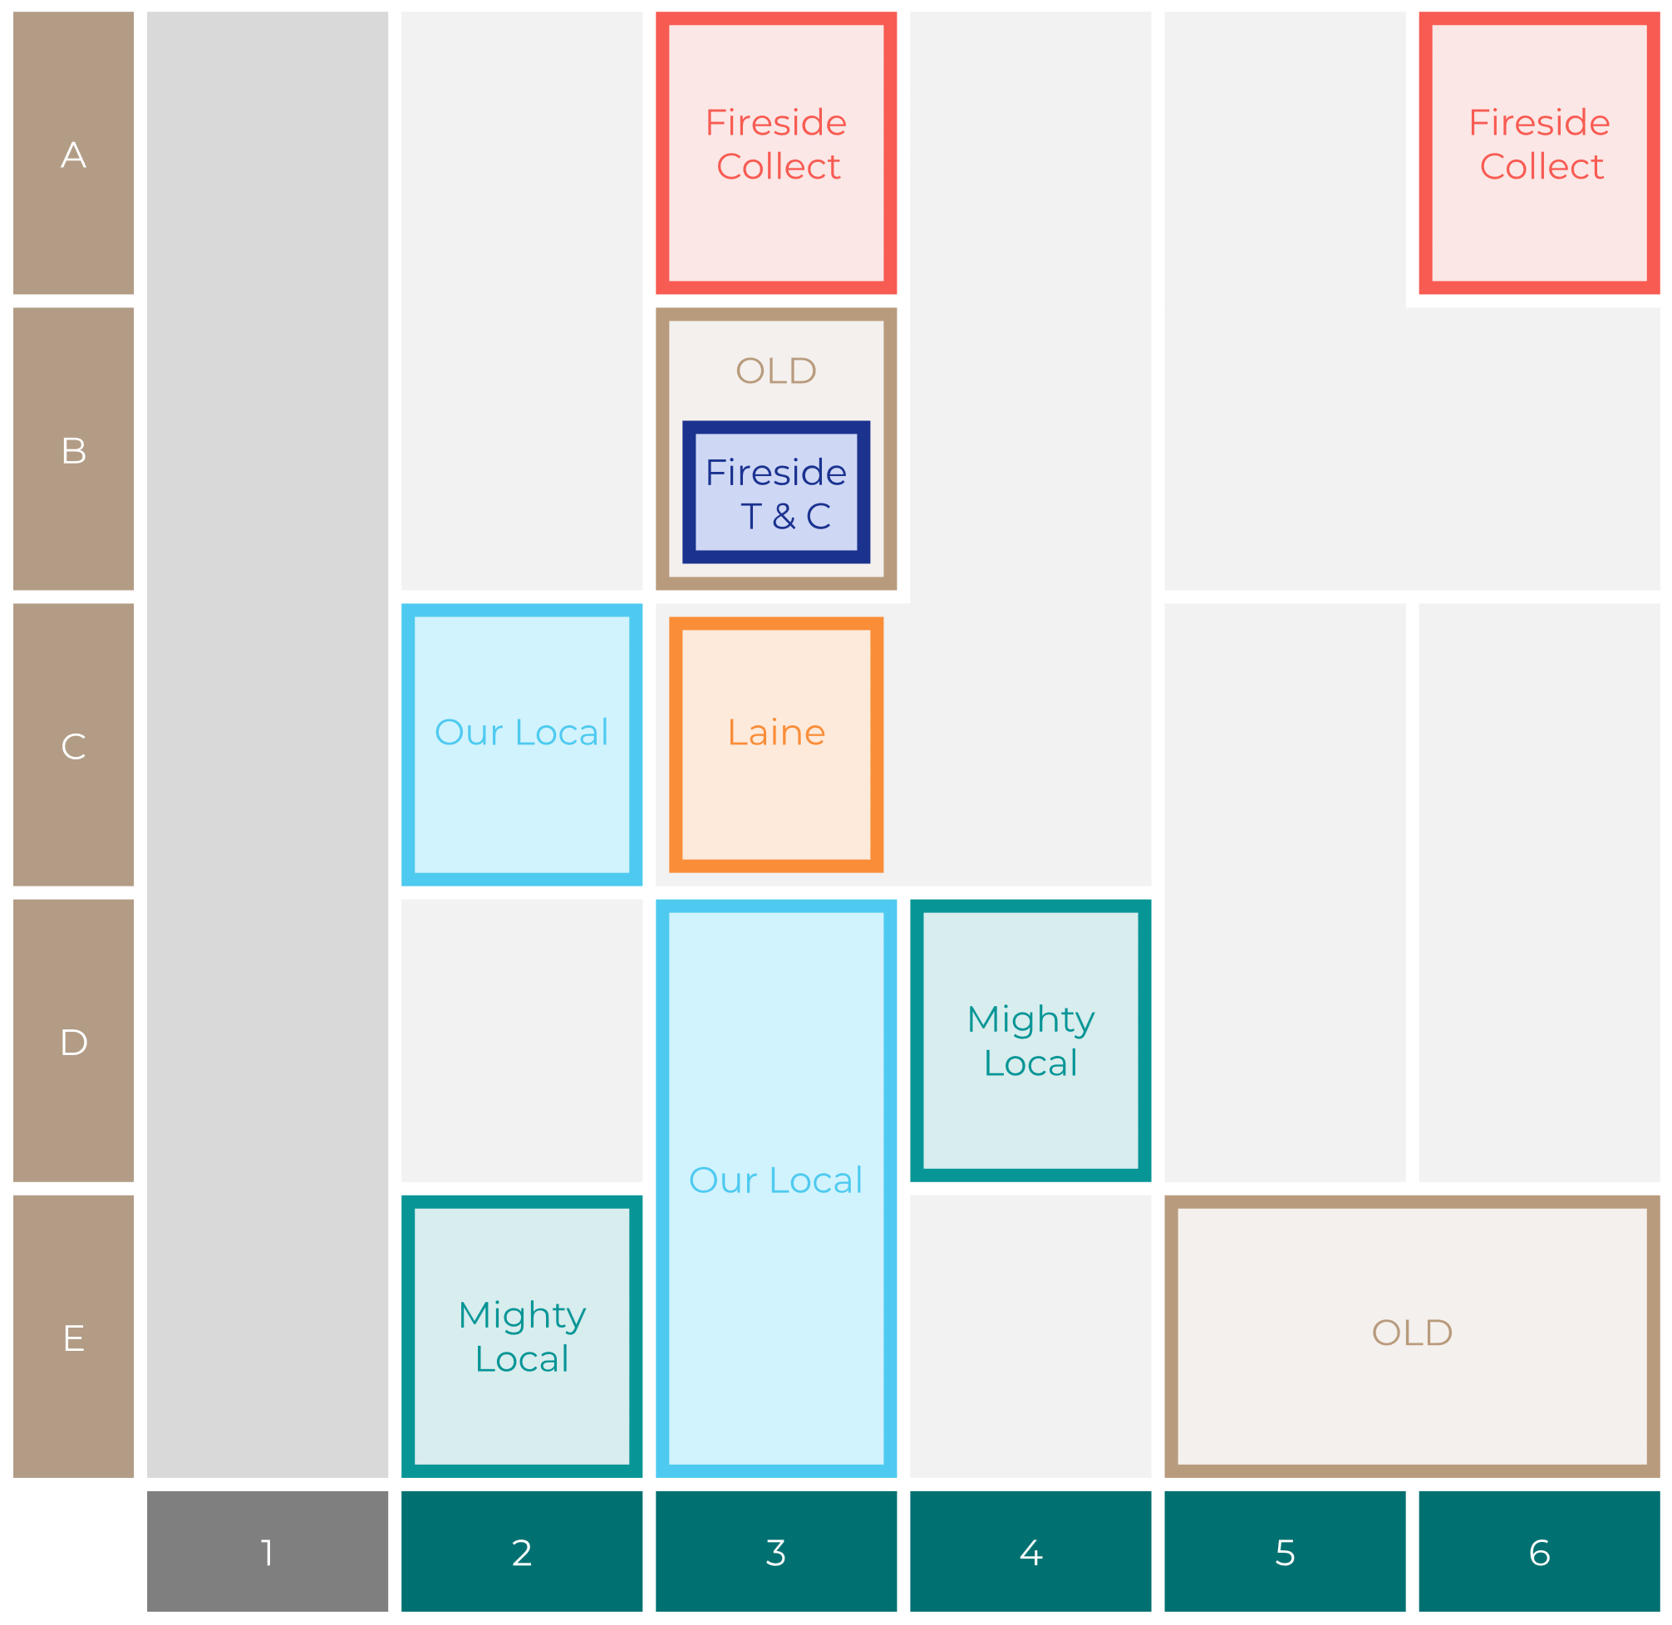

Site Intel
Grapes SW181DX
Site Potential 1
Site Characteristics
£3000
£18000
OCC Concept Fit
Achievable Average Weekly Takings
Fireside Scenic
£10000
A Food-Led High Affluence B Food-Led Mid Affluence C Wet-Led Mid/High Affluence D Wet-Led Low Affluence E Food-Led Low Affluence
AWT 2 Local Regulars 3 Local Passing Trade 4 Destination Wet-Led 5 Destination Food-Led 6 Destination Very Food-Led
A
B
C
D
E
1
2
3
4
5
6

Slide 16
Site Intel
Grapes SW181DX
Site Potential 2
Concept Recommendation

Slide 17
Site Intel
Grapes SW181DX
Local Market Profile
Mix of spend by customer segment in Punch site and local market
 | Customer Count | Family Familiar | Occasional & Local | Mid-Week Seniors | Part Of The Pub | Metro Sophisticates | Young & Connected | Bubbly Weekenders | Upmarket Diners
Grapes | 92 | 0.06% | 0.12% | 57.05% | 16.61% | 16.89% | 3.31% | 4.30% | 1.60%
Local Catchment | 3041 | 0.74% | 3.67% | 5.09% | 1.74% | 33.02% | 3.21% | 5.56% | 46.94%
Punch T&L | 110107 | 8.03% | 5.92% | 29.65% | 11.15% | 11.28% | 11.54% | 7.14% | 15.25%
Grapes vs Local Catchment |  | -0.68% | -3.55% | 51.96% | 14.87% | -16.13% | 0.10% | -1.26% | -45.34%
Grapes vs Punch T&L |  | -7.97% | -5.80% | 27.40% | 5.46% | 5.61% | -8.23% | -2.84% | -13.65%
Local Catchment vs Punch T&L |  | -7.29% | -2.25% | -24.56% | -9.41% | 21.74% | -8.33% | -1.58% | 31.69%

Slide 18
Site Intel
Grapes SW181DX
Local Competitor Profiles
Mix of spend by customer segment in Punch site and local competitors
 | Customer Count | Family Familiar | Occasional & Local | Mid-Week Seniors | Part Of The Pub | Metro Sophisticates | Young & Connected | Bubbly Weekenders | Upmarket Diners
Grapes SW181DX | 92 | 0.06% | 0.12% | 57.05% | 16.61% | 16.89% | 3.31% | 4.30% | 1.60%
Bolingbroke SW116RE | 505 | 0.35% | 2.97% | 3.60% | 1.55% | 27.28% | 3.81% | 3.74% | 56.67%
Brook House SW64SG | 292 | 0.00% | 2.29% | 2.21% | 0.17% | 28.69% | 0.57% | 1.67% | 64.37%
Fox & Pheasant SW109UJ | 495 | 0.36% | 1.52% | 8.68% | 0.51% | 32.16% | 2.32% | 7.10% | 47.30%
Elephant And Barrel SW67LW | 380 | 6.37% | 6.16% | 11.31% | 4.18% | 35.09% | 11.87% | 11.57% | 13.41%
Tap 13 Tooting SW170RJ | 192 | 1.01% | 3.70% | 5.17% | 0.73% | 46.82% | 5.13% | 11.13% | 26.27%
Stonhouse SW46BJ | 498 | 0.18% | 4.14% | 8.36% | 3.96% | 43.90% | 6.50% | 10.45% | 22.47%
Abbeville SW49JW | 450 | 1.03% | 8.00% | 3.53% | 4.63% | 43.36% | 1.64% | 6.79% | 30.99%
Brown Dog SW130AP | 202 | 0.20% | 3.53% | 1.84% | 0.14% | 23.02% | 1.91% | 1.78% | 67.53%

