Slide 1











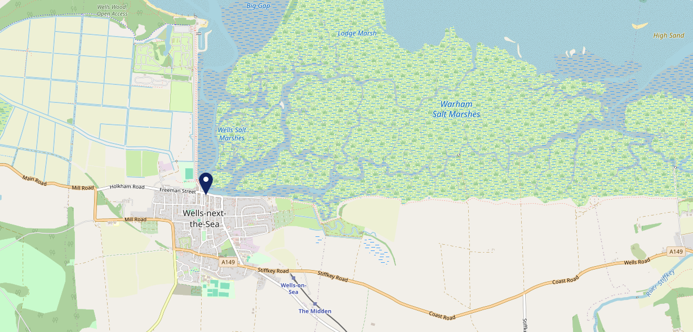











Site Intel
Golden Fleece NR231AH
1 Miles
338 Chains
29/01/2025 - 21/01/2026
Site Summary
Golden Fleece NR231AH
Work Area
Region
TV Region
Urbanicity
Cromer and Sheringham
East of England
Anglia
Rural town and fringe in a sparse setting
NR231AH
Punch - Fireside Inns
Top Competitors
ATV
Gender
Flour
#1
£19.41
68.02%
Male
NR231AH
Restaurant
Affluence
Segmentation
Frenchs Fish And Chips
#2
56.85%
20.16%
Middle Income
Content Communities
NR231AH
Fish And Chips
Age Group
Visit Day
Bowling Green
#3
26.42%
22.82%
NR231JB
55 to 64
Sat
Pub Restaurant
Nearest Station
Sheringham(24.09 miles)
3741 Site Customers
25 Competitors
20315 Competitor Customers

Slide 2

Site Intel
Golden Fleece NR231AH
1 Miles
338 Chains
29/01/2025 - 21/01/2026
Spend by Weekpart
How is customer spend distributed throughout the week for Golden Fleece NR231AH versus its competitors?
% of spend for Golden Fleece NR231AH and 338 Chains in 1 Miles from 29/01/2025 - 21/01/2026 split by Day of Week
3741 Site Customers
25 Competitors
20315 Competitor Customers

Slide 3
Site Intel
Golden Fleece NR231AH
1 Miles
338 Chains
29/01/2025 - 21/01/2026
Visit Frequency
How frequently per year do customers visit Golden Fleece NR231AH versus its competitors?
% of customer numbers for Golden Fleece NR231AH and 338 Chains in 1 Miles from 29/01/2025 - 21/01/2026 and the number of visits made Per Annum
3741 Site Customers
25 Competitors
20315 Competitor Customers

Slide 4
Site Intel
Golden Fleece NR231AH
1 Miles
338 Chains
29/01/2025 - 21/01/2026
ATV Change
How has ATV changed between two date ranges?
3741 Site Customers

Slide 5
Site Intel
Golden Fleece NR231AH
1 Miles
338 Chains
29/01/2025 - 21/01/2026
Market Share Change
How has market share changed between two date ranges?
% of market share spend for Golden Fleece NR231AH and 338 Chains in 1 Miles from 29/01/2025 - 21/01/2026
3741 Site Customers

Slide 6
Site Intel
Golden Fleece NR231AH
1 Miles
338 Chains
29/01/2025 - 21/01/2026
Age
How does the age profile of customers who visit Golden Fleece NR231AH compare versus its competitors?
% of spend for Golden Fleece NR231AH and 338 Chains in 1 Miles from 29/01/2025 - 21/01/2026 split by Age Range
1964 Site Customers
25 Competitors
10456 Competitor Customers

Slide 7
Site Intel
Golden Fleece NR231AH
1 Miles
338 Chains
29/01/2025 - 21/01/2026
Affluence
How does the affluence of customers who visit Golden Fleece NR231AH compare versus its competitors?
% of spend for Golden Fleece NR231AH and 338 Chains in 1 Miles from 29/01/2025 - 21/01/2026 split by Affluence
1826 Site Customers
25 Competitors
9775 Competitor Customers

Slide 8
Site Intel
Golden Fleece NR231AH
1 Miles
338 Chains
29/01/2025 - 21/01/2026
Gender
How does the gender profile of customers who visit Golden Fleece NR231AH compare versus its competitors?
% of spend for Golden Fleece NR231AH and 338 Chains in 1 Miles from 29/01/2025 - 21/01/2026 split by Gender
1902 Site Customers
25 Competitors
10200 Competitor Customers

Slide 9
Site Intel
Golden Fleece NR231AH
1 Miles
338 Chains
29/01/2025 - 21/01/2026
Punch Segmentation
How does the Custom segmentation profile of customers who visit Golden Fleece NR231AH compare versus its competitors?
% of spend for Golden Fleece NR231AH and 338 Chains in 1 Miles from 29/01/2025 - 21/01/2026 split by Segment
3741 Site Customers
25 Competitors
20315 Competitor Customers

Slide 10
Site Intel
Golden Fleece NR231AH
1 Miles
338 Chains
29/01/2025 - 21/01/2026
Spend by Distance
How does the spend profile of Golden Fleece NR231AH compare versus its competitors based on travel distances?
% of spend for Golden Fleece NR231AH and 338 Chains in 1 Miles from 29/01/2025 - 21/01/2026 split by Distance travelled
1898 Site Customers
25 Competitors
10197 Competitor Customers

Slide 11
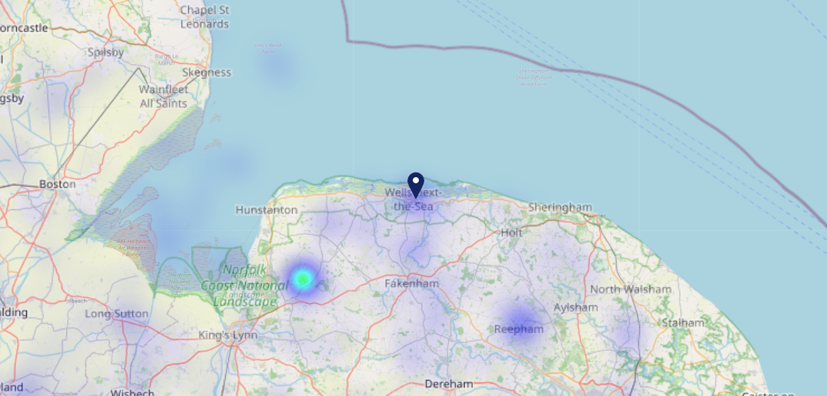

Site Intel
Golden Fleece NR231AH
29/01/2025 - 21/01/2026
Map of Guest Origin
Where do customers of Golden Fleece NR231AH come from?
Where do customers of Golden Fleece NR231AH for 29/01/2025 - 21/01/2026 live
1898 Site Customers

Slide 12
Site Intel
Golden Fleece NR231AH
1 Miles
338 Chains
29/01/2025 - 21/01/2026
Share of Wallet
What are the Top 20 venues (by spend) that customers of Golden Fleece NR231AH also visit?
For customers of Golden Fleece NR231AH, who are the top 20 competitors from 338 Chains in 1 Miles for 29/01/2025 - 21/01/2026 split by Venue
3741 Site Customers

Slide 13
Site Intel
Golden Fleece NR231AH
1 Miles
338 Chains
29/01/2025 - 21/01/2026
Share of Wallet Change
How has share of wallet of customers of Golden Fleece NR231AH changed between two date ranges?
3741 Site Customers

Slide 14
Site Intel
Golden Fleece NR231AH
29/01/2025 - 21/01/2026
Market Summary
How does the local area for Golden Fleece NR231AH compare to the national average (1 = low, 10 = high)
Data Type | Name | Spend in 250m | 250m Spend vs National | Spend in 500m | 500m Spend vs National | Spend in 1 mile | 1 mile Spend vs National | Spend in 3 miles | 3 mile Spend vs National
Total | Annual Sales | £7.10M | 8 | £9.68M | 7 | £10.23M | 4 | £15.28M | 2
Weekpart | Mon - Thu | 47.0% | 9 | 46.5% | 9 | 46.6% | 9 | 46.8% | 9
Weekpart | Fri - Sat | 37.7% | 2 | 36.9% | 2 | 36.3% | 1 | 35.4% | 1
Weekpart | Sun | 15.4% | 6 | 16.7% | 8 | 17.1% | 8 | 17.8% | 9
Age | 18 to 24 | 2.5% | 3 | 2.1% | 2 | 2.1% | 1 | 1.7% | 1
Age | 25 to 34 | 11.2% | 1 | 10.6% | 1 | 10.3% | 1 | 9.6% | 1
Age | 35 to 44 | 22.9% | 5 | 21.0% | 4 | 20.3% | 3 | 21.1% | 3
Age | 45 to 54 | 19.6% | 5 | 20.3% | 5 | 20.1% | 5 | 19.6% | 4
Age | 55 to 64 | 24.1% | 10 | 25.8% | 10 | 25.6% | 10 | 25.9% | 10
Age | 65 to 74 | 13.9% | 9 | 14.1% | 10 | 14.7% | 10 | 14.7% | 10
Age | 75+ | 5.8% | 9 | 6.2% | 9 | 7.0% | 10 | 7.3% | 10
CAMEO | Business Elite | 9.5% | 7 | 10.0% | 7 | 9.8% | 7 | 10.0% | 7
CAMEO | Prosperous Professionals | 7.7% | 7 | 7.9% | 7 | 7.9% | 7 | 8.5% | 8
CAMEO | Flourishing Society | 17.2% | 8 | 18.3% | 8 | 18.3% | 8 | 18.6% | 8
CAMEO | Content Communities | 18.0% | 9 | 17.8% | 9 | 18.0% | 9 | 18.6% | 10
CAMEO | White Collar Neighbourhoods | 10.5% | 5 | 9.8% | 4 | 9.6% | 3 | 9.3% | 3
CAMEO | Enterprising Mainstream | 13.0% | 9 | 12.6% | 9 | 12.5% | 9 | 12.3% | 9
CAMEO | Paying The Mortgage | 12.2% | 4 | 11.9% | 4 | 12.1% | 4 | 11.6% | 3
CAMEO | Cash Conscious Communities | 6.6% | 4 | 6.7% | 3 | 7.0% | 4 | 6.6% | 3
CAMEO | On A Budget | 3.4% | 2 | 3.1% | 2 | 3.1% | 2 | 2.7% | 1
CAMEO | Family Value | 1.9% | 5 | 1.9% | 5 | 1.8% | 4 | 1.6% | 4
Affluence | AB | 34.4% | 7 | 36.2% | 7 | 35.9% | 7 | 37.1% | 7
Affluence | C1C2 | 53.7% | 8 | 52.0% | 7 | 52.2% | 7 | 51.9% | 7
Affluence | DE | 11.9% | 3 | 11.7% | 2 | 11.9% | 2 | 11.0% | 1

Slide 15

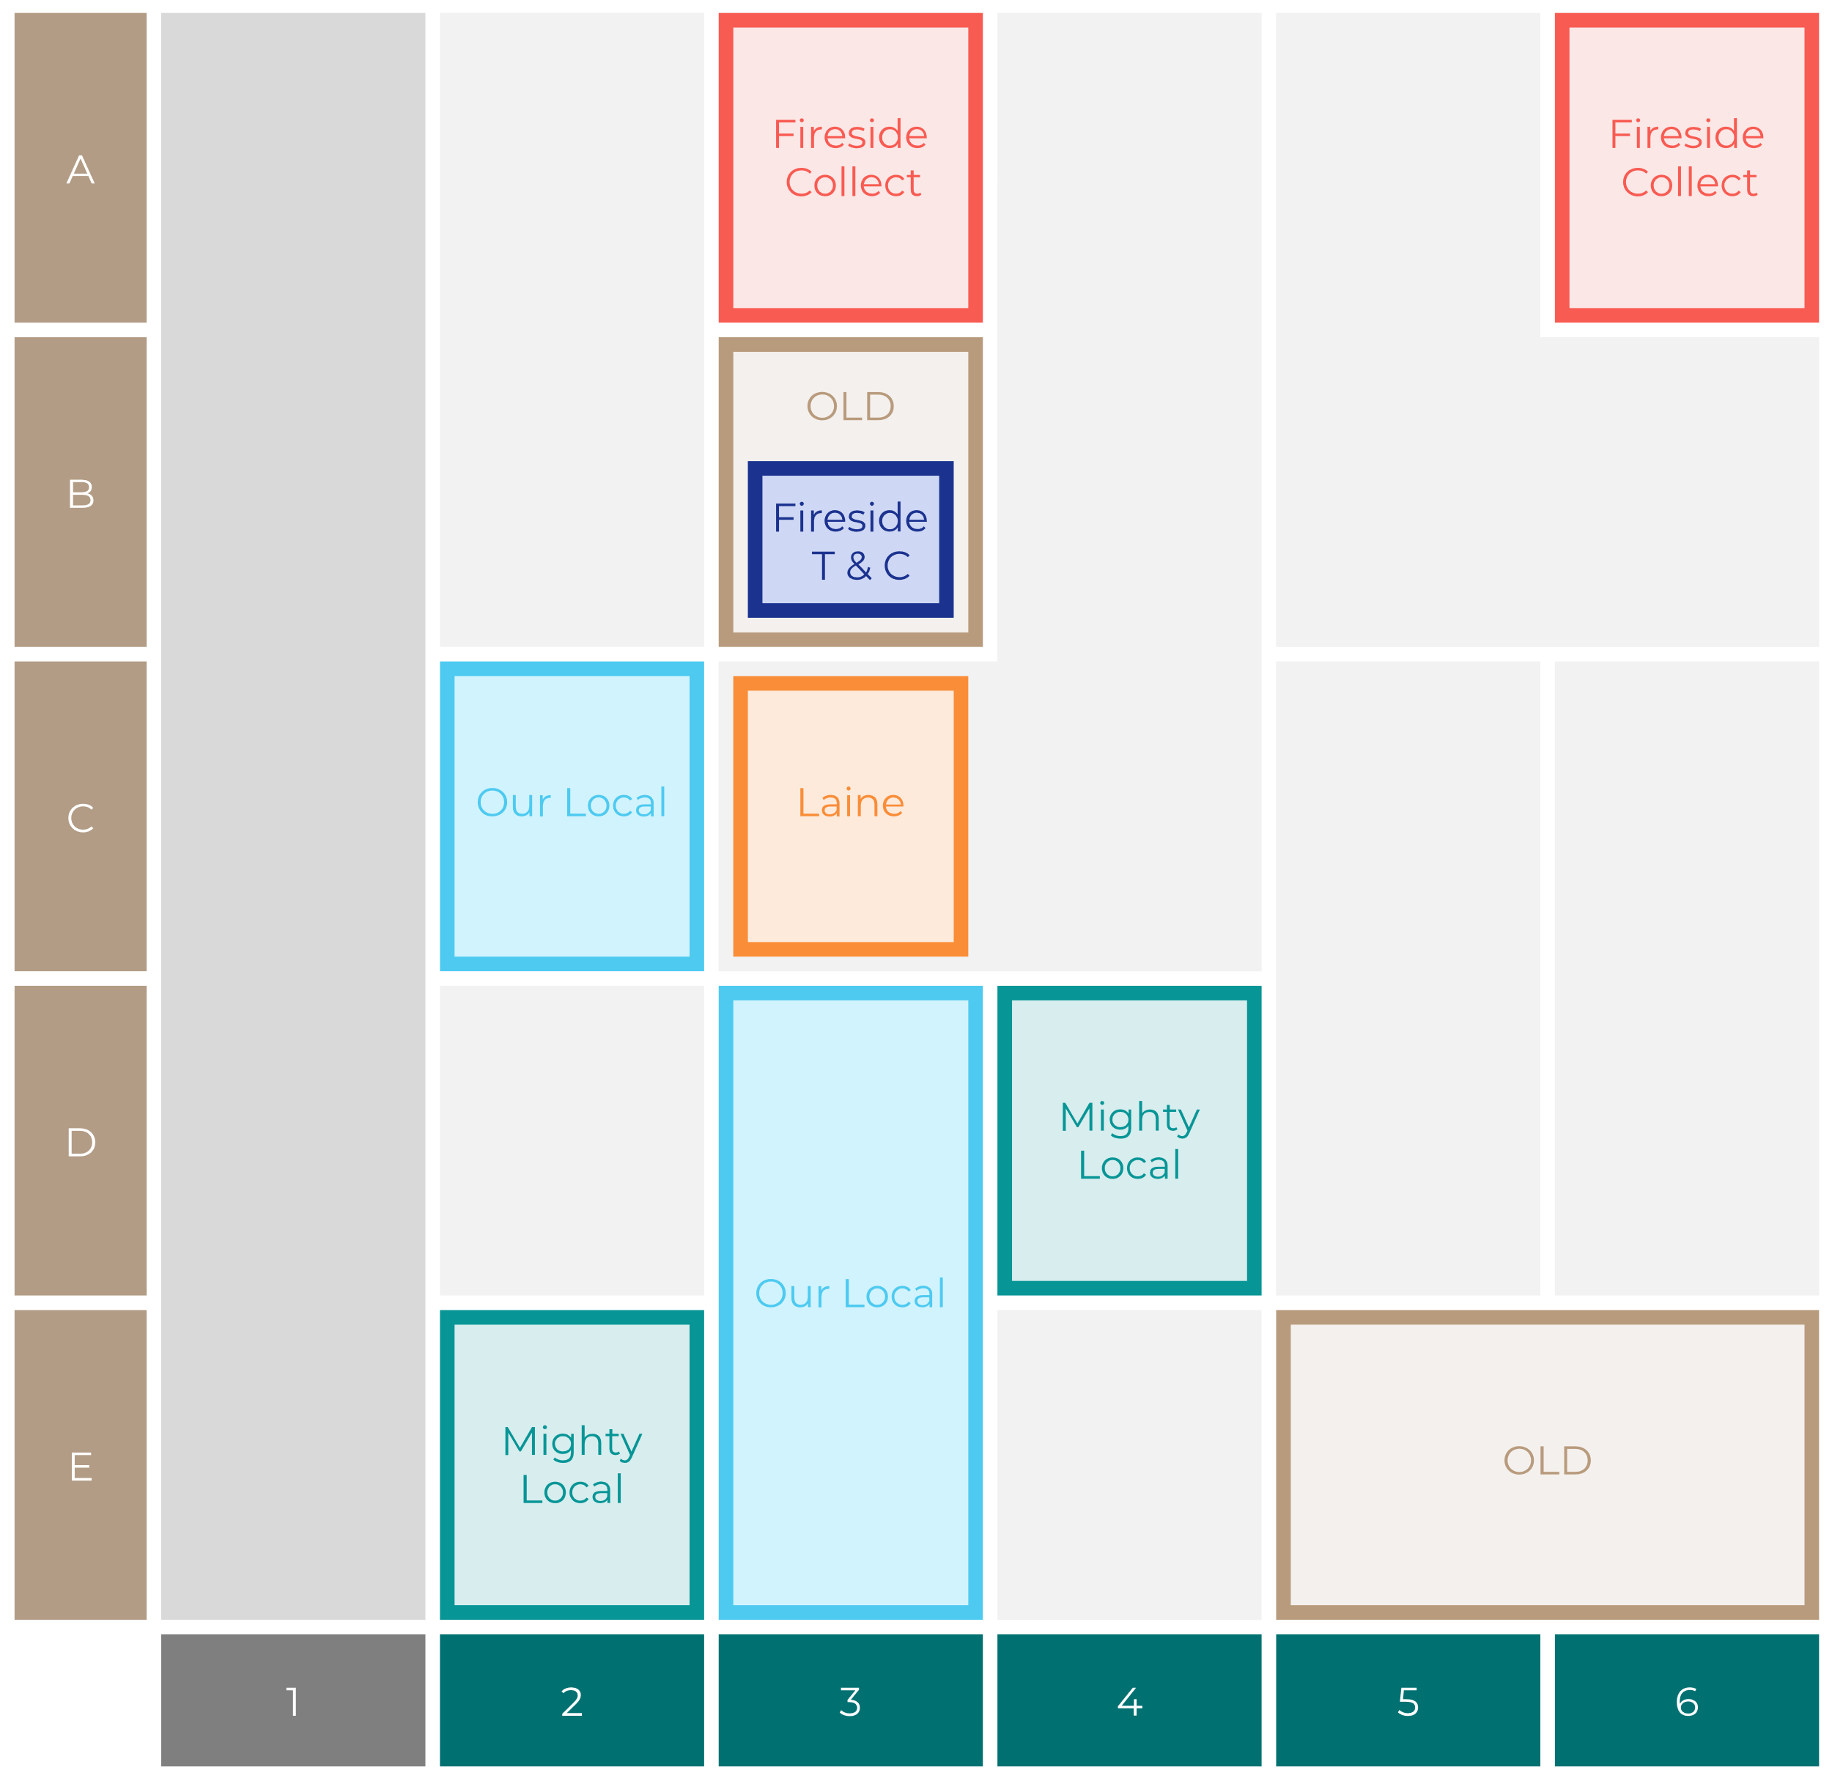

Site Intel
Golden Fleece NR231AH
Site Potential 1
Site Characteristics
£3000
£18000
HDI Concept Fit
Achievable Average Weekly Takings
Our Local Destination
£0
A Food-Led High Affluence B Food-Led Mid Affluence C Wet-Led Mid/High Affluence D Wet-Led Low Affluence E Food-Led Low Affluence
AWT 2 Local Regulars 3 Local Passing Trade 4 Destination Wet-Led 5 Destination Food-Led 6 Destination Very Food-Led
A
B
C
D
E
1
2
3
4
5
6

Slide 16
Site Intel
Golden Fleece NR231AH
Site Potential 2
Concept Recommendation

Slide 17
Site Intel
Golden Fleece NR231AH
Local Market Profile
Mix of spend by customer segment in Punch site and local market
 | Customer Count | Family Familiar | Occasional & Local | Mid-Week Seniors | Part Of The Pub | Metro Sophisticates | Young & Connected | Bubbly Weekenders | Upmarket Diners
Golden Fleece | 822 | 7.39% | 4.35% | 33.50% | 5.79% | 13.05% | 8.95% | 5.88% | 21.05%
Local Catchment | 2500 | 8.32% | 1.87% | 26.80% | 2.34% | 8.54% | 8.19% | 6.62% | 37.28%
Punch T&L | 97271 | 8.89% | 6.07% | 28.67% | 11.39% | 11.22% | 11.04% | 7.12% | 15.56%
Golden Fleece vs Local Catchment |  | -0.93% | 2.48% | 6.70% | 3.45% | 4.51% | 0.76% | -0.74% | -16.23%
Golden Fleece vs Punch T&L |  | -1.50% | -1.72% | 4.83% | -5.60% | 1.83% | -2.09% | -1.24% | 5.49%
Local Catchment vs Punch T&L |  | -0.57% | -4.20% | -1.87% | -9.05% | -2.68% | -2.85% | -0.50% | 21.72%

Slide 18
Site Intel
Golden Fleece NR231AH
Local Competitor Profiles
Mix of spend by customer segment in Punch site and local competitors
 | Customer Count | Family Familiar | Occasional & Local | Mid-Week Seniors | Part Of The Pub | Metro Sophisticates | Young & Connected | Bubbly Weekenders | Upmarket Diners
Golden Fleece NR231AH | 822 | 7.39% | 4.35% | 33.50% | 5.79% | 13.05% | 8.95% | 5.88% | 21.05%
Flour NR231AH | 318 | 8.00% | 1.19% | 22.26% | 1.24% | 10.52% | 6.40% | 5.45% | 44.90%
Frenchs Fish And Chips NR231AH | 1185 | 10.76% | 2.30% | 27.82% | 1.85% | 8.97% | 11.23% | 8.77% | 28.27%
Bowling Green NR231JB | 160 | 2.31% | 1.18% | 32.76% | 7.94% | 7.27% | 5.14% | 2.95% | 40.42%
Wells Crab House NR231BA | 163 | 4.12% | 0.91% | 24.23% | 1.97% | 7.13% | 1.21% | 4.25% | 56.14%
Plattens NR231AH | 753 | 11.81% | 2.77% | 25.43% | 1.68% | 7.98% | 12.68% | 7.80% | 29.80%
One Coffee One NR231AF | 251 | 8.17% | 2.28% | 34.02% | 1.18% | 12.19% | 5.93% | 7.97% | 28.21%
No 57 NR231AN | 72 | 10.55% | 0.00% | 42.89% | 0.00% | 3.25% | 3.29% | 8.62% | 31.37%
Fj Cafe Bar NR231AF | 97 | 2.04% | 2.46% | 34.60% | 1.20% | 7.60% | 3.43% | 5.95% | 42.68%
Nelsons Coffee Shop NR231AG | 13 | 1.84% | 0.00% | 39.08% | 0.00% | 1.73% | 10.17% | 20.67% | 26.48%
Picnic Hut NR231AN | 8 | 0.00% | 11.32% | 12.90% | 0.00% | 10.43% | 0.00% | 0.00% | 65.34%
Wildwood Flori NR231AG | 3 | 0.00% | 0.00% | 56.63% | 0.00% | 8.84% | 0.00% | 0.00% | 34.51%

