Slide 1
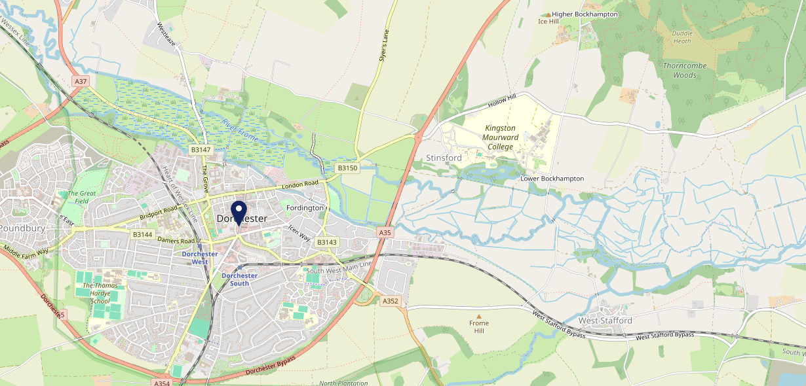
Site Intel
Hardys DT11TU
1 Miles
1 Chain
05/03/2025 - 25/02/2026
Site Summary
Hardys DT11TU
Work Area
Region
TV Region
Urbanicity
Dorchester and Weymouth
South West
HarWest
Urban city and town
DT11TU
Punch T&L
Top Competitors
ATV
Gender
Old Ship Inn
#1
£8.05
67.48%
Male
DT11UW
Pub Restaurant
Affluence
Segmentation
The Sun Inn Dorchester
#2
46.48%
28.88%
Middle Income
Enterprising Mainstream
DT27RZ
Pub Restaurant
Age Group
Visit Day
#3
33.10%
37.64%
35 to 44
Sat
Nearest Station
Dorchester South(0.37 miles)
158 Site Customers
2 Competitors
3068 Competitor Customers

Slide 2
Site Intel
Hardys DT11TU
1 Miles
1 Chain
05/03/2025 - 25/02/2026
Spend by Weekpart
How is customer spend distributed throughout the week for Hardys DT11TU versus its competitors?
% of spend for Hardys DT11TU and 1 Chains in 1 Miles from 05/03/2025 - 25/02/2026 split by Day of Week
158 Site Customers
2 Competitors
3068 Competitor Customers

Slide 3
Site Intel
Hardys DT11TU
1 Miles
1 Chain
05/03/2025 - 25/02/2026
Visit Frequency
How frequently per year do customers visit Hardys DT11TU versus its competitors?
% of customer numbers for Hardys DT11TU and 1 Chains in 1 Miles from 05/03/2025 - 25/02/2026 and the number of visits made Per Annum
158 Site Customers
2 Competitors
3068 Competitor Customers

Slide 4
Site Intel
Hardys DT11TU
1 Miles
1 Chain
05/03/2025 - 25/02/2026
ATV Change
How has ATV changed between two date ranges?
158 Site Customers

Slide 5
Site Intel
Hardys DT11TU
1 Miles
1 Chain
05/03/2025 - 25/02/2026
Market Share Change
How has market share changed between two date ranges?
% of market share spend for Hardys DT11TU and 1 Chains in 1 Miles from 05/03/2025 - 25/02/2026
158 Site Customers

Slide 6
Site Intel
Hardys DT11TU
1 Miles
1 Chain
05/03/2025 - 25/02/2026
Age
How does the age profile of customers who visit Hardys DT11TU compare versus its competitors?
% of spend for Hardys DT11TU and 1 Chains in 1 Miles from 05/03/2025 - 25/02/2026 split by Age Range
74 Site Customers
2 Competitors
1596 Competitor Customers

Slide 7
Site Intel
Hardys DT11TU
1 Miles
1 Chain
05/03/2025 - 25/02/2026
Affluence
How does the affluence of customers who visit Hardys DT11TU compare versus its competitors?
% of spend for Hardys DT11TU and 1 Chains in 1 Miles from 05/03/2025 - 25/02/2026 split by Affluence
71 Site Customers
2 Competitors
1486 Competitor Customers

Slide 8
Site Intel
Hardys DT11TU
1 Miles
1 Chain
05/03/2025 - 25/02/2026
Gender
How does the gender profile of customers who visit Hardys DT11TU compare versus its competitors?
% of spend for Hardys DT11TU and 1 Chains in 1 Miles from 05/03/2025 - 25/02/2026 split by Gender
71 Site Customers
2 Competitors
1537 Competitor Customers

Slide 9
Site Intel
Hardys DT11TU
1 Miles
1 Chain
05/03/2025 - 25/02/2026
Punch Segmentation
How does the Custom segmentation profile of customers who visit Hardys DT11TU compare versus its competitors?
% of spend for Hardys DT11TU and 1 Chains in 1 Miles from 05/03/2025 - 25/02/2026 split by Segment
158 Site Customers
2 Competitors
3068 Competitor Customers

Slide 10
Site Intel
Hardys DT11TU
1 Miles
1 Chain
05/03/2025 - 25/02/2026
Spend by Distance
How does the spend profile of Hardys DT11TU compare versus its competitors based on travel distances?
% of spend for Hardys DT11TU and 1 Chains in 1 Miles from 05/03/2025 - 25/02/2026 split by Distance travelled
71 Site Customers
2 Competitors
1536 Competitor Customers

Slide 11
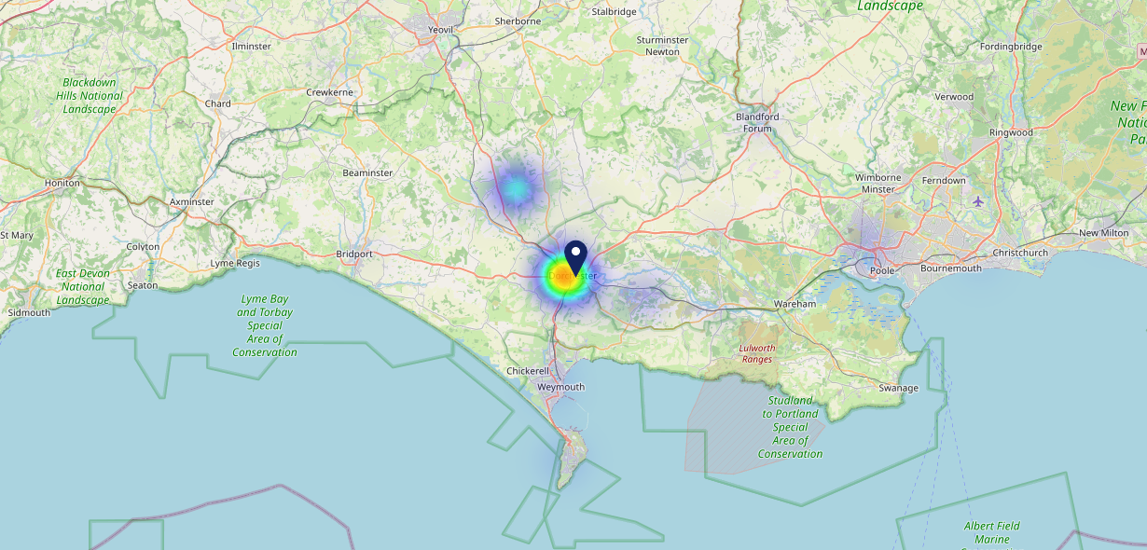
Site Intel
Hardys DT11TU
05/03/2025 - 25/02/2026
Map of Guest Origin
Where do customers of Hardys DT11TU come from?
Where do customers of Hardys DT11TU for 05/03/2025 - 25/02/2026 live
71 Site Customers

Slide 12
Site Intel
Hardys DT11TU
1 Miles
1 Chain
05/03/2025 - 25/02/2026
Share of Wallet
What are the Top 20 venues (by spend) that customers of Hardys DT11TU also visit?
For customers of Hardys DT11TU, who are the top 20 competitors from 1 Chains in 1 Miles for 05/03/2025 - 25/02/2026 split by Venue
158 Site Customers

Slide 13
Site Intel
Hardys DT11TU
1 Miles
1 Chain
05/03/2025 - 25/02/2026
Share of Wallet Change
How has share of wallet of customers of Hardys DT11TU changed between two date ranges?
158 Site Customers

Slide 14
Site Intel
Hardys DT11TU
05/03/2025 - 25/02/2026
Market Summary
How does the local area for Hardys DT11TU compare to the national average (1 = low, 10 = high)
Data Type | Name | Spend in 250m | 250m Spend vs National | Spend in 500m | 500m Spend vs National | Spend in 1 mile | 1 mile Spend vs National | Spend in 3 miles | 3 mile Spend vs National
Total | Annual Sales | £10.40M | 9 | £26.25M | 9 | £36.29M | 7 | £47.70M | 4
Weekpart | Mon - Thu | 46.2% | 8 | 45.5% | 8 | 45.3% | 8 | 45.7% | 9
Weekpart | Fri - Sat | 40.7% | 4 | 41.9% | 4 | 41.2% | 4 | 40.1% | 3
Weekpart | Sun | 13.1% | 4 | 12.6% | 3 | 13.6% | 3 | 14.3% | 2
Age | 18 to 24 | 5.0% | 5 | 4.6% | 4 | 4.7% | 3 | 4.9% | 3
Age | 25 to 34 | 14.1% | 2 | 12.6% | 1 | 12.7% | 1 | 13.1% | 1
Age | 35 to 44 | 20.5% | 4 | 18.3% | 2 | 18.8% | 2 | 18.9% | 1
Age | 45 to 54 | 22.2% | 7 | 20.7% | 6 | 20.6% | 6 | 19.7% | 5
Age | 55 to 64 | 20.3% | 8 | 21.1% | 9 | 20.5% | 9 | 20.2% | 9
Age | 65 to 74 | 10.7% | 8 | 12.6% | 9 | 12.6% | 9 | 13.0% | 10
Age | 75+ | 7.2% | 10 | 10.1% | 10 | 10.1% | 10 | 10.2% | 10
CAMEO | Business Elite | 3.6% | 3 | 3.4% | 3 | 3.1% | 2 | 3.1% | 2
CAMEO | Prosperous Professionals | 7.4% | 7 | 7.8% | 7 | 7.4% | 7 | 7.6% | 7
CAMEO | Flourishing Society | 21.1% | 9 | 21.8% | 9 | 21.2% | 9 | 21.6% | 9
CAMEO | Content Communities | 14.3% | 7 | 14.8% | 8 | 14.7% | 8 | 15.1% | 8
CAMEO | White Collar Neighbourhoods | 9.9% | 4 | 10.3% | 4 | 10.1% | 4 | 10.0% | 3
CAMEO | Enterprising Mainstream | 12.5% | 9 | 12.4% | 9 | 13.0% | 9 | 13.1% | 9
CAMEO | Paying The Mortgage | 14.0% | 5 | 12.6% | 4 | 12.5% | 4 | 12.2% | 4
CAMEO | Cash Conscious Communities | 10.0% | 6 | 10.1% | 6 | 10.6% | 7 | 10.2% | 6
CAMEO | On A Budget | 6.3% | 5 | 6.1% | 5 | 6.4% | 5 | 6.1% | 5
CAMEO | Family Value | 0.9% | 3 | 0.8% | 2 | 0.8% | 2 | 0.9% | 1
Affluence | AB | 32.1% | 7 | 33.0% | 7 | 31.8% | 6 | 32.3% | 6
Affluence | C1C2 | 50.7% | 6 | 50.1% | 6 | 50.4% | 6 | 50.4% | 6
Affluence | DE | 17.2% | 4 | 17.0% | 4 | 17.9% | 5 | 17.2% | 4

Slide 15
Site Intel
Hardys DT11TU
Site Potential 1
Site Characteristics
£3000
£18000
OCC Concept Fit
Achievable Average Weekly Takings
Our Local Destination
£7500
A Food-Led High Affluence B Food-Led Mid Affluence C Wet-Led Mid/High Affluence D Wet-Led Low Affluence E Food-Led Low Affluence
AWT 2 Local Regulars 3 Local Passing Trade 4 Destination Wet-Led 5 Destination Food-Led 6 Destination Very Food-Led
A
B
C
D
E
1
2
3
4
5
6

Slide 16
Site Intel
Hardys DT11TU
Site Potential 2
Concept Recommendation

Slide 17
Site Intel
Hardys DT11TU
Local Market Profile
Mix of spend by customer segment in Punch site and local market
 | Customer Count | Family Familiar | Occasional & Local | Mid-Week Seniors | Part Of The Pub | Metro Sophisticates | Young & Connected | Bubbly Weekenders | Upmarket Diners
Hardys | 42 | 14.47% | 3.84% | 2.29% | 0.55% | 26.03% | 37.96% | 10.98% | 3.82%
Local Catchment | 479 | 8.23% | 6.37% | 32.95% | 5.88% | 6.83% | 13.41% | 5.91% | 20.37%
Punch T&L | 94012 | 8.98% | 6.12% | 29.10% | 11.03% | 10.99% | 11.08% | 7.12% | 15.53%
Hardys vs Local Catchment |  | 6.24% | -2.53% | -30.66% | -5.33% | 19.20% | 24.55% | 5.07% | -16.55%
Hardys vs Punch T&L |  | 5.49% | -2.28% | -26.81% | -10.48% | 15.04% | 26.88% | 3.86% | -11.71%
Local Catchment vs Punch T&L |  | -0.75% | 0.25% | 3.85% | -5.15% | -4.16% | 2.33% | -1.21% | 4.84%

Slide 18
Site Intel
Hardys DT11TU
Local Competitor Profiles
Mix of spend by customer segment in Punch site and local competitors
 | Customer Count | Family Familiar | Occasional & Local | Mid-Week Seniors | Part Of The Pub | Metro Sophisticates | Young & Connected | Bubbly Weekenders | Upmarket Diners
Hardys DT11TU | 42 | 14.47% | 3.84% | 2.29% | 0.55% | 26.03% | 37.96% | 10.98% | 3.82%
Old Ship Inn DT11UW | 69 | 3.20% | 0.20% | 4.51% | 27.83% | 27.04% | 27.68% | 7.01% | 2.50%
The Sun Inn Dorchester DT27RZ | 425 | 9.08% | 7.41% | 37.73% | 2.19% | 3.43% | 11.02% | 5.72% | 23.38%

