Slide 1








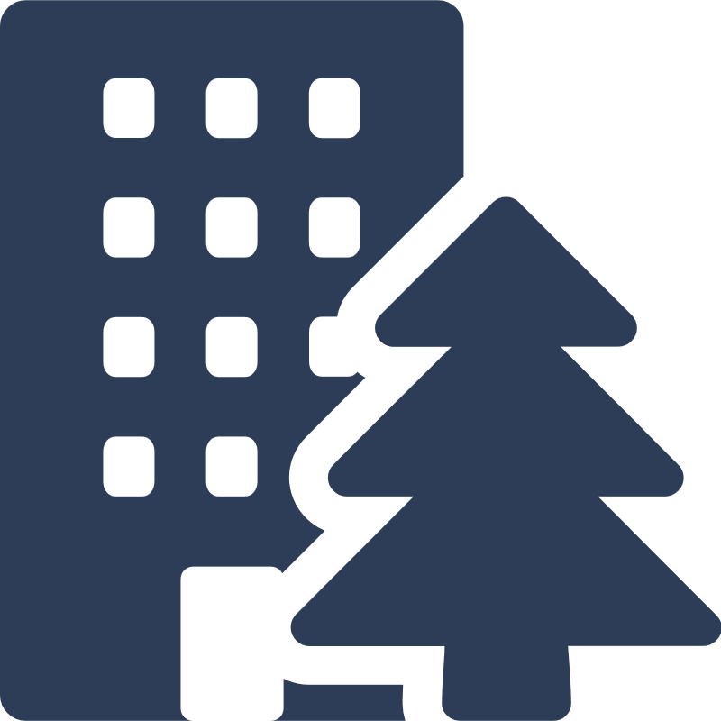

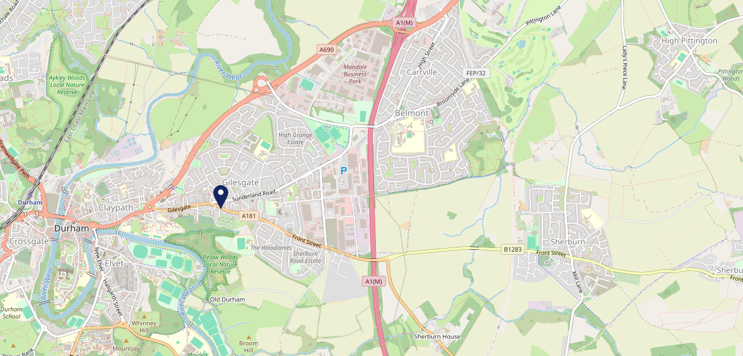









Site Intel
Queens Head Hotel DH12JR
3 Miles
1 Chain
22/02/2023 - 14/02/2024
Site Summary
Queens Head Hotel DH12JR
Work Area
Region
TV Region
Urbanicity
Durham and Bishop Auckland
North East
Tyne Tees
Urban city and town
DH12JR
Punch Unity
Top Competitors
ATV
Gender
Swan & Three Cygnets
#1
£9.16
65.36%
Male
DH13AG
Pub Restaurant
Affluence
Segmentation
#2
62.38%
27.06%
Low Income
On A Budget
Age Group
Visit Day
#3
43.27%
17.84%
55 to 64
Fri
Nearest Station
Durham(1.73 miles)
440 Site Customers
1 Competitors
3169 Competitor Customers

Slide 2

Site Intel
Queens Head Hotel DH12JR
3 Miles
1 Chain
22/02/2023 - 14/02/2024
Spend by Weekpart
How is customer spend distributed throughout the week for Queens Head Hotel DH12JR versus its competitors?
% of spend for Queens Head Hotel DH12JR and 1 Chains in 3 Miles from 22/02/2023 - 14/02/2024 split by Day of Week
440 Site Customers
1 Competitors
3169 Competitor Customers

Slide 3
Site Intel
Queens Head Hotel DH12JR
3 Miles
1 Chain
22/02/2023 - 14/02/2024
Visit Frequency
How frequently per year do customers visit Queens Head Hotel DH12JR versus its competitors?
% of customer numbers for Queens Head Hotel DH12JR and 1 Chains in 3 Miles from 22/02/2023 - 14/02/2024 and the number of visits made Per Annum
440 Site Customers
1 Competitors
3169 Competitor Customers

Slide 4
Site Intel
Queens Head Hotel DH12JR
3 Miles
1 Chain
22/02/2023 - 14/02/2024
ATV Change
How has ATV changed between two date ranges?
440 Site Customers

Slide 5
Site Intel
Queens Head Hotel DH12JR
3 Miles
1 Chain
22/02/2023 - 14/02/2024
Market Share Change
How has market share changed between two date ranges?
% of market share spend for Queens Head Hotel DH12JR and 1 Chains in 3 Miles from 22/02/2023 - 14/02/2024
440 Site Customers

Slide 6
Site Intel
Queens Head Hotel DH12JR
3 Miles
1 Chain
22/02/2023 - 14/02/2024
Age
How does the age profile of customers who visit Queens Head Hotel DH12JR compare versus its competitors?
% of spend for Queens Head Hotel DH12JR and 1 Chains in 3 Miles from 22/02/2023 - 14/02/2024 split by Age Range
164 Site Customers
1 Competitors
843 Competitor Customers

Slide 7
Site Intel
Queens Head Hotel DH12JR
3 Miles
1 Chain
22/02/2023 - 14/02/2024
Affluence
How does the affluence of customers who visit Queens Head Hotel DH12JR compare versus its competitors?
% of spend for Queens Head Hotel DH12JR and 1 Chains in 3 Miles from 22/02/2023 - 14/02/2024 split by Affluence
152 Site Customers
1 Competitors
777 Competitor Customers

Slide 8
Site Intel
Queens Head Hotel DH12JR
3 Miles
1 Chain
22/02/2023 - 14/02/2024
Gender
How does the gender profile of customers who visit Queens Head Hotel DH12JR compare versus its competitors?
% of spend for Queens Head Hotel DH12JR and 1 Chains in 3 Miles from 22/02/2023 - 14/02/2024 split by Gender
158 Site Customers
1 Competitors
823 Competitor Customers

Slide 9
Site Intel
Queens Head Hotel DH12JR
3 Miles
1 Chain
22/02/2023 - 14/02/2024
Punch Segmentation
How does the Custom segmentation profile of customers who visit Queens Head Hotel DH12JR compare versus its competitors?
% of spend for Queens Head Hotel DH12JR and 1 Chains in 3 Miles from 22/02/2023 - 14/02/2024 split by Segment
440 Site Customers
1 Competitors
3169 Competitor Customers

Slide 10
Site Intel
Queens Head Hotel DH12JR
3 Miles
1 Chain
22/02/2023 - 14/02/2024
Spend by Distance
How does the spend profile of Queens Head Hotel DH12JR compare versus its competitors based on travel distances?
% of spend for Queens Head Hotel DH12JR and 1 Chains in 3 Miles from 22/02/2023 - 14/02/2024 split by Distance travelled
158 Site Customers
1 Competitors
821 Competitor Customers

Slide 11
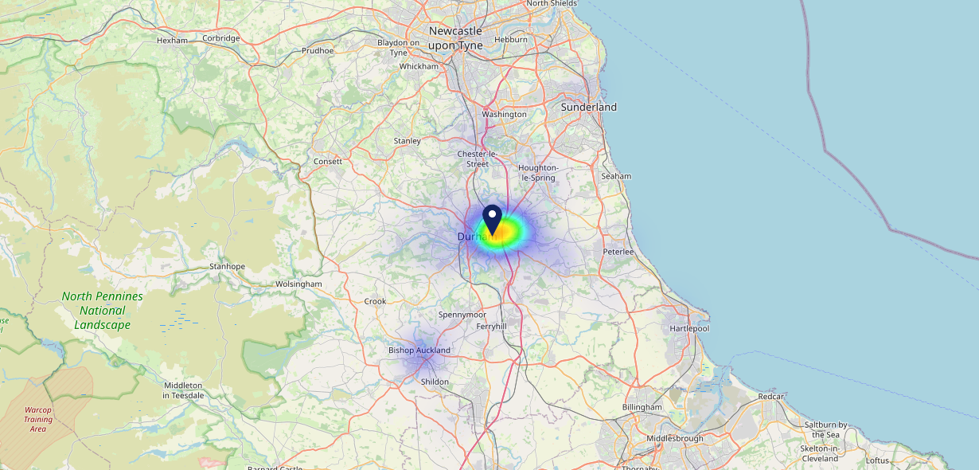

Site Intel
Queens Head Hotel DH12JR
22/02/2023 - 14/02/2024
Map of Guest Origin
Where do customers of Queens Head Hotel DH12JR come from?
Where do customers of Queens Head Hotel DH12JR for 22/02/2023 - 14/02/2024 live
158 Site Customers

Slide 12
Site Intel
Queens Head Hotel DH12JR
3 Miles
1 Chain
22/02/2023 - 14/02/2024
Share of Wallet
What are the Top 20 venues (by spend) that customers of Queens Head Hotel DH12JR also visit?
For customers of Queens Head Hotel DH12JR, who are the top 20 competitors from 1 Chains in 3 Miles for 22/02/2023 - 14/02/2024 split by Venue
440 Site Customers

Slide 13
Site Intel
Queens Head Hotel DH12JR
3 Miles
1 Chain
22/02/2023 - 14/02/2024
Share of Wallet Change
How has share of wallet of customers of Queens Head Hotel DH12JR changed between two date ranges?
440 Site Customers

Slide 14
Site Intel
Queens Head Hotel DH12JR
22/02/2023 - 14/02/2024
Market Summary
How does the local area for Queens Head Hotel DH12JR compare to the national average (1 = low, 10 = high)
Data Type | Name | Spend in 250m | 250m Spend vs National | Spend in 500m | 500m Spend vs National | Spend in 1 mile | 1 mile Spend vs National | Spend in 3 miles | 3 mile Spend vs National
Total | Annual Sales | £700K | 4 | £1.32M | 4 | £68.94M | 8 | £104.57M | 7
Weekpart | Mon - Thu | 48.1% | 9 | 49.6% | 10 | 38.2% | 3 | 41.1% | 5
Weekpart | Fri - Sat | 42.6% | 5 | 41.9% | 4 | 48.1% | 10 | 45.6% | 9
Weekpart | Sun | 9.4% | 2 | 8.5% | 1 | 13.7% | 3 | 13.4% | 1
Age | 18 to 24 | 11.4% | 9 | 6.8% | 6 | 8.1% | 7 | 7.0% | 5
Age | 25 to 34 | 7.6% | 1 | 7.7% | 1 | 16.6% | 2 | 15.3% | 2
Age | 35 to 44 | 22.1% | 5 | 20.7% | 4 | 24.8% | 7 | 25.0% | 7
Age | 45 to 54 | 27.2% | 10 | 27.2% | 10 | 23.3% | 9 | 22.8% | 9
Age | 55 to 64 | 21.4% | 9 | 25.1% | 10 | 17.5% | 7 | 18.1% | 8
Age | 65 to 74 | 8.4% | 7 | 9.2% | 8 | 7.1% | 6 | 8.2% | 8
Age | 75+ | 1.9% | 5 | 3.3% | 7 | 2.7% | 6 | 3.7% | 7
CAMEO | Business Elite | 5.1% | 5 | 5.5% | 5 | 5.3% | 4 | 5.1% | 4
CAMEO | Prosperous Professionals | 3.7% | 3 | 3.0% | 2 | 5.0% | 4 | 4.9% | 3
CAMEO | Flourishing Society | 9.7% | 4 | 7.6% | 3 | 8.8% | 3 | 8.4% | 3
CAMEO | Content Communities | 12.2% | 5 | 11.9% | 5 | 12.3% | 5 | 12.2% | 5
CAMEO | White Collar Neighbourhoods | 11.3% | 5 | 9.9% | 4 | 9.3% | 3 | 9.5% | 3
CAMEO | Enterprising Mainstream | 5.7% | 4 | 6.9% | 5 | 9.6% | 7 | 9.9% | 7
CAMEO | Paying The Mortgage | 18.1% | 8 | 17.5% | 8 | 15.8% | 7 | 15.9% | 7
CAMEO | Cash Conscious Communities | 14.7% | 9 | 17.0% | 10 | 14.4% | 9 | 15.2% | 10
CAMEO | On A Budget | 4.0% | 3 | 3.7% | 2 | 5.2% | 4 | 5.2% | 3
CAMEO | Family Value | 15.6% | 10 | 17.0% | 10 | 14.3% | 10 | 13.6% | 10
Affluence | AB | 18.5% | 3 | 16.1% | 3 | 19.1% | 3 | 18.4% | 3
Affluence | C1C2 | 47.3% | 5 | 46.2% | 5 | 47.0% | 5 | 47.5% | 5
Affluence | DE | 34.2% | 9 | 37.6% | 9 | 33.9% | 9 | 34.0% | 9

