Slide 1










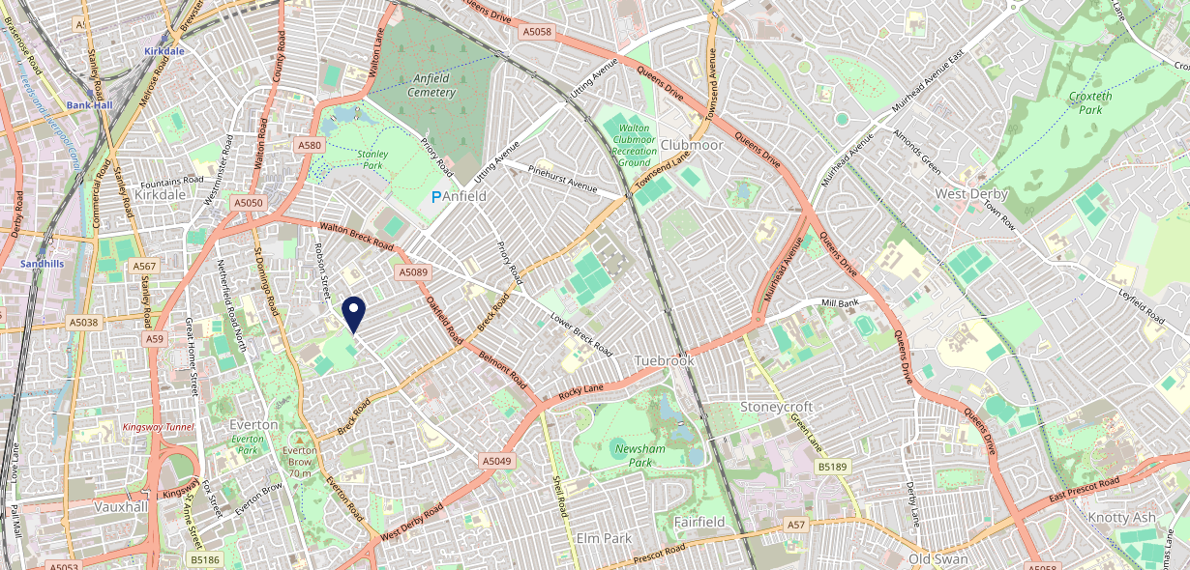









Site Intel
Grove L54QT
1 Miles
1 Chain
05/02/2025 - 28/01/2026
Site Summary
Grove L54QT
Work Area
Region
TV Region
Urbanicity
Liverpool
North West
North West
Urban major conurbation
L54QT
Punch T&L
Top Competitors
ATV
Gender
#1
£10.37
80.92%
Male
Affluence
Segmentation
#2
42.53%
15.84%
Middle Income
On A Budget
Age Group
Visit Day
#3
28.43%
31.63%
35 to 44
Sun
Nearest Station
Sandhills(1.85 miles)
398 Site Customers
0 Competitors
0 Competitor Customers

Slide 2

Site Intel
Grove L54QT
1 Miles
1 Chain
05/02/2025 - 28/01/2026
Spend by Weekpart
How is customer spend distributed throughout the week for Grove L54QT versus its competitors?
% of spend for Grove L54QT and 1 Chains in 1 Miles from 05/02/2025 - 28/01/2026 split by Day of Week
398 Site Customers
0 Competitors
0 Competitor Customers

Slide 3
Site Intel
Grove L54QT
1 Miles
1 Chain
05/02/2025 - 28/01/2026
Visit Frequency
How frequently per year do customers visit Grove L54QT versus its competitors?
% of customer numbers for Grove L54QT and 1 Chains in 1 Miles from 05/02/2025 - 28/01/2026 and the number of visits made Per Annum
398 Site Customers
0 Competitors
0 Competitor Customers

Slide 4
Site Intel
Grove L54QT
1 Miles
1 Chain
05/02/2025 - 28/01/2026
ATV Change
How has ATV changed between two date ranges?
398 Site Customers

Slide 5
Site Intel
Grove L54QT
1 Miles
1 Chain
05/02/2025 - 28/01/2026
Market Share Change
How has market share changed between two date ranges?
% of market share spend for Grove L54QT and 1 Chains in 1 Miles from 05/02/2025 - 28/01/2026
398 Site Customers

Slide 6
Site Intel
Grove L54QT
1 Miles
1 Chain
05/02/2025 - 28/01/2026
Age
How does the age profile of customers who visit Grove L54QT compare versus its competitors?
% of spend for Grove L54QT and 1 Chains in 1 Miles from 05/02/2025 - 28/01/2026 split by Age Range
178 Site Customers
0 Competitors

Slide 7
Site Intel
Grove L54QT
1 Miles
1 Chain
05/02/2025 - 28/01/2026
Affluence
How does the affluence of customers who visit Grove L54QT compare versus its competitors?
% of spend for Grove L54QT and 1 Chains in 1 Miles from 05/02/2025 - 28/01/2026 split by Affluence
163 Site Customers
0 Competitors

Slide 8
Site Intel
Grove L54QT
1 Miles
1 Chain
05/02/2025 - 28/01/2026
Gender
How does the gender profile of customers who visit Grove L54QT compare versus its competitors?
% of spend for Grove L54QT and 1 Chains in 1 Miles from 05/02/2025 - 28/01/2026 split by Gender
172 Site Customers
0 Competitors

Slide 9
Site Intel
Grove L54QT
1 Miles
1 Chain
05/02/2025 - 28/01/2026
Punch Segmentation
How does the Custom segmentation profile of customers who visit Grove L54QT compare versus its competitors?
% of spend for Grove L54QT and 1 Chains in 1 Miles from 05/02/2025 - 28/01/2026 split by Segment
398 Site Customers
0 Competitors
0 Competitor Customers

Slide 10
Site Intel
Grove L54QT
1 Miles
1 Chain
05/02/2025 - 28/01/2026
Spend by Distance
How does the spend profile of Grove L54QT compare versus its competitors based on travel distances?
% of spend for Grove L54QT and 1 Chains in 1 Miles from 05/02/2025 - 28/01/2026 split by Distance travelled
172 Site Customers
0 Competitors
0 Competitor Customers

Slide 11
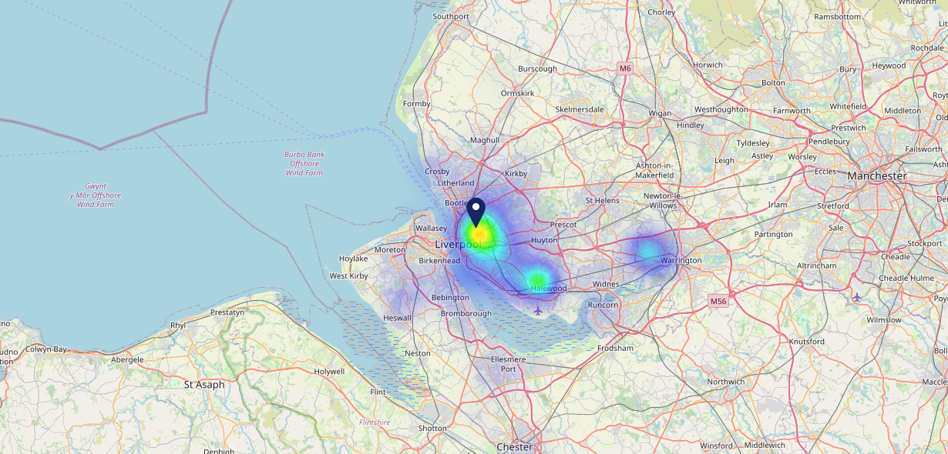

Site Intel
Grove L54QT
05/02/2025 - 28/01/2026
Map of Guest Origin
Where do customers of Grove L54QT come from?
Where do customers of Grove L54QT for 05/02/2025 - 28/01/2026 live
172 Site Customers

Slide 12
Site Intel
Grove L54QT
1 Miles
1 Chain
05/02/2025 - 28/01/2026
Share of Wallet
What are the Top 20 venues (by spend) that customers of Grove L54QT also visit?
For customers of Grove L54QT, who are the top 20 competitors from 1 Chains in 1 Miles for 05/02/2025 - 28/01/2026 split by Venue
398 Site Customers

Slide 13
Site Intel
Grove L54QT
1 Miles
1 Chain
05/02/2025 - 28/01/2026
Share of Wallet Change
How has share of wallet of customers of Grove L54QT changed between two date ranges?
398 Site Customers

Slide 14
Site Intel
Grove L54QT
05/02/2025 - 28/01/2026
Market Summary
How does the local area for Grove L54QT compare to the national average (1 = low, 10 = high)
Data Type | Name | Spend in 250m | 250m Spend vs National | Spend in 500m | 500m Spend vs National | Spend in 1 mile | 1 mile Spend vs National | Spend in 3 miles | 3 mile Spend vs National
Total | Annual Sales | £151K | 2 | £747K | 3 | £18.77M | 6 | £833.05M | 10
Weekpart | Mon - Thu | 28.5% | 1 | 35.3% | 2 | 44.7% | 8 | 36.5% | 1
Weekpart | Fri - Sat | 40.1% | 3 | 39.9% | 3 | 35.9% | 1 | 47.8% | 10
Weekpart | Sun | 31.4% | 10 | 24.8% | 10 | 19.4% | 10 | 15.7% | 6
Age | 18 to 24 | 6.9% | 6 | 12.3% | 9 | 8.5% | 7 | 8.0% | 6
Age | 25 to 34 | 15.0% | 2 | 13.5% | 2 | 18.5% | 3 | 19.6% | 3
Age | 35 to 44 | 28.4% | 9 | 22.0% | 5 | 26.9% | 9 | 25.0% | 7
Age | 45 to 54 | 20.2% | 5 | 21.4% | 7 | 20.9% | 6 | 19.9% | 5
Age | 55 to 64 | 15.6% | 6 | 23.3% | 10 | 18.1% | 8 | 17.8% | 8
Age | 65 to 74 | 12.3% | 9 | 7.1% | 6 | 5.8% | 5 | 7.8% | 7
Age | 75+ | 1.6% | 4 | 0.5% | 1 | 1.1% | 2 | 2.0% | 4
CAMEO | Business Elite | 3.8% | 4 | 4.6% | 4 | 3.4% | 3 | 6.5% | 5
CAMEO | Prosperous Professionals | 3.8% | 3 | 3.4% | 3 | 2.2% | 1 | 4.4% | 3
CAMEO | Flourishing Society | 8.5% | 4 | 9.0% | 4 | 4.4% | 1 | 6.6% | 2
CAMEO | Content Communities | 11.5% | 5 | 6.8% | 1 | 6.5% | 1 | 9.4% | 2
CAMEO | White Collar Neighbourhoods | 13.5% | 8 | 11.2% | 5 | 10.1% | 4 | 13.4% | 8
CAMEO | Enterprising Mainstream | 5.8% | 4 | 6.6% | 4 | 7.2% | 5 | 8.7% | 6
CAMEO | Paying The Mortgage | 10.2% | 3 | 11.7% | 4 | 14.3% | 5 | 15.9% | 7
CAMEO | Cash Conscious Communities | 15.6% | 9 | 12.7% | 8 | 15.7% | 9 | 12.3% | 8
CAMEO | On A Budget | 16.3% | 10 | 18.4% | 10 | 20.3% | 10 | 12.5% | 10
CAMEO | Family Value | 10.9% | 9 | 15.7% | 10 | 15.9% | 10 | 10.4% | 9
Affluence | AB | 16.1% | 3 | 17.0% | 3 | 10.0% | 1 | 17.6% | 2
Affluence | C1C2 | 41.1% | 3 | 36.2% | 2 | 38.1% | 2 | 47.3% | 5
Affluence | DE | 42.8% | 10 | 46.8% | 10 | 51.9% | 10 | 35.2% | 10

Slide 15

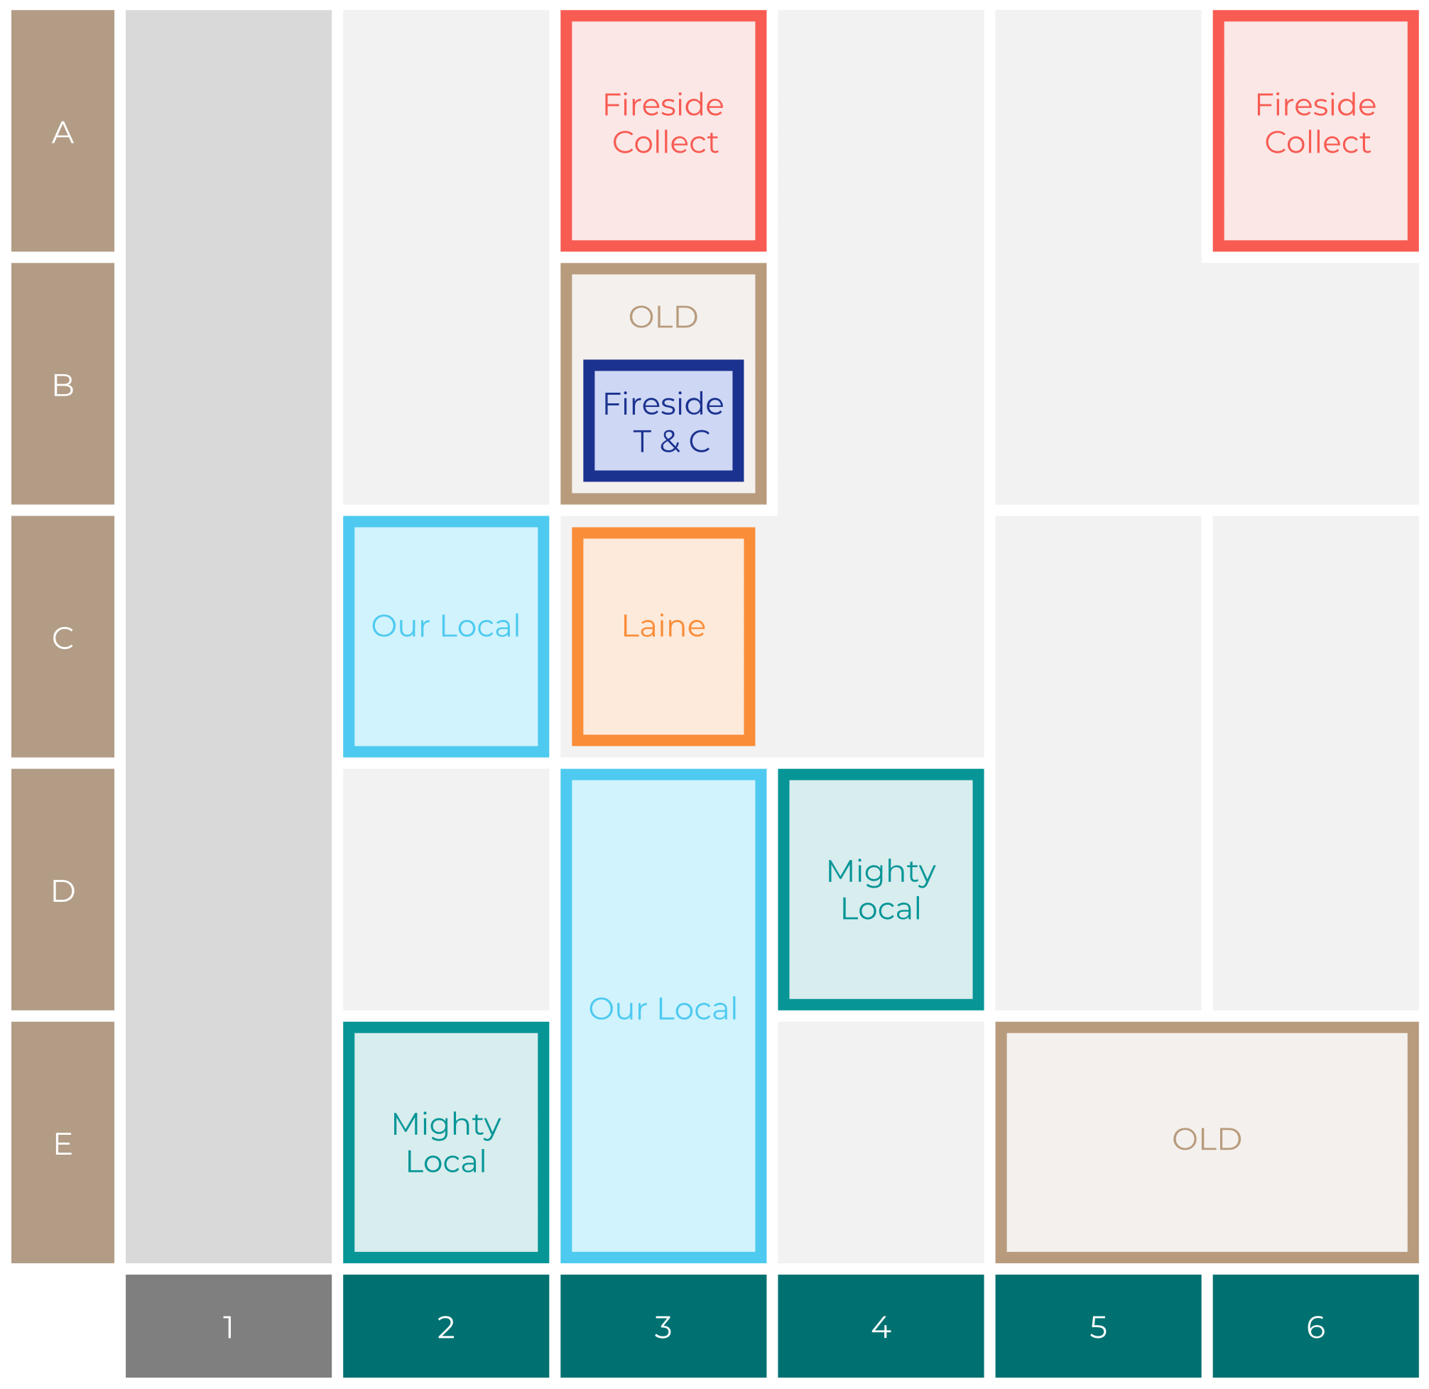

Site Intel
Grove L54QT
Site Potential 1
Site Characteristics
£3000
£18000
OCC Concept Fit
Achievable Average Weekly Takings
Mighty Local
£6000
A Food-Led High Affluence B Food-Led Mid Affluence C Wet-Led Mid/High Affluence D Wet-Led Low Affluence E Food-Led Low Affluence
AWT 2 Local Regulars 3 Local Passing Trade 4 Destination Wet-Led 5 Destination Food-Led 6 Destination Very Food-Led
A
B
C
D
E
1
2
3
4
5
6

Slide 16
Site Intel
Grove L54QT
Site Potential 2
Concept Recommendation

Slide 17
Site Intel
Grove L54QT
Local Market Profile
Mix of spend by customer segment in Punch site and local market
 | Customer Count | Family Familiar | Occasional & Local | Mid-Week Seniors | Part Of The Pub | Metro Sophisticates | Young & Connected | Bubbly Weekenders | Upmarket Diners
Grove | 85 | 28.48% | 7.27% | 13.88% | 4.50% | 16.51% | 17.35% | 5.34% | 6.63%
Punch T&L | 95247 | 8.96% | 6.12% | 29.02% | 11.18% | 10.98% | 11.14% | 7.14% | 15.41%
Grove vs Punch T&L |  | 19.52% | 1.15% | -15.14% | -6.68% | 5.53% | 6.21% | -1.80% | -8.78%

Slide 18
Site Intel
Grove L54QT
Local Competitor Profiles
Mix of spend by customer segment in Punch site and local competitors
 | Customer Count | Family Familiar | Occasional & Local | Mid-Week Seniors | Part Of The Pub | Metro Sophisticates | Young & Connected | Bubbly Weekenders | Upmarket Diners
Grove L54QT | 85 | 28.48% | 7.27% | 13.88% | 4.50% | 16.51% | 17.35% | 5.34% | 6.63%

