Slide 1









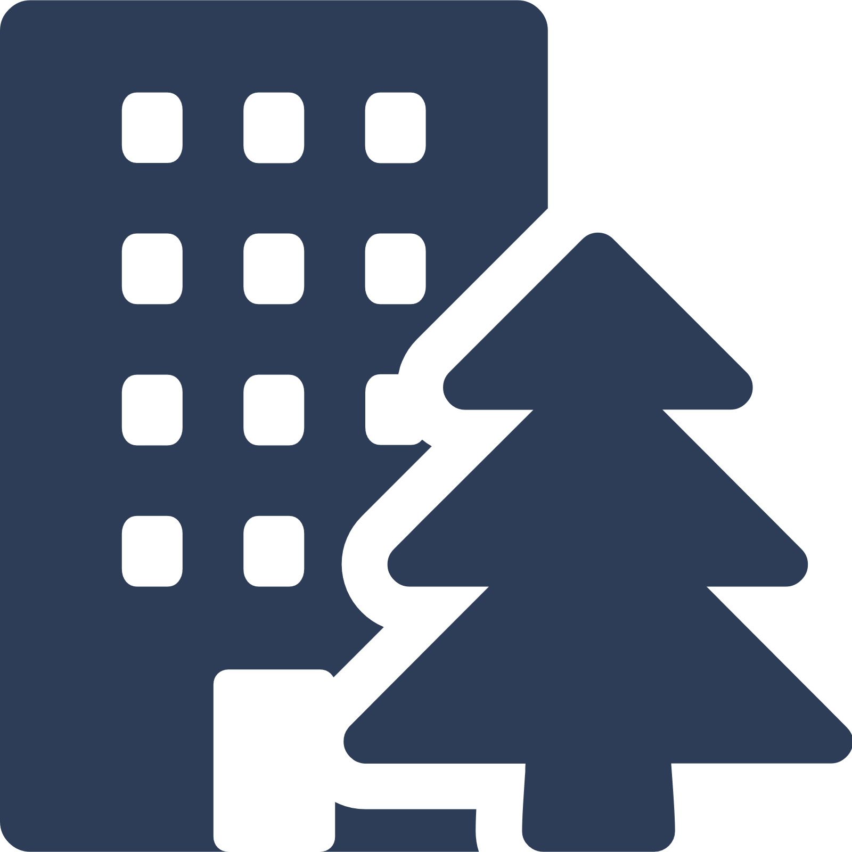

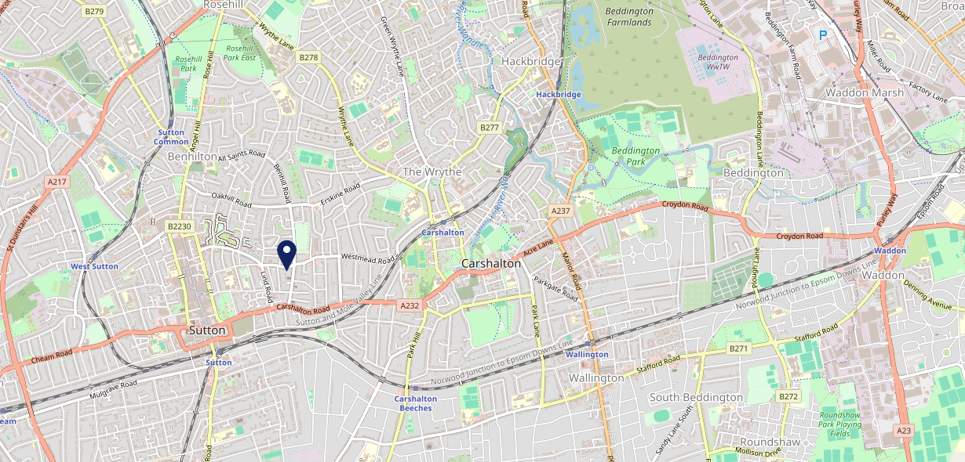











Site Intel
Lord Nelson SM14QP
1 Miles
371 Chains
16/04/2025 - 08/04/2026
Site Summary
Lord Nelson SM14QP
Work Area
Region
TV Region
Urbanicity
London
London
London
Urban major conurbation
SM14QP
Punch T&L
Top Competitors
ATV
Gender
ONeills Sutton
#1
£13.01
97.55%
Male
SM11DJ
O'Neills
Affluence
Segmentation
The Moon on the Hill
#2
39.00%
23.47%
Low Income
On A Budget
SM11DZ
JD Wetherspoon
Age Group
Visit Day
Crown Sutton
#3
49.38%
37.88%
SM11LD
55 to 64
Fri
Craft Union
Nearest Station
Sutton(0.82 miles)
55 Site Customers
300 Competitors
121763 Competitor Customers

Slide 2

Site Intel
Lord Nelson SM14QP
1 Miles
371 Chains
16/04/2025 - 08/04/2026
Spend by Weekpart
How is customer spend distributed throughout the week for Lord Nelson SM14QP versus its competitors?
% of spend for Lord Nelson SM14QP and 371 Chains in 1 Miles from 16/04/2025 - 08/04/2026 split by Day of Week
55 Site Customers
300 Competitors
121763 Competitor Customers

Slide 3
Site Intel
Lord Nelson SM14QP
1 Miles
371 Chains
16/04/2025 - 08/04/2026
Visit Frequency
How frequently per year do customers visit Lord Nelson SM14QP versus its competitors?
% of customer numbers for Lord Nelson SM14QP and 371 Chains in 1 Miles from 16/04/2025 - 08/04/2026 and the number of visits made Per Annum
55 Site Customers
300 Competitors
121763 Competitor Customers

Slide 4
Site Intel
Lord Nelson SM14QP
1 Miles
371 Chains
16/04/2025 - 08/04/2026
ATV Change
How has ATV changed between two date ranges?
55 Site Customers

Slide 5
Site Intel
Lord Nelson SM14QP
1 Miles
371 Chains
16/04/2025 - 08/04/2026
Market Share Change
How has market share changed between two date ranges?
% of market share spend for Lord Nelson SM14QP and 371 Chains in 1 Miles from 16/04/2025 - 08/04/2026
55 Site Customers

Slide 6
Site Intel
Lord Nelson SM14QP
1 Miles
371 Chains
16/04/2025 - 08/04/2026
Age
How does the age profile of customers who visit Lord Nelson SM14QP compare versus its competitors?
% of spend for Lord Nelson SM14QP and 371 Chains in 1 Miles from 16/04/2025 - 08/04/2026 split by Age Range
23 Site Customers
300 Competitors
47689 Competitor Customers

Slide 7
Site Intel
Lord Nelson SM14QP
1 Miles
371 Chains
16/04/2025 - 08/04/2026
Affluence
How does the affluence of customers who visit Lord Nelson SM14QP compare versus its competitors?
% of spend for Lord Nelson SM14QP and 371 Chains in 1 Miles from 16/04/2025 - 08/04/2026 split by Affluence
23 Site Customers
300 Competitors
44809 Competitor Customers

Slide 8
Site Intel
Lord Nelson SM14QP
1 Miles
371 Chains
16/04/2025 - 08/04/2026
Gender
How does the gender profile of customers who visit Lord Nelson SM14QP compare versus its competitors?
% of spend for Lord Nelson SM14QP and 371 Chains in 1 Miles from 16/04/2025 - 08/04/2026 split by Gender
23 Site Customers
300 Competitors
45920 Competitor Customers

Slide 9
Site Intel
Lord Nelson SM14QP
1 Miles
371 Chains
16/04/2025 - 08/04/2026
Punch Segmentation
How does the Custom segmentation profile of customers who visit Lord Nelson SM14QP compare versus its competitors?
% of spend for Lord Nelson SM14QP and 371 Chains in 1 Miles from 16/04/2025 - 08/04/2026 split by Segment
55 Site Customers
300 Competitors
121763 Competitor Customers

Slide 10
Site Intel
Lord Nelson SM14QP
1 Miles
371 Chains
16/04/2025 - 08/04/2026
Spend by Distance
How does the spend profile of Lord Nelson SM14QP compare versus its competitors based on travel distances?
% of spend for Lord Nelson SM14QP and 371 Chains in 1 Miles from 16/04/2025 - 08/04/2026 split by Distance travelled
23 Site Customers
300 Competitors
45903 Competitor Customers

Slide 11
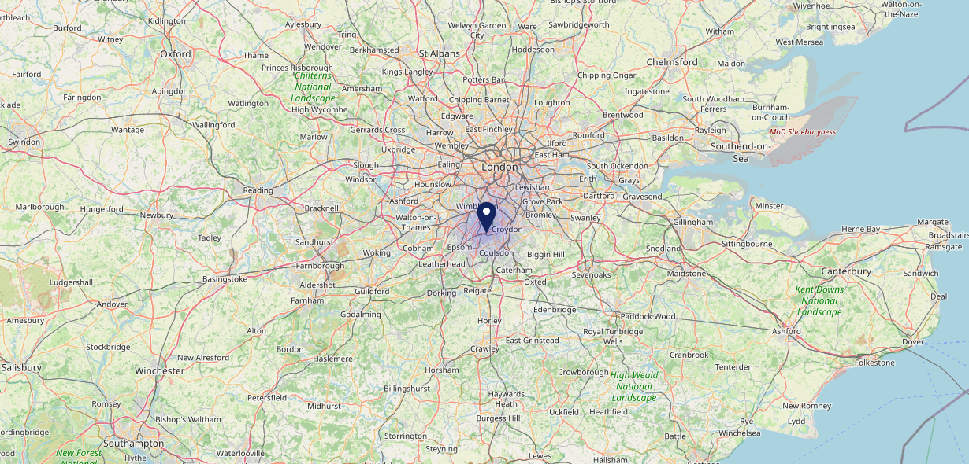

Site Intel
Lord Nelson SM14QP
16/04/2025 - 08/04/2026
Map of Guest Origin
Where do customers of Lord Nelson SM14QP come from?
Where do customers of Lord Nelson SM14QP for 16/04/2025 - 08/04/2026 live
23 Site Customers

Slide 12
Site Intel
Lord Nelson SM14QP
1 Miles
371 Chains
16/04/2025 - 08/04/2026
Share of Wallet
What are the Top 20 venues (by spend) that customers of Lord Nelson SM14QP also visit?
For customers of Lord Nelson SM14QP, who are the top 20 competitors from 371 Chains in 1 Miles for 16/04/2025 - 08/04/2026 split by Venue
55 Site Customers

Slide 13
Site Intel
Lord Nelson SM14QP
1 Miles
371 Chains
16/04/2025 - 08/04/2026
Share of Wallet Change
How has share of wallet of customers of Lord Nelson SM14QP changed between two date ranges?
55 Site Customers

Slide 14
Site Intel
Lord Nelson SM14QP
16/04/2025 - 08/04/2026
Market Summary
How does the local area for Lord Nelson SM14QP compare to the national average (1 = low, 10 = high)
Data Type | Name | Spend in 250m | 250m Spend vs National | Spend in 500m | 500m Spend vs National | Spend in 1 mile | 1 mile Spend vs National | Spend in 3 miles | 3 mile Spend vs National
Total | Annual Sales | £973K | 5 | £1.42M | 4 | £41.00M | 8 | £189.68M | 8
Weekpart | Mon - Thu | 40.7% | 6 | 40.3% | 5 | 44.4% | 8 | 44.5% | 8
Weekpart | Fri - Sat | 39.9% | 3 | 40.8% | 4 | 41.1% | 4 | 39.7% | 3
Weekpart | Sun | 19.4% | 9 | 18.9% | 9 | 14.5% | 4 | 15.8% | 6
Age | 18 to 24 | 0.7% | 1 | 0.7% | 1 | 2.8% | 2 | 4.0% | 2
Age | 25 to 34 | 12.1% | 2 | 11.0% | 1 | 11.8% | 1 | 12.3% | 1
Age | 35 to 44 | 23.7% | 6 | 26.7% | 8 | 22.9% | 5 | 24.0% | 6
Age | 45 to 54 | 26.1% | 10 | 22.1% | 8 | 24.0% | 9 | 22.1% | 8
Age | 55 to 64 | 20.1% | 8 | 24.4% | 10 | 23.1% | 10 | 20.8% | 10
Age | 65 to 74 | 15.3% | 10 | 13.2% | 9 | 10.3% | 9 | 11.1% | 9
Age | 75+ | 1.9% | 5 | 1.9% | 5 | 5.1% | 9 | 5.8% | 9
CAMEO | Business Elite | 9.0% | 7 | 10.1% | 7 | 13.5% | 8 | 13.9% | 8
CAMEO | Prosperous Professionals | 1.2% | 1 | 7.1% | 7 | 4.6% | 4 | 5.0% | 4
CAMEO | Flourishing Society | 16.1% | 7 | 14.0% | 6 | 17.9% | 8 | 21.5% | 9
CAMEO | Content Communities | 6.9% | 2 | 8.7% | 2 | 10.1% | 3 | 9.3% | 2
CAMEO | White Collar Neighbourhoods | 22.6% | 10 | 23.3% | 10 | 19.7% | 10 | 16.6% | 10
CAMEO | Enterprising Mainstream | 2.2% | 1 | 2.0% | 1 | 4.5% | 2 | 3.8% | 1
CAMEO | Paying The Mortgage | 9.2% | 2 | 8.2% | 2 | 11.2% | 3 | 12.1% | 4
CAMEO | Cash Conscious Communities | 19.4% | 10 | 15.5% | 9 | 7.9% | 4 | 8.0% | 4
CAMEO | On A Budget | 13.4% | 9 | 11.1% | 9 | 10.2% | 8 | 9.3% | 8
CAMEO | Family Value | 0.0% | 0 | 0.0% | 0 | 0.6% | 1 | 0.5% | 1
Affluence | AB | 26.3% | 5 | 31.1% | 6 | 36.0% | 7 | 40.4% | 8
Affluence | C1C2 | 40.9% | 3 | 42.3% | 3 | 45.4% | 4 | 41.9% | 3
Affluence | DE | 32.8% | 9 | 26.6% | 7 | 18.6% | 5 | 17.8% | 4

Slide 15

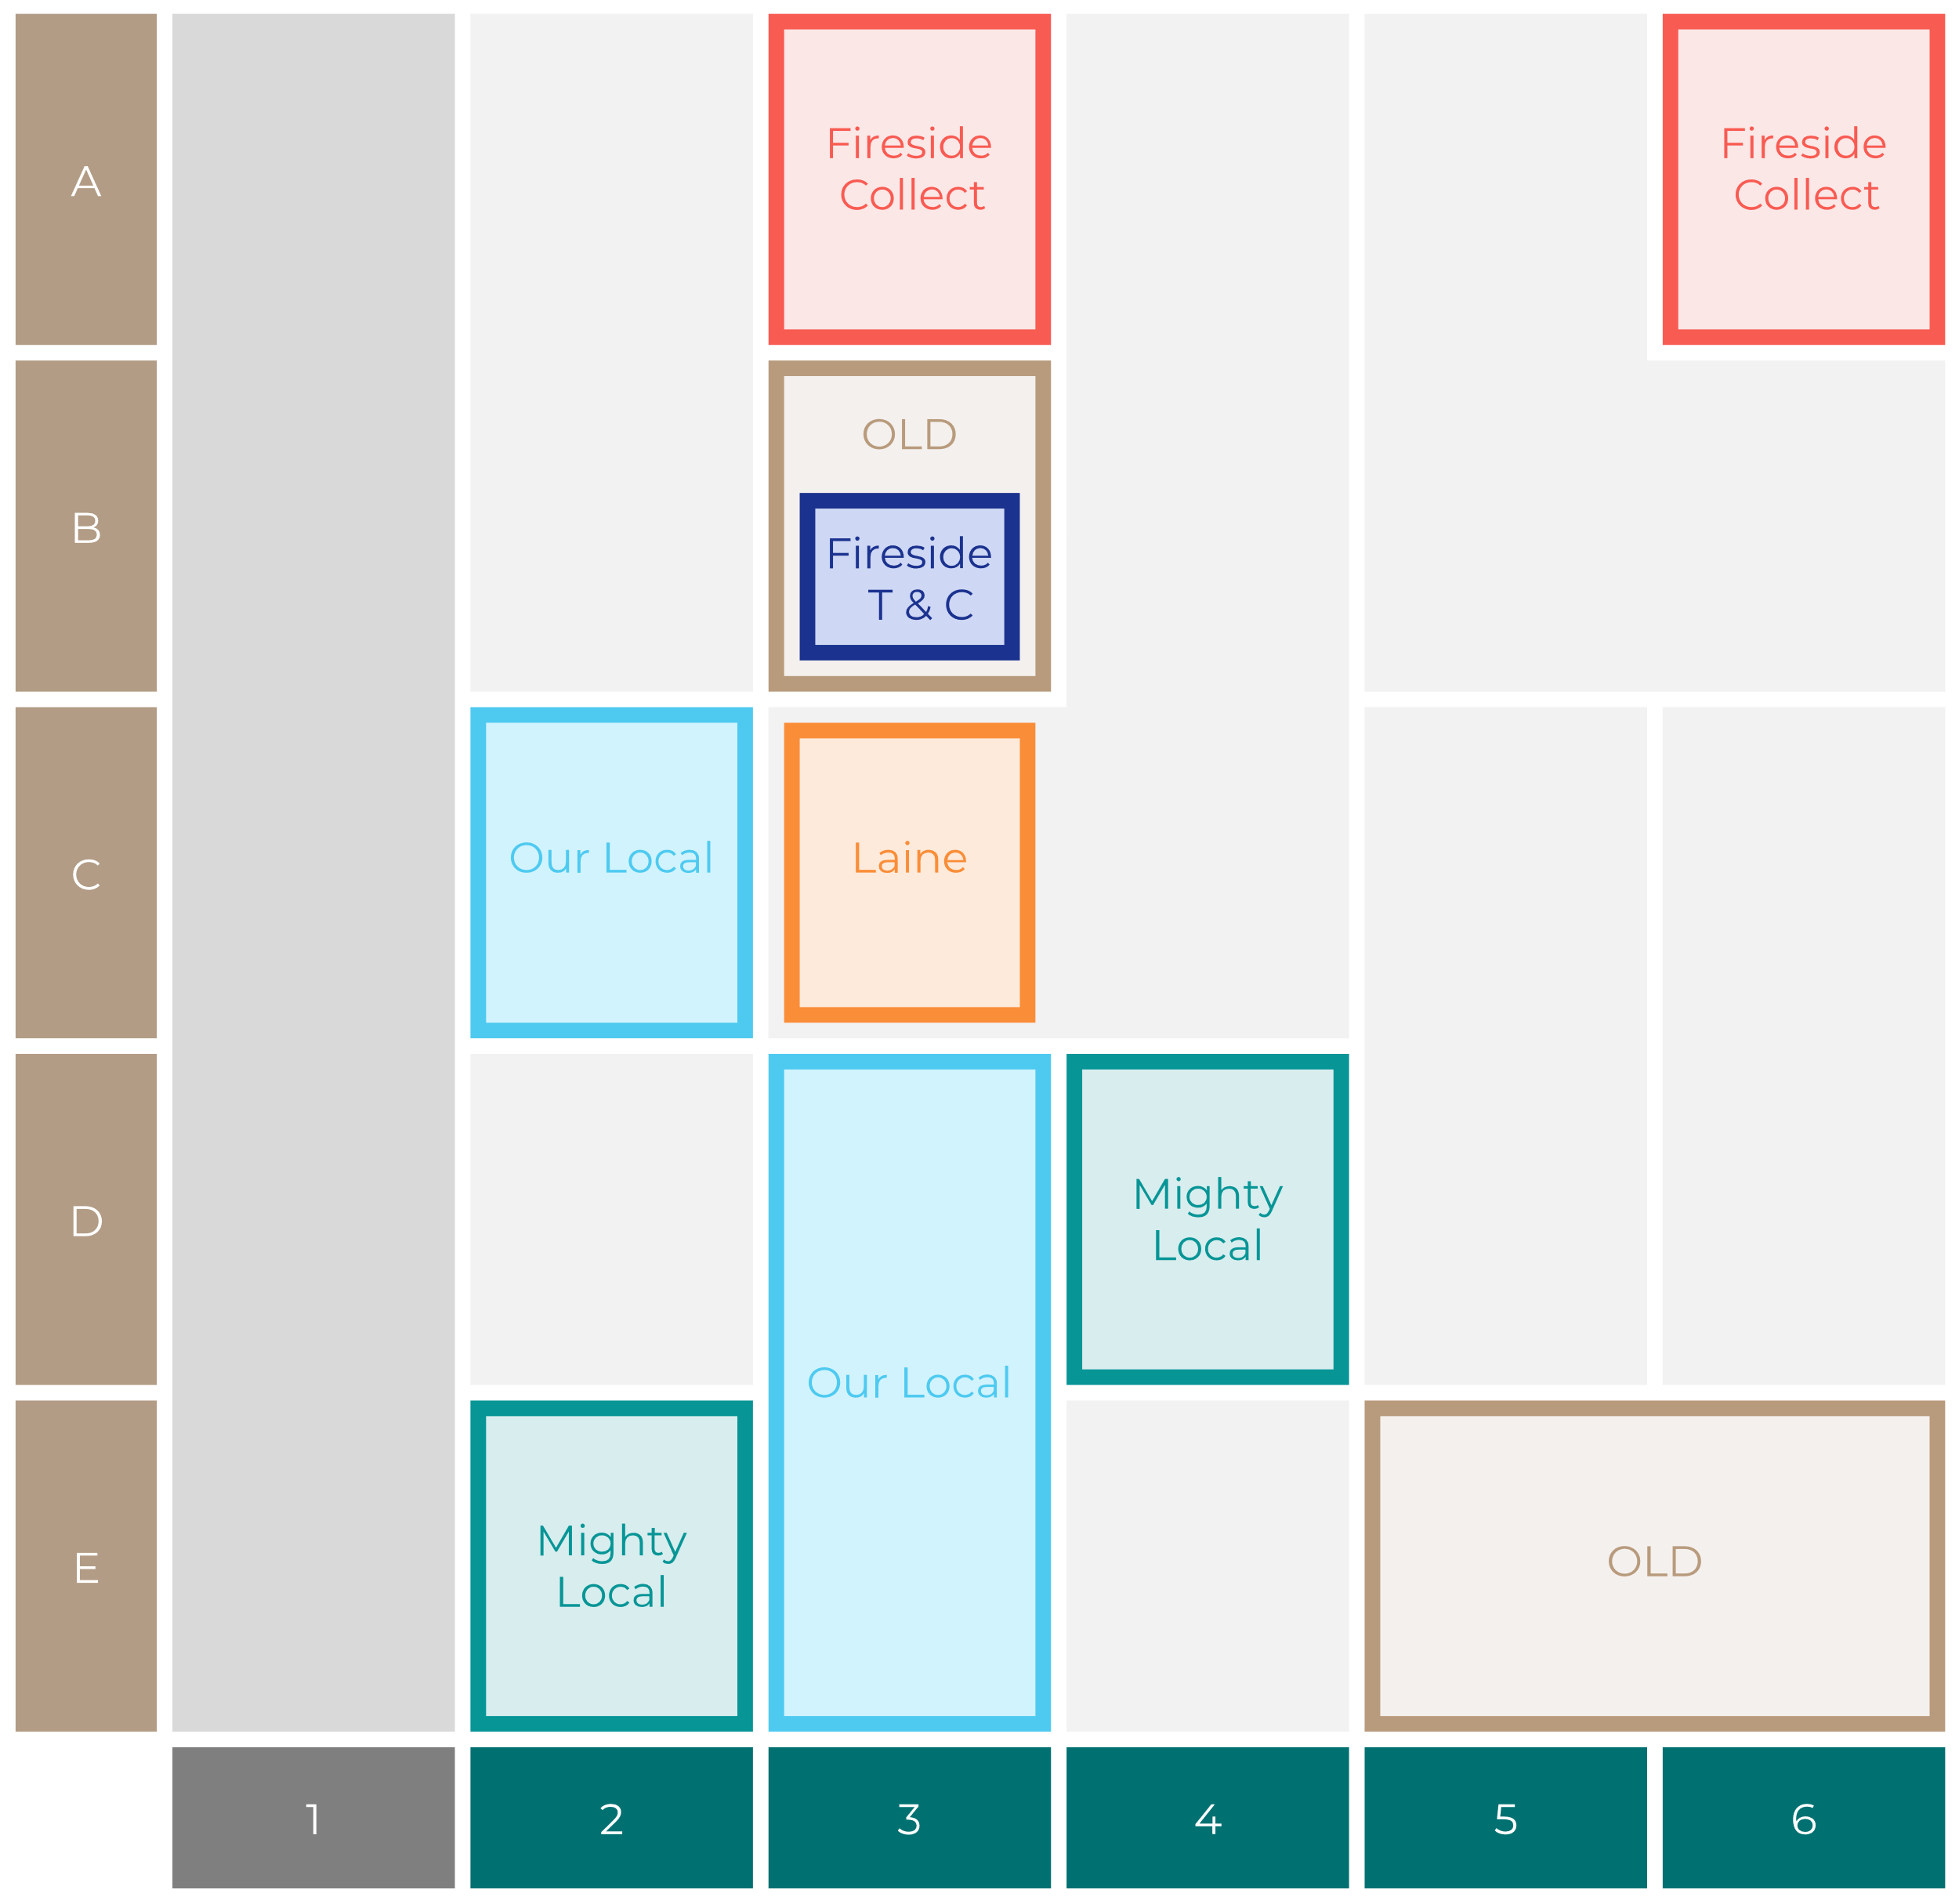

Site Intel
Lord Nelson SM14QP
Site Potential 1
Site Characteristics
£3000
£18000
OCC Concept Fit
Achievable Average Weekly Takings
Non-Core
£7000
A Food-Led High Affluence B Food-Led Mid Affluence C Wet-Led Mid/High Affluence D Wet-Led Low Affluence E Food-Led Low Affluence
AWT 2 Local Regulars 3 Local Passing Trade 4 Destination Wet-Led 5 Destination Food-Led 6 Destination Very Food-Led
A
B
C
D
E
1
2
3
4
5
6

Slide 16
Site Intel
Lord Nelson SM14QP
Site Potential 2
Concept Recommendation

Slide 17
Site Intel
Lord Nelson SM14QP
Local Market Profile
Mix of spend by customer segment in Punch site and local market
 | Customer Count | Family Familiar | Occasional & Local | Mid-Week Seniors | Part Of The Pub | Metro Sophisticates | Young & Connected | Bubbly Weekenders | Upmarket Diners
Lord Nelson | 9 | 22.98% | 11.49% | 51.87% | 6.19% | 7.44% | 0.00% | 0.00% | 0.00%
Local Catchment | 4476 | 8.59% | 5.95% | 9.73% | 11.66% | 15.92% | 19.15% | 11.08% | 17.88%
Punch T&L | 95190 | 8.85% | 6.05% | 28.75% | 10.94% | 11.45% | 10.97% | 7.07% | 15.87%
Lord Nelson vs Local Catchment |  | 14.39% | 5.54% | 42.14% | -5.47% | -8.48% | 0.00% | 0.00% | 0.00%
Lord Nelson vs Punch T&L |  | 14.13% | 5.44% | 23.12% | -4.75% | -4.01% | 0.00% | 0.00% | 0.00%
Local Catchment vs Punch T&L |  | -0.26% | -0.10% | -19.02% | 0.72% | 4.47% | 8.18% | 4.01% | 2.01%

Slide 18
Site Intel
Lord Nelson SM14QP
Local Competitor Profiles
Mix of spend by customer segment in Punch site and local competitors
 | Customer Count | Family Familiar | Occasional & Local | Mid-Week Seniors | Part Of The Pub | Metro Sophisticates | Young & Connected | Bubbly Weekenders | Upmarket Diners
ONeills Sutton SM11DJ | 242 | 6.47% | 5.08% | 4.29% | 39.26% | 14.11% | 22.13% | 5.00% | 3.61%
Lord Nelson SM14QP | 9 | 22.98% | 11.49% | 51.87% | 6.19% | 7.44% | 0.00% | 0.00% | 0.00%
The Moon on the Hill SM11DZ | 488 | 5.53% | 5.86% | 18.72% | 36.27% | 4.83% | 19.21% | 4.46% | 5.08%
Crown Sutton SM11LD | 63 | 0.15% | 7.98% | 0.92% | 78.93% | 2.28% | 6.69% | 1.35% | 1.65%
Butterchurn (Sutton) SM13AS | 45 | 7.09% | 3.57% | 0.41% | 78.61% | 4.43% | 4.29% | 0.90% | 0.65%
The Little Windsor SM14BY | 48 | 7.17% | 11.85% | 46.60% | 26.95% | 3.48% | 1.84% | 0.78% | 1.29%
Hope SM52PR | 369 | 2.93% | 1.90% | 18.35% | 6.19% | 35.11% | 19.23% | 5.07% | 11.18%
Shinner & Sudtone SM11DT | 198 | 2.78% | 0.79% | 12.25% | 3.61% | 24.04% | 25.84% | 15.16% | 15.50%
Portobello Pub Compan SM11DT | 214 | 4.21% | 1.10% | 13.82% | 4.39% | 24.94% | 28.80% | 6.46% | 16.24%
All Bar One Sutton SM11DZ | 288 | 7.11% | 4.22% | 7.07% | 3.60% | 14.51% | 27.56% | 12.82% | 23.08%
Old Bank Sutton SM11HN | 377 | 6.42% | 12.38% | 4.16% | 27.26% | 17.31% | 18.08% | 7.56% | 6.79%
Woodman SM53AG | 195 | 6.93% | 15.70% | 9.51% | 10.40% | 17.45% | 18.11% | 11.51% | 10.36%
Tiempo Lounge SM11DU | 200 | 3.17% | 4.06% | 6.42% | 4.73% | 10.84% | 33.04% | 15.43% | 22.27%
The Sun SM52HU | 354 | 4.11% | 1.18% | 9.25% | 2.90% | 25.87% | 9.16% | 10.08% | 37.41%
The Railway Tavern SM52HG | 122 | 18.54% | 4.86% | 10.53% | 3.78% | 32.92% | 7.30% | 9.46% | 12.57%
Robin Hood SM11SH | 175 | 8.60% | 2.47% | 4.02% | 26.94% | 10.32% | 26.30% | 9.52% | 11.79%
Greyhound Hotel SM53PE | 499 | 6.13% | 1.38% | 8.57% | 3.30% | 23.50% | 15.58% | 10.03% | 31.47%
Windsor Castle SM53PT | 200 | 2.97% | 7.55% | 7.45% | 3.11% | 25.51% | 14.85% | 13.25% | 25.27%
Caffe Nero SM14RA | 222 | 11.08% | 5.79% | 8.30% | 1.35% | 8.25% | 14.10% | 34.80% | 16.28%
United Sevices Club Sutton SM14RS | 34 | 3.62% | 0.99% | 5.64% | 17.62% | 64.97% | 5.26% | 0.54% | 1.32%
Happy House SM14BU | 5 | 3.61% | 0.00% | 53.13% | 0.00% | 0.00% | 37.79% | 5.46% | 0.00%
Palmerston Carshalton SM52JY | 41 | 1.23% | 28.29% | 5.03% | 13.68% | 8.25% | 24.62% | 2.32% | 16.54%
Gosto Fino Sutton Gree SM11LW | 41 | 9.08% | 21.41% | 1.57% | 4.47% | 25.02% | 16.51% | 8.30% | 13.60%
Mad Coffee Bar And Deli SM14PP | 86 | 7.48% | 3.27% | 12.33% | 0.00% | 19.62% | 28.64% | 13.67% | 14.95%
McDonalds High St Sutton SM11NL | 535 | 26.23% | 8.74% | 4.19% | 1.79% | 4.02% | 26.59% | 13.87% | 14.53%

