Slide 1











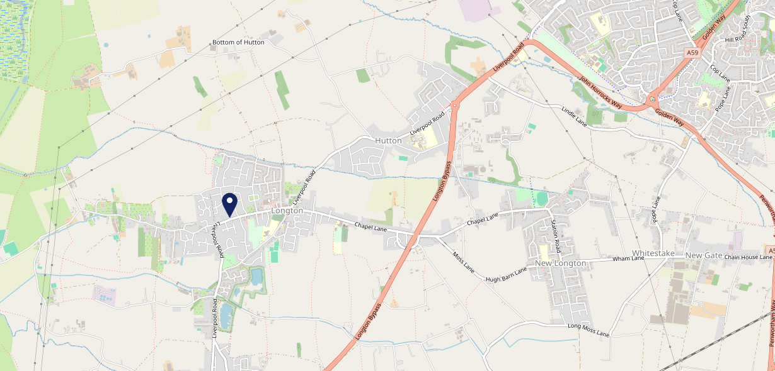











Site Intel
Golden Ball PR45AU
1 Miles
338 Chains
29/01/2025 - 21/01/2026
Site Summary
Golden Ball PR45AU
Work Area
Region
TV Region
Urbanicity
Preston
North West
North West
Urban city and town
PR45AU
Punch - Fireside Inns
Top Competitors
ATV
Gender
Romanos
#1
£16.25
67.80%
Male
PR45NB
Restaurant
Affluence
Segmentation
Smokies Longton
#2
73.68%
46.00%
Middle Income
Enterprising Mainstream
PR45AU
Fast-Food
Age Group
Visit Day
Village Teapot
#3
35.56%
23.87%
PR45QA
65 to 74
Sat
Café
Nearest Station
Preston (Lancs)(6.37 miles)
1096 Site Customers
23 Competitors
3453 Competitor Customers

Slide 2

Site Intel
Golden Ball PR45AU
1 Miles
338 Chains
29/01/2025 - 21/01/2026
Spend by Weekpart
How is customer spend distributed throughout the week for Golden Ball PR45AU versus its competitors?
% of spend for Golden Ball PR45AU and 338 Chains in 1 Miles from 29/01/2025 - 21/01/2026 split by Day of Week
1096 Site Customers
23 Competitors
3453 Competitor Customers

Slide 3
Site Intel
Golden Ball PR45AU
1 Miles
338 Chains
29/01/2025 - 21/01/2026
Visit Frequency
How frequently per year do customers visit Golden Ball PR45AU versus its competitors?
% of customer numbers for Golden Ball PR45AU and 338 Chains in 1 Miles from 29/01/2025 - 21/01/2026 and the number of visits made Per Annum
1096 Site Customers
23 Competitors
3453 Competitor Customers

Slide 4
Site Intel
Golden Ball PR45AU
1 Miles
338 Chains
29/01/2025 - 21/01/2026
ATV Change
How has ATV changed between two date ranges?
1096 Site Customers

Slide 5
Site Intel
Golden Ball PR45AU
1 Miles
338 Chains
29/01/2025 - 21/01/2026
Market Share Change
How has market share changed between two date ranges?
% of market share spend for Golden Ball PR45AU and 338 Chains in 1 Miles from 29/01/2025 - 21/01/2026
1096 Site Customers

Slide 6
Site Intel
Golden Ball PR45AU
1 Miles
338 Chains
29/01/2025 - 21/01/2026
Age
How does the age profile of customers who visit Golden Ball PR45AU compare versus its competitors?
% of spend for Golden Ball PR45AU and 338 Chains in 1 Miles from 29/01/2025 - 21/01/2026 split by Age Range
539 Site Customers
23 Competitors
1570 Competitor Customers

Slide 7
Site Intel
Golden Ball PR45AU
1 Miles
338 Chains
29/01/2025 - 21/01/2026
Affluence
How does the affluence of customers who visit Golden Ball PR45AU compare versus its competitors?
% of spend for Golden Ball PR45AU and 338 Chains in 1 Miles from 29/01/2025 - 21/01/2026 split by Affluence
511 Site Customers
23 Competitors
1456 Competitor Customers

Slide 8
Site Intel
Golden Ball PR45AU
1 Miles
338 Chains
29/01/2025 - 21/01/2026
Gender
How does the gender profile of customers who visit Golden Ball PR45AU compare versus its competitors?
% of spend for Golden Ball PR45AU and 338 Chains in 1 Miles from 29/01/2025 - 21/01/2026 split by Gender
526 Site Customers
23 Competitors
1526 Competitor Customers

Slide 9
Site Intel
Golden Ball PR45AU
1 Miles
338 Chains
29/01/2025 - 21/01/2026
Punch Segmentation
How does the Custom segmentation profile of customers who visit Golden Ball PR45AU compare versus its competitors?
% of spend for Golden Ball PR45AU and 338 Chains in 1 Miles from 29/01/2025 - 21/01/2026 split by Segment
1096 Site Customers
23 Competitors
3453 Competitor Customers

Slide 10
Site Intel
Golden Ball PR45AU
1 Miles
338 Chains
29/01/2025 - 21/01/2026
Spend by Distance
How does the spend profile of Golden Ball PR45AU compare versus its competitors based on travel distances?
% of spend for Golden Ball PR45AU and 338 Chains in 1 Miles from 29/01/2025 - 21/01/2026 split by Distance travelled
524 Site Customers
23 Competitors
1526 Competitor Customers

Slide 11
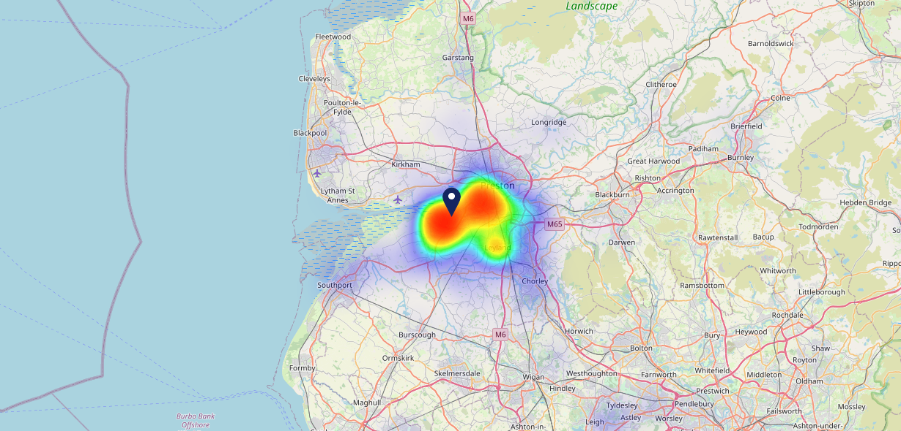

Site Intel
Golden Ball PR45AU
29/01/2025 - 21/01/2026
Map of Guest Origin
Where do customers of Golden Ball PR45AU come from?
Where do customers of Golden Ball PR45AU for 29/01/2025 - 21/01/2026 live
524 Site Customers

Slide 12
Site Intel
Golden Ball PR45AU
1 Miles
338 Chains
29/01/2025 - 21/01/2026
Share of Wallet
What are the Top 20 venues (by spend) that customers of Golden Ball PR45AU also visit?
For customers of Golden Ball PR45AU, who are the top 20 competitors from 338 Chains in 1 Miles for 29/01/2025 - 21/01/2026 split by Venue
1096 Site Customers

Slide 13
Site Intel
Golden Ball PR45AU
1 Miles
338 Chains
29/01/2025 - 21/01/2026
Share of Wallet Change
How has share of wallet of customers of Golden Ball PR45AU changed between two date ranges?
1096 Site Customers

Slide 14
Site Intel
Golden Ball PR45AU
29/01/2025 - 21/01/2026
Market Summary
How does the local area for Golden Ball PR45AU compare to the national average (1 = low, 10 = high)
Data Type | Name | Spend in 250m | 250m Spend vs National | Spend in 500m | 500m Spend vs National | Spend in 1 mile | 1 mile Spend vs National | Spend in 3 miles | 3 mile Spend vs National
Total | Annual Sales | £2.29M | 6 | £4.48M | 6 | £7.56M | 4 | £52.60M | 5
Weekpart | Mon - Thu | 31.7% | 2 | 31.8% | 1 | 30.8% | 1 | 35.6% | 1
Weekpart | Fri - Sat | 49.4% | 8 | 48.8% | 9 | 50.9% | 10 | 45.5% | 9
Weekpart | Sun | 18.8% | 9 | 19.5% | 9 | 18.3% | 9 | 18.9% | 10
Age | 18 to 24 | 5.4% | 5 | 6.4% | 6 | 5.6% | 5 | 5.5% | 4
Age | 25 to 34 | 14.4% | 2 | 14.0% | 2 | 15.3% | 2 | 13.8% | 1
Age | 35 to 44 | 15.3% | 1 | 12.8% | 1 | 17.1% | 1 | 21.1% | 3
Age | 45 to 54 | 19.4% | 5 | 20.7% | 6 | 19.5% | 4 | 19.3% | 4
Age | 55 to 64 | 23.0% | 9 | 23.1% | 10 | 23.7% | 10 | 21.1% | 10
Age | 65 to 74 | 18.8% | 10 | 16.3% | 10 | 12.7% | 9 | 11.9% | 9
Age | 75+ | 3.8% | 8 | 6.7% | 9 | 6.2% | 9 | 7.2% | 10
CAMEO | Business Elite | 9.2% | 7 | 9.8% | 7 | 9.3% | 7 | 8.0% | 6
CAMEO | Prosperous Professionals | 9.1% | 8 | 10.1% | 9 | 8.2% | 8 | 7.4% | 7
CAMEO | Flourishing Society | 5.3% | 2 | 7.1% | 3 | 6.5% | 2 | 7.7% | 2
CAMEO | Content Communities | 21.3% | 10 | 23.3% | 10 | 20.5% | 10 | 19.6% | 10
CAMEO | White Collar Neighbourhoods | 7.8% | 2 | 8.3% | 3 | 10.7% | 5 | 13.5% | 9
CAMEO | Enterprising Mainstream | 32.5% | 10 | 27.1% | 10 | 28.3% | 10 | 17.4% | 10
CAMEO | Paying The Mortgage | 8.5% | 2 | 7.7% | 1 | 9.3% | 2 | 12.7% | 4
CAMEO | Cash Conscious Communities | 3.8% | 2 | 3.6% | 1 | 3.7% | 1 | 6.3% | 3
CAMEO | On A Budget | 1.7% | 1 | 2.0% | 1 | 2.4% | 1 | 4.6% | 2
CAMEO | Family Value | 0.8% | 3 | 1.0% | 3 | 1.1% | 3 | 2.9% | 6
Affluence | AB | 23.6% | 5 | 27.0% | 5 | 24.0% | 4 | 23.0% | 4
Affluence | C1C2 | 70.1% | 10 | 66.4% | 10 | 68.8% | 10 | 63.2% | 10
Affluence | DE | 6.3% | 1 | 6.6% | 1 | 7.2% | 1 | 13.8% | 2

Slide 15

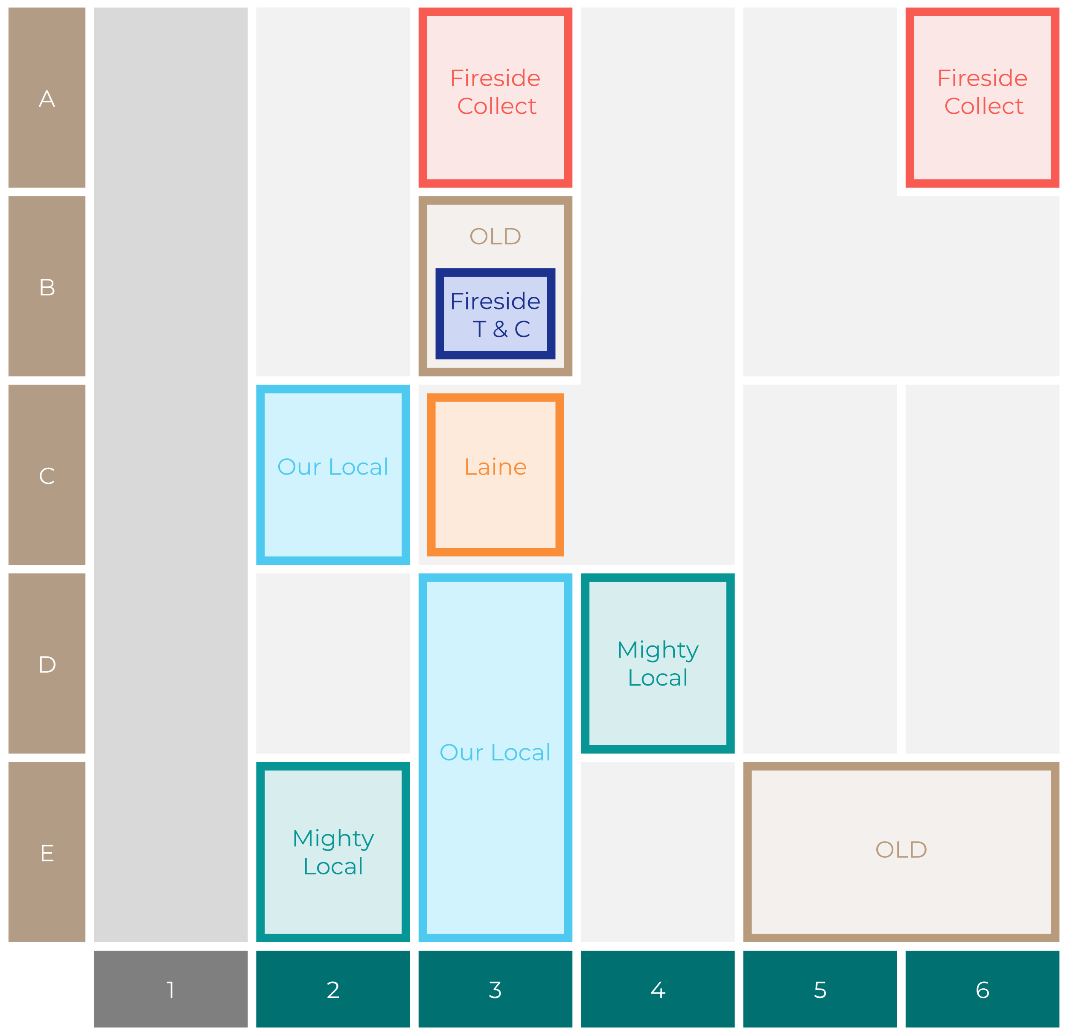

Site Intel
Golden Ball PR45AU
Site Potential 1
Site Characteristics
£3000
£18000
OCC Concept Fit
Achievable Average Weekly Takings
Non-Core
£0
A Food-Led High Affluence B Food-Led Mid Affluence C Wet-Led Mid/High Affluence D Wet-Led Low Affluence E Food-Led Low Affluence
AWT 2 Local Regulars 3 Local Passing Trade 4 Destination Wet-Led 5 Destination Food-Led 6 Destination Very Food-Led
A
B
C
D
E
1
2
3
4
5
6

Slide 16
Site Intel
Golden Ball PR45AU
Site Potential 2
Concept Recommendation

Slide 17
Site Intel
Golden Ball PR45AU
Local Market Profile
Mix of spend by customer segment in Punch site and local market
 | Customer Count | Family Familiar | Occasional & Local | Mid-Week Seniors | Part Of The Pub | Metro Sophisticates | Young & Connected | Bubbly Weekenders | Upmarket Diners
Golden Ball | 213 | 5.24% | 7.90% | 12.86% | 50.66% | 6.61% | 1.64% | 3.79% | 11.26%
Local Catchment | 377 | 17.59% | 6.15% | 17.85% | 6.40% | 9.26% | 6.20% | 9.06% | 27.45%
Punch T&L | 95486 | 8.97% | 6.12% | 29.00% | 11.19% | 10.97% | 11.15% | 7.16% | 15.39%
Golden Ball vs Local Catchment |  | -12.35% | 1.75% | -4.99% | 44.26% | -2.65% | -4.56% | -5.27% | -16.19%
Golden Ball vs Punch T&L |  | -3.73% | 1.78% | -16.14% | 39.47% | -4.36% | -9.51% | -3.37% | -4.13%
Local Catchment vs Punch T&L |  | 8.62% | 0.03% | -11.15% | -4.79% | -1.71% | -4.95% | 1.90% | 12.06%

Slide 18
Site Intel
Golden Ball PR45AU
Local Competitor Profiles
Mix of spend by customer segment in Punch site and local competitors
 | Customer Count | Family Familiar | Occasional & Local | Mid-Week Seniors | Part Of The Pub | Metro Sophisticates | Young & Connected | Bubbly Weekenders | Upmarket Diners
Golden Ball PR45AU | 213 | 5.24% | 7.90% | 12.86% | 50.66% | 6.61% | 1.64% | 3.79% | 11.26%
Romanos PR45NB | 125 | 8.93% | 5.84% | 20.54% | 8.55% | 9.51% | 3.83% | 6.83% | 35.92%
Smokies Longton PR45AU | 68 | 31.73% | 1.58% | 8.62% | 7.78% | 5.83% | 13.44% | 17.74% | 13.25%
Village Teapot PR45QA | 86 | 24.83% | 16.10% | 22.11% | 0.66% | 4.04% | 7.19% | 6.45% | 18.60%
Orchid Cafe And Bar PR45AB | 41 | 16.81% | 0.49% | 15.38% | 1.23% | 1.06% | 2.05% | 34.34% | 28.59%
Happy Bunnies PR45HA | 40 | 28.68% | 13.99% | 18.43% | 2.80% | 0.64% | 6.55% | 0.87% | 28.01%
Lucky Star Preston PR45FE | 13 | 33.76% | 0.00% | 14.71% | 6.33% | 0.00% | 32.42% | 0.64% | 12.10%
Smokies PR45GA | 15 | 54.72% | 1.96% | 9.84% | 0.00% | 0.00% | 14.96% | 0.00% | 18.50%
Mr Slice Guy PR45JE | 29 | 40.62% | 1.75% | 6.76% | 3.44% | 30.62% | 6.39% | 9.15% | 1.24%
Cheek And Tongue S PR45AU | 7 | 23.20% | 0.00% | 8.87% | 0.00% | 0.00% | 23.20% | 36.86% | 7.84%
The Orchid Cafe Bar PR45AB | 2 | 78.86% | 0.00% | 0.00% | 0.00% | 0.00% | 0.00% | 21.13% | 0.00%
Wave Coffee PR45NR | 6 | 51.20% | 0.00% | 0.00% | 0.00% | 13.20% | 6.40% | 29.20% | 0.00%

