Slide 1










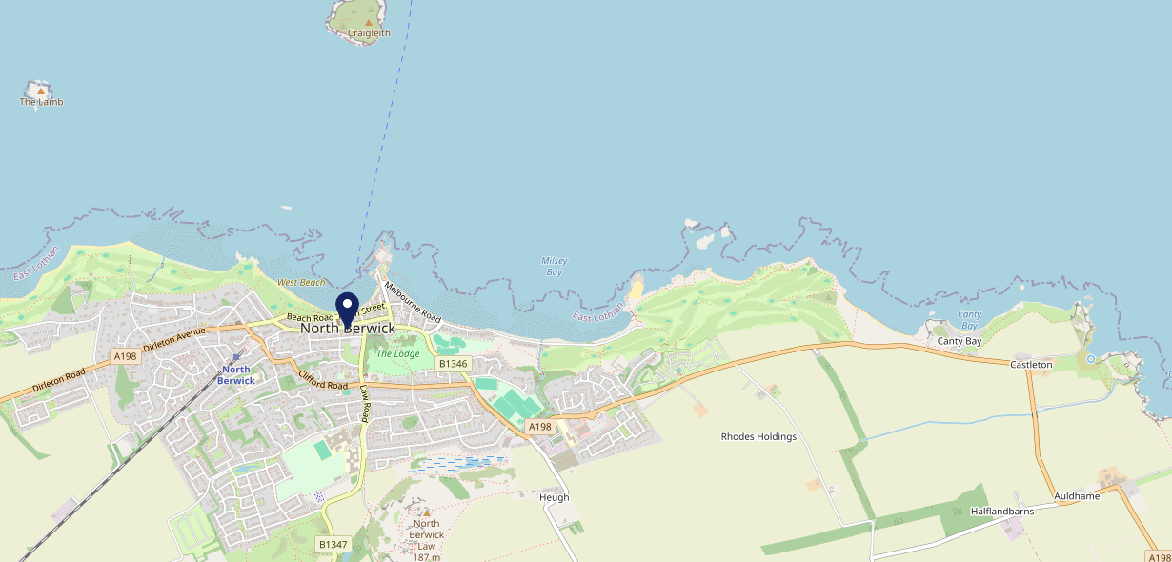









Site Intel
Golfers Rest EH394HD
1 Miles
118 Chains
22/02/2023 - 14/02/2024
Site Summary
Golfers Rest EH394HD
Work Area
Region
TV Region
Urbanicity
Edinburgh
Scotland
Scotland
Remote small town
EH394HD
Punch T&L
Top Competitors
ATV
Gender
#1
£11.04
85.86%
Male
Affluence
Segmentation
#2
50.18%
27.23%
Middle Income
Paying The Mortgage
Age Group
Visit Day
#3
47.71%
36.07%
55 to 64
Sat
Nearest Station
North Berwick(0.60 miles)
1691 Site Customers
0 Competitors
0 Competitor Customers

Slide 2

Site Intel
Golfers Rest EH394HD
1 Miles
118 Chains
22/02/2023 - 14/02/2024
Spend by Weekpart
How is customer spend distributed throughout the week for Golfers Rest EH394HD versus its competitors?
% of spend for Golfers Rest EH394HD and 118 Chains in 1 Miles from 22/02/2023 - 14/02/2024 split by Day of Week
1691 Site Customers
0 Competitors
0 Competitor Customers

Slide 3
Site Intel
Golfers Rest EH394HD
1 Miles
118 Chains
22/02/2023 - 14/02/2024
Visit Frequency
How frequently per year do customers visit Golfers Rest EH394HD versus its competitors?
% of customer numbers for Golfers Rest EH394HD and 118 Chains in 1 Miles from 22/02/2023 - 14/02/2024 and the number of visits made Per Annum
1691 Site Customers
0 Competitors
0 Competitor Customers

Slide 4
Site Intel
Golfers Rest EH394HD
1 Miles
118 Chains
22/02/2023 - 14/02/2024
ATV Change
How has ATV changed between two date ranges?
1691 Site Customers

Slide 5
Site Intel
Golfers Rest EH394HD
1 Miles
118 Chains
22/02/2023 - 14/02/2024
Market Share Change
How has market share changed between two date ranges?
% of market share spend for Golfers Rest EH394HD and 118 Chains in 1 Miles from 22/02/2023 - 14/02/2024
1691 Site Customers

Slide 6
Site Intel
Golfers Rest EH394HD
1 Miles
118 Chains
22/02/2023 - 14/02/2024
Age
How does the age profile of customers who visit Golfers Rest EH394HD compare versus its competitors?
% of spend for Golfers Rest EH394HD and 118 Chains in 1 Miles from 22/02/2023 - 14/02/2024 split by Age Range
810 Site Customers
0 Competitors

Slide 7
Site Intel
Golfers Rest EH394HD
1 Miles
118 Chains
22/02/2023 - 14/02/2024
Affluence
How does the affluence of customers who visit Golfers Rest EH394HD compare versus its competitors?
% of spend for Golfers Rest EH394HD and 118 Chains in 1 Miles from 22/02/2023 - 14/02/2024 split by Affluence
728 Site Customers
0 Competitors

Slide 8
Site Intel
Golfers Rest EH394HD
1 Miles
118 Chains
22/02/2023 - 14/02/2024
Gender
How does the gender profile of customers who visit Golfers Rest EH394HD compare versus its competitors?
% of spend for Golfers Rest EH394HD and 118 Chains in 1 Miles from 22/02/2023 - 14/02/2024 split by Gender
789 Site Customers
0 Competitors

Slide 9
Site Intel
Golfers Rest EH394HD
1 Miles
118 Chains
22/02/2023 - 14/02/2024
Punch Segmentation
How does the Custom segmentation profile of customers who visit Golfers Rest EH394HD compare versus its competitors?
% of spend for Golfers Rest EH394HD and 118 Chains in 1 Miles from 22/02/2023 - 14/02/2024 split by Segment
1691 Site Customers
0 Competitors
0 Competitor Customers

Slide 10
Site Intel
Golfers Rest EH394HD
1 Miles
118 Chains
22/02/2023 - 14/02/2024
Spend by Distance
How does the spend profile of Golfers Rest EH394HD compare versus its competitors based on travel distances?
% of spend for Golfers Rest EH394HD and 118 Chains in 1 Miles from 22/02/2023 - 14/02/2024 split by Distance travelled
787 Site Customers
0 Competitors
0 Competitor Customers

Slide 11
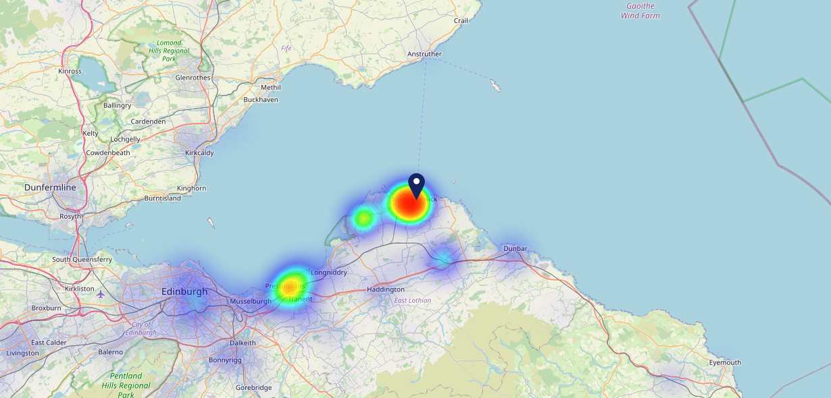

Site Intel
Golfers Rest EH394HD
22/02/2023 - 14/02/2024
Map of Guest Origin
Where do customers of Golfers Rest EH394HD come from?
Where do customers of Golfers Rest EH394HD for 22/02/2023 - 14/02/2024 live
787 Site Customers

Slide 12
Site Intel
Golfers Rest EH394HD
1 Miles
118 Chains
22/02/2023 - 14/02/2024
Share of Wallet
What are the Top 20 venues (by spend) that customers of Golfers Rest EH394HD also visit?
For customers of Golfers Rest EH394HD, who are the top 20 competitors from 118 Chains in 1 Miles for 22/02/2023 - 14/02/2024 split by Venue
1691 Site Customers

Slide 13
Site Intel
Golfers Rest EH394HD
1 Miles
118 Chains
22/02/2023 - 14/02/2024
Share of Wallet Change
How has share of wallet of customers of Golfers Rest EH394HD changed between two date ranges?
1691 Site Customers

Slide 14
Site Intel
Golfers Rest EH394HD
22/02/2023 - 14/02/2024
Market Summary
How does the local area for Golfers Rest EH394HD compare to the national average (1 = low, 10 = high)
Data Type | Name | Spend in 250m | 250m Spend vs National | Spend in 500m | 500m Spend vs National | Spend in 1 mile | 1 mile Spend vs National | Spend in 3 miles | 3 mile Spend vs National
Total | Annual Sales | £12.54M | 9 | £18.16M | 8 | £21.36M | 6 | £22.60M | 3
Weekpart | Mon - Thu | 41.9% | 6 | 42.9% | 7 | 43.5% | 7 | 43.7% | 8
Weekpart | Fri - Sat | 43.5% | 5 | 42.0% | 4 | 41.1% | 4 | 40.7% | 4
Weekpart | Sun | 14.6% | 5 | 15.1% | 6 | 15.4% | 6 | 15.7% | 6
Age | 18 to 24 | 1.9% | 2 | 1.7% | 1 | 1.5% | 1 | 1.5% | 1
Age | 25 to 34 | 6.7% | 1 | 7.0% | 1 | 7.0% | 1 | 7.2% | 1
Age | 35 to 44 | 15.0% | 1 | 14.4% | 1 | 15.1% | 1 | 15.4% | 1
Age | 45 to 54 | 23.4% | 8 | 22.6% | 8 | 22.5% | 8 | 22.4% | 9
Age | 55 to 64 | 28.3% | 10 | 26.7% | 10 | 26.1% | 10 | 26.1% | 10
Age | 65 to 74 | 17.0% | 10 | 18.7% | 10 | 18.7% | 10 | 18.4% | 10
Age | 75+ | 7.6% | 10 | 8.9% | 10 | 9.2% | 10 | 9.0% | 10
CAMEO | Business Elite | 22.7% | 10 | 24.1% | 10 | 24.5% | 10 | 24.5% | 10
CAMEO | Prosperous Professionals | 9.4% | 8 | 10.1% | 9 | 10.1% | 9 | 10.0% | 9
CAMEO | Flourishing Society | 21.2% | 9 | 21.1% | 9 | 21.8% | 9 | 21.9% | 9
CAMEO | Content Communities | 10.3% | 4 | 11.5% | 5 | 11.0% | 4 | 11.0% | 3
CAMEO | White Collar Neighbourhoods | 13.7% | 8 | 13.3% | 8 | 12.9% | 7 | 12.7% | 7
CAMEO | Enterprising Mainstream | 3.5% | 2 | 3.5% | 2 | 3.7% | 1 | 3.7% | 1
CAMEO | Paying The Mortgage | 9.3% | 2 | 8.9% | 2 | 8.5% | 2 | 8.5% | 1
CAMEO | Cash Conscious Communities | 4.5% | 2 | 2.5% | 1 | 2.6% | 1 | 2.7% | 1
CAMEO | On A Budget | 4.2% | 3 | 3.9% | 3 | 3.7% | 2 | 3.7% | 2
CAMEO | Family Value | 1.3% | 4 | 1.2% | 4 | 1.3% | 3 | 1.2% | 3
Affluence | AB | 53.3% | 10 | 55.3% | 10 | 56.4% | 10 | 56.4% | 10
Affluence | C1C2 | 36.8% | 2 | 37.1% | 2 | 36.1% | 1 | 35.9% | 1
Affluence | DE | 10.0% | 2 | 7.6% | 1 | 7.6% | 1 | 7.7% | 1

Slide 15

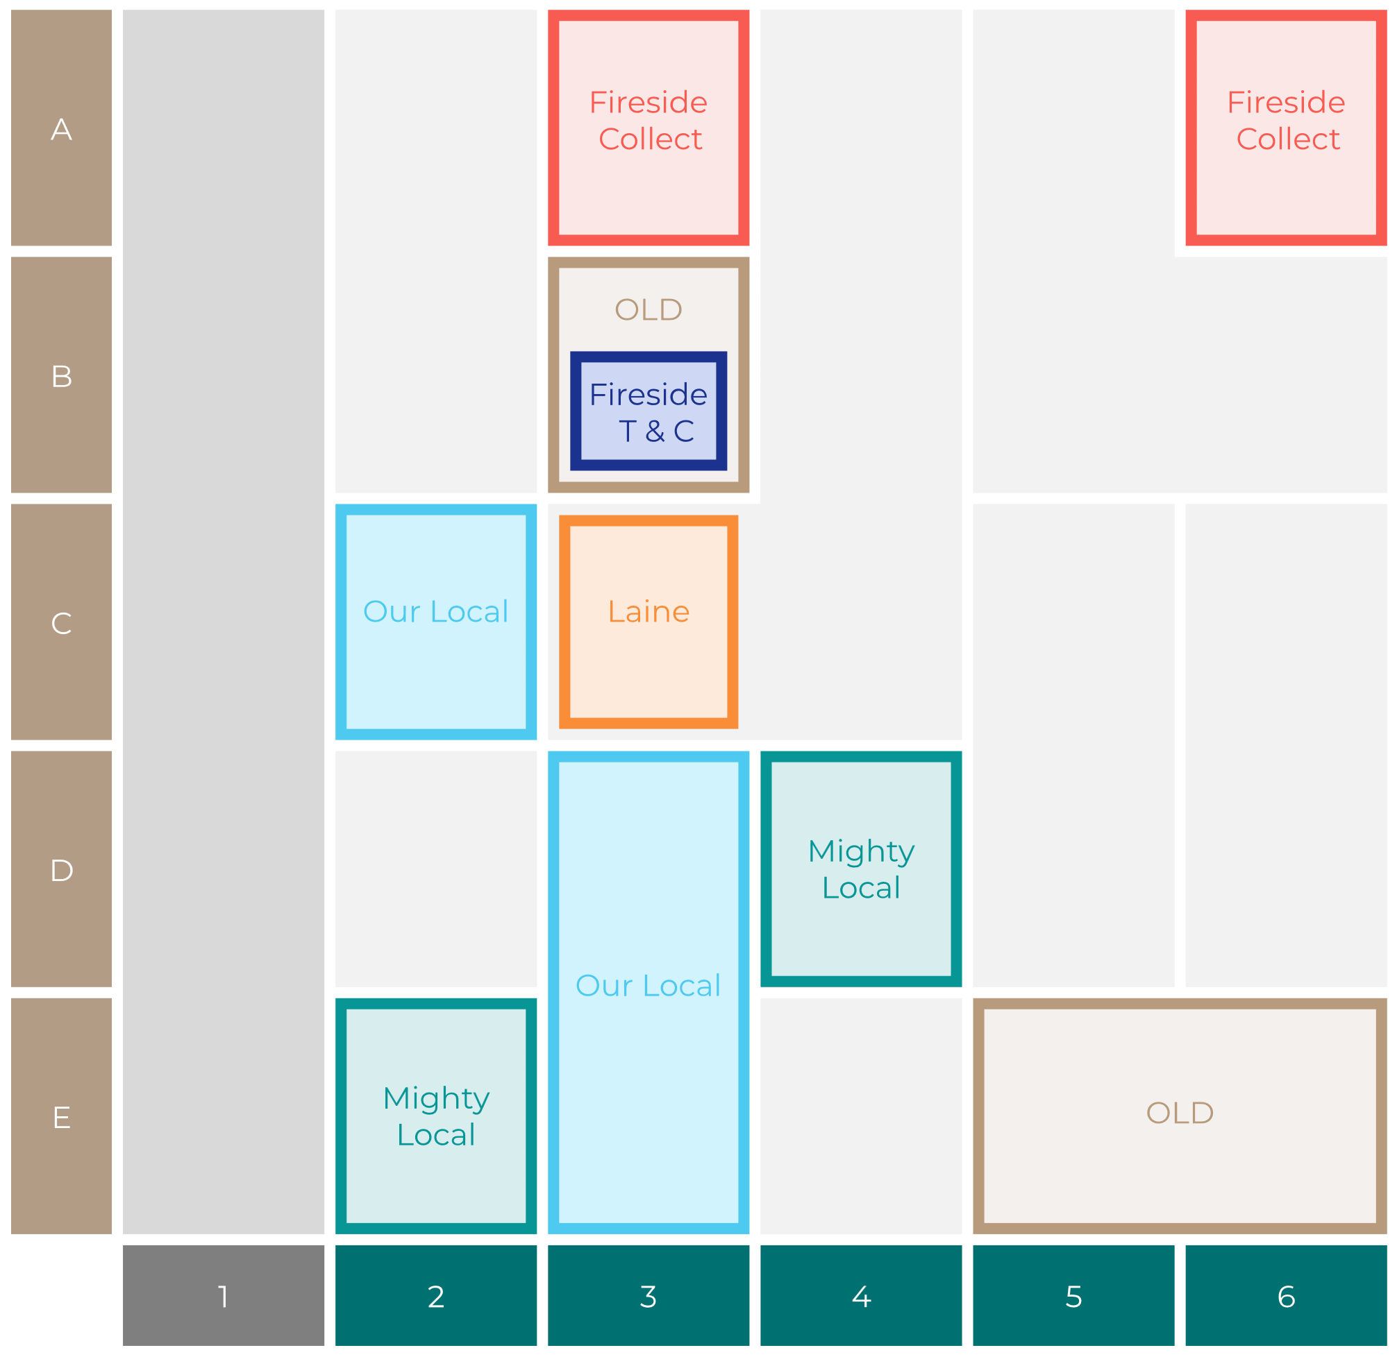

Site Intel
Golfers Rest EH394HD
Site Potential 1
Site Characteristics
£3000
£18000
OCC Concept Fit
Achievable Average Weekly Takings
Fireside Scenic
£9000
A Food-Led High Affluence B Food-Led Mid Affluence C Wet-Led Mid/High Affluence D Wet-Led Low Affluence E Food-Led Low Affluence
AWT 2 Local Regulars 3 Local Passing Trade 4 Destination Wet-Led 5 Destination Food-Led 6 Destination Very Food-Led
A
B
C
D
E
1
2
3
4
5
6

Slide 16
Site Intel
Golfers Rest EH394HD
Site Potential 2
Concept Recommendation

Slide 17
Site Intel
Golfers Rest EH394HD
Local Market Profile
Mix of spend by customer segment in Punch site and local market
 | Customer Count | Family Familiar | Occasional & Local | Mid-Week Seniors | Part Of The Pub | Metro Sophisticates | Young & Connected | Bubbly Weekenders | Upmarket Diners
Golfers Rest | 333 | 2.61% | 4.11% | 44.84% | 3.22% | 20.12% | 3.79% | 10.79% | 10.48%
Punch T&L | 110506 | 8.08% | 5.92% | 29.54% | 11.18% | 11.29% | 11.62% | 7.15% | 15.19%
Golfers Rest vs Punch T&L |  | -5.47% | -1.81% | 15.30% | -7.96% | 8.83% | -7.83% | 3.64% | -4.71%

Slide 18
Site Intel
Golfers Rest EH394HD
Local Competitor Profiles
Mix of spend by customer segment in Punch site and local competitors
 | Customer Count | Family Familiar | Occasional & Local | Mid-Week Seniors | Part Of The Pub | Metro Sophisticates | Young & Connected | Bubbly Weekenders | Upmarket Diners
Golfers Rest EH394HD | 333 | 2.61% | 4.11% | 44.84% | 3.22% | 20.12% | 3.79% | 10.79% | 10.48%

