Slide 1










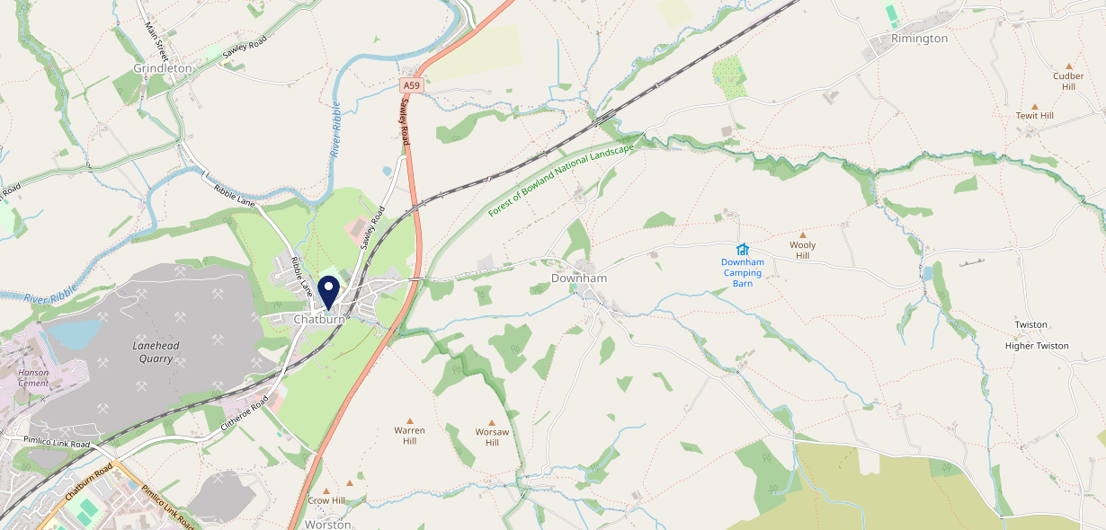









Site Intel
Brown Cow BB74AW
1 Miles
118 Chains
22/02/2023 - 14/02/2024
Site Summary
Brown Cow BB74AW
Work Area
Region
TV Region
Urbanicity
Blackburn
North West
North West
Rural town and fringe
BB74AW
Pub Restaurant
Top Competitors
ATV
Gender
#1
£31.05
64.88%
Male
Affluence
Segmentation
#2
54.98%
20.11%
Middle Income
Enterprising Mainstream
Age Group
Visit Day
#3
21.82%
26.72%
55 to 64
Sun
Nearest Station
Clitheroe(3.39 miles)
1630 Site Customers
0 Competitors
0 Competitor Customers

Slide 2

Site Intel
Brown Cow BB74AW
1 Miles
118 Chains
22/02/2023 - 14/02/2024
Spend by Weekpart
How is customer spend distributed throughout the week for Brown Cow BB74AW versus its competitors?
% of spend for Brown Cow BB74AW and 118 Chains in 1 Miles from 22/02/2023 - 14/02/2024 split by Day of Week
1630 Site Customers
0 Competitors
0 Competitor Customers

Slide 3
Site Intel
Brown Cow BB74AW
1 Miles
118 Chains
22/02/2023 - 14/02/2024
Visit Frequency
How frequently per year do customers visit Brown Cow BB74AW versus its competitors?
% of customer numbers for Brown Cow BB74AW and 118 Chains in 1 Miles from 22/02/2023 - 14/02/2024 and the number of visits made Per Annum
1630 Site Customers
0 Competitors
0 Competitor Customers

Slide 4
Site Intel
Brown Cow BB74AW
1 Miles
118 Chains
22/02/2023 - 14/02/2024
ATV Change
How has ATV changed between two date ranges?
1630 Site Customers

Slide 5
Site Intel
Brown Cow BB74AW
1 Miles
118 Chains
22/02/2023 - 14/02/2024
Market Share Change
How has market share changed between two date ranges?
% of market share spend for Brown Cow BB74AW and 118 Chains in 1 Miles from 22/02/2023 - 14/02/2024
1630 Site Customers

Slide 6
Site Intel
Brown Cow BB74AW
1 Miles
118 Chains
22/02/2023 - 14/02/2024
Age
How does the age profile of customers who visit Brown Cow BB74AW compare versus its competitors?
% of spend for Brown Cow BB74AW and 118 Chains in 1 Miles from 22/02/2023 - 14/02/2024 split by Age Range
888 Site Customers
0 Competitors

Slide 7
Site Intel
Brown Cow BB74AW
1 Miles
118 Chains
22/02/2023 - 14/02/2024
Affluence
How does the affluence of customers who visit Brown Cow BB74AW compare versus its competitors?
% of spend for Brown Cow BB74AW and 118 Chains in 1 Miles from 22/02/2023 - 14/02/2024 split by Affluence
820 Site Customers
0 Competitors

Slide 8
Site Intel
Brown Cow BB74AW
1 Miles
118 Chains
22/02/2023 - 14/02/2024
Gender
How does the gender profile of customers who visit Brown Cow BB74AW compare versus its competitors?
% of spend for Brown Cow BB74AW and 118 Chains in 1 Miles from 22/02/2023 - 14/02/2024 split by Gender
876 Site Customers
0 Competitors

Slide 9
Site Intel
Brown Cow BB74AW
1 Miles
118 Chains
22/02/2023 - 14/02/2024
Punch Segmentation
How does the Custom segmentation profile of customers who visit Brown Cow BB74AW compare versus its competitors?
% of spend for Brown Cow BB74AW and 118 Chains in 1 Miles from 22/02/2023 - 14/02/2024 split by Segment
1630 Site Customers
0 Competitors
0 Competitor Customers

Slide 10
Site Intel
Brown Cow BB74AW
1 Miles
118 Chains
22/02/2023 - 14/02/2024
Spend by Distance
How does the spend profile of Brown Cow BB74AW compare versus its competitors based on travel distances?
% of spend for Brown Cow BB74AW and 118 Chains in 1 Miles from 22/02/2023 - 14/02/2024 split by Distance travelled
875 Site Customers
0 Competitors
0 Competitor Customers

Slide 11
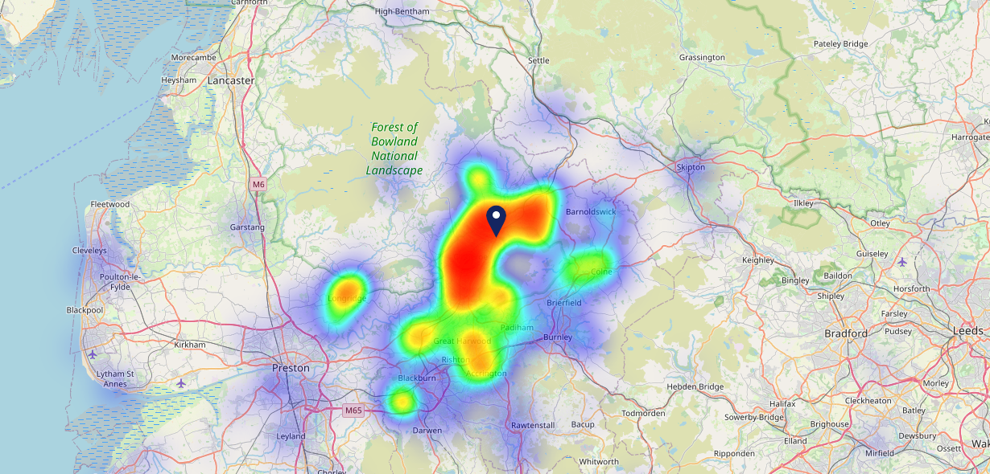

Site Intel
Brown Cow BB74AW
22/02/2023 - 14/02/2024
Map of Guest Origin
Where do customers of Brown Cow BB74AW come from?
Where do customers of Brown Cow BB74AW for 22/02/2023 - 14/02/2024 live
875 Site Customers

Slide 12
Site Intel
Brown Cow BB74AW
1 Miles
118 Chains
22/02/2023 - 14/02/2024
Share of Wallet
What are the Top 20 venues (by spend) that customers of Brown Cow BB74AW also visit?
For customers of Brown Cow BB74AW, who are the top 20 competitors from 118 Chains in 1 Miles for 22/02/2023 - 14/02/2024 split by Venue
1630 Site Customers

Slide 13
Site Intel
Brown Cow BB74AW
1 Miles
118 Chains
22/02/2023 - 14/02/2024
Share of Wallet Change
How has share of wallet of customers of Brown Cow BB74AW changed between two date ranges?
1630 Site Customers

Slide 14
Site Intel
Brown Cow BB74AW
22/02/2023 - 14/02/2024
Market Summary
How does the local area for Brown Cow BB74AW compare to the national average (1 = low, 10 = high)
Data Type | Name | Spend in 250m | 250m Spend vs National | Spend in 500m | 500m Spend vs National | Spend in 1 mile | 1 mile Spend vs National | Spend in 3 miles | 3 mile Spend vs National
Total | Annual Sales | £1.58M | 5 | £1.64M | 4 | £3.53M | 3 | £47.68M | 4
Weekpart | Mon - Thu | 26.6% | 1 | 25.8% | 1 | 37.0% | 2 | 34.3% | 1
Weekpart | Fri - Sat | 47.2% | 7 | 48.9% | 9 | 41.1% | 4 | 49.3% | 10
Weekpart | Sun | 26.2% | 10 | 25.3% | 10 | 21.9% | 10 | 16.5% | 8
Age | 18 to 24 | 5.8% | 6 | 5.8% | 5 | 2.9% | 2 | 5.1% | 3
Age | 25 to 34 | 6.7% | 1 | 7.6% | 1 | 6.7% | 1 | 12.7% | 1
Age | 35 to 44 | 14.3% | 1 | 14.4% | 1 | 11.5% | 1 | 19.8% | 2
Age | 45 to 54 | 17.4% | 3 | 18.5% | 4 | 14.6% | 1 | 17.7% | 2
Age | 55 to 64 | 19.9% | 8 | 19.2% | 8 | 23.4% | 10 | 21.9% | 10
Age | 65 to 74 | 25.7% | 10 | 24.7% | 10 | 24.7% | 10 | 15.0% | 10
Age | 75+ | 10.2% | 10 | 9.7% | 10 | 16.2% | 10 | 7.9% | 10
CAMEO | Business Elite | 5.5% | 5 | 6.6% | 5 | 8.5% | 6 | 9.0% | 6
CAMEO | Prosperous Professionals | 7.4% | 7 | 7.3% | 7 | 7.3% | 7 | 6.0% | 5
CAMEO | Flourishing Society | 17.2% | 8 | 17.3% | 8 | 18.0% | 8 | 14.8% | 7
CAMEO | Content Communities | 6.3% | 1 | 6.1% | 1 | 10.9% | 4 | 11.7% | 4
CAMEO | White Collar Neighbourhoods | 17.0% | 9 | 16.6% | 9 | 13.3% | 8 | 14.6% | 9
CAMEO | Enterprising Mainstream | 14.2% | 9 | 14.0% | 9 | 15.2% | 10 | 12.4% | 9
CAMEO | Paying The Mortgage | 10.7% | 3 | 11.0% | 3 | 10.9% | 3 | 12.8% | 4
CAMEO | Cash Conscious Communities | 16.9% | 9 | 16.3% | 9 | 11.5% | 8 | 10.5% | 7
CAMEO | On A Budget | 3.8% | 3 | 3.7% | 2 | 3.2% | 2 | 6.4% | 5
CAMEO | Family Value | 1.1% | 3 | 1.1% | 3 | 1.2% | 3 | 1.7% | 4
Affluence | AB | 30.0% | 6 | 31.2% | 6 | 33.8% | 7 | 29.9% | 6
Affluence | C1C2 | 48.3% | 5 | 47.7% | 5 | 50.3% | 6 | 51.5% | 7
Affluence | DE | 21.8% | 6 | 21.1% | 6 | 15.9% | 4 | 18.6% | 5

